Slide 1
CS276: Information Retrieval and Web Search
Pandu Nayak and Prabhakar Raghavan
Lecture 3: Dictionaries and tolerant retrieval

Slide 2
This lecture
Ch. 3
Dictionary data structures
“Tolerant” retrieval
Wild-card queries
Spelling correction
Soundex

Slide 3
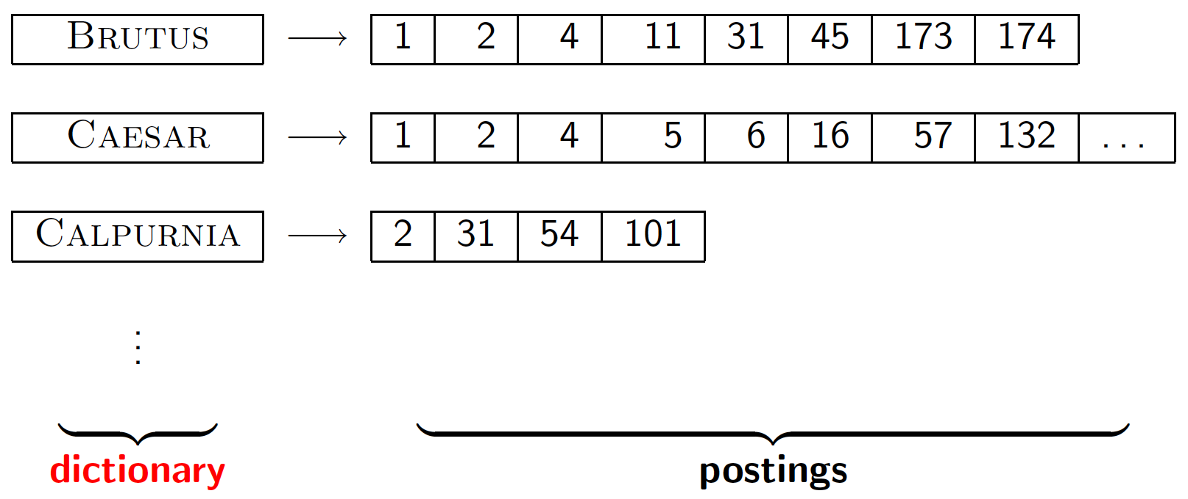
Dictionary data structures for inverted indexes
Sec. 3.1
The dictionary data structure stores the term vocabulary, document frequency, pointers to each postings list … in what data structure?

Slide 4
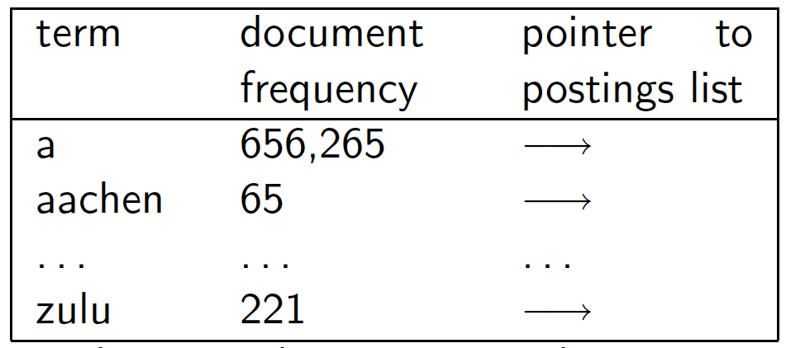
A naïve dictionary
Sec. 3.1
An array of struct:
char[20] int Postings *
20 bytes 4/8 bytes 4/8 bytes
How do we store a dictionary in memory efficiently?
How do we quickly look up elements at query time?

Slide 5
Search structure for Dictionary
Sec. 3.1
Two main choices:
Hashtables
Search Trees
Some IR systems use hashtables, some trees

Slide 6
Hashtables
Sec. 3.1
Each vocabulary term is hashed to an integer
Pros:
Lookup is faster than for a tree: O(1)
Cons:
No easy way to find minor variants:
judgment/judgement
No prefix search (judg*) [tolerant retrieval]
If vocabulary keeps growing, need to occasionally do the expensive operation of rehashing everything ( to avoid collision).

Slide 7
Tree: binary tree
Sec. 3.1
Root
a-m
n-z
a-hu
hy-m
n-sh
si-z
huygens
sickle
zygot
aardvark

Slide 8
Tree: B-tree with Fixed Intervals
Sec. 3.1
a-hu
n-z
hy-m
Definition: Every internal nodel has a number of children in the interval [a,b] where a, b are appropriate natural numbers, e.g., [2,4].

Slide 9
Trees
Sec. 3.1
Simplest: binary tree
More usual: B-trees
Trees require a standard ordering of characters and hence strings … but we typically have one
Pros:
Solves the prefix problem (terms starting with hyp)
Cons:
Slower: [and this requires balanced tree]
Rebalancing binary trees is expensive (inserting into or deleting)
But B-trees mitigate the rebalancing problem

