Slide 1
CS276: Information Retrieval and Web Search
Pandu Nayak and Prabhakar Raghavan
Lecture 4: Index Construction

Slide 2
Index construction
Ch. 4
How do we construct an index?
-Indexing: process of constructing an index.
-Indexer: machine which perform indexing.
What strategies can we use with limited main memory?(Real data is so big to be fit into RAM)

Slide 3
Hardware basics
Sec. 4.1
Many design decisions in information retrieval(Algorthims and techniques) are based on the characteristics of hardware
We begin by reviewing hardware basics

Slide 4
Hardware basics
Sec. 4.1
Access to data in memory is much faster than access to data on disk.
Smaller Size
Processor
Faster
More expensive
Register
Cache
Main Memory
Hard disk
Subset of data in lower level
Memory Hierchary

Slide 5
Hardware basics
Disk seeks: No data is transferred from disk while the disk head is being positioned.
-Seek time: Time for disk head to reach the right track.
-Rotational Delay: Time of rotating till reaching a spot directly under the head.
-Transfer time: amount of time to transfer one block from disk to memory.
Therefore: Transferring one large chunk of data from disk to memory is faster than transferring many small chunks.
Disk I/O is block-based: Reading and writing of entire blocks (as opposed to smaller chunks).
Block sizes: 8KB to 256 KB.

Slide 6
Hardware basics
Sec. 4.1
Buffer: the part of main memory into which a block of data is transferred in /from.
Servers(machine) used in IR systems now typically have several GB of main memory, sometimes tens of GB.
Available disk space is several (2–3) orders of magnitude larger.
Fault tolerance(machines that doesn’t fail) is very expensive: It’s much cheaper to use many regular machines(as distributed machines) rather than one fault tolerant machine. If one fails of distributed computer fails ,reassigned the task to another working machine

Slide 7
Hardware assumptions for this lecture
Sec. 4.1
symbol statistic value
s average seek time 5 ms = 5 x 10⁻³ s
b transfer time per byte 0.02 μs = 2 x 10⁻⁸ s
processor’s clock rate 10⁹ s^{−1(access a byte from RAM)}
size of main memory several GB
size of disk space 1 TB or more

Slide 8
RCV1: Our collection for this lecture
Sec. 4.2
Shakespeare’s collected works definitely aren’t large enough for demonstrating many of the points in this course.
The collection we’ll use isn’t really large enough either, but it’s publicly available and is at least a more plausible example.
As an example for applying scalable index construction algorithms, we will use the Reuters RCV1 collection.
This is one year of Reuters newswire (part of 1995 and 1996)

Slide 9

A Reuters RCV1 document
Sec. 4.2

Slide 10
Reuters RCV1 statistics
Sec. 4.2
symbol statistic value
N documents 800,000
L avg. # tokens per doc 200
M terms (Distinict) 400,000
avg. # bytes per token 6
(incl. spaces/punct.)
avg. # bytes per token 4.5
(without spaces/punct.)
avg. # bytes per term 7.5
100,000,000 non-positional postings
4.5 bytes per word token vs. 7.5 bytes per word term: why?

Slide 11
Recall IIR 1 index construction
Sec. 4.2
Documents are parsed to extract words and these are saved with the Document ID.
Sorted by term(primary key) and if word is duplicated sorted with doc id(secondary key)
Sorting step was done in main memory(chapter 1)
Doc 1
Doc 2
I did enact Julius
Caesar I was killed
i' the Capitol;
Brutus killed me.
So let it be with
Caesar. The noble
Brutus hath told you
Caesar was ambitious

Slide 12
Key step
Sec. 4.2
After all documents have been parsed, the inverted file is sorted by terms.
We focus on this sort step.
We have 100M items to sort.

Slide 13
Scaling index construction
Sec. 4.2
In-memory index construction does not scale
Can’t stuff entire collection into memory, sort, then write back
How can we construct an index for very large collections?
Taking into account the hardware constraints we just learned about . . .
Memory, disk, speed, etc.
Objectives: min number of disk seeks instead of min number of operation in main memory

Slide 14
Sort-based index construction
Sec. 4.2
The final postings for any term are incomplete until the end.
At 8 bytes per non-positional postings entry (term id, doc id), demands a lot of space for large collections.
T = 100,000,000 in the case of RCV1
So … we can do this in memory in 2009, but typical collections are much larger. E.g., the New York Times provides an index of >150 years of newswire
Thus: We need to store intermediate results on disk.

Slide 15
Sort using disk as “memory”?
Sec. 4.2
Can we use the same index construction algorithm for larger collections, but by using disk instead of memory?
No: Sorting T = 100,000,000 records on disk is too slow – too many disk seeks.
We need an external sorting algorithm.
Note:
-Internal sorting Algorthims:data is stored internal in main memory
-External sorting Algorithms: all data is stored externally to main memory

Slide 16
Bottleneck
Sec. 4.2
Parse and build postings entries one doc at a time
Now sort postings entries by term (then by doc within each term)
Doing this with random disk seeks would be too slow – must sort T=100M records
If every comparison took 2 disk seeks, and N items could be
sorted with N log₂N comparisons, how long would this take?

Slide 17
BSBI: Blocked sort-based Indexing (Sorting with fewer disk seeks)
Sec. 4.2
8-byte (4+4) records (term id, doc id).
These are generated as we parse docs.
Must now sort 100M such 8-byte records by term id.
Define a Block ~ 10M such records
Can easily fit a couple into memory.
Will have 10 such blocks to start with.
Basic idea of algorithm:
Accumulate postings for each block, sort, write to disk.
Then merge the blocks into one long sorted order.

Slide 18
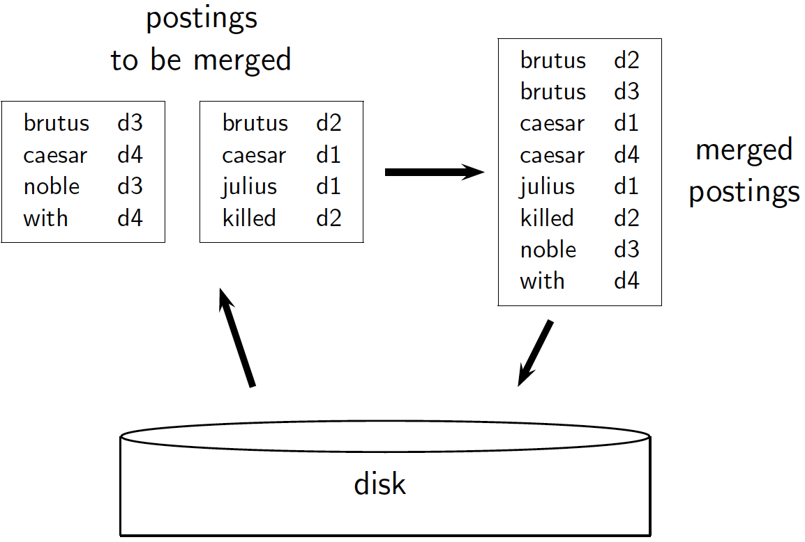
Sec. 4.2
By merge sorting

Slide 19
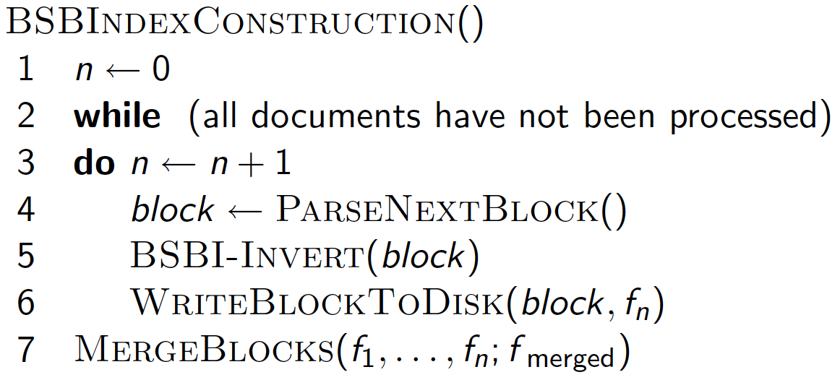
Sec. 4.2
Block no
Sort block+ posting list for same term is formed

Slide 20
How to merge the sorted runs?
Sec. 4.2
Can do binary merges, with a merge tree of log₂10 = 4 layers.
During each layer, read into memory runs in blocks of 10M, merge, write back.
1
1
2
2
Merged run.
3
4
3
4
Runs being
merged.
Disk

Slide 21
How to merge the sorted runs?
Sec. 4.2
But it is more efficient to do a multi-way merge, where you are reading from all blocks simultaneously
Providing you read decent-sized chunks of each block into memory and then write out a decent-sized output chunk, then you’re not killed by disk seeks
Notes:
What is the overall complexity of

Slide 22
Remaining problem with sort-based algorithm
Sec. 4.3
Our assumption was: we can keep the dictionary(map term-termID) in memory.no stage it can’t fit in memory(impossible assumption).
Maintain mapping(term-term ID):(dictionary grows dynamically in size)
1)begins by reading first document term
2)map each term to a termID
3)each term check if it’s a new(takes an incremental ID) or existing term(takes the same ID of the existing term)
Actually, we could work with term,docID postings instead of termID,docID postings but will not fit into 4 bytes.
. . . but then intermediate files become very large. (We would end up with a scalable, but very slow index construction method.)

