Slide 1
SPIMI: Single-pass in-memory indexing
Sec. 4.3
Key idea 1: Generate separate dictionaries for each block – no need to maintain term-termID mapping across blocks.
Key idea 2: Don’t sort. Accumulate postings in postings lists as they occur.
With these two ideas we can generate a complete inverted index for each block.
These separate indexes can then be merged into one big index.

Slide 2
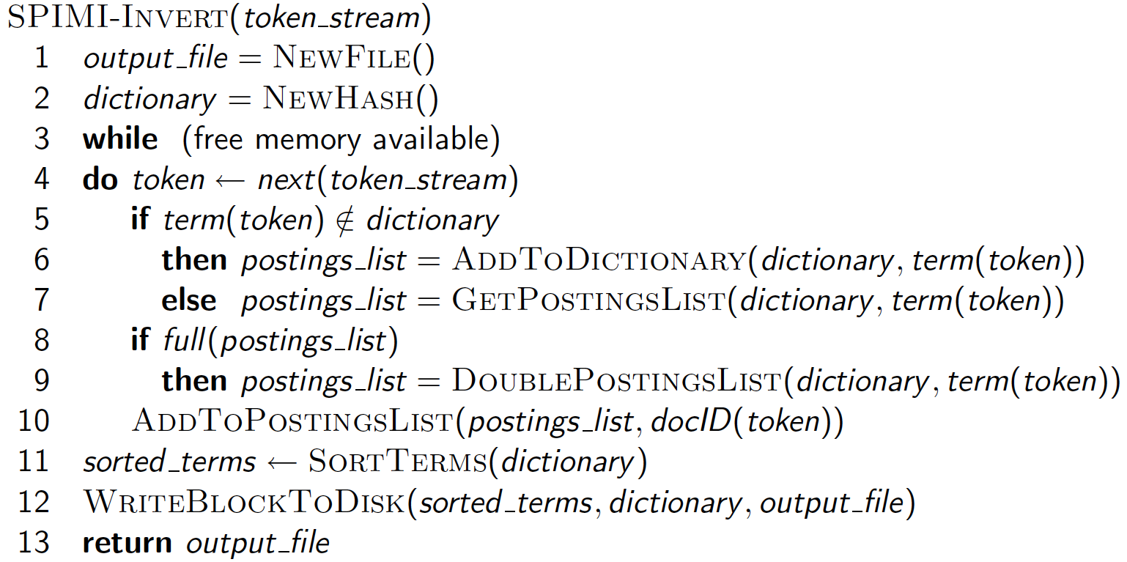
SPIMI-Invert
Sec. 4.3
Generate next (term , docid )
Merging of blocks is analogous to BSBI.

Slide 3
Compare between BSBI and SIMPI
Algorithms/Factors | BSBI | SIMPI
Mapping
Sorting
Block size
Token pairs
Faster
Efficiency

Slide 4
Distributed indexing
Sec. 4.4
All pervious algorithms work on:
1)Static data
2)Data fits in a single machine
3)Fits in a single hard disk
For web-scale indexing :
must use a distributed computing cluster(tasks of indexing is distributed along the cluster)
Each single computer in a cluster is called a “node”
Individual machines are fault-prone
Can unpredictably slow down or fail
Need to reassign the task to another machine
How do we exploit such a pool of machines to carry indexing tasks?

Slide 5
Web search engine data centers
Sec. 4.4
Web search data centers (Google, Bing, Baidu) mainly contain cheap/commodity machines(processor, memory, disk).
Data centers are distributed around the world.
Estimate: Google ~1 million machine, 3 million processors/cores (Gartner 2007)

Slide 6
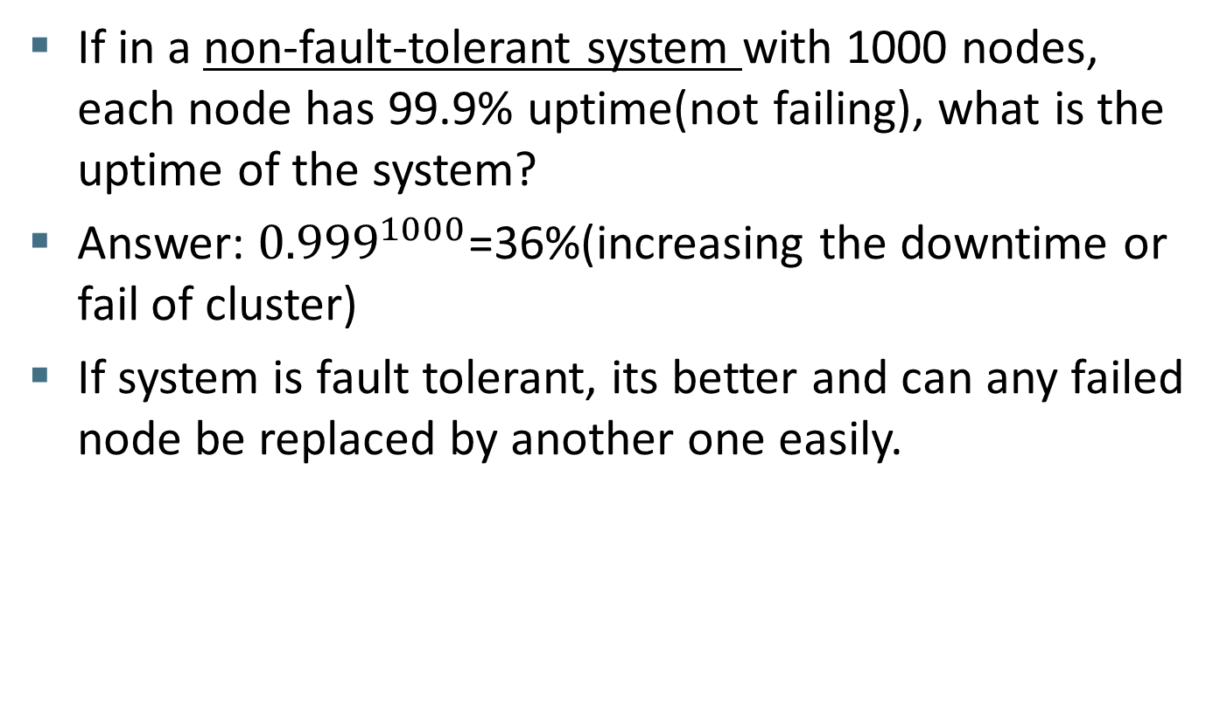
Massive data centers
Sec. 4.4

Slide 7
Distributed indexing
Sec. 4.4
Maintain a master machine directing the indexing job – considered “ fail safe”.
Break up indexing problem into sets of (parallel) tasks.
Master machine assigns each task to an idle machine from a pool.

Slide 8
Parallel tasks
Sec. 4.4
We will use two sets of parallel tasks
Parsers(ouput: Term,docID pairs),sorted by docID
Inverters(aggregate to perform posting lists)
Break the input document collection into splits
Each split is a subset of documents (corresponding to blocks in BSBI/SPIMI)

Slide 9
Parsers
Sec. 4.4
Master assigns a split to an idle parser machine
Parser reads a document at a time and emits (term, doc) pairs
Parser writes pairs into j partitions
Each partition is for a range of terms’ first letters
(e.g., a-f, g-p, q-z) – here j = 3.
Now to complete the index inversion

Slide 10
Inverters
Sec. 4.4
An inverter collects all (term,doc) pairs (= postings) for one term-partition.
Sorts and writes to postings lists

Slide 11
Data flow
Sec. 4.4
assign
Master
assign
Postings
Parser
a-f
g-p
q-z
Inverter
a-f
Parser
a-f
g-p
q-z
Inverter
g-p
splits
Inverter
q-z
Parser
a-f
g-p
q-z
Map
phase
Reduce
phase
Segment files

Slide 12
MapReduce
Sec. 4.4
The index construction algorithm we just described is an instance of MapReduce.
MapReduce (Dean and Ghemawat 2004) is a robust and conceptually simple framework for distributed computing …
… without having to write code for the distribution part.
having to write code for parser and inverter only
They describe the Google indexing system (ca. 2002) as consisting of a number of phases, each implemented in MapReduce.

Slide 13
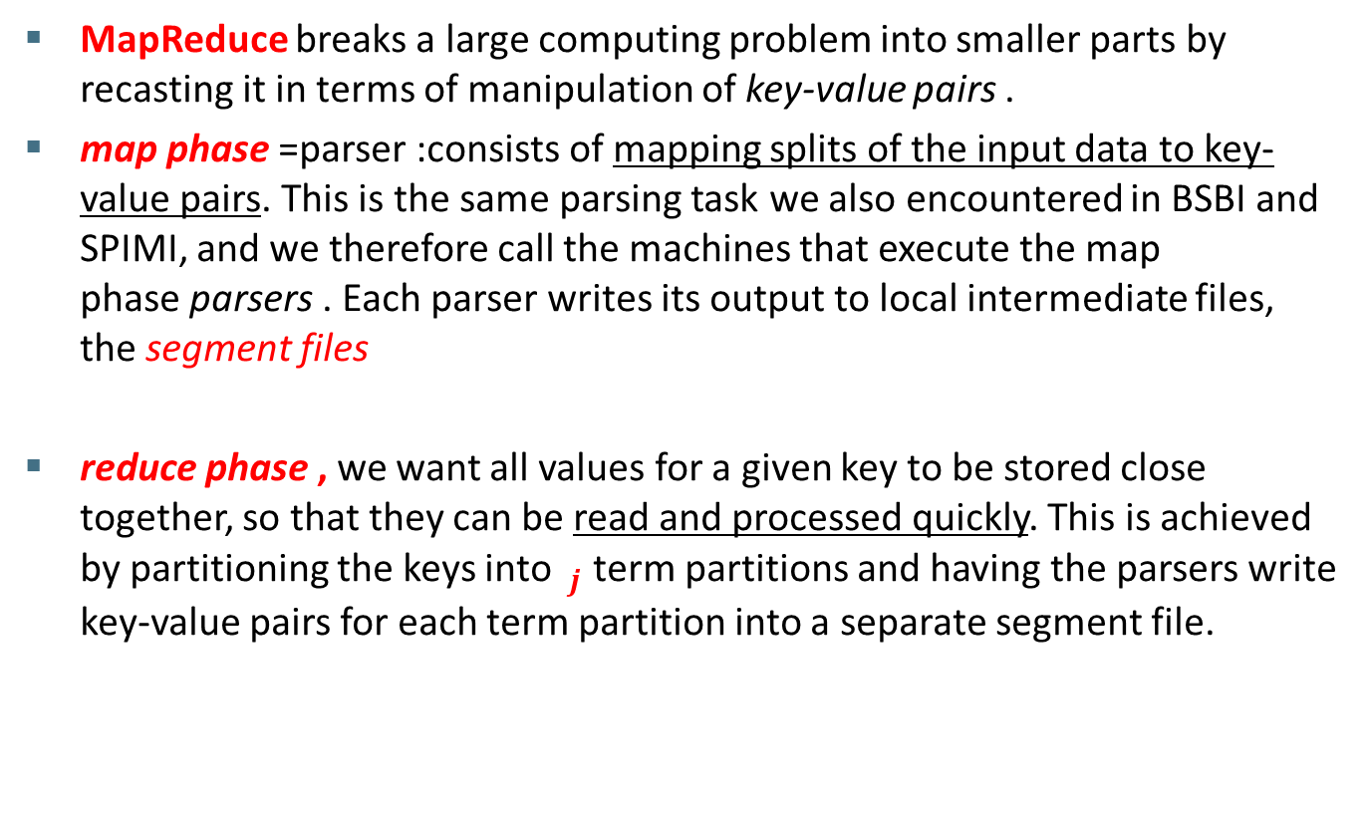

MapReduce

Slide 14
MapReduce
Sec. 4.4
Index construction was just one phase.
Another phase: transforming a term-partitioned index into a document-partitioned index.
Term-partitioned: one machine handles a subrange of terms
Document-partitioned: one machine handles a subrange of documents
As we’ll discuss in the web part of the course, most search engines use a document-partitioned index … better load balancing, etc.

Slide 15
Schema for index construction in MapReduce
Sec. 4.4
Schema of map and reduce functions
map: input → list(k, v) reduce: (k,list(v)) → output
Instantiation of the schema for index construction
map: collection → list(term, docID)
reduce: (<term, list(docID)>, <term, list(docID)>, …) → (postings list1, postings list2, …)

Slide 16
Example for index construction
Map:
d1 : C came, C c’ed.
d2 : C died. →
<C,d1>, <came,d1>, <C,d1>, <c’ed, d1>, <C, d2>, <died,d2>
Reduce:
(<C,(d1,d2,d1)>, <died,(d2)>, <came,(d1)>, <c’ed,(d1)>) → (<C,(d1:2,d2:1)>, <died,(d2:1)>, <came,(d1:1)>, <c’ed,(d1:1)>)

Slide 17
Dynamic indexing
Sec. 4.5
Up to now, we have assumed that collections are static.
They rarely are:
Documents come in over time and need to be inserted.
Documents are deleted and modified.
This means that the dictionary and postings lists have to be modified:
Postings updates for terms already in dictionary
New terms added to dictionary

Slide 18
Simplest approach
Sec. 4.5
1) Reconstruct the index from scratch periodically
-Number of changes over time is small.
-Delay in making new documents searchable is accepted.
-Enough resources are available to construct a new index while old one still available.
2) Maintain two indexes; large main index, small auxiliary index
If new documents need to be included quickly.
Inserts
New docs go into “small” auxiliary index
auxiliary index is kept in memory.
Search across both, merge results(OR)

Slide 19
Simplest approach
Deletions
Invalidation bit-vector for deleted docs
Filter docs output on a search result by this invalidation bit-vector
Periodically, merge auxiliary index into big main index
-when auxiliary index comes too large

Slide 20
Issues with main and auxiliary indexes
Sec. 4.5
Problem of frequent merges – you touch stuff a lot
Poor performance during merge on query(system is busy)
Actually:
Merging of the auxiliary index into the main index is efficient if we keep a separate file for each postings list.
Merge is the same as a simple append.
But then we would need a lot of files (no. of terms)– inefficient for OS.
Assumption for the rest of the lecture: The index is one big file.
In reality: Use a scheme somewhere in between (e.g., split very large postings lists, collect postings lists of length 1 in one file etc.)

Slide 21
Logarithmic merge
Sec. 4.5
Maintain a series of indexes, each twice as large as the previous one
At any time, some of these powers of 2 are instantiated(0)
At any time some of these indexes can exist and others may not exist Keep smallest (Z₀) in memory
Larger ones (I₀, I₁, …) on disk
If Z₀ gets too big (> n), write to disk as I₀
or merge with I₀ (if I₀ already exists) as Z₁
Either write merge Z₁ to disk as I₁ (if no I₁)
Or merge with I₁ to form Z₂

Slide 22
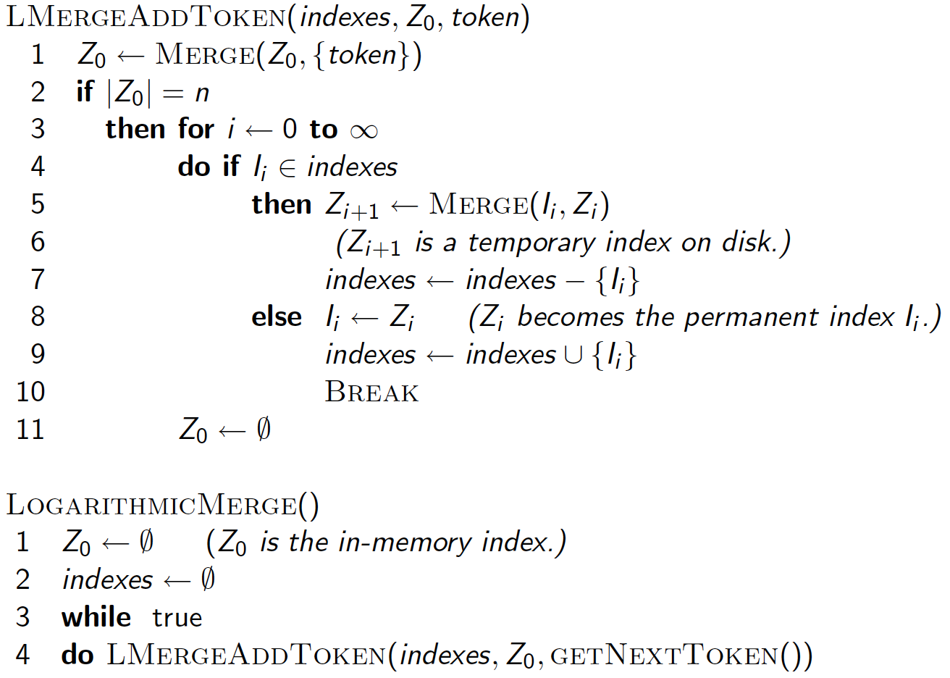
Sec. 4.5
Exist
Token occur

Slide 23
Logarithmic merge
Sec. 4.5
How many indexes will be searched when a query arrives?(number of maintained indexes in disk+Z₀ in memory)
Auxiliary and main index: index construction time is O(T²) as each posting is touched in each merge.
Logarithmic merge: Each posting is merged O(log T) times.
So logarithmic merge is much more efficient for index construction
But query processing now requires the merging of O(log T) indexes

Slide 24
Further issues with multiple indexes
Sec. 4.5
Collection-wide statistics are hard to maintain
E.g., when we spoke of spell-correction: which of several corrected alternatives do we present to the user?
We said, pick the one with the most hits
How do we maintain the top ones with multiple indexes and invalidation bit vectors?
One possibility: ignore everything but the main index for such ordering

Slide 25
Dynamic indexing at search engines
Sec. 4.5
All the large search engines now do dynamic indexing
Their indices have frequent incremental changes
News items, blogs, new topical web pages
Sarah Palin, …
But (sometimes/typically) they also periodically reconstruct the index from scratch
Query processing is then switched to the new index, and the old index is deleted

