Slide 1
TTC Bus Transit
By: Muhammad Hassan Zahoor

Slide 2

Introduction
Data Source Overview: 2021 TTC bus delay data from the Toronto Transit Commission."
Analysis Goal: Analyzing TTC bus operational efficiency and incident impact on delays.
Study Importance: Aiming to enhance TTC bus service reliability and management insights.

Slide 3
Data Description
Dataset Composition: Includes 2,832 records detailing incident types, timings, and delay durations for TTC buses in 2021.
Key Variables: Focuses on date, time, incident type, delay duration (Min.Delay and Min.Gap), and bus routes.
Analysis Focus: Concentrates on the top five common incidents to assess their impact on bus delay times.

Slide 4

Hypothesis 1
Null Hypothesis (H0): Incident type doesn't significantly affect delay duration.
Alternative Hypothesis (H1): Incident type significantly affects delay duration.
Rationale: Identifying key incidents for targeted operational improvements.

Slide 5
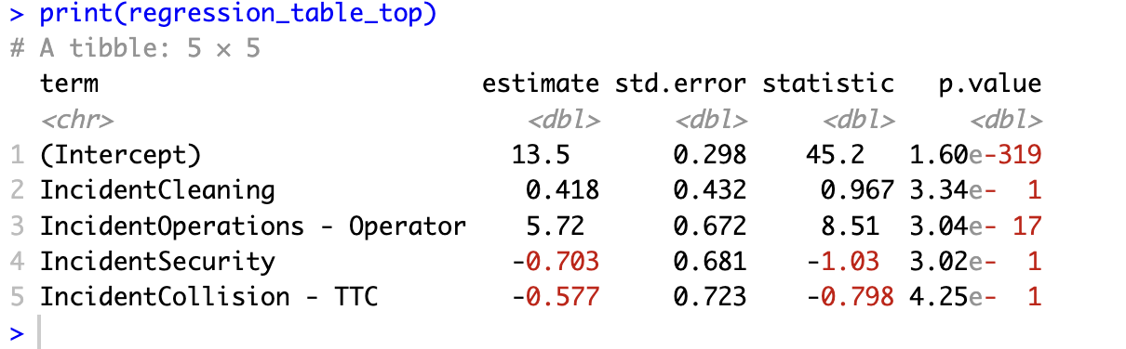
Regression Analysis Findings
Regression Focus: Analyzing impact of incident types on TTC bus delays, with 'Cleaning' as reference.
Significant Finding: 'Operations - Operator' incidents increase delays by approximately 5.72 minutes, significantly more than 'Cleaning'.
Statistical Significance: Notable p-value (< 0.05) for 'Operations - Operator', indicating a strong and significant effect on delays.
Comparative Analysis: 'Security' and 'Collision - TTC' show no significant difference in delay impact compared to 'Cleaning', as indicated by higher p-values

Slide 6
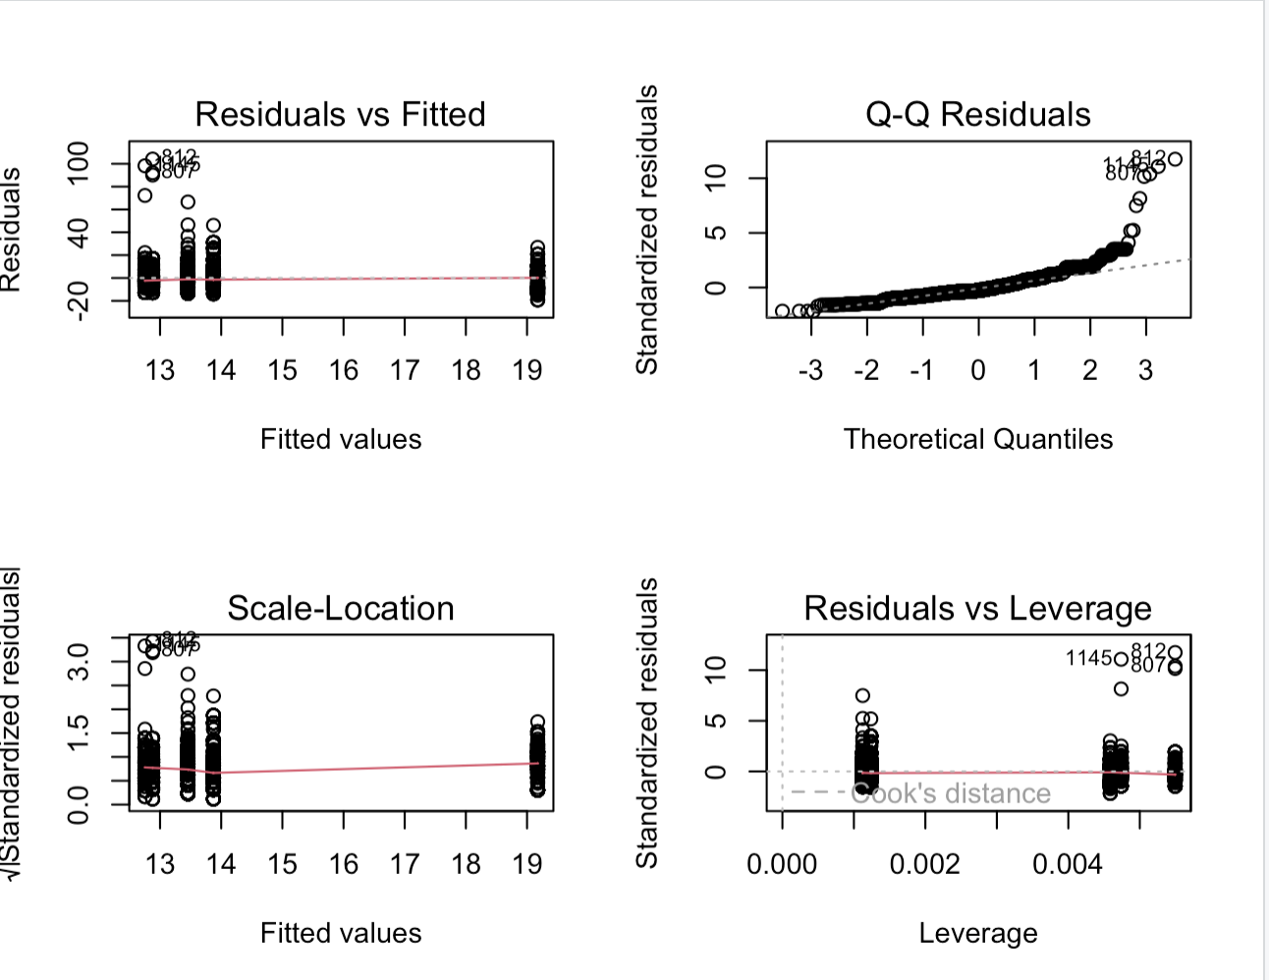
Residual Plots
Residuals vs Fitted: No clear patterns, indicating model assumptions are generally met.
Scale-Location Plot: Random spread of points suggests consistent variance (homoscedasticity) across predictions.
Normal Q-Q Plot: Residuals mostly align with a straight line, implying approximate normal distribution.
Residuals vs Leverage: Absence of points with high leverage shows no significant outliers impacting the model.

Slide 7
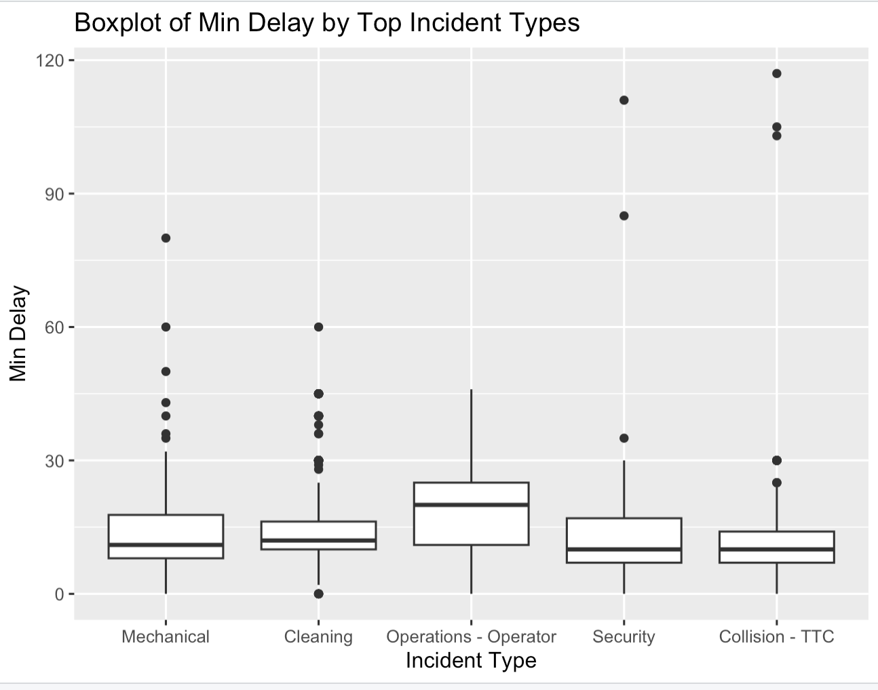
Boxplot
Boxplot highlights the central tendency and dispersion of delay times by incident type.
Mechanical incidents show wide delay variability; Cleaning incidents exhibit consistent, shorter delays.
Operations - Operator incidents generally lead to longer delays, indicated by higher median values.
Security and Collision - TTC incidents resemble Cleaning in delay consistency, but Collision - TTC shows more variability.

Slide 8
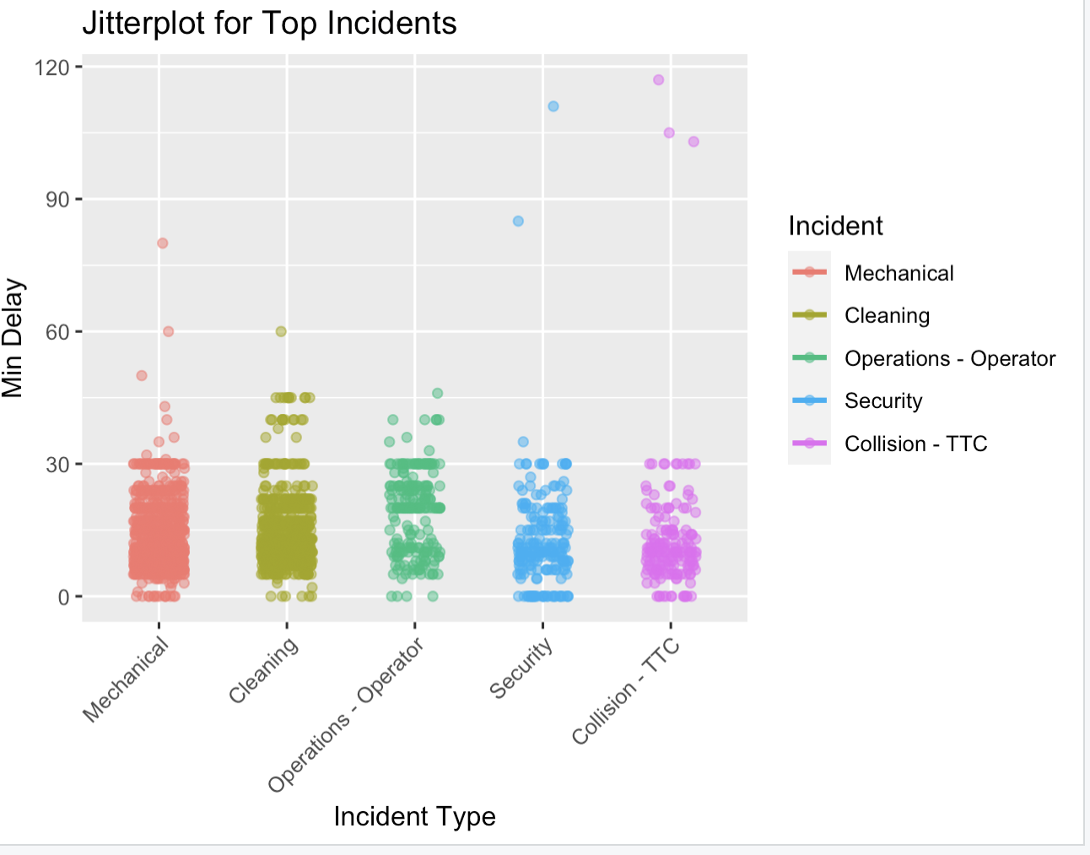
Jitter Plot
Jitter plot offers detailed delay time visualization for each incident type, reducing data overlap.
Mechanical and Operations - Operator incidents show varied delay durations; Cleaning and Security incidents often cause shorter delays.
Collision - TTC incidents, though less frequent, display notable delay time variability.

Slide 9
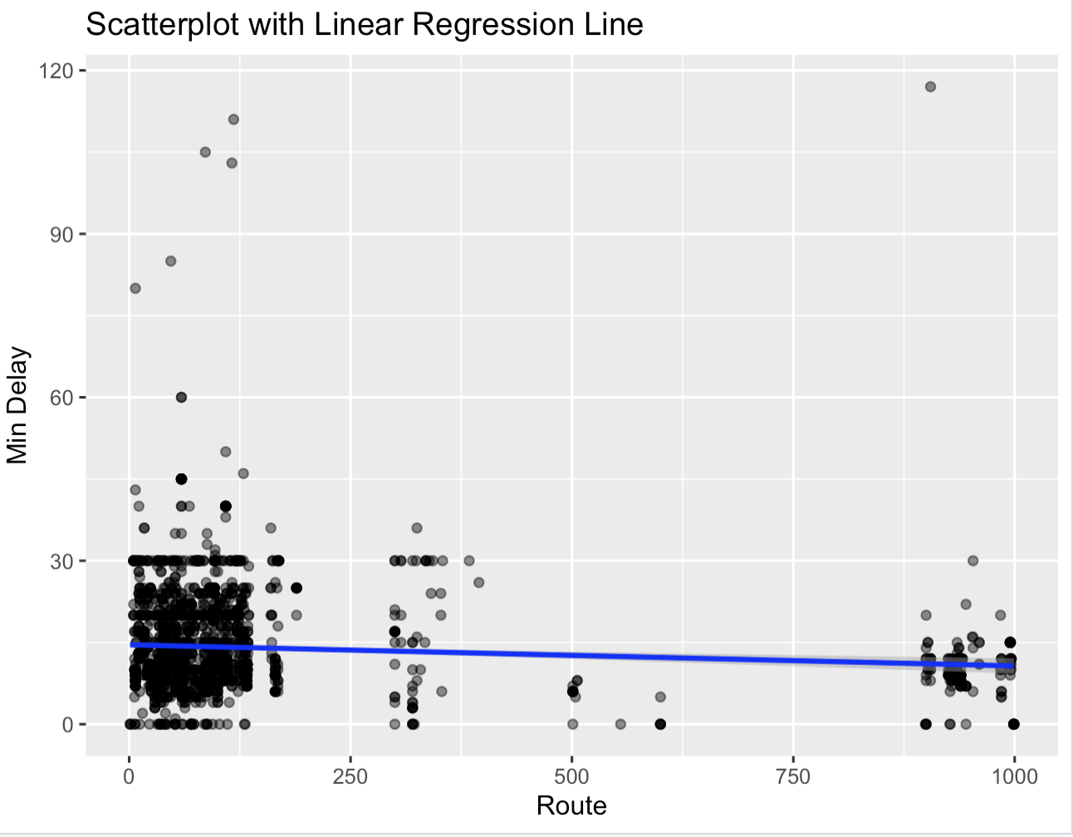
Scatterplot
Scatterplot examines the relationship between incident types and delay times with linear regression lines.
Steeper slope for Operations - Operator incidents suggests a strong link to longer delays.
Mechanical incidents show significant delays, but with less steep slope than Operations - Operator.
Cleaning, Security, and Collision - TTC incidents generally associate with shorter delays, indicated by flatter regression lines.

Slide 10
Conclusion
Overview:
The regression analysis reveals 'Operations - Operator' incidents significantly impact TTC bus delays, necessitating rejection of the null hypothesis for this category.
Significance of 'Operations - Operator':
Incidents linked to operations and operators correlate with increased delay times, as evidenced by a p-value below 0.05.
Analysis of 'Security' and 'Collision - TTC':
These incident types show no significant difference in delay times compared to 'Cleaning', leading to retention of the null hypothesis for these categories.
Visual Data Confirmation
The boxplot, jitter plot, and scatterplot corroborate the significant impact of 'Operations - Operator' incidents on delays. Addressing these operational issues is vital for improving TTC bus punctuality.

Slide 11
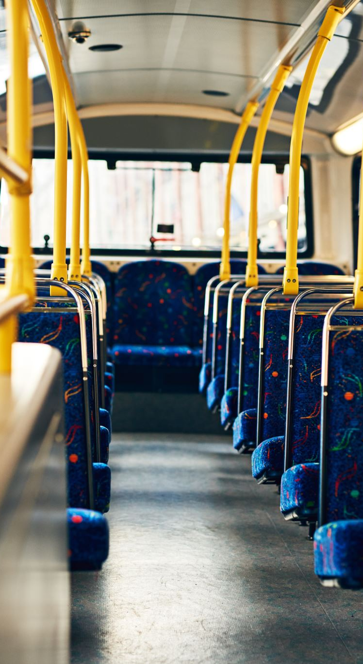
Hypothesis 2
Null Hypothesis (H0): The time of day does not significantly affect the duration of delay (Min Delay) for TTC buses.
Alternative Hypothesis (H1): The time of day has a significant effect on the duration of delay for TTC buses.
We chose this hypothesis to understand if there's a systematic pattern in bus delays that correlate with certain times of the day,

Slide 12
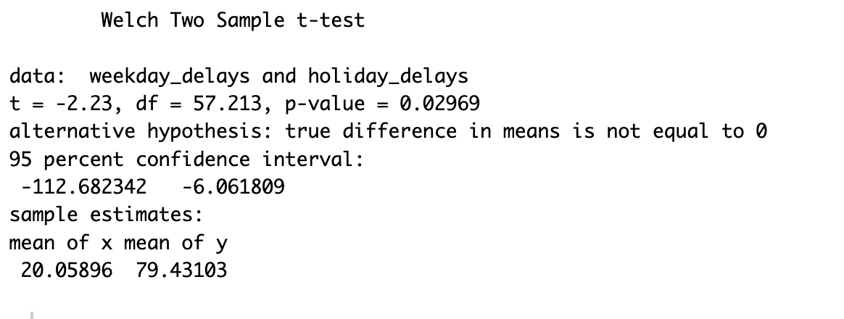
Two Sample T-Test
The t-test indicates significant differences in average delays (p-value = 0.02969 which is less than 0.05), with holidays having longer delays than weekdays.
The 95% confidence interval ranges between -113 to -6 minutes, suggesting more extended delays during holidays.
Variance test results show a notable disparity in delay variability between weekdays and holidays.

Slide 13
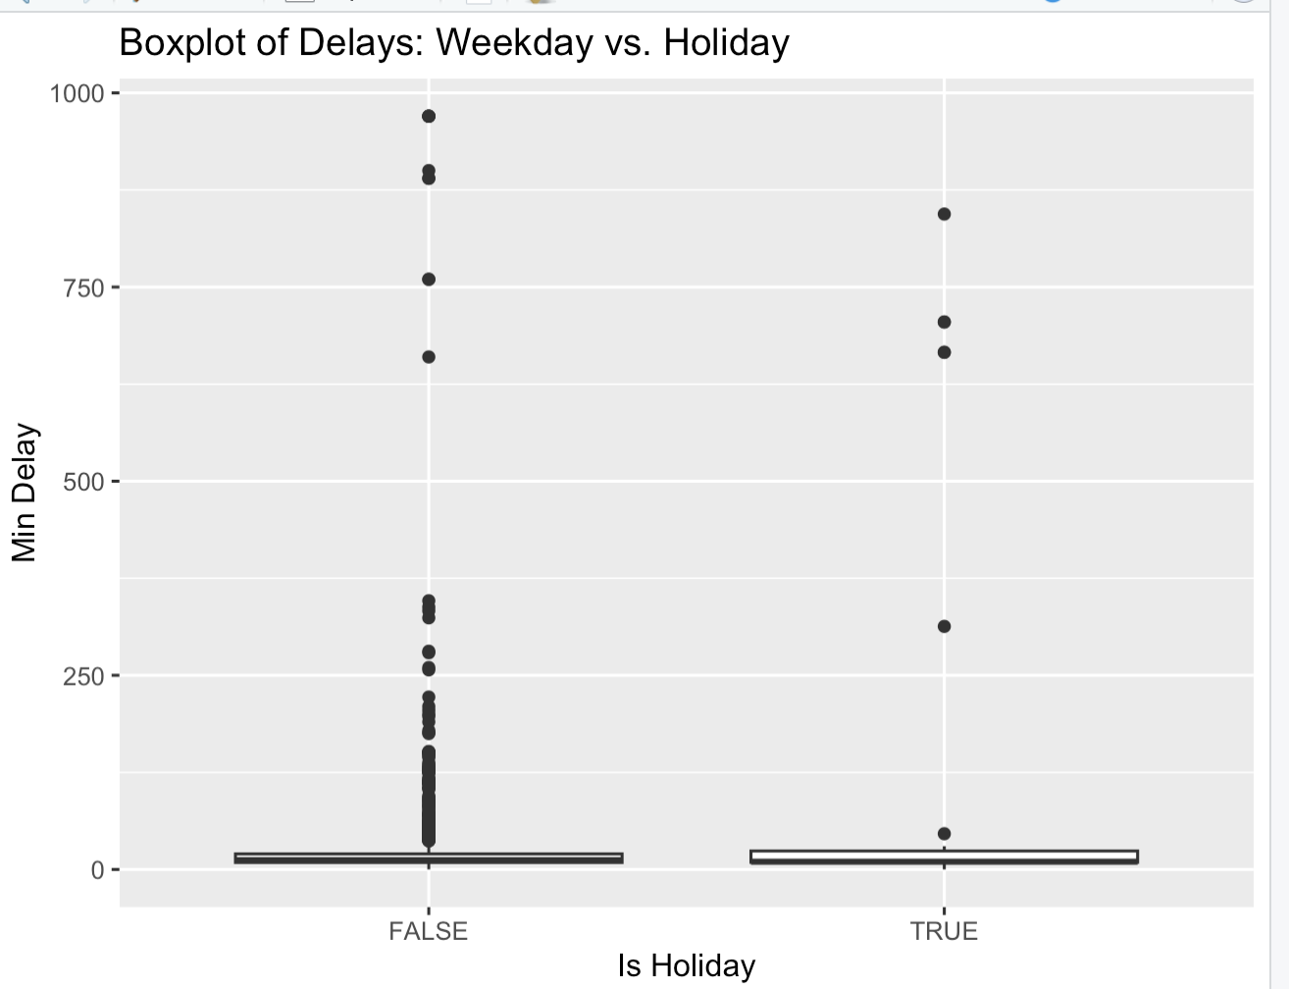
Boxplot
The boxplot reveals greater delay variability on holidays, with a wider interquartile range.
Holidays are characterized by several longer delay outliers.
Weekdays generally exhibit more consistency with fewer and shorter delays.

Slide 14
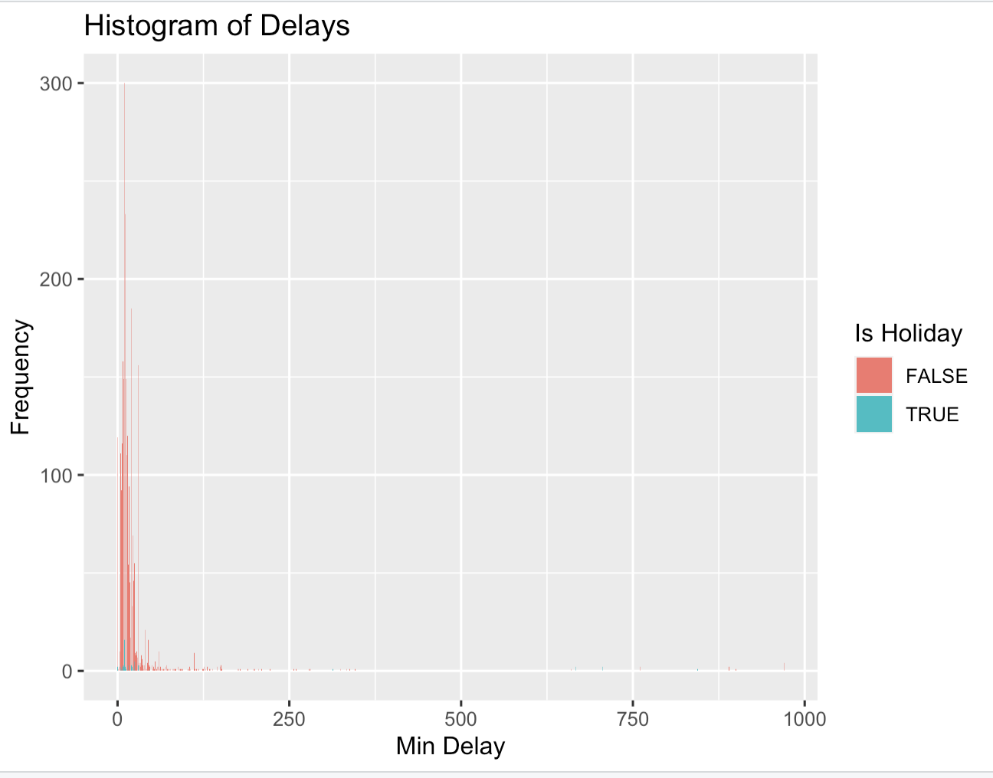
Two Sample T-Test
Histogram displays a broader spread of delays during holidays, indicating a mix of short and prolonged delays.
The frequency of shorter delays is higher, but holidays show an increased likelihood of extended delays.
This pattern reflects the varying impact of different days on delay durations.

Slide 15
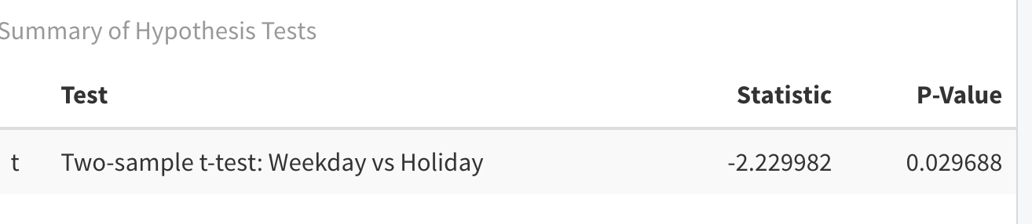
Conclusion
Null hypothesis rejected: Statistical analysis (t-test p-value = 0.02969) indicates significant differences in delay durations between weekdays and holidays.
Holidays exhibit longer delays (95% confidence interval: -113 to -6 minutes) and greater variability compared to weekdays.
The histogram and boxplot visualizations confirm these findings, showing broader spread and more outliers for holiday delays.
This evidence suggests holidays impact TTC bus delays more significantly, emphasizing the need for targeted operational strategies during these periods.

Slide 16
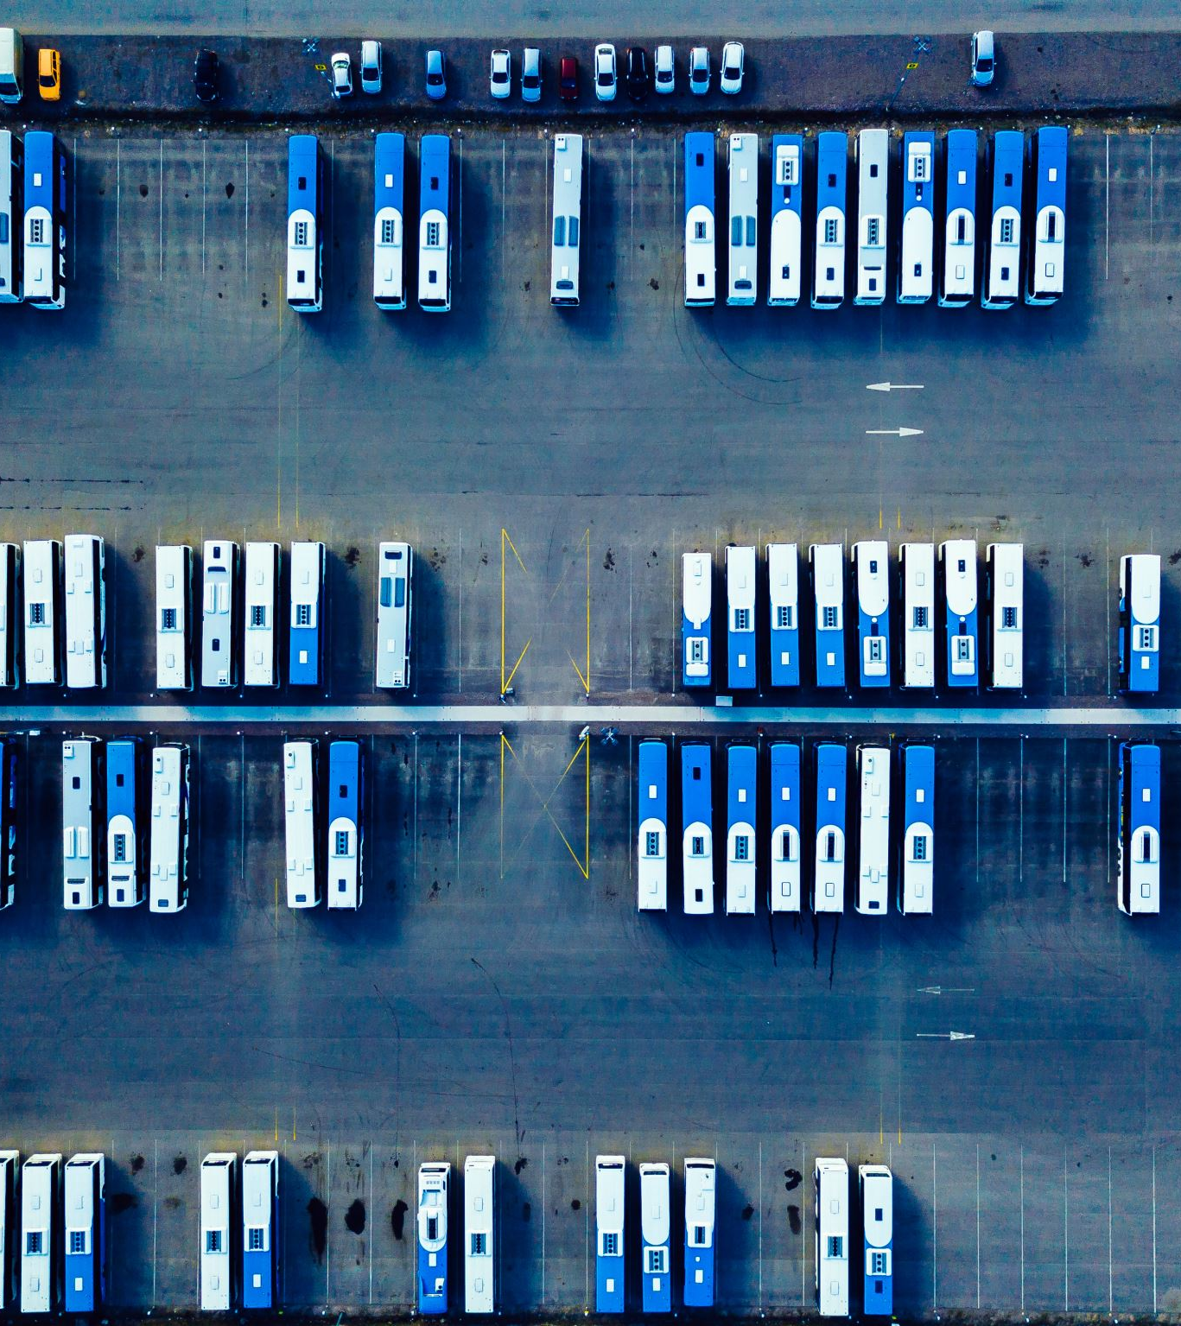
Hypothesis 3
Null Hypothesis (H0): The time of day does not significantly affect the duration of delay (Min Delay) for TTC buses.
Alternative Hypothesis (H1): The time of day has a significant effect on the duration of delay for TTC buses.
This hypothesis was chosen to understand whether certain times of the day are associated with longer or shorter delays,

Slide 17
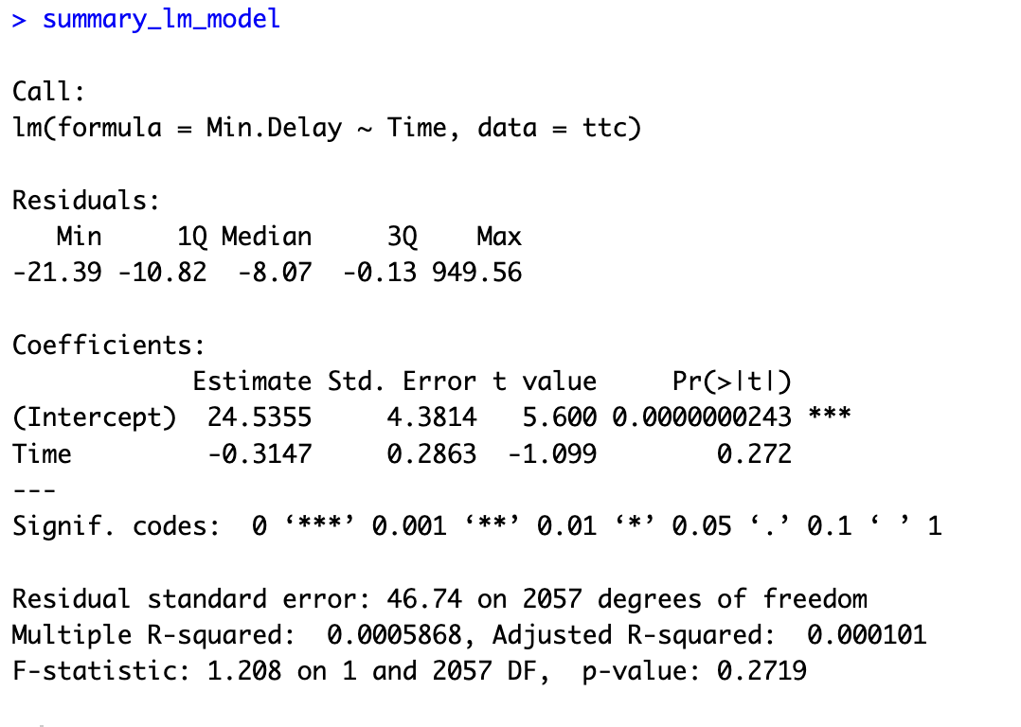
Regression Model
Model Summary: Time coefficient is -0.3147, suggesting a slight decrease in delay time as the day progresses.
Statistical Significance: P-value of 0.272 for time variable, exceeding the alpha level of 0.05, indicates no significant effect of time on delay duration.
Null Hypothesis Retention: High p-value leads to acceptance of Null Hypothesis; time of day doesn't significantly affect delay duration.
Key Insight: Time of day, as a standalone factor, is not a strong predictor of TTC bus delays.

Slide 18
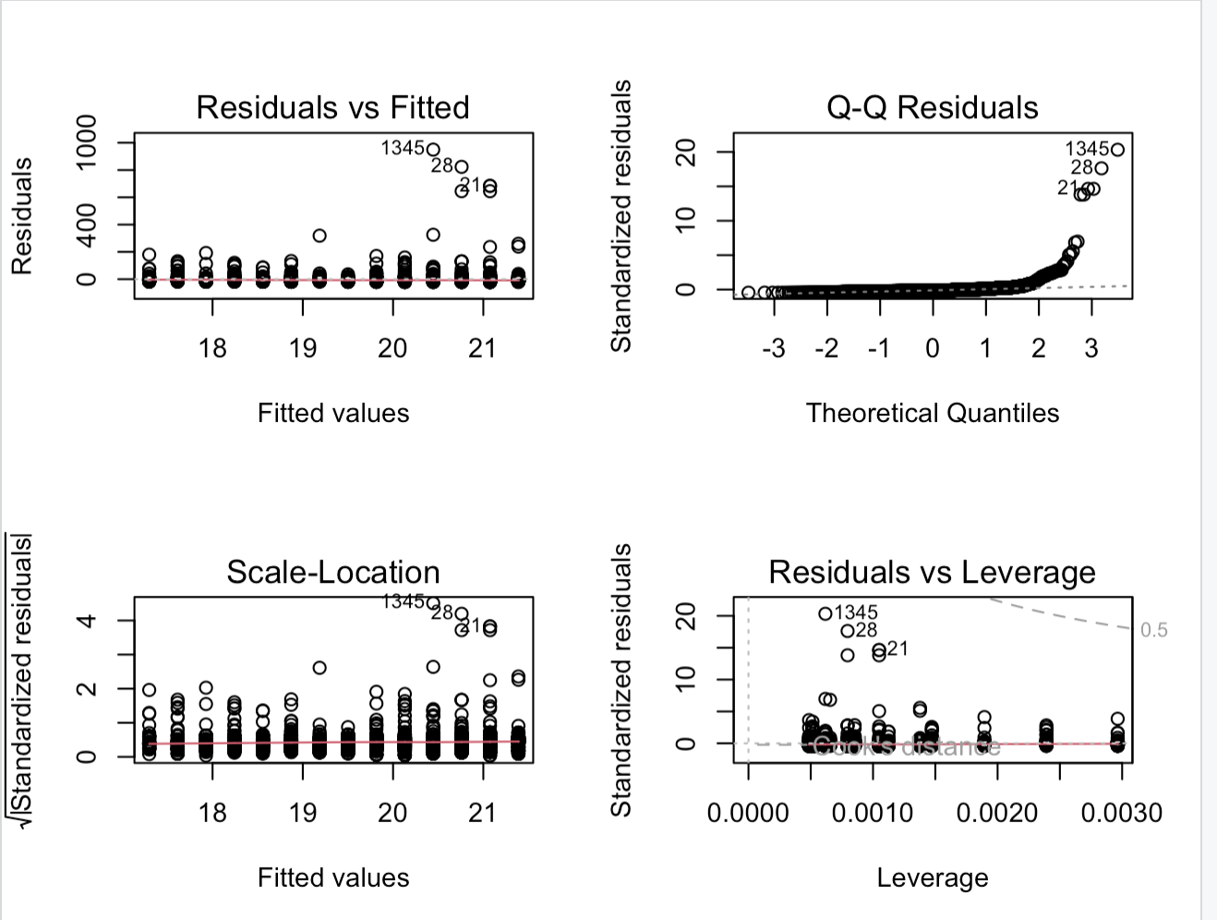
Residual Plot
Residuals vs. Fitted: Random scatter suggests no strong linear relationship between time of day and delays.
Scale-Location Plot: Consistent variance across predicted values, indicating homoscedasticity.
Normal Q-Q Plot: Some deviations from normality, especially at the tails.
Residuals vs Leverage: No data points with high leverage, indicating no influential outliers.

Slide 19
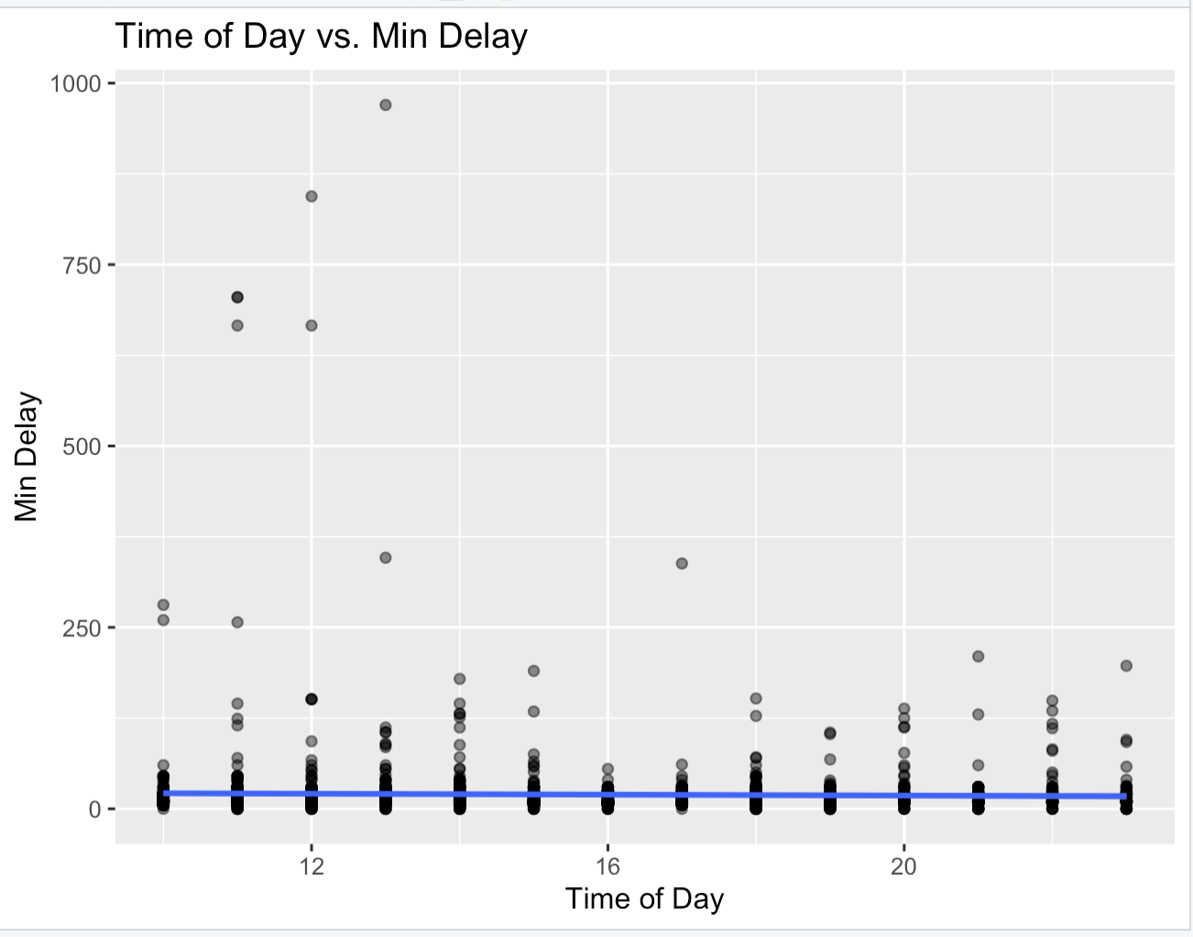
Scatterplot
Overview: Scatterplot shows the relationship between time of day (hour) and delay duration (minutes).
Data Distribution: Most delays are short, indicated by the cluster of points near the bottom.
Regression Line Analysis: Near-horizontal line suggests a negligible negative correlation between time of day and delay duration.
Outlier Observations: Presence of several outliers representing occasional, significantly longer delays.

Slide 20
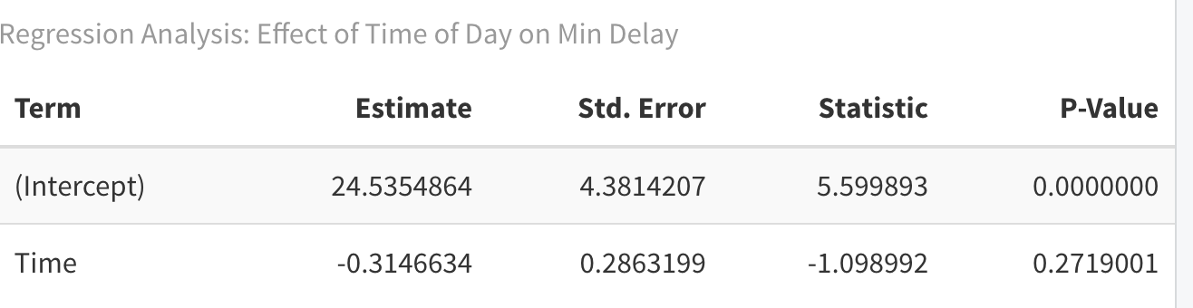
Conclusion
Conclusion: Time of day does not significantly impact TTC bus delays (p-value = 0.272, coefficient = -0.3147).
Null Hypothesis: Accepted due to lack of statistical significance in time coefficient.
Overall Insight: Other factors beyond time of day likely have more influence on delay durations.
Future Focus: Suggests need for investigating other potential predictors to enhance transit efficiency.

