Slide 1
Welcome

Slide 2
Debugging

Slide 3
What is debugging?

Slide 4
What is debugging?
Something we do to identify unexpected behaviors

Slide 5
Unexpected behaviors

Slide 6
Unexpected behaviors = Bugs

Slide 7
What is bugs?

Slide 8
What is bugs?
Crashes

Slide 9
What is bugs?
Crashes
Wrong values

Slide 10
What is bugs?
Crashes
Wrong values
Unexpected results

Slide 11
What is bugs?
Crashes
Wrong values
Unexpected results
Memory leaks

Slide 12
What is bugs?
Crashes
Wrong values
Unexpected results
Memory leaks
Exceptions / freezes

Slide 13
What is the causes?

Slide 14
What is the causes?
Human design error

Slide 15
What is the causes?
Human design error
Software limitation

Slide 16
What is the causes?
Human design error
Software limitation
Hardware limitation

Slide 17
Type of errors

Slide 18
Type of errors
Compiler time error

Slide 19
Type of errors
Compiler time error
Runtime error

Slide 20
Type of errors
Compiler-time error
Runtime error
Error produced at compiler level

Slide 21
Type of errors
Compiler time error
Runtime error
Error produced at compiler level
Ex: Missing double quotations

Slide 22
Type of errors
Compiler time error
Runtime error
Error produced at compiler level
Ex: Missing double quotations
String name = “ Bassam ;

Slide 23
Type of errors
Compiler time error
Runtime error
Error produced at compiler level
Ex: Missing double quotations
String name = “ Bassam ;
String name = “ Bassam “ ;

Slide 24
Type of errors
Compiler time error
Runtime error
Error produced at compiler level
Errors produced at execution-time
Ex: Missing double quotations
String name = “ Bassam ;
String name = “ Bassam “ ;

Slide 25
Type of errors
Compiler time error
Runtime error
Error produced at compiler level
Errors produced at execution-time
Ex: Missing double quotations
String name = “ Bassam ;
String name = “ Bassam “ ;
Ex: logical error Division by Zero ( 3/0 )

Slide 26
Dealing with errors

Slide 27
Dealing with errors
Android studio debugging tool

Slide 28
Log messages

Slide 29
Log messages
Something we write to understand code’s behavior

Slide 30
Log messages
Log

Slide 31
Log messages
Log <log-level>

Slide 32
Log messages
Log <log-level> TAG

Slide 33
Log messages
Log <log-level> TAG Message

Slide 34
Log messages
Log <log-level> TAG Message
v

Slide 35
Log messages
Log <log-level> TAG Message
v
d

Slide 36
Log messages
Log <log-level> TAG Message
v
d
i

Slide 37
Log messages
Log <log-level> TAG Message
v
d
i
w

Slide 38
Log messages
Log <log-level> TAG Message
v
d
i
w
e

Slide 39
Log messages
Log <log-level> TAG Message
v
d
i
w
e
a

Slide 40
Log messages
Log <log-level> TAG Message
Log. v
d
i
w
e
a

Slide 41
Log messages
Log <log-level> TAG Message
Log. v
d
i
w
e
a

Slide 42
Log messages
Log <log-level> TAG Message
Log. v ”any string” d
i
w
e
a

Slide 43
Log messages
Log <log-level> TAG Message
Log. v ”any string” “any string”
d
i
w
e
a

Slide 44
Log messages
Log.<log-level>(TAG, "Message");

Slide 45
Log messages
Log.<log-level>(TAG, "Message");
Log.d(“Bassam”, “Bassam”);

Slide 46
Log messages
Log.<log-level>(TAG, "Message");
Log.d(“Bassam”, “Bassam”);
Log.d(“ Class name “, “ Method name + what do you want to know “ );

Slide 47
Log messages
Verbose - All system logs
Debug - All debug logs, variable values, debugging notes
Info - Status info, such as database connection
Warning - Unexpected behavior, non-fatal issues
Error - Serious error conditions, exceptions, crashes only
Assert – wtf (should never happen)
Notes:
Verbose = words more than needed
Wtf = what a terrible failure

Slide 48
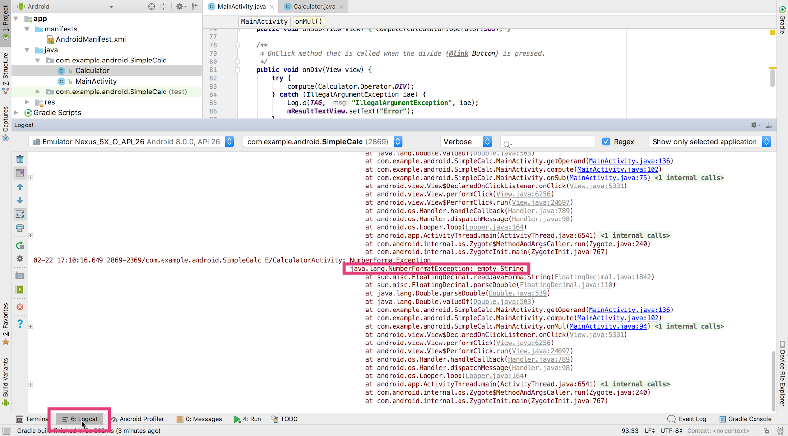
Logcat pane
Logcat tab

Slide 49
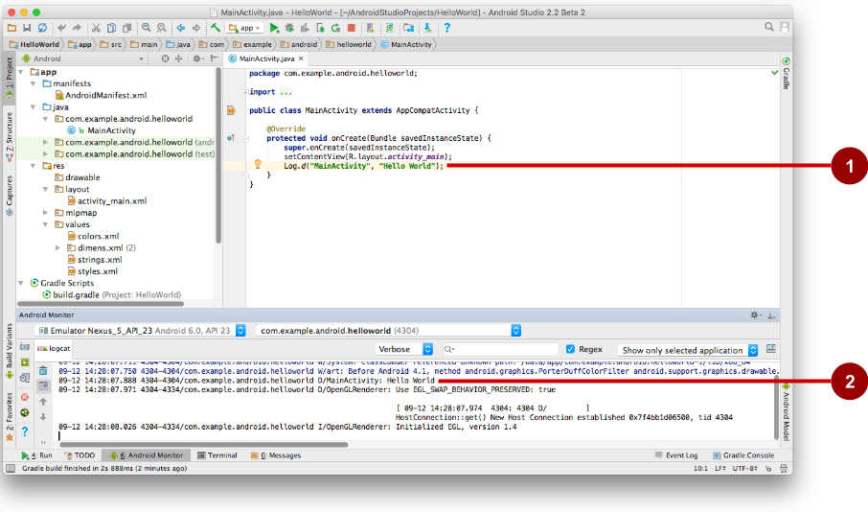
Log.d("MainActivity", "Hello World");
09-12 14:28:07.971 4304 /com.example.android.helloworld D/MainActivity: Hello World
Notes:
Verbose = words more than needed

Slide 50
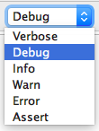
Displays logs with levels at this level or higher
Notes:
Verbose = words more than needed

Slide 51
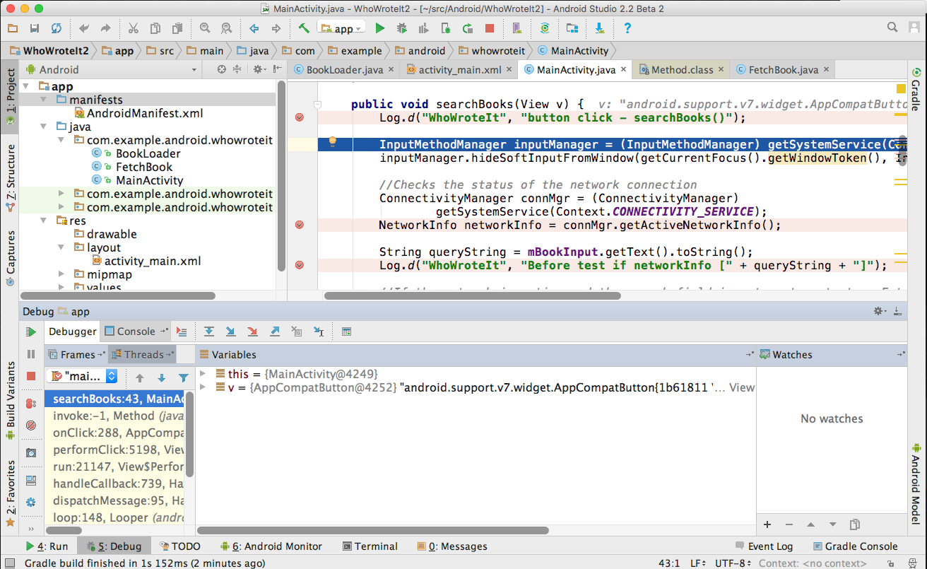
1
2
Debugger pane
Menu:
Run > Debug 'your app'

Slide 52
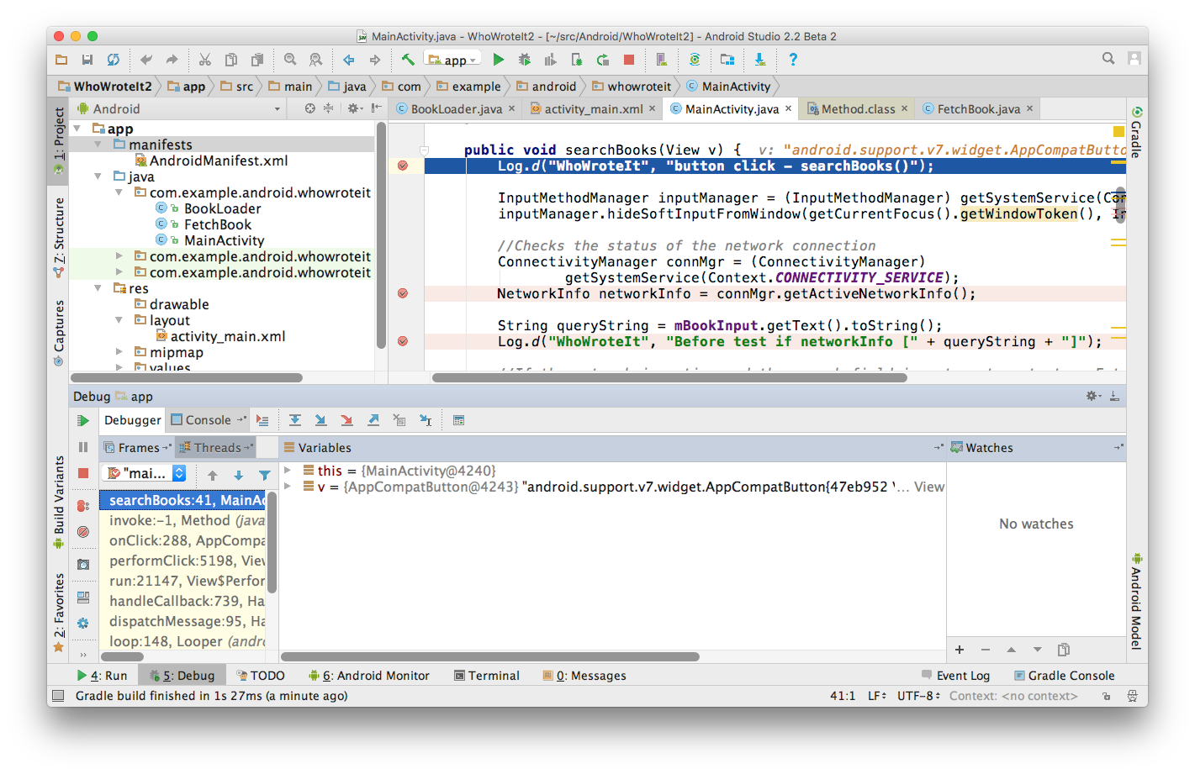
Frames
Variables
Watches
Notes:
Verbose = words more than needed

Slide 53
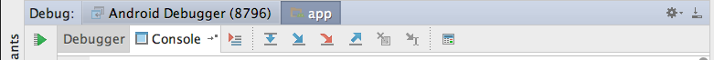
Show execution point
Notes:
Verbose = words more than needed

Slide 54
Show execution point
Drop frame
Notes:
Verbose = words more than needed

Slide 55
Show execution point
Drop frame
Run to Cursor
Notes:
Verbose = words more than needed

Slide 56
Show execution point
Drop frame
Run to Cursor
Step over
Notes:
Verbose = words more than needed

Slide 57
Show execution point
Drop frame
Run to Cursor
Step over
Step into
Notes:
Verbose = words more than needed

Slide 58
Show execution point
Drop frame
Run to Cursor
Step over
Step into
Force step into
Notes:
Verbose = words more than needed

Slide 59
Show execution point
Drop frame
Run to Cursor
Step over
Step out
Step into
Force step into
Notes:
Verbose = words more than needed

Slide 60
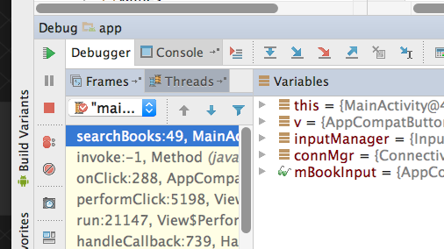
Resume

Slide 61
Resume
Pause

Slide 62
Resume
Pause
Mute all breakpoints

Slide 63
Breakpoints

Slide 64
Breakpoints
Allow you to stop the execution at which line you want.

Slide 65
Testing

Slide 66
Why testing is important?

Slide 67
Why testing is important?
Rapid feedback
Notes:
Rapid feedback on failures.
Early failure detection in the development cycle.
Safer code refactoring, letting you optimize code without worrying about regressions.
Stable development velocity, helping you minimize technical debt.

Slide 68
Why testing is important?
Rapid feedback
Early failure detection
Notes:
Rapid feedback on failures.
Early failure detection in the development cycle.
Safer code refactoring, letting you optimize code without worrying about regressions.
Stable development velocity, helping you minimize technical debt.

Slide 69
Why testing is important?
Rapid feedback
Early failure detection
Safer code refactoring
Notes:
Rapid feedback on failures.
Early failure detection in the development cycle.
Safer code refactoring, letting you optimize code without worrying about regressions.
Stable development velocity, helping you minimize technical debt.

Slide 70
Why testing is important?
Rapid feedback
Early failure detection
Safer code refactoring
Stable development velocity
Notes:
Rapid feedback on failures.
Early failure detection in the development cycle.
Safer code refactoring, letting you optimize code without worrying about regressions.
Stable development velocity, helping you minimize technical debt.

Slide 71
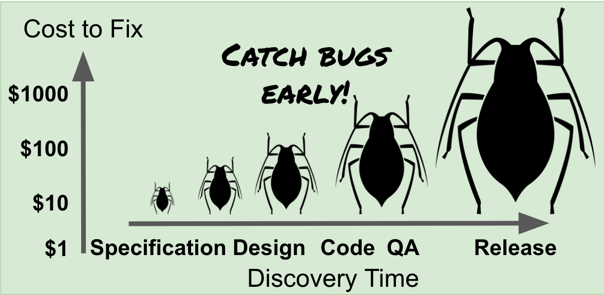

Slide 72
Type of Testing

Slide 73
Type of Testing
Installation

Slide 74
Type of Testing
Installation
Compatibility

Slide 75
Type of Testing
Installation
User Interface
Compatibility

Slide 76
Type of Testing
Usability
Installation
User Interface
Compatibility

Slide 77
Type of Testing
Usability
Installation
User Interface
Compatibility
Scalability

Slide 78
Type of Testing
Usability
Installation
Security
User Interface
Compatibility
Scalability

Slide 79
Type of Testing
Usability
Installation
Security
User Interface
Compatibility
Scalability
Performance

Slide 80
Type of Testing
Usability
Installation
Security
User Interface
Integration
Compatibility
Scalability
Performance

Slide 81
Type of Testing
Usability
Installation
Security
User Interface
Integration
Component
Compatibility
Scalability
Performance

Slide 82
Type of Testing
Usability
Installation
Security
User Interface
Integration
Component
Compatibility
Scalability
Performance
Regression

Slide 83
Type of Testing
Usability
Installation
Acceptance
Security
User Interface
Integration
Component
Compatibility
Scalability
Performance
Regression

Slide 84
Type of Testing
Usability
Installation
Acceptance
Security
User Interface
Integration
And so many…
Component
Compatibility
Scalability
Performance
Regression

Slide 85
Android testing

Slide 86
Android testing
main—code and resources

Slide 87
Android testing
main—code and resources
(test)—local unit tests

Slide 88
Android testing
main—code and resources
(test)—local unit tests
(androidTest)—instrumented tests

Slide 89
Unit test

Slide 90
Unit test
Test the smallest testable part

Slide 91
Unit test
Test the smallest testable part
Isolate each component

Slide 92
Test-Driven Development

Slide 93
Test-Driven Development
Define a use case

Slide 94
Test-Driven Development
Define a use case
Write test code

Slide 95
Test-Driven Development
Define a use case
Write test code
Write your logic

Slide 96
Test-Driven Development
Define a use case
Write test code
Write your logic
Repeat

Slide 97
Testing
Find the view

Slide 98
Testing
Find the view
Perform action

Slide 99
Testing
Find the view
Perform action
Check if it’s passed

Slide 100
Testing
onView

Slide 101
Testing
onView -> Method

Slide 102
Testing
onView -> Method
onView(ViewMatcher)

Slide 103
Testing
onView -> Method
onView(ViewMatcher)
Help us to specify the class

Slide 104
Testing
onView(ViewMatcher)
ViewMatcher -> So many methods

Slide 105
Testing
onView(ViewMatcher)
ViewMatcher -> So many methods
withId(…)

Slide 106
Testing
onView(ViewMatcher)
ViewMatcher -> So many methods
withId(…)
withText(…)

Slide 107
Testing
onView(ViewMatcher)
ViewMatcher -> So many methods
withId(…)
withText(…)
withHint(…)

Slide 108
Practical

Slide 109
Practical
Create the test class

Slide 110
Practical
Create the test class
Create the test method

Slide 111
Practical
Create the test class
Create the test method
Test the logic

Slide 113
Support libraries

Slide 114
Support libraries
Backward compatibility
Notes:
Backward Compatibility for newer APIs - A large amount of the support libraries provide backward compatibility for newer framework classes and methods. For example, the Fragment support class provides support for fragments on devices running versions earlier than Android 3.0 (API level 11).
Convenience and Helper Classes - The support libraries provides a number of helper classes, particularly for user interface development. For example the RecyclerView class provides an user interface widget for displaying and managing very long lists, useable on versions of Android from API level 7 and up.
Debugging and Utilities - There are a number of features that provide utility beyond code you incorporate into your app, including the support-annotations library for improved code lint checks on method inputs and Multidex support for configuring and distributing apps with over 65,536 methods.

Slide 115
Support libraries
Backward compatibility
Helper classes
Notes:
Backward Compatibility for newer APIs - A large amount of the support libraries provide backward compatibility for newer framework classes and methods. For example, the Fragment support class provides support for fragments on devices running versions earlier than Android 3.0 (API level 11).
Convenience and Helper Classes - The support libraries provides a number of helper classes, particularly for user interface development. For example the RecyclerView class provides an user interface widget for displaying and managing very long lists, useable on versions of Android from API level 7 and up.
Debugging and Utilities - There are a number of features that provide utility beyond code you incorporate into your app, including the support-annotations library for improved code lint checks on method inputs and Multidex support for configuring and distributing apps with over 65,536 methods.

Slide 116
Support libraries
Backward compatibility
Helper classes
Debugging and Utilities
Notes:
Backward Compatibility for newer APIs - A large amount of the support libraries provide backward compatibility for newer framework classes and methods. For example, the Fragment support class provides support for fragments on devices running versions earlier than Android 3.0 (API level 11).
Convenience and Helper Classes - The support libraries provides a number of helper classes, particularly for user interface development. For example the RecyclerView class provides an user interface widget for displaying and managing very long lists, useable on versions of Android from API level 7 and up.
Debugging and Utilities - There are a number of features that provide utility beyond code you incorporate into your app, including the support-annotations library for improved code lint checks on method inputs and Multidex support for configuring and distributing apps with over 65,536 methods.

Slide 117
Support libraries

Slide 118
Support libraries
Deprecated

Slide 119
Android Jetpack

Slide 120
Android Jetpack
Modern App Architecture

Slide 121
Android Jetpack
Modern App Architecture
Eliminate boiler plate code

Slide 122
Android Jetpack
Modern App Architecture
Eliminate boiler plate code
Simplifying complex tasks

Slide 123
Android Jetpack
Modern App Architecture
Eliminate boiler plate code
Simplifying complex tasks
And so many…

Slide 124
Android Jetpack philosophy

Slide 125
Android Jetpack philosophy
Focus in Four key areas of Android

Slide 126
Android Jetpack philosophy
Focus in Four key areas of Android
Architecture

Slide 127
Android Jetpack philosophy
Focus in Four key areas of Android
Architecture
UI

Slide 128
Android Jetpack philosophy
Focus in Four key areas of Android
Architecture
UI
Behavior

Slide 129
Android Jetpack philosophy
Focus in Four key areas of Android
Architecture
UI
Behavior
Foundation

Slide 130
Android Jetpack philosophy
Focus in Four key areas of Android
Architecture
UI
Behavior
Foundation
Individually adapted but work well together

Slide 131
Architecture
Lifecycle management
Data persistence
Paging
Navigation
Work manager

Slide 132
Navigation
Deep linking
Automated Fragment Transactions
Overflow menu
Navigation Drawer
Bottom navigation

Slide 133
UI
Animation & Transitions
Layout
Emoji
Fragments
TV, Wear, Auto Libraries

Slide 134
Behavior
Notifications
Permissions
Sharing

Slide 135
Foundation
AppCompat
Testing Libraries
Koltin extensions (ktx)

Slide 136
To know more
developer.android.com/jetpack

Slide 137
Thanks

