Slide 1
User Experience

Slide 2
Bad
Good

Slide 3
Performance
Accuracy
Responsiveness

Slide 4
Drawables
Styles
Themes

Slide 5
Faster
Reduce code

Slide 6
Drawable is generic class used to present any kind of graphic
res/drawable project folder

Slide 7
Bitmap file (png. Jpeg)
Shape drawable
Layer List
Vector drawable
Transition drawable

Slide 8
Bitmap files are a set of pixels in a grid
Vector graphics are describing the objects geometrically. (this means vector can scale with no loss of quality

Slide 9
Image asset Studio
Helps you to build multiple versions of each bitmap for different disparate resolutions.
Create your own app icon

Slide 10
Vector asset Studio
Create one image in xml and it will be able to scale for all different devices.
Create your own app icon

Slide 11
Performance
Use smallest resolution
Resize, crop, compress
Vector drawings for simple images
Use Lib: Glide or Picasso
Use lossy image formats and adjust quality where possible

Slide 12
Performance
Image downloading and caching library for Android (glide, Picasso)

Slide 13
Style
Specify the look and feel of individual views in android
Why?
Reduce duplication
Make code more compact
Manage visual appearance of many components with one style.
Inherit and expand of a parent style

Slide 14
Theme
Is a style which applied to an entire activity or even entire application
Applied in the Android Manifest
There are few Android templates “AppTheme”
High-density pixles
Px = dp * (dpi / 160)

Slide 15

Layer List example

Slide 16
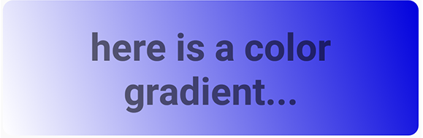
GradientDrawable example

Slide 17
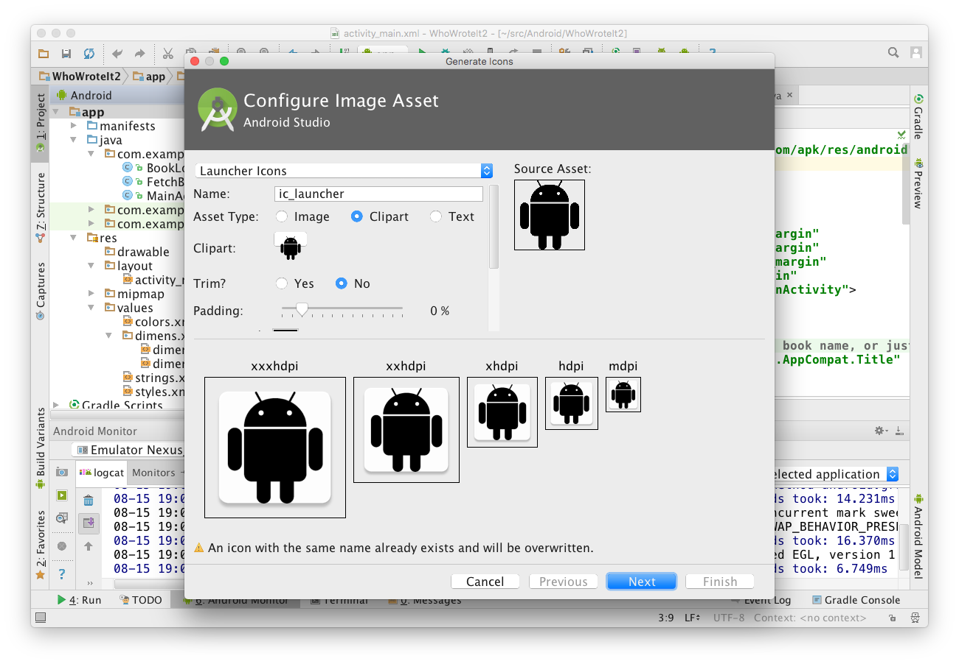
Chose icon typeand change name
Choose Image, Clipart, or Text
Click icon to chose clipart
Inspect assets for multiple screen sizes

Slide 18
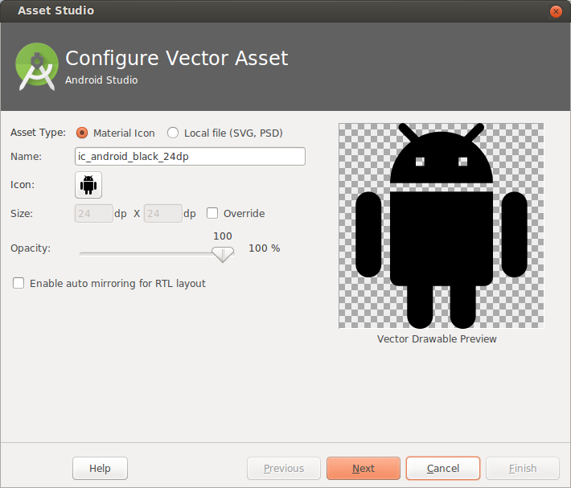
Choose from Material Icon library, or supply your own SVG or PSD vector drawing
Opens Material Icon library

Slide 19
What is a Style?
Collection of attributes that define the visual appearance of a View
Reduce duplication
Make code more compact
Manage visual appearance of many components with one style

Slide 20
<TextView
android:layout_width="match_parent"
android:layout_height="wrap_content"
android:textColor="#00FF00"
android:typeface="monospace"
android:text="@string/hello" />
<TextView
style="@style/CodeFont"
android:text="@string/hello" />

Slide 21
styles.xml is in res/values
<resources>
<style name="CodeFont">
<item name="android:textColor">#00FF00</item>
<item name="android:typeface">monospace</item>
</style>
</resources>

Slide 22
Define a parent style...
<resources>
<style name="CodeFont">
<item name="android:layout_width">match_parent</item>
<item name="android:layout_height">wrap_content</item>
<item name="android:textColor">#00FF00</item>
<item name="android:typeface">monospace</item>
</style>
</resources>

Slide 23
Define child with Codefont as parent
<resources>
<style name="RedCode" parent="@style/Codefont>
<item name="android:textColor">#FF0000</item>
</style>
</resources>

Slide 24
Theme
A Theme is a style applied to an entire activity or even the entire application
Themes are applied in AndroidManifest.xml
<application android:theme="@style/AppTheme">

Slide 25
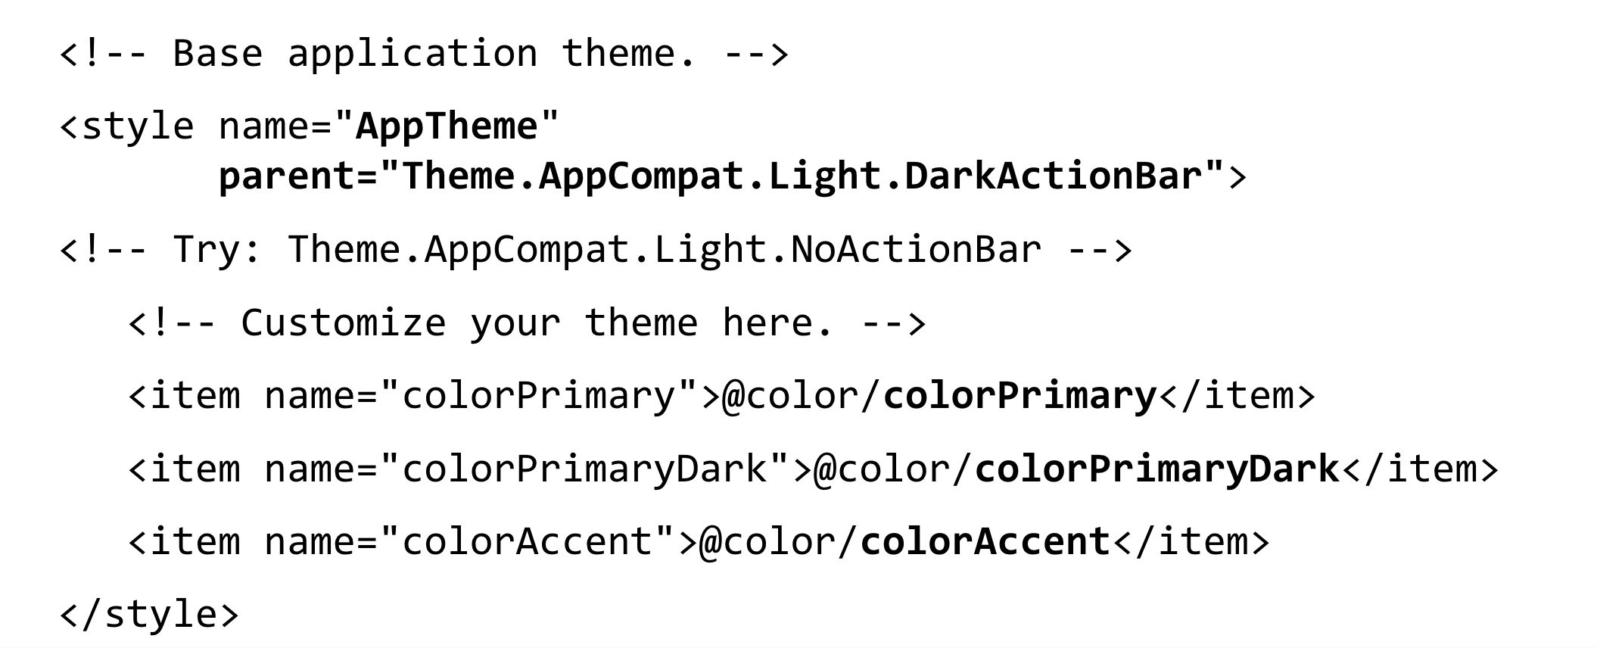
Customize AppTheme of Your Project

