Slide 1
Software Development Project Group: 6 Team Color: Brown
Name: Hunain Arif MtrNr.: 1501421
Submitted to: Prof. Michael Jahn head of research and academy

Slide 2
Project Description:
To develop and deliver an end-to-end Change Data Capture (CDC) tool tailored for small and medium-sized enterprises, alongside a compliant medical registry for diabetic foot syndrome data collection. The project encompasses:
Requirements & Research: Analysis of CDC architectures, registry structures and legal/standard compliance (German & EU medical data regulations)
Implementation: Real-time CDC engine paired with a user-friendly frontend, secure storage, and integration with orthopedic shoe technology workflows
Data Protection & Evaluation: End-to-end encryption, role-based access, and built-in analytics for ongoing clinical and operational insights
Timeline: April 15 – July 17, 2025, culminating in a fully functional CDC application and registry demonstration.
2

Slide 3
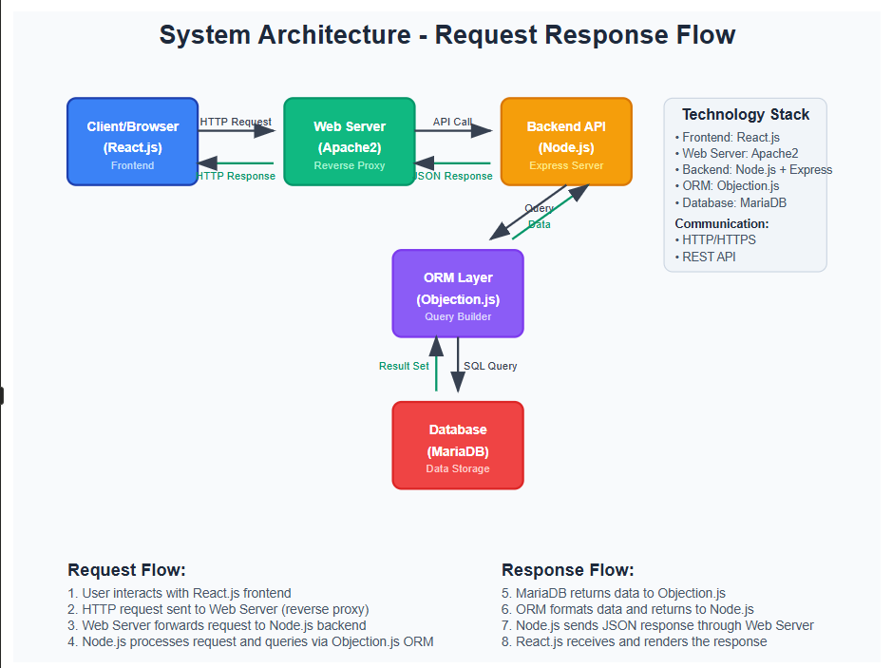
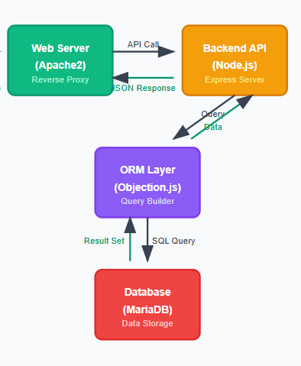
^{System Architecture}
MY PART

Slide 4
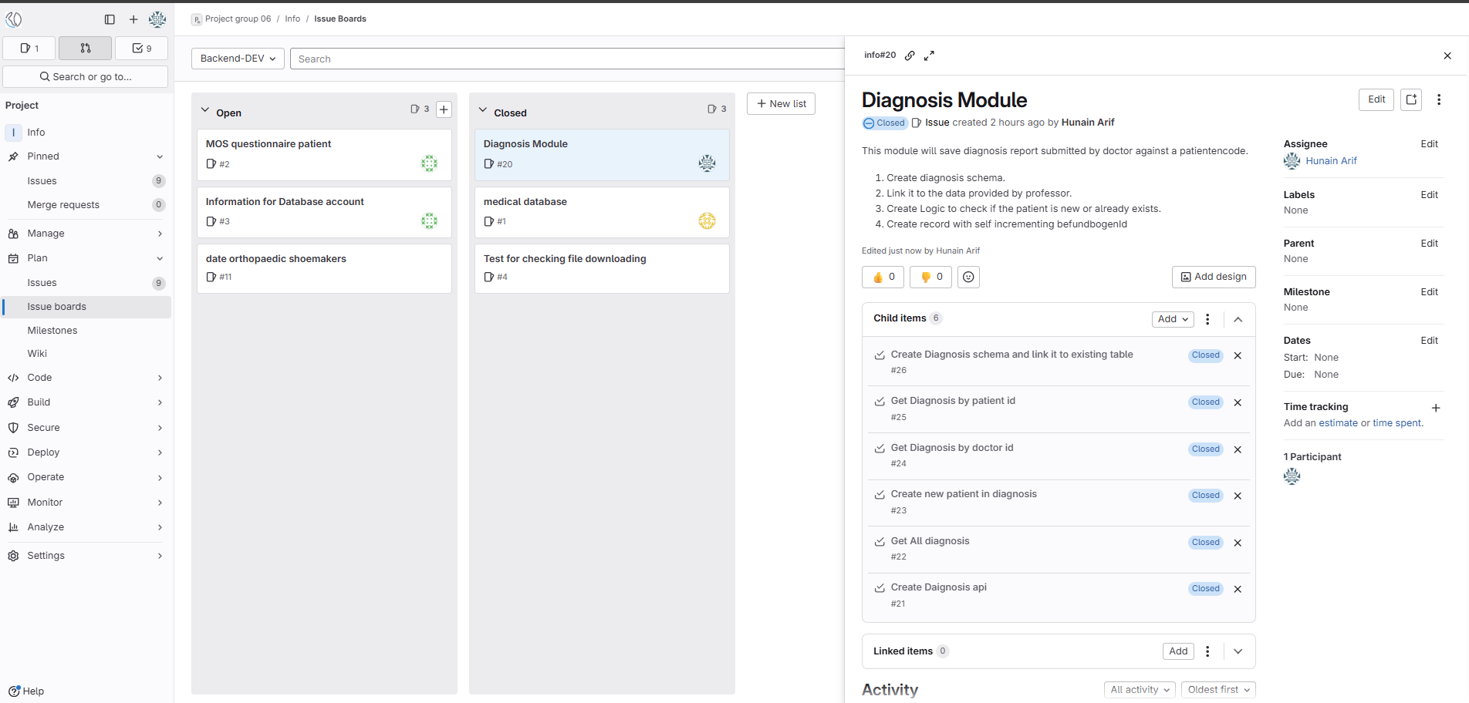
Process(Agile):
4

Slide 5
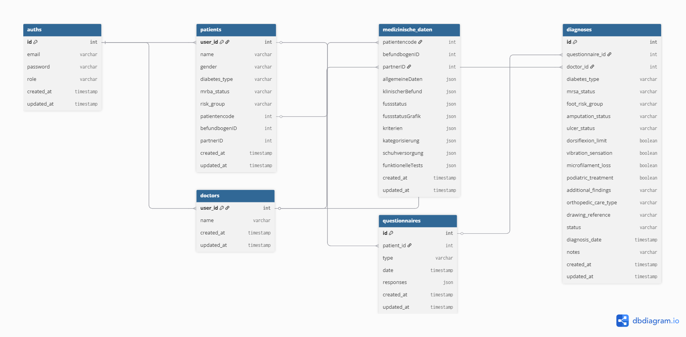
^{ER Diagram of the system:}

Slide 6
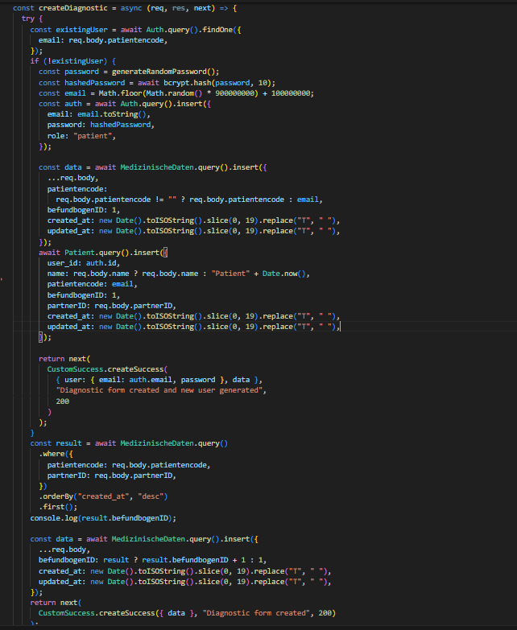
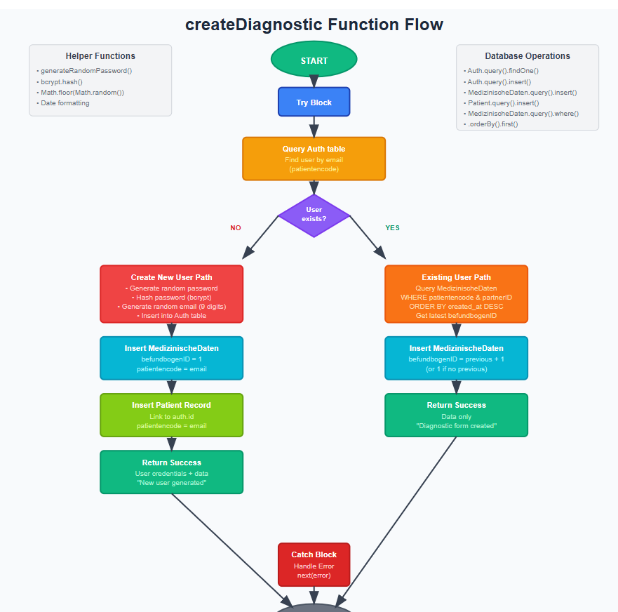
Diagnosis Flow:
6

Slide 7
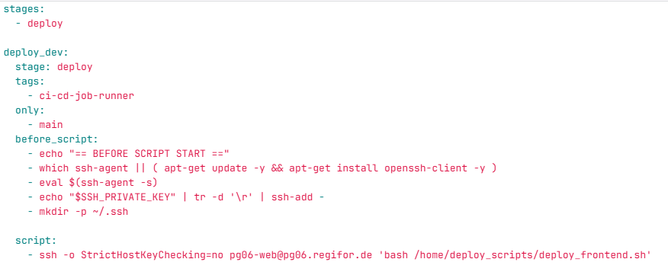
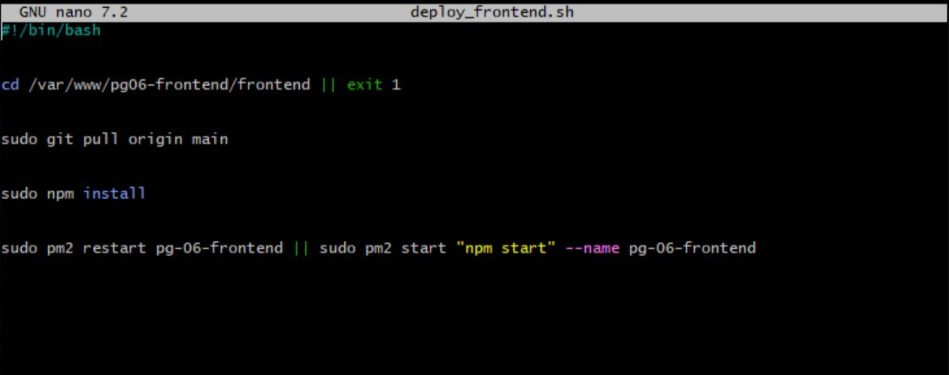
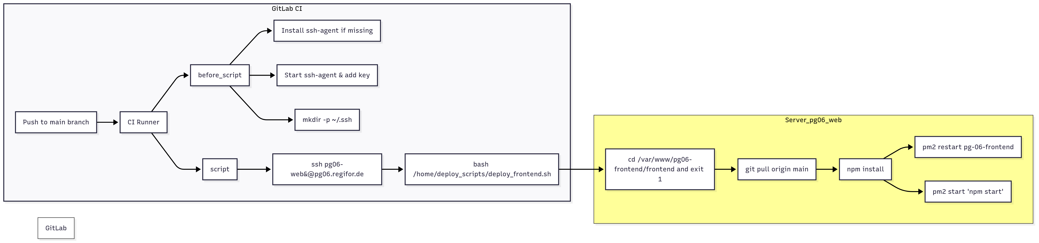
Webserver/CI-CD Part:
7

Slide 8
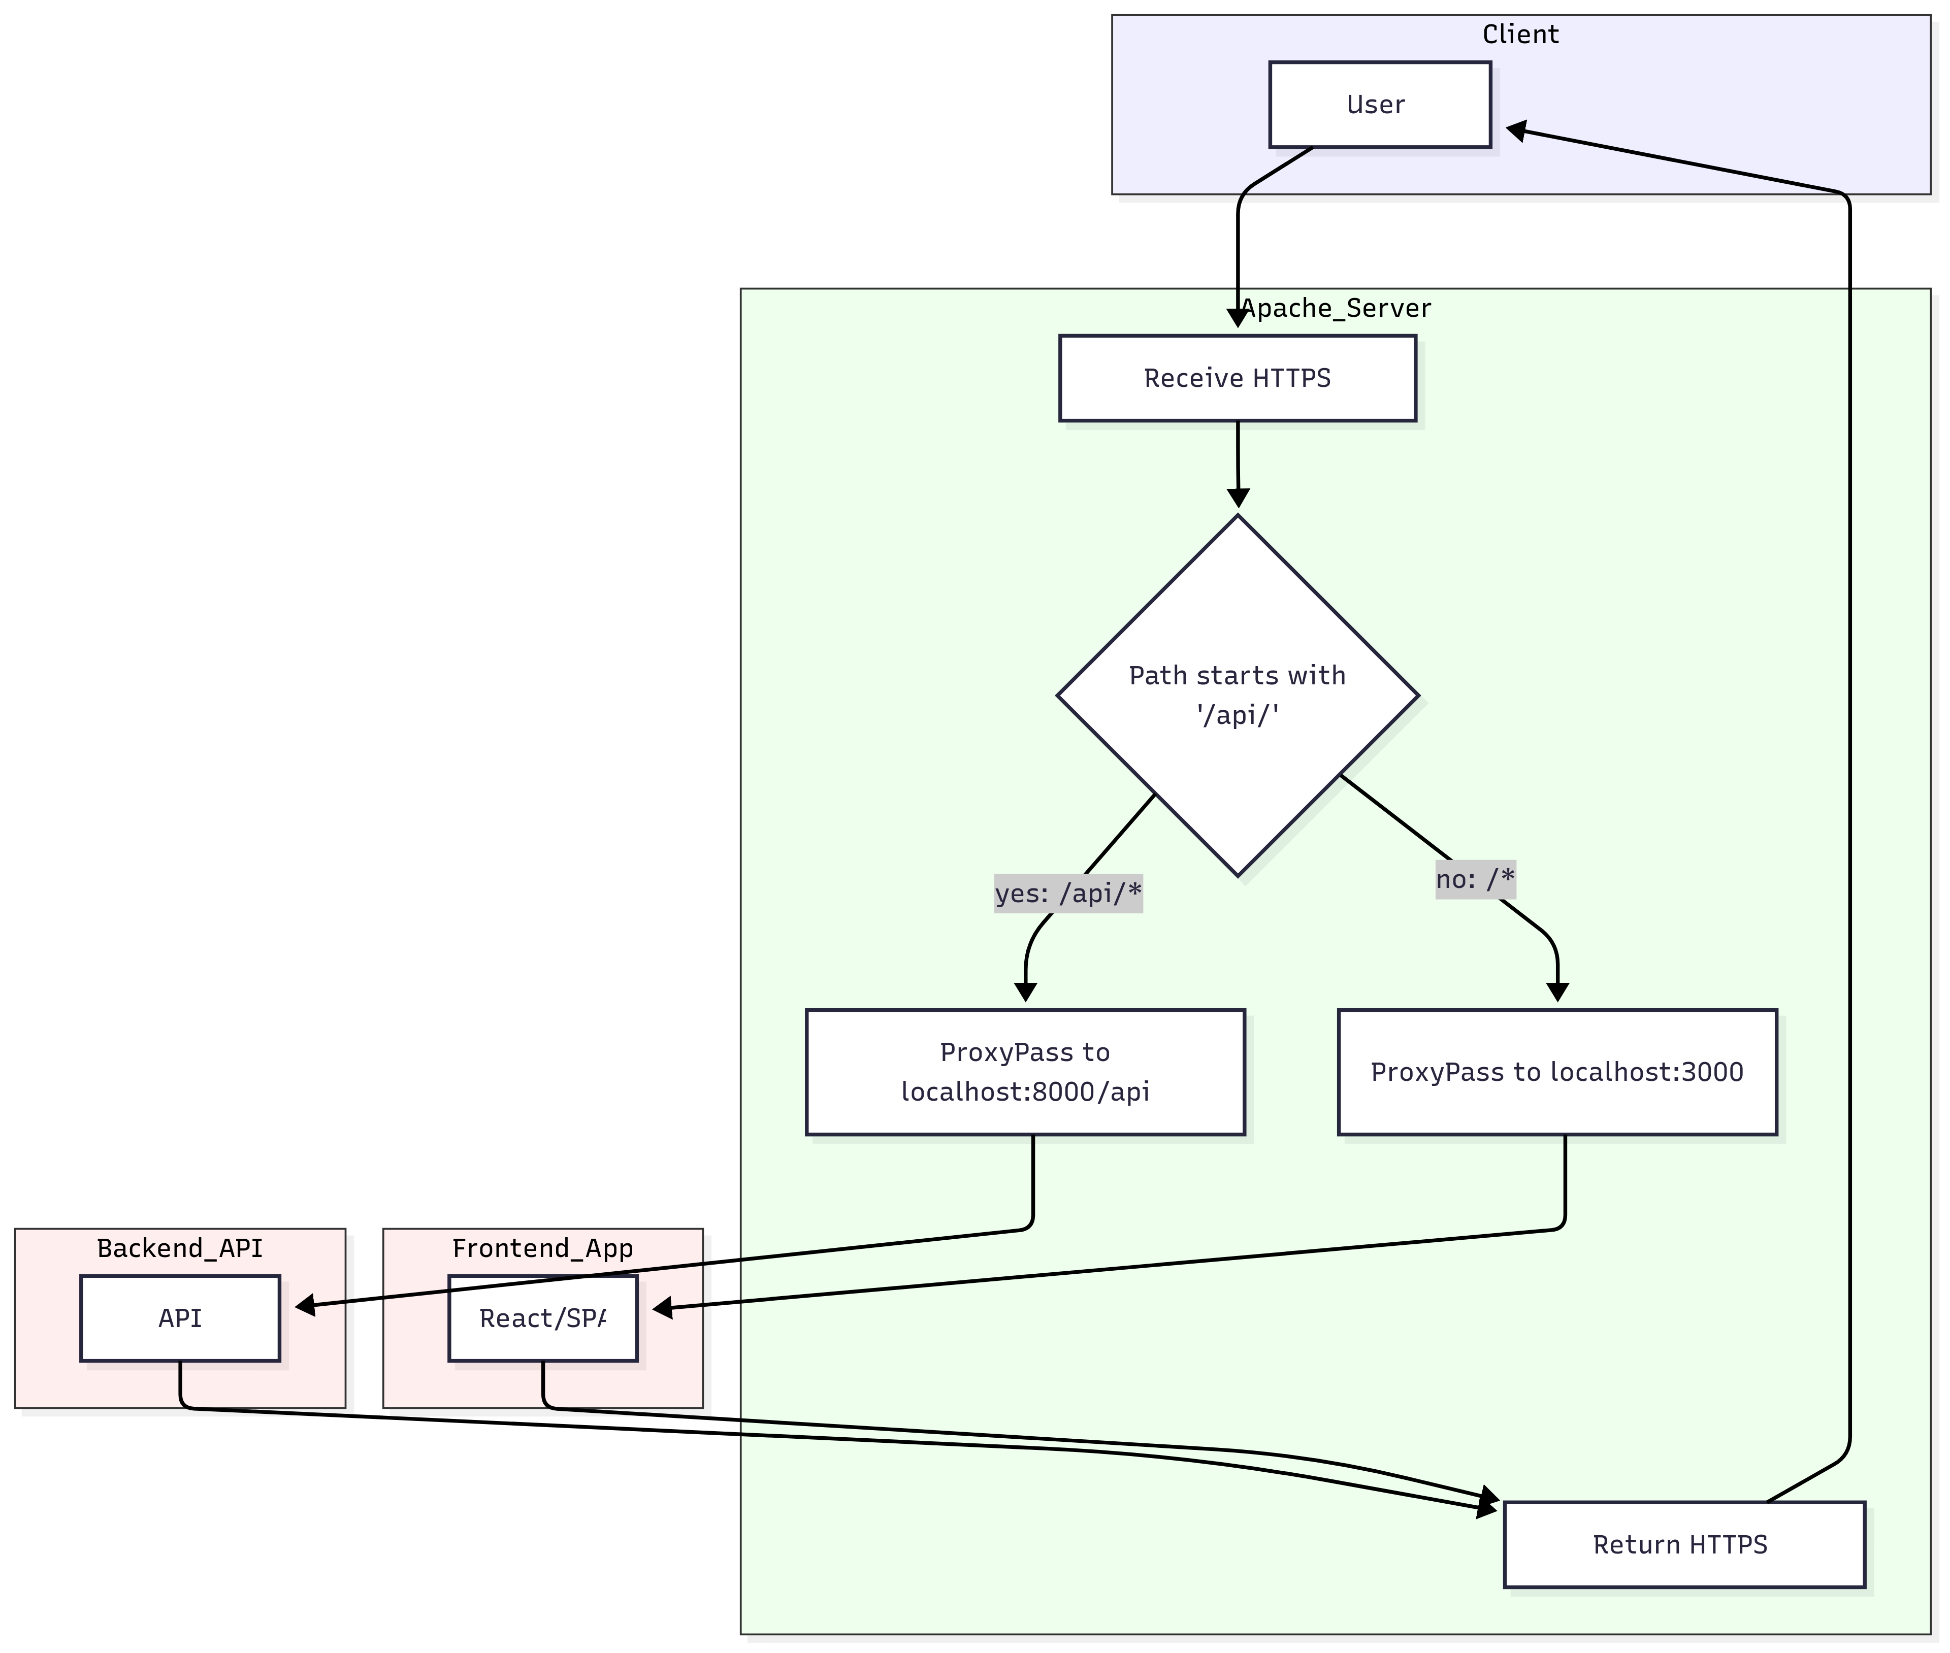
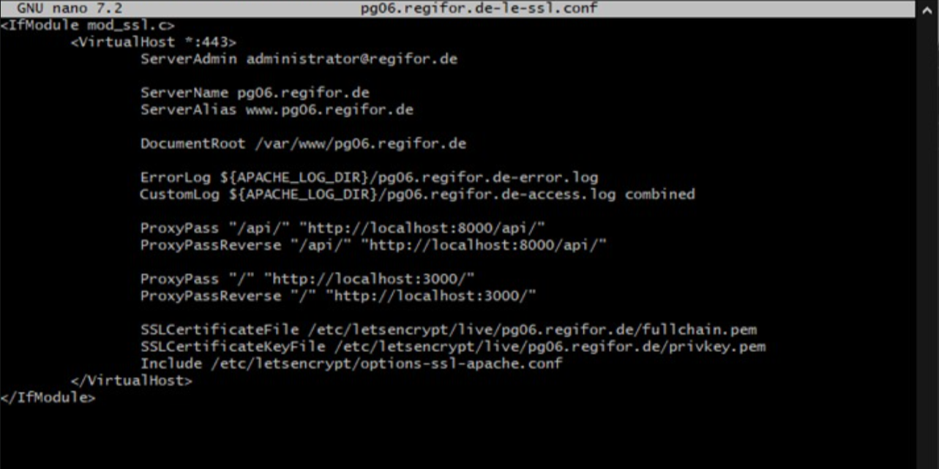
Reverse Proxy:
8

Slide 9
Conclusion/What I learned
Hands-On Data Engineering: Gained practical experience designing and implementing a full-stack Change Data Capture solution.
Domain-Driven Compliance: Deepened understanding of German & EU medical data regulations, ensuring our registry met strict privacy and security standards.
Agile Collaboration: Practiced Scrum-style sprints, iterative planning, and cross-functional teamwork, which improved adaptability and communication within our project group.
DevOps & CI/CD Skills: Built and configured our web server pipeline—complete with reverse proxy and deployment workflows—to deliver reliable, production-ready software.
Modeling & Architecture: Refined ER-diagramming and system-architecture design techniques, laying a strong foundation for scalable, maintainable data platforms.
Outcome-Oriented Learning: Learned to balance technical requirements, regulatory constraints, and user needs—culminating in a functional CDC tool and medical registry that demonstrate the power of integrated, compliant data solutions.
Peer Support & Mentorship: Assisted teammates with onboarding, code reviews, and troubleshooting, fostering a culture of knowledge sharing and collective problem-solving.
9

Slide 10
THANK YOU!!

