Slide 1
CS-404 Big Data Analytics | NUST SEECS | Spring 2026
Brazilian E-Commerce
Data Warehouse & Analytics
Olist Public Dataset | Assignments 02 & 03
Hassan Aamir (453976) | Umair Naeem (479984)
Instructor: Ms. Zahida Kausar

Slide 2
Presentation Agenda
01
Group Introduction & Task Division
04
ETL Pipeline & Star Schema
02
Dataset Overview
05
Analytics & Visualizations
03
Data Quality Issues & Cleaning
06
Business Insights & Resources

Slide 3
SECTION 01
Group Introduction & Task Division
Umair Naeem
Hassan Aamir
Student ID: 479984
Student ID: 453976
Responsibilities:
HDFS environment setup & configuration
ingest.py — ingestion pipeline (A2)
etl.py — PySpark ETL pipeline (A3)
Star schema design & implementation
GitHub repository setup & README
Responsibilities:
profiling_report.py — data profiling (A2)
analytics.py — Spark SQL queries (A3)
final_report.py — PDF report generation
Charts, visualizations & business insights
Presentation slides
3 / 12

Slide 4
SECTION 02
Dataset Overview — Olist Brazilian E-Commerce
What is the Olist Dataset?
A public Brazilian e-commerce dataset released by Olist, covering real orders placed between 2016 and 2018. It contains 8 relational tables spanning the full order lifecycle: from purchase to delivery and customer review.
Why This Dataset?
Over 1 million records justify distributed HDFS/Spark processing.
8 tables across multiple data types: timestamps, numerics, categorical, and free text.
Rich relational structure naturally maps to a star schema.
Real business questions around revenue, delivery, and customer satisfaction.
1.1 M+
Total Records
8
Relational Tables
2016–18
Dataset Period
4 / 12

Slide 5
SECTION 02
The 8 Source Tables
olist_orders
olist_sellers
112,650 rows — Order lifecycle & status
3,095 rows — Seller location info
olist_order_items
olist_order_payments
112,650 rows — Products per order + pricing
103,886 rows — Payment method & installments
olist_customers
olist_order_reviews
99,441 rows — Customer location info
99,224 rows — Customer ratings & comments
olist_products
olist_geolocation
32,951 rows — Product catalogue & dimensions
1,000,163 rows — ZIP-code coordinate mapping
5 / 12

Slide 6
SECTION 03
Data Quality Issues Identified (A2 Profiling)
Geolocation Duplicates
~79%
Outliers (IQR)
99th Pct
1,000,163 raw rows reduced to ~194,000 after deduplication on (zip, lat, lng)
Extreme values in price, freight, and payment_value skew aggregations
Fix: dropDuplicates then groupBy zip for avg coordinates
Fix: Winsorized at 99th percentile; original values preserved in raw_* columns
NULL Delivery Timestamps
Expected
NULL Review Comments
~59%
Cancelled and unavailable orders have no delivery dates: correlated nulls, not errors
review_comment_message is optional: missing does not mean a quality problem
Fix: Added is_delivered flag; delivery duration computed only for delivered orders
Fix: Added has_comment flag; NULL text replaced with empty string for NLP
Invalid Prices & Freight
0.07%
Misspelled Column Name
Schema
price <= 0 and freight_value < 0 found in order_items, likely data entry errors
product_name_lenght (typo) present in products table across all rows
Fix: price <= 0 set to NULL (cast DoubleType); freight < 0 clamped to 0.0
Fix: Renamed via withColumnRenamed at ETL schema level — no data values changed
6 / 12

Slide 7
SECTION 04
PySpark ETL Pipeline & Star Schema
Star Schema
1
Extract
dim_customers
dim_products
Read raw CSVs from HDFS /warehouse/raw/
fact_orders
2
Transform
Apply A2 cleaning rules; derive new columns; cast types
dim_sellers
dim_payments
3
Load
Write Parquet to /warehouse/processed/; partition by year/month
dim_date
dim_geolocation
4
Validate
Assert null counts on key columns; verify row counts
Optimizations: Partitioning | Broadcast Join | Caching
7 / 12

Slide 8
SECTION 05 Analytics & Business Questions
5 Business Questions Answered with Spark SQL
Q1
What are the monthly revenue trends over time, and how does month-over-month growth change?
LAG() Window
Q2
Which product categories generate the highest revenue, and how do they rank against each other?
RANK() Window
Q3
Which sellers have the highest sales volume, and how do they rank within their state?
ROW_NUMBER() by State
Q4
How do delivery times vary by seller state, and does delay correlate with customer ratings?
Correlation Analysis
Q5
Which payment methods dominate, and how do installment counts affect average order value?
8 / 12
Aggregation

Slide 9
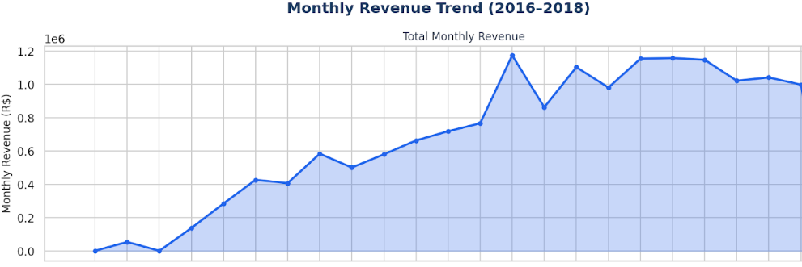
SECTION 05
Q1 — Monthly Revenue Trend (2016–2018)
Key Findings
3.3x
revenue growth from Oct 2016 to Aug 2018
Nov 2017
largest single-month spike — Black Friday
LAG()
window function tracks MoM change each month
9 / 12

Slide 10
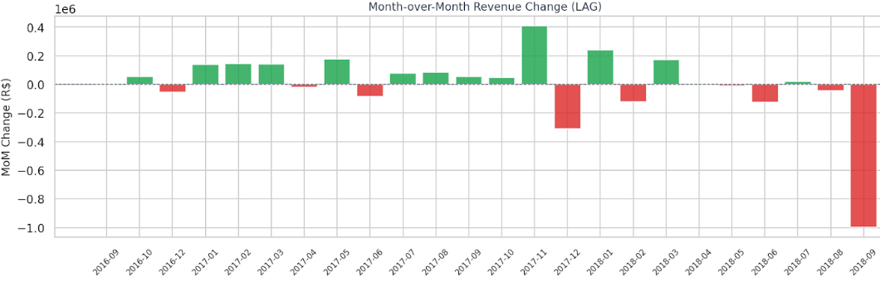
SECTION 05
Q1 — Monthly Revenue Trend (2016–2018)
Key Findings
3.3x
revenue growth from Oct 2016 to Aug 2018
Nov 2017
largest single-month spike — Black Friday
LAG()
window function tracks MoM change each month
9 / 12

Slide 11
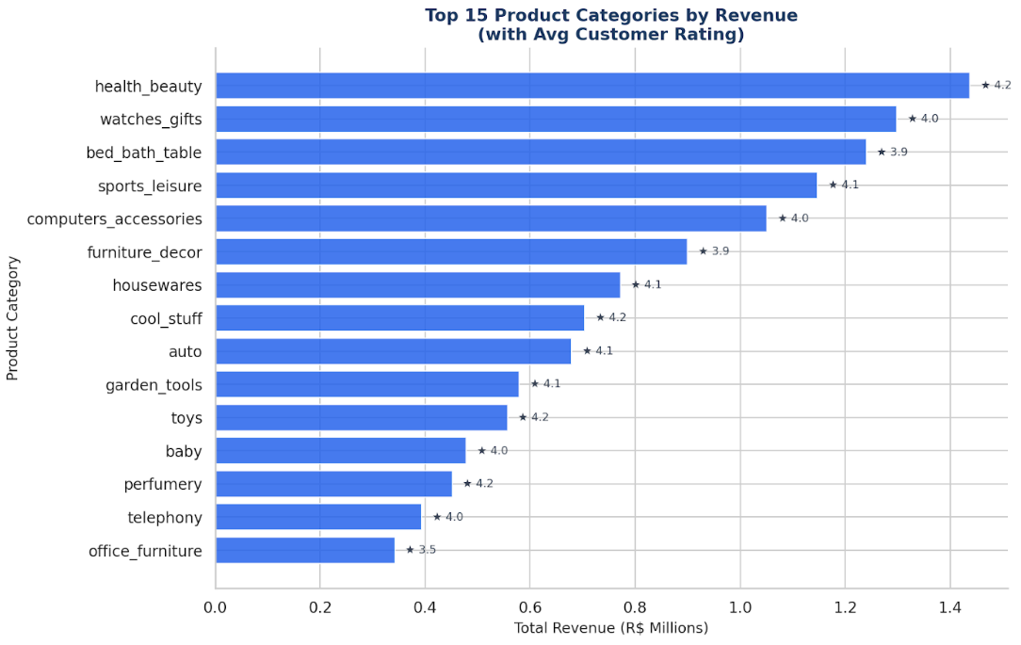
SECTION 05
Q2 & Q5 — Category Revenue and Payment Methods
Top 15 Revenue Categories
10 / 12

Slide 12
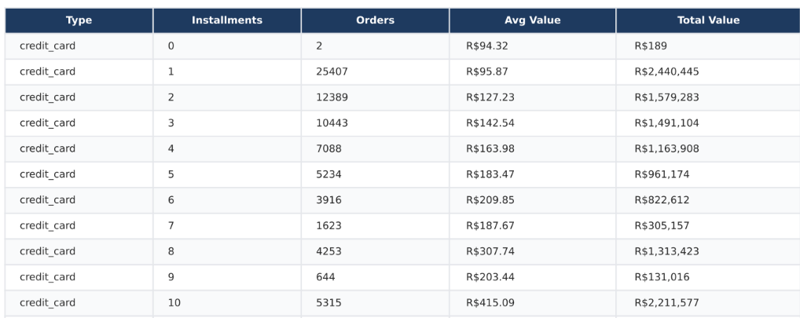
SECTION 05
Q2 & Q5 — Category Revenue and Payment Methods
10 / 12

Slide 13
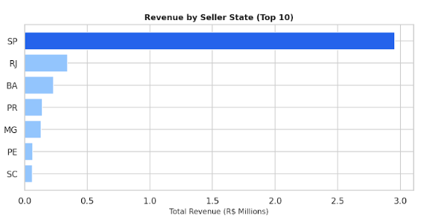
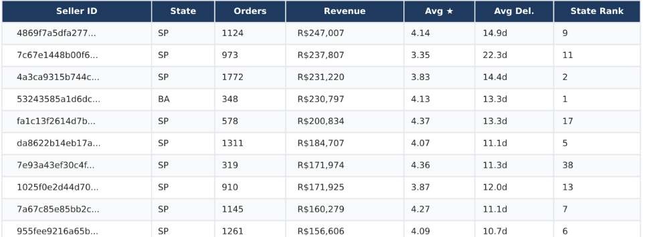
SECTION 05
Q3 & Q4 — Delivery Performance and Seller Performance per state
Top Sellers
10 / 12

Slide 14
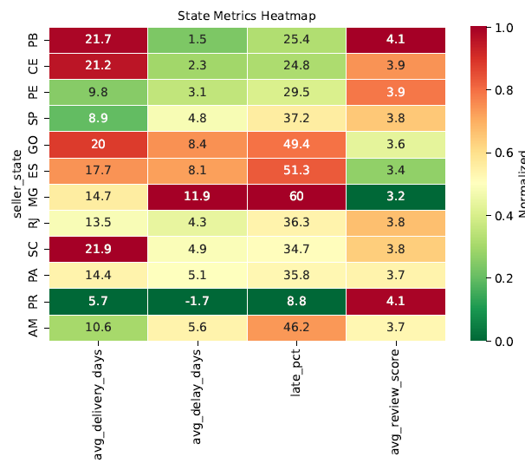
SECTION 05
Q3 & Q4 — Delivery Performance and Seller Performance per state
10 / 12

Slide 15
SECTION 05
Key Business Insights
3.3x
Revenue Growth
-0.08
Delivery & Ratings
Platform revenue grew 3.3x from late 2016 to mid-2018. Black Friday 2017 produced the single largest revenue spike, validating seasonal marketing investment.
Each additional day of delivery delay is associated with a 0.08-point drop in average review score. Northern states show the highest delays and lowest ratings — a clear logistics gap.
Top 4
Category Leadership
2.8x
Installment Effect
bed_bath_table, watches_gifts, health_beauty, and sports_leisure together account for the majority of GMV. Protecting share in these categories is the highest-priority seller acquisition target.
Credit card orders with 10+ installments have average values 2.8x higher than single-payment orders. Interest-free installment promotions in high-price categories can significantly grow basket size.
11 / 12

Slide 16
Section 06 — Resources
Thank You
Questions are welcome.
DATASET
GITHUB REPOSITORY
kaggle.com/datasets/olistbr/brazilian-ecommerce
github.com/hassan2-aamir/Ecommerce_Analysis_BDA
Olist Brazilian E-Commerce Public Dataset
Source code: ingest.py, etl.py, analytics.py, final_report.py
CS-404 Big Data Analytics | NUST SEECS | Hassan Aamir & Umair Naeem | Spring 2026

