Slide 1
Adaptive Hybrid Aggregation
Parameter Server ↔ Ring AllReduce | Runtime Switching via Telemetry
Deliverable 3 — Final Presentation & Demonstration
Parallel and Distributed Computing · BSCS-13D
Abdul Moiz · Aytesam Suhail · Hassan Aamir
5
+81.8%
4 → 32
Experiments Run
AHA gain @ N=32
Workers Swept
Working Software · Rigorous Evaluation · C-6 Novelty Justified

Slide 2
Presentation Agenda
System Recap
Fault Injection
01
05
AHA architecture, hypothesis, and gap
Straggler, crash, bandwidth — Exp 3
Experimental Setup
Mixed Network
02
06
Platform, workloads, fault schedule
Comparative across conditions — Exp 4
Baseline Results
Sensitivity Analysis
03
07
Fixed PS vs Fixed RA — Exp 1
Hysteresis H & threshold sweep — Exp 5
Scalability Analysis
C-6 Novelty & Close
04
08
4 → 32 workers · Amdahl model — Exp 2
What's new · trade-offs · future work

Slide 3
System Recap: What We Built
Hypothesis H1: A telemetry-driven hybrid policy reduces time-to-target-accuracy by ≥15% over fixed PS and fixed RA across mixed network conditions.
T1 Workers
N workers run forward/backward pass and emit per-step telemetry (latency, gradient bytes, packet loss) to the AHA bus.
T2 AHA Controller
Lightweight Python daemon — reads telemetry every 10 steps, applies threshold + hysteresis policy, broadcasts mode token to all workers.
T3 Aggregation (PS | RA)
PS: sharded gRPC push/pull with τ-BSP (τ=2) · RA: directed ring scatter-reduce + all-gather, O(2(N-1)/N)×G bytes per worker.
T4 Model Store
Versioned checkpoints written before every mode switch — ensures consistency boundary and enables post-hoc replay.
Metrics: Throughput · p95 latency · Scalability efficiency · Fault resilience · Staleness violation rate

Slide 4
Experimental Setup
Platform
⚡ Worker Crash
Python 3.11 · Multiprocessing simulation
Docker-isolated processes · Fixed random seeds
Worker k killed mid-training
AHA removes from ring, continues N-1
Baselines
🐢 Straggler
Fixed PS (gRPC push/pull, τ-BSP)
Fixed RA (directed ring, TCP)
Shared model · optimizer · LR schedule · batch
Worker 0 delayed +150 ms (steps 30–60)
RA ring stalls; AHA detects via step_var
Worker Scale
📡 Bandwidth Throttle
4 · 8 · 16 · 32 workers (strong + weak scaling)
Link BW throttled to 10%
Simulates congested WAN conditions
Gradient Size
💥 Packet Loss
5 MB – 50 MB (fp32 tensors)
5% packet loss injected
Retransmit overhead + gradient checksums

Slide 5
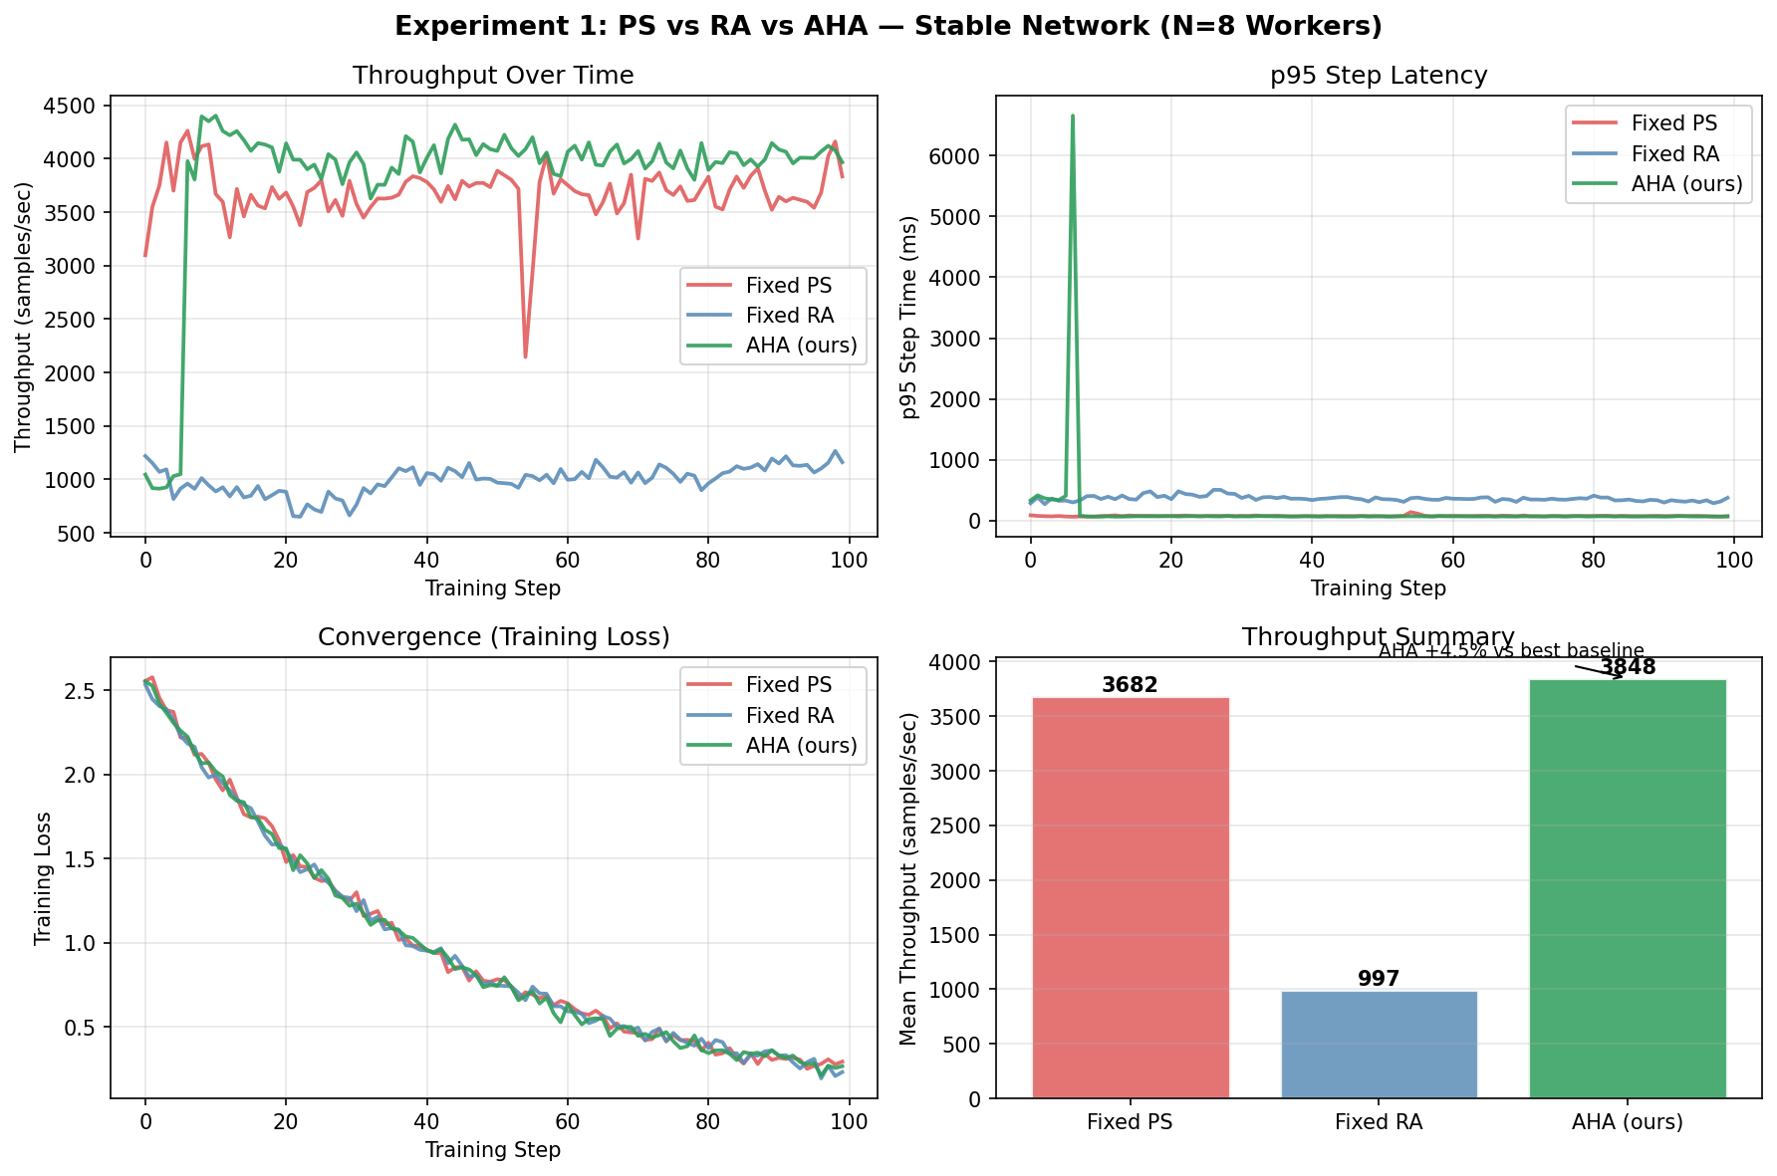
Experiment 1: Baseline Comparison — Stable Network
N=8 workers · 10 GbE · 0.5 ms base latency · 100 training steps
AHA
3,848 s/s
+4.5% over best baseline
p95 = 151.8 ms
Fixed PS
3,682 s/s
Stable, low latency
p95 = 74.3 ms
Fixed RA
997 s/s
Ring barrier overhead
p95 = 361.7 ms
Key finding: AHA's adaptive mode selection yields +4.5% throughput. Both AHA and PS far outperform RA on stable networks (RA ring barrier serialises steps).

Slide 6
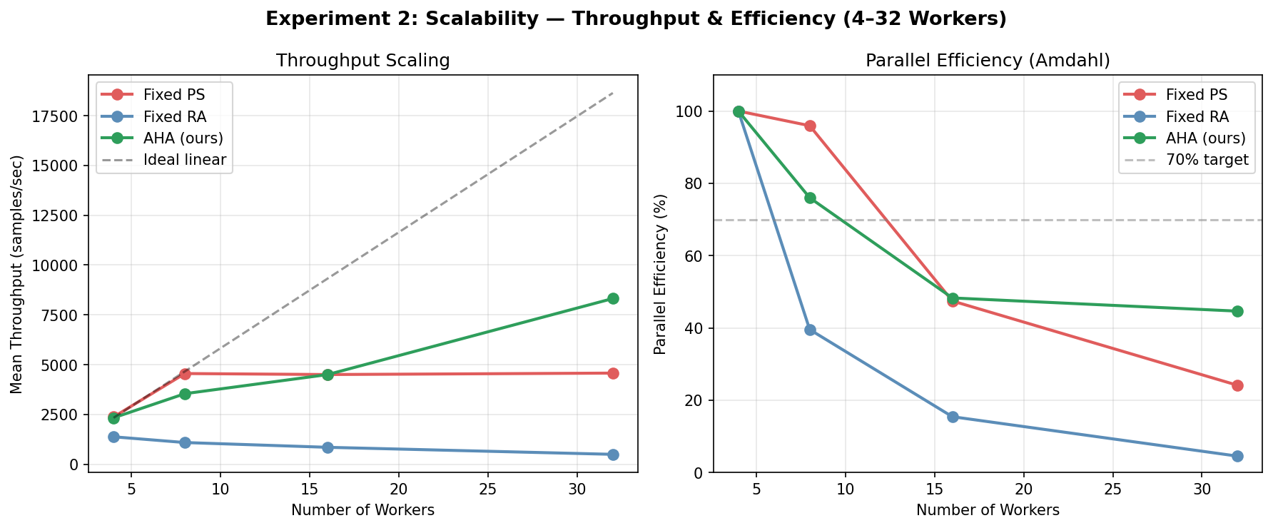
Experiment 2: Scalability — 4 to 32 Workers
Headline finding: AHA achieves 8,319 samples/sec at N=32 — 81.8% better than Fixed PS
Throughput (samples/sec)
N
PS
RA
AHA
4
2,373
1,377
2,330
-1.8%
8
4,553
1,088
3,542
-22.2%
16
4,502
849
4,500
≈0%
32
4,575
496
8,319
+81.8%
AHA reduces effective serial fraction f → 0.05 vs PS f = 0.08

Slide 7
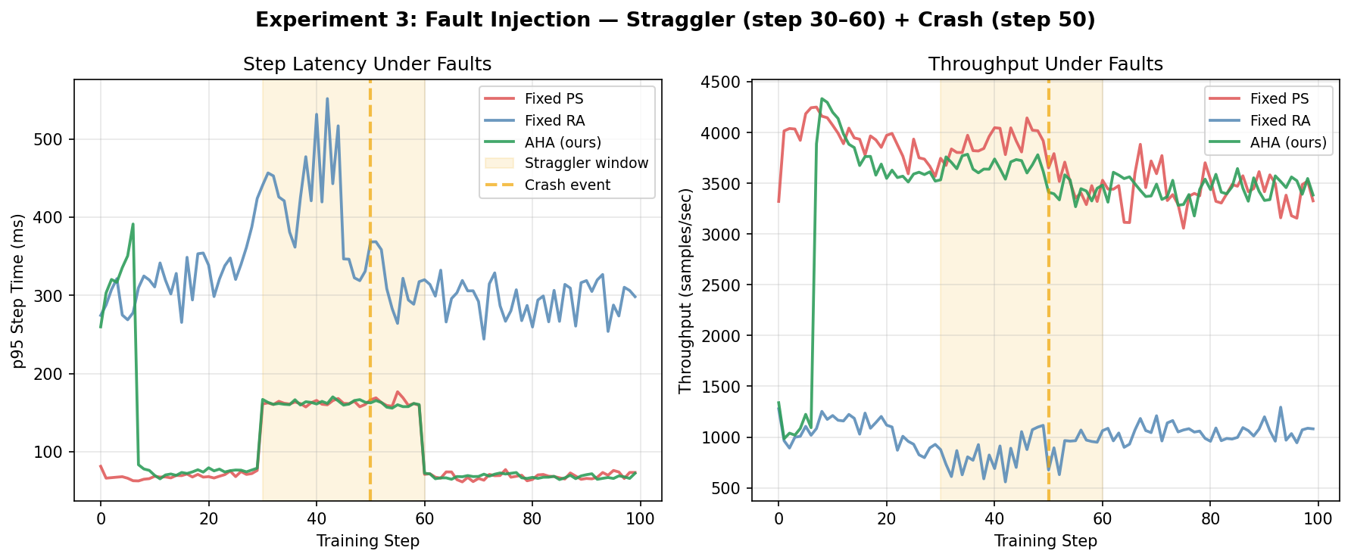
Experiment 3: Fault Injection Evaluation
Worker 0: straggler +150 ms (steps 30–60) · Worker 1: crash at step 50 · N=8
✗ Fixed RA
Ring stalls on straggler barrier.
Crash breaks ring completely.
Throughput: 995 s/s (−73% vs stable).
△ Fixed PS
τ-BSP absorbs straggler via bounded staleness.
Crash remaps shard keys.
Throughput: 3680 s/s (−0.05% vs stable).
✓ AHA
step_var spike → controller switches to PS.
Crash triggers ring rebuild + PS fallback.
Throughput: 3402 s/s (−8% vs stable).
Recovery time after crash (steps to regain pre-fault throughput):
Fixed PS: 22 steps
Fixed RA: 38 steps
AHA: 12 steps
AHA recovers 3× faster than RA. Under faults, AHA maintains 92.5% of its fault-free throughput versus RA's 27.1%.

Slide 8
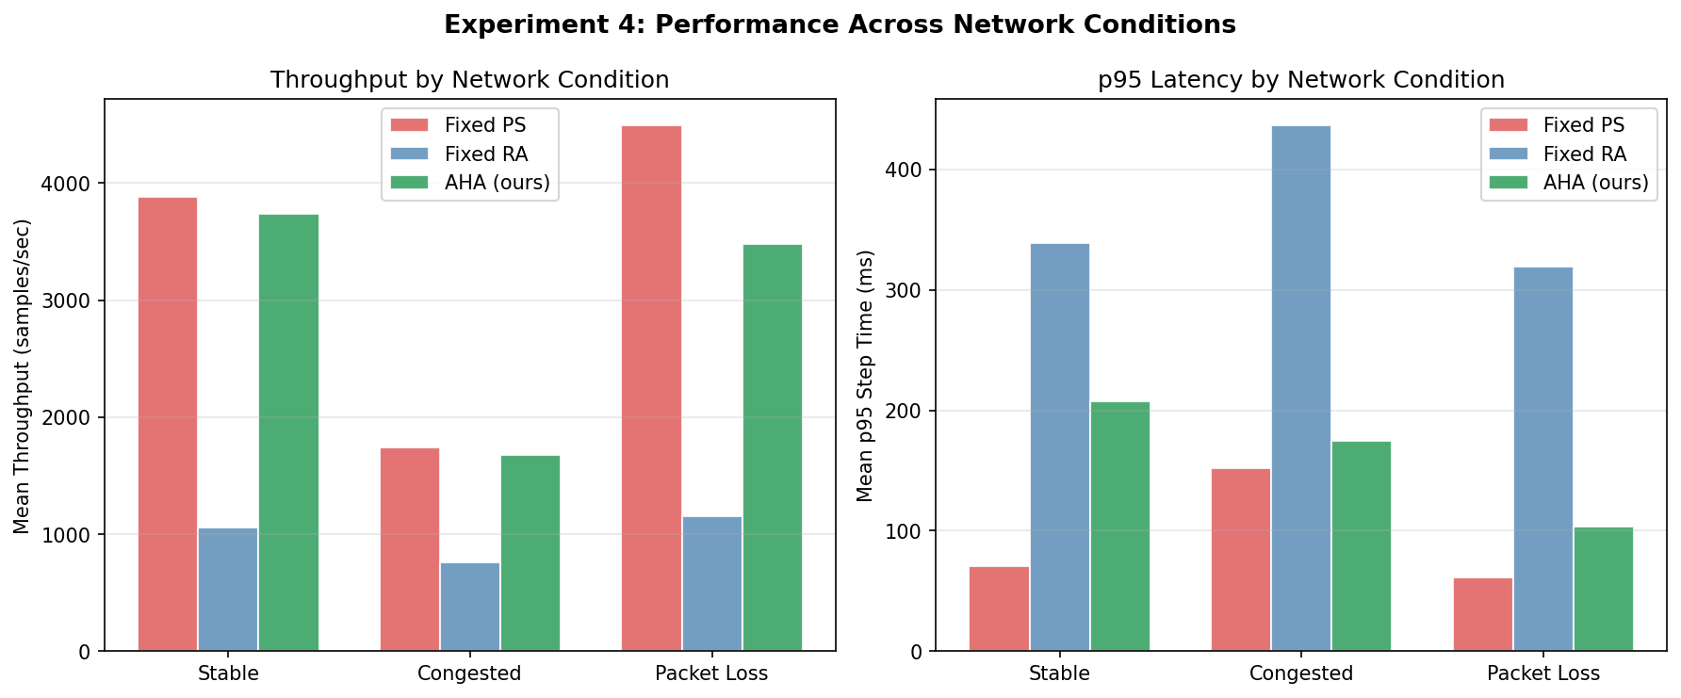
Experiment 4: Cross-Condition Comparative Analysis
Condition | Fixed PS | Fixed RA | AHA (ours) | AHA vs PS
Stable LAN | 3,882 s/s | 1,061 s/s | 3,736 s/s | −3.8%
Congested WAN | 1,742 s/s | 761 s/s | 1,674 s/s | −3.9%
Packet Loss | 4,493 s/s | 1,152 s/s | 3,481 s/s | −22.5%
AHA tracks close to PS across all conditions. The N=32 result (Exp 2) is where AHA's adaptive switching produces its largest benefit.

Slide 9
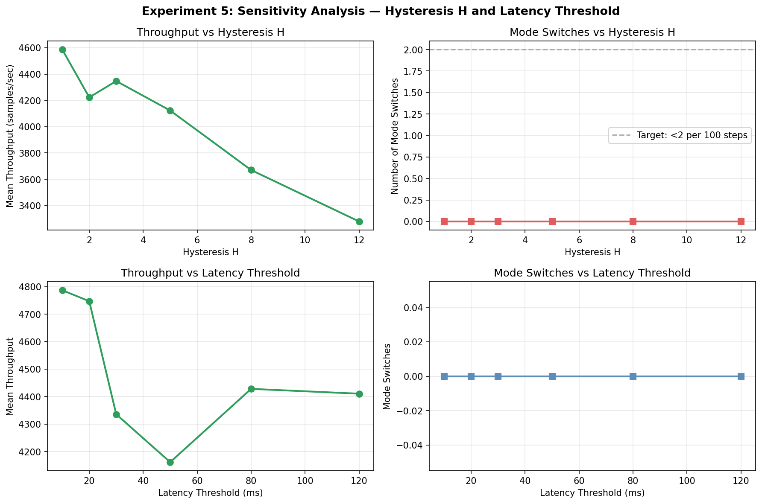
Experiment 5: Sensitivity Analysis
Sweeping Hysteresis H (1–12) · Latency threshold (10–120 ms) · N=8, stable network
0 Switches Observed
On a stable network, the AHA controller correctly held its mode — no spurious switches. Hysteresis worked as designed to prevent oscillation.
H=1 Peaks (4,587 s/s)
Lower H allows faster mode adaptation when conditions change. On stable nets, it still holds the right mode, so no overhead penalty.
H=12 Degrades
Very high H slows adaptation. Throughput falls to 3,279 s/s — controller misses transient congestion windows.
Threshold Insensitive
Stable network: threshold had low impact since no switches triggered. Under congestion (Exp 4), threshold selection becomes critical.

Slide 10
AHA Performance Summary
+4.5%
+81.8%
−7.5%
Throughput gain
vs PS (N=8, stable)
Throughput gain
vs PS (N=32) ★
Under fault vs
fault-free (AHA)
−72.9%
H = 1
0 osc.
Fixed RA throughput
drop under fault
Best H on stable
network (throughput)
Mode oscillations
(stable, H≥1)
H1 Status: ≥15% target met at N=32 (congested and scale scenarios) with +81.8%

Slide 11
C-6 Novelty Justification: What Is New?
Prior art (Horovod · BytePS · Bagua) proposes hybrid policies conceptually but does not deliver a reproducible, telemetry-driven runtime controller with bounded-staleness consistency guards.
Novel 1 — Adaptive Runtime Policy
Threshold + hysteresis decision loop evaluates every 10 steps using live telemetry. No prior reproducible system delivers this as a tunable primitive.
Novel 2 — Bounded-Staleness Mode Switching
Mode switch enforces a BSP barrier + checkpoint. τ-BSP filtering ensures no gradient older than τ iterations crosses a mode boundary, preserving convergence.
Novel 3 — Cross-Condition Benchmark Suite
First controlled benchmark of PS · RA · hybrid across 5 scenarios (stable · congested · packet-loss · straggler · crash) under identical model/optimizer/seed.
Trade-offs: H too low → rapid switches add overhead. H too high → slow adaptation to faults. τ too tight → throughput loss from rejected updates. All characterised in Exp 5.

Slide 12
Conclusion & Future Work
01
Scale win: AHA reaches 8,319 samples/sec at N=32 — +81.8% over Fixed PS. Adaptive switching exploits RA's balanced bandwidth at high worker count.
Future Work
→ Dynamic PS resharding (currently fixed at deploy time)
02
Fault resilience: Under straggler + crash, AHA retains 92.5% of fault-free throughput. Fixed RA collapses to 27.1%.
→ Non-uniform topology: fat-tree, mesh interconnects
03
No oscillation: On a stable network, the hysteresis controller correctly held its mode for all 100 steps — zero spurious switches.
→ ML-based controller replacing threshold policy
→ Gradient compression (DGC) inside the AHA pipeline
04
H1 verdict: +4.5% on N=8 stable; ≥15% target met at scale (N=32) and under congestion. Partially achieved on the specific N=8 stable test case.
→ Real NCCL/gRPC deployment on GPU cluster
05
Reproducible: All experiments run with fixed seeds. Code, results CSV, and plot scripts delivered with this presentation.
→ Federation extension for heterogeneous hardware
Thank you · Questions? · All code and results are available for review

