Slide 1
HUMAN RESOURCE MANAGEMENT:
AN OVERVIEW

Slide 2
Chapter Objectives
Identify the human resource management functions.
Explain how organizations are adjusting to human resource restructuring trends.
Explain the need for human resources to be a strategic partner.
Distinguish among executives, generalists, and specialists.

Slide 3
Chapter Objectives (Continued)
Describe the changes that occur in the human resource function as a firm grows larger and more complex.
Explain the nature of professionalization of human resources and the direction it has taken.
Define ethics and relate ethics to human resource management.

Slide 4
Human Resource Management
Utilization of individuals to achieve organizational objectives
All managers at every level must concern themselves with human resource management
Five functions

Slide 5
Human Resource Management Functions
Staffing
Human
Resource
Development
Employee
& Labor
Relations
HUMAN RESOURCE
MANAGEMENT
FUNCTIONS
Compensation
& Benefits
Safety &
Health

Slide 6
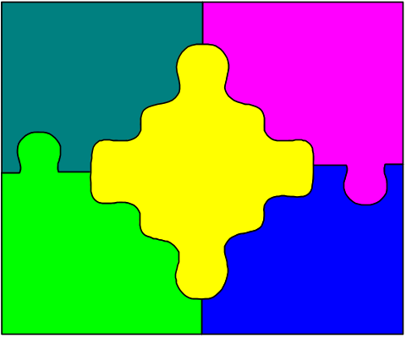
Staffing
Job Analysis
Human Resource Planning (HRP)
Recruitment
Selection

Slide 7
Staffing (Continued)
Staffing - Process through which an organization ensures that it always has the proper number of employees with the appropriate skills in the right jobs at the right time to achieve the organization’s objectives
Job analysis - Systematic process of determining the skills, duties, and knowledge required for performing jobs in an organization

Slide 8
Staffing (Continued)
Human resource planning - Process of systematically reviewing human resource requirements to ensure that the required numbers of employees, with the required skills, are available when needed.
Recruitment - Process of attracting qualified individuals and encouraging them to apply for work with the organization

Slide 9
Staffing (Continued)
Selection - Process through which the organization chooses, from a group of applicants, the individual best suited for the company and the position

Slide 10
Human Resource Development
Training
Development
Career Planning
Career Development
Performance Appraisal

Slide 11
Human Resource Development (Continued
Training - Designed to provide the knowledge and skills needed for a particular job.
Development - Involves learning that goes beyond today's job. It has a more long-term focus

Slide 12
Human Resource Development (Continued)
Career planning - An ongoing process whereby an individual sets career goals and identifies the means to achieve them
Career development - A formal approach used by the organization to ensure that people with the proper qualifications and experiences are available when needed
Performance appraisal - Employees and teams are evaluated to determine how well they are performing their assigned tasks

Slide 13
Compensation & Benefits
Pay - Money that a person receives for performing a job
Benefits - Financial rewards in addition to base pay
Nonfinancial Rewards
  The Job
  The Environment

Slide 14
Safety and Health
Safety - Involves protecting employees from injuries caused by work-related accidents
Health - Refers to the employees' freedom from illness and their general physical and mental well-being

Slide 15
EMPLOYEE AND LABOR RELATIONS

Slide 16
Unionization
13.9% Union
Membership In
Public Sector
Firms Must
Recognize A
Union
Firms Must
Bargain In
Good Faith
9.5% of Private
Industry

Slide 17

Human Resource Research
Human resource research is not a separate function
It pervades all HR functional areas

Slide 18

Interrelationships of HRM Functions
All HRM functions are interrelated
Each function affects other areas

Slide 19
HR RESTRUCTURING TRENDS

Slide 20
Who Performs Human
Resource Management Tasks?
Human Resource Managers
Shared Service Centers
Outsourcing Firms
Line Managers

Slide 21
Human Resource Manager
Acts in advisory or staff capacity
Serves an increasing number of employees
Shares responsibility with line managers and HR professionals
Coordinates HR activities to help achieve organizational goals

Slide 22

Shared Service Centers (SSCS)
Takes routine, transaction-based activities that are dispersed and consolidates them.

Slide 23
Shared Service Centers (SSCS) Performing HR Tasks
Fewer HR Personnel Needed
HR Managers Assume
a More Strategic Role
Improves Quality

Slide 24

Outsourcing Firms
Transfers responsibility to an external provider

Slide 25
Outsourcing
Reduces:
Cost
Transaction Time
Improves Quality

Slide 26
Line Managers Performing
HR Tasks
Involved with Human Resources
Used more to deliver HR services
Reduces size of HR department

Slide 27
HR as a Strategic Partner
  HR is a legitimate business unit
  Highly strategic in nature
  Critical to achieving corporate objectives

Slide 28
HR as a Strategic Partner
(Continued)
  Determine workforce capabilities
  HR managers must forge strategic partnerships
  HR executives must understand the total organization

Slide 29
Technology's Impact on HR
Rapid Skills Technological Change
  Changes 3 or 4
Impact Times During
HR Careers

Slide 30
HUMAN RESOURCE EXECUTIVES, GENERALISTS AND SPECIALISTS

Slide 31
Characteristics of an HR
Executive
Performs One or More HR Functions
A Top-Level Manager
Reports Directly to the Corporation's CEO

Slide 32
Characteristics of an HR Generalist
Often an Executive
Performs Tasks in Various HR Related Areas
Involved in Several or all of the Five HRM Functions

Slide 33
Characteristics of an HR Specialist
May be an HR Executive, Manager, or Non-Manager
Typically Concerned with Only One of the Five Functional Areas

Slide 34
HR Executives, Generalists & Specialists
VP
HUMAN RESOURCES
*1 & *2
VP
INDUSTRIAL
RELATIONS
*1 & *3
MANAGER,
COMPENSATION
& BENEFITS
*3
MANAGER,
TRAINING &
DEVELOPMENT
*3
MANAGER,
EMPLOYMENT
*3
BENEFITS
ANALYST
*3
*1--Executive
*2--Generalist
*3--Specialist

Slide 35
THE HUMAN RESOURCE FUNCTION IN ORGANIZATIONS OF VARIOUS SIZES

Slide 36
HR in Small Businesses
Seldom Have a Formal HR Unit
Other Managers Handle HR Functions
Focuses on Hiring & Retaining Capable Employees

Slide 37
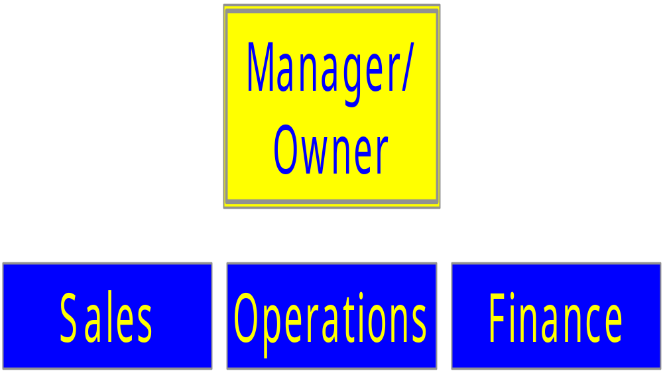
The Human Resource Function in a Small Business

Slide 38
HR in a Medium-Sized Firm
Little specialization
HR Manager is essentially the entire department

Slide 39
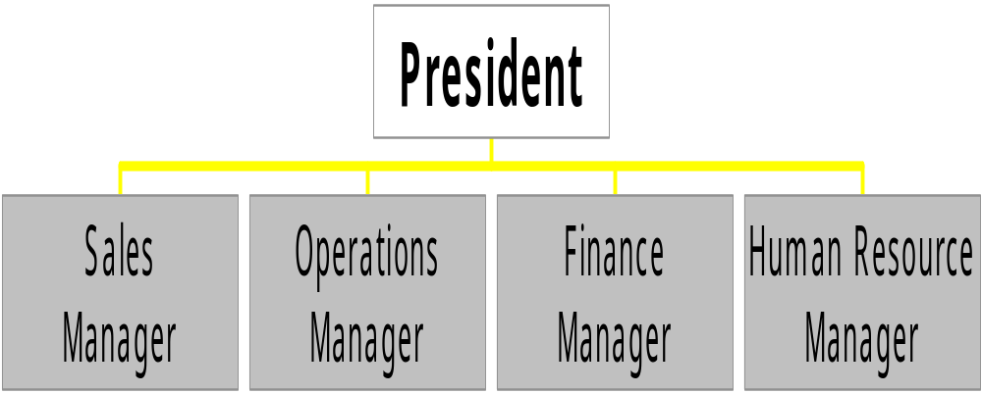
The Human Resource Function in a Medium-Sized Business

Slide 40
Traditional Human Resource Functions in a Large-Sized Firm
Separate sections are often created
Placed under an HR Manager
Each HR function may have a supervisor & staff
HR Manager works closely with top management in formulating policy

Slide 41
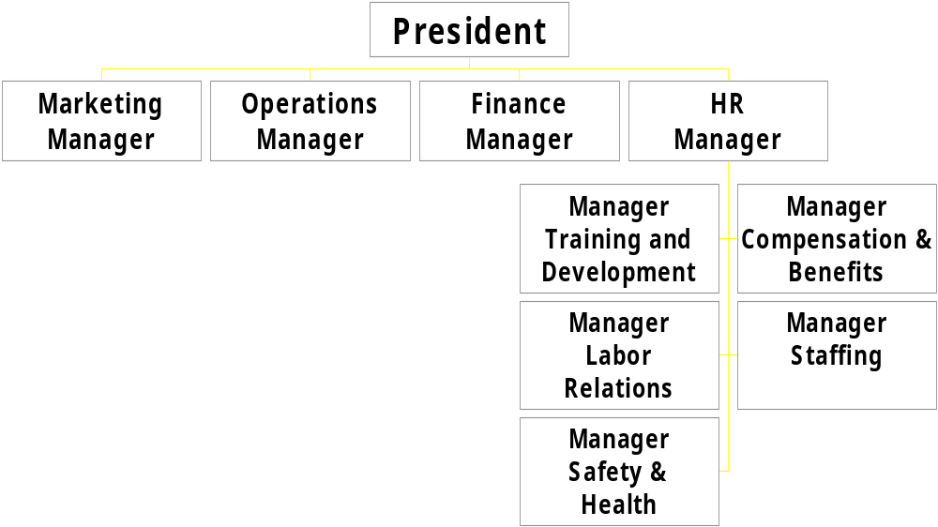
The Human Resource Functions in a Large Firm

Slide 42

A New and Evolving HR Organization for
Large-size Firms
Performance in Five Functional Areas
Outsource
Shared Service Centers
Line Managers Have More HR Authority

Slide 43
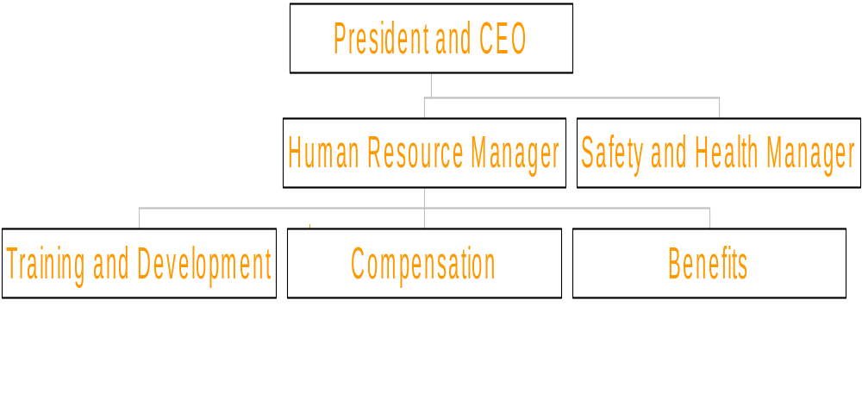
Example of a New and Evolving HR Organization for Large Firms

Slide 44
PROFESSIONALIZATION OF HUMAN RESOURCE MANAGEMENT

Slide 45
The Nature of a Profession
Existence of a Common Body of Knowledge
A Procedure for Certifying Members of a Profession
Performance Standards are Established by Members of a Profession

Slide 46

HR Professional Groups
Society for Human Resource Management
American Society for Training and Development
International Personnel Management Association
WorldatWork
Human Resource Certification Institute

Slide 47
Ethics and HR
Management
A
discipline dealing
with what is:
  good & bad right & wrong
  moral duty & obligation

