Slide 1
Code Coverage Analysis with LCOV

Slide 2
Introduction
What is Code Coverage?
Measures the extent to which your code is executed during testing.
Helps identify untested parts of your codebase.
Why is Code Coverage Important?
Ensures thorough testing. Improves code quality and reliability.
Helps maintain high standards for software development.

Slide 3
Overview of LCOV
What is LCOV?
a tool for code coverage analysis.
It helps tester understand how much of their code is executed during testing.
Generates detailed coverage reports .

Slide 4
Overview of Google Test (Gtest)
What is Google Test?
A popular C++ testing framework by Google.
Facilitates writing and running C++ tests.
Simple syntax for writing tests.
Rich set of assertions for checking values.
Supports automatic test discovery and execution.

Slide 5
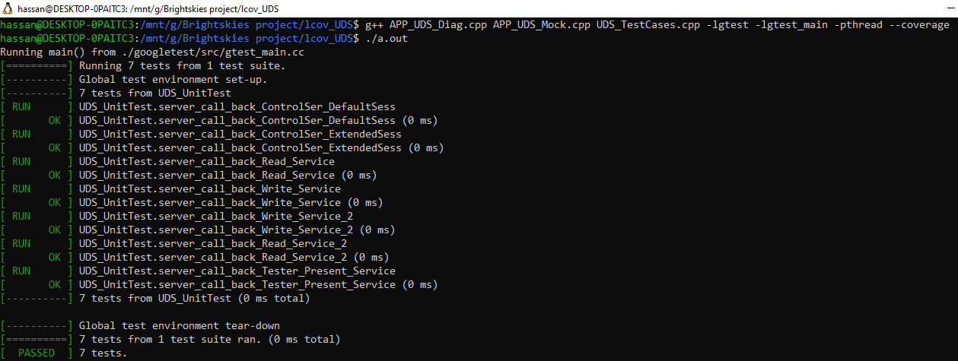
Integrating LCOV

Slide 6
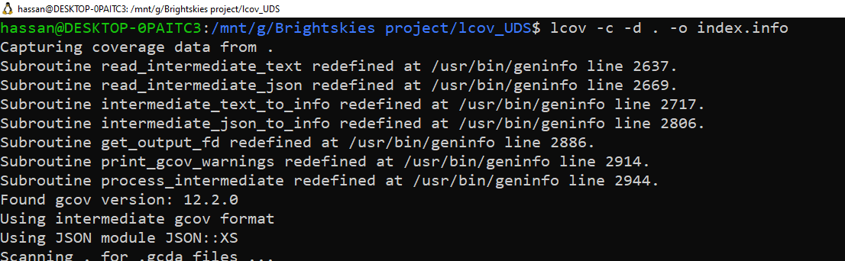
Integrating LCOV

Slide 7
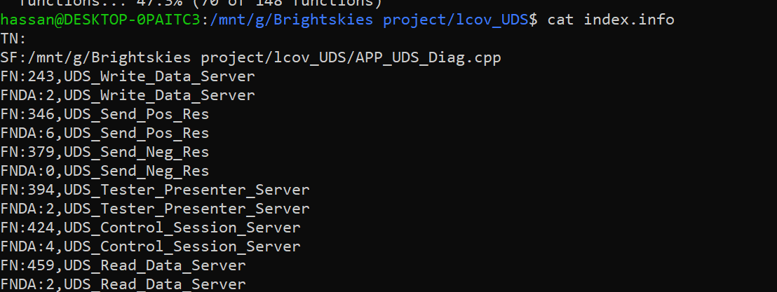
Integrating LCOV

Slide 8
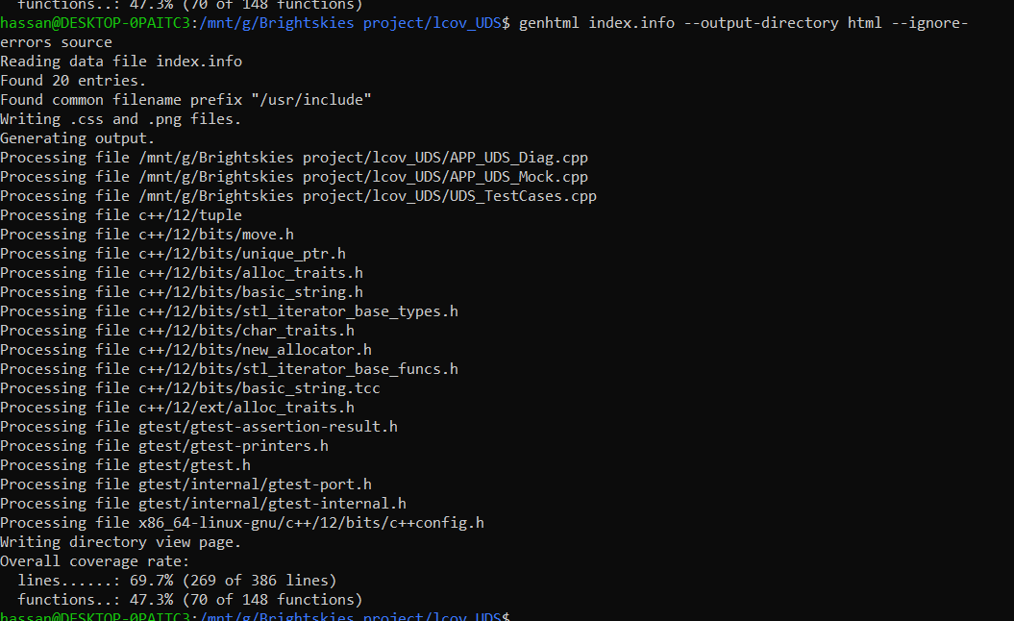

Slide 9
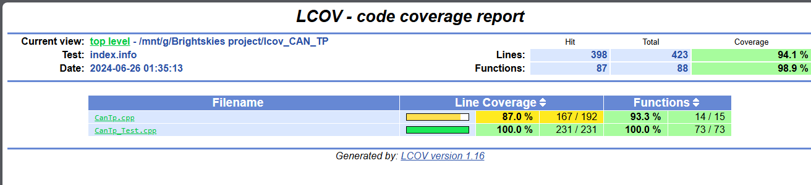
LCOV for CANTP

Slide 10
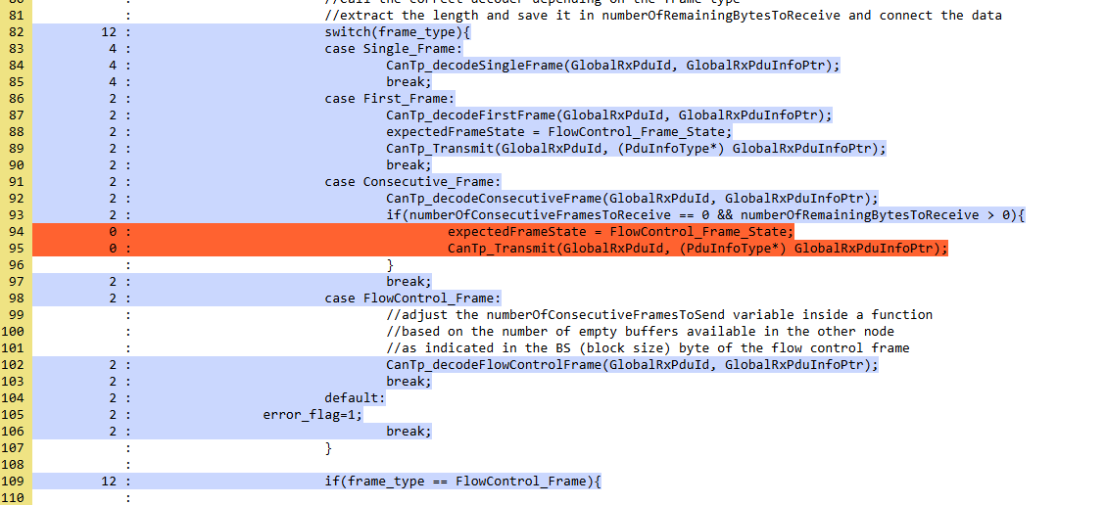
LCOV for CANTP

Slide 11
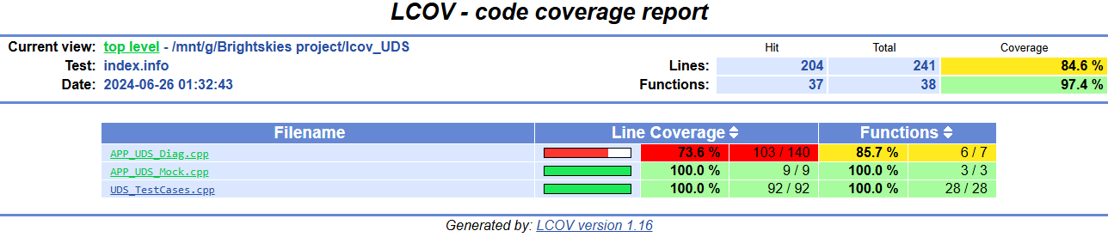
LCOV for UDS

Slide 12
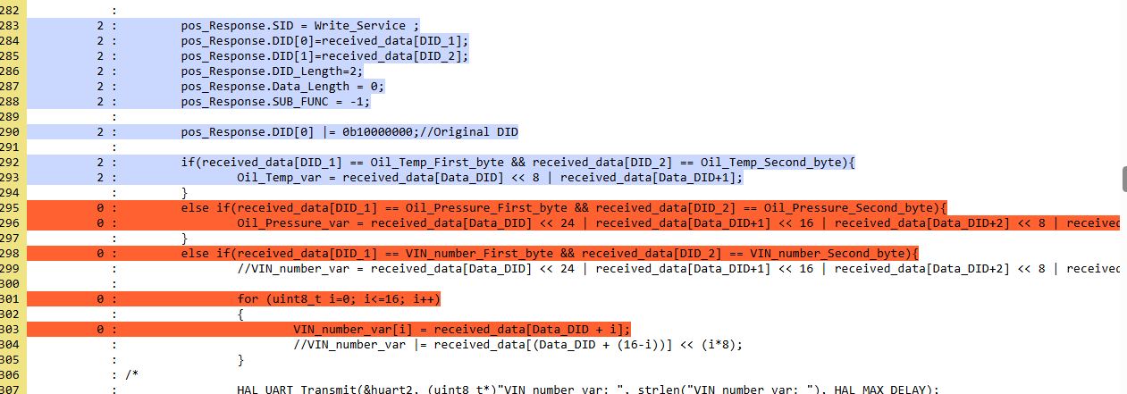
LCOV for UDS

Slide 13
Conclusion
Recap
Code coverage is vital for maintaining high code quality.
LCOV and gtest provide powerful tools for coverage analysis.

Slide 14
Thanks!

