Slide 1
Finite Fields
King Fahd University of Petroleum & Minerals
College of Computer Sciences & Engineering
Cryptography and Blockchain Applications
Prepared by:
Sultan Almuhammadi
This lecture is based on:
Stallings, Cryptography and Network Security: Chapter 5
(See also: Forouzan, Chapter 4)

Slide 2
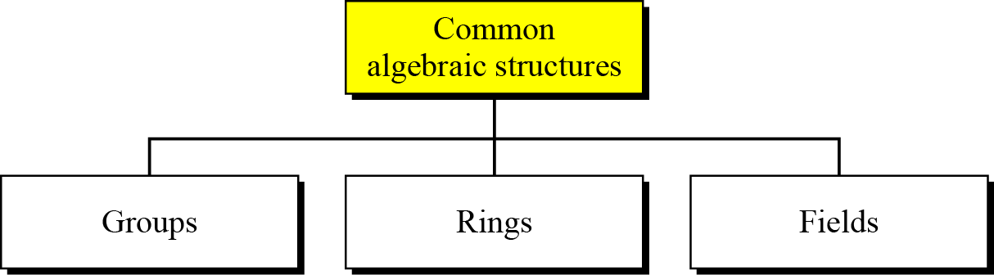
Algebraic Structures

Slide 3
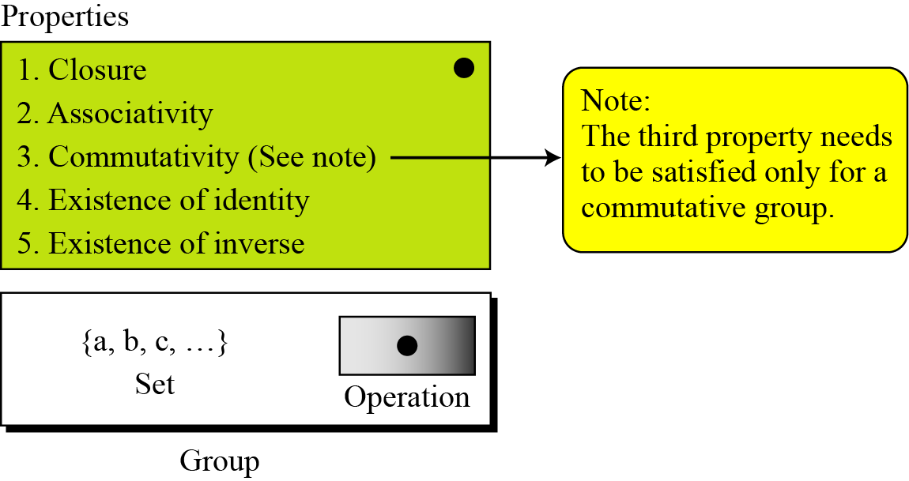
Group

Slide 4
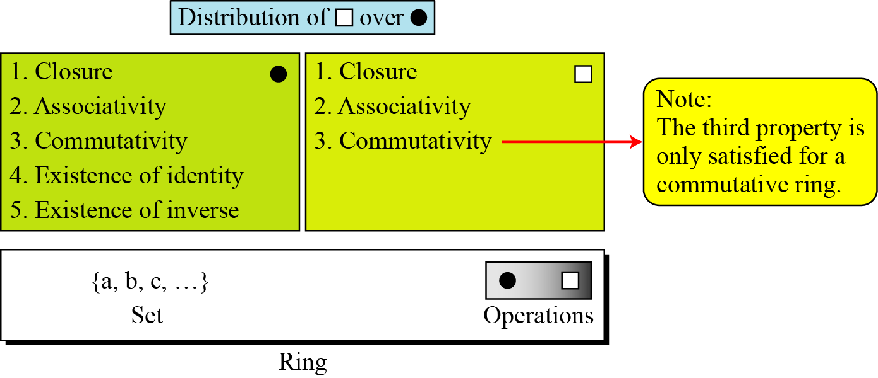
Ring
A ring, R = ({…}, •, ), is an algebraic structure with two operations.
e.g. ( Z, + , ×)

Slide 5
Continued
The set Z with two operations, addition and multiplication, is a commutative ring. We show it by R = (Z, +, ×). Addition satisfies all of the five properties; multiplication satisfies only three properties.

Slide 6
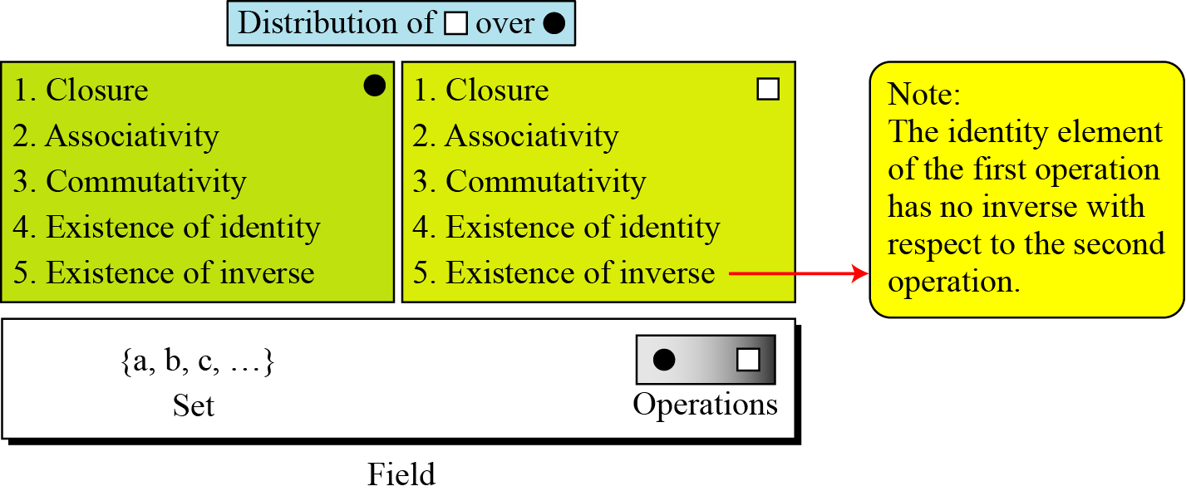
Field
A field, denoted by F = ({…}, •, ) is a commutative ring in which the second operation satisfies all five properties defined for the first operation except that the identity of the first operation has no inverse.
e.g. (R, + , × )

Slide 7

Finite Fields
Galois showed that for a field to be finite, the number of elements should be p^{n}, where p is a prime and n is a positive integer.
Note
A Galois field, GF(p^{n}), is a finite field with p^{n} elements.

Slide 8
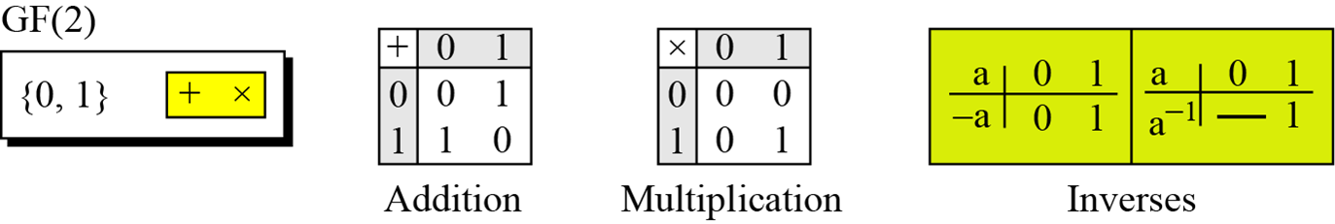
Example
A very common field in this category is GF(2) with the set {0, 1} and two operations, addition and multiplication, as shown in Figure 4.6.
GF(2) field

Slide 9
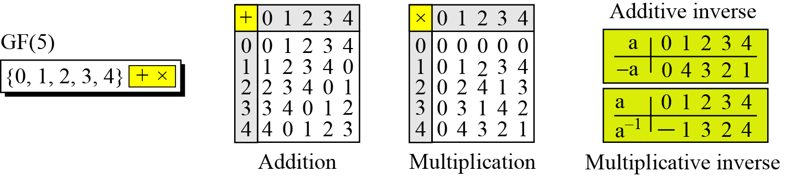
Example
We can define GF(5) on the set Z₅ (5 is a prime) with addition and multiplication operators as shown in the figures below.
GF(5) field

Slide 10
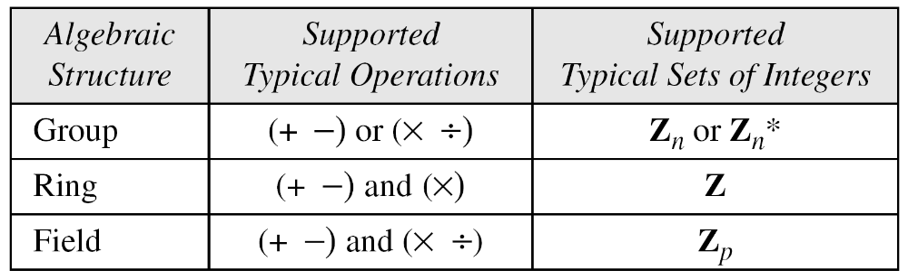
Summary

Slide 11
GF(2^{n}) FIELDS
In cryptography, we often need to use four operations (addition, subtraction, multiplication, and division). In other words, we need to use fields. We can work in GF(2^{n}) and uses a set of 2^{n} elements. The elements in this set are n-bit words.

Slide 12
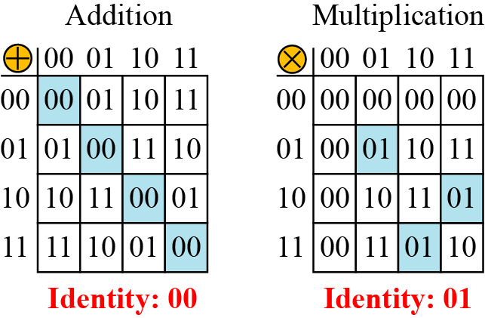
Example
Let us define a GF(2²) field in which the set has four 2-bit words: {00, 01, 10, 11}. We can redefine addition and multiplication for this field in such a way that all properties of these operations are satisfied, as shown below.
An example of GF(2²) field

Slide 13
Polynomials
A polynomial of degree n − 1 is an expression
of the form
where x^{i} is called the ith term and a_{i} is called coefficient of the ith term.

Slide 14
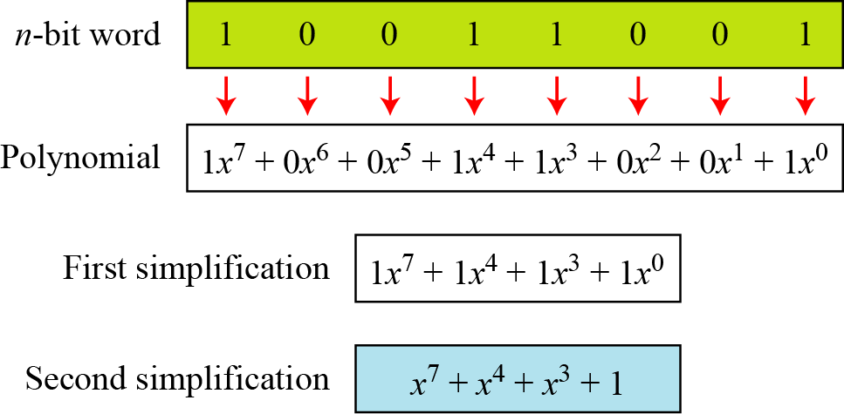
Example
How to represent the 8-bit word (10011001) using a polynomials?
Representation of an 8-bit word by a polynomial

Slide 15
Example
To find the 8-bit word related to the polynomial x⁵ + x² + x, we first supply the omitted terms. Since n = 8, it means the polynomial is of degree 7. The expanded polynomial is
This is related to the 8-bit word 00100110.

Slide 16
GF(2^{n}) Fields
Note
Polynomials representing n-bit words use two fields: GF(2) and GF(2^{n}).

Slide 17
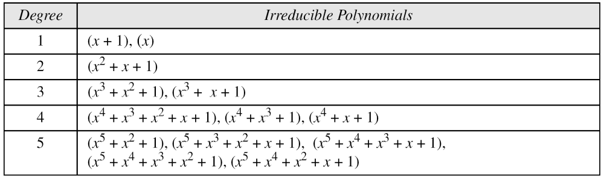
Continued
Modulus
For the sets of polynomials in GF(2^{n}), a group of polynomials of degree n is defined as the modulus. Such polynomials are referred to as irreducible polynomials.
List of irreducible polynomials

Slide 18
Continued
Addition
Note
Addition and subtraction operations on polynomials are the same operation.

Slide 19
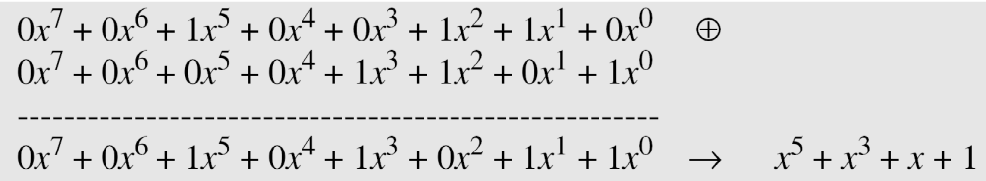
Example
Let us do (x⁵ + x² + x) ⊕ (x³ + x² + 1) in GF(2⁸). We use the symbol ⊕ to show that we mean polynomial addition. The following shows the procedure:

Slide 20
Example
There is also another short cut. Because the addition in GF(2) means the exclusive-or (XOR) operation. So we can exclusive-or the two words, bits by bits, to get the result. In the previous example, x⁵ + x² + x is 00100110 and x³ + x² + 1 is 00001101. The result is 00101011 or in polynomial notation x⁵ + x³ + x + 1.

Slide 21
Multliplication
1. The coefficient multiplication is done in GF(2).
2. The multiplying x^{i} by x^{j} results in x^{i+j}.
3. The multiplication may create terms with degree more than n − 1, which means the result needs to be reduced using a modulus polynomial.

Slide 22
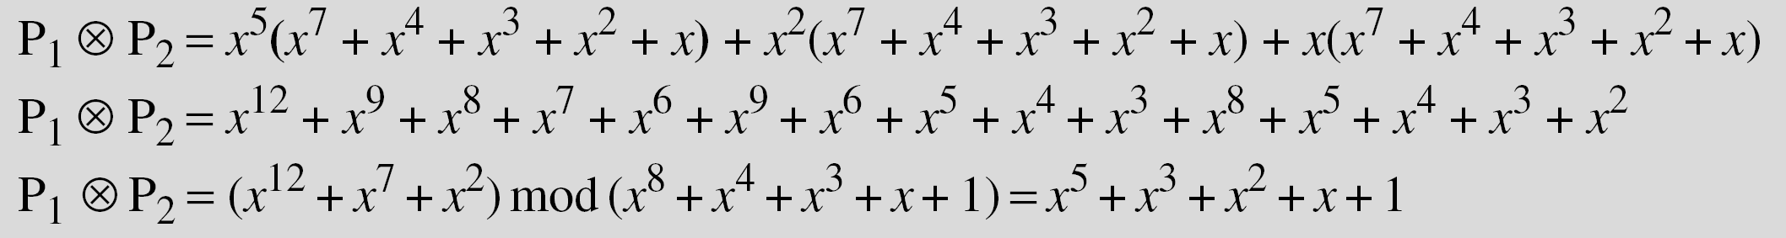
Example
Find the result of (x⁵ + x² + x) ⊗ (x⁷ + x⁴ + x³ + x² + x) in GF(2⁸) with irreducible polynomial (x⁸ + x⁴ + x³ + x + 1). Note that we use the symbol ⊗ to show the multiplication of two polynomials.
Solution
To find the final result, divide the polynomial of degree 12 by the polynomial of degree 8 (the modulus) and keep only the remainder. Figure 4.10 shows the process of division.

Slide 23
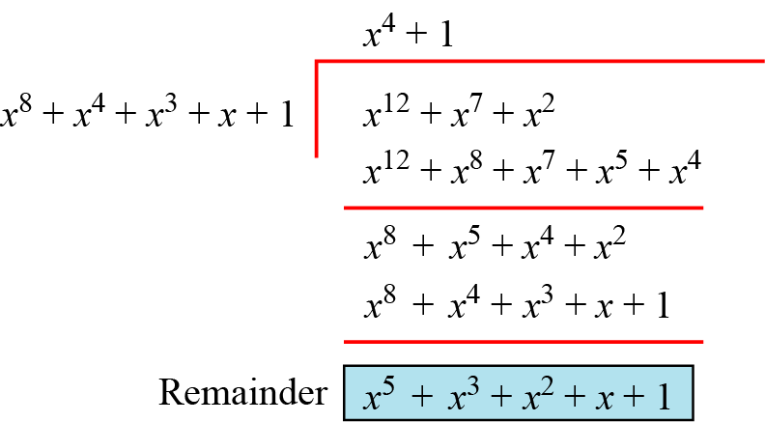
Polynomial division with coefficients in GF(2)

Slide 24
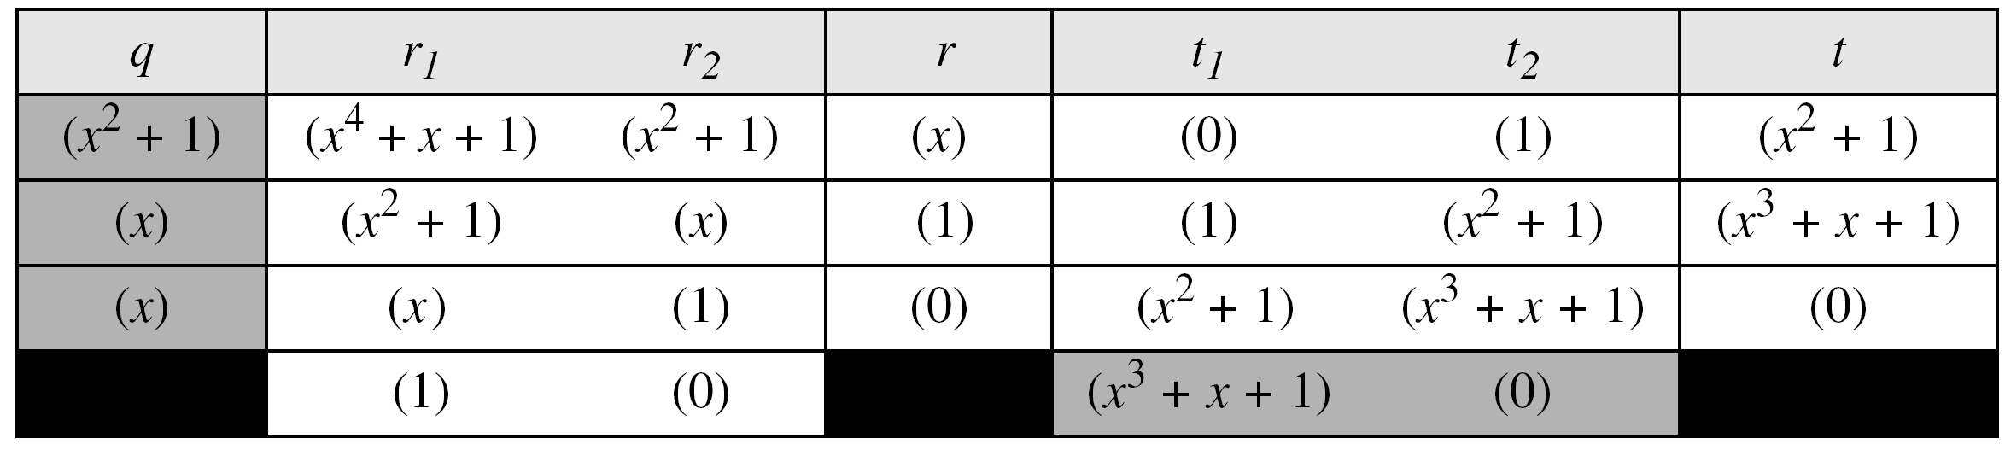
Example
In GF (2⁴), find the inverse of (x² + 1) modulo (x⁴ + x + 1).
Solution
The answer is (x³ + x + 1) as shown in the table below.
Euclidean algorithm for this example

Slide 25
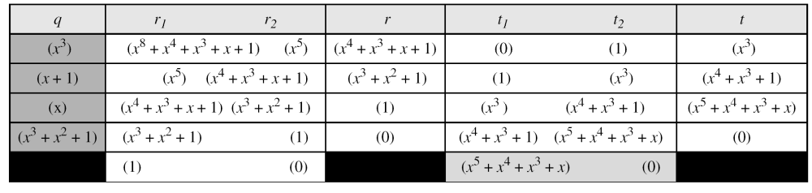
Example
In GF(2⁸), find the inverse of (x⁵) modulo (x⁸ + x⁴ + x³ + x + 1).
Solution
The answer is (x⁵ + x⁴ + x³ + x) as shown in the table below.

Slide 26
Multliplication Using Computer
The computer implementation uses a better algorithm, repeatedly multiplying a reduced polynomial by x.

Slide 27
Example
Find the result of multiplying P₁ = (x⁵ + x² + x) by P₂ = (x⁷ + x⁴ + x³ + x² + x) in GF(2⁸) with irreducible polynomial (x⁸ + x⁴ + x³ + x + 1) using the algorithm described above.
Solution
The process is shown in Table 4.7. We first find the partial result of multiplying x⁰, x¹, x², x³, x⁴, and x⁵ by P₂. Note that although only three terms are needed, the product of x^{m} ⊗ P₂ for m from 0 to 5 because each calculation depends on the previous result.

Slide 28
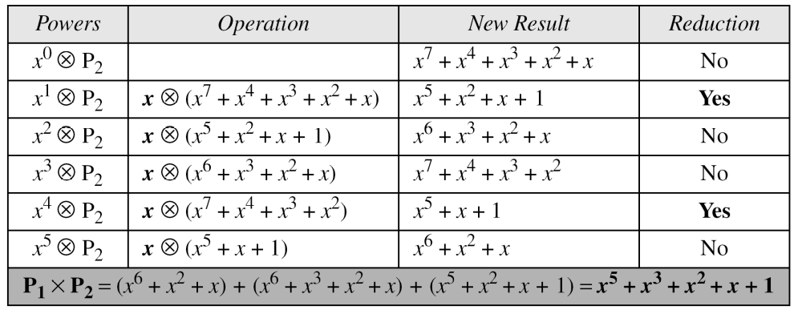
Example
Continued
If multiplication results in a polynomial of degree greater than n - 1, then the polynomial is reduced modulo some irreducible polynomial
An efficient algorithm

Slide 29

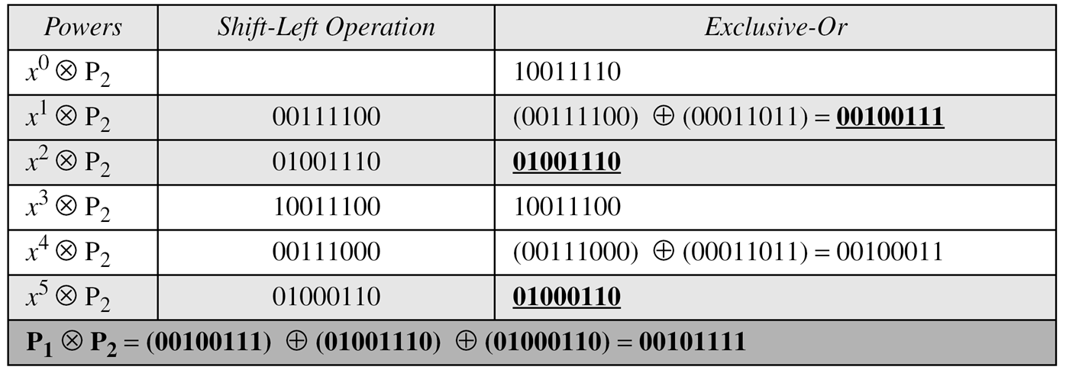
When the first digit on the left is 1 and is shifted out, an xor with the mod is performed
Example
Repeat the Example using bit patterns of size 8.
Solution
if x^{n} =1 ⊗ P2 we take it in the final result and xor all found
We have P1 = 000100110, P2 = 10011110, modulus = 100011011 (nine bits). We show the exclusive or operation by ⊕.
An efficient algorithm for multiplication using n-bit words

Slide 30
Example: GF(2³)
The GF(2³) field has 8 elements. We use the irreducible polynomial (x³ + x² + 1) and show the addition and multiplication tables for this field. We show both 3-bit words and the polynomials. Note that there are two irreducible polynomials for degree 3. The other one, (x³ + x + 1), yields a totally different table for multiplication.

Slide 31
Continued
Addition table for GF(23)

Slide 32
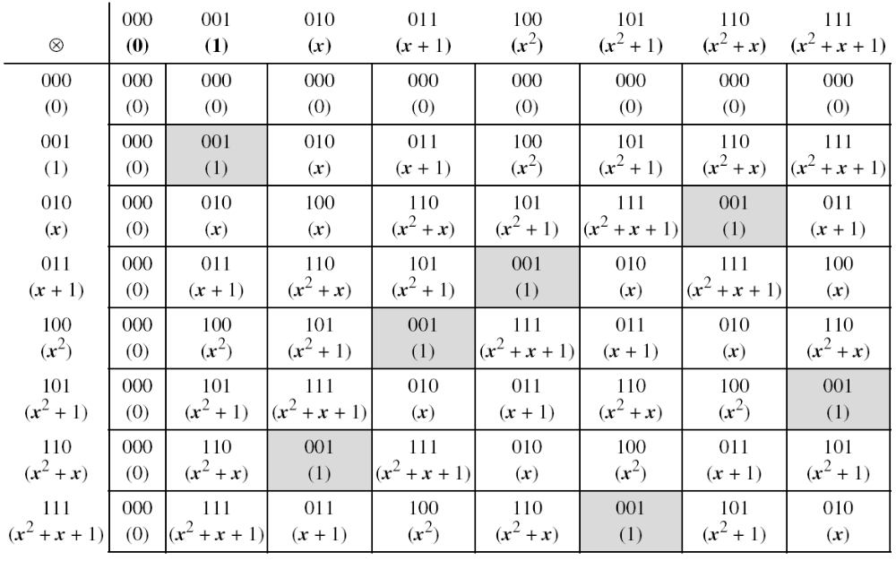
Continued
Multiplication table for GF(2³)

Slide 33
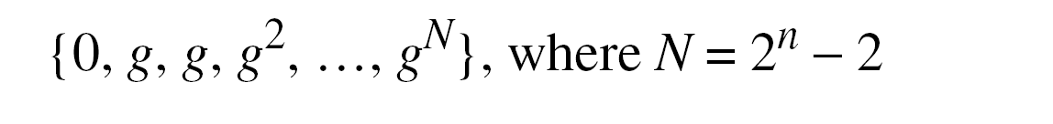
Using a Generator
Sometimes it is easier to define the elements of the GF(2^{n}) field using a generator.

Slide 34
Example
Generate the elements of the field GF(2⁴) using the irreducible polynomial ƒ(x) = x⁴ + x + 1.
Solution
The elements 0, g⁰, g¹, g2, and g³ can be easily generated, because they are the 4-bit representations of 0, 1, x², and x³. Elements g⁴ through g¹⁴, which represent x⁴ though x¹⁴ need to be divided by the irreducible polynomial. To avoid the polynomial division, the relation ƒ(g) = g⁴ + g + 1 = 0 can be used (See next slide).

Slide 36
Example
The following show the results of addition and subtraction operations:
Addition and subtraction are the same as xor operation

Slide 37
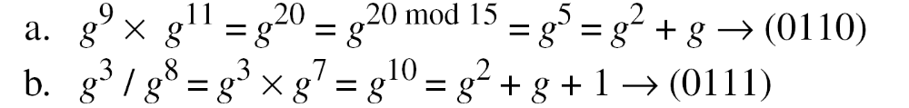
Example
The following show the result of multiplication and division operations:.
g³/g⁸→ g³/g⁸⁻¹⁵ ⁼ ⁻⁷ →g³/g⁻⁷ → g³ * g⁷

Slide 38
Summary
The finite field GF(2^{n}) can be used to define four operations of addition, subtraction, multiplication and division over n-bit words. The only restriction is that division by zero is not defined.

