Slide 1



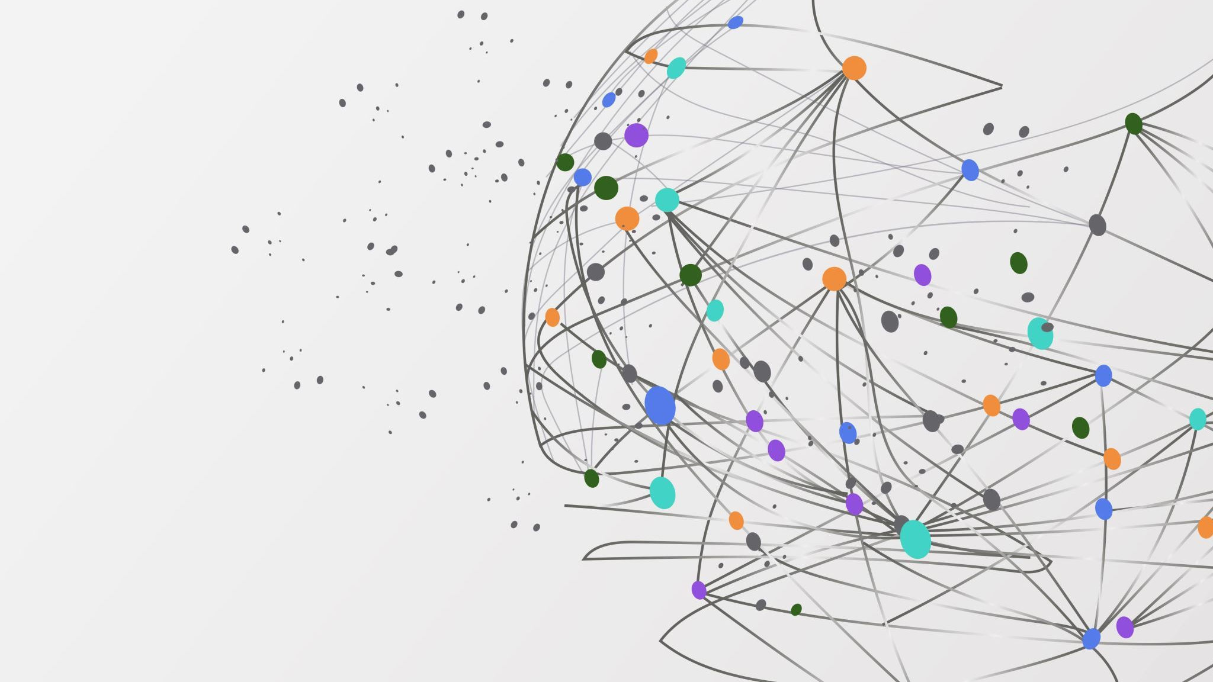
My Personal & Professional Project
Hassan EL SAHILY
M1 Architecture, Systems & Networks – ENSEEIHT
Professional Objective:
PhD → Enseignant-Chercheur

Slide 2
MY PROFILE
Academic Background
Professional Background
Bachelor degree in informatics (University of Strasbourg ) - parcours CMI
Engineering student (M1) - Architecture, Systems & Networks
Target specialization (M2) : Infrastructure, Big Data & IoT
2 professional internships done :
One in a company, the other in a lab
Strong interest in Research and Teaching/Education
Civic engagement : Red Cross Lebanon
(this summer)
Exempt from international mobility

Slide 3
How can I build a career that combines research and teaching in computer science, with a focus on systems and networks?

Slide 4
Explored Career Paths
Industry Engineer + External Lecturer at a University
Academic Researcher / Enseignant-Chercheur
R&D Engineer (Research & Development Engineer)

Slide 5
Concrete Experiences
2 Professional Internships :
Company — SMART WATERS (Nice) : Data analysis & processing
Research Laboratory — ICube (Strasbourg): Localization Using Ultra-Wideband (UWB) Radio Signals
Private Tutoring for University-Level Students in Mathematics and Computer Science
Academic & Technical Projects : Bachelor Final-Year Project (L3), Assembly project, etc.

Slide 6
Validation & Adjustments
Internships: Exposure to industrial and research environments → stronger interest in laboratory-based research
Research Environment: Positive influence of supervisors and PhD researchers on my academic motivation
Personal Validation: Preference for long-term, challenging problems in systems and networks
Teaching Experience: Private tutoring confirmed my interest in teaching

Slide 7
Roadmap & Conclusion
Short Term :
  M2 specialization (Infrastructure, Big Data & IoT)
  + Master recherche – REOC : Réseaux Embarqués et Objets Connectés
  Laboratory internship in S10
Mid Term : PhD in computer science (systems & networks)
Long Term : Lecturer-Researcher (Enseignant-Chercheur)

Slide 8
References
Personal interview with Dr. F. Theoleyre, Directeur de Recherche CNRS, University of Strasbourg, juillet 2025.
Personal interview with Dr. P. David, Maître de conférence, University of Strasbourg, novembre 2025.
Personal interview with G.Eid, CEO at GMIV, novembre 2025.
Faste, R. (1980s). Design thinking method. Stanford University. Referenced in course materials.

