Slide 1
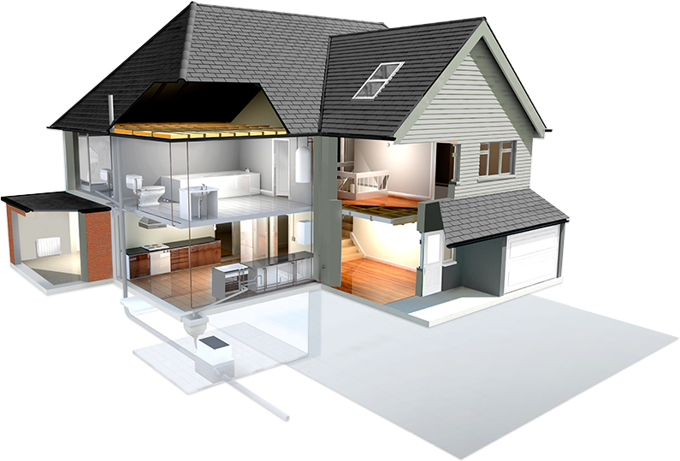
SMART HOUSE
Device Development
Paul Damon
Jabir Al Fatah
&
Hassan

Slide 2
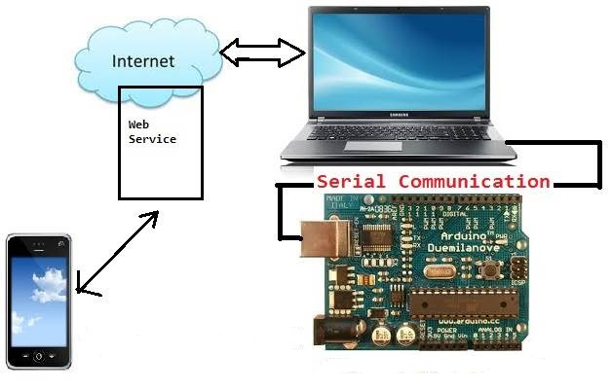
Design Overview
Arduino-devices connection
Writing sketch
Passing and receiving the information to
and from the server through URI
Example URI: http://thesmarthouse.azurewebsites.net/restAPI/Room/1

Slide 3
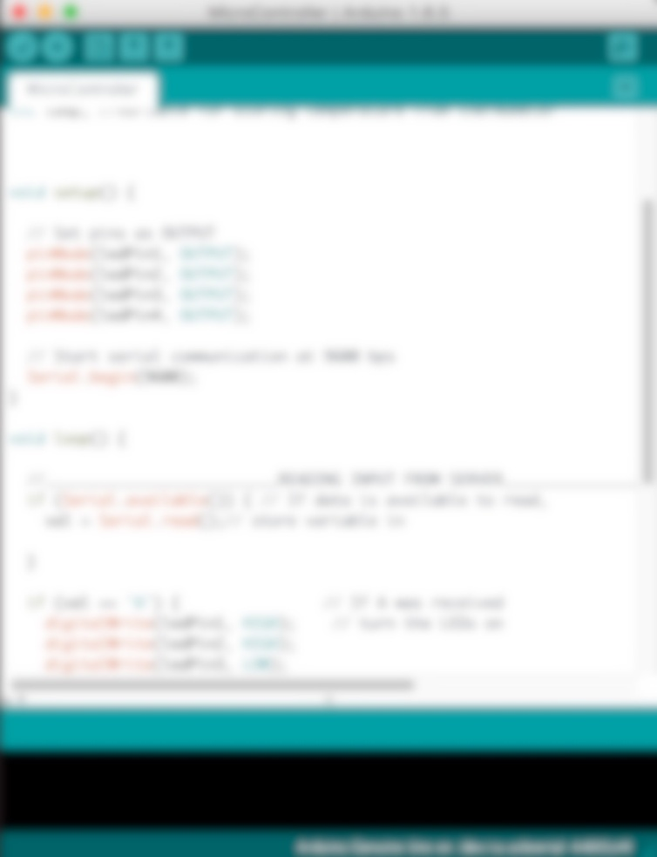
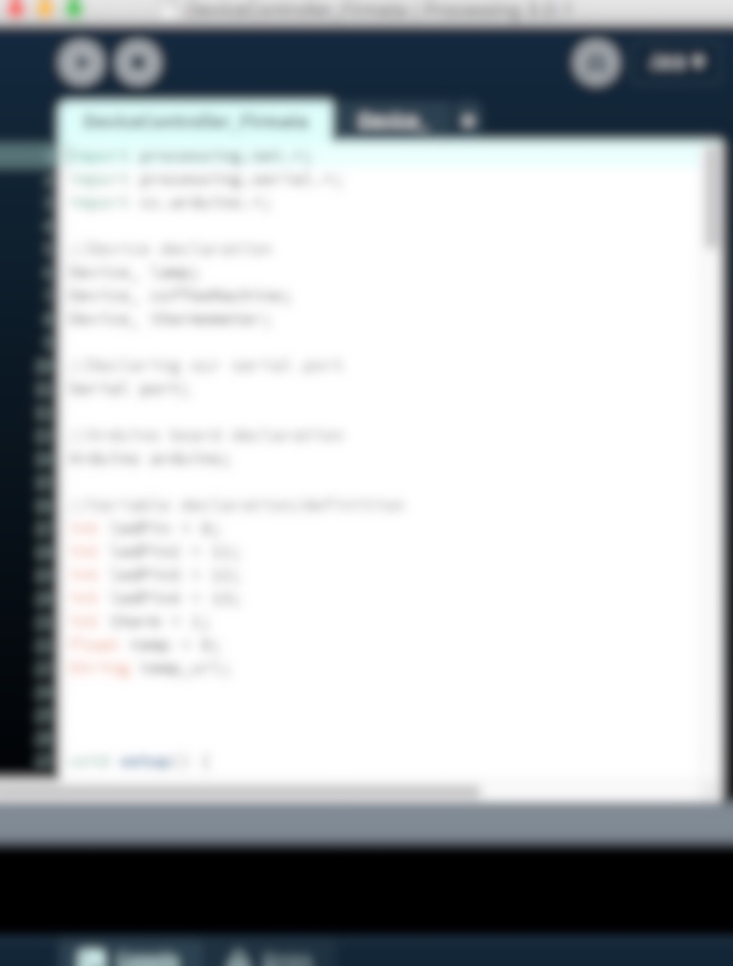
Serial Communication
Arduino Sketch
Sending Command
Processing Sketch
Reading Status

Slide 4


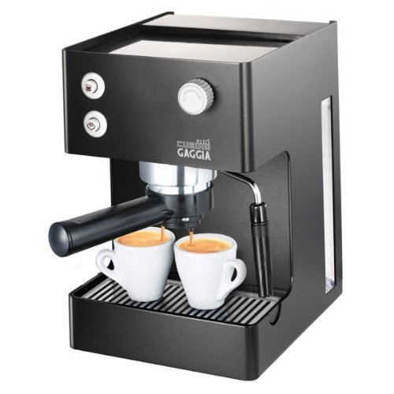
Working Devices
Lamp
Temperature &
Virtual Coffee
Machine
Displaying information in GUI

Slide 5
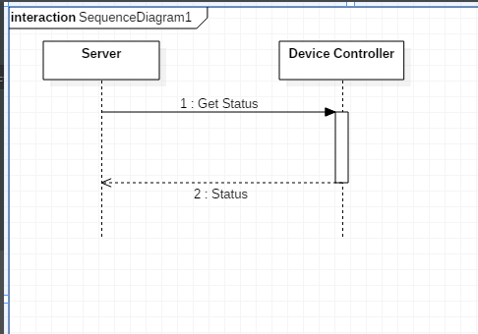
Design Overview
- Sequence Diagram-1

Slide 6
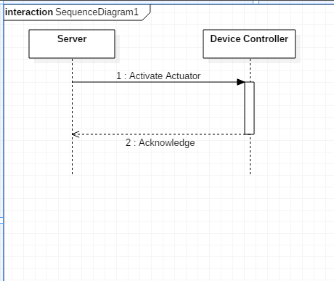
Design Overview
- Sequence Diagram-2

Slide 7
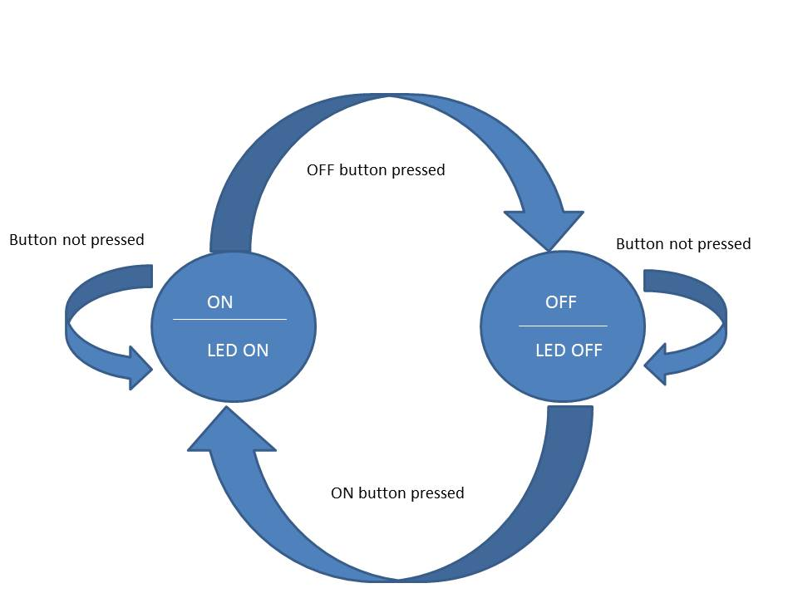
Design Overview
-State Diagram

Slide 8
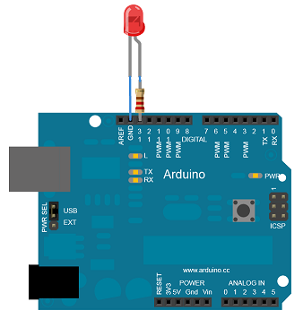

Design Details: Lamp
→ Accessing to the JSON object in Server
Example: String []json=loadStrings("http://thesmarthouse.azurewebsites.net/restAPI/Room/1");
Saving them in a local file.
Example: saveStrings("data.json", json);
Getting the device details from the file
Make change in the device.
Keep checking the database frequently and do the action.
Receive data

Slide 9
Design Details: Temperature
→Get the temp from the sensor.
Example: temp=port.read();
→Update the temp to the server
Example: temp_url="https://thesmarthouse.azurewebsites.net/restAPI/Device/updateTemp/"+temp+"/1";

Slide 10
Design Details: Virtual Coffee Machine
Check the device status inside the JSON array.
Example: if (devices.equals("coffeeMachine")==true) {
stat = jobj.getString("status");
//print the status
}
Print out the satus in the pannel

Slide 11
Challenges We Faced
Designing the project
Communicating among subgroups.
Time constraints

Slide 12
Further works..
Optimize the System
2. Scalability
3. Research and Documentation

Slide 13
In Summary…….
New experiences
&
Good starting point for the final presentation !

Slide 14


