Slide 1

CISC 839:Topics in Data Analytics Final Project Fraud Detection
Group 9
Amr Sayed 20398048
Bilal Morsy 20398551
Hassan Ahmed 20399136
Omar Amer 20401064
Supervised by:
Dr. Yuan Tian

Slide 2
Outline
Introduction and Motivation
Dataset Statistics and EDA
Methodology
Experimental Results
Discussion and Conclusion

Slide 3
Introduction & Motivation
In this section we define what is the problem as well as the motivation why solving this problem is important.

Slide 4
Introduction
Bank fraud: A financial institution challenge.
Detecting fraud: Key to success.
Imbalanced data: Model development challenge.
Privacy-preserving: Dataset features.
Reducing financial risks: Fraud detection impact.
Enhancing customer trust: Fraud prevention importance.
Notes:
#Fraudulent bank account opening applications can be used to commit various financial crimes.
#Detecting and preventing fraudulent bank account opening applications is critical to the financial institution’s success by reducing their exposure to financial and reputational risks.
Bank account fraud is a significant problem for financial institutions, causing significant financial losses and damage to the customer’s trust.
However, it is challenging to detect these fraudulent applications since only a small percentage of applications are labeled a positive, and the data is highly imbalanced.
Our main objective is to develop fair machine learning and deep learning models
Our objective from these models is to accurately predict fraudulent bank account opening applications using a highly imbalanced labeled dataset with biasing to different groups
Bank fraud: A financial institution challenge.
Detecting fraud: Key to success.
Imbalanced data: Model development challenge.
Fair machine learning: Our objective.
Privacy-preserving, realistic: BAF dataset features.
Reducing financial risks: Fraud detection impact.
Enhancing customer trust: Fraud prevention importance.

Slide 5
Motivation
Fraud detection: Safeguarding customers and institutions.
Transaction security: Maintaining financial safety.
Trust preservation: Ensuring reliable services.
Loss minimization: Reducing financial impacts.
Bias avoidance: Upholding ethical AI practices.
Fairness in ML: Ensuring equitable model outcomes.
Notes:
Model Robustness :
Model robustness testing identifies vulnerabilities and ensures stable performance even with adversarial data, guarding against security breaches and enabling trustworthy predictions.
Performance Evaluation:
Accurate performance evaluation is crucial for selecting the best machine learning model for a task. Proper evaluation allows objective comparison of models, identifies areas for improvement, and informs deployment and optimization decisions.
Fraud Detection:
Fraud detection in banking and finance is important to protect customers and institutions from unauthorized activities and losses. It ensures transaction security, maintains trust, and minimizes financial losses.
Fairness Evaluation:
Evaluating fairness in machine learning is important to ensure model decisions do not discriminate against certain groups. It helps avoid bias, maintain ethics, and prevent harm.
Model Generalization:
Good generalization enables models to handle real-world data. Models that generalize well can provide accurate predictions for new examples, which is essential for deploying models in applications with changing data distributions.
Fraud detection: Safeguarding customers and institutions.
Transaction security: Maintaining financial safety.
Trust preservation: Ensuring reliable services.
Loss minimization: Reducing financial impacts.
Bias avoidance: Upholding ethical AI practices.
Fairness in ML: Ensuring equitable model outcomes.

Slide 6
Dataset and Statistics
In this section we discover the dataset structure and perform EDA.

Slide 7
Datasets
We used the introduced Bank Account Fraud (BAF) dataset, which is the first publicly available privacy-preserving, large-scale and realistic suite of tabular datasets. BAF suite of datasets has been published at NeurIPS 2022.
The suite’s datasets were created using advanced Generative Adversarial Network (GAN) models to ensure the privacy of applicants, which is a growing concern in today’s society and legal landscape.
The BAF dataset advantages:
It mimics a real banking dataset
It consists of 6 datasets (Base and 5 variants for comparison)
Provides privacy-protected attributes
Serves as a large-scale test set which helps in model generalization
Notes:
We use the introduced Bank Account Fraud (BAF) dataset, which is the first publicly available privacy-preserving, large-scale and realistic suite of tabular datasets.
The dataset addresses the lack of publicly available, large-scale, realistic tabular datasets for evaluating the performance and fairness of Machine Learning (ML) models in real-world applications.
The BAF dataset provides a realistic dataset that can help ML models learn to identify fraudulent activities in banking and finance.
The BAF dataset provides a privacy-protected attributes that enables identifying, analyzing, and ultimately mitigating biases and unfairness in ML models.
The BAF dataset serves as a large-scale test set that can be used to evaluate the generalization capabilities of ML models for fraud detection.
It mimics a real banking dataset
It consists of 6 datasets (Base and 5 variants for comparison)
Provides privacy-protected attributes
Serves as a large-scale test set which helps in model generalization

Slide 8
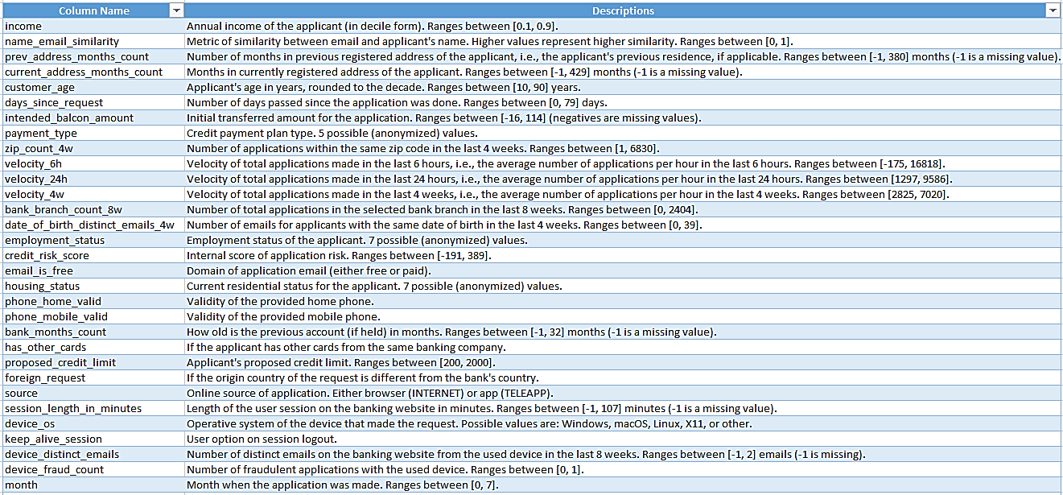
Datasets (Cont’d)
Our BAF base dataset contains:
1 million instances
32 realistic features used in the fraud detection use-case
A column of “month”, providing temporal information about the dataset
Protected attributes, (age group, employment status and % income).
Notes:
1 million instances;
32 realistic features used in the fraud detection use-case;
A column of “month”, providing temporal information about the dataset;
Protected attributes, (age group, employment status and % income).

Slide 9
Datasets (Cont’d): Variants
1st variant
2nd variant
3rd variant
4th variant
5th variant
Introduces higher group size disparity in protective fields.
Introduces higher prevalence disparity.
Provides better separability for one of the demographic groups.
Introduces higher prevalence disparity in the training dataset.
Provides better separability in the training dataset for one of the demographic groups.

Slide 10
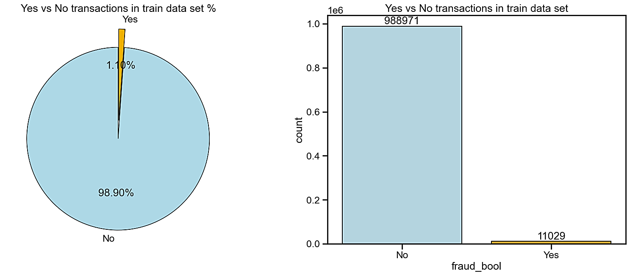
Base Dataset Statistics: Imbalance
We have 98.90% of non-fraud (988971) and only 1.103% (11029) of fraud transactions!

Slide 11
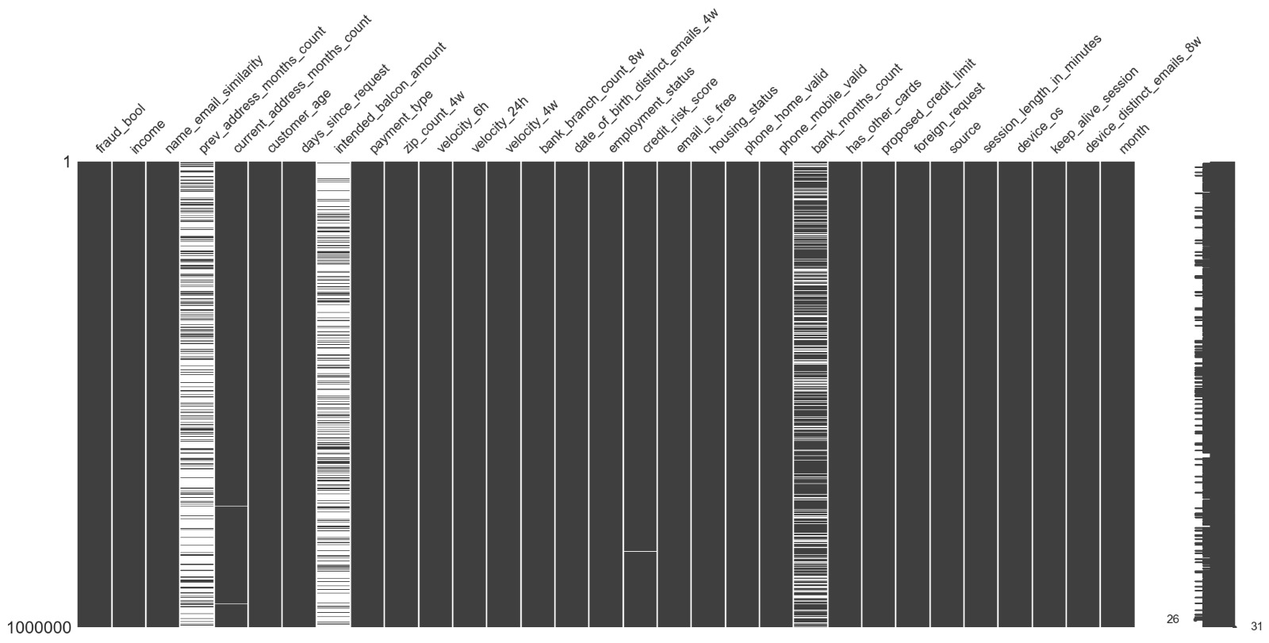
Base Dataset Statistics (Cont’d): Nulls
Features | Nulls %
prev_address_months_count | 71.2920
intended_balcon_amount | 74.2523
current_address_months_count | 0.4254
credit_risk_score | 0.0488
bank_months_count | 25.3635
session_length_in_minutes | 0.2015
device_distinct_emails_8w | 0.0359

Slide 12
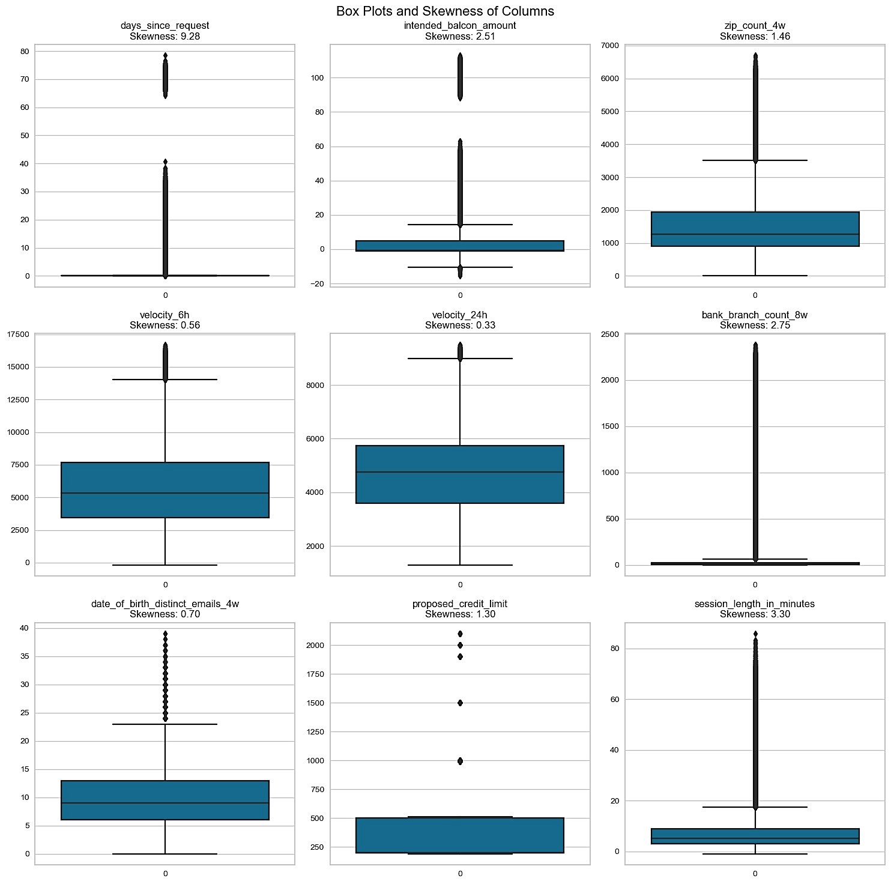
Base Dataset Statistics (Cont’d): Outliers
Features Having Outliers
days_since_request
intended_balcon_amount
zip_count_4w
velocity_6h
velocity_24h
bank_branch_count_8w
date_of_birth_distinct_emails_4w
proposed_credit_limit
session_length_in_minutes

Slide 13
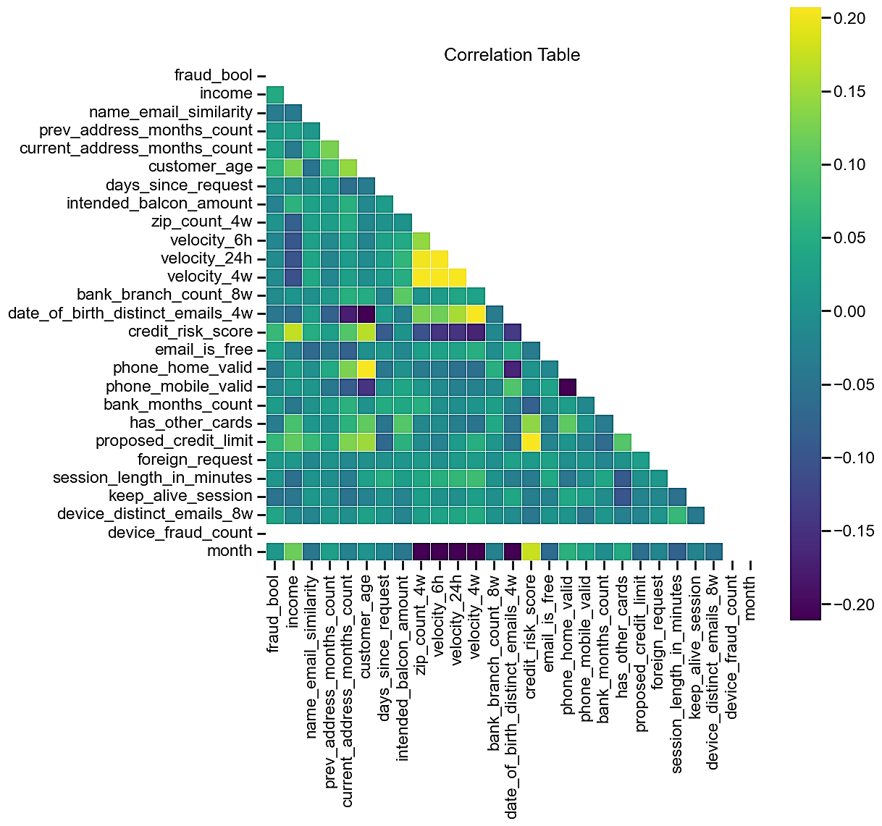
Base Dataset Statistics (Cont’d): Correlation
No features exceeded 20% correlation. Thus, there’s a little multi-co-linearity.

Slide 14
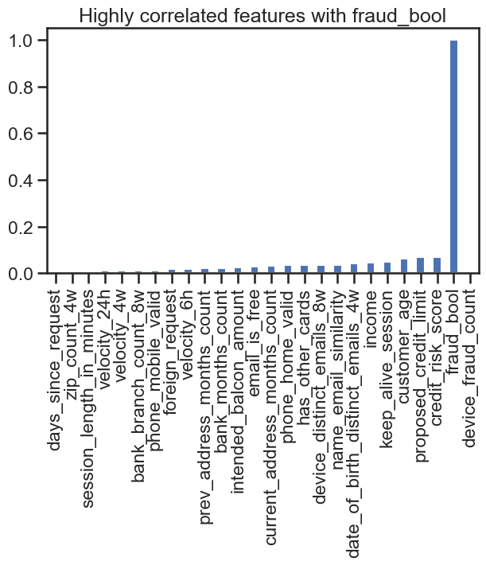
Base Dataset Statistics (Cont’d): Correlation
No features correlated with the fraud bool.

Slide 15
Methodology
In this section we describe our modeling strategy as well as our evaluation metrics.

Slide 16
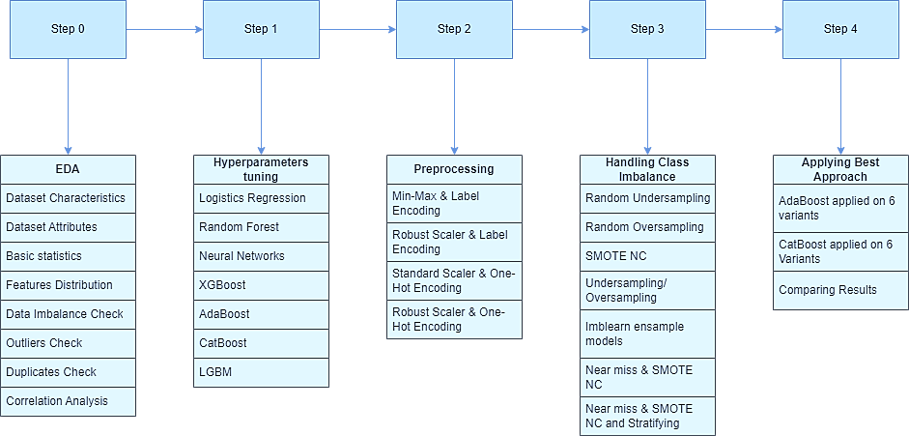
Methodology: Pipelines

Slide 17


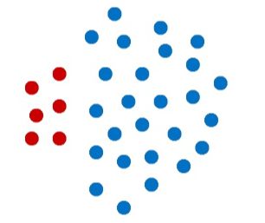
Methodology (Cont’d): Evaluation Metrics
Performance Metric: Recall @ 5% FPR (False Positive Rate)
AUC - Area Under the Curve
Fairness Metric: Predictive Equality (FPR Balance)
Notes:
Performance Metric: Recall @ 5% FPR (False Positive Rate)
Recall measures the proportion of actual fraud cases correctly identified by the model.
It is used instead of accuracy because fraud detection is an imbalanced classification problem with around 1% fraud labels.
Using accuracy alone would result in a bias towards predicting non-fraudulent transactions to achieve high accuracy.
By focusing on a fixed 5% FPR (which measures incorrect fraud labelling), the metric evaluates the model's ability to correctly identify fraudulent transactions (high Recall or True Positive Rate) while controlling for a tolerable level of incorrectly flagged transactions (False Positives).
In summary, Recall @ 5% FPR focuses on the model's True Positive Rate for fraud detection, while keeping the False Positive Rate at an acceptable level of 5%, making it an effective performance metric for the fraud detection task.
Fairness Metric: Predictive Equality (FPR Balance)
The fairness of the models is evaluated using the Predictive Equality metric, also known as FPR Balance.
This metric measures the difference (or ratio) in False Positive Rates (FPR) between demographic groups at a global FPR threshold of 5%.
The FPR represents the proportion of legitimate transactions that are incorrectly flagged as fraudulent. A higher FPR for a particular group indicates potential unfairness against that group.
The authors choose to use this metric because a false positive in fraud detection (denying a legitimate applicant a bank account) can have significant societal impacts, while a false negative (missing a fraudulent transaction) mainly incurs financial losses to the bank.
In summary, the Predictive Equality metric focuses on controlling the False Positive Rate across different demographic groups at a fixed global threshold, in order to detect potential unfairness in the models' predictions against specific groups. The choice of this metric reflects the authors' prioritization of reducing harms to legitimate applicants over financial losses.
AUC - Area Under the Curve
It’s a performance metric used to evaluate classification models. It is a measure of the model's ability to distinguish between classes (e.g. fraudulent vs non-fraudulent transactions).
AUC is calculated based on the Receiver Operating Characteristic (ROC) curve, which plots the True Positive Rate (Sensitivity) against the False Positive Rate (1 - Specificity) at various classification thresholds. The AUC is then the area under the ROC curve.
In practice, AUC scores typically range from 0.5 to 0.9 or higher for good performing models. Higher AUC scores mean the model is better able to distinguish between classes across all possible classification thresholds. Therefore, AUC is a useful overall performance measure that is insensitive to class imbalance (unlike accuracy).
In the context of fraud detection, a model with a high AUC score (e.g. 0.9 or above) is able to accurately separate fraudulent from non-fraudulent transactions across the full range of decision thresholds.

Slide 18
Experimental Results
In this section we go through the performed pipelines and their results from Step 1 till Step 4.

Slide 19
Step 1
Hyperparameters Tuning for the Baseline Models.

Slide 20
Experiments Results: Step 1
Model | AUC | TPR | Predictive equality
Logistic Regression | 0.877 | 49.69% | 89.52%
Random Forest | 0.805 | 33.39% | 34.14%
Neural Network | 0.884 | 51.88% | 84.36%
XGBoost | 0.867 | 46.63% | 76.07%
Baseline Models
Model | AUC | TPR | Predictive equality
Logistic Regression | 0.879 | 49.65% | 88.42%
Random Forest | 0.872 | 48.68% | 96.23%
Neural Network | 0.884 | 52.19% | 99.25%
AdaBoost | 0.893 | 52.40% | 100.00%
XGBoost | 0.886 | 54.66% | 88.81%
CatBoost | 0.895 | 55.14% | 86.27%
LGBM | 0.886 | 51.91% | 79.99%
Model | AUC | TPR | Predictive equality
Logistic Regression | 0.002 | -0.0004 | -0.011
Random Forest | 0.067 | 0.1529 | 0.6209
Neural Network | 0 | 0.0031 | 0.1489
XGBoost | 0.019 | 0.0803 | 0.1274
Deviation of results from baseline models
Results after Hyperparameters Tuning
Notes:
Boosting algorithms, especially AdaBoost, are designed to handle imbalanced datasets effectively. They assign higher weights to misclassified instances during each iteration, which helps them focus on the minority class and learn from the imbalanced data.
After tuning, the logistic regression model's performance remains similar to the baseline, but there is a slight improvement in fairness.
The random forest model shows significant improvement in both AUC and TPR compared to the baseline. The most notable enhancement is in predictive equality, indicating improved fairness.
The neural network maintains its performance, but there are substantial improvements in fairness, with the predictive equality score significantly increasing.
The AdaBoost model demonstrates impressive performance with a high AUC and TPR, achieving perfect fairness with a predictive equality score of 100.0%.
the XGBoost model exhibits better performance and improved fairness compared to the baseline.
The CatBoost model performs well, with good AUC and TPR, and it shows some improvement in fairness compared to the baseline models.
The LGBM model maintains good performance, and there is some enhancement in fairness, but further improvements are possible.

Slide 21
Experiments Results: Step 1(cont’d)
Notes:
The logistic regression model shows reasonable performance, with a good AUC and a moderate True Positive Rate (TPR). The fairness evaluation indicates good predictive equality, but there is still room for improvement in fairness across protected groups.
The random forest model exhibits lower AUC and TPR compared to other models. Additionally, there are significant disparities in the False Positive Rate (FPR) across protected groups, highlighting the need for improved fairness.
The neural network model demonstrates promising results with a high AUC and TPR. However, the fairness evaluation shows some disparities in the FPR across protected groups, indicating room for improvement in fairness.
The XGBoost model performs reasonably well with a decent AUC and TPR. However, the fairness evaluation reveals disparities in the FPR between protected groups, suggesting possible fairness enhancements.

Slide 22
Experiments Results: Step 1(cont’d)

Slide 23
Step 2 – 4 Pipelines
Experimenting with Different Preprocessing Pipelines.

Slide 24
Step 2 - Pipeline 1
Step 1
Imputing the missing values by Mean, Mode
Step 2
Detect outliers
Clip outliers
Step 3
Using MinMax Scaler
Using Label encoding
Step 4
Model selection(using the same models of step 1 )
Step 5
Tuning the best model(CatBoost)

Slide 25
Step 2 - Pipeline 1 Results
Model | AUC | TPR | Predictive equality
Logistic Regression | 0.867 | 46.11% | 89.01%
Random Forest | 0.801 | 30.33% | 33.84%
Neural Network | 0.872 | 47.88% | 93.63%
XGBoost | 0.888 | 52.99% | 94.11%
AdaBoost | 0.8893 | 53.47% | 100.00%
CatBoost(after tuning again) | 0.893 | 54.93% | 85.81%
LGBM | 0.882 | 50.38% | 79.88%
Model | AUC | TPR | Predictive equality
Logistic Regression | -0.012 | -0.035 | 0.0059
Random Forest | -0.071 | -0.184 | -0.62391
Neural Network | -0.012 | -0.043 | -0.0562
XGBoost | 0.002 | -0.017 | 0.053
AdaBoost | -0.004 | 0.0107 | 0
CatBoost | -0.002 | -0.002 | -0.0046
LGBM | -0.004 | -0.015 | -0.0011
Pipeline results
Deviation from step 1 results

Slide 26
Step 2 - Pipeline 2
Step 1
Imputing the missing values by Mean, Mode
Step 2
Didn't handle the outliers.
Step 3
Using Robust Scaler
Using Label encoding
Step 4
Model selection (using the same models of step 1 )
Step 5
Tuning the best model (CatBoost)
Deleted 'prev_address_months_count','bank_months_count'

Slide 27
Step 2 - Pipeline 2 Results
Model | AUC | TPR | Predictive equality
Logistic Regression | 0.859 | 44.89% | 92.65%
Random Forest | 0.875 | 48.19% | 98.92%
Neural Network | 0.8749 | 48.26% | 92.91%
XGBoost | 0.884 | 51.11% | 80.26%
AdaBoost | 0.885 | 52.61% | 100.00%
CatBoost(after tuning again) | 0.893 | 55.35% | 87.51%
LGBM | 0.882 | 50.42% | 79.69%
Model | AUC | TPR | Predictive equality
Logistic Regression | -0.02 | -0.0476 | 0.0423
Random Forest | 0.003 | -0.0049 | 0.0269
Neural Network | -0.0091 | -0.0393 | -0.0634
XGBoost | -0.002 | -0.0355 | -0.08551
AdaBoost | -0.008 | 0.0021 | 0
CatBoost | -0.002 | 0.0021 | 0.0124
LGBM | -0.004 | -0.0149 | -0.003
Pipeline results
Deviation from step 1 results

Slide 28
Step 2 - Pipeline 3
Step 1
Imputing the missing values by Mean, Mode
Step 2
Deleted the outliers.
Step 3
Using Standard Scaler
Using One Hot Encoding
Step 4
Model selection (using the same models of step 1 )
Step 5
Tuning the best model (CatBoost)
Deleted 'prev_address_months_count','bank_months_count'

Slide 29
Step 2 - Pipeline 3 Results
Model | AUC | TPR | Predictive equality
Logistic Regression | 0.877 | 48.55% | 87.48%
Random Forest | 0.872 | 47.00% | 99.53%
Neural Network | 0.878 | 49.81% | 86.79%
XGBoost | 0.883 | 52.08% | 91.38%
AdaBoost | 0.884 | 52.03% | 100.00%
CatBoost(after tuning again) | 0.885 | 51.94% | 91.97%
LGBM | 0.871 | 46.90% | 82.56%
Model | AUC | TPR | Predictive equality
Logistic Regression | -0.002 | -0.011 | -0.0094
Random Forest | 0 | -0.0168 | 0.033
Neural Network | -0.006 | -0.0238 | -0.1246
XGBoost | -0.003 | -0.0258 | 0.0257
AdaBoost | -0.009 | -0.0037 | 0
CatBoost | -0.01 | -0.032 | 0.057
LGBM | -0.015 | -0.0501 | 0.0257
Pipeline results
Deviation from step 1 results

Slide 30
Step 2 - Pipeline 4
Step 1
Imputing the missing values by Mean, Mode
Step 2
Didn't handle the outliers.
Step 3
Using Robust Scaler
Using One Hot Encoding
Step 4
Model selection (using the same models of step 1 )
Step 5
Tuning the best model (CatBoost)
Deleted 'prev_address_months_count'
.And deleted the last column created for each feature after one hot encoding manually

Slide 31
Step 2 - Pipeline 4 Results
Model | AUC | TPR | Predictive equality
Logistic Regression | 0.8646 | 45.97% | 90.09%
Random Forest | 0.8724 | 48.05% | 99.77%
Neural Network | 0.884 | 51.18% | 93.76%
XGBoost | 0.8863 | 52.22% | 82.13%
AdaBoost | 0.8874 | 52.81% | 100.00%
CatBoost(after tuning again) | 0.8933 | 54.86% | 86.46%
LGBM | 0.8789 | 49.79% | 80.52%
Model | AUC | TPR | Predictive equality
Logistic Regression | -0.0144 | -0.0368 | 0.0167
Random Forest | 0.0004 | -0.0063 | 0.0354
Neural Network | 0 | -0.0101 | -0.0549
XGBoost | 0.0003 | -0.0244 | -0.0668
AdaBoost | -0.0056 | 0.0041 | 0
CatBoost | -0.0017 | -0.0028 | 0.0019
LGBM | -0.0071 | -0.0212 | 0.0053
Pipeline results
Deviation from step 1 results

Slide 32
Step 3 – 7 Pipelines
Experimenting with Different SOTA techniques to Handle the Class Imbalance Issue.

Slide 33
Step 3 - Pipeline 1
Step 1
Step 2
Handled Class Imbalance using “imblearn” ensemble models
Used Step 2 – Pipeline 3 Preprocessing
Imblearn Ensemble models Benefits
No need for manual class balancing
Reduced Overfitting
Provides both Bagging and Boosting Models
Notes:
Thoughts on Training Results
During this experiment we tried multiple ensemble models that handle the class imbalance out-of-the-box without the need for manual data resampling techniques.
BalancedBaggingClassifier
Since we perfomred bagging of Logistic regression models we can compare this model performance with previously tried logistic regression models.
We can notice that the AUC and TPR didn't change compared by the LR Basline and Step 1 and Step 2 models however the Predictive Equality (Fairness) has improved significantly from ~86% to ~95%.
so using the bagging with logistic regression has improved the LR performance as it kept the TPR and AUC without degradation and improved the fairness.
BalancedRandomForestClassifier
Since this ensemble model is just a balanced random forest which randomly under-samples each bootstrap sample to achieve balancing, we can compare its perfomance with the previous random forest models such as the Baseline, Step 1 and Step 2 models.
We can notice immediately that all the metrics have improved for the random forest when we performed balanced bagging where the fairness is improved tremendously from ~37% to 100%.
Also the TPR and AUC have been improved
RUSBoostClassifier
In RUSBoost model we used the default decision tree estimator with max depth of one so it resembles an AdaBoost model.
When we compare by AdaBoost we see that the fairness is preserved however the TPR has decreased while the AUC is approximately constant.
EasyEnsembleClassifier
“EasyEnsemble” is made specificaly from ensembled AdaBoost models combining the bagging and boosting and sampling.
So this model can be compared by AdaBoost models of Baseline, Step 1 and Step 2.
When we compare it by previous AdaBoost implementations we notice that the performance across all metrics is approximately constant suggesting that the base AdaBoost model is the best we can achieve using this model class as no improvement is noticed as with other models.

Slide 34
Step 3 - Pipeline 1 Results
Model | AUC | TPR | Predictive equality
Logistic Regression | 0.877 | 48.55% | 87.48%
Random Forest | 0.872 | 47.00% | 99.53%
Neural Network | 0.878 | 49.81% | 86.79%
XGBoost | 0.883 | 52.08% | 91.38%
AdaBoost | 0.884 | 52.03% | 100.00%
CatBoost(after tuning again) | 0.885 | 51.94% | 91.97%
LGBM | 0.871 | 46.90% | 82.56%
Model | AUC | TPR | Predictive equality
Balanced Bagging Classifier | 0.8777 | 49.42% | 95.37%
Balanced Random Forest | 0.8542 | 41.29% | 100.00%
RUS Boosting Classifier | 0.8774 | 48.98% | 100.00%
Easy Ensemble Classifier | 0.8861 | 52.08% | 100.00%
Pipeline Results
Step 2 Pipeline 3 Results
Model | Compared With | AUC | TPR | Predictive equality
Balanced Bagging Classifier | Logistic Regression | 0.0007 | 0.87% | 7.89%
Balanced Random Forest | Random Forest | -0.018 | -5.71% | 0.47%
RUS Boosting Classifier | AdaBoost | -0.007 | -3.05% | 0.00%
Easy Ensemble Classifier | AdaBoost | 0.0021 | 0.05% | 0.00%
Deviation from Step 2 Pipeline 3 Results
Notes:
Thoughts on Training Results
During this experiment we tried multiple ensemble models that handle the class imbalance out-of-the-box without the need for manual data resampling techniques.
BalancedBaggingClassifier
Since we perfomred bagging of Logistic regression models we can compare this model performance with previously tried logistic regression models.
BalancedRandomForestClassifier
Since this ensemble model is just a balanced random forest which randomly under-samples each bootstrap sample to achieve balancing, we can compare its perfomance with the previous random forest models such as the Baseline, Step
RUSBoostClassifier
In RUSBoost model we used the default decision tree estimator with max depth of one so it resembles an AdaBoost model.
EasyEnsembleClassifier
“EasyEnsemble” is made specificaly from ensembled AdaBoost models combining the bagging and boosting and sampling.
.

Slide 35
Step 3 - Pipeline 2
Step 1
Step 2
Handled Class Imbalance using Random Undersampling
Used Step 2 – Pipeline 4 Preprocessing
Random Undersampling Benefits
Balancing the dataset
Reduce Overfitting
Faster Training
Notes:
Address Class Imbalance: In imbalanced datasets, the majority class may dominate the learning process, leading to biased models that perform poorly on the minority class. By undersampling the majority class, you balance the class distribution, allowing the model to give more attention to the minority class during training.
Reduce Overfitting: When the class distribution is highly imbalanced, the classifier may become overfit to the majority class and struggle to generalize to unseen data. Random undersampling can reduce the risk of overfitting by providing a more balanced training set.
Faster Training: Imbalanced datasets with a large majority class can result in longer training times for the model. Random undersampling reduces the size of the training set, making the training process faster and more efficient.

Slide 36
Step 3 - Pipeline 2 Results
Model | AUC | TPR | Predictive equality
Logistic Regression | 0.8697 | 47.12% | 95.99%
Random Forest | 0.8701 | 48.33% | 99.96%
Neural Network | 0.8858 | 52.08% | 85.67%
XGBoost | 0.8819 | 50.49% | 63.85%
AdaBoost | 0.8827 | 51.77% | 100.00%
CatBoost(after tuning again) | 0.8921 | 54.10% | 89.29%
LGBM | 0.8889 | 52.74% | 87.27%
Model | AUC | TPR | Predictive equality
Logistic Regression | 0.0051 | 0.0115 | 0.059
Random Forest | -0.0023 | 0.0028 | 0.0019
Neural Network | 0.0018 | 0.009 | -0.0809
XGBoost | -0.0044 | -0.0173 | -0.1828
AdaBoost | -0.0047 | -0.0104 | 0
CatBoost | -0.0012 | -0.0076 | 0.0283
LGBM | 0.01 | 0.0295 | 0.0675
Pipeline Results
Deviation from Step 2 Pipeline Results

Slide 37
Step 3 - Pipeline 3
Step 1
Step 2
Handled Class Imbalance using Random Oversampling
Used Step 2 – Pipeline 4 Preprocessing
Random Oversampling Benefits
Improve Minority Class Representation
Prevent Overfitting on Majority Class
Avoid Information Loss
Notes:
Improve Minority Class Representation: In imbalanced datasets, the minority class may have very few samples, leading to poor representation and limited learning opportunities. By oversampling the minority class, you provide the classifier with more examples, making it easier for the model to learn patterns specific to that class.
Address Class Imbalance: Class imbalance can lead to biased models that favor the majority class. Random oversampling helps mitigate this issue by increasing the number of samples in the minority class, making the class distribution more balanced.
Prevent Overfitting on Majority Class: When the class distribution is highly imbalanced, the classifier may be biased towards the majority class, resulting in overfitting. Random oversampling helps prevent overfitting by increasing the representation of the minority class and reducing the chances of the model focusing solely on the majority class.
Avoid Information Loss: Other techniques like undersampling or data augmentation may discard valuable information from the majority class. Random oversampling preserves all the samples from the majority class while creating synthetic samples for the minority class.

Slide 38
Step 3 - Pipeline 3 Results
Model | AUC | TPR | Predictive equality
Logistic Regression | 0.8652 | 46.35% | 92.96%
Random Forest | 0.8724 | 48.12% | 99.79%
Neural Network | 0.8863 | 53.27% | 88.72%
XGBoost | 0.8845 | 53.27% | 78.64%
AdaBoost | 0.8874 | 53.02% | 100.00%
CatBoost(after tuning again) | 0.8937 | 54.76% | 85.90%
LGBM | 0.8916 | 54.03% | 83.86%
Model | AUC | TPR | Predictive equality
Logistic Regression | 0.0006 | 0.0038 | 0.0287
Random Forest | 0 | 0.0007 | 0.0002
Neural Network | 0.0023 | 0.0209 | -0.0504
XGBoost | -0.0018 | 0.0105 | -0.0349
AdaBoost | 0 | 0.0021 | 0
CatBoost | 0.0004 | -0.001 | -0.0056
LGBM | 0.0127 | 0.0424 | 0.0334
Pipeline Results
Deviation from Step 2 Pipeline Results

Slide 39
Step 3 - Pipeline 4
Step 1
Step 2
Handled Class Imbalance using SMOTE-NC Oversampling
Used Step 2 – Pipeline 4 Preprocessing
SMOTE-NC Benefits
Handling Continuous and Categorical Features
Enhancing Generalization
Avoiding Data Loss
Notes:
Preserving Data Structure: In real-world datasets, it is common to have a mix of numerical and categorical features. Using traditional SMOTE on such datasets may not consider the unique characteristics of categorical features, leading to synthetic samples that do not represent the original data's structure accurately. SMOTE-NC addresses this issue by handling both numerical and categorical features appropriately, preserving the data structure.
Addressing Class Imbalance: Imbalanced datasets have significantly fewer instances of the minority class compared to the majority class. This imbalance can lead to biased models that favor the majority class. SMOTE-NC helps alleviate class imbalance by generating synthetic samples for the minority class, increasing its representation in the dataset.
Enhancing Generalization: SMOTE-NC can improve the generalization ability of classifiers trained on imbalanced data. By generating synthetic samples, the classifier is exposed to more diverse instances of the minority class, reducing the risk of overfitting to the limited training data.
Fairness Considerations: When dealing with imbalanced data, fairness becomes a critical concern. SMOTE-NC can help improve fairness by providing a more balanced representation of different classes and potentially reducing the bias towards the majority class.
Avoiding Data Loss: Some resampling techniques, like random undersampling, remove instances from the majority class, resulting in data loss and a reduced training set size. SMOTE-NC, being an oversampling technique, retains all instances of the original data while creating synthetic samples for the minority class.

Slide 40
Step 3 - Pipeline 4 Results
Model | AUC | TPR | Predictive equality
Logistic Regression | 0.8384 | 40.58% | 80.36%
Random Forest | 0.8582 | 44.48% | 100.00%
Neural Network | 0.8443 | 42.81% | 100.00%
XGBoost | 0.8393 | 38.60% | 61.05%
AdaBoost | 0.8467 | 42.77% | 100.00%
CatBoost(after tuning again) | 0.8567 | 45.59% | 55.84%
LGBM | 0.8462 | 43.71% | 65.23%
Model | AUC | TPR | Predictive equality
Logistic Regression | -0.0262 | -0.0539 | -0.0973
Random Forest | -0.0142 | -0.0357 | 0.0023
Neural Network | -0.0397 | -0.0837 | 0.0624
XGBoost | -0.047 | -0.1362 | -0.2108
AdaBoost | -0.0407 | -0.1004 | 0
CatBoost | -0.0366 | -0.0927 | -0.3062
LGBM | -0.0327 | -0.0608 | -0.1529
Pipeline Results
Deviation from Step 2 Pipeline Results

Slide 41
Step 3 - Pipeline 5
Step 1
Step 2
Handled Class Imbalance using Random Undersampling followed by Random Oversampling
Used Step 2 – Pipeline 4 Preprocessing
Undersampling then Oversampling Benefits
Improved Generalization
Reduced Overfitting
Computationally Efficient
Notes:
Preserving Data Structure: In real-world datasets, it is common to have a mix of numerical and categorical features. Using traditional SMOTE on such datasets may not consider the unique characteristics of categorical features, leading to synthetic samples that do not represent the original data's structure accurately. SMOTE-NC addresses this issue by handling both numerical and categorical features appropriately, preserving the data structure.
Addressing Class Imbalance: Imbalanced datasets have significantly fewer instances of the minority class compared to the majority class. This imbalance can lead to biased models that favor the majority class. SMOTE-NC helps alleviate class imbalance by generating synthetic samples for the minority class, increasing its representation in the dataset.
Enhancing Generalization: SMOTE-NC can improve the generalization ability of classifiers trained on imbalanced data. By generating synthetic samples, the classifier is exposed to more diverse instances of the minority class, reducing the risk of overfitting to the limited training data.
Fairness Considerations: When dealing with imbalanced data, fairness becomes a critical concern. SMOTE-NC can help improve fairness by providing a more balanced representation of different classes and potentially reducing the bias towards the majority class.
Avoiding Data Loss: Some resampling techniques, like random undersampling, remove instances from the majority class, resulting in data loss and a reduced training set size. SMOTE-NC, being an oversampling technique, retains all instances of the original data while creating synthetic samples for the minority class.

Slide 42
Step 3 - Pipeline 5 Results
Model | AUC | TPR | Predictive equality
Logistic Regression | 0.8509 | 43.29% | 74.09%
Random Forest | 0.8663 | 45.21% | 90.91%
Neural Network | 0.8742 | 49.76% | 57.10%
XGBoost | 0.8648 | 45.21% | 54.34%
AdaBoost | 0.8727 | 48.85% | 100.00%
CatBoost(after tuning again) | 0.8791 | 51.18% | 60.85%
LGBM | 0.8754 | 50.24% | 54.95%
Model | AUC | TPR | Predictive equality
Logistic Regression | -0.0137 | -0.0268 | -0.16
Random Forest | -0.0061 | -0.0284 | -0.0886
Neural Network | -0.0098 | -0.0142 | -0.3666
XGBoost | -0.0215 | -0.0701 | -0.2779
AdaBoost | -0.0147 | -0.0396 | 0
CatBoost | -0.0142 | -0.0368 | -0.2561
LGBM | -0.0035 | 0.0045 | -0.2557
Pipeline Results
Deviation from Step 2 Pipeline Results

Slide 43
Step 3 - Pipeline 6
Step 1
Step 2
Handled Class Imbalance using Near Miss Undersampling then SOMTE-NC Oversampling
Used Step 2 – Pipeline 4 Preprocessing
Near Miss Undersampling then SMOTE-NC Oversampling Benefits
Improved Generalization
Reduced Overfitting
Computationally Efficient
Complementary Effects
Handling Continuous and Categorical Features
Notes:
Preserving Data Structure: In real-world datasets, it is common to have a mix of numerical and categorical features. Using traditional SMOTE on such datasets may not consider the unique characteristics of categorical features, leading to synthetic samples that do not represent the original data's structure accurately. SMOTE-NC addresses this issue by handling both numerical and categorical features appropriately, preserving the data structure.
Addressing Class Imbalance: Imbalanced datasets have significantly fewer instances of the minority class compared to the majority class. This imbalance can lead to biased models that favor the majority class. SMOTE-NC helps alleviate class imbalance by generating synthetic samples for the minority class, increasing its representation in the dataset.
Enhancing Generalization: SMOTE-NC can improve the generalization ability of classifiers trained on imbalanced data. By generating synthetic samples, the classifier is exposed to more diverse instances of the minority class, reducing the risk of overfitting to the limited training data.
Fairness Considerations: When dealing with imbalanced data, fairness becomes a critical concern. SMOTE-NC can help improve fairness by providing a more balanced representation of different classes and potentially reducing the bias towards the majority class.
Avoiding Data Loss: Some resampling techniques, like random undersampling, remove instances from the majority class, resulting in data loss and a reduced training set size. SMOTE-NC, being an oversampling technique, retains all instances of the original data while creating synthetic samples for the minority class.

Slide 44
Step 3 - Pipeline 6 Results
Model | AUC | TPR | Predictive equality
Logistic Regression | 0.8946 | 57.44% | 68.26%
Random Forest | 0.9138 | 62.30% | 91.18%
Neural Network | 0.9372 | 73.31% | 57.96%
XGBoost | 0.8648 | 45.21% | 54.34%
AdaBoost | 0.91 | 63.17% | 100.00%
CatBoost(after tuning again) | 0.9414 | 75.30% | 60.79%
LGBM | 0.9343 | 71.58% | 62.57%
Model | AUC | TPR | Predictive equality
Logistic Regression | 0.03 | 0.1147 | -0.2183
Random Forest | 0.0414 | 0.1425 | -0.0859
Neural Network | 0.0532 | 0.2213 | -0.358
XGBoost | -0.0215 | -0.0701 | -0.2779
AdaBoost | 0.0226 | 0.1036 | 0
CatBoost | 0.0481 | 0.2044 | -0.2567
LGBM | 0.0554 | 0.2179 | -0.1795
Pipeline Results
Deviation from Step 2 Pipeline Results

Slide 45
Step 3 - Pipeline 7
Step 1
Step 2
Handled Class Imbalance using Near Miss Undersampling then SOMTE-NC Oversampling and Stratifying
Used Step 2 – Pipeline 4 Preprocessing
Near Miss Undersampling then SMOTE-NC Oversampling and Stratifying Benefits
Improved Generalization
Reduced Overfitting
Computationally Efficient
Complementary Effects
Handling Continuous and Categorical Features
Maintain the distribution of classes across the train and test datasets
Notes:
Preserving Data Structure: In real-world datasets, it is common to have a mix of numerical and categorical features. Using traditional SMOTE on such datasets may not consider the unique characteristics of categorical features, leading to synthetic samples that do not represent the original data's structure accurately. SMOTE-NC addresses this issue by handling both numerical and categorical features appropriately, preserving the data structure.
Addressing Class Imbalance: Imbalanced datasets have significantly fewer instances of the minority class compared to the majority class. This imbalance can lead to biased models that favor the majority class. SMOTE-NC helps alleviate class imbalance by generating synthetic samples for the minority class, increasing its representation in the dataset.
Enhancing Generalization: SMOTE-NC can improve the generalization ability of classifiers trained on imbalanced data. By generating synthetic samples, the classifier is exposed to more diverse instances of the minority class, reducing the risk of overfitting to the limited training data.
Fairness Considerations: When dealing with imbalanced data, fairness becomes a critical concern. SMOTE-NC can help improve fairness by providing a more balanced representation of different classes and potentially reducing the bias towards the majority class.
Avoiding Data Loss: Some resampling techniques, like random undersampling, remove instances from the majority class, resulting in data loss and a reduced training set size. SMOTE-NC, being an oversampling technique, retains all instances of the original data while creating synthetic samples for the minority class.

Slide 46
Step 3 - Pipeline 7 Results
Model | AUC | TPR | Predictive equality
Logistic Regression | 0.8932 | 56.98% | 81.77%
Random Forest | 0.921 | 65.50% | 94.18%
Neural Network | 0.9451 | 75.70% | 65.07%
XGBoost | 0.9018 | 58.57% | 67.81%
AdaBoost | 0.9285 | 69.49% | 100.00%
CatBoost(after tuning again) | 0.9546 | 79.69% | 55.26%
LGBM | 0.9489 | 77.70% | 56.87%
Model | AUC | TPR | Predictive equality
Logistic Regression | 0.0286 | 0.1101 | -0.0832
Random Forest | 0.0486 | 0.1745 | -0.0559
Neural Network | 0.0611 | 0.2452 | -0.2869
XGBoost | 0.0155 | 0.0635 | -0.1432
AdaBoost | 0.0411 | 0.1668 | 0
CatBoost | 0.0613 | 0.2483 | -0.312
LGBM | 0.07 | 0.2791 | -0.2365
Pipeline Results
Deviation from Step 2 Pipeline Results

Slide 47
Step 4
Applying Our Best Approach to the Different Variants of the Dataset.

Slide 48
Experiments Results: Step 4
Since the last experiment with NearMiss for undersampling followed by stratifying while creating the train and test sets then apply SMOTE-NC on the train data get the highest results. we use the same technique with the preprocessing done in experiment 7 in step 3 on all the variants of the dataset and here are the results.
Dataset | AUC | TPR | Predictive equality
Base AdaBoost | 0.9346 | 72.08% | 100.00%
Variant 1 AdaBoost | 0.9324 | 69.63% | 100.00%
Variant 2 AdaBoost | 0.9378 | 71.21% | 100.00%
Variant 3 AdaBoost | 0.9329 | 70.67% | 100.00%
Variant 4 AdaBoost | 0.9383 | 72.21% | 100.00%
Variant 5 AdaBoost | 0.931 | 69.58% | 100.00%
Dataset | AUC | TPR | Predictive equality
CatBoost Base | 0.9535 | 80.37% | 58.40%
CatBoost Variant 1 | 0.9538 | 77.88% | 98.03%
CatBoost Variant 2 | 0.9549 | 79.37% | 55.36%
CatBoost Variant 3 | 0.9534 | 78.47% | 92.92%
CatBoost Variant 4 | 0.9561 | 80.05% | 63.03%
CatBoost Variant 5 | 0.952 | 78.15% | 87.26%
If we’re concerned about the fairness and final output we could use AdaBoost
If we’re concerned only about the fraud detection then we could use CatBoost
Notes:
The Predictive Equality score of 100.0% indicates that all variants achieve perfect fairness, with no disparity in the False Positive Rate (FPR) across protected groups. This means that all variants of the AdaBoost model are highly fair models.

Slide 49
Discussion & Conclusion

Slide 50
Discussion
Limitations
Slow training time prevented the usage of cross validation.
Using Stratified splitting.
Apply insufficient number of hyperparameter combinations in hyperparameter tuning process.
Although we mentioned in the proposal that we will use SVM algorithm, but we don’t use it since the kernel trick needs high resources.

Slide 51
Conclusion
1. Class Imbalance Matters: Addressing class imbalance is crucial for better model performance, fairness, and generalization in fraud detection.
2. Fairness Consideration: We evaluated fairness using Predictive Equality. Ensemble models like BalancedRandomForestClassifier and AdaBoost achieved good fairness results.
3. Fraud Detection Performance: CatBoost consistently performed well in detecting fraud, making it a strong candidate for fraud detection applications.
4. Ensemble Models Shine: Models from the imblearn library automatically handle class imbalance and improve both performance and fairness.
5. Model Variants: AdaBoost variants showed similar fairness results. CatBoost variants had varying fairness and fraud detection performance.
6. Data Preprocessing Matters: Proper data preprocessing, including handling missing values and scaling, contributed to better model results.
7. Choose Wisely: The final model choice depends on your priorities—prioritize fairness.

Slide 52
Work Load
Classes
 | Data Cleaning | Hassan Ahmed
 | Data Preprocessing | Amr Sayed
 | Modeling | Bilal Morsy
 | NN Modeling | Omar Amer
Step 0
 | EDA | Bilal Morsy
 | Comparing Variance Datasets | Amr Sayed
Step 1
 | LGBM & Random Forest | Amr Sayed
 | XGBoost and AdaBoost | Hassan Ahmed
 | Logistic Regression and Neural Networks | Omar Amer
 | CatBoost | Bilal Morsy
Step 2
 | Pipeline 1 | Amr Sayed
 | Pipeline 2 | Bilal Morsy
 | Pipeline 3 | Omar Amer
 | Pipeline 4 | Hassan Ahmed
Step 3
 | Under Sampling | Amr Sayed
 | Over Sampling | Amr Sayed
 | Under Sampling then Over Sampling | Bilal Morsy
 | SMOTE - NC | Bilal Morsy
 | Imblearn ensemble | Omar Amer
 | Near miss and SMOTE - NC | Hassan Ahmed
 | Near miss and SMOTE – NC and Stratifying | Omar Amer
Step 4
 | (CatBoost and AdaBoost and comparison) | Hassan Ahmed
Readme
 | Readme | Amr Sayed & Hassan Ahmed

Slide 53
Thank You

