Slide 1




Graph-based cyber-attacks detection in IoT networks
AI
Thesis of the Master degree in data science for risk analysis
By Hassan ABDALLAH
September 2022
1

Slide 2
Content
01
Introduction
04
Background
02
Related works
05
Implementation
03
Research problem
06
Results and evaluation
2

Slide 3

Introduction
Importance
Some intelligent objects can be controlled remotely
IoT systems
Limitation
Computing power and storage capacity
Security
IoT security fails to keep up
Attacks Detection
Graph & Artificial Intelligence
3

Slide 4
Related Works
01
02
03
04
2018
2019
2020
2020
Jia et al. [1]
Paudel, Muncy, et al. [2]
Nguyen et al. [3]
Smys et al. [4]
IoT systems potential vulnerabilities
Detecting DOS attacks
Detecting IoT botnet attacks
Detecting IoT intrusions using deep learning
05
06
2021
2022
Mills et al. [5]
Lo et al. [6]
Detecting attacks in real-time
A graph-based method for detecting attacks in IoT
4

Slide 5
Challenges
IoT devices and sensors are not as secure as machines in traditional networks
01
Limitations in memory and computing power of devices
02
IoT applications generates a large amount of data
03
6

Slide 6

Research problem
01
02
IoT is Important
AI
IoT Security is also Improtant
5

Slide 7


Background (1/3)
Online approach
Offline approach
Vs
Detecting active attacks
Making a proactive decision
Detecting passive attacks
Making a reactive decision
7

Slide 8

Background (2/3)
01
02
Main idea (1/2)
Main idea (2/2)
Anomalies detection from the data stored
Data modeling in a graph database
Graph-based technique
03
04
Why graph? (1/2)
Why graph? (2/2)
A graph naturally represents highly relational data
In IoT, devices can be
treated as nodes and communications as edges
8

Slide 9


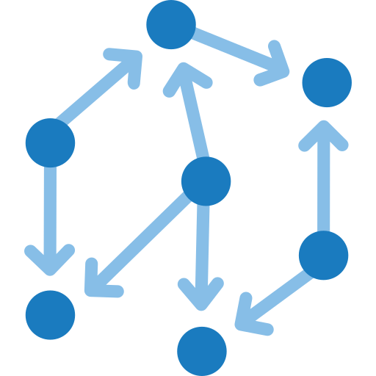



Background (3/3)
Abnormal
Normal
1
2
3
9

Slide 10



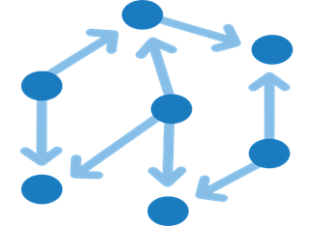











Implementation
An example of an IoT environment
Generate numerical vectors
1
2
Network data modeling in Neo4j
GraphSAGE model training
Split the data into 30-second chunks and then pass it to the model in order
1- Collect network data and store it in a PCAP file
4
3
5
Generate a trained model
generate a numeric vector for each chunk
5- Continuously collect data for the last 30 s, modeling them in Neo4j, and generate a numeric vector
Building a second AI model
3- Taking the first model
6- Feeding the output vector to the second model
Normal
2- Store numeric vectors with their labels in a CSV file
Training a new AI model based on data stored in a CSV file
Abnormal
4- Taking the second model
10

Slide 11
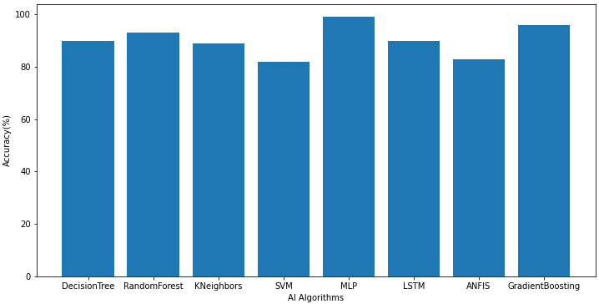
Results (1/2)
11

Slide 12
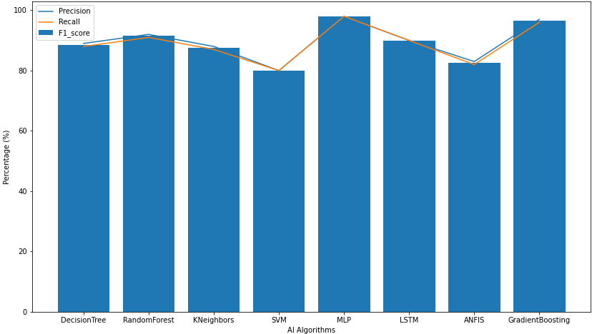
Results (2/2)
12

Slide 13
Evaluation
Approaches | Accuracy | Precision | Recall
GODIT [2] | not mentioned | 98% | 92%
HCNN [4] | 98% | not mentioned | not mentioned
E-GraphSAGE [6] | 97% | 100% | 97%
Our approach | 99% | 98% | 98%
13

Slide 14
Conclusion
01
02
IoT improves quality of life
IoT is vulnerable to cyber-attacks
A modern intrusion detection system is needed
03
04
The state-of-the-art proves that graph-based techniques have given good results
AI for cyber-security
Our approach has outperformed existing ones
05
14

Slide 15
References
[1] Jia, Yizhen, Xiao, Yinhao, Yu, Jiguo, Cheng, Xiuzhen, Liang, Zhenkai, and Wan, Zhiguo (2018). “A novel graph-based mechanism for identifying traffic vulnerabilities in smart home IoT”. In: IEEE INFOCOM 2018-IEEE Conference on Computer Communications. IEEE, pp. 1493–1501.
[2] Paudel, Ramesh, Muncy, Timothy, and Eberle, William (2019). “Detecting DoS attack in smart home IoT devices using a graph-based approach”. In: 2019 IEEE International Conference on Big Data (Big Data). IEEE, pp. 5249–5258.
[3] Nguyen, Huy-Trung, Ngo, Quoc-Dung, and Le, Van-Hoang (2020). “A novel graph-based approach for IoT botnet detection”. In: International Journal of Information Security 19.5, pp. 567–577.
[4] Smys, S, Basar, Abul, Wang, Haoxiang, et al. (2020). “Hybrid intrusion detection system for internet of things (IoT)”. In: Journal of ISMAC 2.04, pp. 190–199.
[5] Mills, Ryan, Marnerides, Angelos K, Broadbent, Matthew, and Race, Nicholas (2021). “Practical intrusion detection of emerging threats”. In: IEEE Transactions on Network and Service Management 19.1, pp. 582–600.
[6] Lo, Wai Weng, Layeghy, Siamak, Sarhan, Mohanad, Gallagher, Marcus, and Portmann, Marius (2022). “E-GraphSAGE: A Graph Neural Network based Intrusion Detection System for IoT”. In: NOMS 2022-2022 IEEE/IFIP Network Operations and Management Symposium. IEEE, pp. 1–9.
15

Slide 16
Thank you

