Slide 1
Duplicate question analysis and inference
on stack overflow data
DILIP
HASSAN
NAGENDRA
RUBIN

Slide 2
Introduction
Question and answer forums like StackExchange, Quora and Reddit are hubs for gathering, storing, and sharing knowledge on a multitude of topics. Given the heavy traffic on these sites, it can be difficult for moderators and users to monitor and filter through the influx of posts.
This project targets a specific problem that arises from the large inflow of unmonitored data on these forums: duplicate questions. Our work focuses on StackOverflow, a forum for software developers and programmers, that currently relies on vigilant, high-reputation users to report duplicate questions.
Our project includes extracting duplicate and non-duplicate questions from StackOverflow data. Using that data, we have performed data analysis, created visualizations and trained two NLP models that can 1) detect if two questions are duplicates and 2) search for similar questions over a large corpus of data.

Slide 3
DATASET
Posts | PostLinks | Tags | Users
Id ViewCount (nullable) Body Title (nullable) Tags | Id primary key CreationDate PostId id of source post RelatedPostId id of target post LinkTypeId | PostId TagId | Id Location

Slide 4
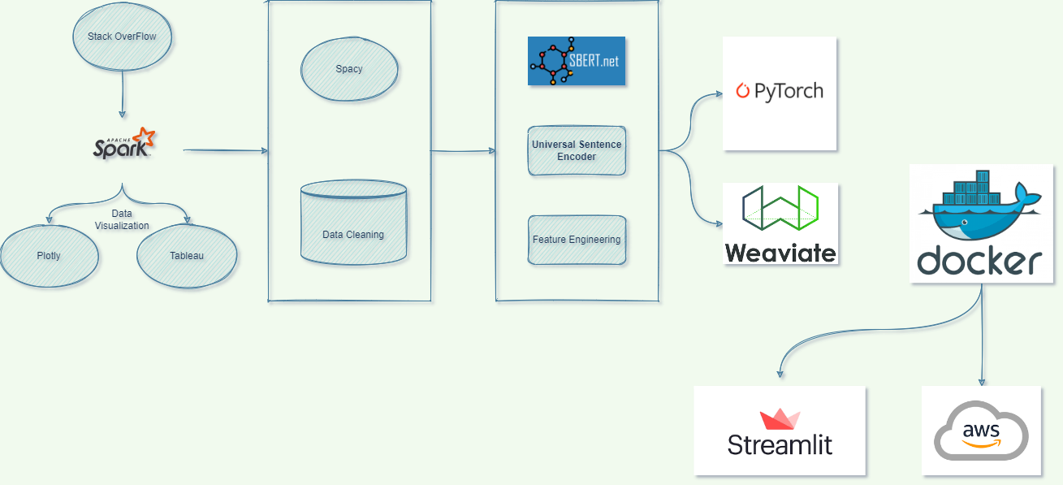
Work Flow

Slide 5
DATA ANALYSIS AND VISUALIZATION
Data analysis is done mainly in four categories based on:
Duplicate vs overall questions
Tags
Time series analysis
Location based analysis

Slide 6
Classification Model
Extracting positive and negative pairs using PySpark
Removing stop words and
Lemmatization
SBERT and USE embeddings
Similarity metrics
Feature engineering

Slide 7
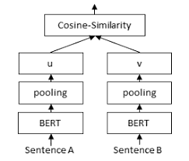
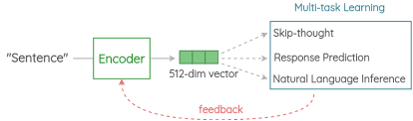
SBERT AND USE
SBERT uses Siamese twin network architecture to train transformer models, this makes embedding generated by SBERT much more useful for semantic similarity tasks.
Whereas Universal Sentence encoder is better than LM models like BERT because, same embedding is used to solve multiple tasks and based on the mistakes it makes on those, it updates the sentence embedding. Since the same embedding has to work on multiple generic tasks, it will capture only the most informative features and discard noise.

Slide 8

Similarity model
50 EPOCHS
ADAM
We have used PyTorch to build a MLP model with two layers with Relu and Sigmoid activation functions. Adam optimizer was used to train the model. After 50 epochs we got 89 percent training and testing accuracy and model.

Slide 9
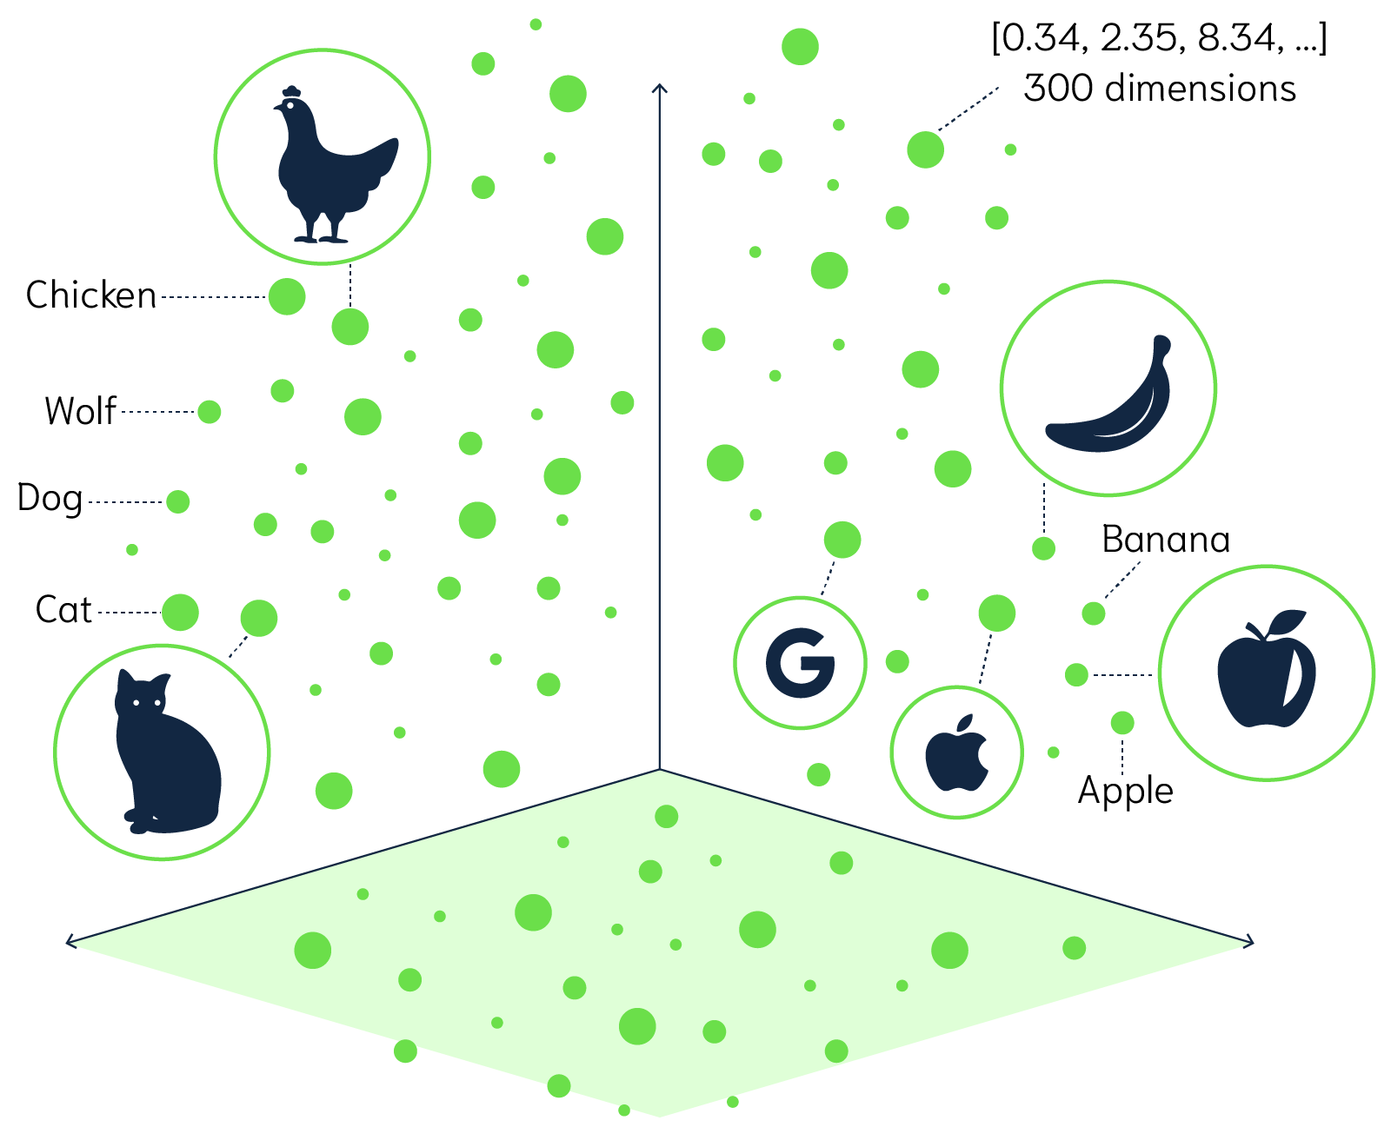
Vector Space – semantic search
Vector space can be accessed through models like KNN, but there are not practical (slow) when querying large datasets, so we have used Weaviate.

Slide 10
Weaviate Model
Weaviate is a low-latency vector search engine used to store text and its embeddings. Under the hood, Weaviate uses a variation of the HNSW index which is a graph based indexing system that can help to reduce search time complexity.
Weaviate typically performs nearest neighbour searches of millions of objects in considerably less than 100ms.
Weaviate can be accessed through docker container and this pipeline is highly scalable and persistant.
This pipeline is used to search similar questions in a large corpus of data. We have used questions from python, big data, Facebook and image processing tags to build a corpus of 60,000 questions and these questions are converted to vectors using the USE model. Further these questions and corresponding embeddings are uploaded to Weaviate for searching.

Slide 11
Frontend-DOCKER-AWS
Streamlit is used to build the front-end for this application. Streamlit app and data required for visualizations are packaged into docker image and this image is uploaded to AWS ECR. ECS cluster and EC2 nodes are used as compute resources for scalability and availability so that users can access this application from anywhere and compute resources can be scaled based on the usage.

