Slide 1
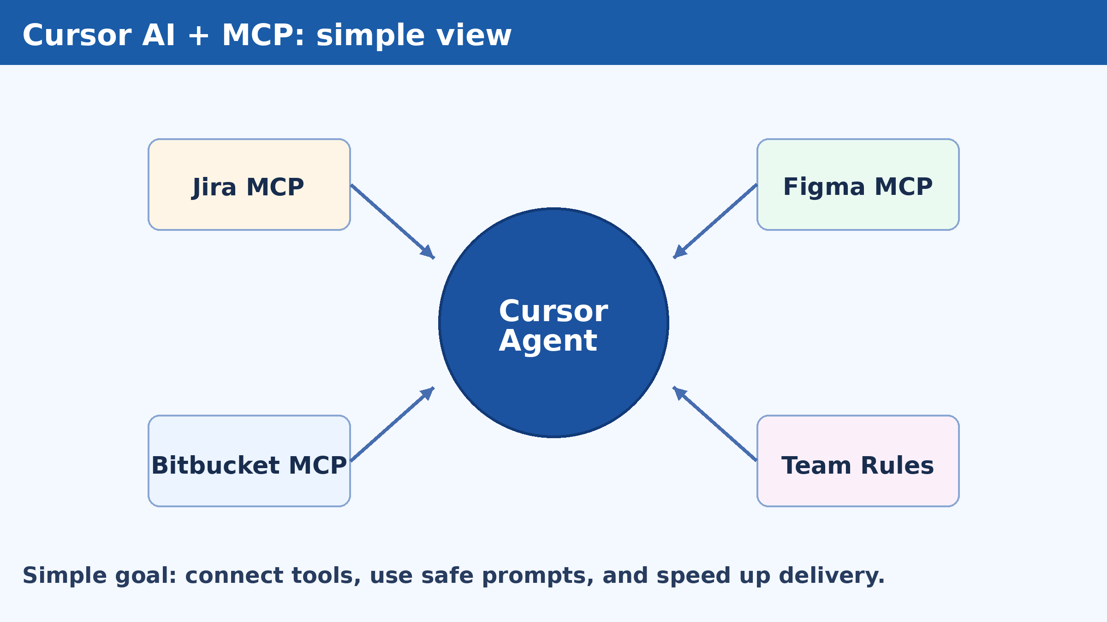
Solution Assessment: Cursor AI Capabilities and Integration Review
Spoon-feed training edition: simple English, clear steps, and full tutorial.
What this deck gives you:
  - Top MCP tools for development
  - Top agent skills to start fast
  - Step-by-step setup in Cursor
  - Commands your team can copy and run
Updated: 2026-02-10

Slide 2
What your team will learn (easy words)
1) What MCP is and why it helps developers.
2) Which MCP tools give the fastest value.
3) How to connect Jira, Figma, and Bitbucket in Cursor.
4) How to create reusable agent skills.
5) How to use safe controls so automation stays trusted.

Slide 3
Agenda (spoon-feed order)
Part A: Top MCP tools for development
Part B: Top agent skills for developers
Part C: Prompt formula + Do/Don't quick guide
Part D: Step-by-step Cursor setup tutorial
Part E: Common errors and quick fixes
Part F: Daily routine + risk controls + roadmap

Slide 4
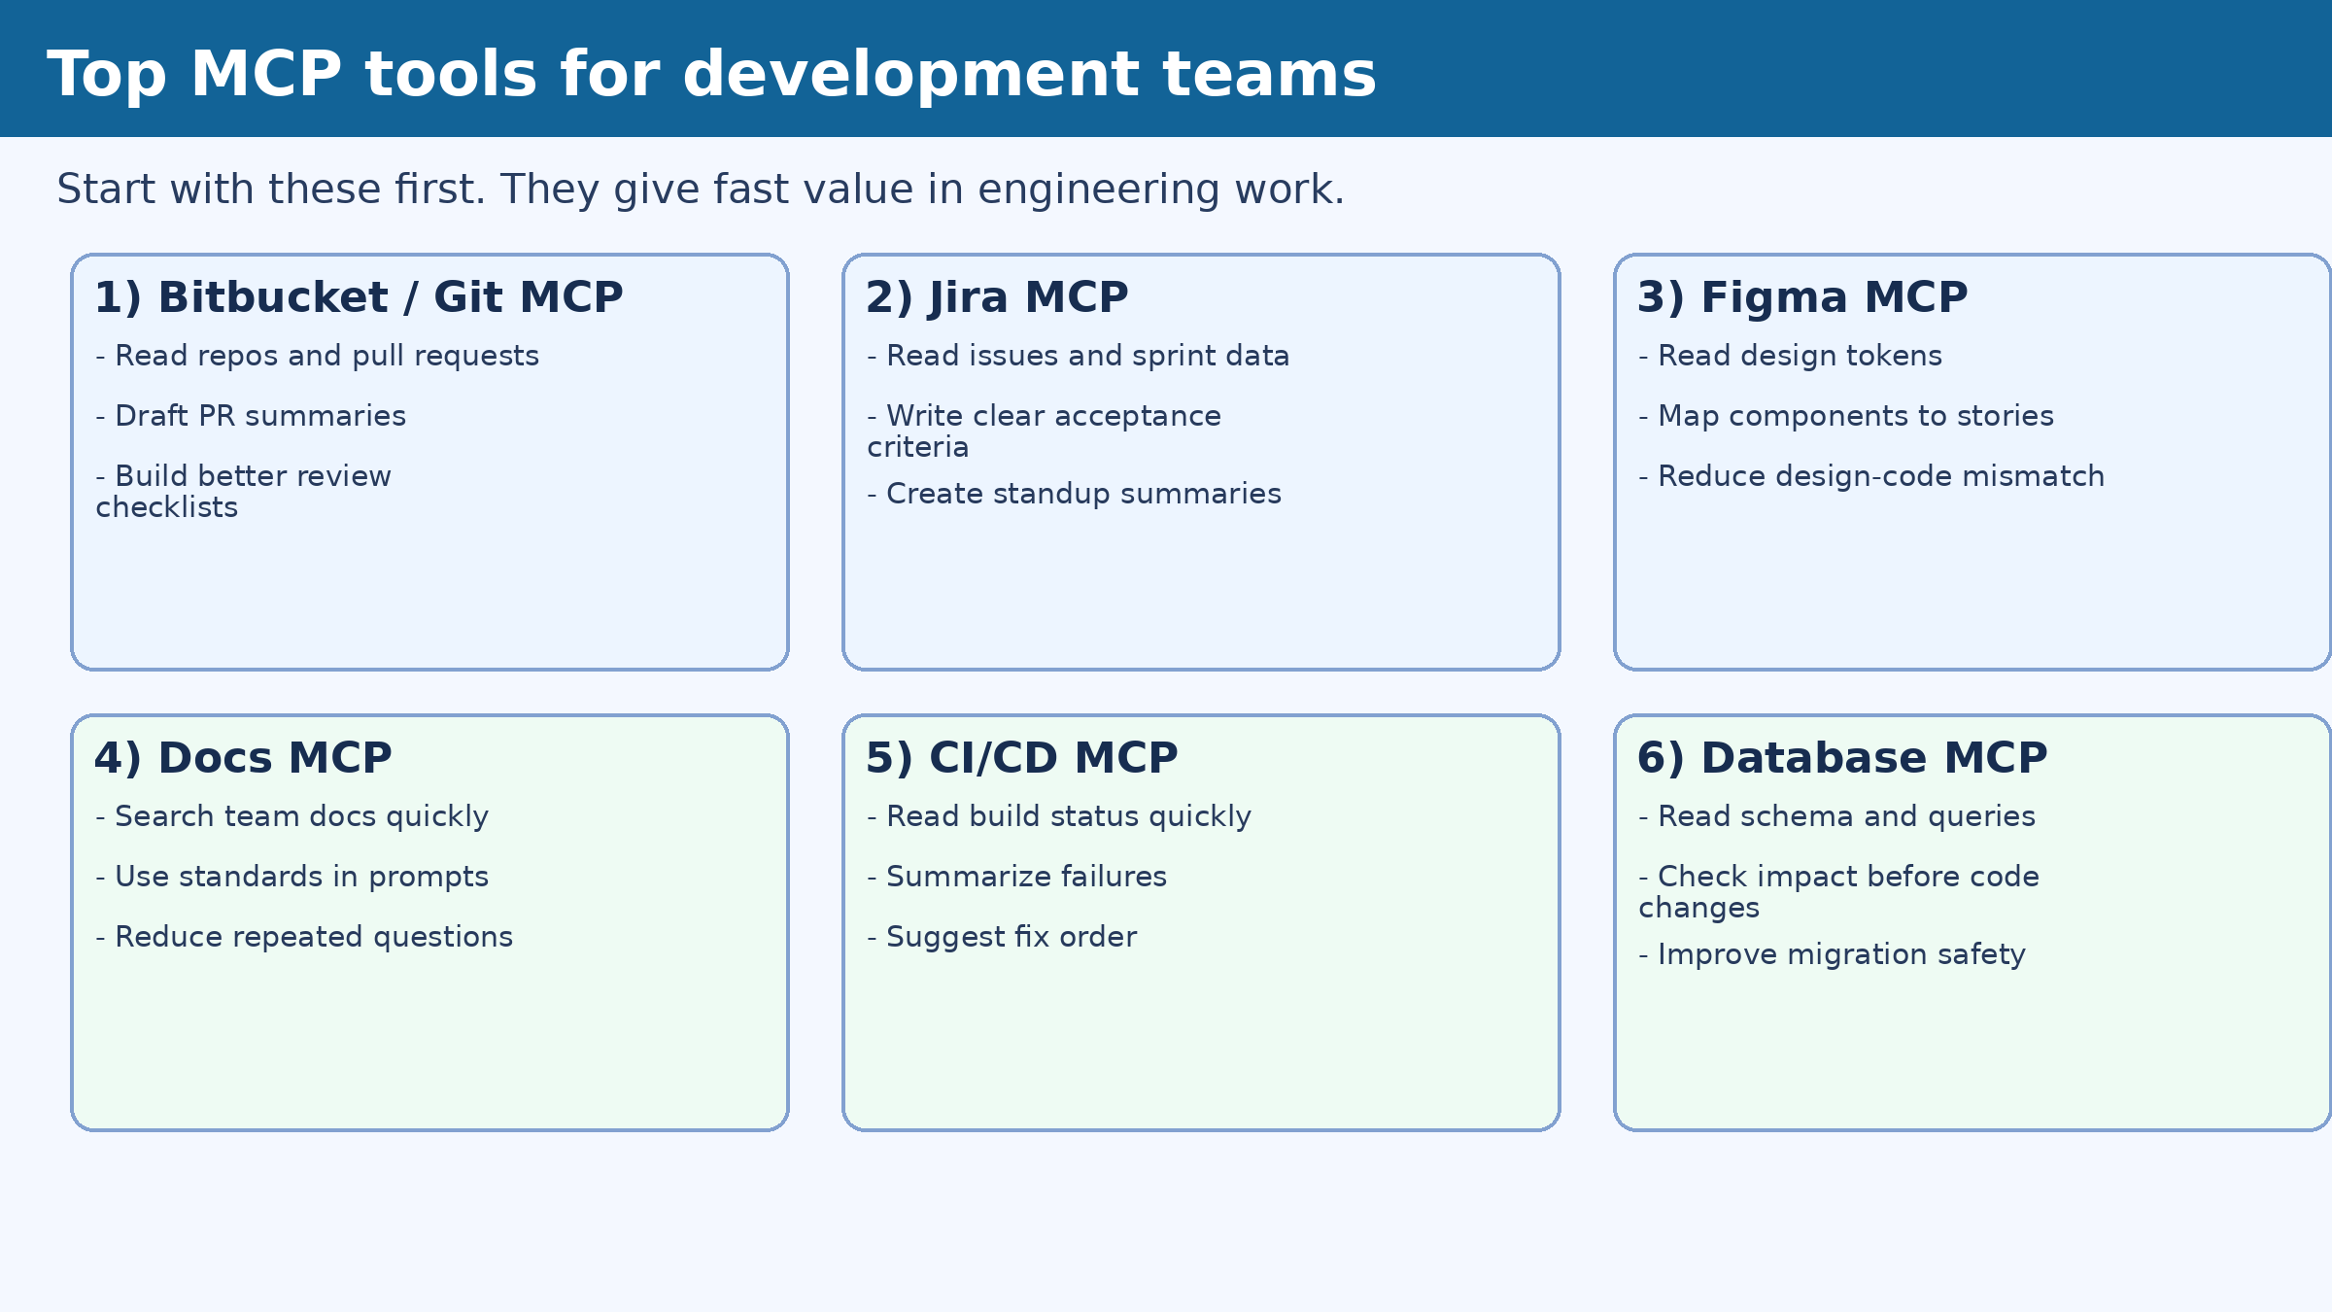
Top MCP tools that help development teams most
Pick these first in your pilot:
  1) Bitbucket/Git MCP
  2) Jira MCP
  3) Figma MCP
  4) Docs MCP
  5) CI/CD MCP
  6) Database MCP

Slide 5
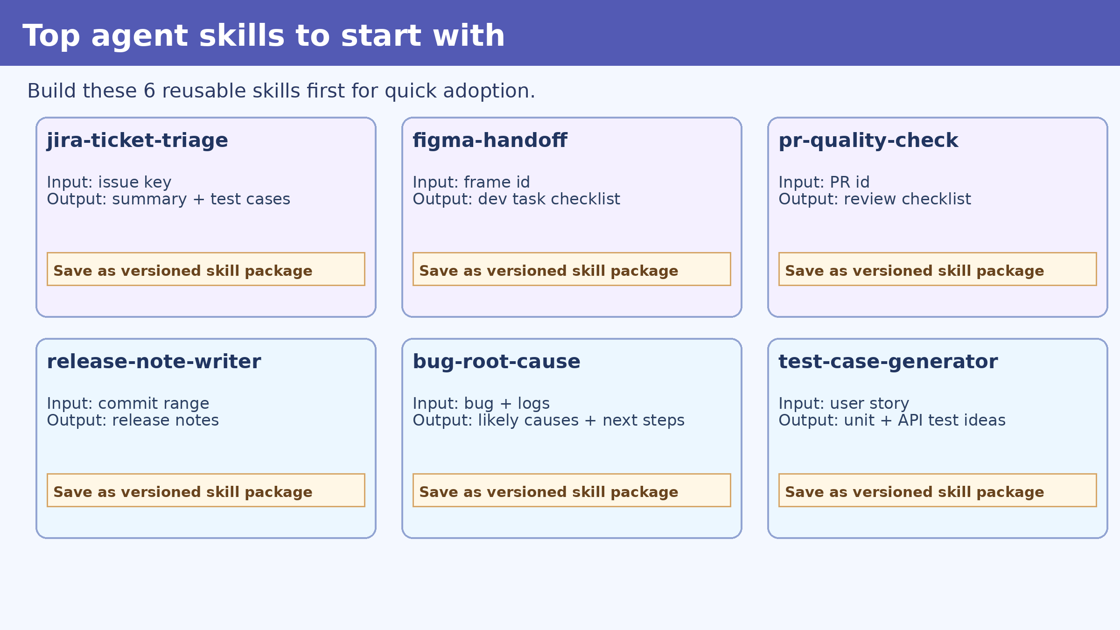
Top agent skills to create first
Build a small skill library in week 1:
  - jira-ticket-triage
  - figma-handoff
  - pr-quality-check
  - release-note-writer
  - bug-root-cause
  - test-case-generator

Slide 6
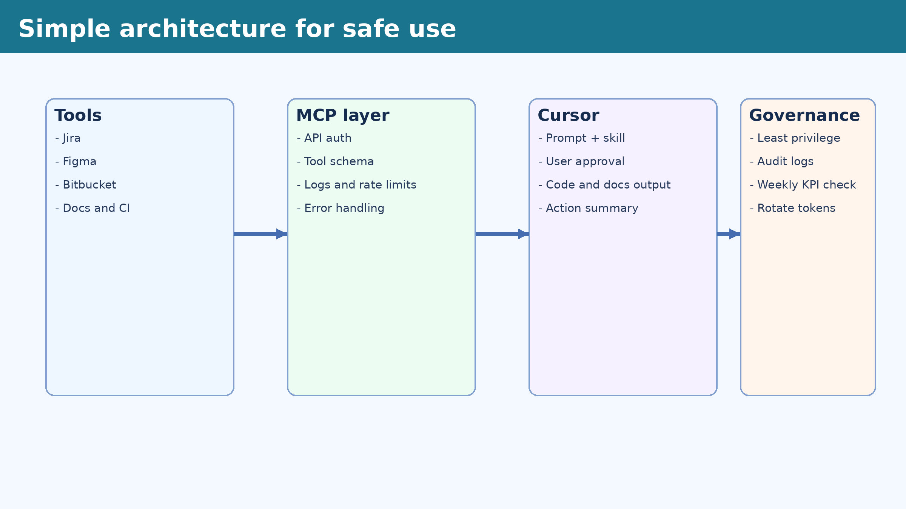
How the connection works (simple architecture)
Tools -> MCP layer -> Cursor -> Governance
MCP gives one common interface for each tool.
Cursor uses prompts + skills to call those tools.
Team rules control access, approvals, and logs.

Slide 7
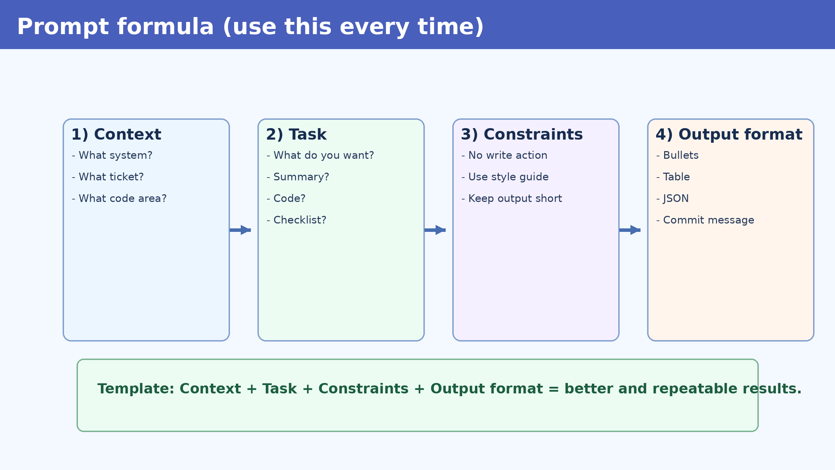
Prompt formula cheat sheet
Use this every time:
  Context: where and what
  Task: what output you need
  Constraints: limits and rules
  Output format: bullet/table/json

Slide 8
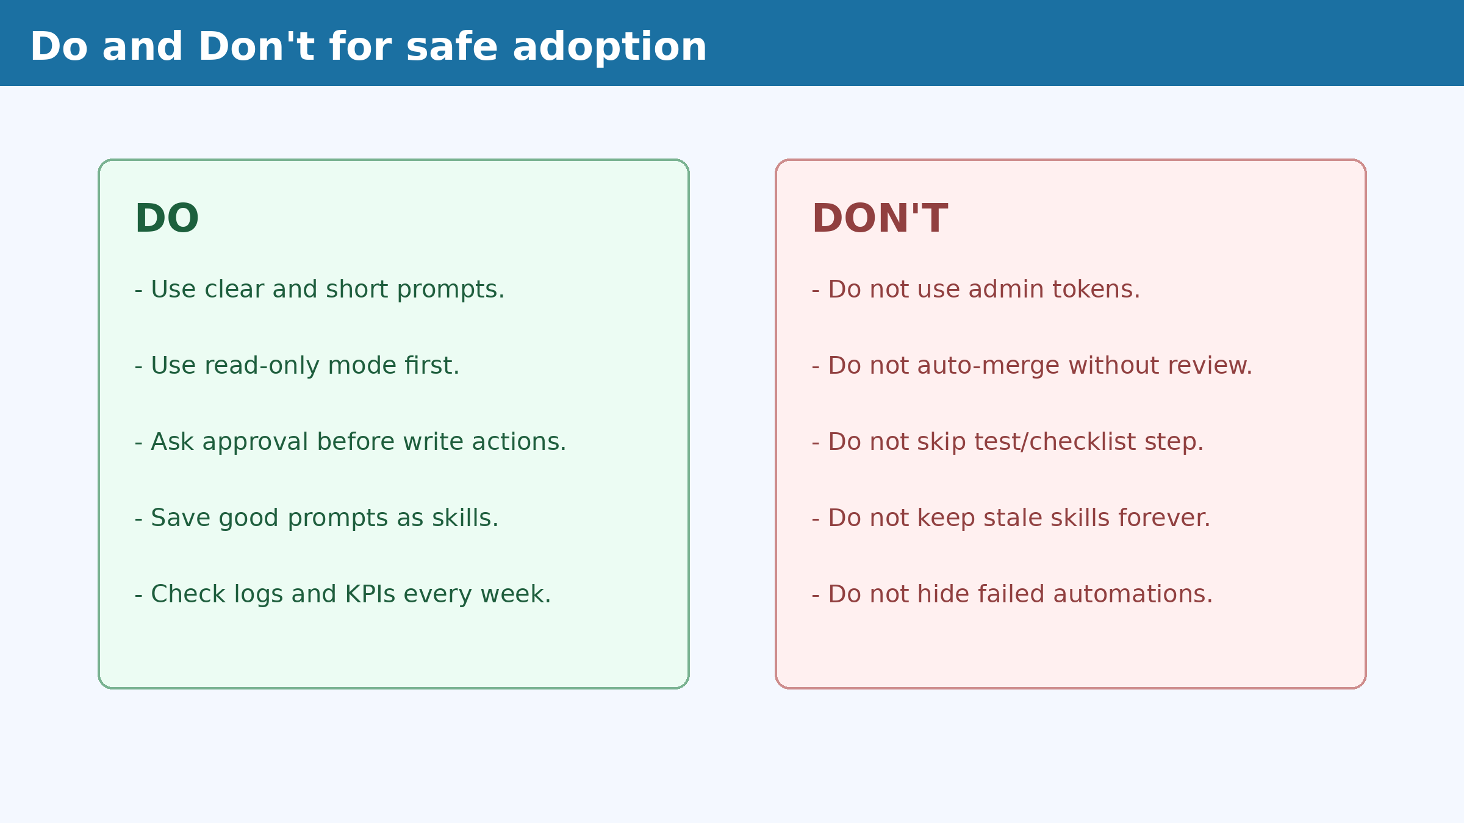
Do and Don't (simple rules)
Use this for new team members:
  Do: read-only first, then safe write with approval
  Do: save good prompts as skills
  Don't: use admin tokens
  Don't: auto-merge without review

Slide 9
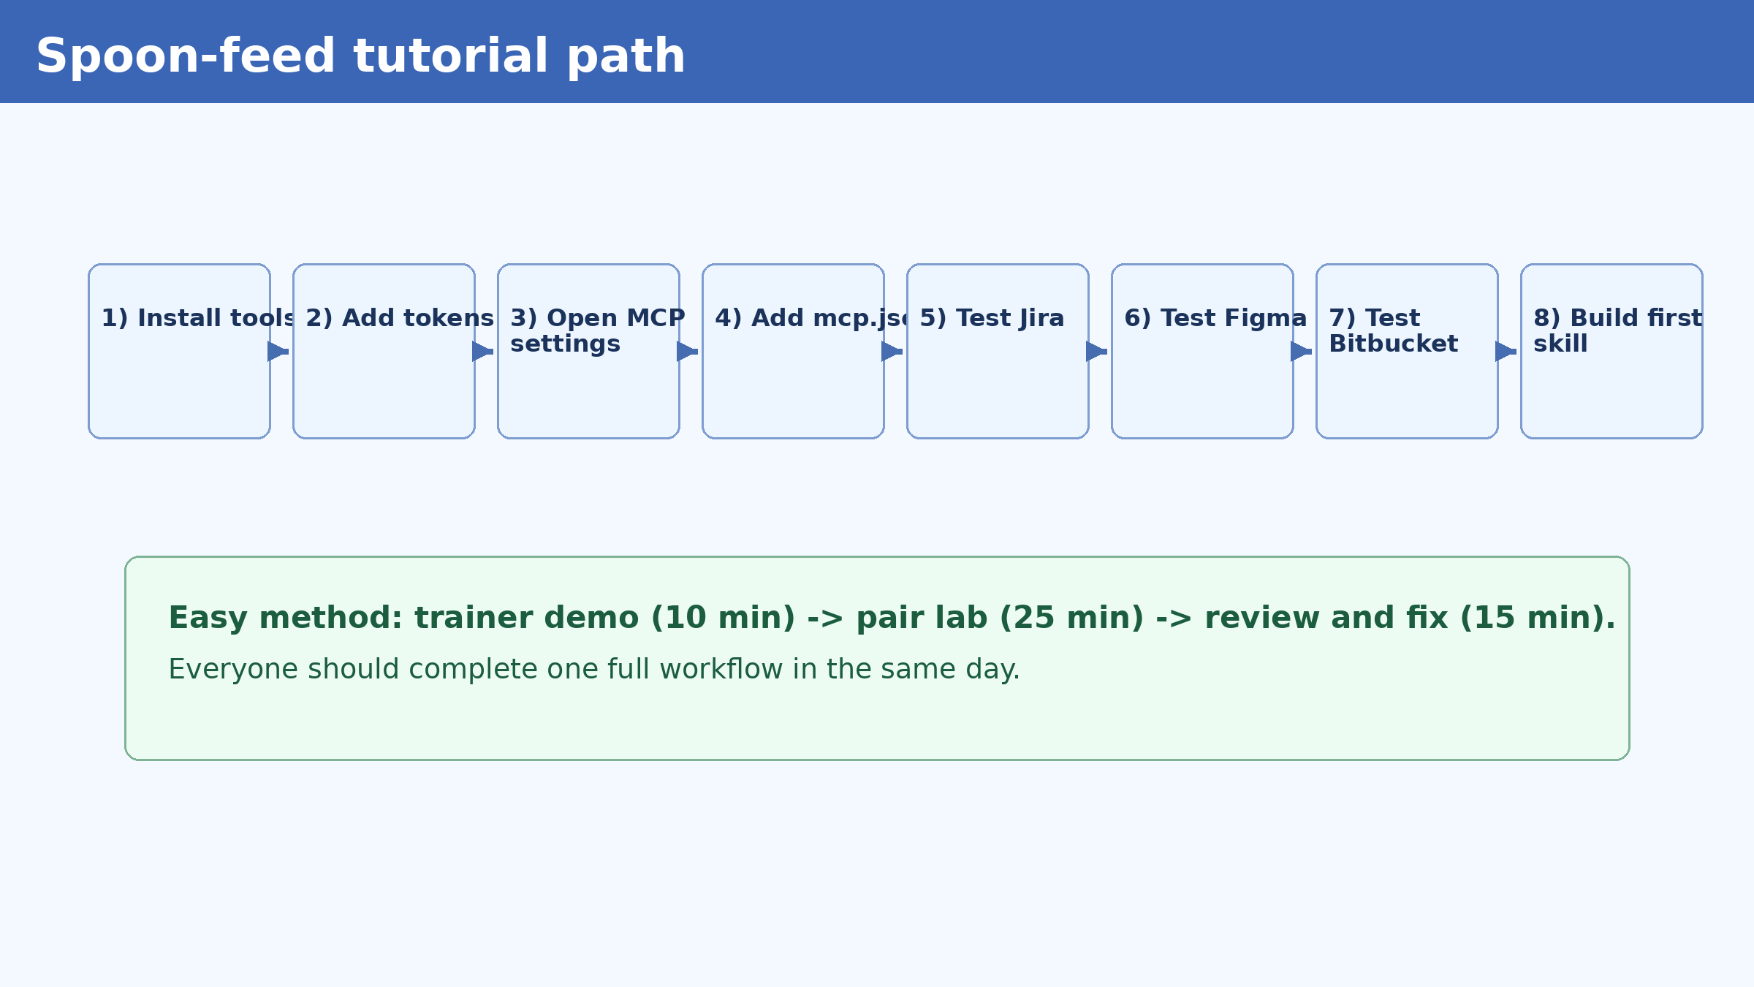
Tutorial map: follow these 8 steps
Trainer flow for one session (about 90 minutes):
  10 min demo + 25 min pair lab + 15 min review
  Repeat for Jira, Figma, and Bitbucket
  End with one reusable skill per developer

Slide 10
Step 1: Prepare local machine (copy and run)
mkdir -p ~/cursor-mcp-training/{servers,skills,logs} && cd ~/cursor-mcp-training
python3 -m venv .venv
source .venv/bin/activate
python -m pip install --upgrade pip
pip install mcp httpx python-dotenv pyyaml
python --version && node --version && npm --version
sudo apt-get update && sudo apt-get install -y jq
# Create environment file for tokens
cat > .env <<'EOF'
JIRA_BASE_URL=https://your-company.atlassian.net
JIRA_EMAIL=you@company.com
JIRA_API_TOKEN=<jira_token>
FIGMA_TOKEN=<figma_token>
BITBUCKET_WORKSPACE=<workspace>
BITBUCKET_USERNAME=<username>
BITBUCKET_APP_PASSWORD=<app_password>
EOF

Slide 11
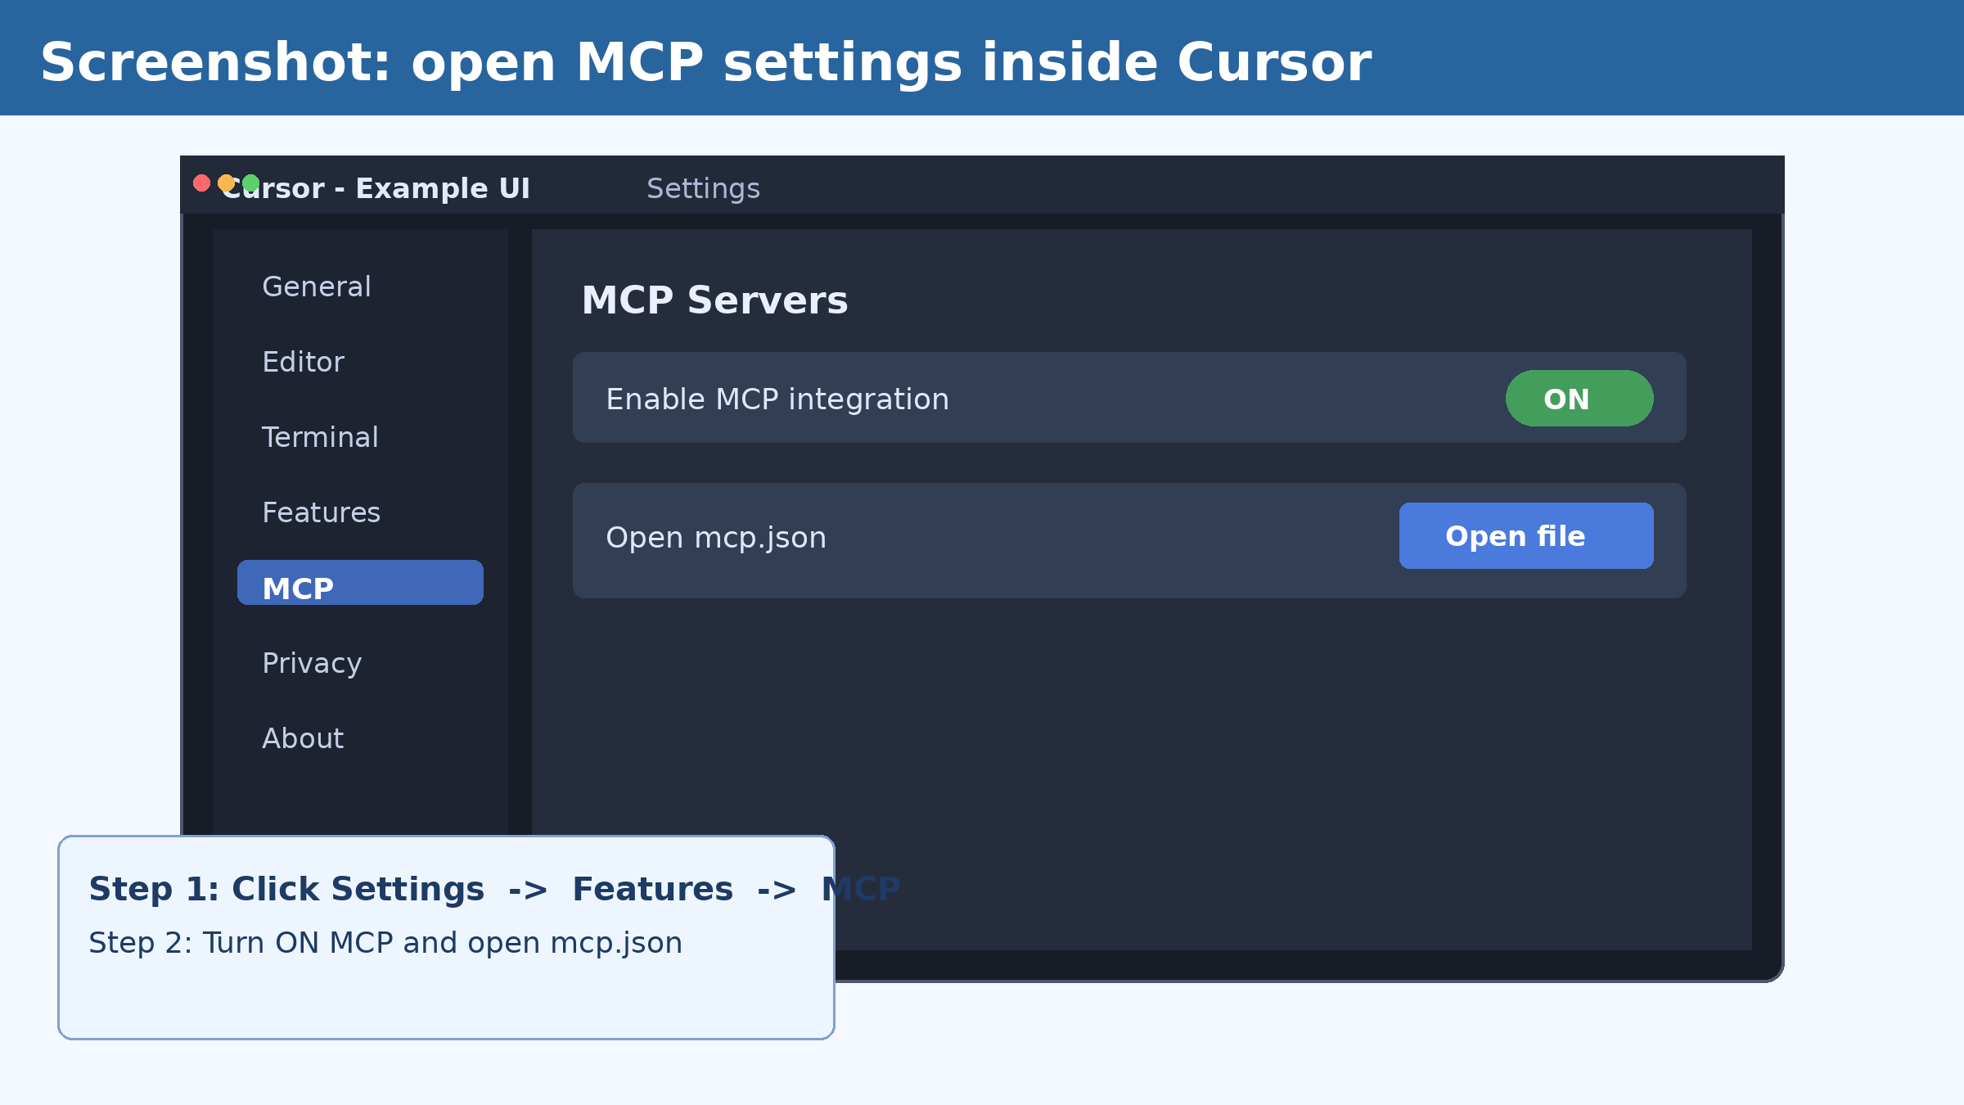
Step 2: Open Cursor settings and go to MCP
Click Settings in Cursor.
Open Features tab.
Open MCP section.
Turn MCP ON.
Click Open mcp.json.

Slide 12
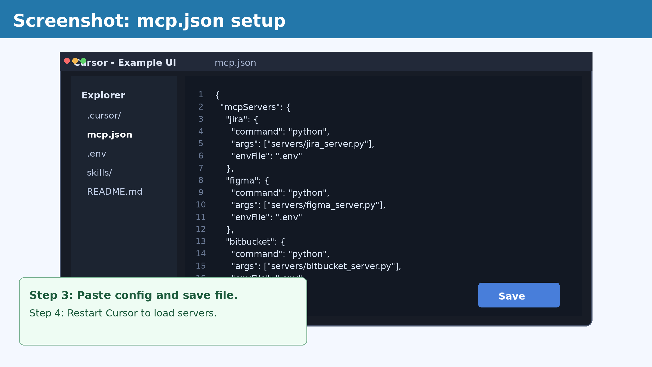
Step 3: Add mcp.json config in Cursor
Paste this config in .cursor/mcp.json:
Use your own server script paths.
Save file and restart Cursor.
{
"mcpServers": {
"jira": {"command":"python","args":["servers/jira_server.py"],"envFile":".env"},
"figma": {"command":"python","args":["servers/figma_server.py"],"envFile":".env"},
"bitbucket": {"command":"python","args":["servers/bitbucket_server.py"],"envFile":".env"}
}
}

Slide 13
Step 4: Add tokens in .env file
cat > .env <<'EOF'
JIRA_BASE_URL=https://your-company.atlassian.net
JIRA_EMAIL=you@company.com
JIRA_API_TOKEN=<jira_token>
FIGMA_TOKEN=<figma_token>
BITBUCKET_WORKSPACE=<workspace>
BITBUCKET_USERNAME=<username>
BITBUCKET_APP_PASSWORD=<app_password>
EOF
# Keep .env out of git
echo '.env' >> .gitignore
Important:
  Never commit .env to repository.
  Rotate tokens every 90 days.

Slide 14
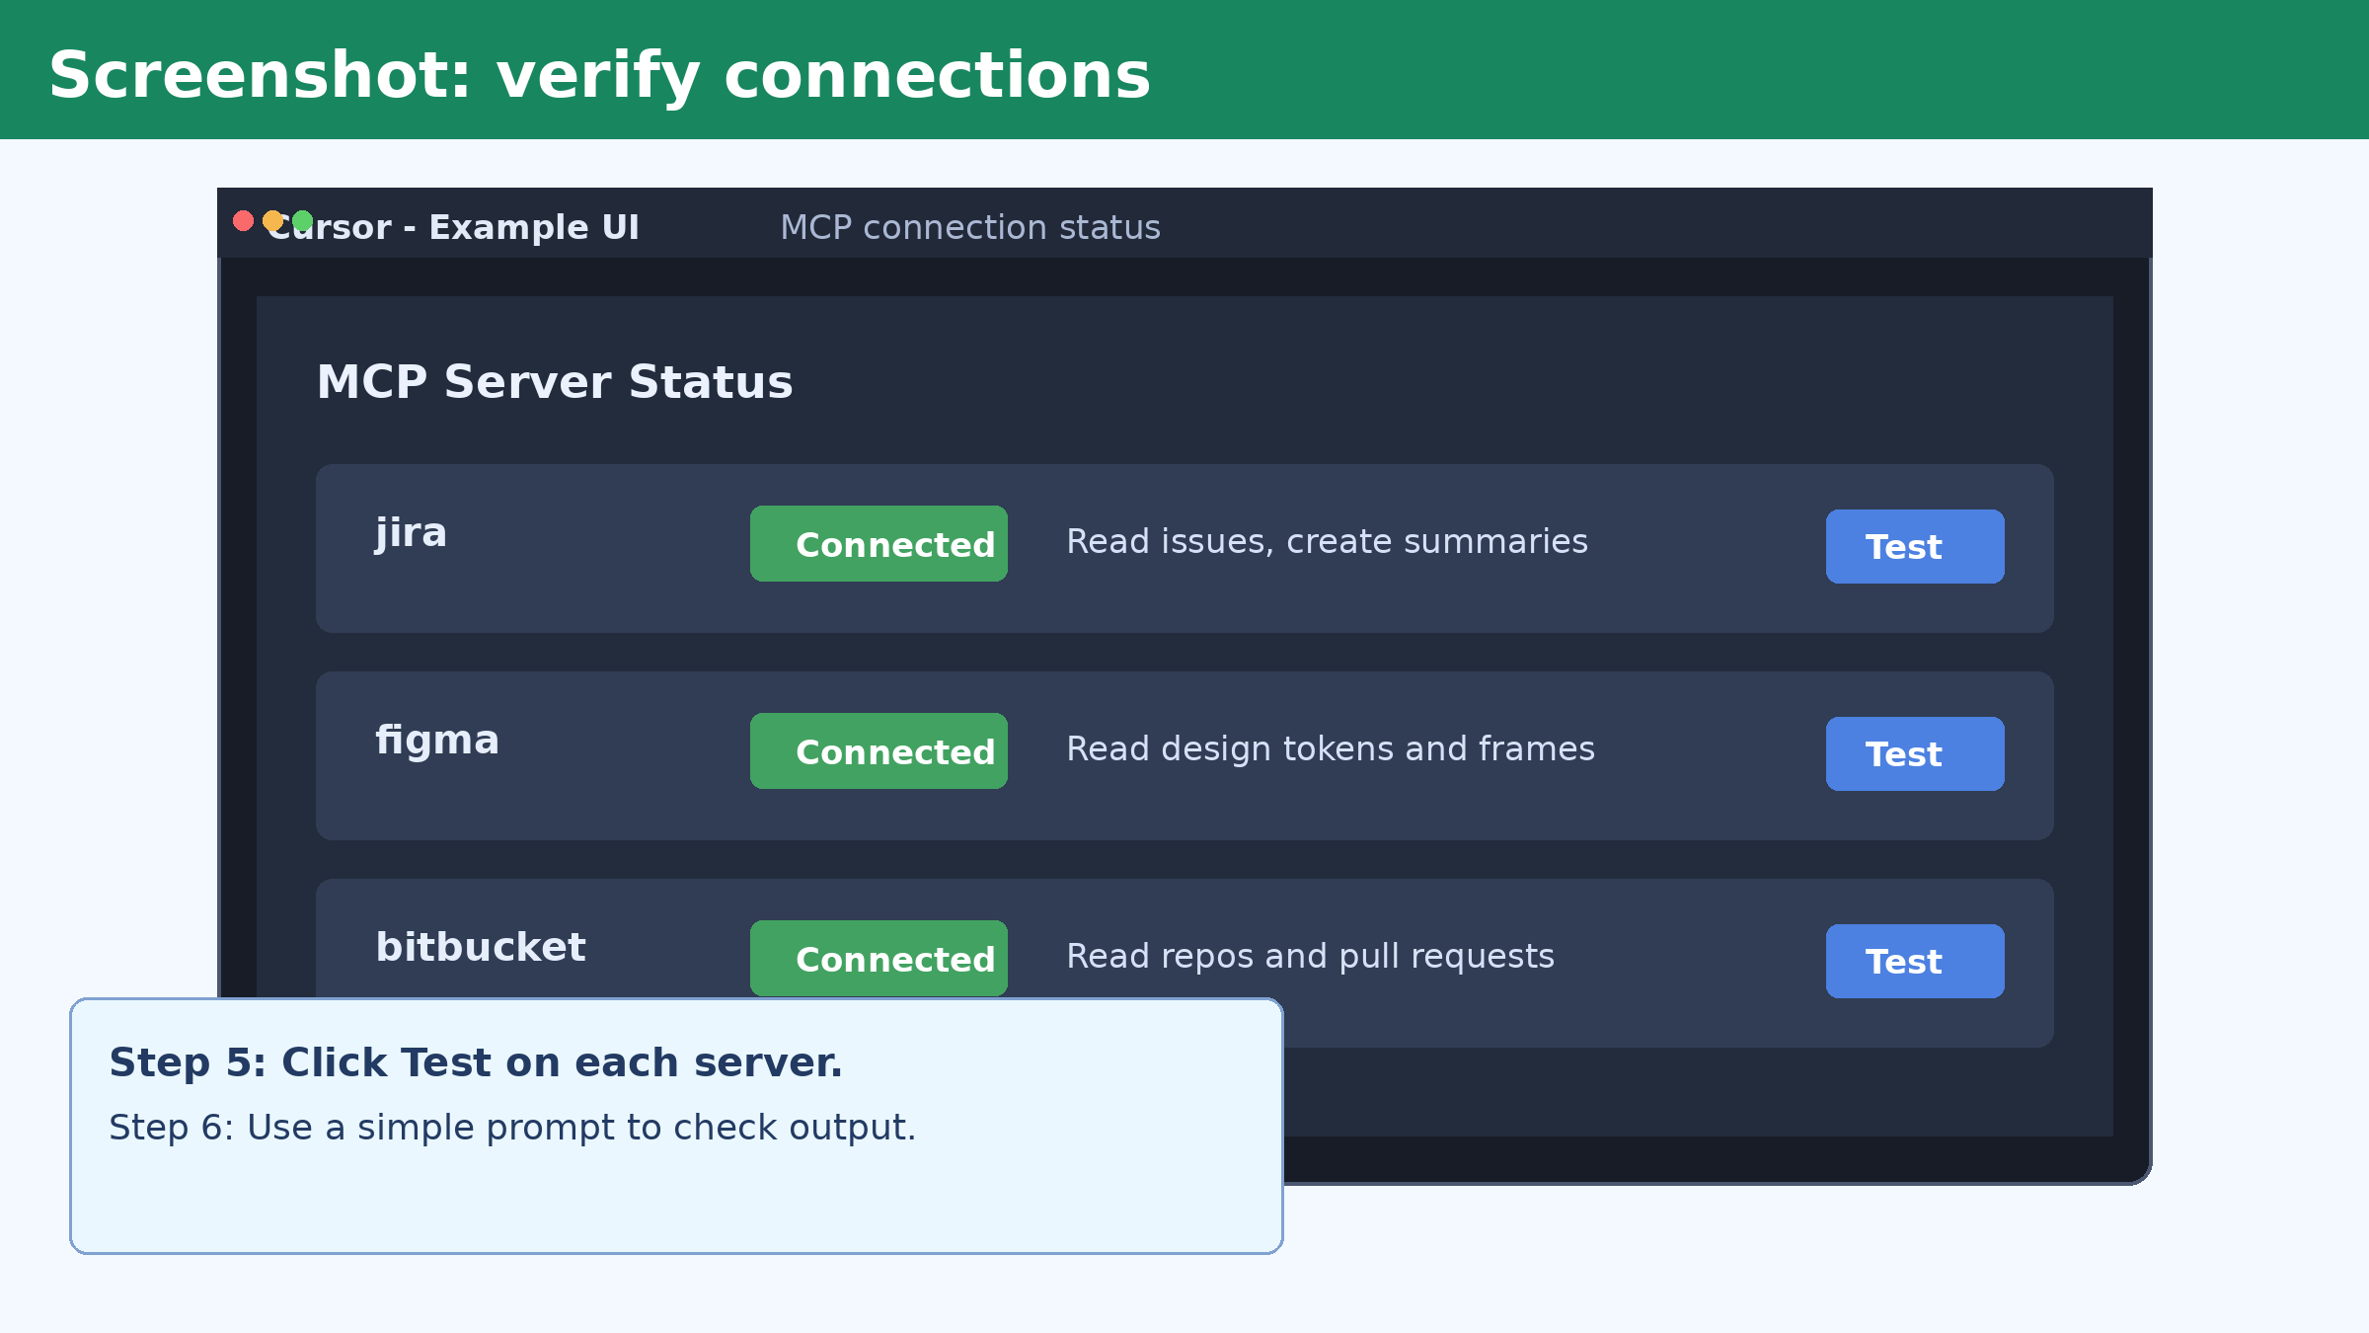
Step 5: Test Jira connection
Run test command:
  curl -s -u "$JIRA_EMAIL:$JIRA_API_TOKEN" "$JIRA_BASE_URL/rest/api/3/myself" | jq '.displayName'
Then ask in Cursor:
  "Using Jira MCP, summarize PROJ-101 and draft acceptance criteria."

Slide 15
Step 6: Test Figma connection
source .venv/bin/activate && source .env
export FIGMA_FILE_KEY=<file_key>
curl -s -H "X-Figma-Token: $FIGMA_TOKEN" "https://api.figma.com/v1/files/$FIGMA_FILE_KEY" | jq '.name'
# Prompt in Cursor
Using Figma MCP, extract design tokens and map components to frontend stories.

Slide 16
Step 7: Test Bitbucket connection
source .venv/bin/activate && source .env
curl -s -u "$BITBUCKET_USERNAME:$BITBUCKET_APP_PASSWORD" \
"https://api.bitbucket.org/2.0/repositories/$BITBUCKET_WORKSPACE" | jq '.values[0].full_name'
# Prompt in Cursor
Using Bitbucket MCP, summarize PR #123 and create review checklist.

Slide 17
Step 8: Build your first agent skill
mkdir -p skills/jira-ticket-triage && cd skills/jira-ticket-triage
cat > skill.yaml <<'YAML'
name: jira-ticket-triage
version: 1.0.0
description: Triage issue and return action plan
tools: [jira.search, jira.get_issue]
YAML
cat > prompts.md <<'MD'
# Inputs: issue_key, team_context, done_definition
# Output: summary, acceptance criteria, test cases
MD
echo '[{"input":"PROJ-101","assert_contains":["Summary","Acceptance"]}]' > tests.json

Slide 18
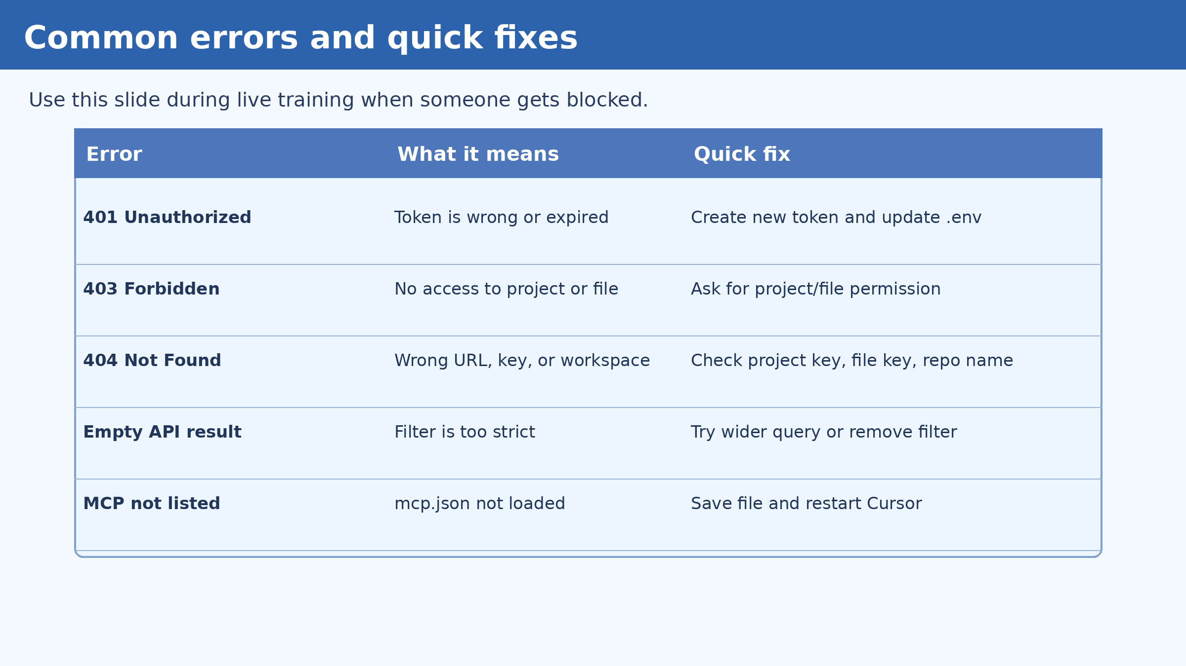
Common errors and fixes (use in live training)
Most common issues:
  401: token expired or wrong
  403: missing project/file permission
  404: wrong key or URL
  MCP not showing: restart Cursor after save

Slide 19
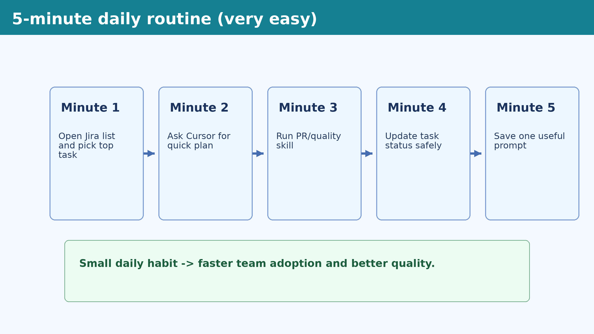
5-minute daily routine (adoption booster)
Do this daily:
  Minute 1: pick top task
  Minute 2: ask Cursor for plan
  Minute 3: run quality skill
  Minute 4: update status
  Minute 5: save one useful prompt

Slide 20
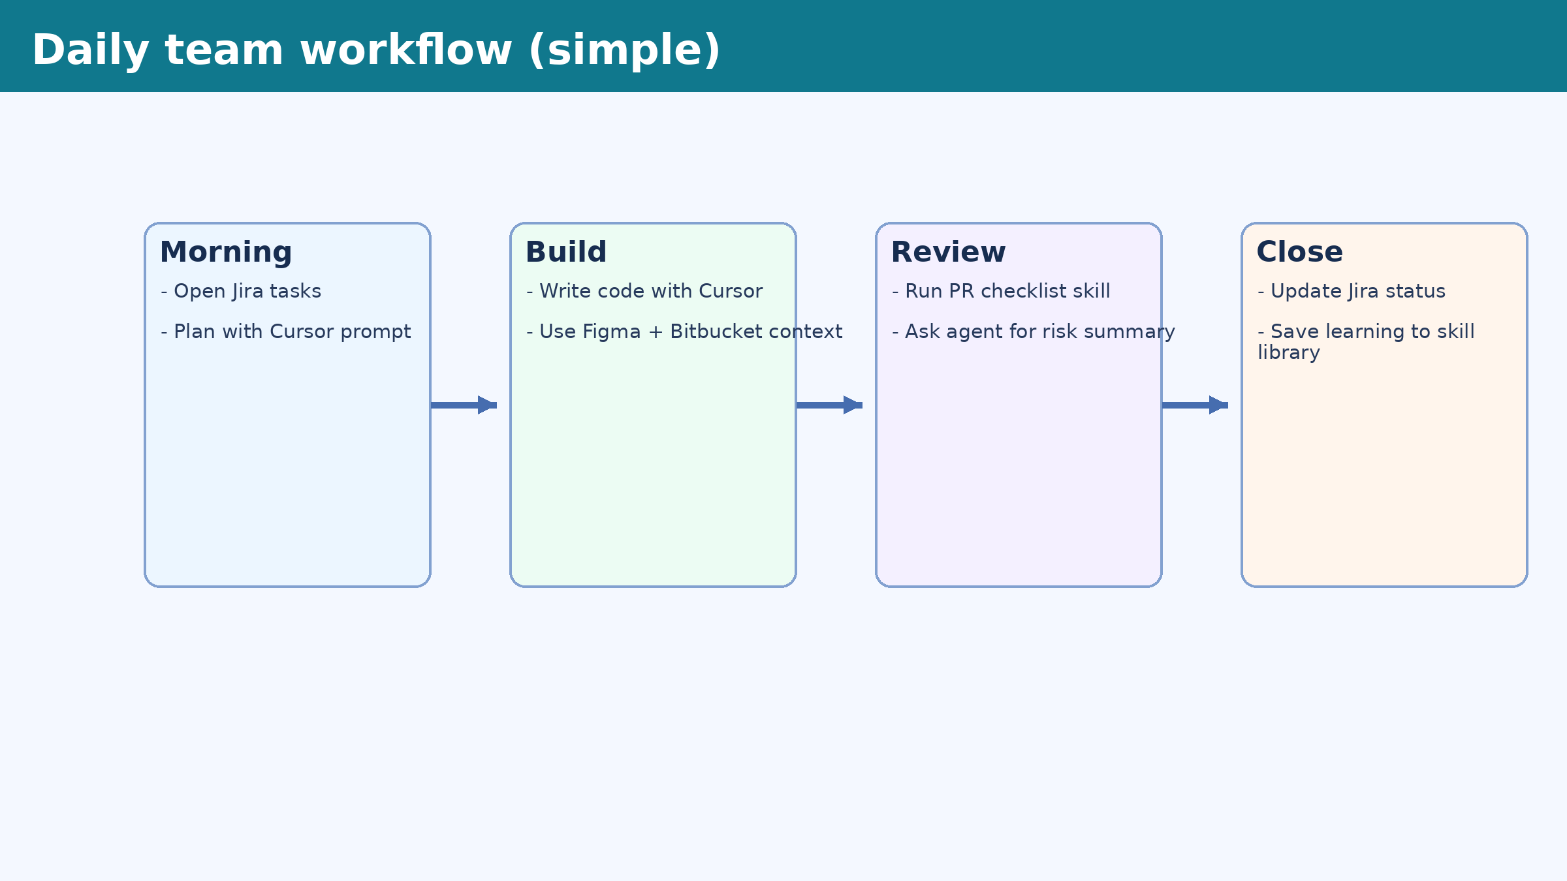
Daily workflow your team can follow
Keep it simple:
  Morning plan -> Build -> Review -> Close
  Save good prompts as team skills
  Do weekly quality review

Slide 21
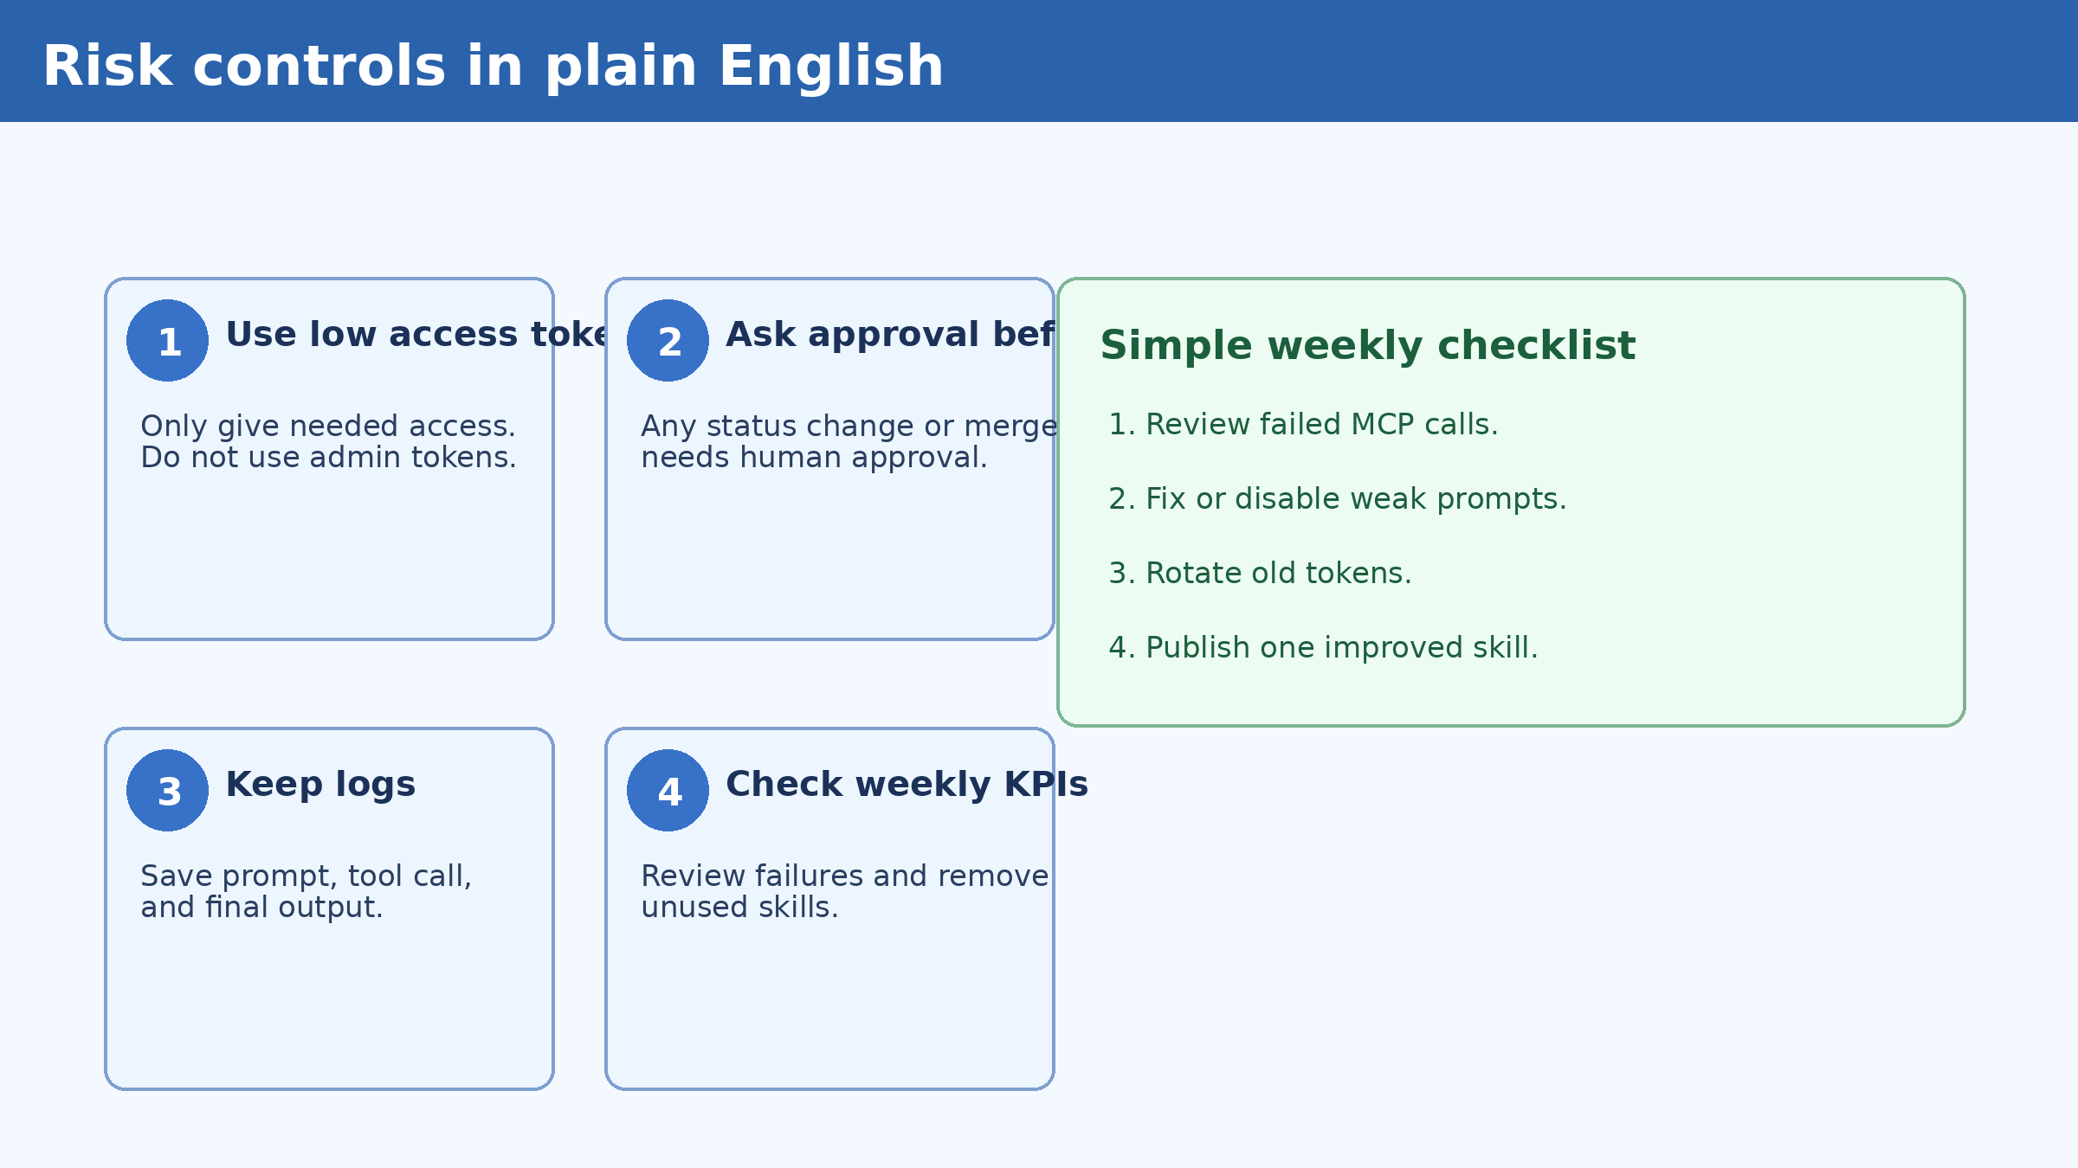
Risk Management and Governance Controls (simple)
Four must-have controls:
  1) Low-access tokens
  2) Human approval for write actions
  3) Audit logs for every automation
  4) Weekly KPI and failure review

Slide 22
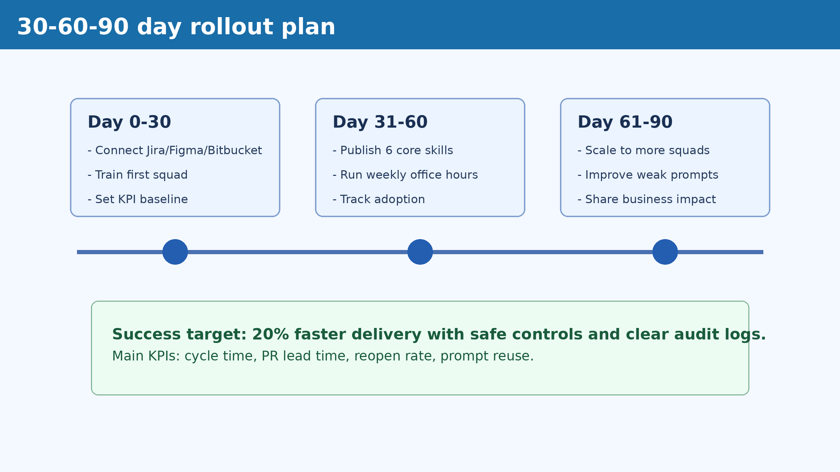
30-60-90 day adoption roadmap
0-30 days: connect tools and train first squad.
31-60 days: publish top skills and run office hours.
61-90 days: scale to more teams and report KPI impact.
Target: 20% faster delivery with safe controls.

Slide 23
Final checklist for trainer and team
Before session:
  Tokens ready and mcp.json template prepared
  Pilot repo, Jira project, and Figma file selected
During session:
  Everyone completes one end-to-end workflow
  Everyone creates at least one simple skill
After session:
  Review KPIs and improve weak prompts weekly
Q&A

