Slide 1
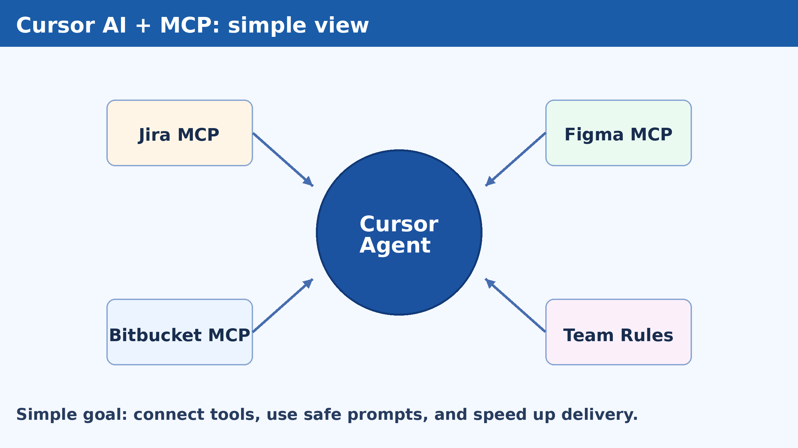
Trainer Deck (45 min): Cursor AI + MCP Enablement
Facilitator version with talking points, pacing, and troubleshooting cues.
Audience: developers and team leads
Goal: connect tools, run safe workflows, publish first skills
Format: short demo + labs + troubleshooting
Updated: 2026-02-10

Slide 2
45-minute trainer run-of-show
0-5 min: explain MCP in simple terms
5-12 min: show Top MCP and Top Skills
12-22 min: live setup in Cursor settings
22-34 min: Jira/Figma/Bitbucket connection tests
34-40 min: build one simple agent skill
40-45 min: common errors, Q&A, next steps

Slide 3
What to teach first (order matters)
1) Top MCP tools
2) Top agent skills
3) Prompt formula
4) Do/Don't safe rules
5) Setup steps and command practice
6) Common errors and quick fixes

Slide 4
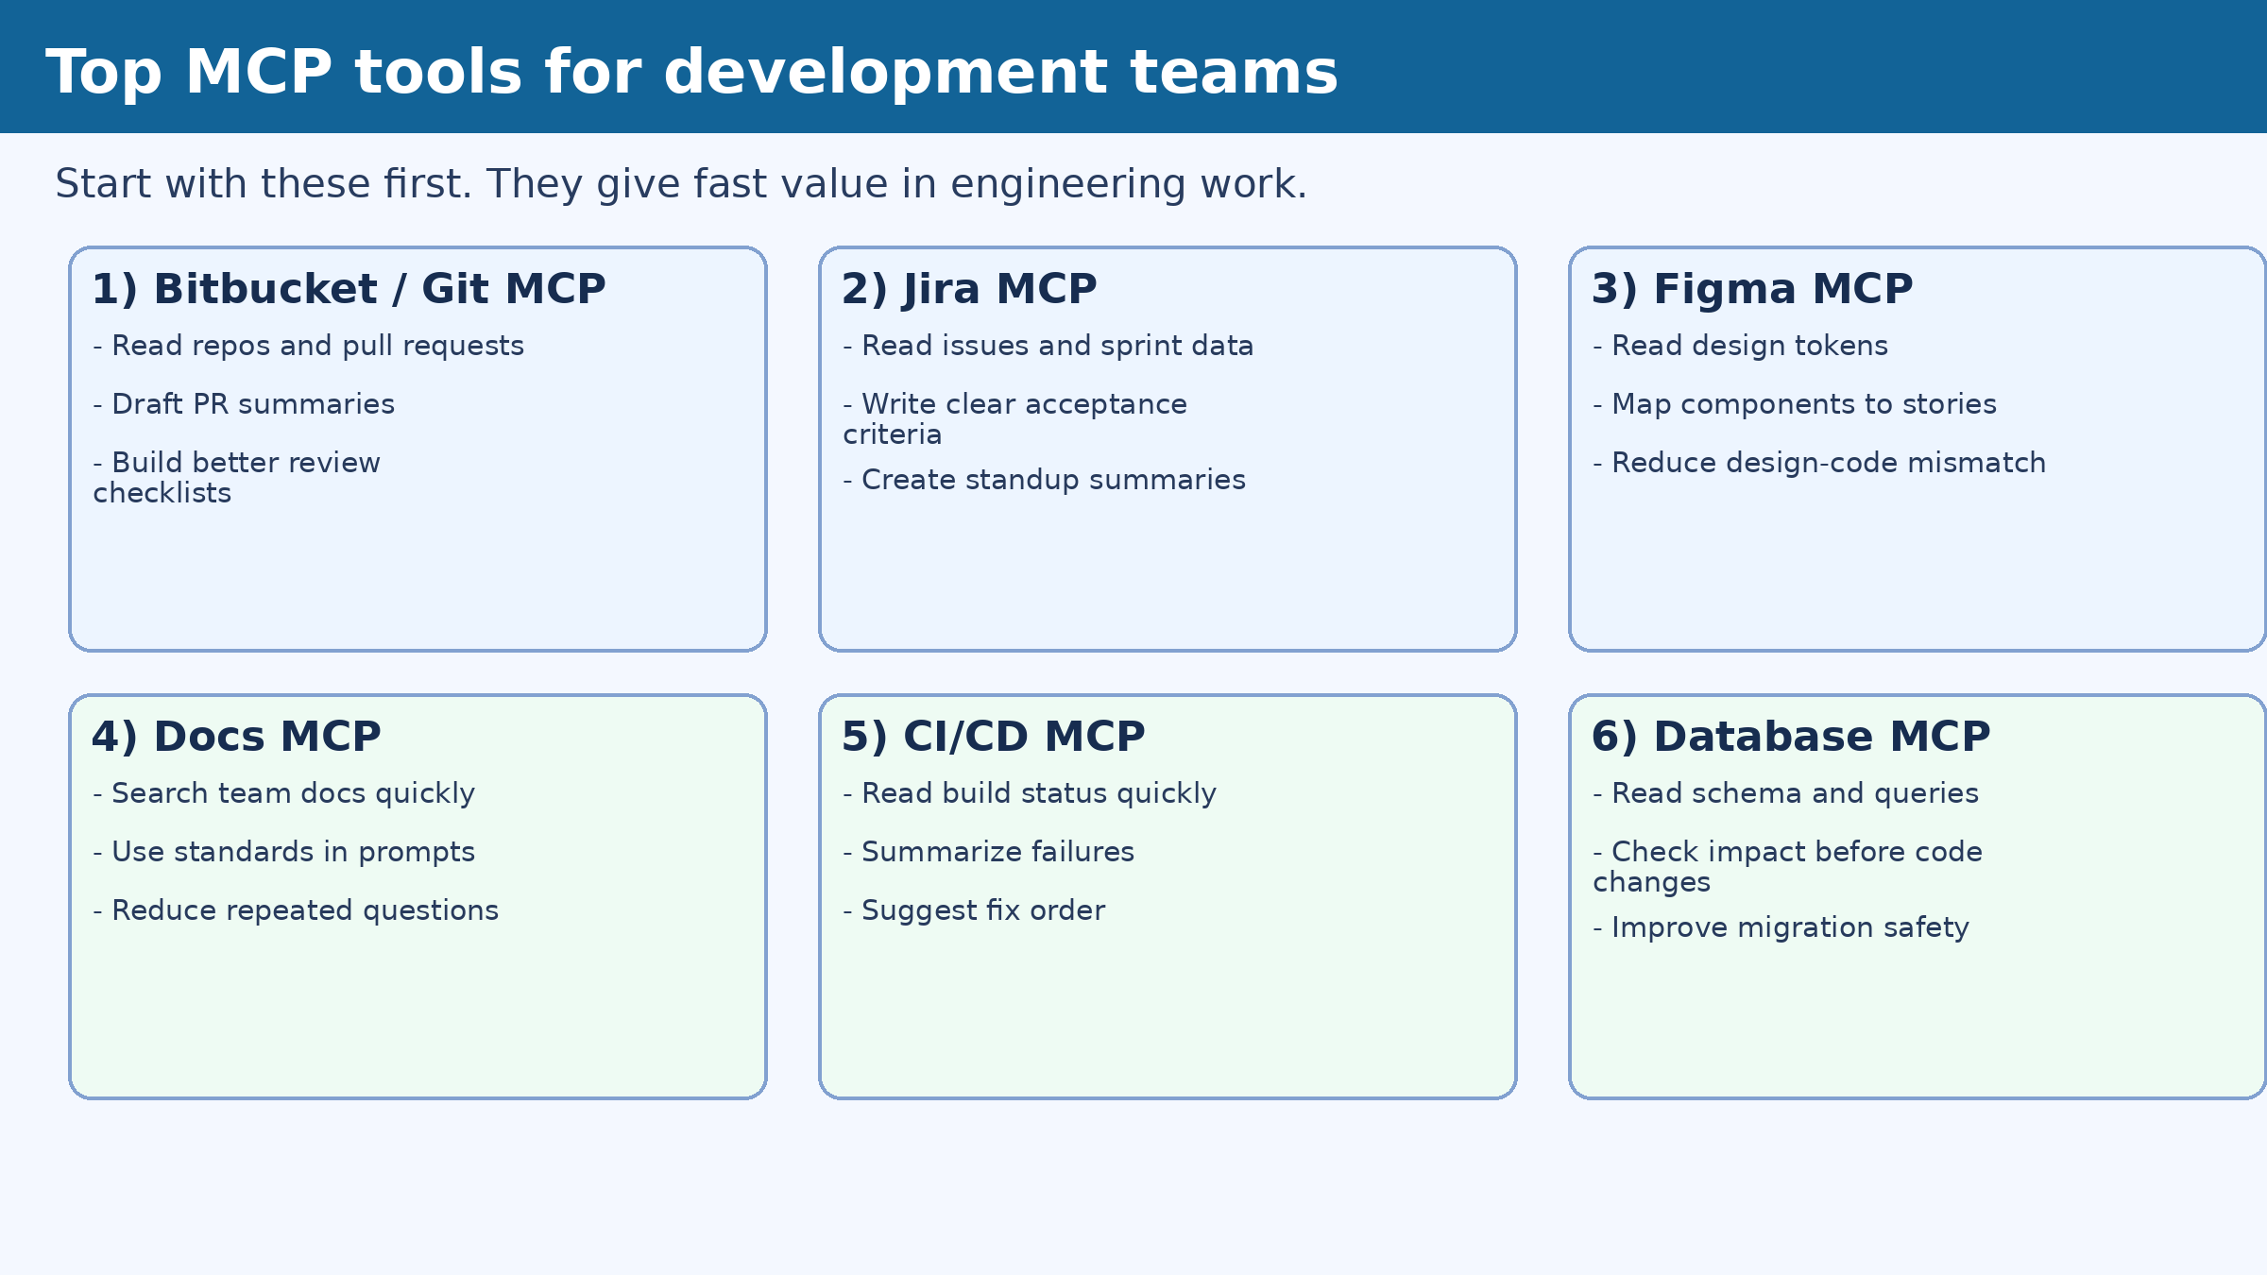
Top MCP tools for development teams
Use these in your pilot first:
  Bitbucket/Git, Jira, Figma
  Docs MCP, CI/CD MCP, Database MCP
Reason: fast wins and clear ROI

Slide 5
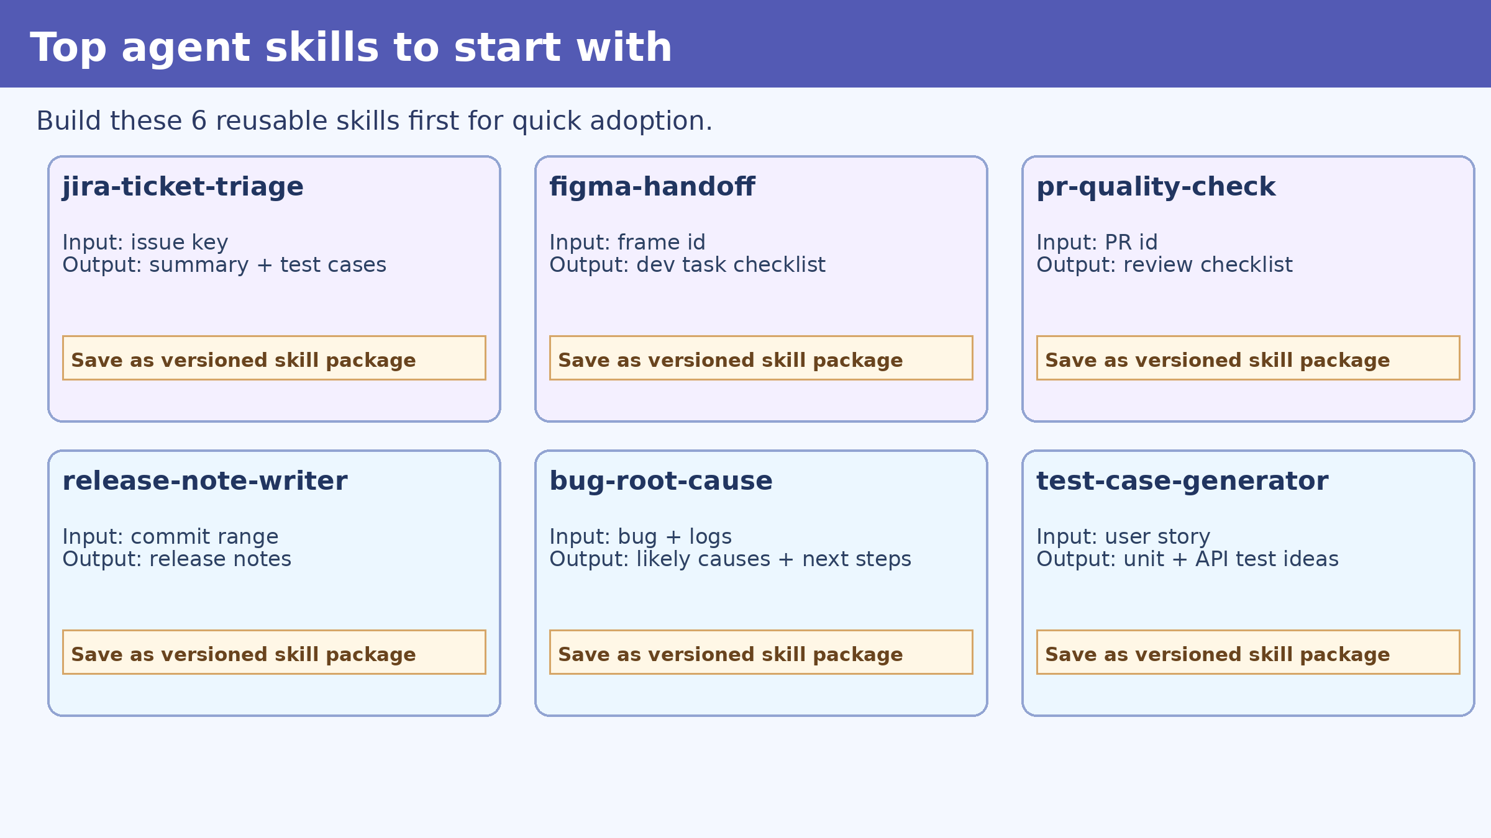
Top starter agent skills
Required first set:
  jira-ticket-triage
  figma-handoff
  pr-quality-check
  release-note-writer
  bug-root-cause
  test-case-generator

Slide 6
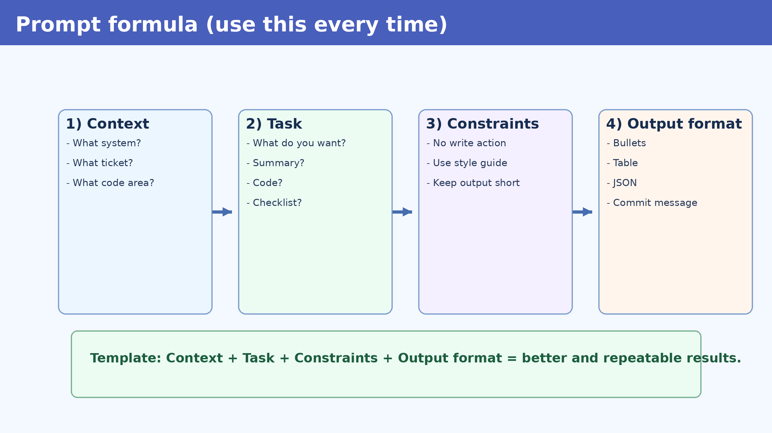
Prompt formula (repeat every demo)
Trainer talking line:
  "Context + Task + Constraints + Output format"
Ask participants to use this format in all labs.
This reduces confusion and bad outputs.

Slide 7
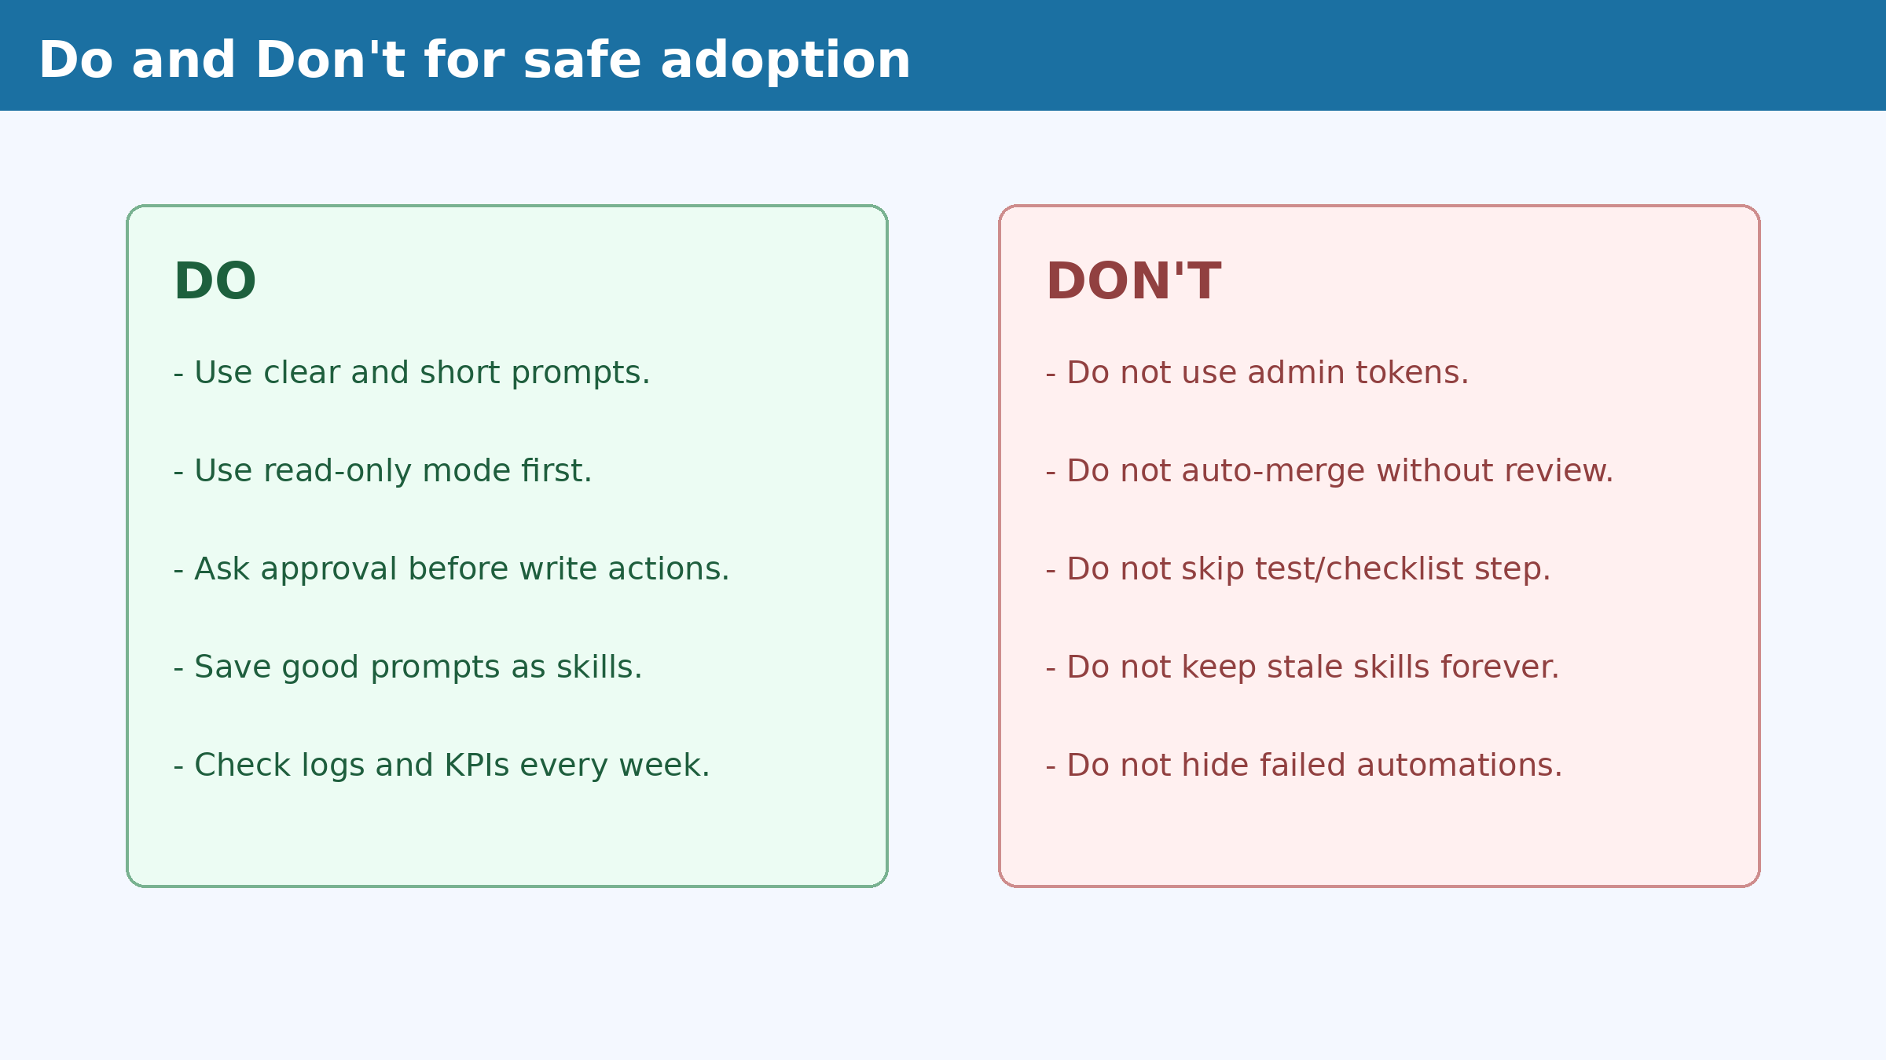
Do and Don't (safety first)
Call this out clearly before labs:
  Do: use read-only first
  Do: request approval before write actions
  Don't: use admin tokens
  Don't: skip review/checklist

Slide 8
Lab setup commands (copy and run)
mkdir -p ~/cursor-mcp-training/{servers,skills,logs} && cd ~/cursor-mcp-training
python3 -m venv .venv && source .venv/bin/activate
python -m pip install --upgrade pip
pip install mcp httpx python-dotenv pyyaml
cat > .env <<'EOF'
JIRA_BASE_URL=https://your-company.atlassian.net
JIRA_EMAIL=you@company.com
JIRA_API_TOKEN=<jira_token>
FIGMA_TOKEN=<figma_token>
BITBUCKET_WORKSPACE=<workspace>
BITBUCKET_USERNAME=<username>
BITBUCKET_APP_PASSWORD=<app_password>
EOF

Slide 9
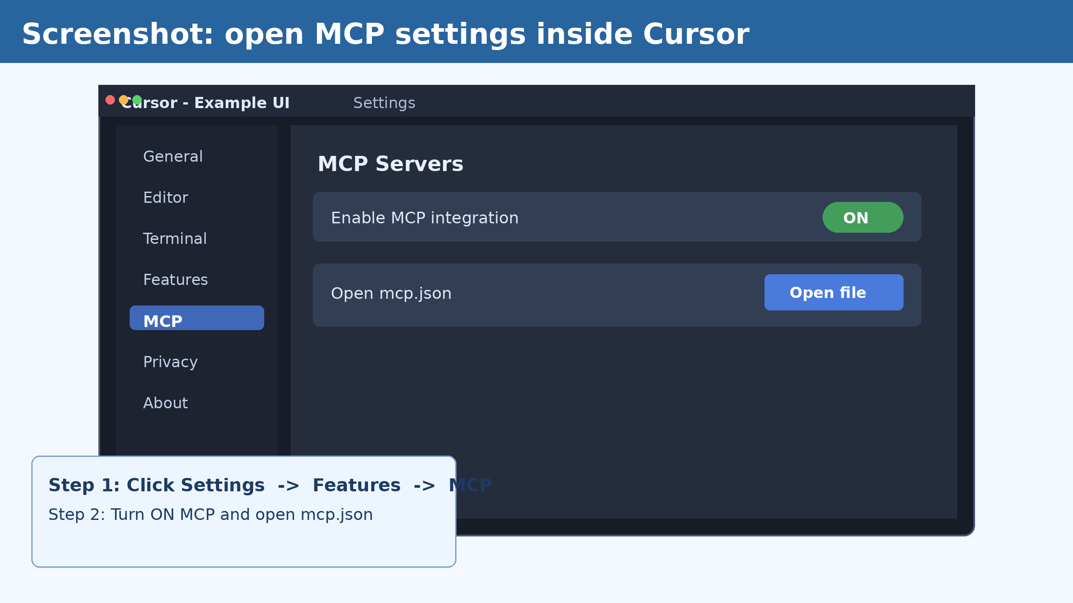
Live demo: Cursor settings -> MCP
Step 1: open Settings
Step 2: Features -> MCP
Step 3: switch MCP to ON
Step 4: open mcp.json

Slide 10
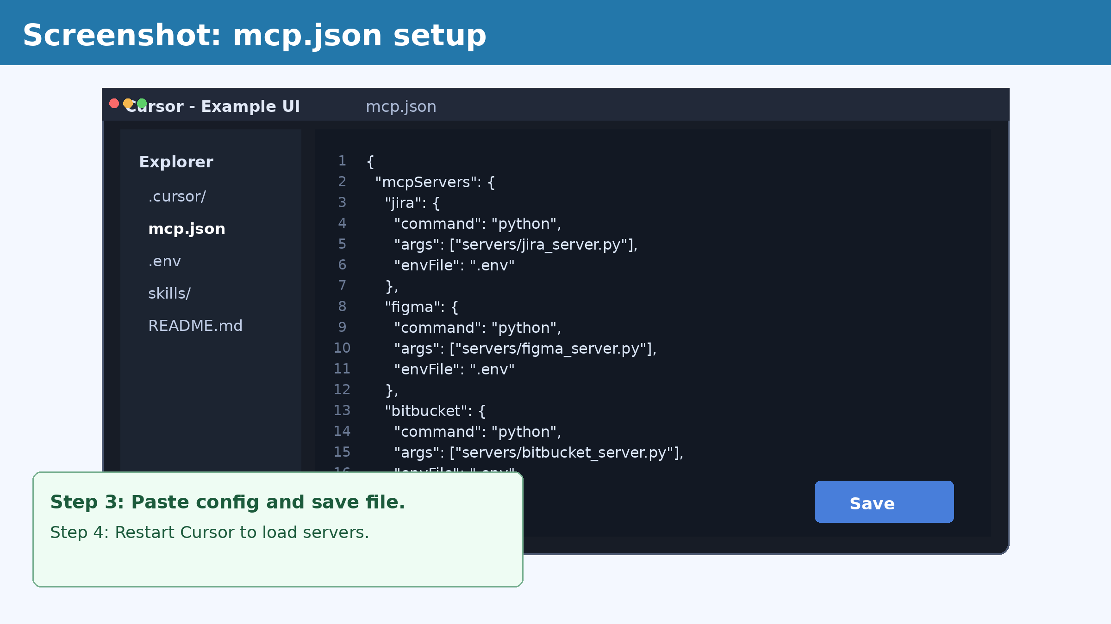
Live demo: mcp.json content
{
"mcpServers": {
"jira": {"command":"python","args":["servers/jira_server.py"],"envFile":".env"},
"figma": {"command":"python","args":["servers/figma_server.py"],"envFile":".env"},
"bitbucket": {"command":"python","args":["servers/bitbucket_server.py"],"envFile":".env"}
}
}
# Save and restart Cursor

Slide 11
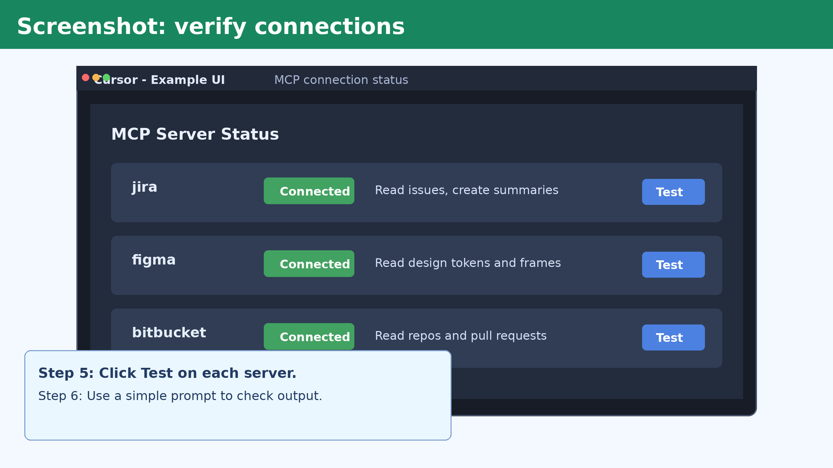
Live demo: test connections (Jira/Figma/Bitbucket)
# Jira
curl -s -u "$JIRA_EMAIL:$JIRA_API_TOKEN" "$JIRA_BASE_URL/rest/api/3/myself" | jq '.displayName'
# Figma
curl -s -H "X-Figma-Token: $FIGMA_TOKEN" "https://api.figma.com/v1/files/$FIGMA_FILE_KEY" | jq '.name'
# Bitbucket
curl -s -u "$BITBUCKET_USERNAME:$BITBUCKET_APP_PASSWORD" "https://api.bitbucket.org/2.0/repositories/$BITBUCKET_WORKSPACE" | jq '.values[0].full_name'

Slide 12
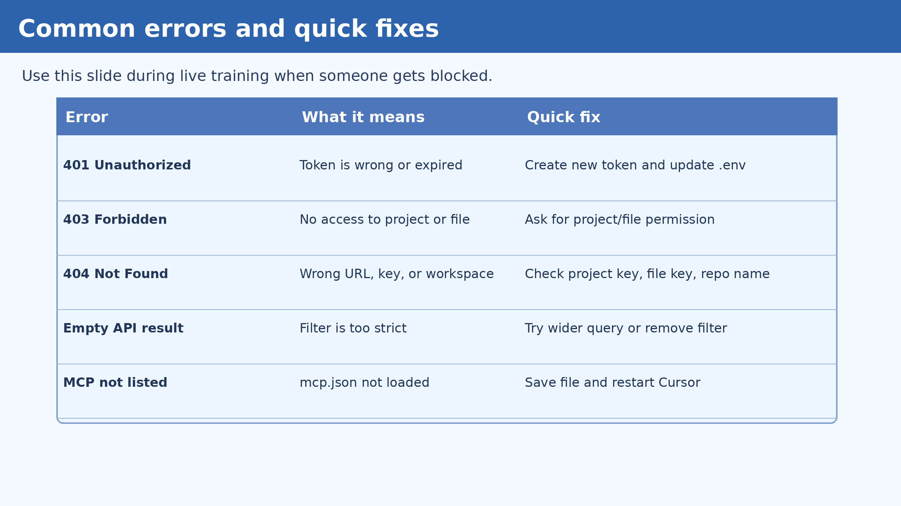
Live support slide: common errors and fixes
Use this during Q&A:
  401 -> token issue
  403 -> permission issue
  404 -> wrong key/url
  MCP not listed -> restart Cursor

Slide 13
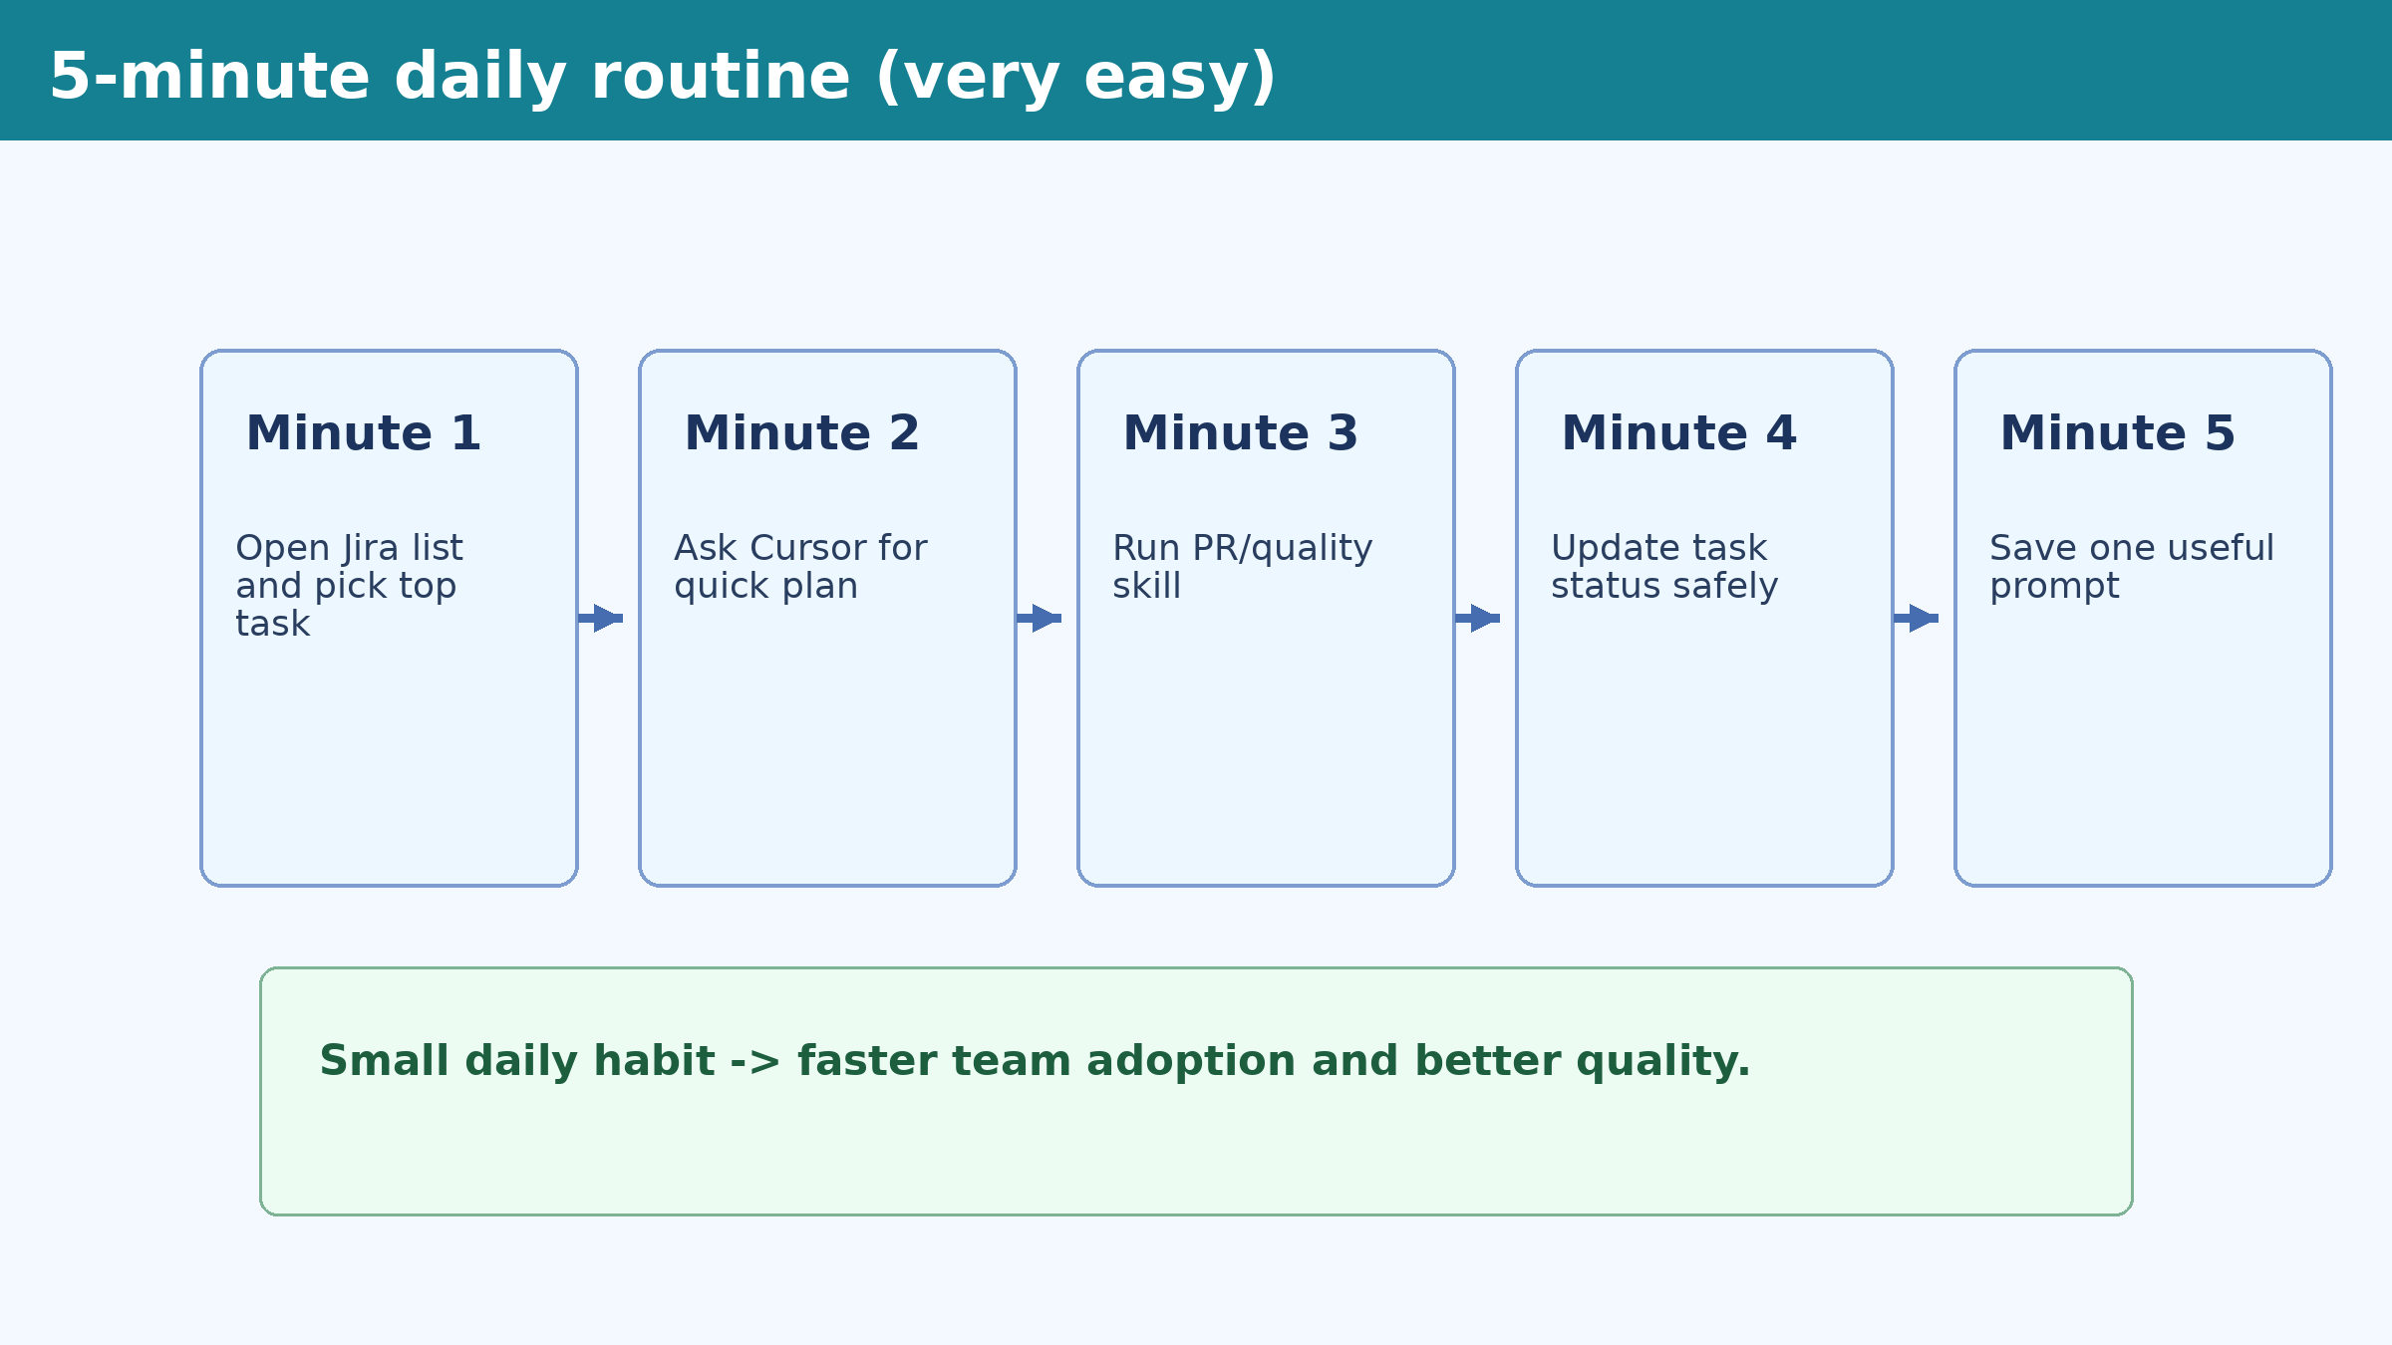
Coach this habit: 5-minute daily routine
Ask every participant to follow this daily.
This is the easiest way to keep adoption active.
Review weekly and celebrate improvements.

Slide 14
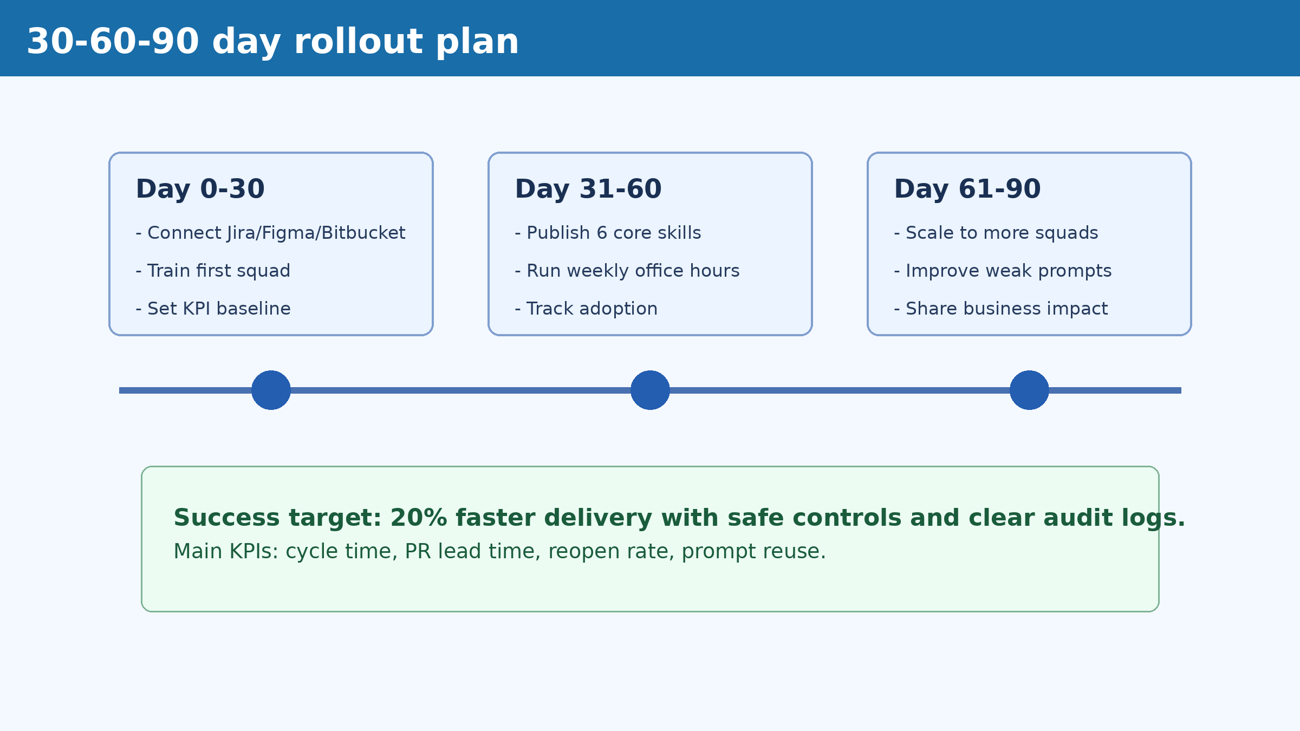
Risk controls and 30-60-90 rollout
Must-have controls:
  Low-access tokens + human approvals
  Audit logs + weekly KPI review
Rollout: 0-30 connect, 31-60 standardize, 61-90 scale.

Slide 15
Recommended video links (share as homework)
Use these links to support practice after the 45-minute session.
1. Cursor AI beginner tutorial
https://www.youtube.com/results?search_query=Cursor+AI+beginner+tutorial
2. Cursor MCP setup tutorial
https://www.youtube.com/results?search_query=Cursor+MCP+setup+tutorial
3. Model Context Protocol explained
https://www.youtube.com/results?search_query=Model+Context+Protocol+explained
4. Anthropic MCP tutorial
https://www.youtube.com/results?search_query=Anthropic+MCP+tutorial
5. Jira REST API tutorial
https://www.youtube.com/results?search_query=Jira+REST+API+tutorial+developers
6. Figma API tutorial
https://www.youtube.com/results?search_query=Figma+API+tutorial+for+developers
7. Bitbucket API tutorial
https://www.youtube.com/results?search_query=Bitbucket+API+tutorial
8. Prompt engineering for developers
https://www.youtube.com/results?search_query=Prompt+engineering+for+software+developers
9. AI agent workflow tutorials
https://www.youtube.com/results?search_query=AI+agent+workflow+tutorial+developers
10. Build MCP server in Python
https://www.youtube.com/results?search_query=Build+MCP+server+Python+tutorial
11. API token security best practices
https://www.youtube.com/results?search_query=API+token+security+best+practices
12. LLM governance for enterprise
https://www.youtube.com/results?search_query=LLM+governance+for+enterprise+teams

Slide 16
Trainer checklist (before, during, after)
Before: test tokens and demo environment.
During: keep prompts simple and repeat formula.
During: pause at each error and show quick fix.
After: share participant deck and runbook.
After: schedule weekly office hours.
Q&A

