Slide 1

REAL TIME CAR PARKING OCCUPANCY PREDICTION SYSTEM
Hassan Arif (193880)
Program: MPhil-CS
Supervised BY:
Dr. Mazhar Bukhari
Head of Department

Slide 2
OUTLINES
Background
Contributions of other researchers
Limitations, issues and problems
Problem
Research questions
Research Objectives
Proposed Methodology
Results and discussion
Conclusion

Slide 3
BACKGROUND
Detecting parking occupancy is a challenge in urban areas.
Growing vehicle numbers worsen the problem.
This leads to traffic congestion and environmental concerns.
Accurate detection is essential.
Cost-effective solutions are required.
Parking occupancy detection is a core aspect of Smart Parking Systems.
It plays a vital role in efficient urban planning.
It helps reduce traffic congestion.
It minimizes environmental impact by aiding drivers in finding available parking spaces easily.

Slide 4
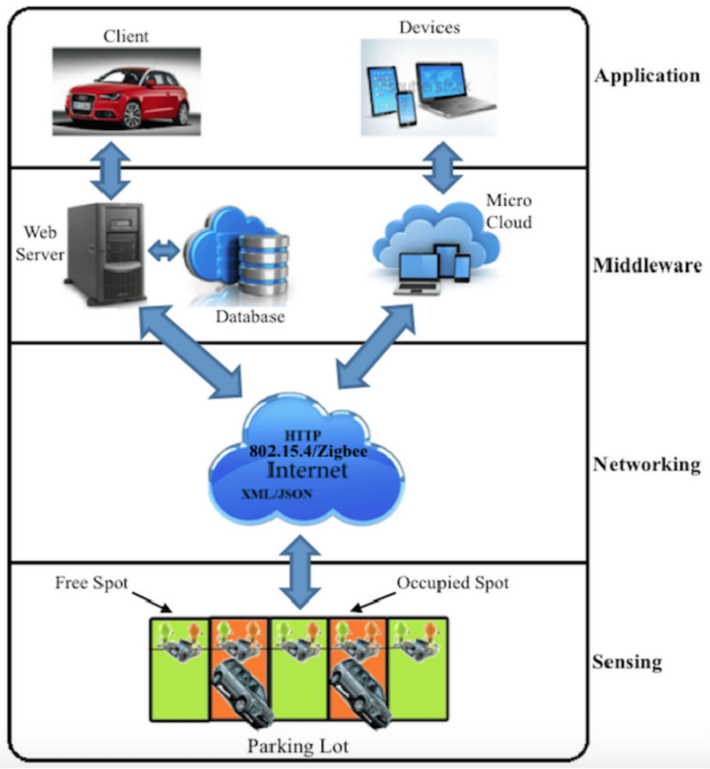
CONTINUE…
Smart Parking System
Smart parking systems use advanced technology to tackle the issue of limited parking spaces in cities.
Smart parking systems use sensors and technology for real-time parking data.
Data is sent to a central cloud server for user access.
User-friendly apps and websites offer parking info, reservations, and payments.
Systems optimize parking with dynamic pricing and user-specific reservations.
Benefits include time and cost savings, reduced traffic, and better customer experiences.

Slide 5
Contributions of other Researchers
Real-time image-based parking occupancy detection using deep learning
Authors: Debaditya Acharya, Weilin Yan, et al.
Parking occupancy detection framework using deep CNN and SVM Detect outdoor parking space occupancy from images. Transfer learning is evaluated on a new dataset created for this research.
Model Used | Dataset Used | Accuracy Achieved
Pre-trained CNN For Feature Extraction | PKLot dataset | 99.7% on different weather conditions.
SVM (Transfer Learning) For Classification | Barry Street dataset using features from Pre-trained CNN | 96.7% on Pre-trained CNN (Transfer Learning)

Slide 6
CONTINUE…
Automated Vehicle Parking Occupancy Detection in Real-Time
Authors: Heshan Padmasiri, Chamath Abeysinghe, et al.
Automated vehicle parking occupancy detection system. Utilizes object detection techniques. Eliminates manual video stream segmentation Microservices for scalability. Web and Mobile application for efficient parking space detection.
Model Used | Dataset Used | Accuracy Achieved
RetinaNet (ResNet-50+FPN) | PKLot dataset | AP = 20.15% (Occupied), AP = 21.47% (Unoccupied)
RetinaNet (ResNet-101+FPN) | PKLot dataset | AP = 20.63% (Occupied), AP = 22.57% (Unoccupied)
Faster RCNN (ResNet-50-C4) | PKLot dataset | AP = 18.35% (Occupied), AP = 20.15% (Unoccupied)

Slide 7
CONTINUE…
Image-Based Parking Space Occupancy Classification: Dataset and Baseline
Authors: Martin Marek.
The paper compares two model architectures: R-CNN and Faster R-CNN FPN. It evaluates the performance of these models on the ACPDS dataset. The results show that the Faster R-CNN FPN architecture outperforms the R-CNN architecture in terms of accuracy.
Model Used | Dataset Used | Accuracy Achieved
R-CNN (Square, 256) | ACPDS | 97.62% ± 0.07%
R-CNN (Square, 128) | ACPDS | 97.97% ± 0.07%
R-CNN (Square, 64) | ACPDS | 97.73% ± 0.13%
R-CNN (Quadrilateral, 256) | ACPDS | 96.08% ± 0.12%
R-CNN (Quadrilateral, 128) | ACPDS | 96.63% ± 0.15%
R-CNN (Quadrilateral, 64) | ACPDS | 96.39% ± 0.17%
Faster R-CNN FPN (Square, 800) | ACPDS | 98.31% ± 0.08%
Faster R-CNN FPN (Square, 1100) | ACPDS | 98.52% ± 0.11%
Faster R-CNN FPN (Square, 1440) | ACPDS | 98.51% ± 0.10%
Faster R-CNN FPN (Quadrilateral, 800) | ACPDS | 97.97% ± 0.14%
Faster R-CNN FPN (Quadrilateral, 1100) | ACPDS | 98.00% ± 0.08%
Faster R-CNN FPN (Quadrilateral, 1440) | ACPDS | 97.97% ± 0.14%

Slide 8
CONTINUE…
Revising deep learning methods in parking lot occupancy detection
Authors: Anastasia Martynova, Mikhail Kuznetsov, et al.
The paper focuses on parking lot occupancy detection for smart city development. Evaluated various deep learning models for parking lot occupancy detection. Assessed model performance across diverse weather and lighting conditions.
Model Used | Dataset Used | Accuracy Achieved
EfficientNet-P | ACMPS (Aerial Car Park) | 98%
MobileNet | ACMPS (Aerial Car Park) | 88%
VGG-19 | ACMPS (Aerial Car Park) | 89%
ResNet50 | ACMPS (Aerial Car Park) | 91%
DeiT (pre-trained) | ACMPS (Aerial Car Park) | 93%
PiT (pre-trained) | ACMPS (Aerial Car Park) | 92%
Vision Transformers | ACMPS (Aerial Car Park) | 94%
Contrastive Detection | ACMPS (Aerial Car Park) | 92%

Slide 9
CONTINUE…
EfficientNet-P | ACPDS (Aerial Car Parking) | 87%
MobileNet | ACPDS (Aerial Car Parking) | 85%
VGG-19 | ACPDS (Aerial Car Parking) | 86%
ResNet50 | ACPDS (Aerial Car Parking) | 88%
DeiT (pre-trained) | ACPDS (Aerial Car Parking) | 90%
PiT (pre-trained) | ACPDS (Aerial Car Parking) | 89%
Vision Transformers | ACPDS (Aerial Car Parking) | 91%
Contrastive Detection | ACPDS (Aerial Car Parking) | 88%

Slide 10
Limitations, Issues and Problems
Real-time image-based parking occupancy detection using deep learning
Authors: Debaditya Acharya, Weilin Yan, et al.
Limitation | Description
Sensitivity to Lighting Conditions | The framework's performance in low-light or nighttime conditions is unexplored.
Ambiguity in Partially Occupied Spaces | Accurate detection is challenging when vehicles occupy parking spaces partially.
Impact of Shadows | Shadows from buildings or objects can affect classification accuracy.

Slide 11
CONTINUE…
Automated Vehicle Parking Occupancy Detection in Real-Time
Authors: Heshan Padmasiri, Chamath Abeysinghe, et al.
Limitation | Description
Limited Night-Time Operation | The system hasn't been tested for night-time operation due to the lack of a supportive dataset, potentially limiting its use in low-light conditions.
Dataset Limitations | The system's performance is affected by the limited size and scope of the training dataset, which may reduce accuracy in real-world scenarios.

Slide 12
Problem
Urban parking faces escalating challenges due to a surge in vehicle numbers and limited parking space availability. Current parking slot detection models encounter significant hurdles, particularly in adverse scenarios such as low light conditions and obstructed views, constraining their practical utility.

Slide 13
Research Questions
How can the performance of the model be improved?
How can the model be generalized to different environments?

Slide 14
Research Objectives
This could involve exploring different deep learning architectures, training on more data, or employing data augmentation techniques.
This could involve training on data from different parking lots, with different lighting and weather conditions.

Slide 15
Proposed Methodology

Slide 16
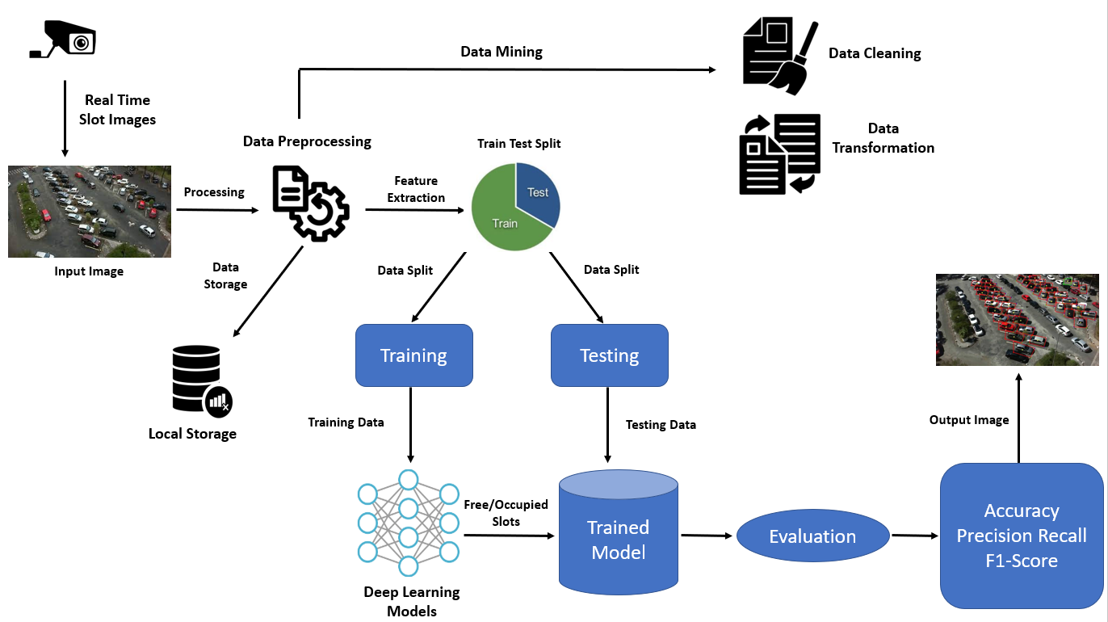

Slide 17
Methodology
Input data: Real Time Slot Images
Preprocessing: The image is first preprocessed to remove noise and standardize the data. This may involve resizing the image, cropping it to focus on the parking slots, and converting it to grayscale.
Feature extraction: A deep learning model is then used to extract features from the image. This is done by training the model to identify patterns in the data that are associated with parking slots.
Model prediction: The deep learning model then predicts whether each parking slot in the image is empty or occupied.

Slide 18
CONTINUE…
Convolutional neural networks (CNNs) are a type of deep learning model that are well-suited for image classification tasks.
CNNs work by extracting features from images at different levels of abstraction.
The first layer of a CNN extracts simple features, such as edges and corners.
The subsequent layers extract more complex features, such as shapes and objects.
The output of a CNN is a set of feature vectors.
The feature vectors are then fed into a classifier, which classifies the parking slots in the image as either empty or occupied.
The classifier can be any type of machine learning classifier, such as a logistic regression classifier or a support vector machine classifier.

Slide 19
CONTINUE…
The model is evaluated using the following metrics:
Accuracy: Accuracy is the percentage of predictions that the model makes correctly.
Precision: Precision is the percentage of positive predictions that the model makes that are actually correct.
Recall: Recall is the percentage of all positive cases that the model correctly predicts.
F1-Score: The F1-Score is a weighted average of precision and recall. It is a useful metric for evaluating the performance of machine learning models because it takes into account both precision and recall.

Slide 20
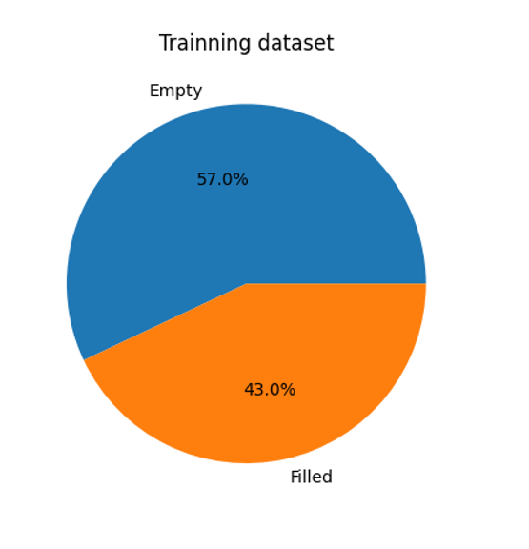
Results and Discussion
Training Dataset
Data analysis in Google Colab streamlined the process.
Uploaded collected data to Google Drive for real-time analysis and model training.
Essential libraries included TensorFlow, NumPy, pandas, and Keras.
The data was prepared and enhanced using TensorFlow.
Dataset had 30,000 images having 15000 Images for Free and 15000 Images for Occupied slots.
"Free" and "Occupied" classes defined for training the occupancy recognition model.
57.0% of slots were "Empty," and 43.0% were "Filled.

Slide 21
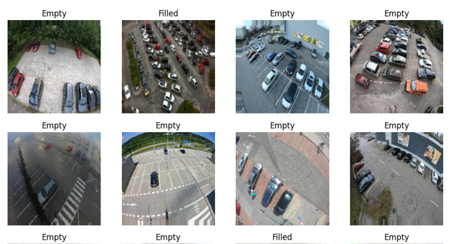
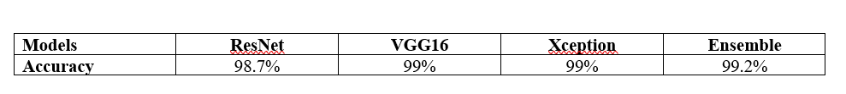
CONTINUE…
Data Analysis
Plotted images from dataset used for data augmentation and preprocessing.
These images are from various weather and lighting conditions.
The preparation of our model with these images ensures its effectiveness in detecting parking slot occupancy across different scenarios.
ResNet, VGG16, and Xception models excelled with accuracy scores over 98%.
The ensemble model, combining strengths from various models, achieved the highest accuracy at 99.2%, as shown in Table.
Plotted Images from Dataset
Table. Accuracy Achieved with Different Deep Learning Models

Slide 22
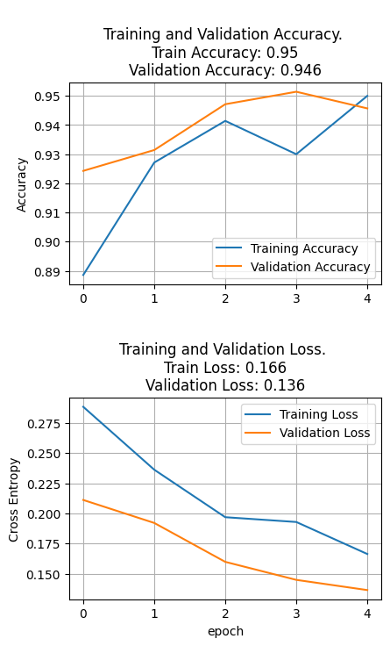
CONTINUE…
Accuracy and Loss
Our presentation evaluates model performance in parking slot occupancy detection.
Graph 1 displays accuracy scores across epochs.
Training Accuracy = 5%
Validation Accuracy = 94.6%
Graph 2 monitors loss during training and validation.
Training Loss = 16.6%
Validation Loss = 13.6%
These results affirm our model's high accuracy and error minimization, enhancing parking management.

Slide 23
Conclusion
Focus on Real-Time Car Parking Occupancy Prediction in urban areas using PKLot dataset.
Evaluated state-of-the-art models including ResNet, VGG16, Xception, and Ensemble model.
Ensemble model achieved remarkable 99.2% accuracy for parking prediction in PKLot.
Limitations include dataset representation, limited evaluation of extreme conditions, and cost-effectiveness considerations.
Future work should focus on real-time data, scalability, hardware, and privacy.
Overall, the research advances urban parking management by optimizing slot allocation and reducing congestion.

Slide 24


