Slide 1

REAL TIME CAR PARKING OCCUPANCY PREDICTION SYSTEM
Hassan Arif (193880)
Program: MPhil-CS
Supervised BY:
Dr. Mazhar Bukhari
Head of Department

Slide 2
OUTLINES
Background
Contributions of other researchers
Limitations, issues and problems
Problem
Research questions
Research Objectives
Proposed Methodology
Results and discussion
Conclusion

Slide 3
BACKGROUND
Parking occupancy detection is a challenge in urban areas.
With increasing number of vehicles on the roads.
Traffic congestion and environmental impact challenges.
Need for accurate occupancy detection.
Cost Efficiency
Urban planning, traffic management, sustainability.

Slide 4
Contributions of other Researchers
1. Contribution (Authors: Padmasiri, Madurawe, Abeysinghe et al., 2020)
Real-time surveillance-based automated detection.
Modular software architecture for scalability.
Cost-effective and adaptable deployment.
2. Contribution (Authors: Taylor, Ezekiel, and Emmah in 2021)
State-of-the-art algorithms for vehicle identification.
Real-time IoT monitoring for reduced congestion.
Data-backed guidance.
Improved parking experiences and reduced frustration.

Slide 5
3. Contribution (Authors: Stojanović, Damjanović, Vukmirović et al., 2021)
Smart Edge devices with AI accelerators.
Utilizing recent CV algorithms.
Edge AI for autonomous parking occupancy computation
Contributions (Authors: Chen, Qiu, Sheng et al., 2021)
Generative Parking Spot Detection (GPSD) algorithm.
Multi-clue recovery model for accurate detection.
Layered Analytical Illumination Balance (LAIB) for preprocessing.
Highly accurate parking spot detection.
Improved robustness in varying lighting conditions.

Slide 6
5. Contribution (Authors: Martynova, Kuznetsov, Porvatov, & Tishin, 2023)
Vision transformers vs. CNNs.
Performance analysis under challenging conditions.
Advancing parking lot occupancy detection.
Enhancing accuracy and efficiency.

Slide 7
Limitations, Issues and Problems
Limitations (Authors: Stojanović, Damjanović, Vukmirović et al., 2021)
Delays: High server requests led to delays in object detection.
Lighting: Challenging in varying lighting conditions.
Costs: Expensive hardware may limit cost-effectiveness.
Reallocation: Accurate parking space reallocation remains a challenge.
2. Limitations (Authors: Taylor, Ezekiel, and Emmah in 2021)
Cost-effective: Potential cost concerns.
Dataset: May not fully represent diverse scenarios.

Slide 8
3. Limitations (Authors: Martynova, Kuznetsov, Porvatov, & Tishin, 2023)
Dataset: May lack diversity and scale.
Optimization: Effectiveness can vary across scenarios.
4. Limitations (Authors: Padmasiri, Madurawe, Abeysinghe et al., 2020)
Dataset: Improved results possible with a fully annotated dataset.
Night-time: Untested for night-time operation, limiting 24/7 use.
5. Limitations (Authors: Chen, Qiu, Sheng et al., 2021)
Illumination: Challenges in extreme illumination conditions.
Real-time: Need for exploration in real-time implementation.

Slide 9
Problem
Urban parking challenges arise from increasing vehicles and limited space. Current methods struggle in poor lighting and occlusions, affecting parking occupancy detection

Slide 10
Research Questions
How can deep learning improve parking lot occupancy detection in challenging visual conditions ?
How do integrated technologies enhance the Smart Parking Management System to address urban parking challenges efficiently and cost-effectively?

Slide 11
Research Objectives
To improve deep learning models for more accurate parking lot occupancy detection in challenging visual conditions and enhance urban mobility.
This study combines image processing and deep learning to enhance the Smart Parking Management System, addressing urban parking challenges effectively and efficiently.

Slide 12
Proposed Methodology

Slide 13
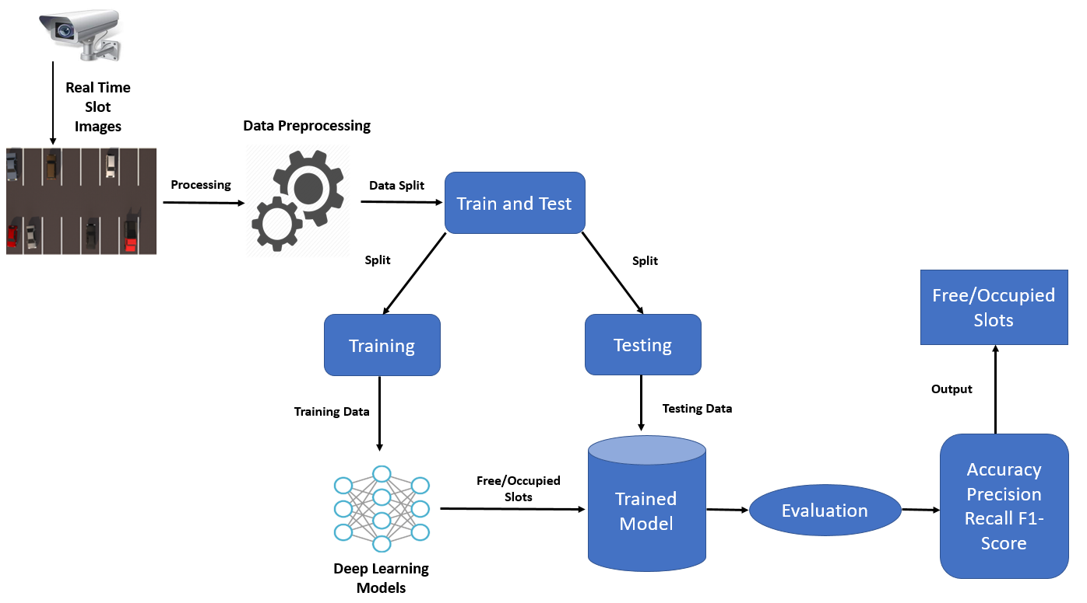

Slide 14
Methodology
Input data: Real Time Slot Images
Preprocessing: The image is first preprocessed to remove noise and standardize the data. This may involve resizing the image, cropping it to focus on the parking slots, and converting it to grayscale.
Feature extraction: A deep learning model is then used to extract features from the image. This is done by training the model to identify patterns in the data that are associated with parking slots.
Model prediction: The deep learning model then predicts whether each parking slot in the image is empty or occupied.

Slide 15
Convolutional neural networks (CNNs) are a type of deep learning model that are well-suited for image classification tasks.
CNNs work by extracting features from images at different levels of abstraction.
The first layer of a CNN extracts simple features, such as edges and corners.
The subsequent layers extract more complex features, such as shapes and objects.
The output of a CNN is a set of feature vectors.
The feature vectors are then fed into a classifier, which classifies the parking slots in the image as either empty or occupied.
The classifier can be any type of machine learning classifier, such as a logistic regression classifier or a support vector machine classifier.

Slide 16
The model is evaluated using the following metrics:
Accuracy: Accuracy is the percentage of predictions that the model makes correctly.
Precision: Precision is the percentage of positive predictions that the model makes that are actually correct.
Recall: Recall is the percentage of all positive cases that the model correctly predicts.
F1-Score: The F1-Score is a weighted average of precision and recall. It is a useful metric for evaluating the performance of machine learning models because it takes into account both precision and recall.

Slide 17
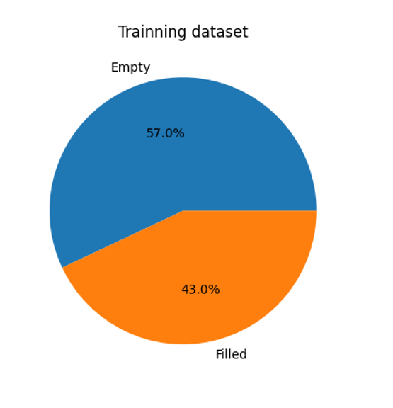
Results and Discussion
Training Dataset
Data analysis in Google Colab streamlined the process.
Uploaded collected data to Google Drive for real-time analysis and model training.
Essential libraries included TensorFlow, NumPy, pandas, and Keras.
The data was prepared and enhanced using TensorFlow.
Dataset had 30,000 images having 15000 Images for Free and 15000 Images for Occupied slots.
"Free" and "Occupied" classes defined for training the occupancy recognition model.
57.0% of slots were "Empty," and 43.0% were "Filled.

Slide 18
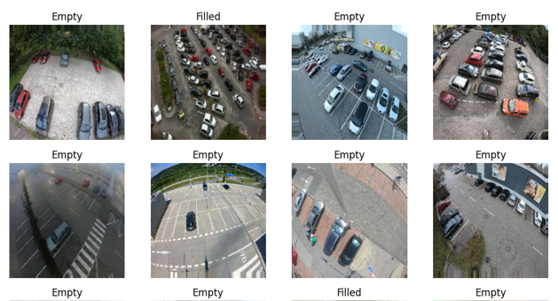
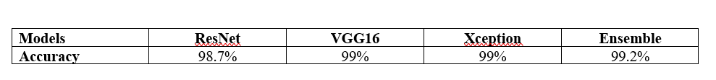
Data Analysis
Plotted images from dataset used for data augmentation and preprocessing.
These images are from various weather and lighting conditions.
The preparation of our model with these images ensures its effectiveness in detecting parking slot occupancy across different scenarios.
ResNet, VGG16, and Xception models excelled with accuracy scores over 98%.
The ensemble model, combining strengths from various models, achieved the highest accuracy at 99.2%, as shown in Table.
Plotted Images from Dataset
Table. Accuracy Achieved with Different Deep Learning Models

Slide 19
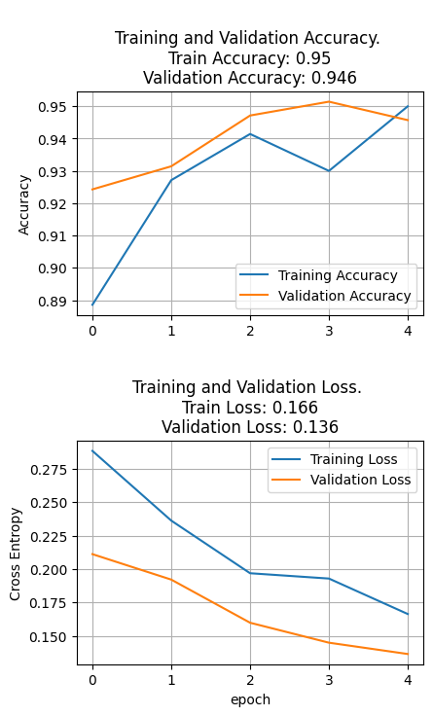
Accuracy and Loss
Our presentation evaluates model performance in parking slot occupancy detection.
Graph 1 displays accuracy scores across epochs.
Training Accuracy = 5%
Validation Accuracy = 94.6%
Graph 2 monitors loss during training and validation.
Training Loss = 16.6%
Validation Loss = 13.6%
These results affirm our model's high accuracy and error minimization, enhancing parking management.

Slide 20
Conclusion
Focus on Real-Time Car Parking Occupancy Prediction in urban areas using PKLot dataset.
Evaluated state-of-the-art models including ResNet, VGG16, Xception, and Ensemble model.
Ensemble model achieved remarkable 99.2% accuracy for parking prediction in PKLot.
Limitations include dataset representation, limited evaluation of extreme conditions, and cost-effectiveness considerations.
Future work should focus on real-time data, scalability, hardware, and privacy.
Overall, the research advances urban parking management by optimizing slot allocation and reducing congestion.

Slide 21


