Slide 1
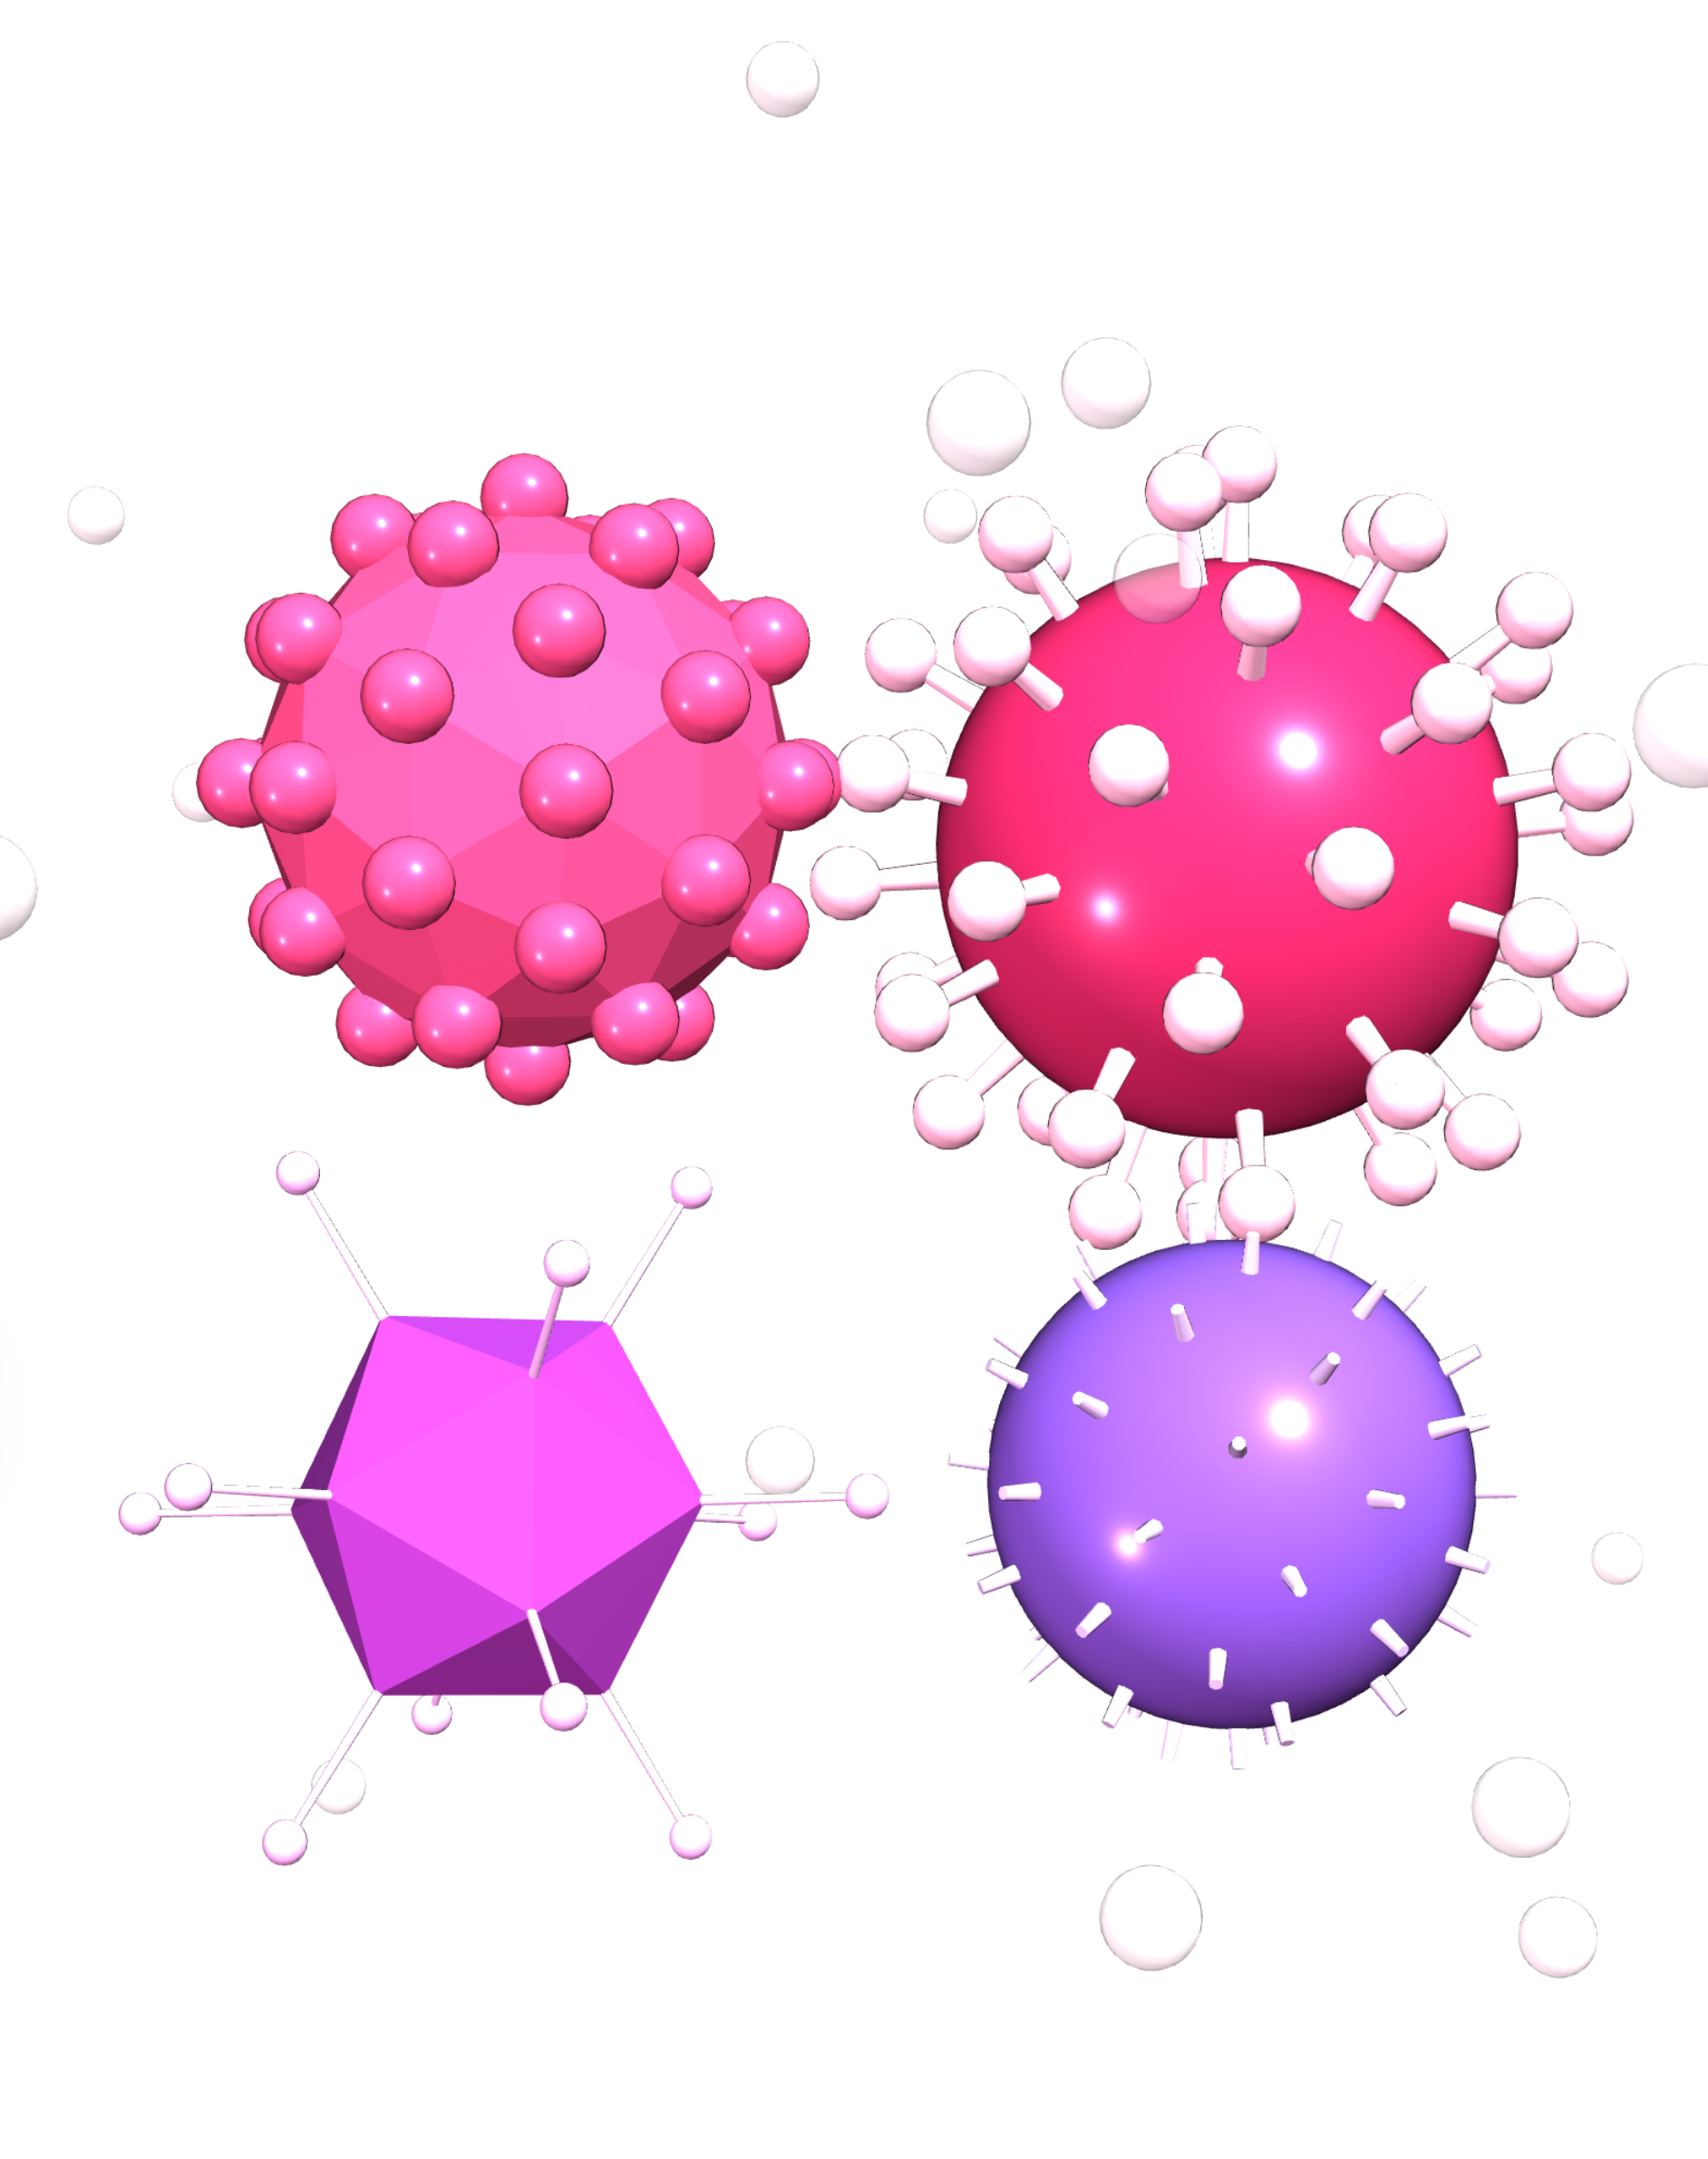

PEDIATRICS
Upper respiratory
tract infections
(URTIs)
Common cold
Pharyngitis
Tonsillitis
PRESENTED BY
Dr. Ruqaiah Alhebshi MBBS

Slide 2
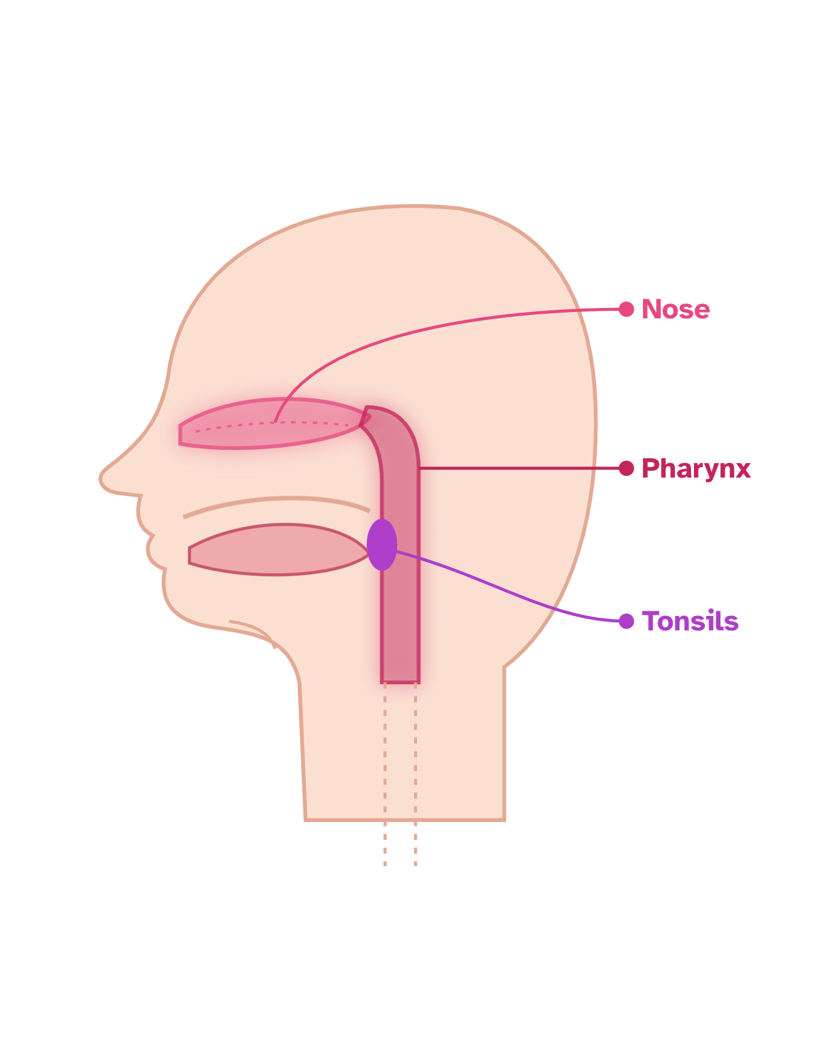




Upper respiratory tract infections (URTIs)
INTRODUCTION
URTIs are common infections in children affecting the nose, pharynx and tonsils.
THE COMMON TYPES INCLUDE
Common cold
Part 1
Pharyngitis
Part 2
Tonsillitis
Part 3
Most cases are caused by viruses.

Slide 3
Common cold
PART 1
Definition and causes · clinical manifestations · physical examination · management and nursing care

Slide 4

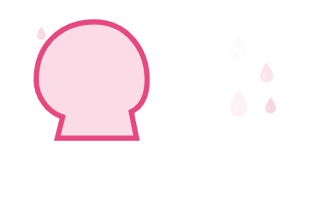
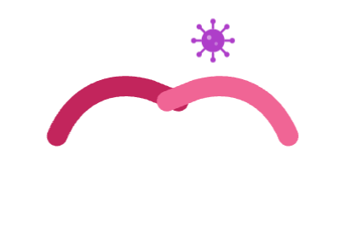
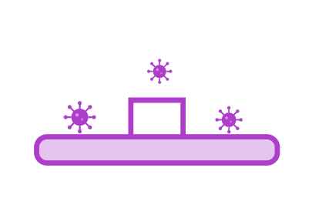
Definition and causes
01
COMMON COLD
Common cold is a viral infection of the upper respiratory tract, mainly affecting the nose and throat.
CAUSES
Rhinovirus
most common
Coronavirus
Adenovirus
RSV
TRANSMISSION
Respiratory droplets
Direct contact
Contaminated surfaces

Slide 5
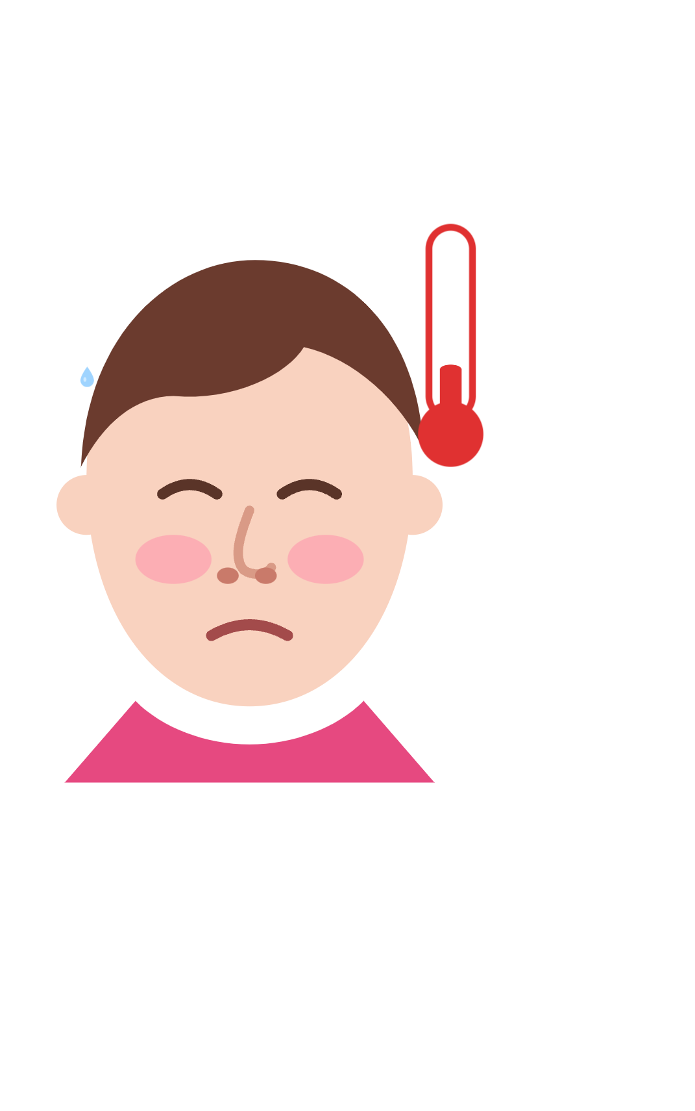






Clinical manifestations
01
COMMON COLD
Runny nose
Rhinorrhea
Nasal congestion
Sneezing
Mild sore throat
Cough
Mild fever
Headache
Decreased appetite

Slide 6


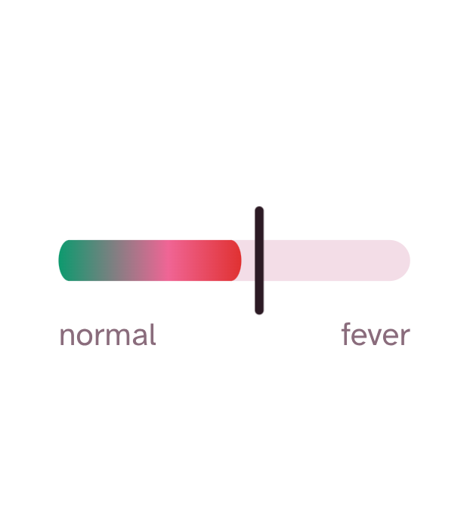
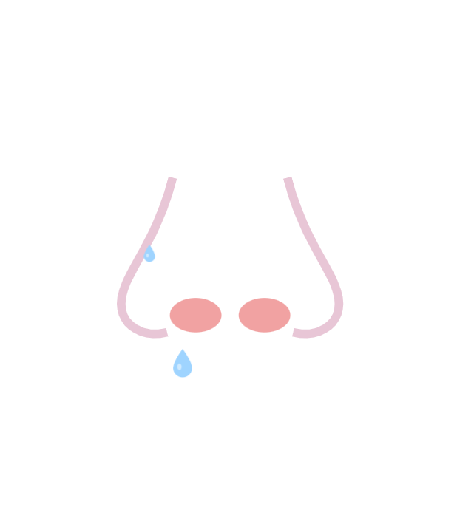


Physical examination
01
COMMON COLD
General examination
Nose examination
Throat examination
Chest examination
Child may appear mildly ill.
Normal or mildly elevated temperature.
Nasal congestion.
Redness of nasal mucosa.
Watery nasal discharge.
Mild redness of the pharynx.
Tonsils usually normal.
Usually normal breath sounds.

Slide 7








Management and nursing care
01
COMMON COLD
Management
Nursing care
Adequate fluids
1
Monitor temperature and respiratory rate.
Rest
2
Encourage fluid intake.
Saline nasal drops
3
Keep the nose clean.
Paracetamol for fever when needed
4
Provide adequate nutrition.
Honey for cough in children older than one year
5
Educate parents about handwashing.
Note: Antibiotics are not indicated for common cold.

Slide 8
Pharyngitis
PART 2
Definition and causes · clinical manifestations · physical examination · diagnosis and management

Slide 9

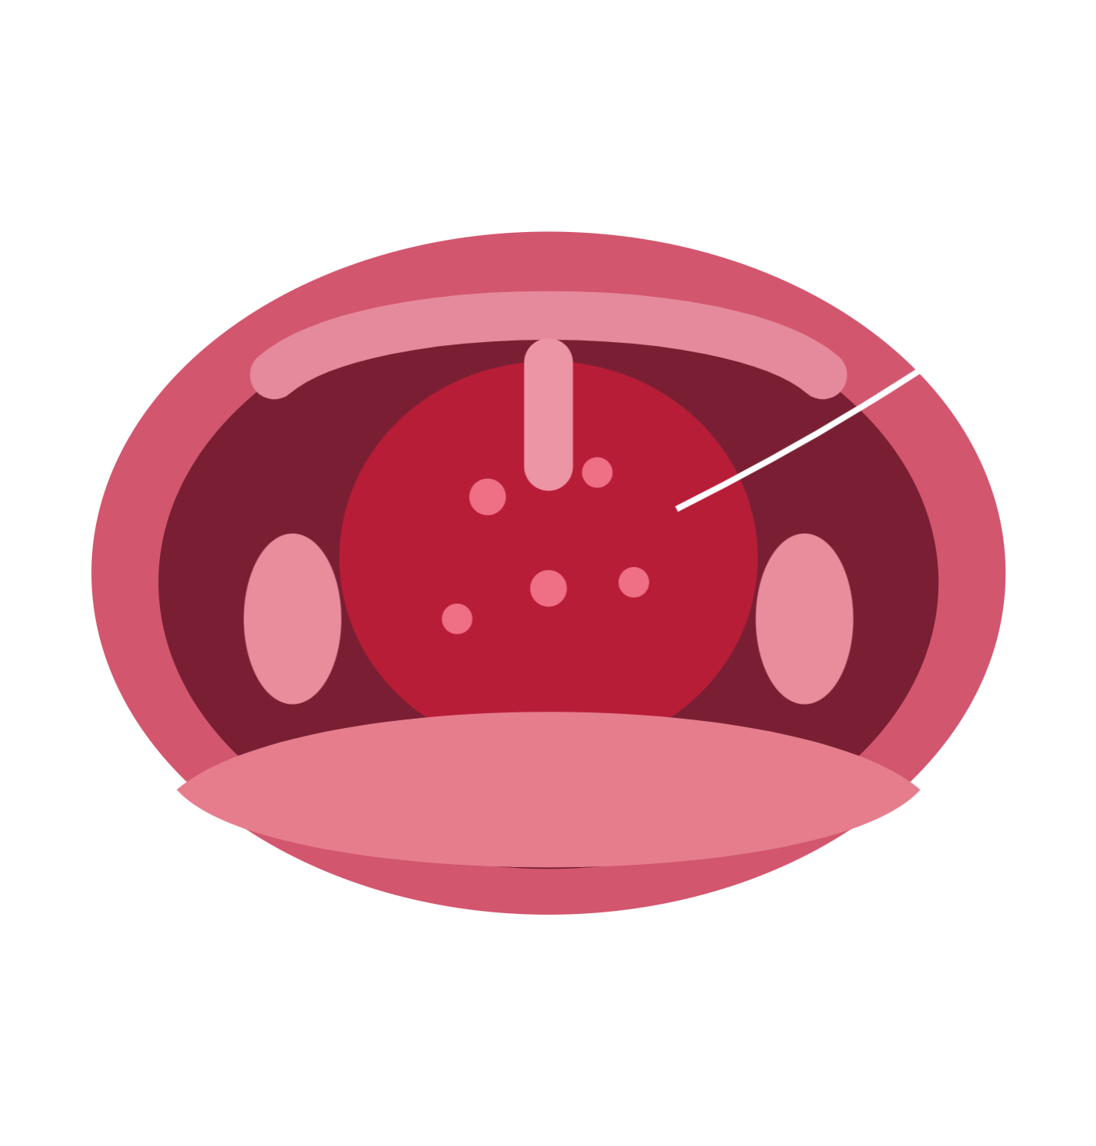

Definition and causes
02
PHARYNGITIS
Pharyngitis is inflammation of the pharynx (throat), causing pain and difficulty swallowing.
CAUSES
Viral
Adenovirus
Influenza virus
Rhinovirus
Bacterial
Group A Streptococcus (GAS)

Slide 10


Clinical manifestations
02
PHARYNGITIS
Sore throat
Painful swallowing
Odynophagia
Viral infection may cause
Fever
Headache
Cough
Runny nose
Poor appetite
Enlarged cervical lymph nodes
Hoarseness

Slide 11
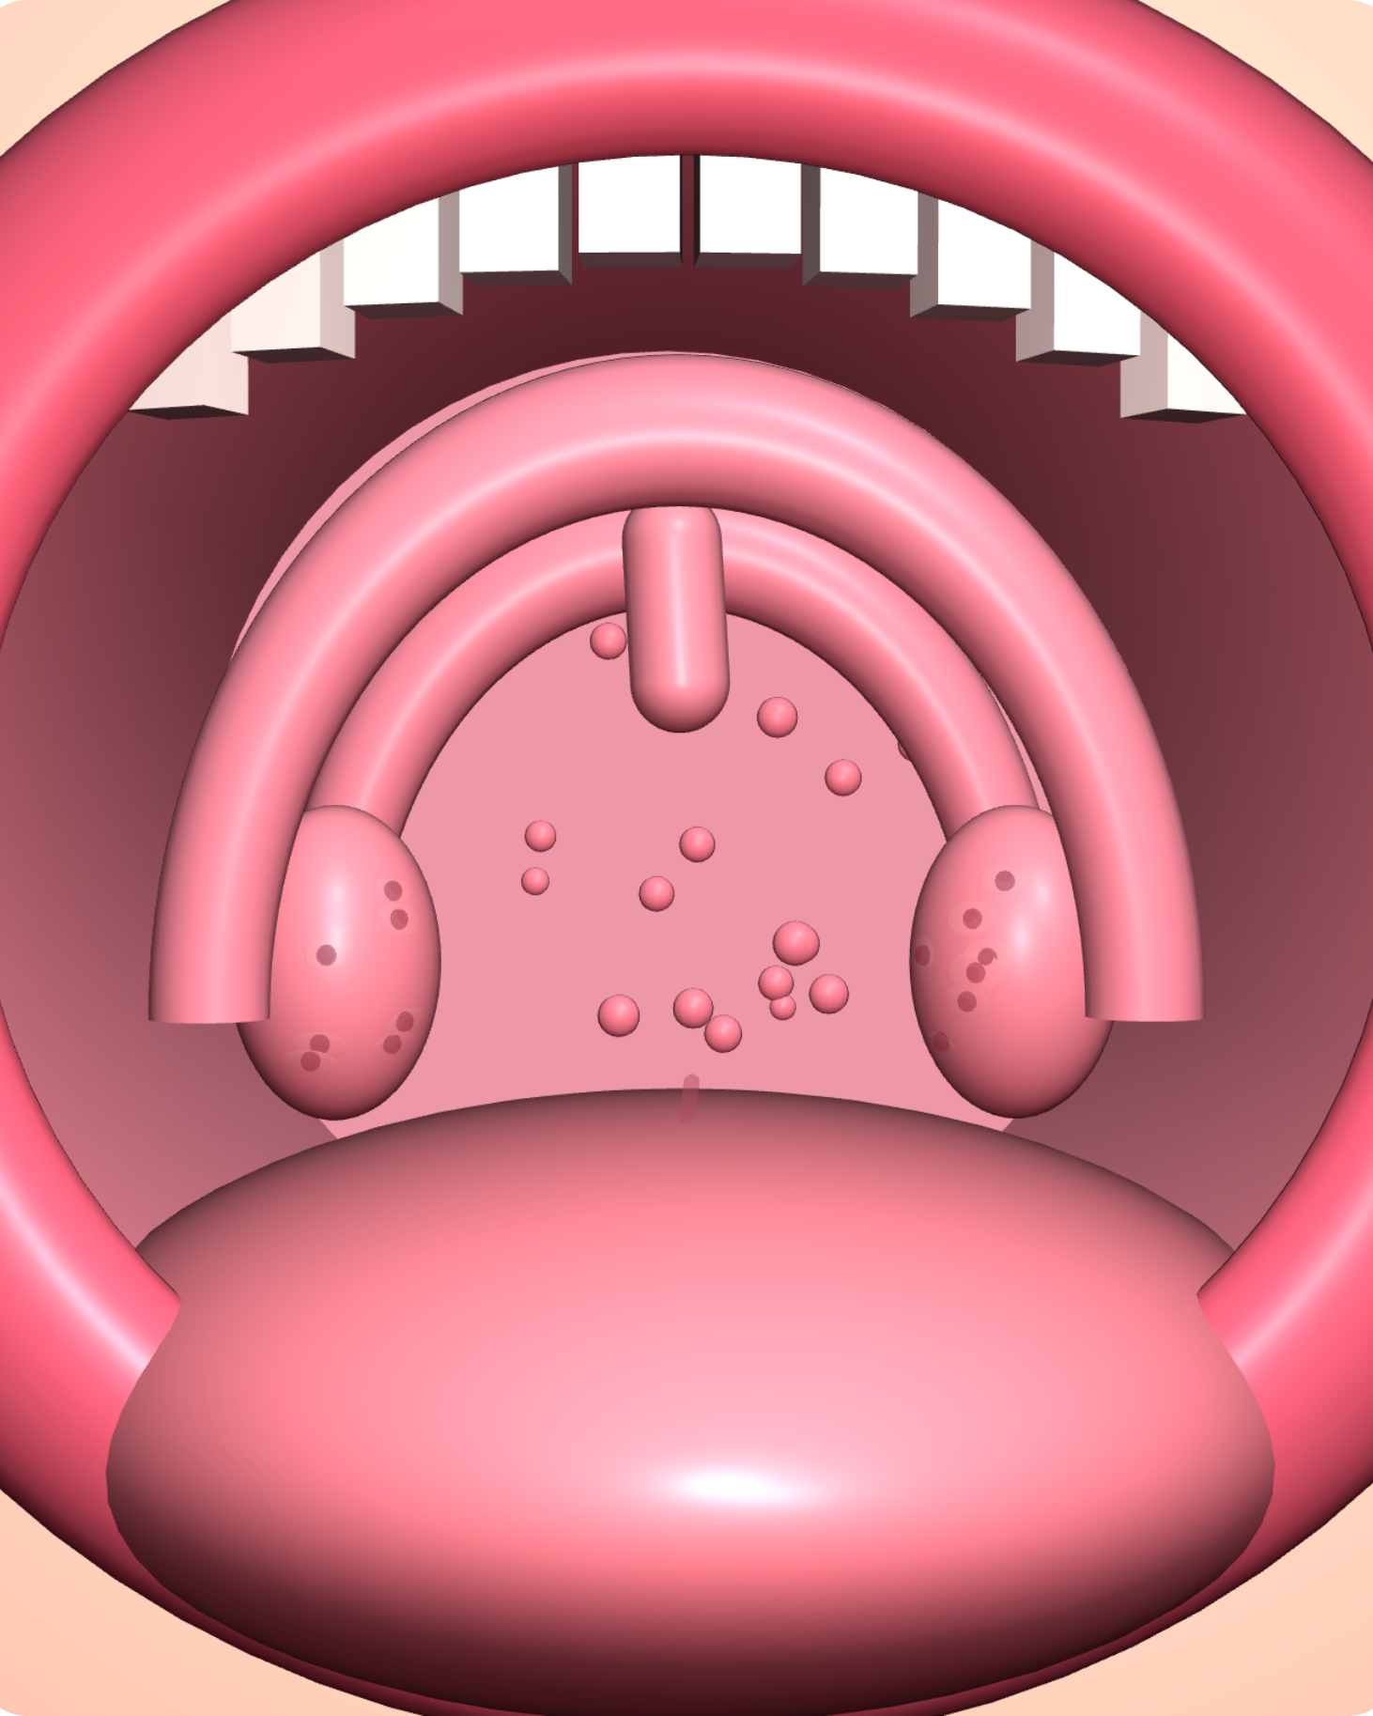
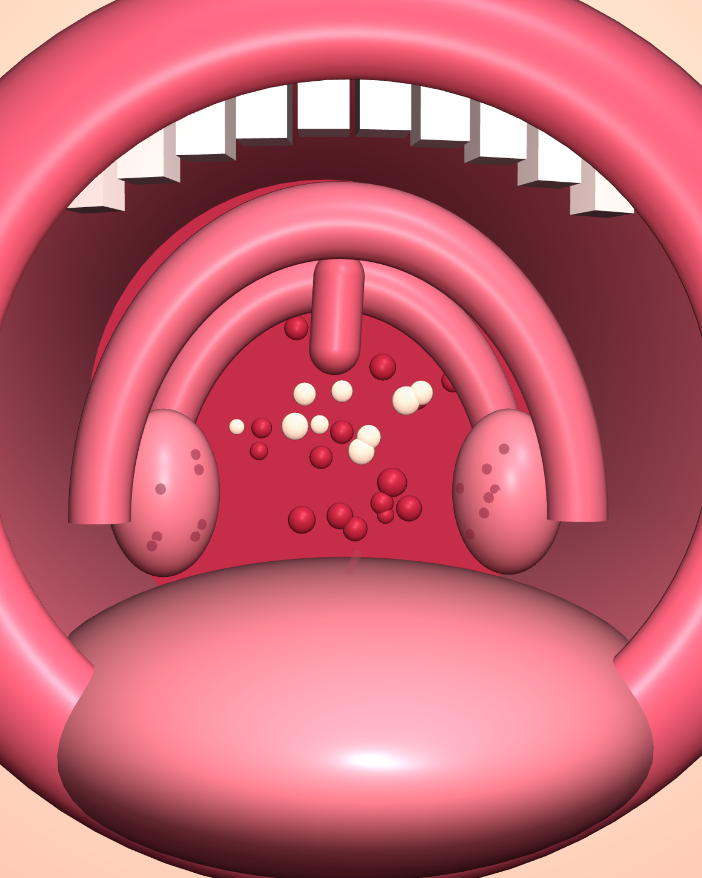
Physical examination
02
PHARYNGITIS
General examination
Child may appear ill.
Fever may be present.
Throat examination
Redness of posterior pharyngeal wall.
Pharyngeal swelling.
Possible white patches or exudates.
Neck examination
Enlarged cervical lymph nodes.
Tender anterior cervical lymph nodes, especially in bacterial infection.
Normal
Pharyngitis

Slide 12




Diagnosis and management
02
PHARYNGITIS
DIAGNOSIS
Clinical examination
Rapid antigen detection test
RADT
Throat culture
when indicated
Viral pharyngitis
Bacterial pharyngitis
Antibiotics such as Penicillin or Amoxicillin when indicated.
Fluids
Rest
Paracetamol
Important: Antibiotics do not treat viral infections.

Slide 13
Tonsillitis
PART 3
Definition and causes · clinical manifestations · physical examination · management · nursing care · complications

Slide 14
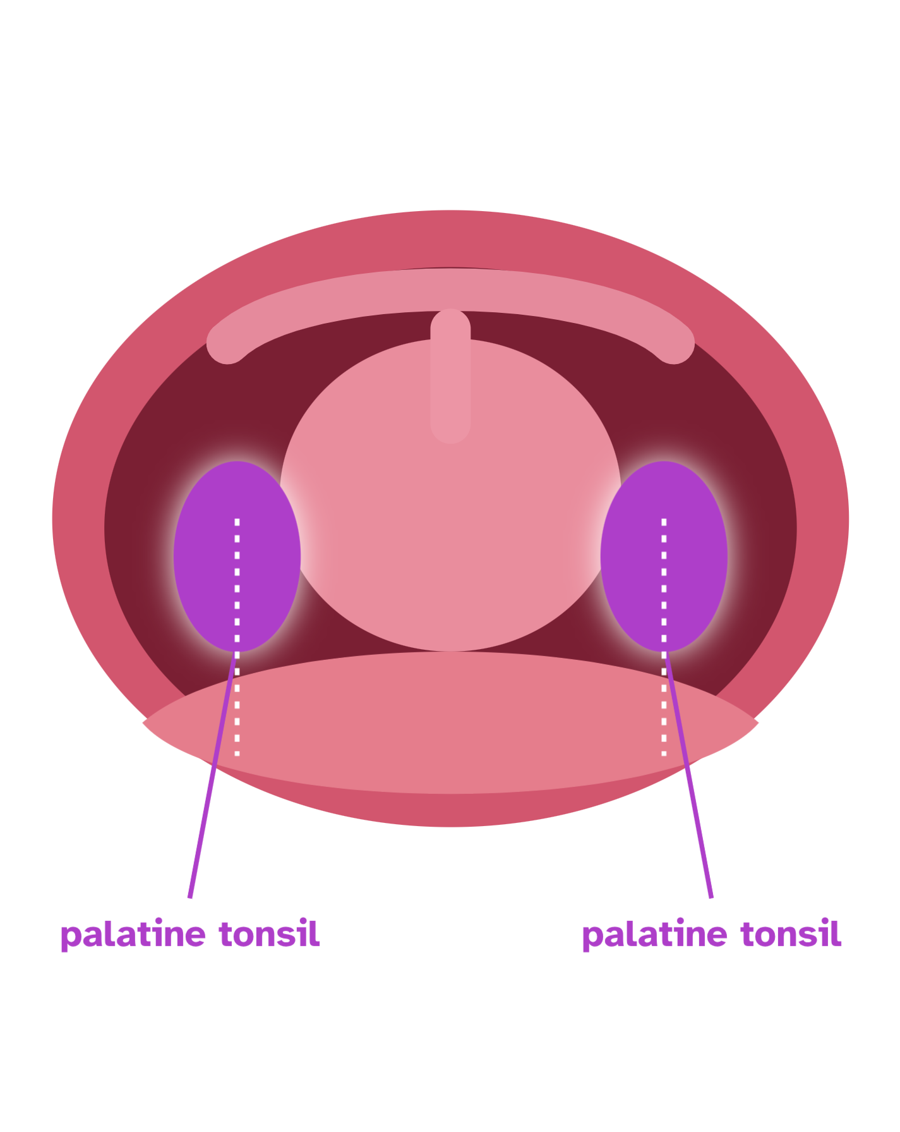
Definition and causes
03
TONSILLITIS
Tonsillitis is inflammation of the palatine tonsils, located on both sides of the throat.
CAUSES
Viral infections
most common
Bacterial infections
especially Group A Streptococcus

Slide 15



Clinical manifestations
03
TONSILLITIS
Sore throat
Fever
In young children
Difficulty swallowing
Enlarged tonsils
Refusal to eat or drink
White or yellow patches on tonsils
Bad breath
Vomiting
Enlarged cervical lymph nodes
Decreased appetite
Irritability

Slide 16
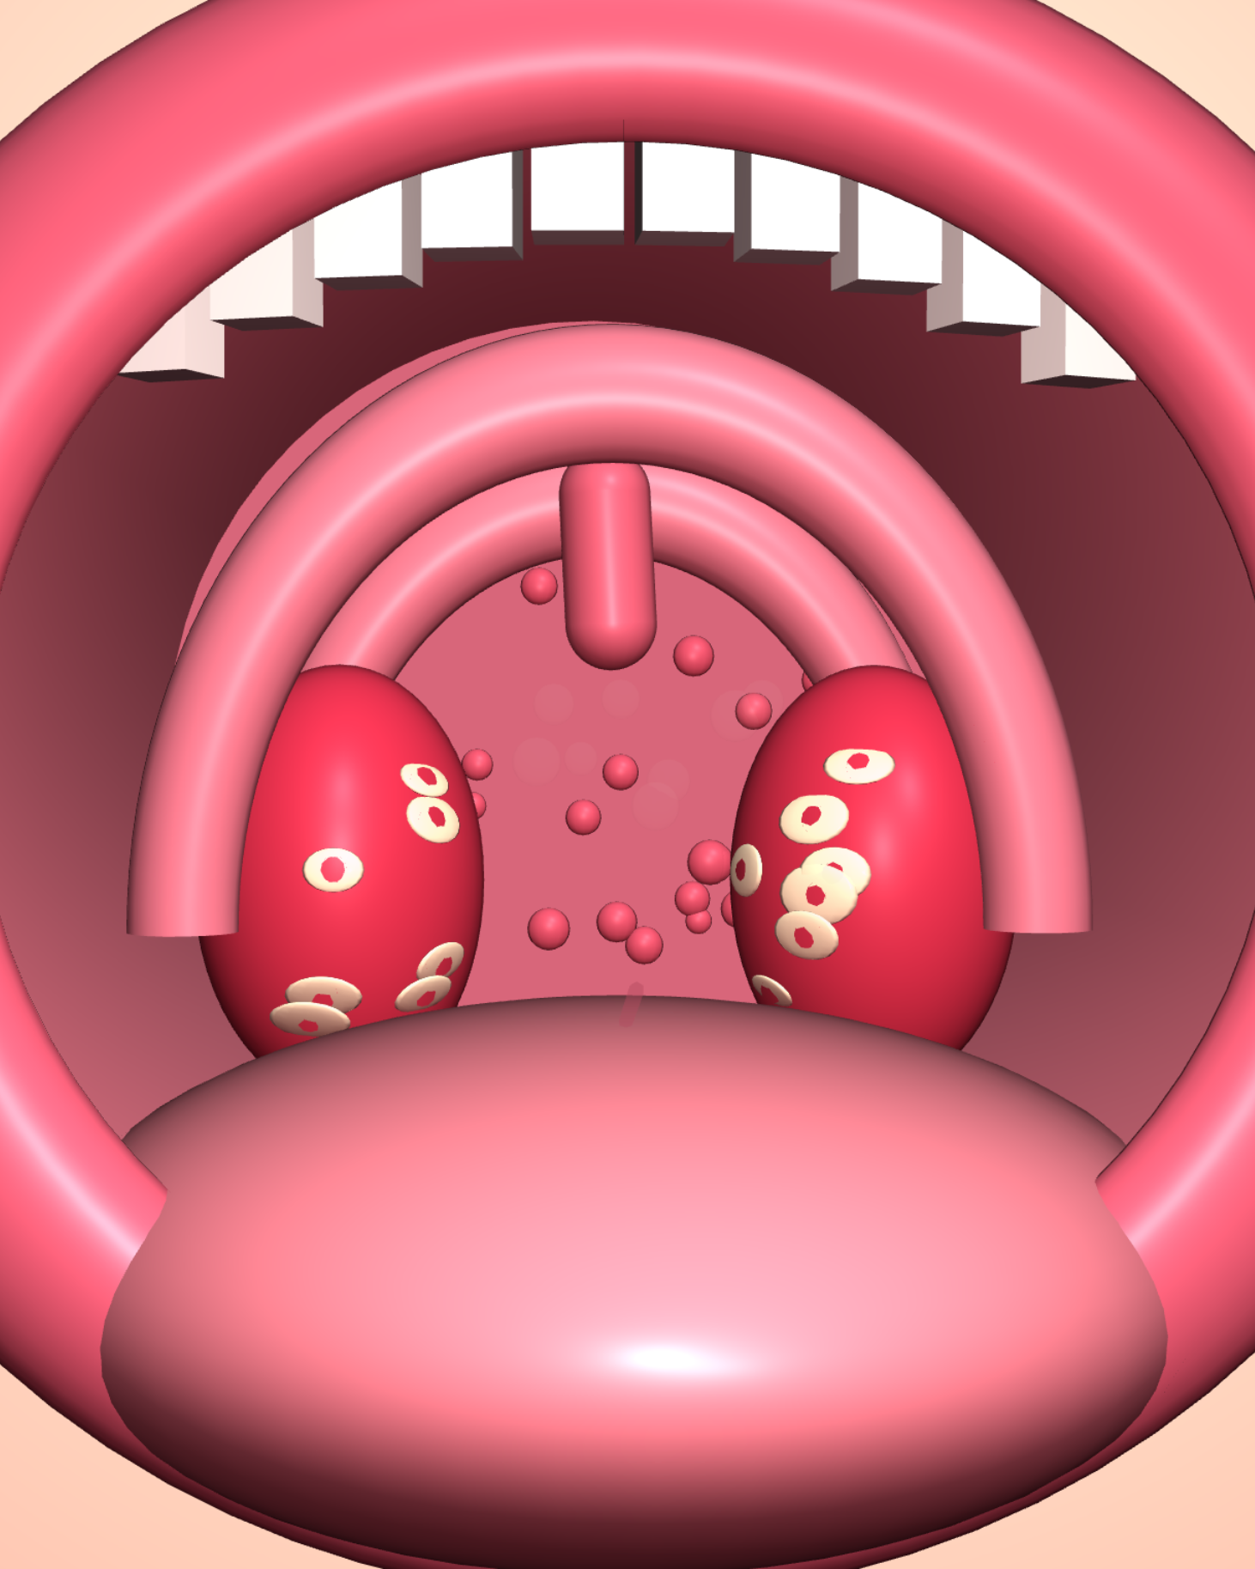
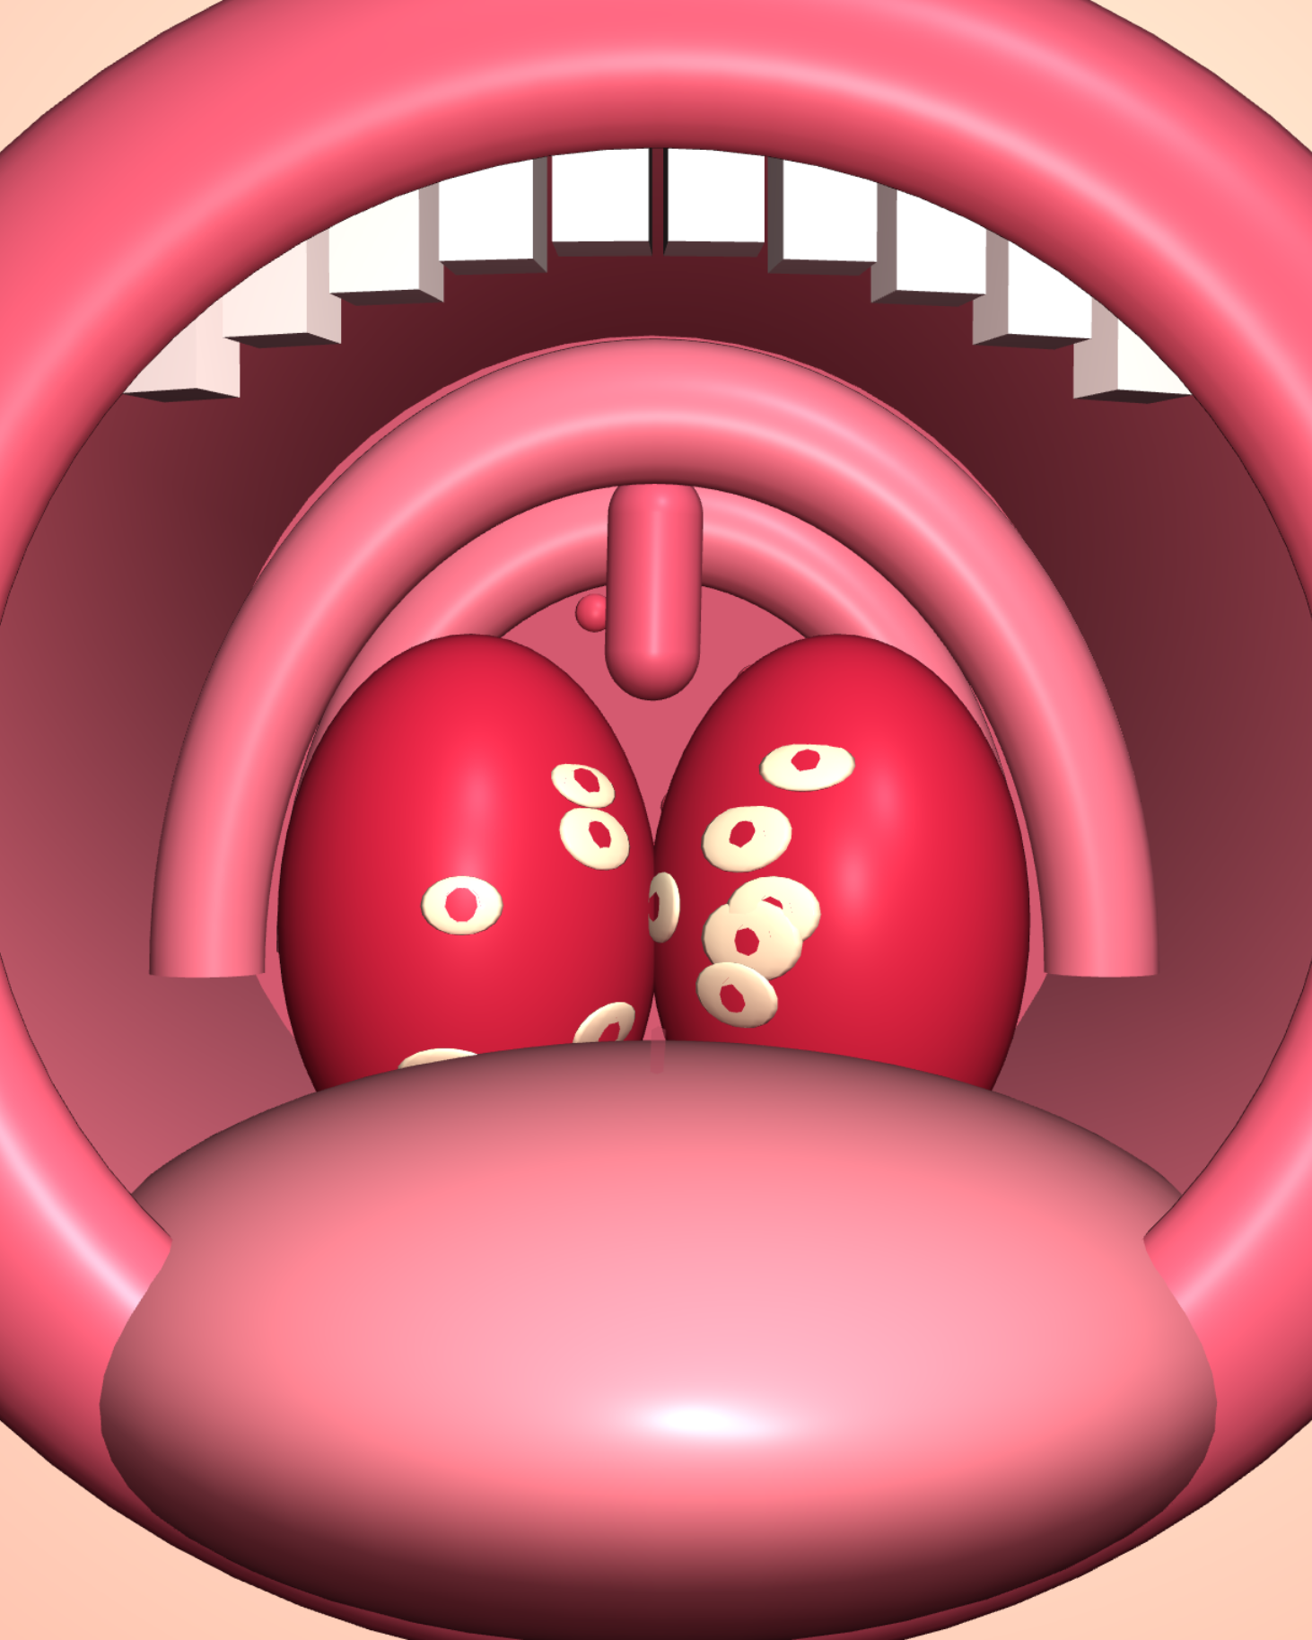
Physical examination
03
TONSILLITIS
General examination
Fever.
Child may appear sick and uncomfortable.
Mouth and throat examination
Enlarged tonsils.
Red and swollen tonsils.
White or yellowish exudates may be present.
Severe cases: tonsils nearly touching each other.
Neck examination
Normal
Tonsillitis
Severe
Enlarged and tender anterior cervical lymph nodes.

Slide 17


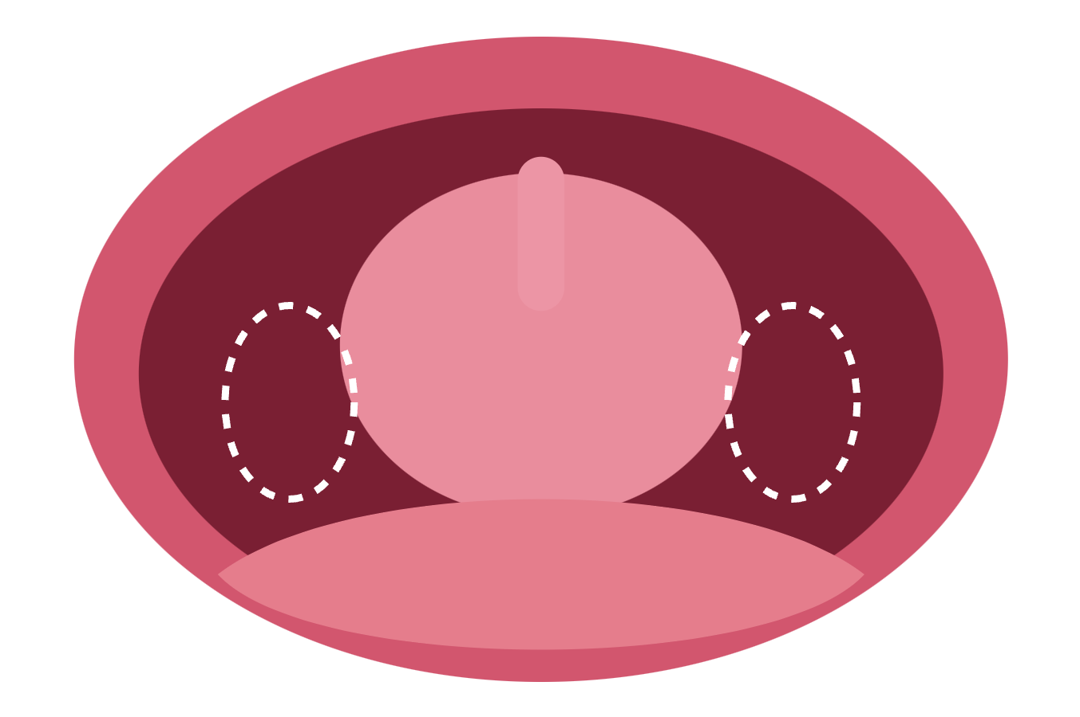


Medical and surgical management
03
TONSILLITIS
MEDICAL MANAGEMENT
Paracetamol
for pain and fever
Adequate fluids
Soft diet
Antibiotics
if bacterial infection is confirmed or indicated
SURGICAL MANAGEMENT
Tonsillectomy
Removal of tonsils, may be indicated in:
Recurrent severe infections
Obstructive sleep apnea

Slide 18


Nursing care
03
TONSILLITIS
1
2
3
4
Monitor temperature
Assess swallowing difficulties
Encourage fluids
Provide soft foods
5
6
7
Administer prescribed medications
Monitor for dehydration
Educate parents about completing prescribed antibiotics

Slide 19
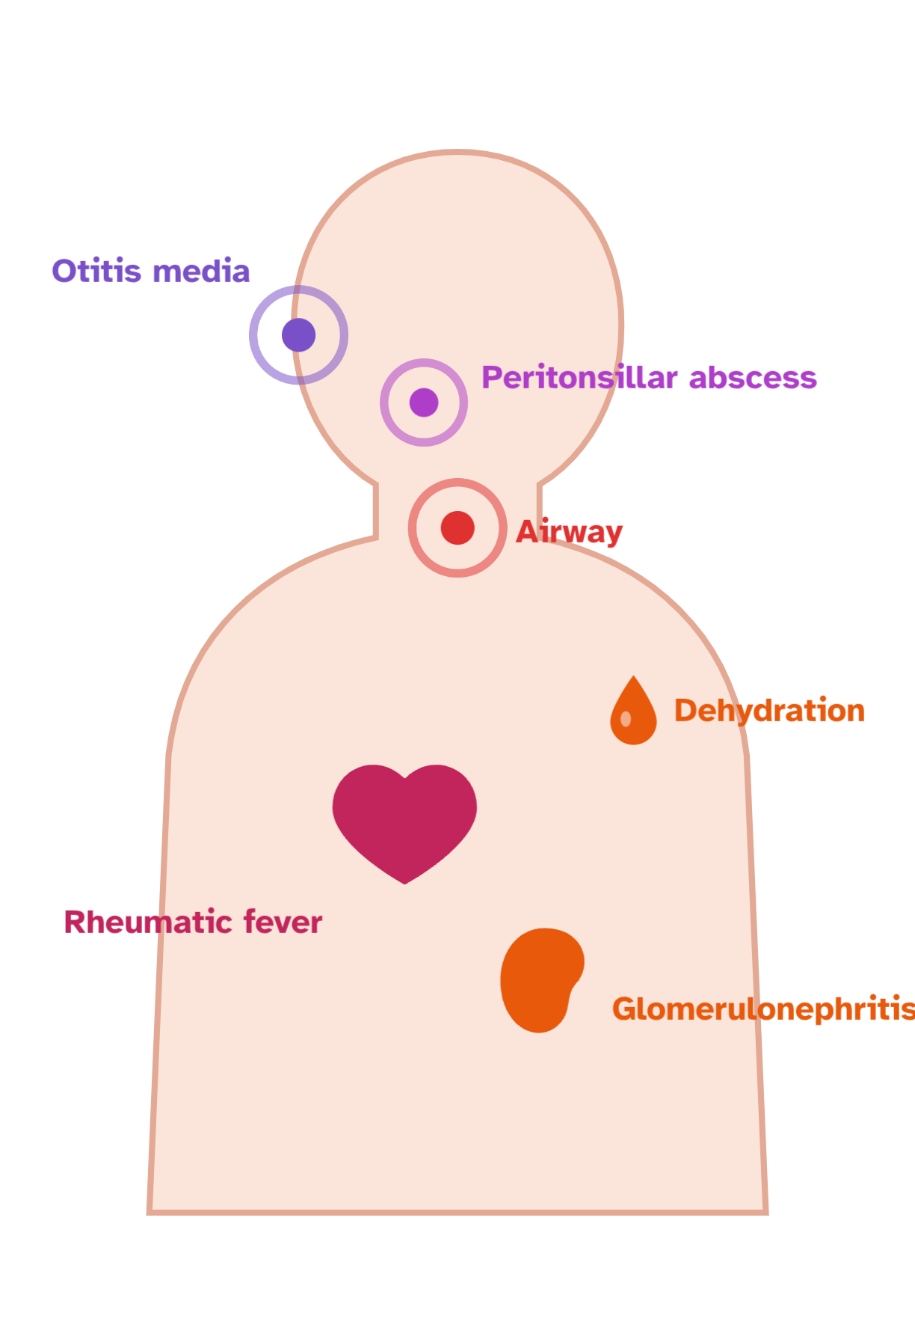



Complications
03
TONSILLITIS
Possible complications
Otitis media
Peritonsillar abscess
Dehydration
Airway obstruction (severe cases)
Complications of Group A Streptococcal infection
Acute rheumatic fever
Post-streptococcal glomerulonephritis

Slide 20

Comparison
PART 4
Comparison between the three conditions

Slide 21
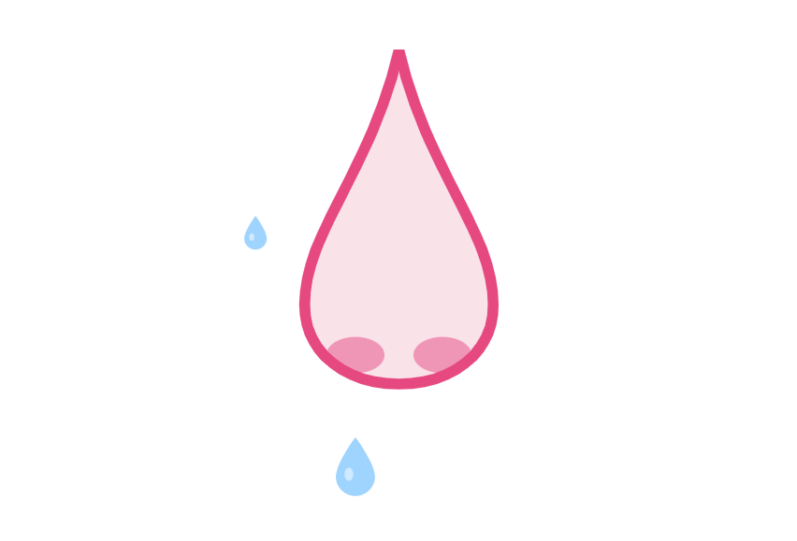
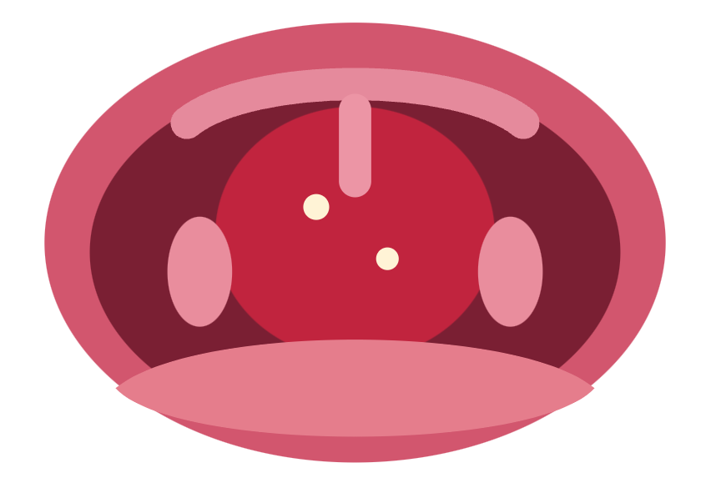
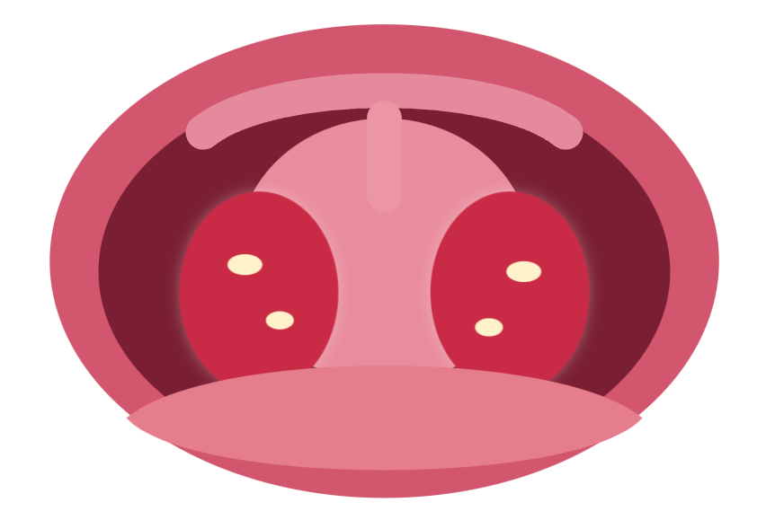
Comparison between the three conditions
04
COMPARISON
Common cold
Pharyngitis
Tonsillitis
Mainly affects the nose
Affects the pharynx
Affects the tonsils
Runny nose and sneezing.
Mild fever.
Normal tonsils usually.
Redness of posterior pharyngeal wall.
Sore throat and painful swallowing.
Enlarged and red tonsils.
Possible tonsillar exudates.
Fever and difficulty swallowing.

Slide 22
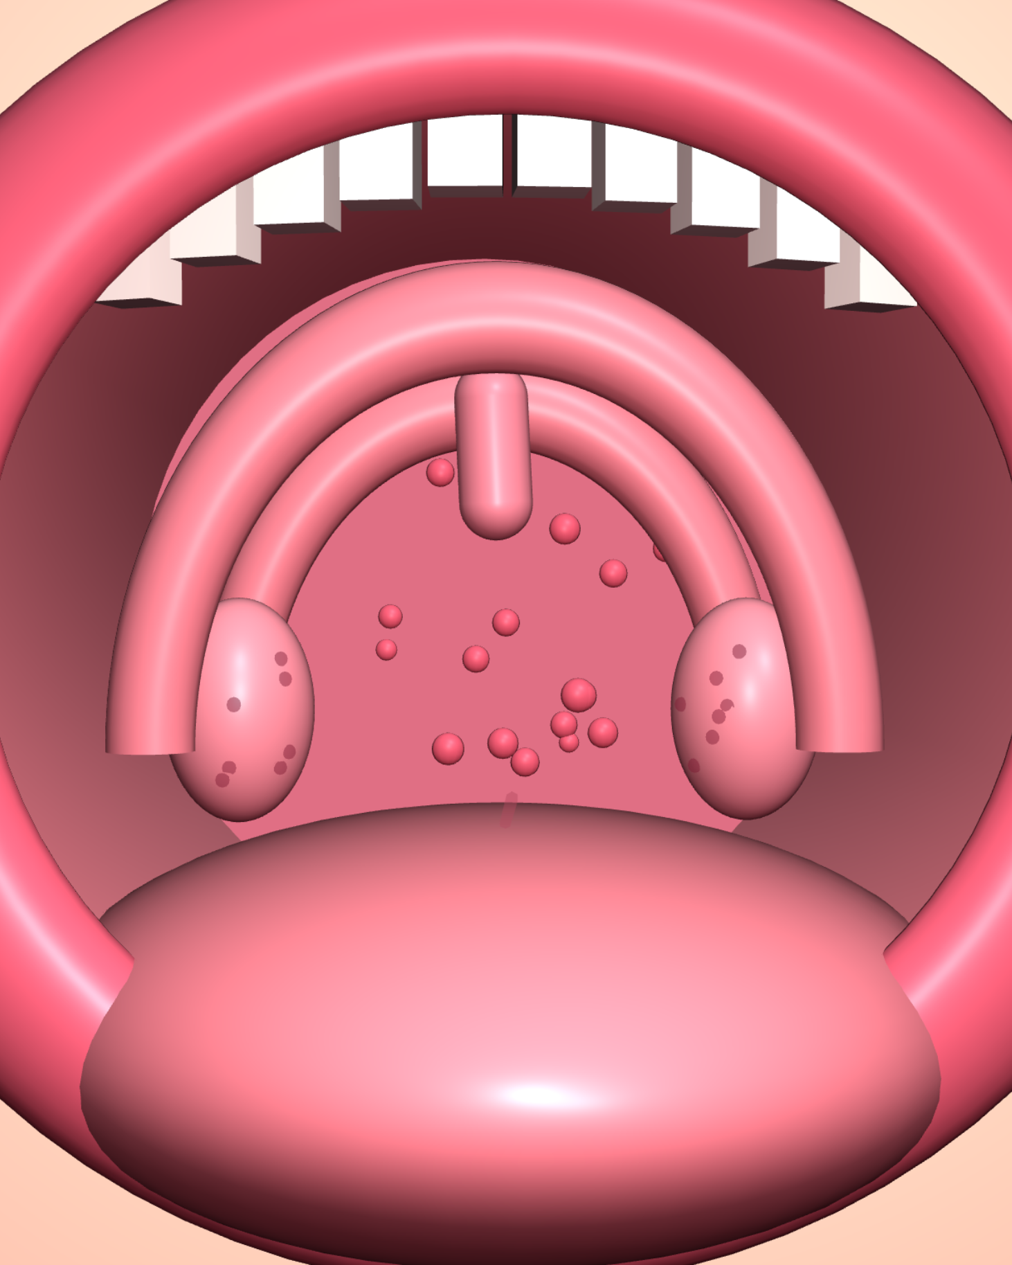
Look into the throat: the four views
04
COMPARISON
Common cold
Pharyngitis
Tonsillitis
Severe tonsillitis
Mild redness of the pharynx · tonsils usually normal
Redness and swelling of the posterior pharyngeal wall · possible white patches
Enlarged, red and swollen tonsils · possible exudates
Tonsils nearly touching each other

Slide 23
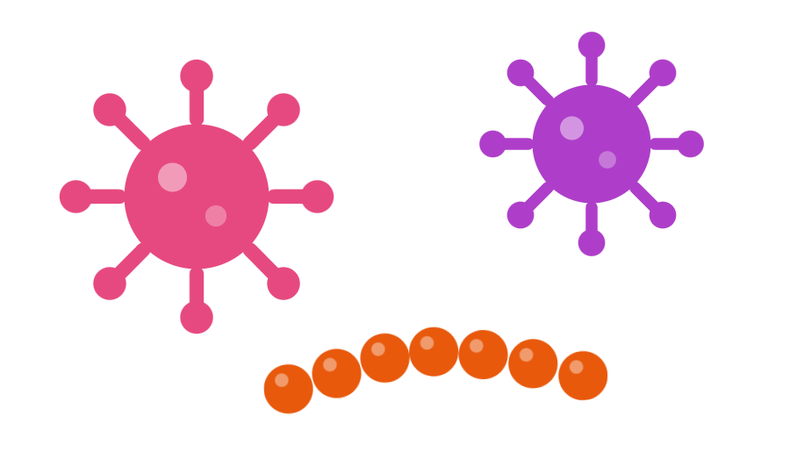
Thank you
Upper respiratory tract infections (URTIs)
PRESENTED BY
Dr. Ruqaiah Alhebshi MBBS

