Slide 1

CLINICAL SKILLS
Basic Clinical
Examination
PRESENTED BY
Dr. Ruqaiah Aidaros Alhebshi
General physical examination
Vital signs
Systemic examination

Slide 2
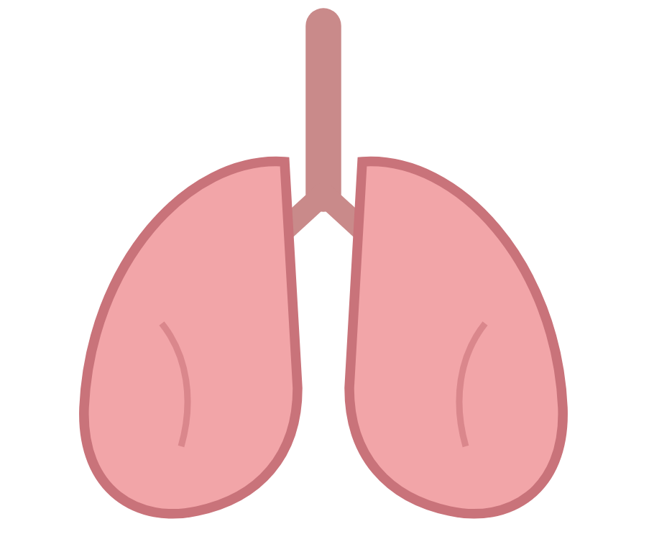
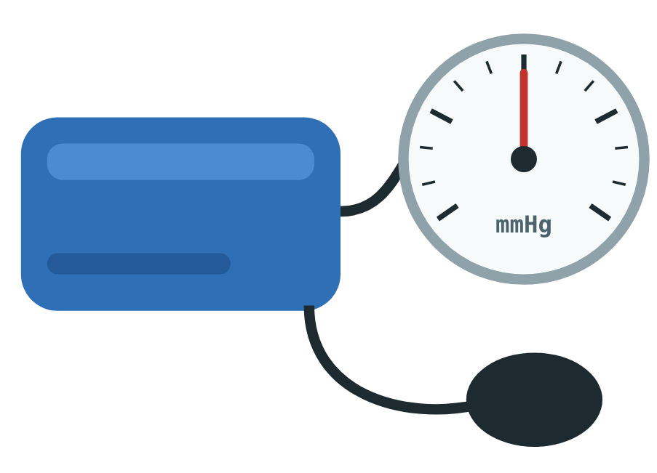
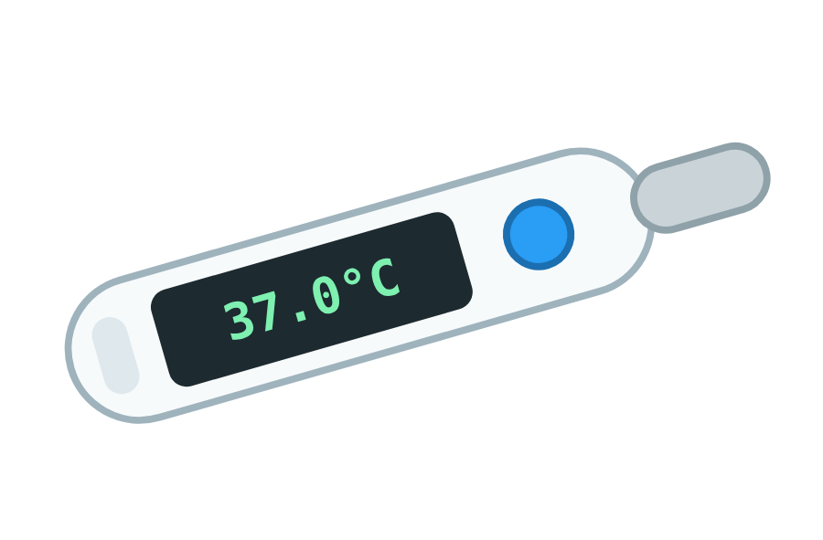
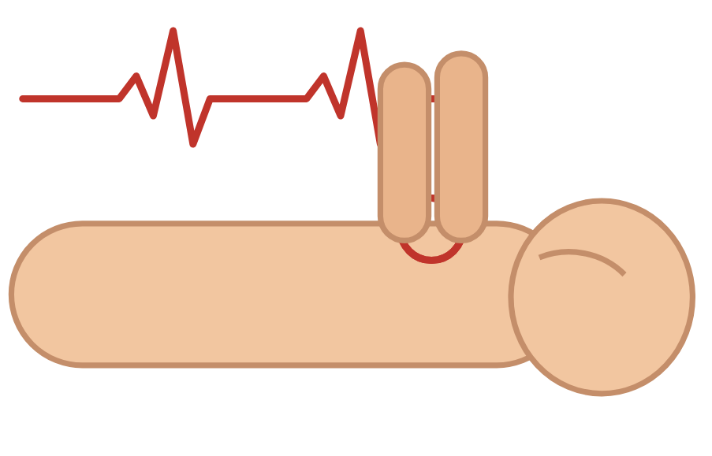
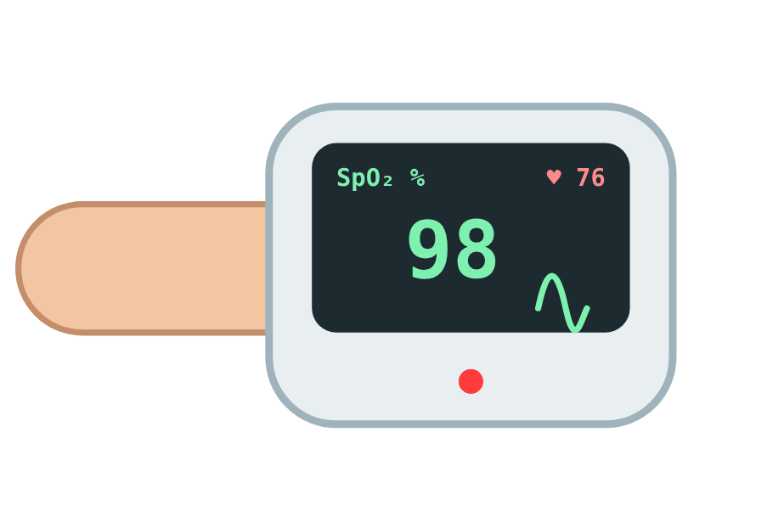
General physical examination
GENERAL EXAMINATION
General examination is a quick assessment of the patient’s overall condition before examining individual body systems.
IT STARTS WITH THE VITAL SIGNS
Temperature
Pulse
Respiratory rate
Blood pressure
SpO₂

Slide 3
Vital signs: normal values
VITAL SIGNS
Temperature
Pulse
Respiratory rate
Blood pressure
SpO₂
36.5–37.5 °C
60–100 /min
12–20 /min
≈ 90/60–120/80 mmHg
95–100 %
Fever ≥38 °C
Hypothermia <35 °C
Tachycardia >100
Bradycardia <60
Tachypnea >20
Bradypnea <12
Hypertension ≥140/90
Hypotension <90/60
Low <94 %
Severe hypoxemia <90 %

Slide 4
Temperature
VITAL SIGNS
NORMAL
36.5–37.5 °C
Hypothermia
Normal
Fever
35
36.5
38 °C
37.5
Normal: 36.5–37.5 °C
Fever: ≥38 °C
DIGITAL THERMOMETER
Hypothermia: <35 °C

Slide 5
Pulse
VITAL SIGNS
NORMAL
60–100 beats/min
Bradycardia
Normal
Tachycardia
60
100 /min
Normal: 60–100 beats/min
Tachycardia: >100 beats/min
RADIAL PULSE
Bradycardia: <60 beats/min

Slide 6
Respiratory rate
VITAL SIGNS
NORMAL
12–20 breaths/min
Bradypnea
Normal
Tachypnea
12
20 /min
Normal: 12–20 breaths/min
Tachypnea: >20/min
COUNT BREATHS PER MINUTE
Bradypnea: <12/min

Slide 7
Blood pressure
VITAL SIGNS
NORMAL ADULT BP · APPROXIMATELY
90/60–120/80 mmHg
Hypotension
Normal
Hypertension
90/60
120/80
140/90
Normal adult BP: approximately 90/60–120/80 mmHg
Hypertension: ≥140/90 mmHg
SPHYGMOMANOMETER
Hypotension: <90/60 mmHg

Slide 8
SpO₂
VITAL SIGNS
NORMAL
95–100 %
Severe hypoxemia
Low
Normal
90
94
100 %
95
Normal: 95–100%
Low: <94%
PULSE OXIMETER
Severe hypoxemia: <90%

Slide 9

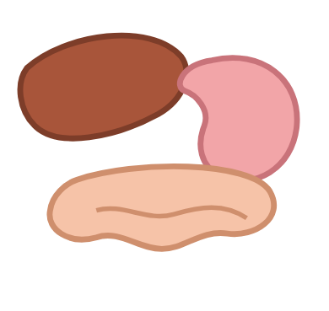
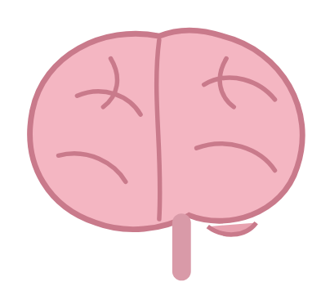

Basic systemic examination
SYSTEMIC EXAMINATION
Basic systemic examination is a focused physical examination of a specific body system to identify abnormal signs.
Main systems
Cardiovascular system
Respiratory system
Abdomen / Gastrointestinal system
Neurological system
Musculoskeletal system

Slide 10


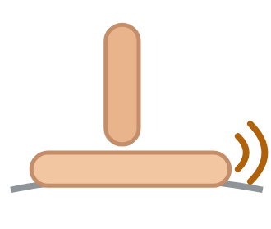

Basic examination sequence
SYSTEMIC EXAMINATION
For most systems:
STEP 1
STEP 2
STEP 3
STEP 4
Inspection
Palpation
Percussion
Auscultation

Slide 11
Cardiovascular System
SYSTEM 1
Inspection
Palpation
Percussion
Auscultation

Slide 12
Cardiovascular system: inspection & palpation
CARDIOVASCULAR SYSTEM
Inspection
Palpation
Pallor
Cyanosis
Edema
JVP
Precordial pulsations
Pulse: rate, rhythm, volume
Peripheral pulses
Capillary refill
Apex beat
Edema
PULSE: RATE, RHYTHM, VOLUME

Slide 13
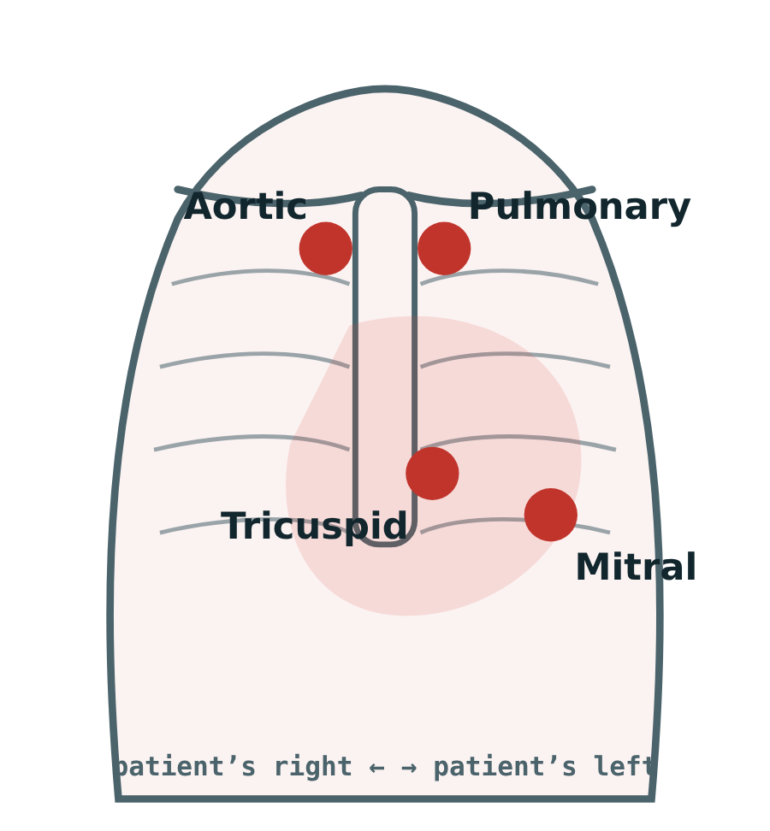
Cardiovascular system: percussion & auscultation
CARDIOVASCULAR SYSTEM
Percussion
Auscultation
Usually not routinely performed
May help estimate cardiac borders
S1 and S2
S3 / S4
Murmurs
Main valve areas
MAIN VALVE AREAS

Slide 14
Respiratory System
SYSTEM 2
Inspection
Palpation
Percussion
Auscultation

Slide 15
Respiratory system: inspection & palpation
RESPIRATORY SYSTEM
Inspection
Palpation
Respiratory rate
Pattern
Chest shape
Chest movement
Accessory muscle use
Cyanosis
Chest expansion
Tracheal position
Tactile vocal fremitus
CHEST MOVEMENT & EXPANSION

Slide 16
Respiratory system: percussion & auscultation
RESPIRATORY SYSTEM
Percussion
Auscultation
Resonant
Normal
Breath sounds
Wheeze
Crackles
Bronchial breathing
Reduced / absent sounds
Dull
Consolidation / effusion
Hyperresonant
Pneumothorax

Slide 17
Abdomen
SYSTEM 3
Inspection
Palpation
Percussion
Auscultation

Slide 18
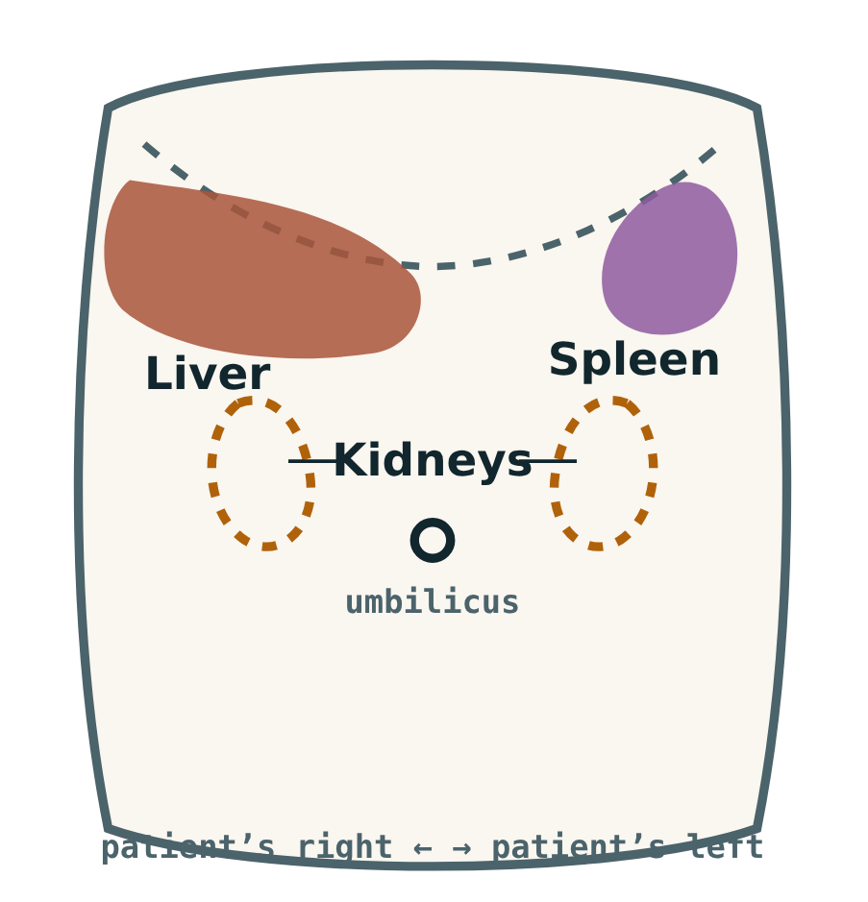
Abdomen: inspection & palpation
ABDOMEN
Inspection
Palpation
Distension
Scars
Masses
Visible veins
Umbilicus
Tenderness
Guarding / rigidity
Masses
Liver
Spleen
Kidneys
LIVER · SPLEEN · KIDNEYS

Slide 19
Abdomen: percussion & auscultation
ABDOMEN
Percussion
Auscultation
Liver
Spleen
Ascites
Bowel sounds
Bruits when indicated
ABDOMEN / GI SYSTEM

Slide 20
Neurological System
SYSTEM 4
Inspection
Assessment
Reflexes

Slide 21
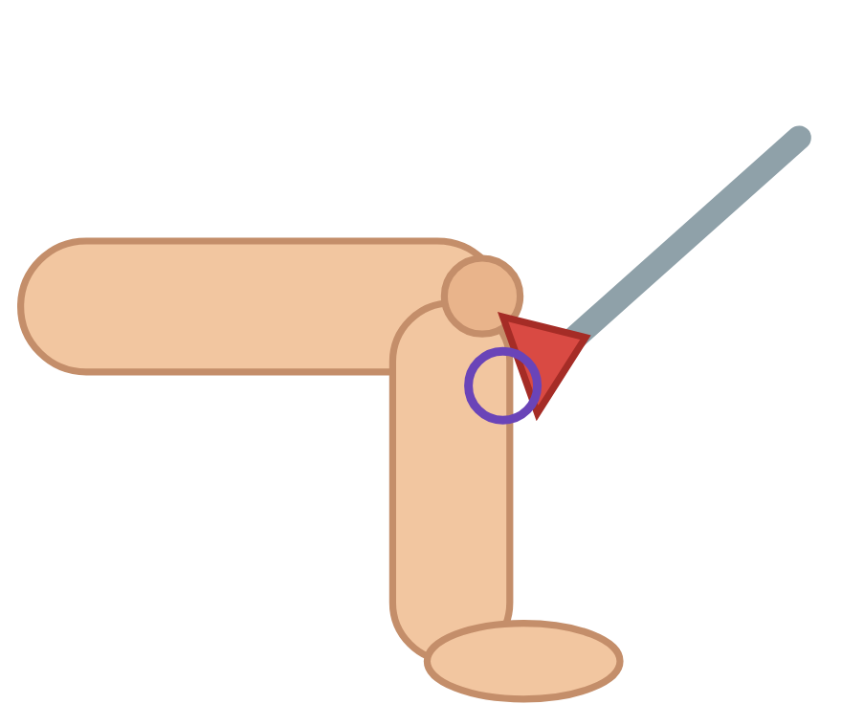

Neurological system
NEUROLOGICAL SYSTEM
Inspection
Assessment
Level of consciousness
Speech
Posture
Gait
Involuntary movements
Cranial nerves
Muscle power
Muscle tone
Sensation
Coordination
Reflexes: deep tendon reflexes
DEEP TENDON REFLEX
GAIT

Slide 22
Thank
you
BASIC CLINICAL EXAMINATION
Dr. Ruqaiah Aidaros Alhebshi

