Slide 1
Design and Implementation of a Multi-Floor TCN Organization
Cisco Packet Tracer Based LAN Project
Presented By:
Muhammad Hassan – F24608010
M Rehan Muddassir – F24608041
Course:
Computer Networks

Slide 2
INTRODUCTION & OBJECTIVES
Modern organizations require reliable and scalable networks
Multiple departments across different floors need secure communication
Manual IP assignment is inefficient and error-prone
Project Objectives:
Design a multi-floor enterprise LAN
Implement VLAN-based segmentation
Enable inter-VLAN communication
Automate IP addressing using DHCP
Deploy Web and Email services

Slide 3
NETWORK TOPOLOGY & DESIGN
Hierarchical star topology was selected
Ground floor acts as the core network layer
Each floor has a dedicated access switch
VLANs are assigned per department
Router-on-a-stick is used for inter-VLAN routing
Benefits:
Scalability
Easy management
Reduced broadcast traffic

Slide 4
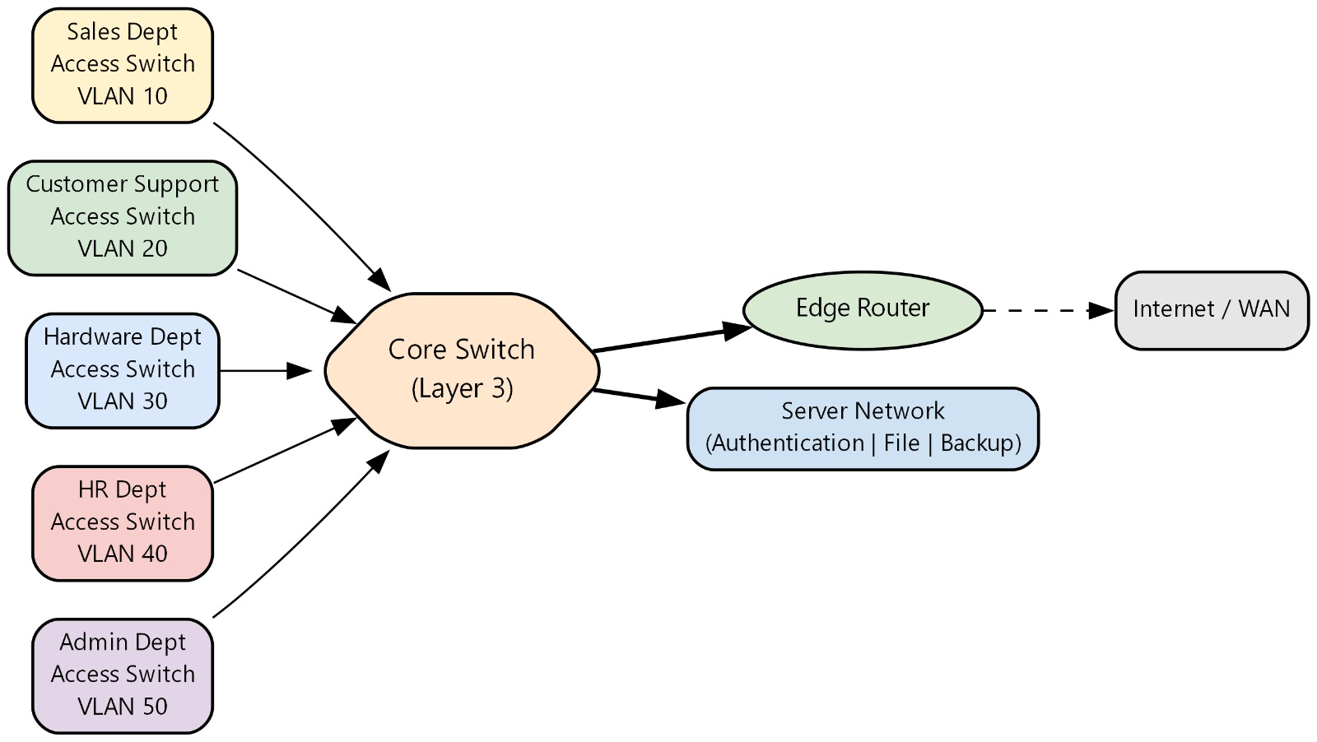
Topology preview

Slide 5
VLAN & IP ADDRESSING SCHEME
Separate VLAN created for each department
VLSM applied on 199.99.99.0/24 network
Efficient IP utilization based on department size
Examples:
Sales VLAN – 199.99.99.0/27
Software VLAN – 199.99.99.32/27
Administration VLAN – 199.99.99.128/28
Management/Servers VLAN – 199.99.99.224/28

Slide 6
ROUTING & DHCP IMPLEMENTATION
Router-on-a-stick used for inter-VLAN routing
Subinterfaces created for each VLAN
Default route configured for Internet access
DHCP Implementation:
Centralized DHCP on router
Automatic IP assignment to all PCs
Reduced configuration errors
Improved scalability

Slide 7
NETWORK SERVICES (WEB & EMAIL)
Web Server:
Hosts internal enterprise website
Accessible from all VLANs
Email Server:
Provides internal communication
Uses SMTP and POP3
Domain-based email addressing
DNS Service:
Resolves web and mail server names
Enables hostname-based access

Slide 8
ISSUES FACED & SOLUTIONS
Issues Faced:
Inter-VLAN ping failure
VLAN not active on trunk
Email client domain mismatch
Solutions Applied:
VLANs created on all switches
Trunk ports properly configured
Correct DNS records and email domain setup

Slide 9
CONCLUSION & FUTURE ENHANCEMENTS
Conclusion:
Successfully designed and implemented a multi-floor enterprise LAN
VLANs improved security and traffic management
DHCP and routing ensured efficient communication
Web and Email services validated application-layer functionality
Future Enhancements:
Implement network security (ACLs, firewall)
Add wireless LAN infrastructure
Introduce redundancy using multiple routers
Implement monitoring and logging tools

Slide 10
Thank you

