Slide 1
NEO: A Decentralized Social Media Platform
Group Members:
Wilayat Ali (F22-BSCS-006)
Hassan Raza (F22-BSCS-022)
Maham Zaka (F22-BSCS-013)

Slide 2
Problem Statement / Type of Work:
Addressing the "Centralization Trap" where reliance on central servers leads to censorship, mass surveillance, and communication blackouts during internet outages or disasters.
Serverless, peer-to-peer social media application using Bluetooth mesh networking.

Slide 3
Literature Review / Background (Table)
Existing System
Technology Used
Limitation
How Neo Improves
Bridgefy
Bluetooth Mesh
Only messaging, no feed
Full social feed with posts and reactions
Briar
Secure P2P messaging
No public social content
Supports public posts and comments
Manyverse
Scuttlebutt protocol
Heavy and not Bluetooth-optimized
Lightweight Bluetooth-based system
Traditional Social Media
Central servers
Censorship, outages, surveillance
Fully decentralized, serverless

Slide 4

Business Scope
Target Users:
Market Need:
Disaster-affected communities
Rural or internet-deprived areas
Privacy-sensitive users
Emergency response teams
Communication without internet
Privacy-preserving social platforms
Resilient communication systems
Potential Applications:
Disaster coordination
Local community networks
Secure field communication

Slide 5
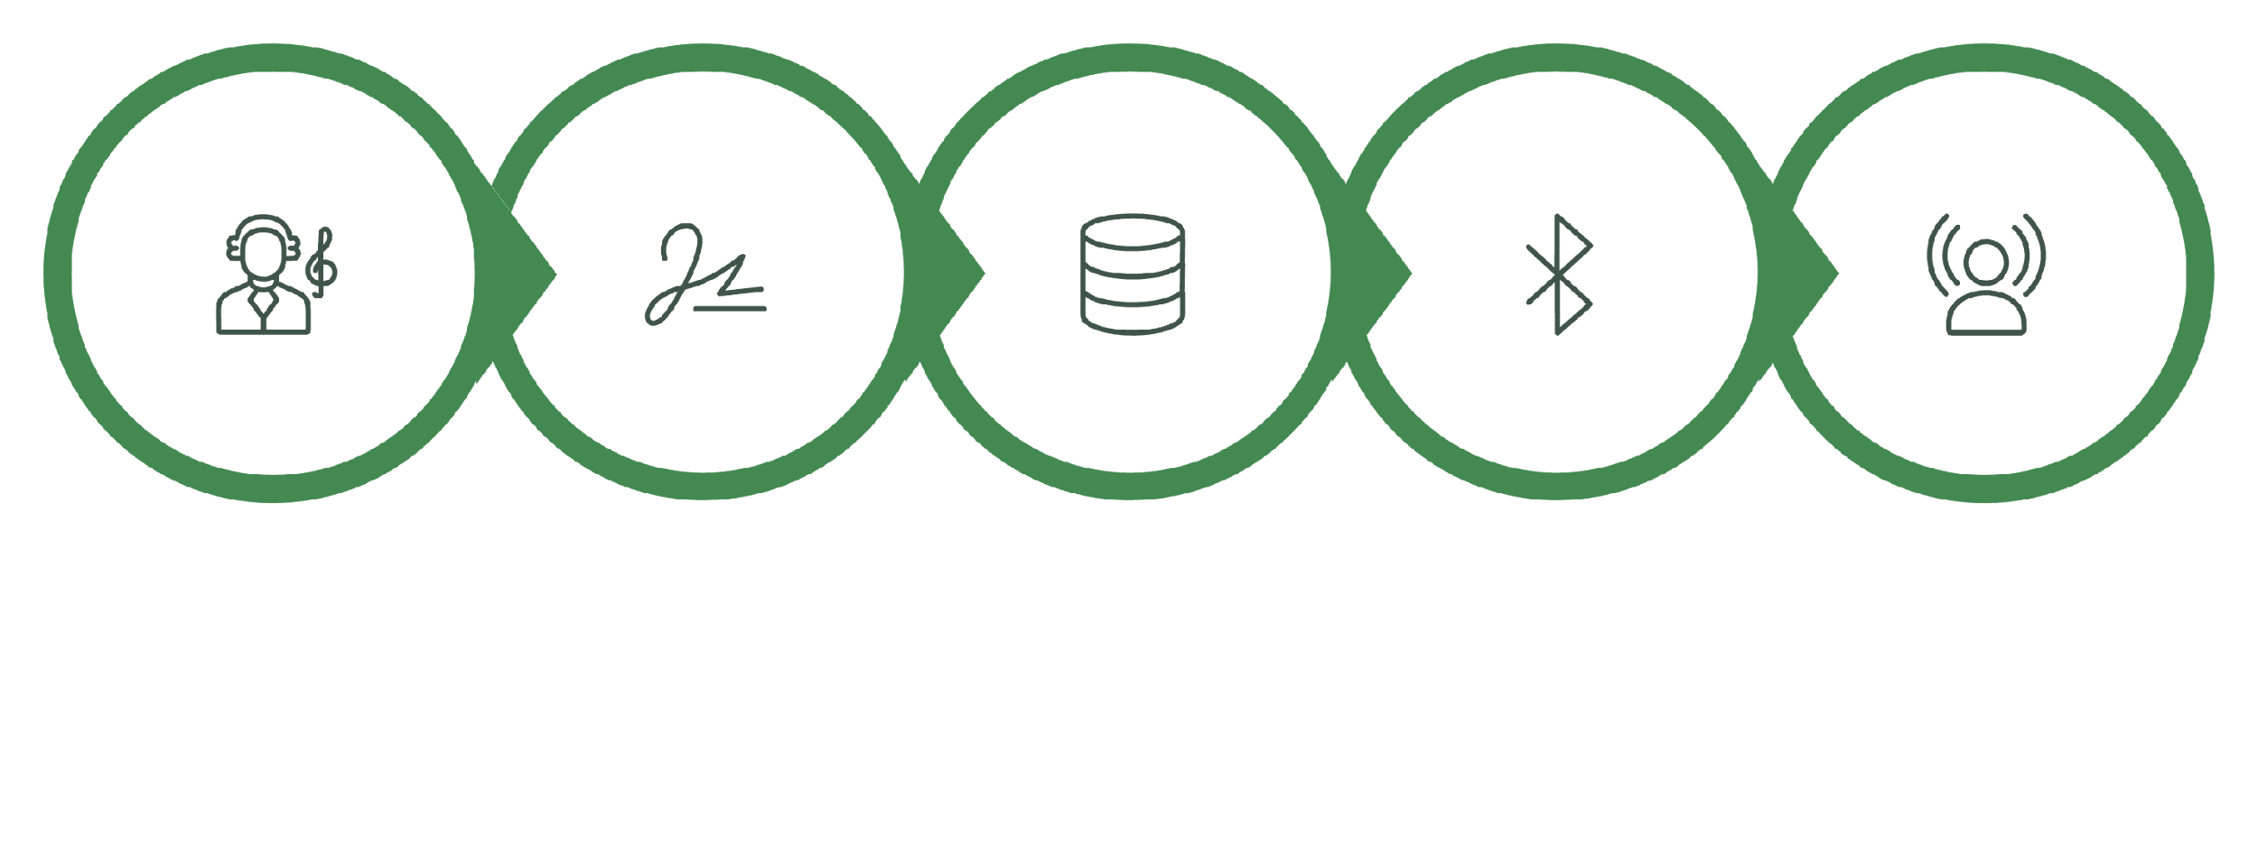

Methodology / Framework
System Workflow
Digitally Sign
Discover Peers
Gossip Broadcast
Create Post
Save Locally
Result: Serverless, decentralized data propagation.

Slide 6
Tools and Languages
Programming Language:
Networking:
Kotlin
Bluetooth Classic
Bluetooth Low Energy (BLE)
Frameworks:
Jetpack Compose (UI)
Room Persistence Library
Security:
Ed25519 digital signatures
Android Keystore
Development Tools:
Android Studio
StarUML

Slide 7

Constraints and Limitations
Limited Bluetooth range
Slower propagation compared to internet
No video support
Mesh performance depends on number of nearby devices

Slide 8
Work Breakdown with Timelines
Project Timeline (227 Days)
Phase
Duration
Key Tasks
Planning
Sep 2025
Idea finalization, research
Design
Oct–Nov 2025
Architecture, UI mockups
Development
Dec 2025 – Feb 2026
Core features, gossip protocol, security
Testing
Mar 2026
Multi-device testing
Finalization
Apr 2026
Documentation and presentation

Slide 9

Conclusion
Successfully built a 100% serverless social media platform.
Implemented Bluetooth mesh networking using gossip protocol.
Ensured cryptographic trust using Ed25519 signatures.
Achieved offline-first communication with local database.
Demonstrated reliable text and image propagation across devices.
Neo proves that social communication can exist without central servers or internet.

Slide 10
References
Android Developer Documentation
Bluetooth Mesh Networking Research Papers
Ed25519 Cryptographic Documentation
Jetpack Compose Official Guides
Room Persistence Library Documentation

