Slide 1

Ciphertext-Policy Attribute-Based Encryption
By: Max Dawson, Evan Hassan, and Marcel Jonas
Notes:
marcel

Slide 2
Our Goal
To monitor the impact on performance of a Kali Linux system when encrypting and decrypting text files using a different number of attributes for key generation.
Notes:
marcel

Slide 3
Motivation
Not many people trust the security of usernames and passwords to properly protect data; we continue to use them for data access
Security concerns are a primary focus for information systems, given the fact that cloud computing has fundamentally changed the spectrum of computers, storage, and services
CP-ABE is a countermeasure that provides cloud security and access control
Allows encryption and decryption of data based upon attributes/credentials describing users; data owner will chose eligible users to access information
Motivation behind our interest in exploring the CP-ABE cryptosystem
Notes:
Evan

Slide 4
Types of CryptoSystems
Homomorphic encryption(HE)
cryptosystem with the additional property
Example - E(X1)+E(X2) = E(X1+X2) and will become X1 + X2
Full Homomorphic Cryptosystems(FHE)
which supports both addition and multiplication. Such a system also preserves the useful algebraic properties, but it is very taxing on the system.
Partially Homomorphic Cryptosystems(PHE)
more efficient of the two systems at the moment
Can only support certain mathematical functions
CP-ABE is a partially homomorphic
Notes:
Allow to do products and sums of encrypted files
marcel

Slide 5
Types of CryptoSystems con.
Functional Encryption (FE)
enables fine control of sensitive data by allowing users to only compute certain functions for which they have a key.
An example of this would be a picture that is blurred out where the patient to protect that person's privacy
Notes:
Marcel

Slide 6
What is Ciphertext-Policy Attribute-Based Encryption (CP-ABE)?
CP-ABE is a cryptosystem, where a user’s private key is associated with a set of attributes (user’s permissions)
An encrypted ciphertext will specify an access policy over attributes
A user will be able to decrypt if and only if his/her attributes satisfy the ciphertext policy
Embeds encryption into the actual data and defines the access rights
Notes:
marcel

Slide 7
CP-ABE : A Case Study
http://acsc.cs.utexas.edu/cpabe/tutorial.html
Notes:
marcel

Slide 8
CPABE Toolkit
Set of programs to facilitate keygeneration, encryption, and decryption.
Consists of two different libraries Cpabe and Libbswabb
Libbswabb is the library Cpabe is built on
Cpabe contains the user interface and core functions.
Cpabe is the library that does the crypto operations.
http://acsc.cs.utexas.edu/cpabe/
Notes:
marcel

Slide 9
How We Did Our Testing
Automate script to aid in performing key-generation, encryption and decryption of a text file.
Text generation scripts to create large amounts of unique attributes.
Text manipulation scripts to append generated attributes to automation script.
All scripts created aided in the process of testing the differing number of attributes used for key generation.
Notes:
MAx

Slide 10

Cpabe Layout
CP-ABE uses a tree structure with different keys in order to access given attributes
Setup Phase - Generates public key (PK) and master key (MK)
Key Generation Phase - Obtains MK and a number of attributes that define the key (S) and outputs the private key(SK)
Encrypt Phase - Takes PK and a message (M), along with an access structure for all the attributes (A). Outputs ciphertext (CT), which embeds (A).
Decrypt Phase - Takes PK, the CT (which contains the access policy) and the S (for given set of attributes) and tries to decrypt ciphertext. Returns message (M) back again if successful
Notes:
Evan

Slide 11
CP-ABE Example
Simple example using cpabe
$ cpabe-keygen -o phil_priv_key pub_key master_key \
attorney legal_department 'emp_id = 8404'
$ cpabe-enc pub_key test.txt 'legal_department and (attorney or emp_id)'
$ cpabe-dec pub_key phil_priv_key test.txt.cpabe
$ ls master_key pub_key phil_priv_key test.txt
Notes:
Evan

Slide 12
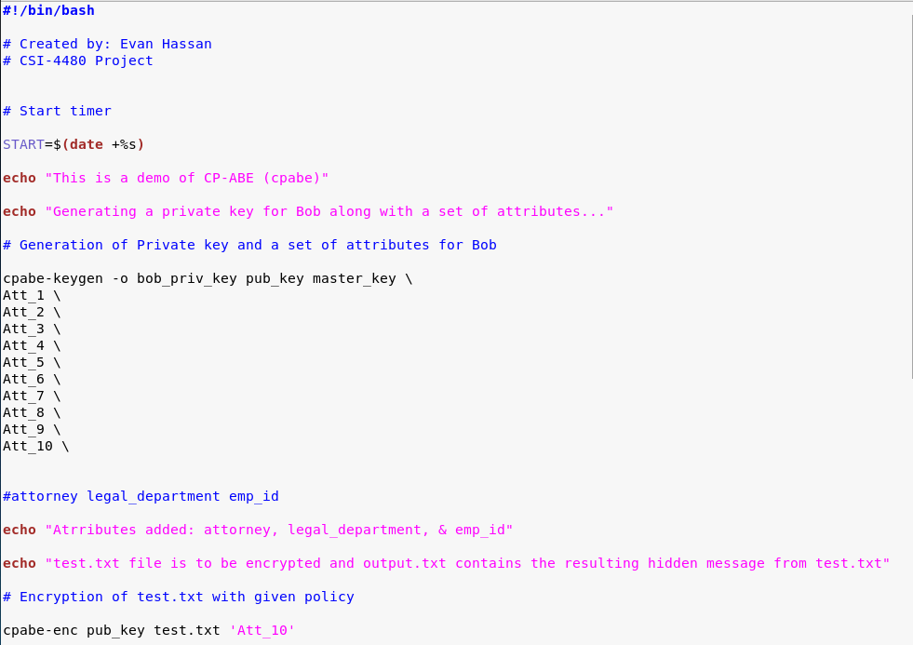
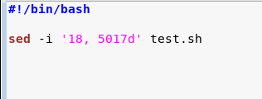
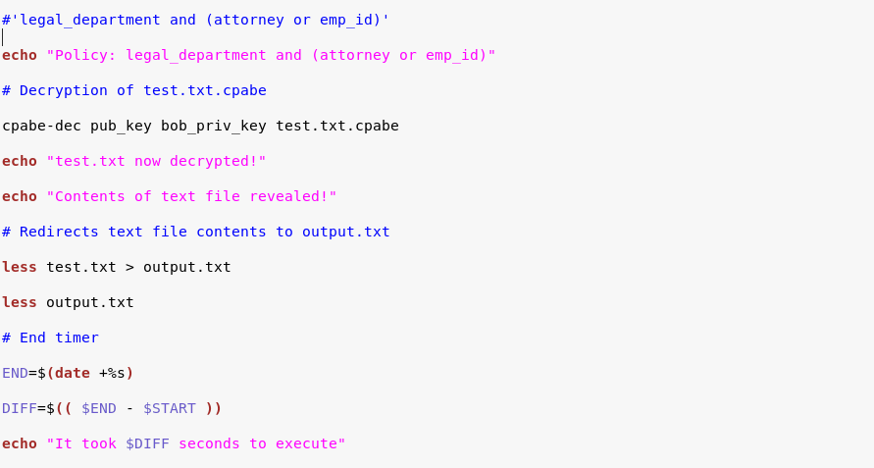
Starts the timer
Creates Bob’s Private key with list of attributes below
Policy that the decryption is looking for
Remove the lines within a range
Decrypts test.txt.cpabe
Redirects test.txt text into output.txt
Ends timer and prints the time
Notes:
Evan

Slide 13
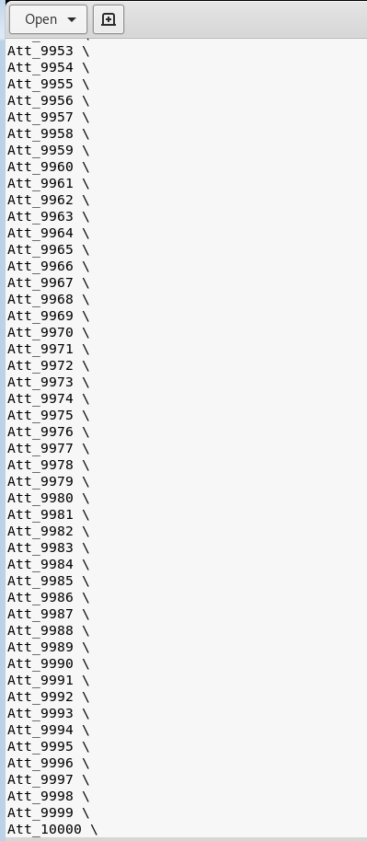
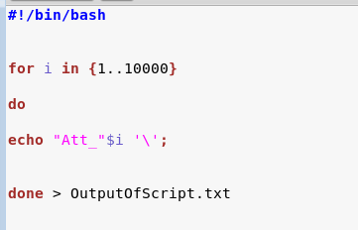

Loop that can be controlled to print the attributes into OutputofScript.txt
Content of the OutputifScript.txt
Takes the content in text file and prints into line 18 for test.sh
Notes:
Evan

Slide 14
Timeline / Progress
Research & Analysis
2-13-19 (2 weeks)
Cryptographic tools & testing
2-27-19 (2 weeks)
Midterm Report & midterm presentation preparation
3-6-19 (1 week)
Implementation
3-20-19 (2 weeks)
Final presentation preparation
4-3-19 (2 weeks)
Final report & Peer reviews
4-16-19 (approximately 2 weeks)

Slide 15

Demo
Notes:
Max

Slide 16

Any questions?

Slide 17
References
Lai, Junzuo & Deng, Robert & Yang, Yanjiang & Weng, Jian. (2014). Adaptable Ciphertext-Policy Attribute-Based Encryption. 10.1007/978-3-319-04873-4_12.
Bethencourt, John & Sahai, Amit & Waters, Brent. (2007). Ciphertext-Policy Attribute-Based Encryption. Proceedings - IEEE Symposium on Security and Privacy. 321-334. 10.1109/SP.2007.11.
“Ciphertext-Policy Attribute-Based Encryption.” Advanced Crypto Software Collection, 1 Dec. 2006, http://hms.isi.jhu.edu/acsc/cpabe/
Buchanan, Bill. “Ciphertext-Policy Attribute-Based Encryption.” YouTube, uploaded by Bill Buchanan OBE, 3 January 2019, https://www.youtube.com/watch?v=pd42NCGiryQ.
Parit, Sneha C. and Rachh, Rashmi “Ciphertext Policy Attribute Based Encryption” International Research Journal of Engineering and Technology (IRJET), vol. 4, no. 4, 2017, https://www.academia.edu/33454777/Ciphertext_Policy_Attribute_Based_Encryption. Accessed 20 March 2019.
Zamani, M., & Movahedi, M. (n.d.). 8 Homomorphic Encryption. Retrieved April 4, 2019, from http://mahdiz.com/crypto/basics/page-8.html#prev
Agrawal, S., & WU, D. J. (n.d.). Functional Encryption: Deterministic to Randomized Functions from Simple Assumptions. Retrieved April 4, 2019, from https://www.cs.virginia.edu/dwu4/talks/UCLASeminar0916.pdf

