Slide 1
Autofy CRM

Slide 2
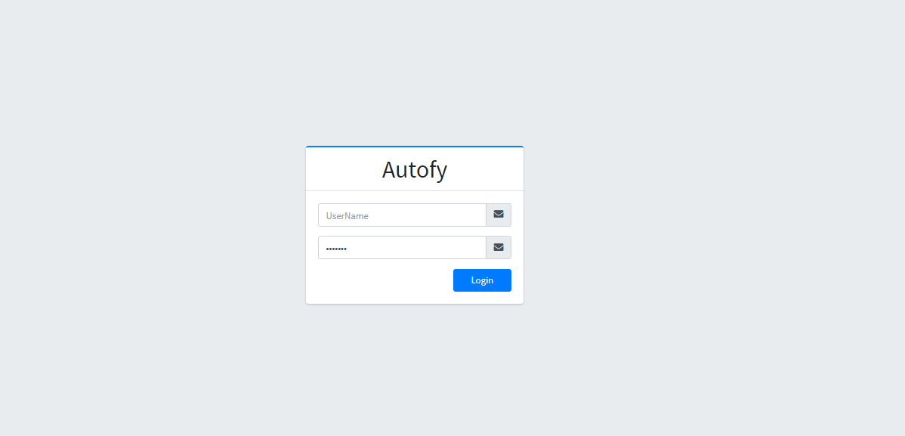
Login

Slide 3
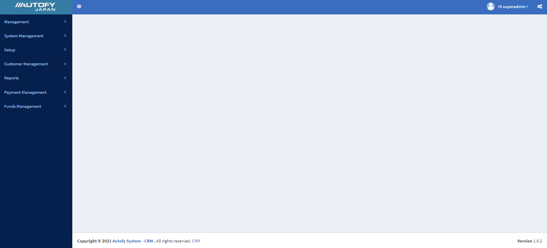
Administration area

Slide 4
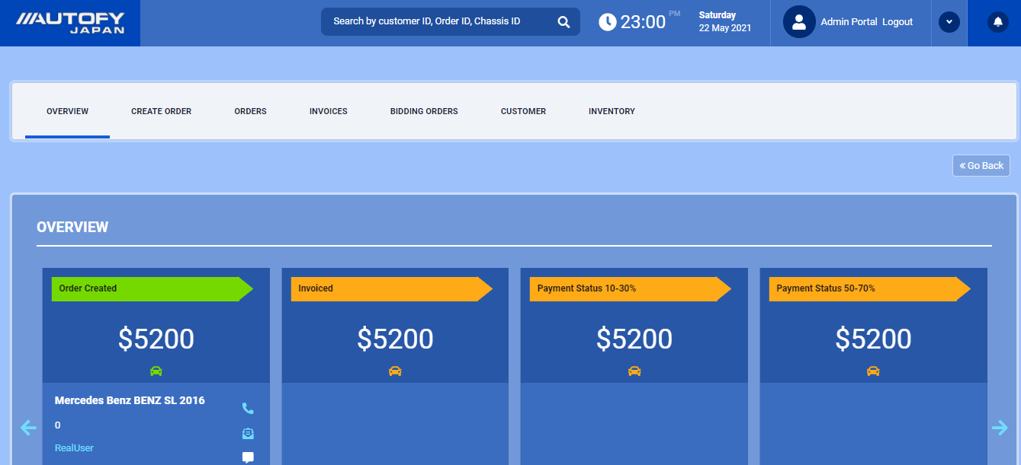
Agent Area

Slide 5
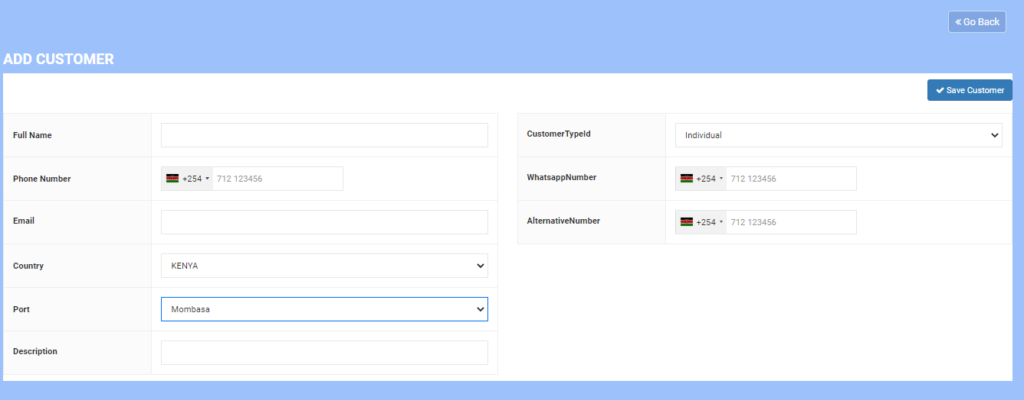
Create Customer Lead

Slide 6
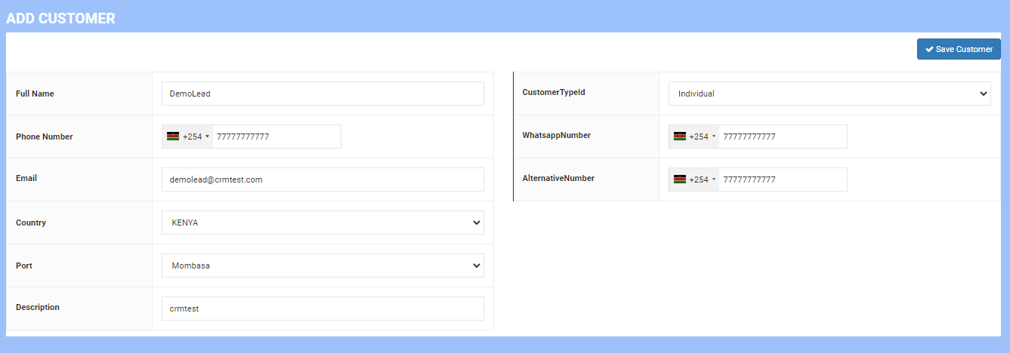
Sample Customer Lead

Slide 7
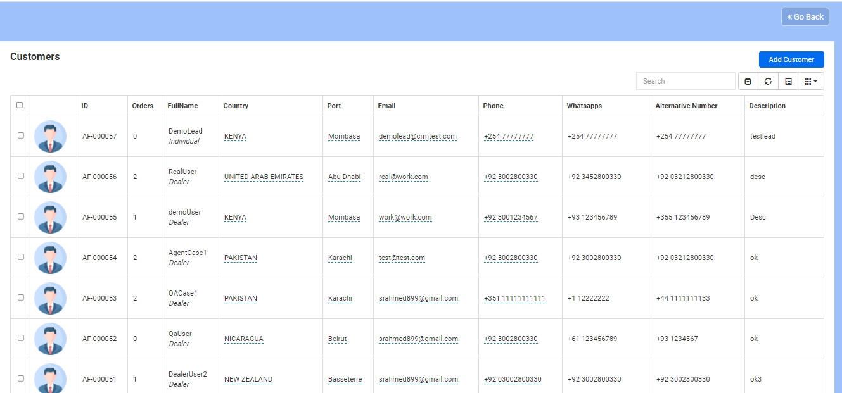
Customer Lead Listing

Slide 8
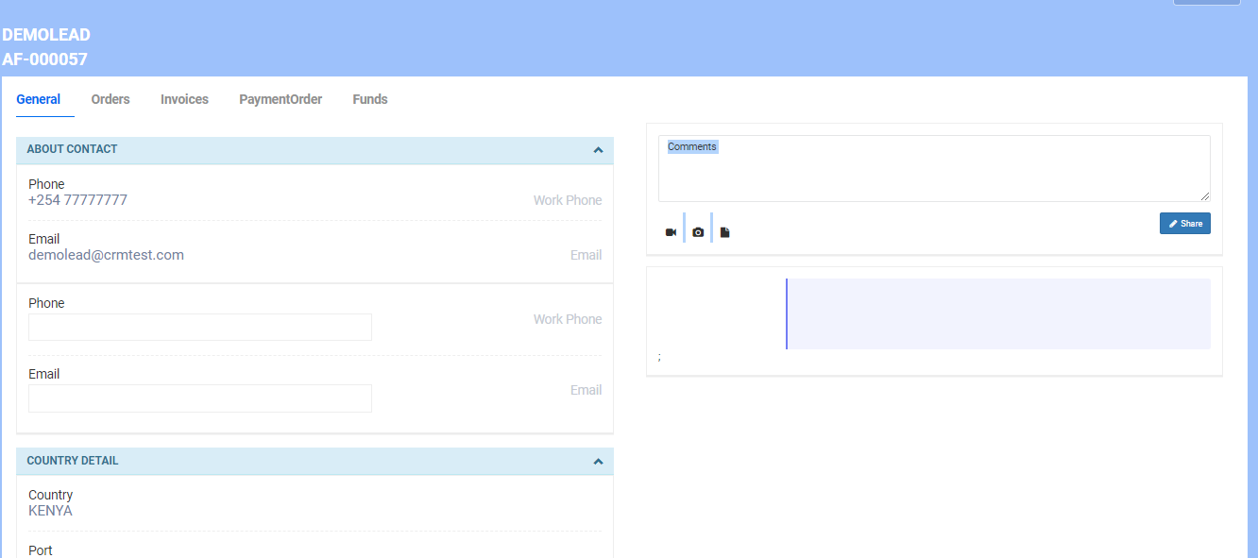
Customer Profile section

Slide 9
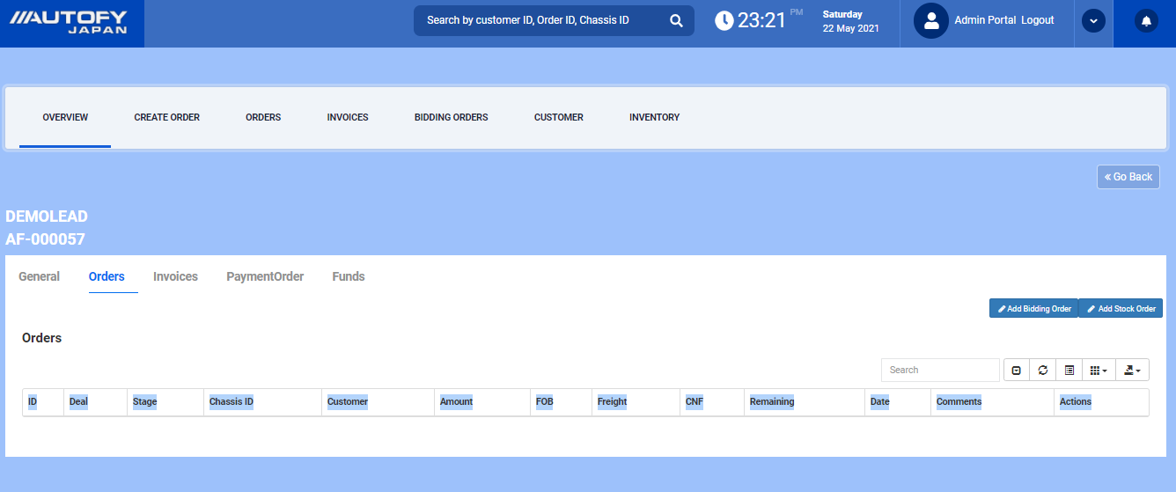
Customer Profile section:Orders

Slide 10
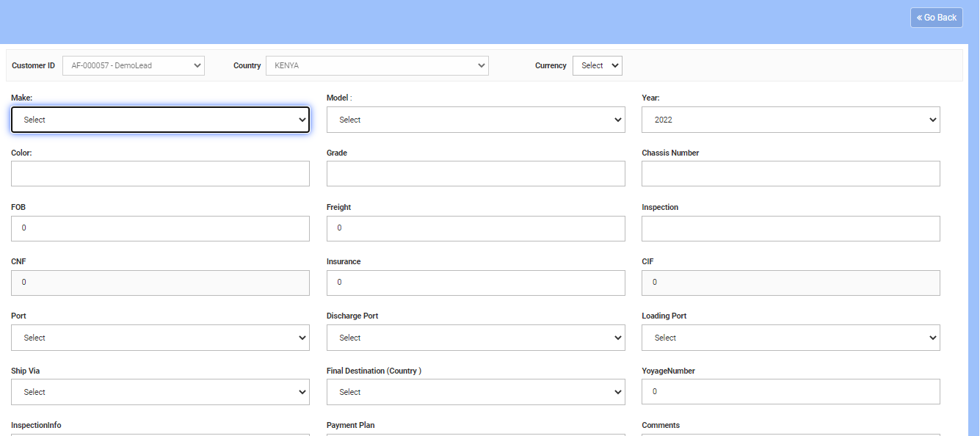
Customer Profile : Add Stock Order

Slide 11
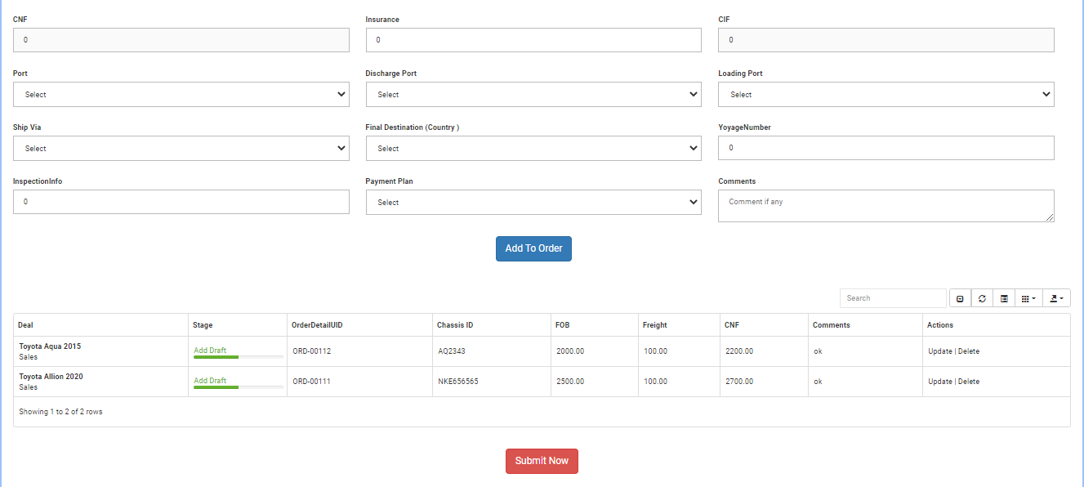
Customer Profile : Add Stock Order

Slide 12
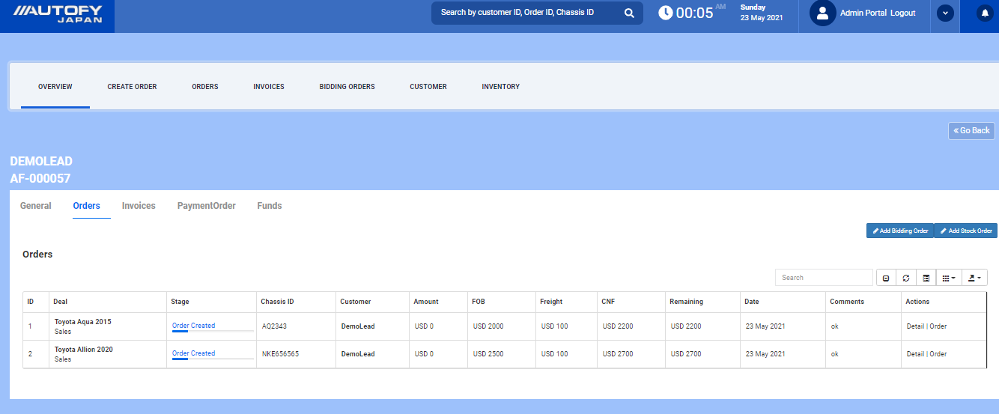
Customer Profile : Add Stock Order

Slide 13
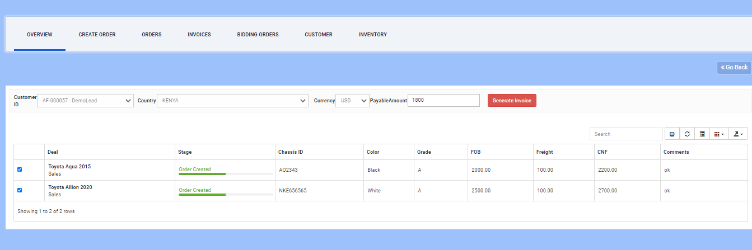
Add Stock Order : Generate PDF Invoice

Slide 14
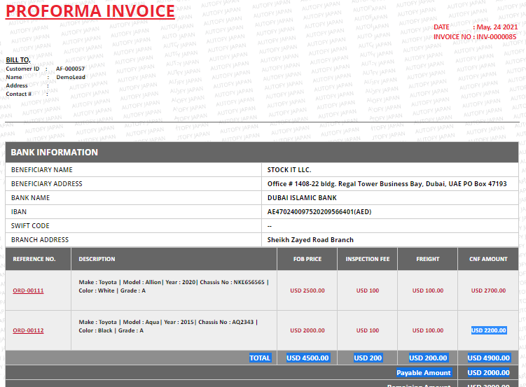
Add Stock Order : Generate PDF Invoice

Slide 15
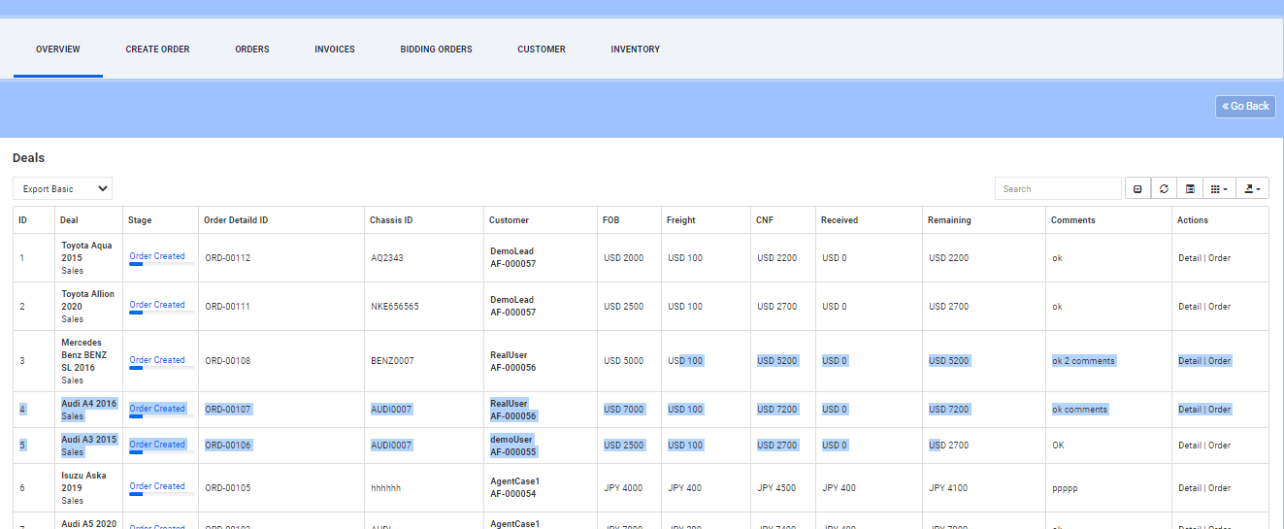
Add Stock Order :all order listing

Slide 16
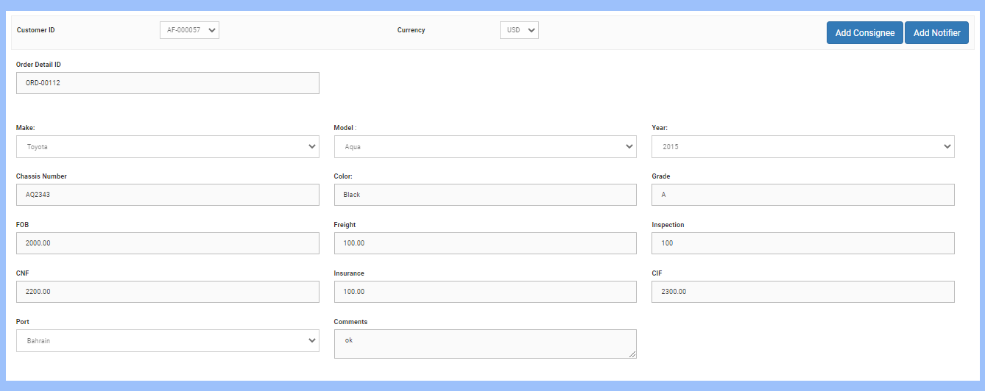
Add Stock Order :Consignee & Notifier

Slide 17
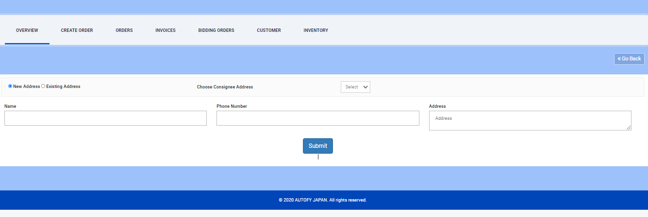
Add Stock Order :Consignee & Notifier

Slide 18
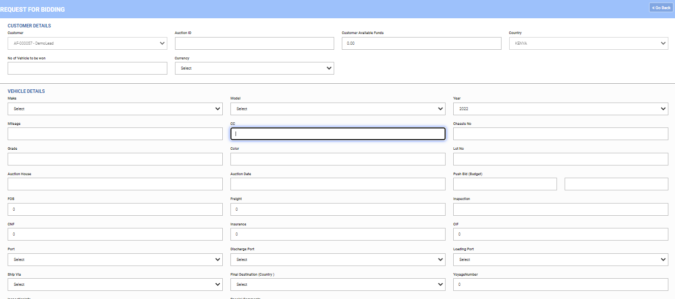
Customer Profile : Add Bidding Order

Slide 19
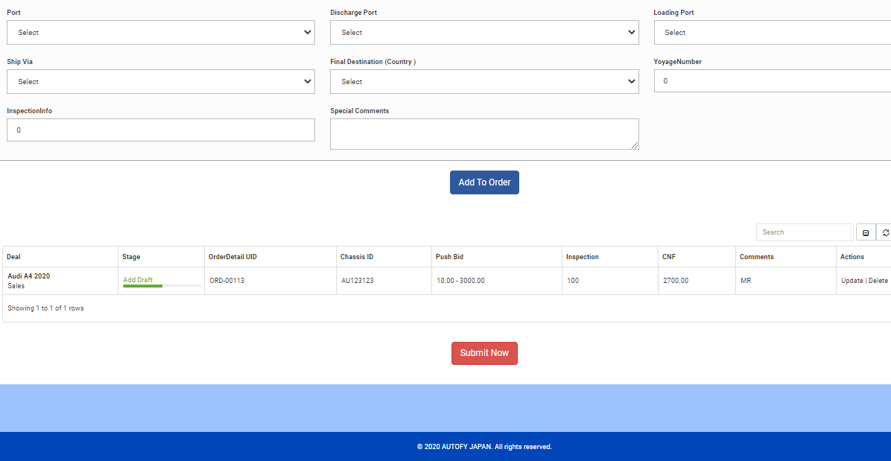
Customer Profile : Add Bidding Order

Slide 20
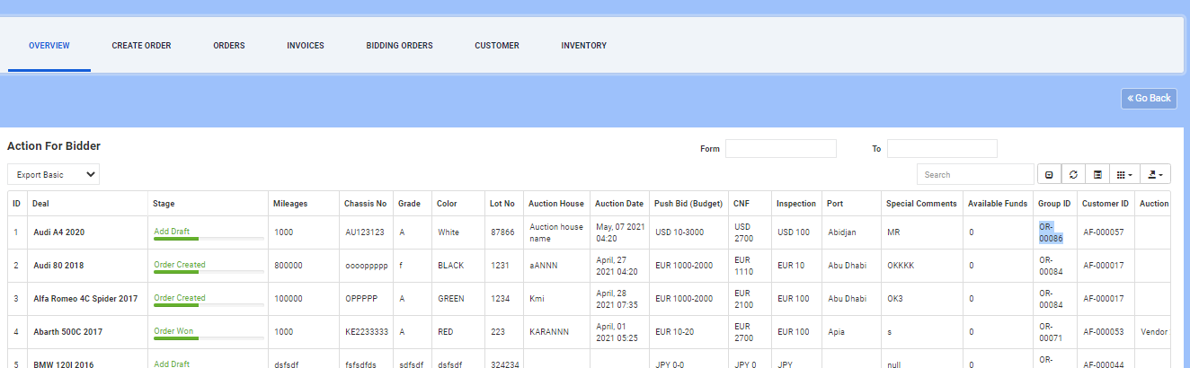
Add Bidding Order: listing

Slide 21
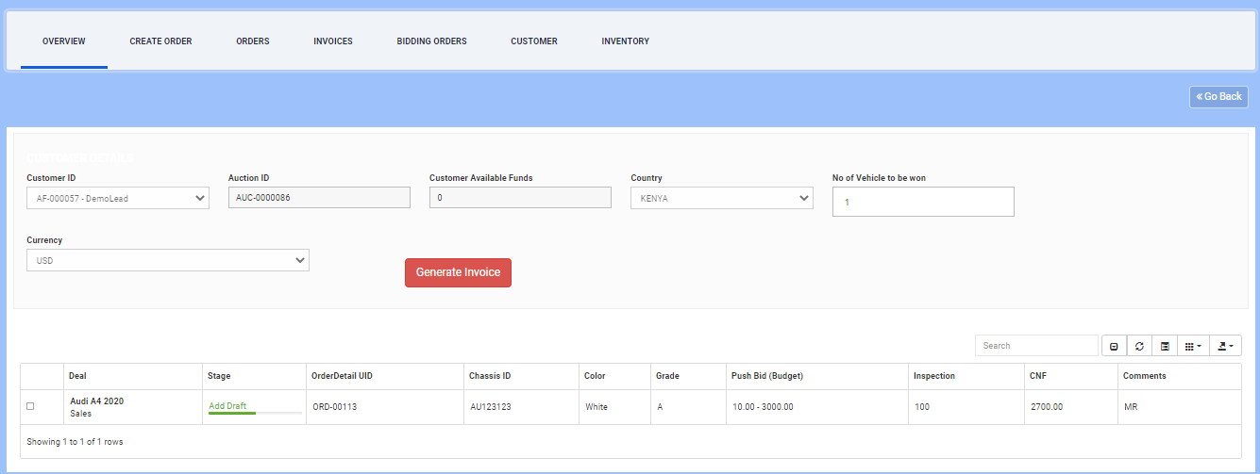
Add Bidding Order: Detail

Slide 22
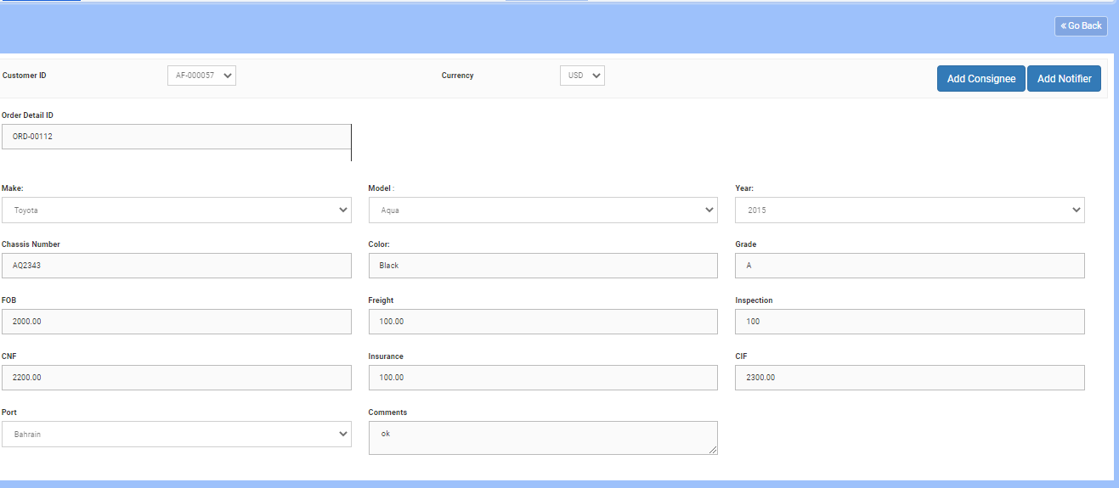
Add Bidding Order: Consignee & Notifier

Slide 23
Add Bidding Order: Consignee & Notifier

Slide 24
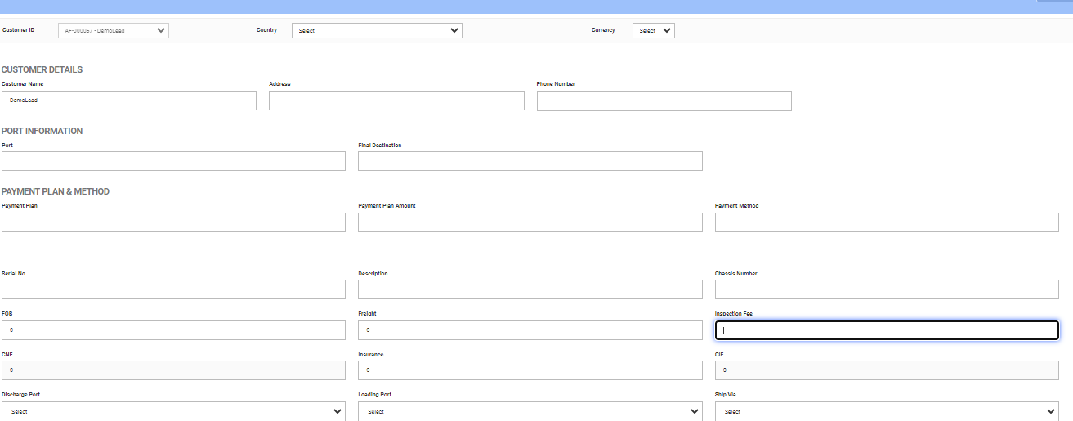
Create Custom Invoice

Slide 25
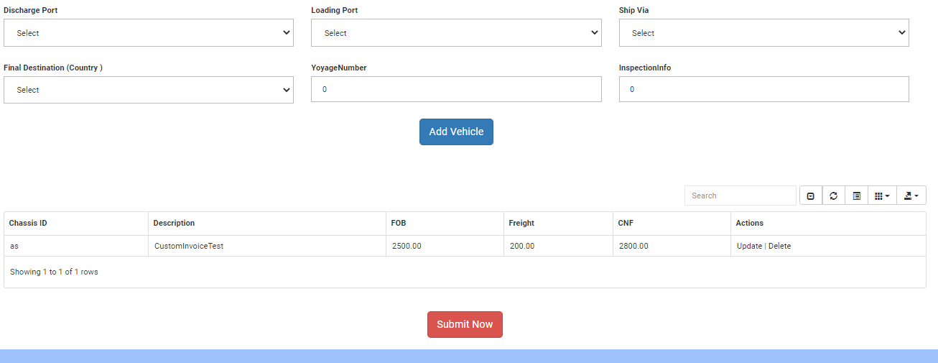
Create Custom Invoice

Slide 26
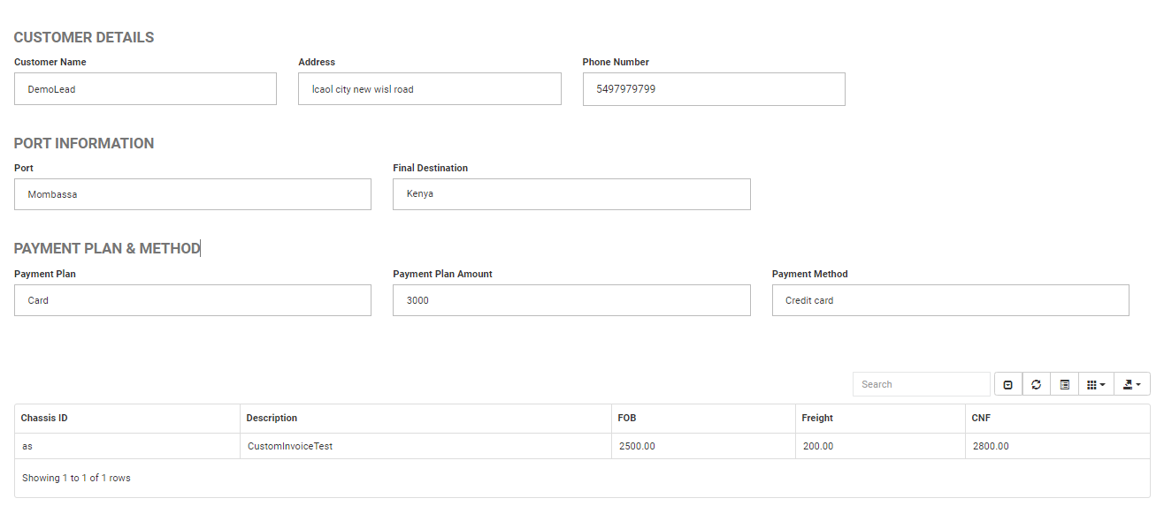
Create Custom Invoice :preview

Slide 27
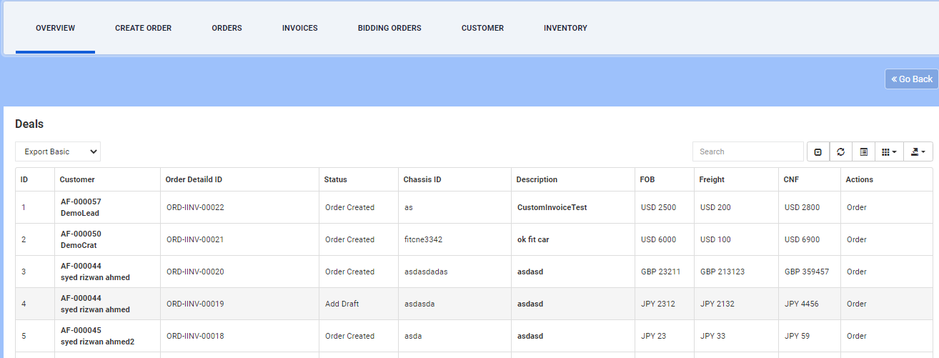
Create Custom Invoice :preview

Slide 28
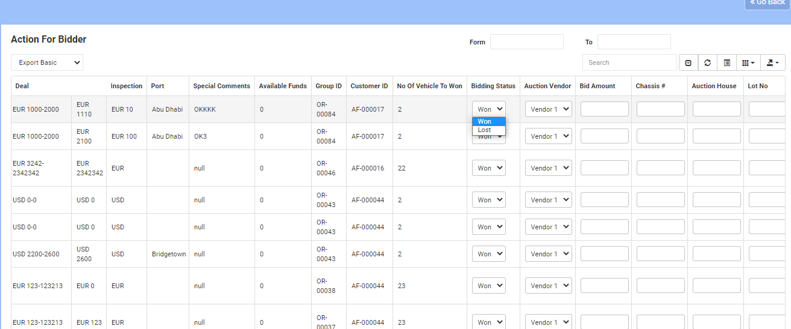
Auction Order : Won/Lost marking

Slide 29
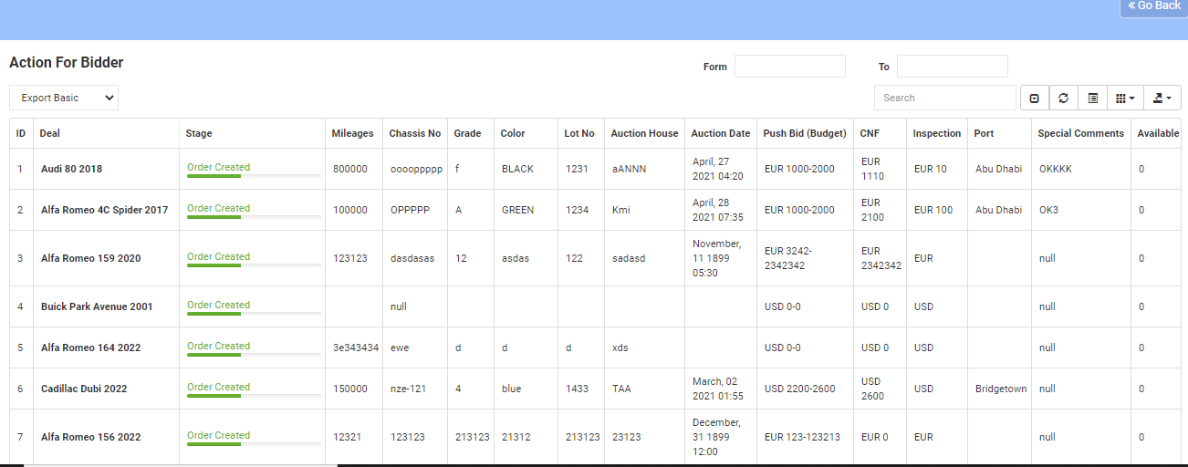
Auction Order : Pending ordre listing

Slide 30
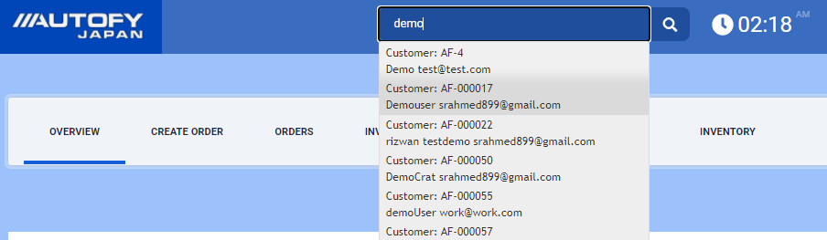
Master Search: find customer

Slide 31
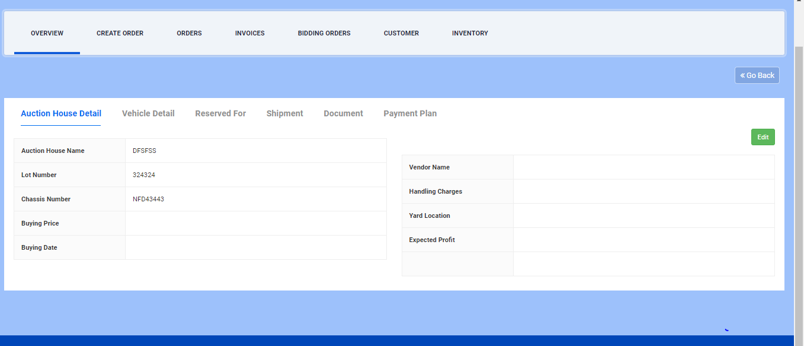
Inventory Preview:

Slide 32
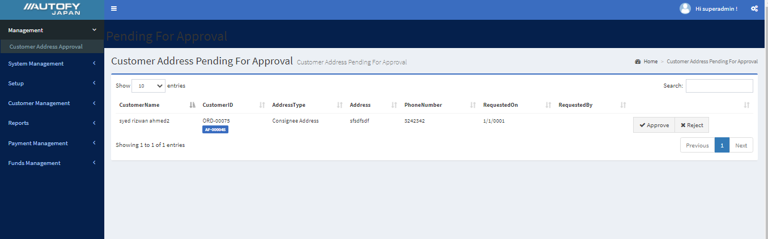
Consignee&Notifier Approval screen

Slide 33
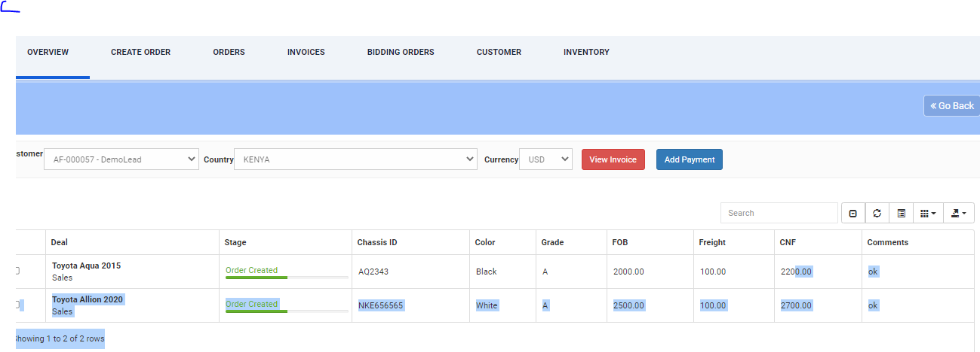
Add Payment

Slide 34
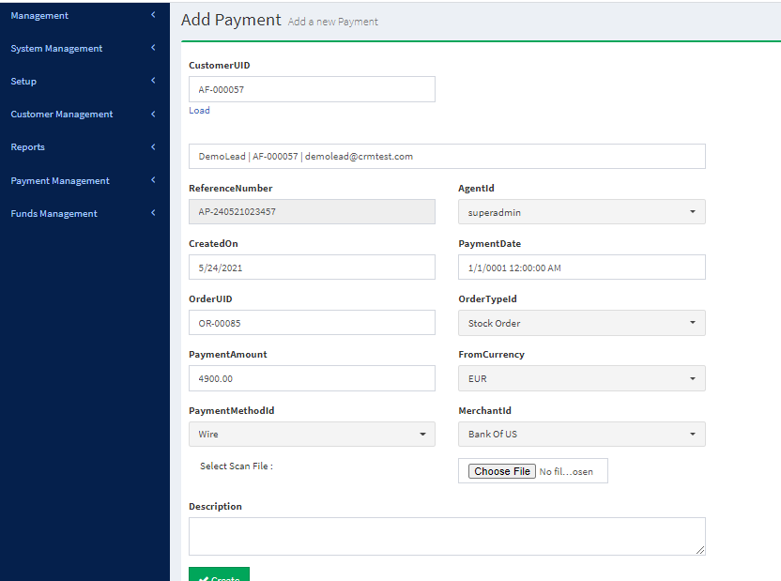
Add Payment

Slide 35
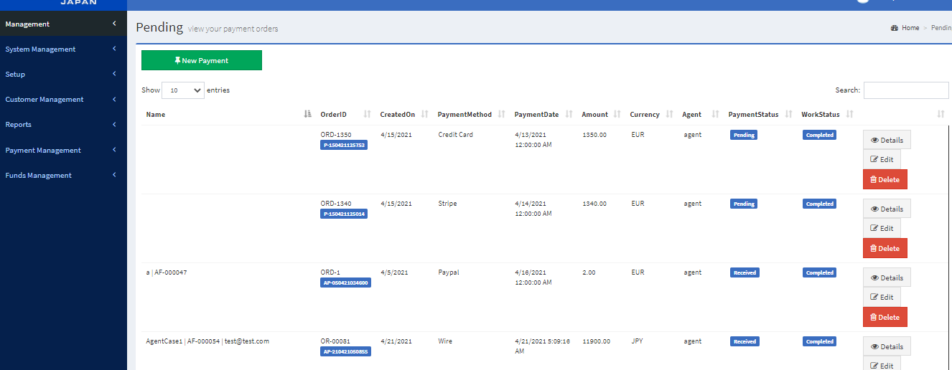
Pending Payment

Slide 36
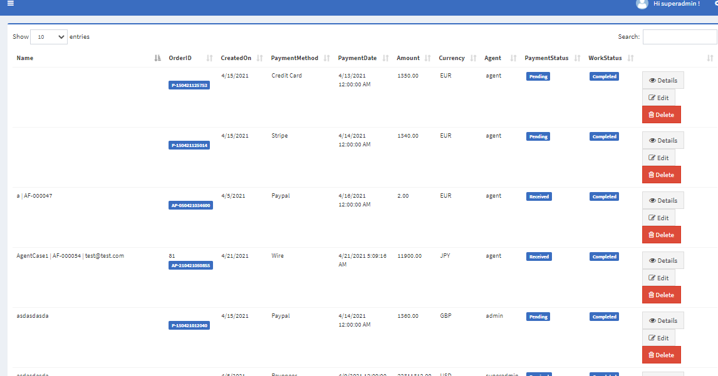
All Payment

Slide 37
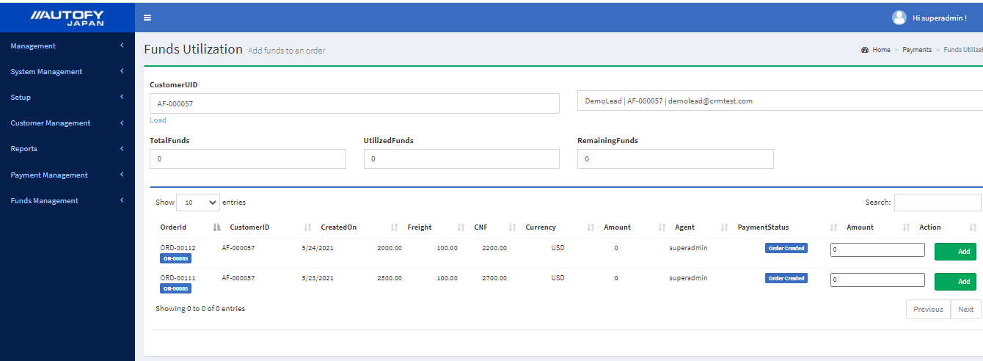
Fund utilization Screen

Slide 38
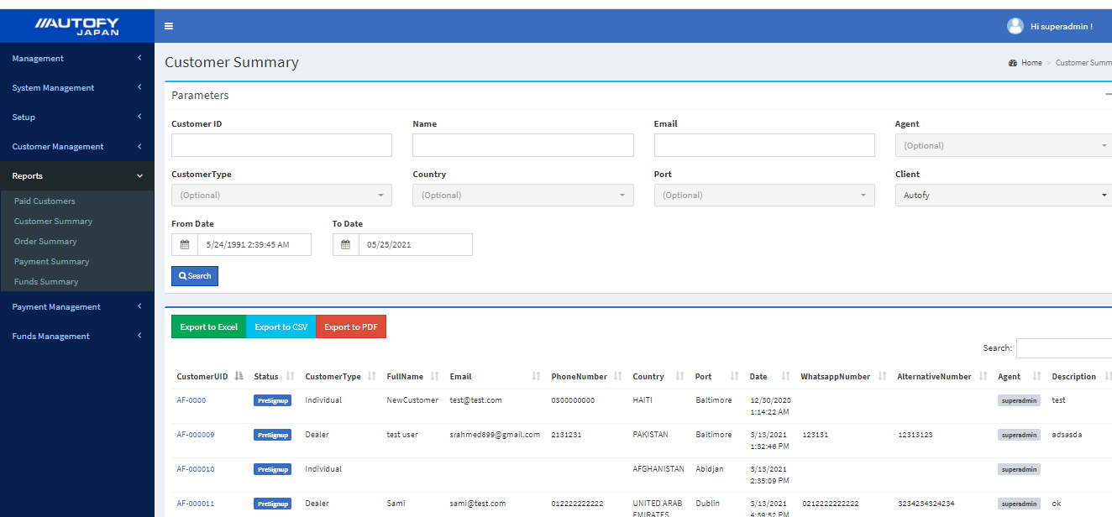
Report : Customer Summary

Slide 39
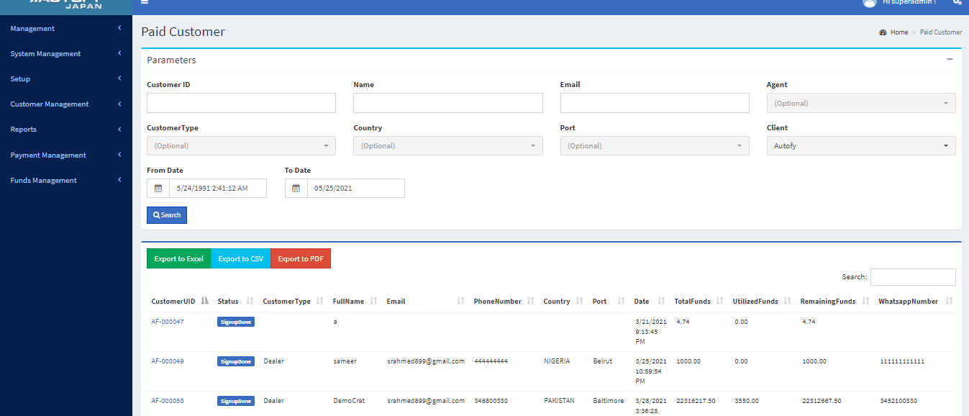
Report : Paid Customer Summary

Slide 40
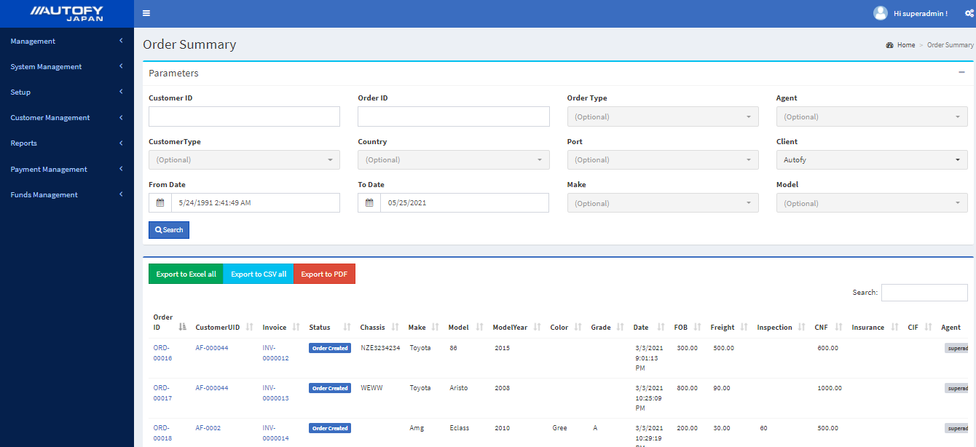
Report : Order Summary

Slide 41
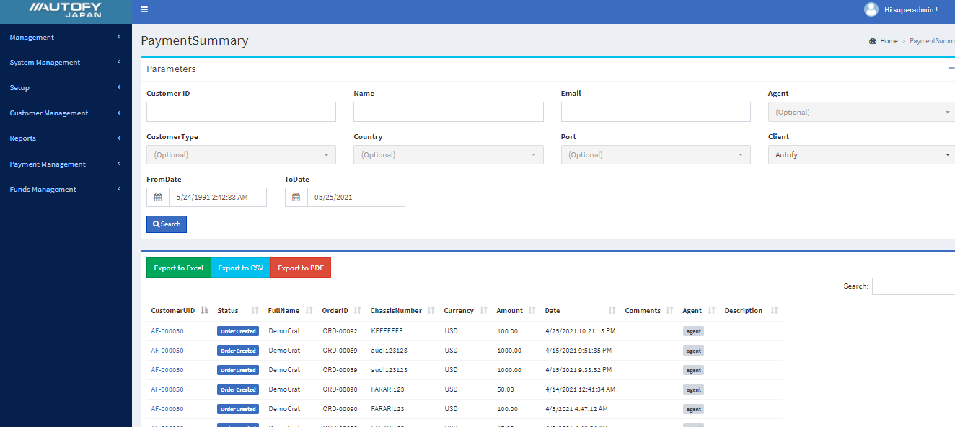
Report : Payment Summary

Slide 42
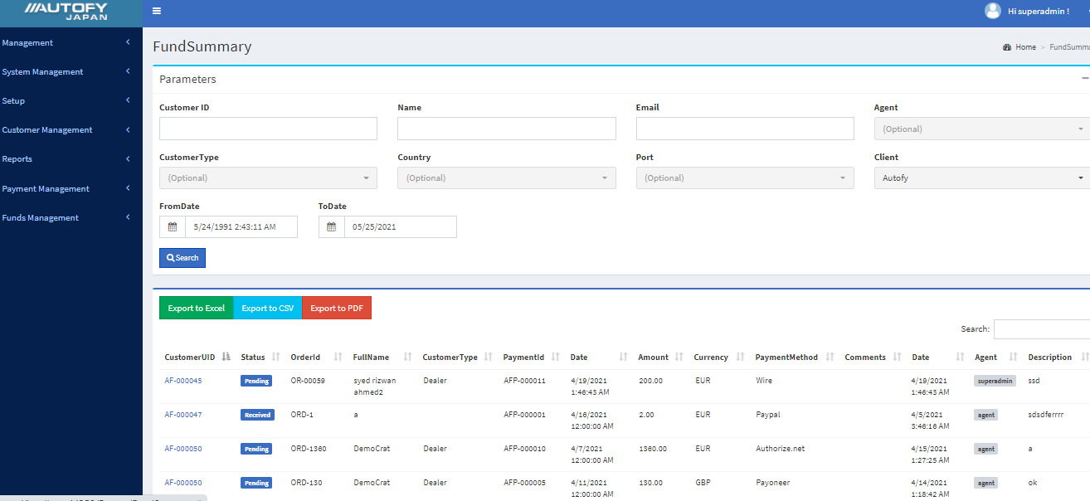
Report : Fund Summary

Slide 43
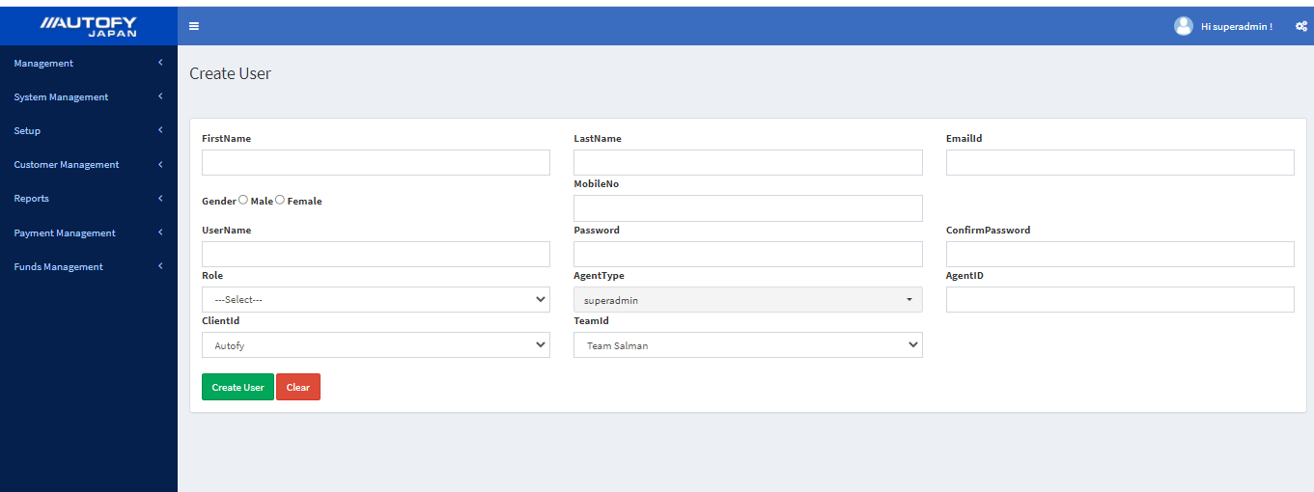
CRM : User creation

Slide 44
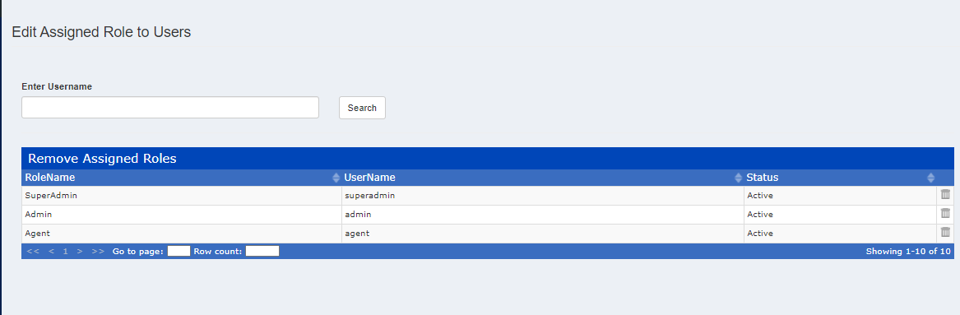

Slide 45
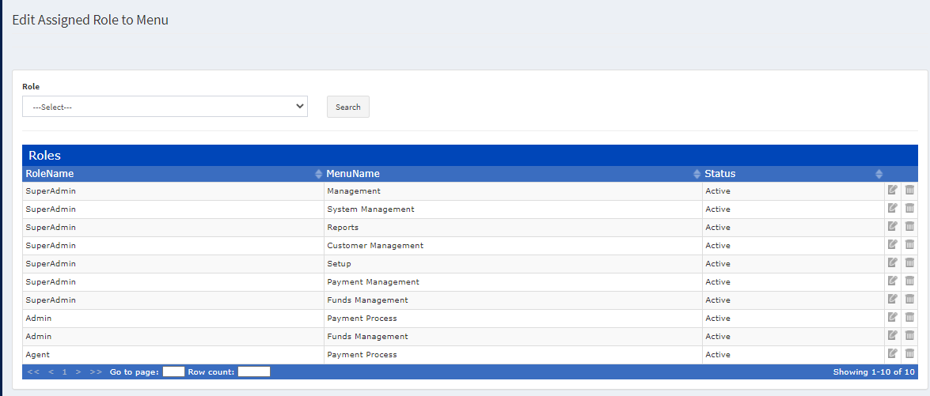

Slide 46
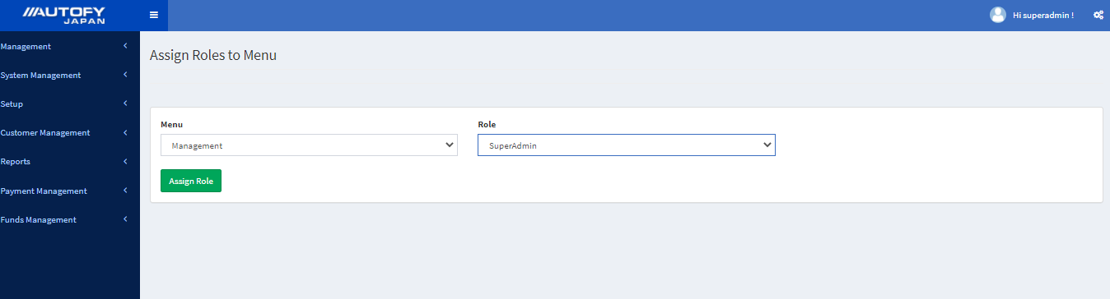

Slide 47
