Slide 1
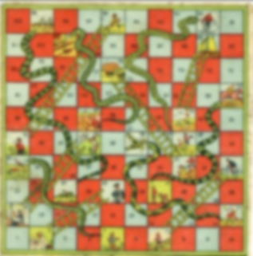
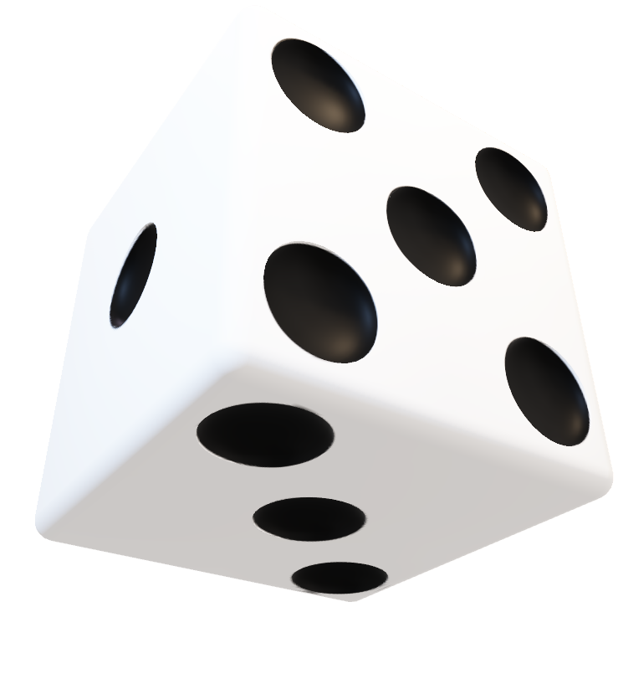
Snakes and Ladders
Snakes and Ladders
Snakes and Ladders
Snakes and Ladders
Snakes and Ladders
23K-0769 Hassan Nafees
23K-3000 Mohid Raheel Khan
23k-9625 Aaqib Shivji

Slide 2
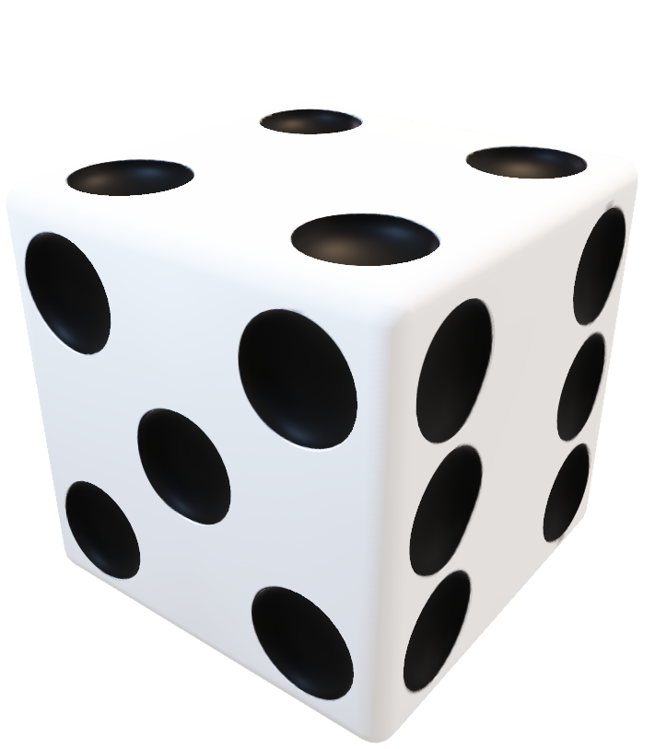
Snakes and Ladders
Snakes and Ladders
Snakes and Ladders
Snakes and Ladders
Snakes and Ladders
23K=0769 Hassan Nafees
23K-3000 Mohid Raheel Khan
23k-9625 Aaqib Shivji
The existing board game Snakes and Ladders is a multiplayer game which follows the rules above. A player rolls a dice and moves his piece according to a random number that appears on the dice from 1-6. The game plays out in alternative turns between players

Slide 3

Snakes and Ladders
Snakes and Ladders
Snakes and Ladders
We are turning the board game into a virtual game and found that the game cannot be played by a single player. If a single player does play on the existing board, there is no other way of the game ending other than the player winning it by reaching the score 100.
The existing board game Snakes and Ladders is a multiplayer game which follows the rules above. A player rolls a dice and moves his piece according to a random number that appears on the dice from 1-6. The game plays out in alternative turns between players
Snakes and Ladders
Snakes and Ladders

Slide 4
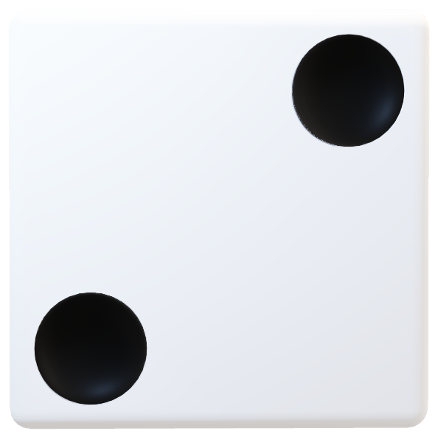
Snakes and Ladders
Snakes and Ladders
We are making the game suitable for a single player by introducing a limited tries feature. If the player is struck with a Snake, he would not only reduce his total score but also would deplete his total lives of 3 tries. If the players life count turns to 0, the game will be ended, stating that the player has lost. Then he can restart the game for another round. He can play with himself, comparing his previously played rounds and see how less moves he took to complete the game through the leaderboard feature.
Snakes and Ladders
We are turning the board game into a virtual game and found that the game cannot be played by a single player. If a single player does play on the existing board, there is no other way of the game ending other than the player winning it by reaching the score 100.
Snakes and Ladders
Snakes and Ladders
The existing board game Snakes and Ladders is a multiplayer game which follows the rules above. A player rolls a dice and moves his piece according to a random number that appears on the dice from 1-6. The game plays out in alternative turns between players

Slide 5
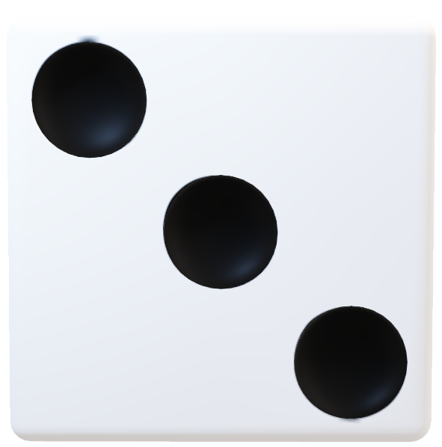
Snakes and Ladders
Snakes and Ladders
We solved our problem of snakes and ladders on the board by introducing 2D-arrays:
addSnakeOrLadder(gameboard, 72, 91, 1);
addSnakeOrLadder(gameboard, 62, 19, 2);
Type 1 being Ladders and Type 2 being Snakes.
And we solved our problem of random numbers from the dice (1-6) by using standard library (rand () function) and our numbers should remain in between 1 to 6 we use this logic
(Rand%6) +1.
We are making the game suitable for a single player by introducing a limited tries feature. If the player is struck with a Snake, he would not only reduce his total score but also would deplete his total lives of 3 tries. If the players life count turns to 0, the game will be ended, stating that the player has lost. He can play with himself, comparing his previously played rounds and see how less moves he took to complete the game through the leaderboard feature.
Snakes and Ladders
Snakes and Ladders
Snakes and Ladders
We are turning the board game into a virtual game and found that the game cannot be played by a single player. If a single player does play on the existing board, there is no other way of the game ending other than the player winning it by reaching the score 100.

Slide 6
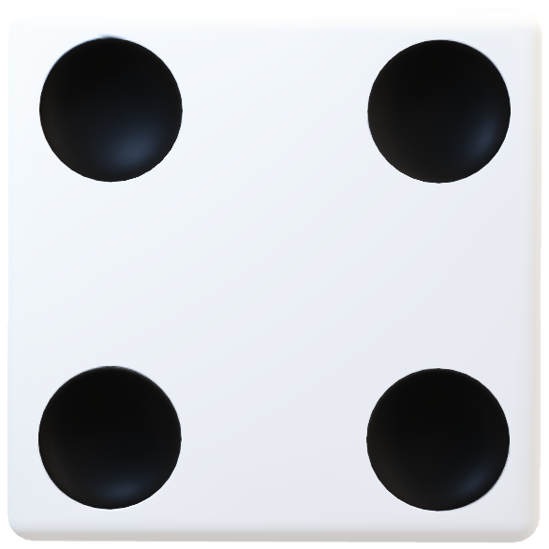
Snakes and Ladders
Snakes and Ladders
We solved our problem of snakes and ladders on the board by introducing Structures and Functions:
addSnakeOrLadder(gameboard, 72, 91, 1);
addSnakeOrLadder(gameboard, 62, 19, 2);
Type 1 being Ladders and Type 2 being Snakes.
And we solved our problem of random numbers from the dice (1-6) by using standard library (rand () function) and our numbers should remain in between 1 to 6 we use this logic
(Rand%6) +1.
Snakes and Ladders
SILENT FEATURES:
Game board.
1 player.
Dice rolling.
Snakes.
Ladders.
Win condition (to complete game by reaching 100 with 1 or more lives left).
Game loop (user will continuously play until he wins, loses, or decides to quit).
The Leaderboards entry after winning the game.
Snakes and Ladders
Snakes and Ladders
We are making the game suitable for a single player by introducing a limited tries feature. If the player is struck with a Snake, he would not only reduce his total score but also would deplete his total lives of 3 tries. If the players life count turns to 0, the game will be ended, stating that the player has lost. Then he can restart the game for another round. He can play with himself, comparing his previously played rounds and see how less moves he took to complete the game through the leaderboard feature.

Slide 7
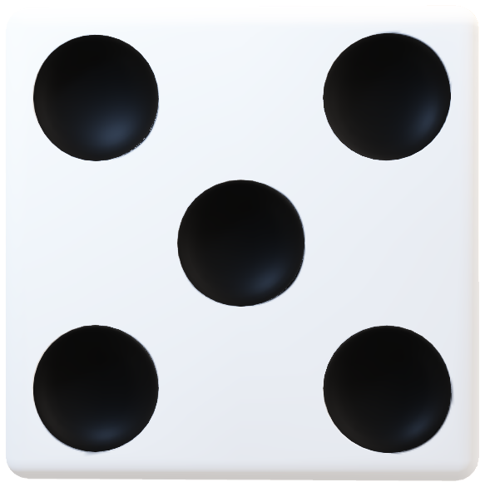
Snakes and Ladders
Snakes and Ladders
SILENT FEATURES:
Game board.
1 player.
Dice rolling.
Snakes.
Ladders.
Win condition (to complete game by reaching 100 with 1 or more lives left).
Game loop (user will continuously play until he wins, loses, or decides to quit).
The Leaderboards entry after winning the game.
Snakes and Ladders
Snakes and Ladders
Snakes and Ladders
We solved our problem of snakes and ladders on the board by introducing 2D-arrays:
addSnakeOrLadder(gameboard, 72, 91, 1);
addSnakeOrLadder(gameboard, 62, 19, 2);
Type 1 being Ladders and Type 2 being Snakes.
And we solved our problem of random numbers from the dice (1-6) by using standard library (rand () function) and our numbers should remain in between 1 to 6 we use this logic
(Rand%6) +1.

Slide 8
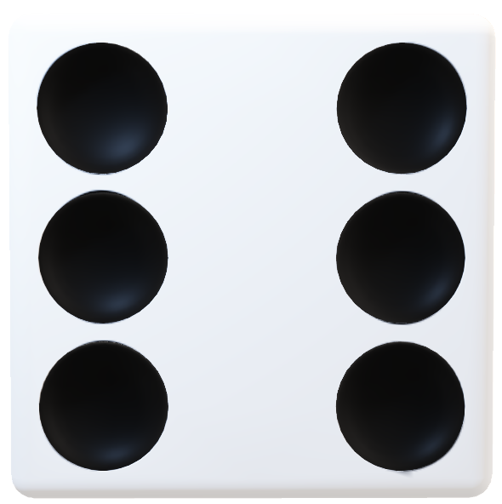
Snakes and Ladders
Snakes and Ladders
Snakes and Ladders
We have used These concepts:
Structures
Dynamic Memory Allocation
2D-Arrays
Pointers and Double Pointers
String Functions
Time.h and stdlib.h Libraries
Basic Concepts such as:
Switch Cases, If statements, Functions etc.
Snakes and Ladders
Snakes and Ladders

Slide 9
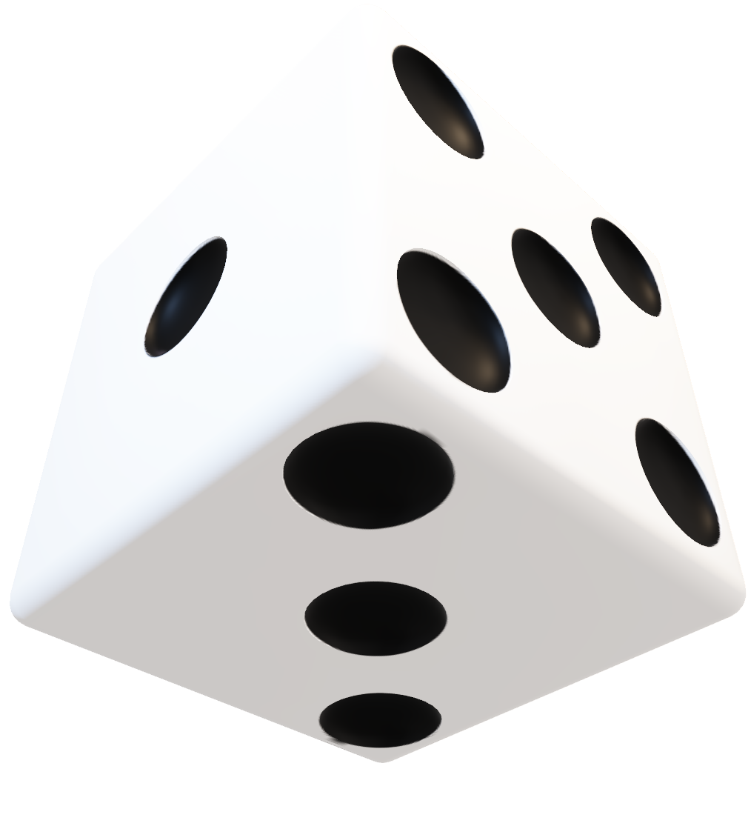
Snakes and Ladders
Snakes and Ladders
Snakes and Ladders
Thank You!
Snakes and Ladders
Snakes and Ladders

