Slide 1
Acquire – Design and Implementation
Pair 18
Raj Hassani
Shreya Rattan

Slide 2
Code History
Board Representation creation
Administrator representation
Unit test cases using Mockito + JUnit
Implemented strategies – tightly coupled
Separated Player and Administrator by using Proxy pattern
Added new strategies
Game tree implementation – level by level
Game tree tweak for creating complete game tree at start of the game – flyweight pattern
Server code – work in progress

Slide 3
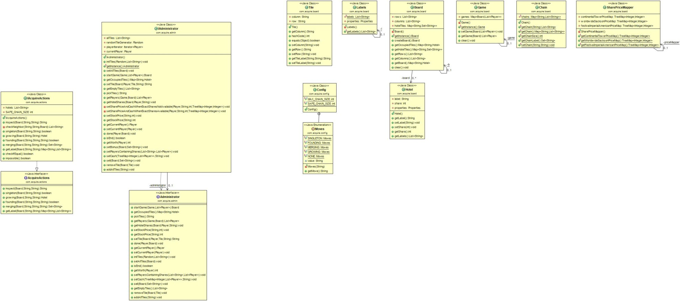

Slide 4
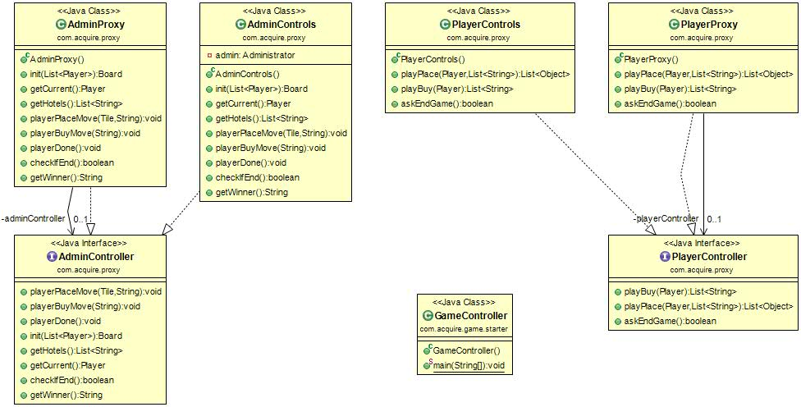

Slide 5
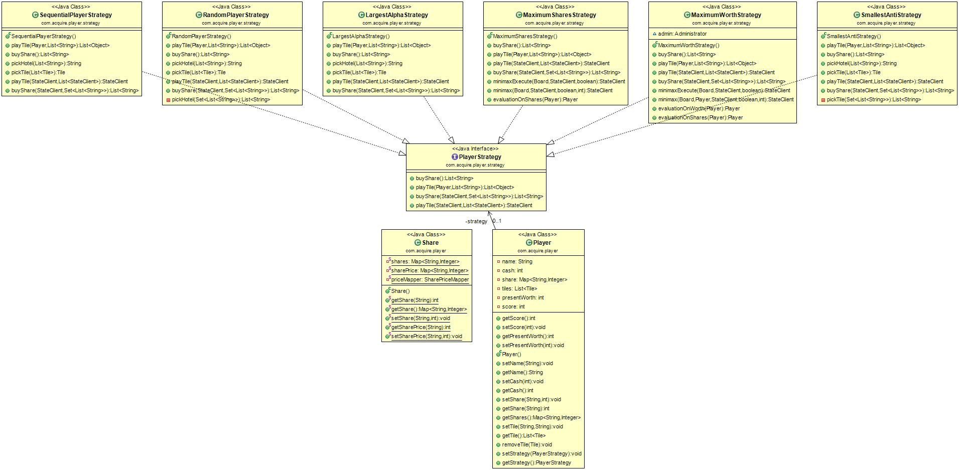

Slide 6
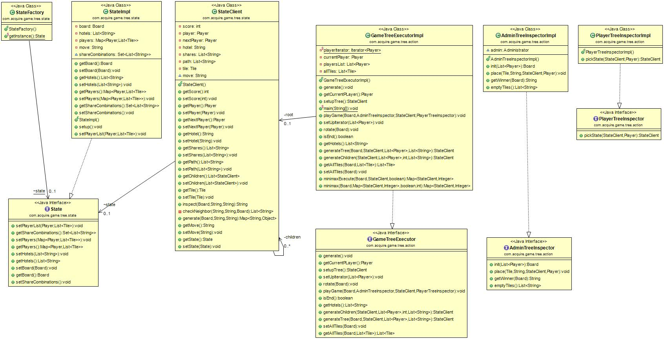

Slide 7
Design
Player
Game Tree Executor
Administrator
init
board
pickState
tile/shares
place
isEnd?
True

Slide 8
Testing Strategy
Unit tests using Mockito
Manual testing

Slide 9
Current Status
In progress…
Utilize Client-Server architecture used in Assignment 3 to do the following assignment
Refine minimax strategies

