Slide 1
Microbenchmarks for Memory Hierarchy
Brooks Mattox
Matthew Sweet

Slide 2
Overview
Objective
Microbenchmarks
Verifying Known P4 Specifications
Vtune Data observations
Tree-based Pseudo Least Recently Used Policy
Conclusions

Slide 3
Objective
Verify known attributes of P4 using Vtune and microbenchmarks
Determine the LRU policy of Pentium 4 using similar benchmarks

Slide 4
Microbenchmark
for (i = 0; i < iterations; i++) {
for (j = 0; j < vectorSize; j = j + stride) {
vector[j] = vector[j] + 1;
}

Slide 5
Verify L1 & L2 cache size
Measure the number of cache misses over an interval of vector size increases
Point at which cache misses begin to increase substantially with corresponding vector size, indicates cache size

Slide 6
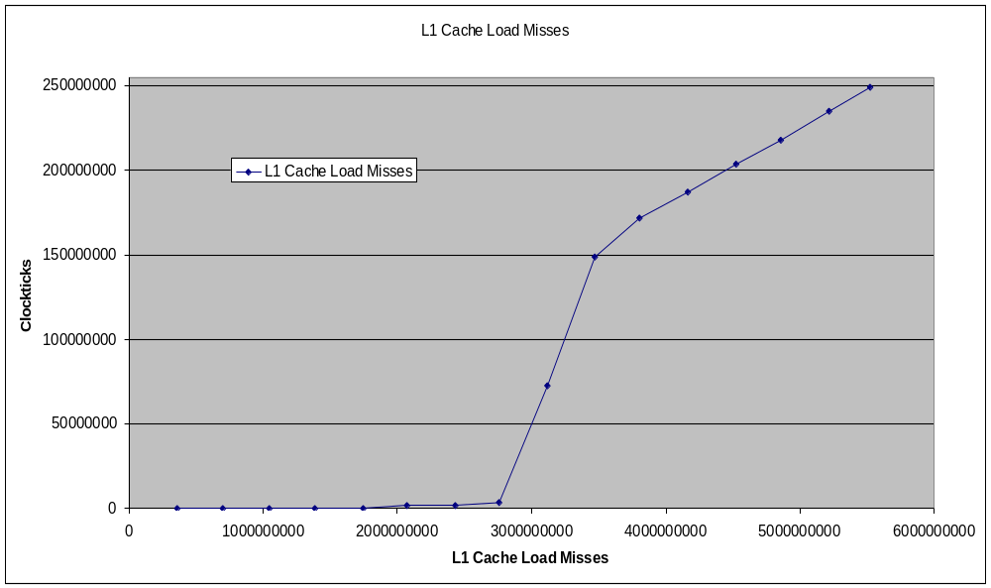
L1 Cache Size Benchmark Results
~8KB

Slide 7
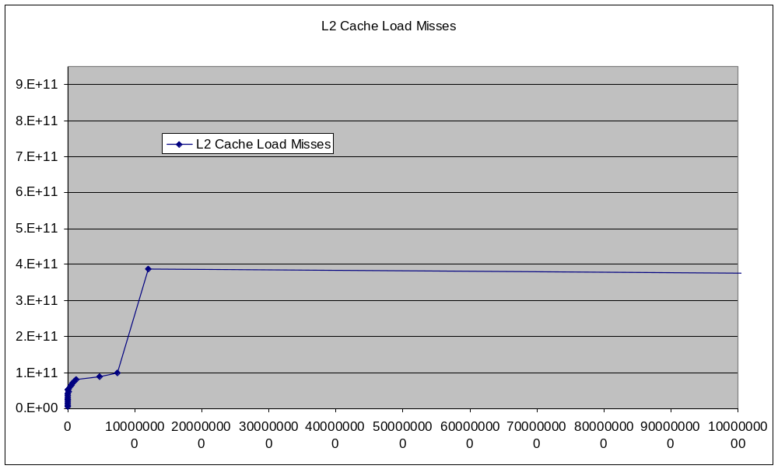
L2 Cache Size Benchmark Results
~512KB

Slide 8
Suspected P4 LRU Policy
Tree-based Pseudo LRU
Characteristics
  Requires only one track bit for 2-way associativity
  With higher associativity PLRUt still has better performance and lower complexity than the basic LRU, Round Robin, or Random policies.

Slide 9
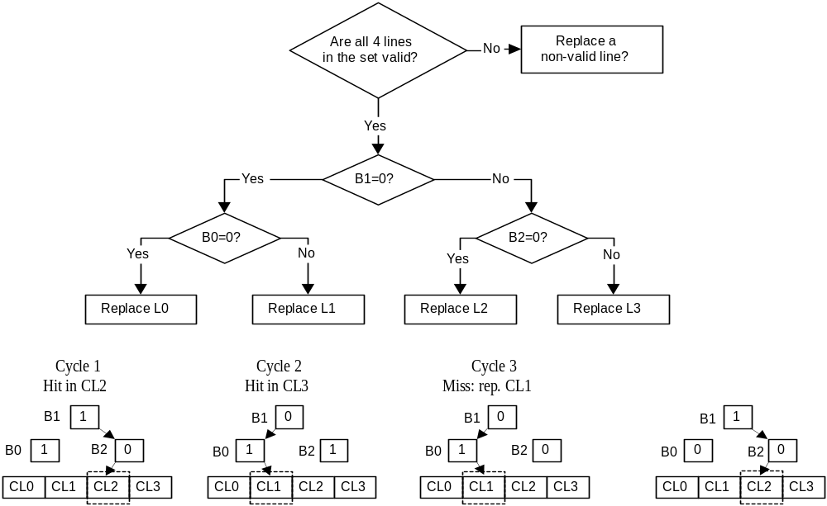
Tree-based Pseudo Least Recently Used Policy

Slide 10
Sources
Aleksandar Milenkovic, “Cache Replacement Polices for Future Processors”
Rafael H. Saavedra, Chapter 5 - "Locality Effects and Characterization of the Memory Hierarchy" in “CPU Evaluation Performance and Execution Time Prediction Using Narrow Spectrum Benchmarking”

