Slide 1
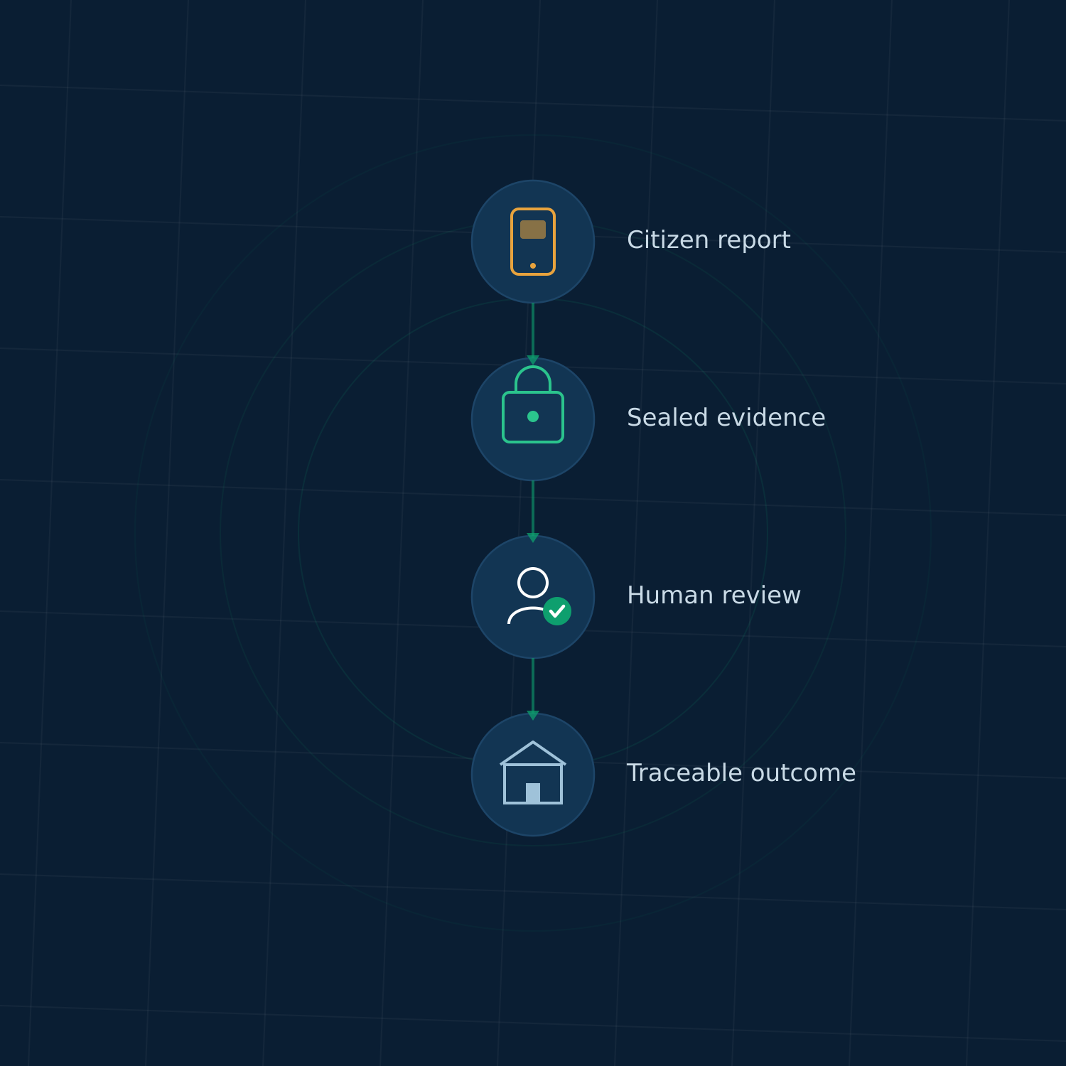
MASTER DOCUMENT v1.2.1 · FINAL DEVELOPER HANDOFF RELEASE
Parakh
Developer & Director Handoff
How the product works, what must be built, and what must be validated
Design baseline
FINAL
Application
NOT YET BUILT
Pilot
NOT APPROVED TO LAUNCH
Founder: Hassan
Notes:
Design is locked. The app does not exist yet. The pilot cannot open until 11 blockers close.

Slide 2
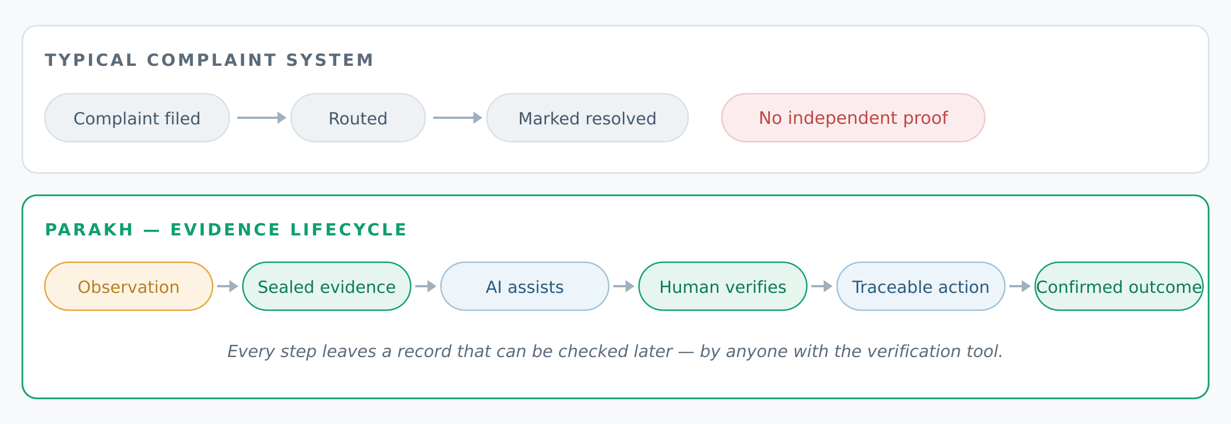
THE THESIS
Most civic platforms digitize the complaint. Parakh digitizes the proof.
A complaint is an assertion. Evidence is something a third party can check — months later, after staff change, after denial.
Master Doc §4.1–4.3
02

Slide 3
THE PROBLEM
Three parties, one shared blind spot
CITIZENS
INSTITUTIONS
ACCOUNTABILITY
Reports get lost, ignored, or transferred
Language and literacy limit who can participate
Little visibility after submission
Field information is fragmented and hard to verify
Independent evidence is scarce
Administrative status ≠ physical resolution
Completion and durability are hard to trace
Repeat problems aren't linked to earlier work
Quality is rewarded by paperwork, not outcome
Parakh proposes a way to close these gaps. It has not yet demonstrated that it does. Whether it works is the question the pilot exists to answer.
Master Doc §1.3–1.4 · claims are hypotheses, not findings
03

Slide 4
VALUE PROPOSITION
What makes Parakh different — and why Punjab
Voice-first Report in Urdu or English, including code-switching. No typing required.
WHY PUNJAB
Founder Hassan grew up in Ladheywala Virkan, where monsoon flooding repeatedly damaged farmland.
Filming farmers explain the flooding made the gap obvious: the knowledge already existed, in Punjabi, held by the people living it. What was missing was a path for it to become traceable evidence.
Evidence-first Sealed capture with location and time — not free text.
AI assists, humans decide Every consequential decision has an accountable person behind it.
Traceable history Each issue carries a record that survives staff turnover.
Privacy-preserving validation Community confirms the problem without seeing who reported it.
Starting where the language and stakes are understood — not designing remotely.
Master Doc §0.7, §4.5
04

Slide 5
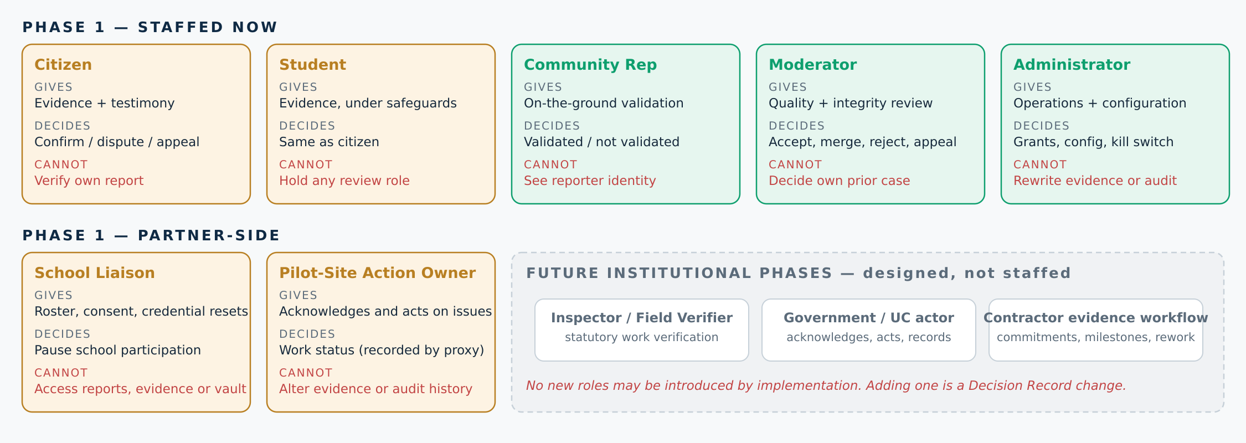
WHO USES IT
Roles: what each gives, decides, and cannot do
Grants are scoped to a site or ward and carry an expiry date
Conflict rules run at assignment time, not when a screen renders
Revocation takes effect on the next action, and every grant change is logged
Master Doc §5.3, DR-1 · Inspector & contractor roles: future phase
05

Slide 6
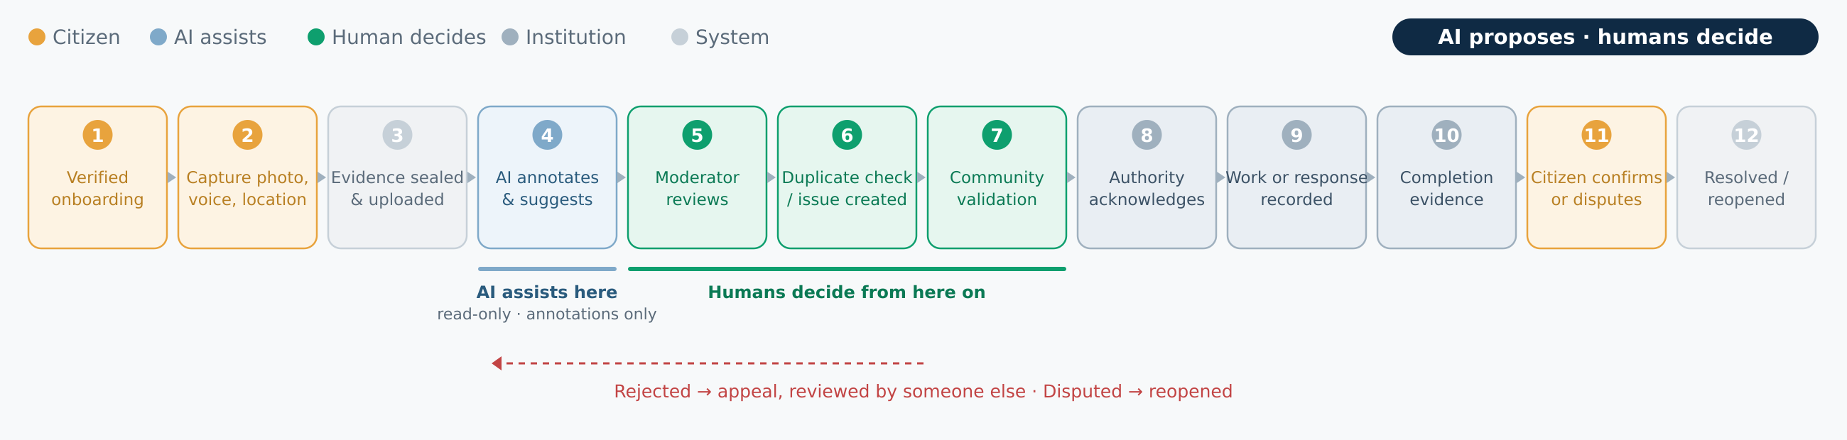
END-TO-END
One report, twelve steps, one rule
Citizen supplies evidence
AI annotates — never decides
Humans hold every decision
Institution acts
An issue only becomes VERIFIED when an independent person confirms it on the ground — never because a model was confident.
Implement transitions T1–T12 exactly as specified — that table, not this diagram, is the build contract.
Master Doc §6.1 transitions T1–T12
06

Slide 7
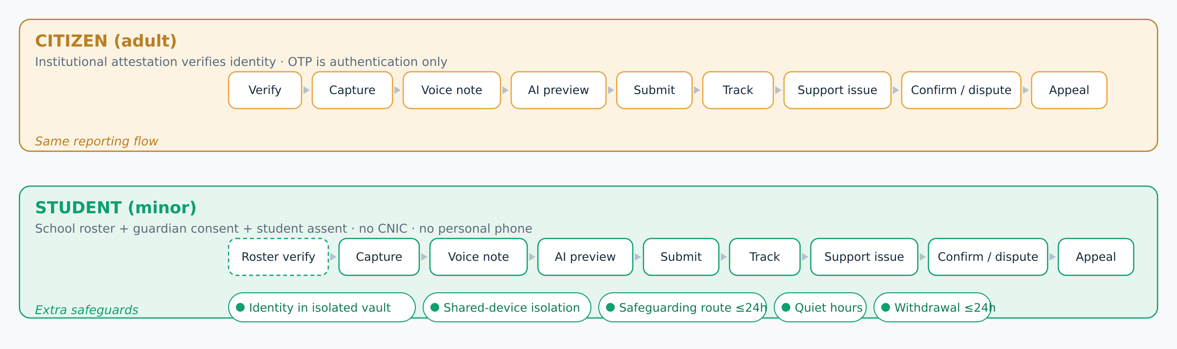
USER JOURNEYS
Citizen and student: same flow, different safeguards
Students are never asked for a CNIC or a personal phone number. Shared devices are assumed, not treated as an edge case.
Student credentials are issued and reset by the school liaison only
Offline queues are encrypted per account and locked on account switch
Withdrawal deactivates within 24 hours and erases the device queue
Master Doc §6.2, DR-9, C-8
07

Slide 8
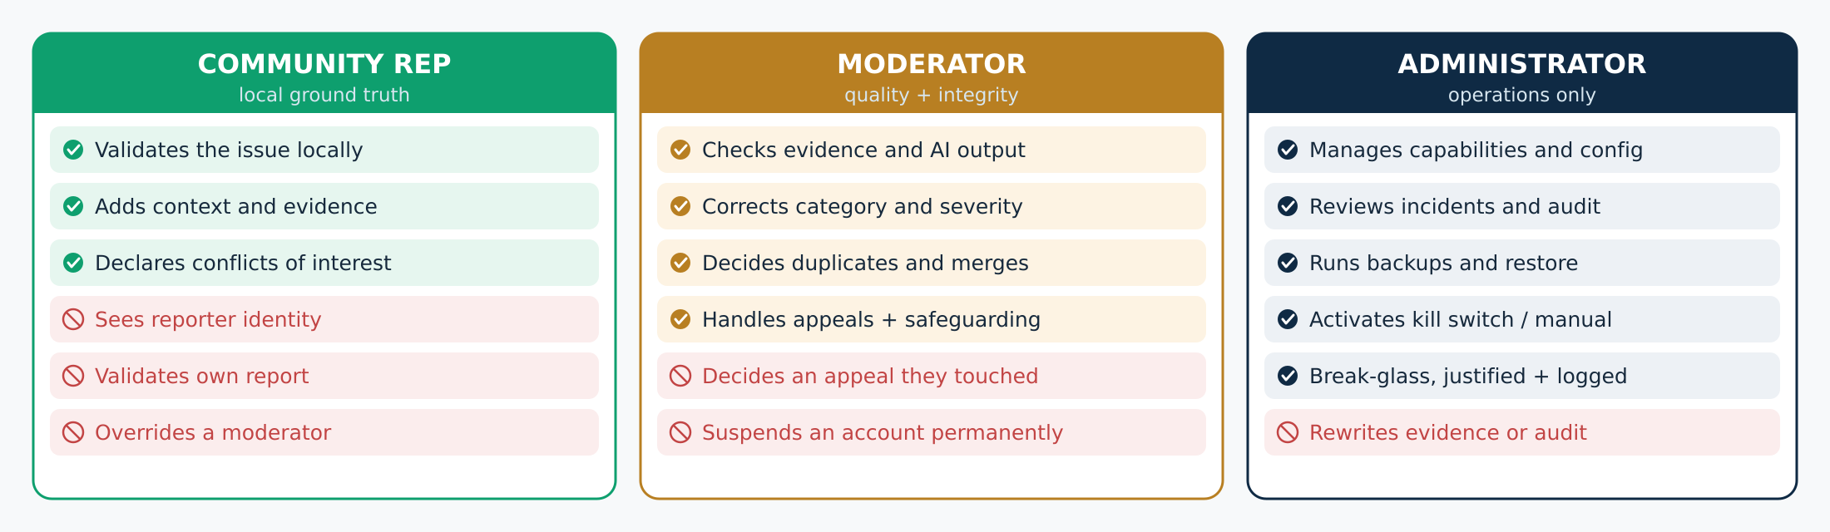
HUMAN REVIEW
Three roles, separated on purpose
Separation of duties is enforced at assignment, not at display. A conflicted reviewer never receives the item — hiding a button is not a control. Appeals always route to someone who was not involved.
Strip reporter identity in the query that builds the validation packet — never in the template layer.
Master Doc §6.3–6.4, §6.9 · DR-1, DR-18
08

Slide 9
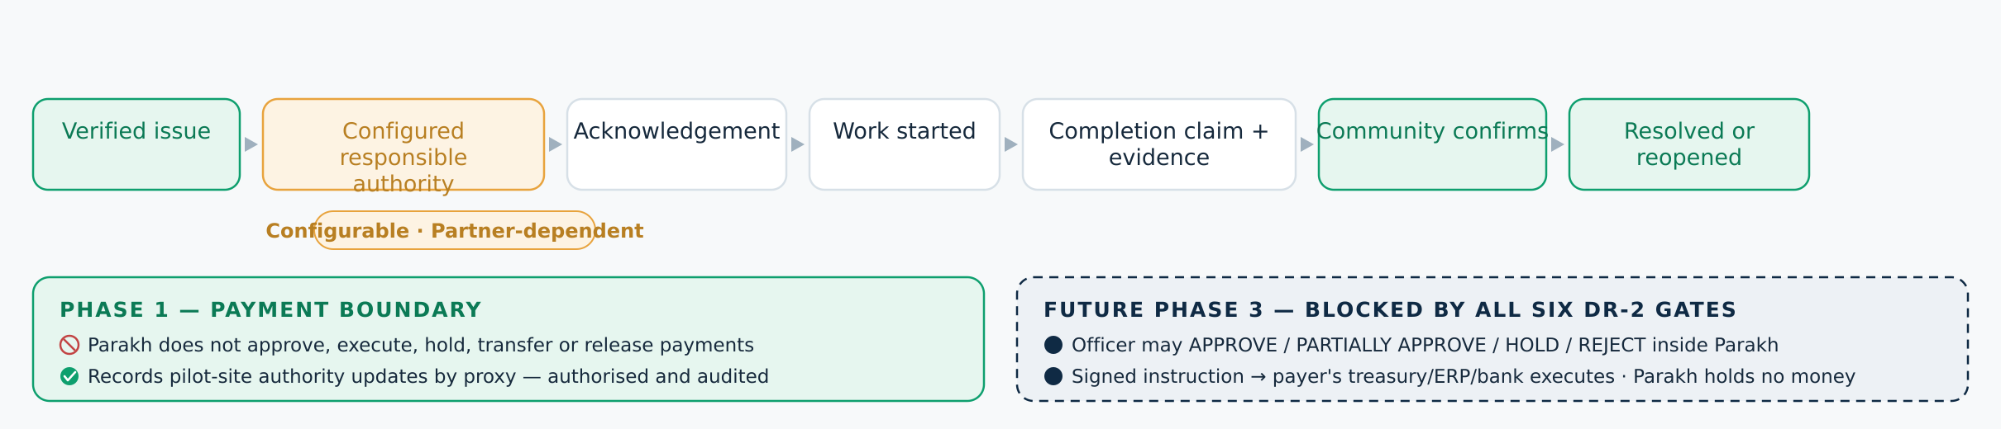
INSTITUTIONAL FLOW
Future-ready, authority-neutral
Configurable
Open Item
Phase 1
The responsible department is a setting, not a hard-coded office.
Statutory mapping under the Punjab LG Act 2025 must be confirmed with the partner.
No formal government authority involved. No payment functionality of any kind.
Keep the action owner a configuration value. Punjab has passed four local-government statutes since 2013 — hard-coding a department guarantees rework.
Master Doc §6.7.1, §6.7.7, §1.2 · DR-2 revised v1.2 · OI-9
09

Slide 10
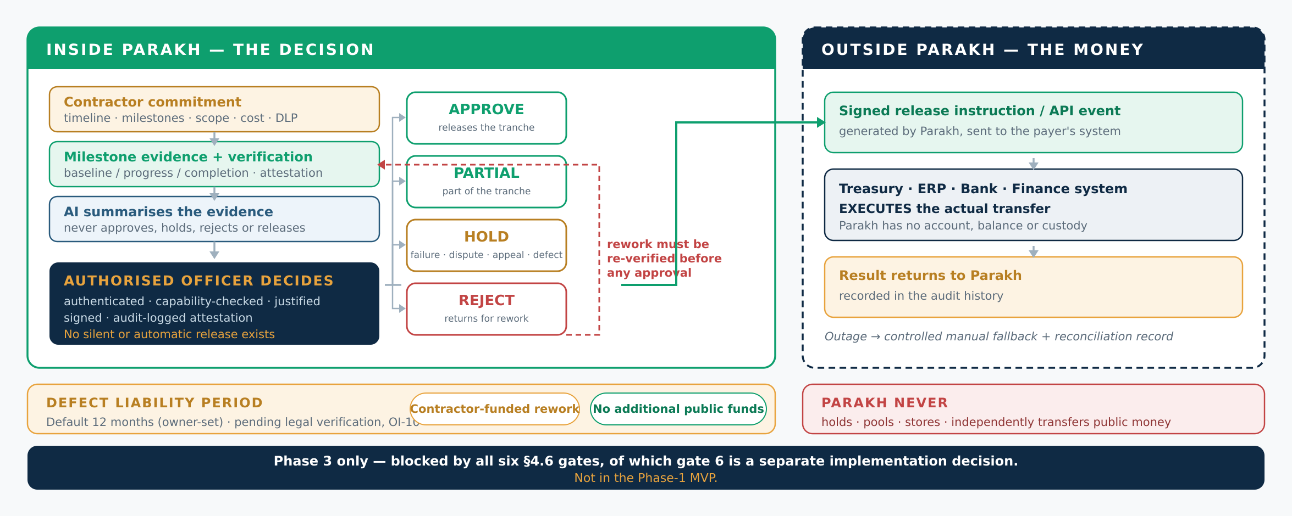
FUTURE PHASE 3
Milestone approval inside Parakh · money moves outside it
The decision happens in Parakh. The money never does. Not in the MVP — a Phase-3 direction blocked until all six DR-2 gates close, of which gate 6 is a separate implementation decision.
Master Doc §6.7.7, §6.7.4, §6.7.5 · DR-2 revised v1.2 · OI-10
10

Slide 11
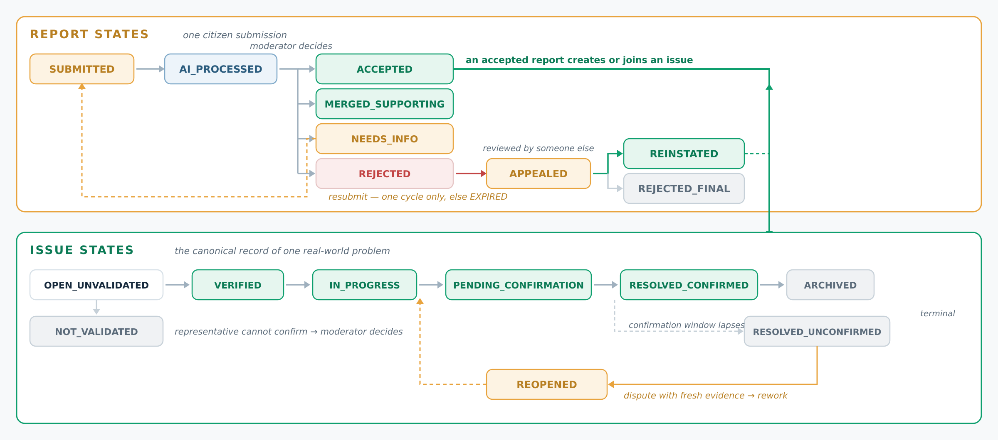
LIFECYCLE
Report states and issue states, kept separate
Master Doc §6.1.1 report states · §6.1.2 issue states and transitions T1–T12
11

Slide 12
SCOPE
Build now · not now · later
BUILD IN PHASE 1
NOT IN PHASE 1
FUTURE PHASES
Verified onboarding (dual-track)
Citizen issue reporting
Photo evidence capture
Urdu / English voice
AI issue understanding
Category suggestions
Human moderation
Duplicate suggestions
Community validation
Issue tracking
Basic dashboard + private heatmap
Audit + research events
Payment or escrow
Contractor selection
Automated prioritization
AI-made final decisions
Automated fraud labels
Public map or public heatmap
Officer payment decisions + execution
Institutional pilot
Contractor milestones + staged release
Additional languages
Public heatmap after privacy review
Larger-scale integration
Scope may be reduced. Safeguards may not.
Master Doc §4.7, DR-3
12

Slide 13
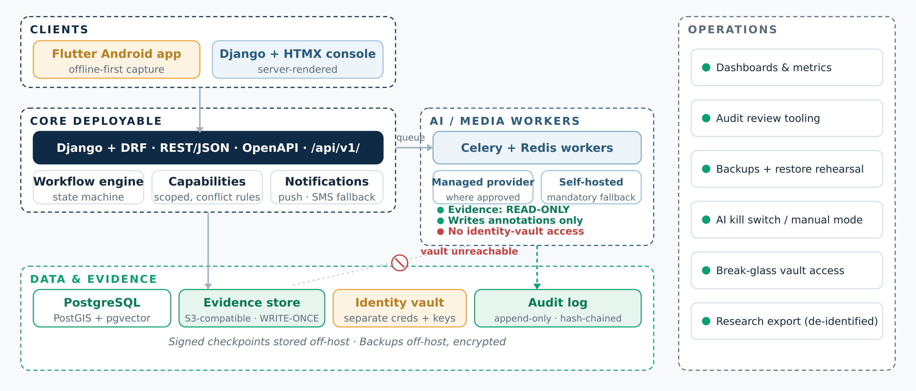
ARCHITECTURE
Modular monolith + detached AI worker tier
Two deployables, one database engine, one queue — no service mesh
Workers hold read-only evidence credentials and no vault access at all
Stopping the worker tier must leave the platform fully usable
Master Doc §9, DR-5, DR-6
13

Slide 14
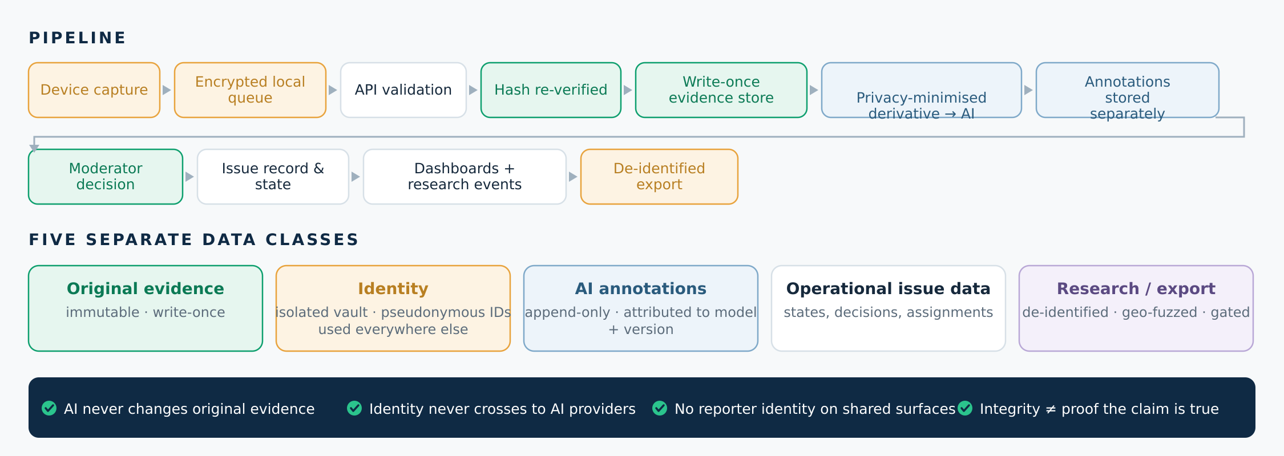
INFORMATION FLOW
Five data classes that never mix
Evidence integrity proves the record was not altered. It does not prove the claim inside it is true — that is what human verification is for.
Hash over media bytes plus a versioned manifest, with identical canonical serialization on client and server.
Master Doc §12, §9.7, DR-8
14

Slide 15
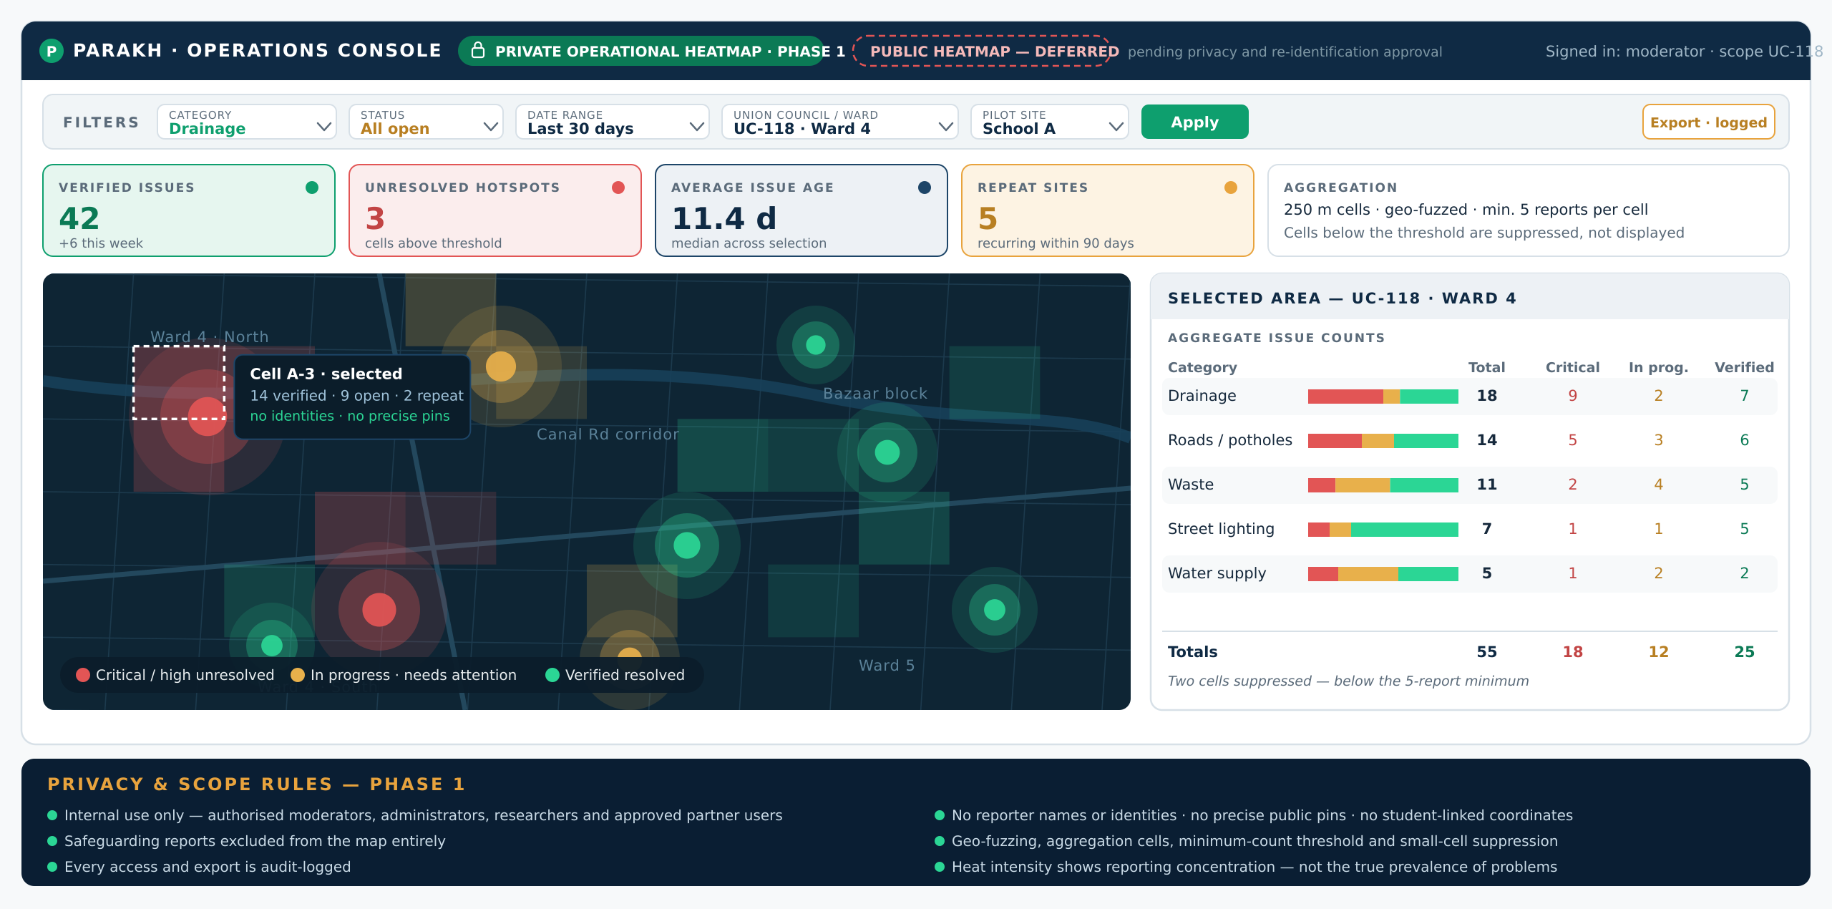
DASHBOARD
Phase-1 Operational Heatmap
Master Doc §8.4, §8.7 · DR-4 · FR-308, NFR-P2, C-8 · private, role-restricted, audit-logged
15

Slide 16
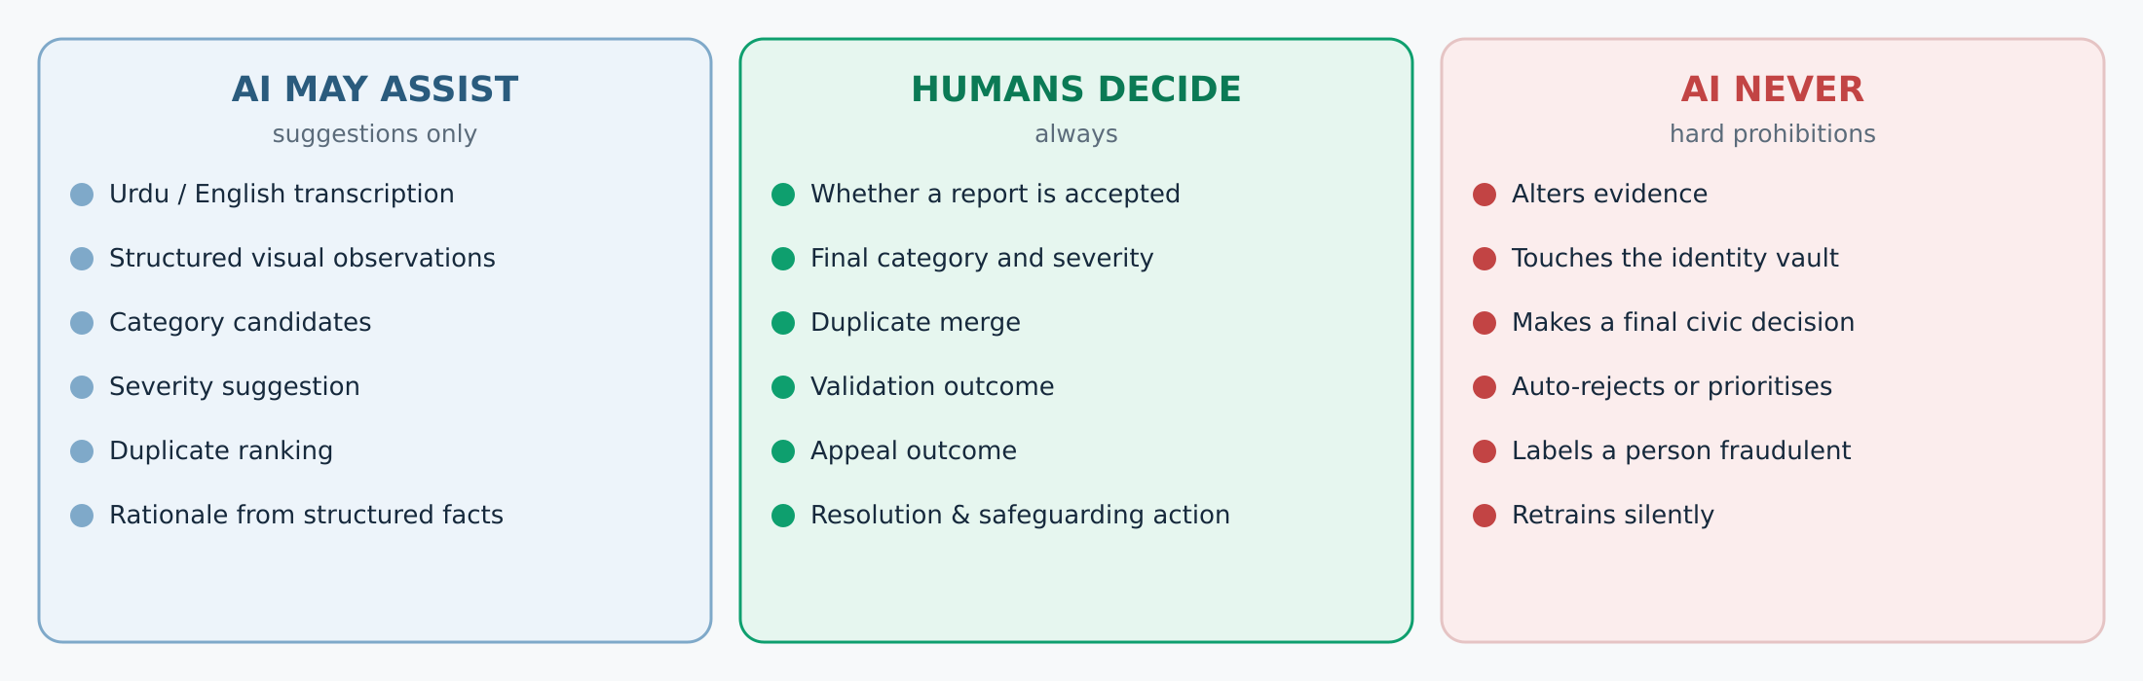
AI BOUNDARY
Assist · decide · never
Fallback: if the AI tier is unavailable, reports route to a manual queue and the workflow continues. The pilot must be provably runnable with AI switched off.
Every annotation records provider, model and version. Unattributed AI output is invalid and rejected at write time.
Master Doc §15–§16, DR-10 to DR-13, NFR-AI1/AI7
16

Slide 17
NON-NEGOTIABLE
Ten rules we must not break
Evidence cannot be rewritten after capture
AI outputs stay separate annotations
1
2
Humans make consequential decisions
Reporter identity is protected
3
4
Student safeguards are non-negotiable
Verified identity ≠ public identity
5
6
No payment functionality in the MVP
No public live map during the pilot
7
8
AI failure must not stop the workflow
Changing a Decision Record needs owner approval
9
10
If a requirement conflicts with one of these, the requirement is wrong. Escalate — do not resolve it in code.
Master Doc §9.6, §13, C-6, C-8
17

Slide 18
LOCKED
Approved technical decisions — 18 of 18
Roles
Capability-based hybrid model
Architecture
Modular monolith + AI workers
Stack
Flutter · Django · PostgreSQL · Celery
API
REST + JSON + OpenAPI
Evidence
Write-once + hash-chained audit
Identity
Dual-track verified identity
AI sourcing
Hybrid managed / self-hosted
Fusion
Deterministic late fusion
Duplicates
Geo-temporal + embeddings + human merge
Prioritization
Future advisory model only
Payments
Ph-1 verify-only · Ph-3 officer decision
Transparency
Private heatmap; public deferred
DR-2 revised v1.2; DR-4 revised v1.1. Any further deviation requires formal owner approval — it is not an engineering call.
Master Doc §0.4 Decision Register · DR-1 to DR-18, all approved · DR-2 revised v1.2; DR-4 revised v1.1
18

Slide 19
VALIDATION
What we must learn in the field
STAKEHOLDER
WHAT WE NEED TO LEARN
WHAT IT SHAPES
Citizens
Can they report unaided? Voice vs typing? Retaliation fears?
Onboarding + report flow
Students, schools, guardians
Consent and assent? Shared devices? Age-appropriate wording?
Student track + consent pack
Moderators
What evidence is enough? Which categories confuse? When does AI mislead?
Review screen + taxonomy
Community reps
Is on-site validation practical? What creates conflict?
Validation packet + timing
Institutional contacts
Who acknowledges? How are departments assigned? What format?
Action-owner configuration
Technical field tests
Street audio ASR · low-end Android · weak connectivity · GPS · upload recovery
Benchmarks + parameters
Research improves the product. Approvals permit the pilot. They are different tracks and must run in parallel.
Master Doc §3.2, §21.2 · feeds OI-5, OI-8
19

Slide 20
READINESS
Build can start. The pilot cannot.
BUILD CAN START NOW
PILOT CANNOT START UNTIL — ALL 11
Repository and environments
Backend and database
Mobile reporting flow
Manual moderation console
Evidence storage
Audit foundations
Synthetic-data testing
Formal partner agreement
Independent ethics review (non-waivable)
Legal + child-data review
Retention periods approved
Benchmark + parameter values approved
ASR normalization rules defined (OI-8)
AI provider reviewed, if used
Self-hosted fallback built + benchmarked
Staffing named and trained
School liaison + backup confirmed
Restore rehearsal + security checks
The design is final. The pilot is not launch-ready — 11 blockers remain open.
Master Doc §26 Open Items Register
20

Slide 21
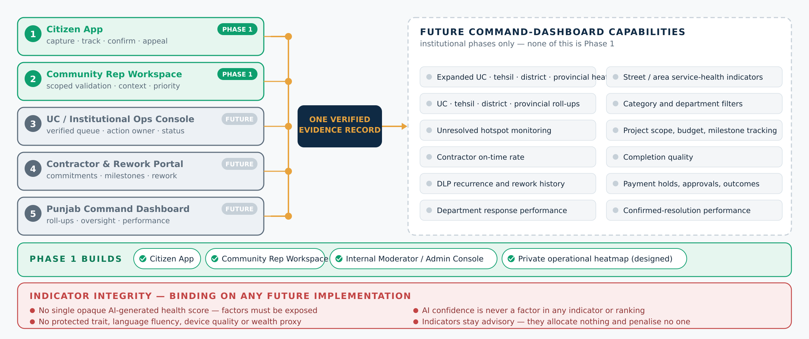
NORTH STAR
Punjab Civic Operations System
Phase 1 builds the Citizen App, Community Representative Workspace, and the internal Moderator/Admin Operations Console. Union Council, contractor and Punjab command interfaces remain future institutional capabilities. The private operational heatmap is Phase 1 and role-restricted; the public aggregate heatmap stays deferred behind privacy and re-identification approval.
Master Doc §25.1, §8.4, §8.7 · future institutional capabilities · DR-4, DR-15 constraints apply
21

Slide 22
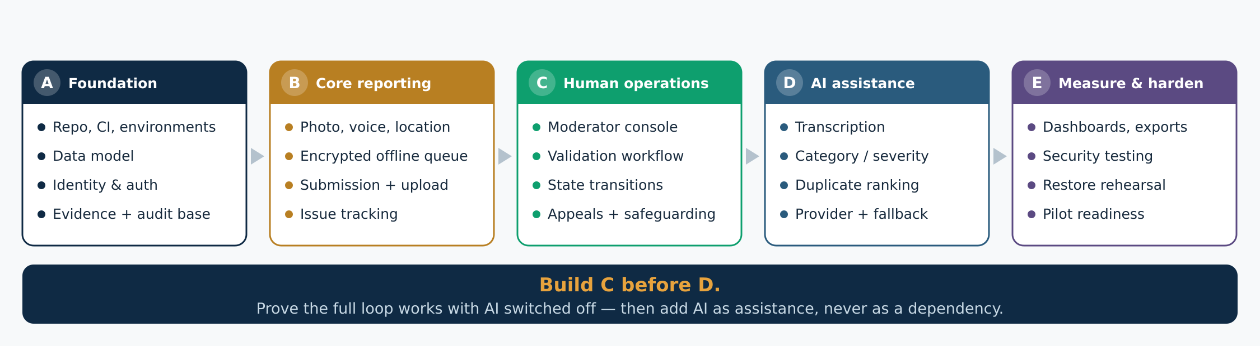
SEQUENCE
Recommended development order
Why this order: a loop that only works when the model works is not a verification system — it is an AI demo. Building human operations first also gives the research design its AI-disabled comparison condition, and guarantees a working pilot even if the AI underperforms.
Master Doc §23.4, DR-3, §3.2 · staged payment (§6.7.7) is outside this build sequence
22

Slide 23
NEXT ACTIONS
Three tracks, running in parallel
DEVELOPMENT TEAM RETURNS
FOUNDER / PRODUCT
PARALLEL EXTERNAL WORK
Feasibility assessment
Sprint plan and estimates
Team roles
Backlog + screen inventory
Schema and API review
Deployment plan
Risks + proposed deviations
Approve priorities and benchmarks
Resolve team and budget
Provide partner context
Answer build questions
Approve any deviation formally
Partner agreement
Ethics and legal review
Child-data review
Field research
Staffing and training
AI-provider assessment
Build the verified reporting loop first. Prove it manually. Add AI as assistance — not dependency.
Master Doc §23, §26
23

Slide 24
APPENDIX A
Technology stack reference
Mobile
Flutter (Android-first)
Offline-first capture
DR-6
Console
Django templates + HTMX
Server-rendered review UI
DR-6
Backend
Django + DRF
API, workflow, capabilities
DR-6
Database
PostgreSQL
Relational + JSON
DR-6
Geospatial
PostGIS + GeoDjango
Radius queries, scope
§12.4
Vectors
pgvector
Duplicate embeddings
DR-14
Jobs
Celery + Redis
AI/media worker tier
DR-5
Evidence
S3-compatible, write-once
Immutable artifacts
§9.7
API
REST + JSON, OpenAPI
Authoritative contract
DR-7
Deploy
Docker on small VPS
Off-host encrypted backups
§9.9.1
CI/CD
GitHub Actions
Tests, builds, deploys
DR-6
Full rationale: Master Doc §9.13
24

Slide 25
APPENDIX B
Development epics
EPIC
GOAL
KEY DEPENDENCY
DONE WHEN
Identity
Dual-track verified accounts
—
OTP alone never verifies
Reporting
Report without typing
Identity
Zero-typing test passes
Evidence capture
Tamper-evident artifacts
Reporting
Offline sync, no loss
Moderation
Human decision surface
Evidence
All outcomes reachable
Validation
Independent ground truth
Moderation
Conflicts never assigned
AI transcription
Urdu/English/code-switched
Evidence
Fallback benchmarked
AI classification
Suggest, never decide
Transcription
No auto-accept path
Duplicate detection
Find same-issue reports
Classification
Category never blocks a match
Tracking & appeals
Visible, contestable state
Moderation
All transitions tested
Dashboard & analytics
Research-grade measurement
Tracking
Values match raw logs
Security & audit
Defensible by construction
Identity
Chain verifier runs
Research export
Clean study data
Analytics
De-identification passes
Testing & deployment
Provable readiness
All
Checklist green
Detail: Master Doc §7 requirements
25

Slide 26
APPENDIX C
Decision Record map — all 18 approved (DR-2 revised v1.2; DR-4 revised v1.1)
DR-1
Roles
DR-2
Payment posture
DR-3
MVP boundary
Capability-based hybrid
Verify now · staged Ph-3
MoSCoW, 5 conditions
DR-4
Transparency
DR-5
Architecture
DR-6
Stack
Private map · public later
Monolith + AI workers
Python-centred
DR-7
API
DR-8
Evidence integrity
DR-9
Identity
REST + OpenAPI
Hashes + hash chain
Dual-track
DR-10
AI sourcing
DR-11
Speech-to-text
DR-12
Image understanding
Hybrid + fallback
Managed + self-hosted
VLM, gated classifier
DR-13
Fusion
DR-14
Duplicates
DR-15
Prioritization
Deterministic late fusion
Geo + embeddings
Future advisory only
DR-16
Fraud
DR-17
Location fallback
DR-18
Reporter identity
Baseline + signals
Pin-drop, flagged
Hidden from reps
Full analysis: Master Doc §0.4 and host sections
26

Slide 27
APPENDIX D
Open items — 15 open, 11 launch-blocking
OI-1
Partner agreement
Founder
LAUNCH
OI-2
Independent ethics review
Founder + partner
LAUNCH
OI-3
Legal + data-protection review
Founder + counsel
LAUNCH
OI-4
Retention periods
Founder
LAUNCH
OI-5
Benchmark + parameter values
Founder
LAUNCH
OI-6
AI provider approval
Founder
LAUNCH
OI-7
Self-hosted fallback benchmarked
Tech lead
LAUNCH
OI-8
ASR normalization rules
Founder
LAUNCH
OI-12
Child-data review
Founder + partner
LAUNCH
OI-15
Minimum staffing named
Founder
LAUNCH
OI-16
Restore rehearsal + security
Tech lead
LAUNCH
OI-9
Statutory dept. mapping
Founder + partner
PHASE
OI-10
Procurement defect-liability law
Founder + counsel
PHASE
OI-11
PCP workflow comparison
Founder
QUALITY
OI-13
Provider version exposure
Tech lead
QUALITY
OI-14 (founder motivation) closed at v1.0. Statuses preserved from the Master Document register.
Master Doc §26
27

