Slide 1
Web Engineering
Engr. Javed Ali Abbasi
Lecturer Department of Computer Science, SIBAU

Slide 2
Ajax POST requests
httpRequest.open(“POST”, “ajax_post.php”, true);
httpRequest.send();

Slide 3
Ajax POST requests
httpRequest.open(“POST”, “ajax_post.php”, true);
httpRequest.setRequestHeader(“Content-Type”, “application/x-www-form-urlencoded”);
httpRequest.send(“fname=John&lname=Gage”);
Notes:
If you want to send information with the POST method, set an HTTP header with setRequestHeader() and specify the data you want to send in the send() method.
The setRequestHeader() method accepts two parameters:
The first parameter specifies the header name
The second parameter specifies the header value

Slide 4
PHP time function
$valueInSeconds = time();
Notes:
PHP's time() function gives you all the information that you need about the current date and time.
It requires no arguments but returns an integer value.
The integer returned by time() represents the number of seconds elapsed since midnight GMT on January 1, 1970.
This moment is known as the UNIX epoch, and the number of seconds that have elapsed since then is referred to as a time stamp.

Slide 5
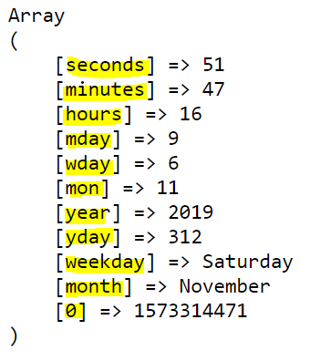
PHP time and getdate() function
$valuesArray = getdate();
Notes:
The function getdate() optionally accepts a time stamp and returns an associative array containing information about the date.
If you omit the time stamp, it works with the current time stamp as returned by the time().
Following indexes will be there in returned array.
The index seconds indicates seconds passed from 0 – 59
The index minutes indicates minutes passed from 0 – 59
The index hours indicates hours passed from 0 – 23
The index mday indicates day of the month in number
The index wday indicates day of the week in number 1-7
The index mon indicates month of the year in number
The index year indicates year
The index yday indicates day of the year in number from 0 – 365
The index weekday indicates day of the week in text
The index month indicates month of the year in text
The index 0 indicates time stamp itself used by the getdate() the time at which it is called

Slide 6
PHP time and date() function
$formattedValue = date(formatString,timestamp)
Notes:
The date() function returns a formatted string representing a date.
You can exercise an enormous amount of control over the format that date() returns with a string argument that you must pass to it.
The date() optionally accepts a time stamp if omitted then current date and time will be used.
Any other data you include in the format string passed to date() will be included in the return value.

Slide 7
PHP time and date() function and format string flags
a : am or pm
A : AM or PM
d : 02
j : 2
D : Thu
z : 365
l : Thursday
Notes:
1 a 'am' or 'pm' lowercase pm
2 A 'AM' or 'PM' uppercase PM
3 d Day of month, a number with leading zeroes 20
4 D Day of week (three letters) Thu
5 l (Lower 'L') Day of the week Thursday
6 j Day of the month (no leading zeroes 20)
7 z Day of year (0 - 365) 206

Slide 8
PHP time and date() function and format string flags
h : 01
H : 13
g : 1
I: 23
G: 13
Notes:
8 h Hour (12-hour format - leading zeroes) 12
9 H Hour (24-hour format - leading zeroes) 22
10 g Hour (12-hour format - no leading zeroes) 12
11 G Hour (24-hour format - no leading zeroes) 22
12 I Minutes ( 0 - 59 ) 23

Slide 9
PHP time and date() function and format string flags
L : Leap year
m : 01
F : January
M : Jan
n : 1
Notes:
13 L Leap year ('1' for yes, '0' for no) 1
14 m Month of year (number - leading zeroes) 1
15 M Month of year (three letters) Jan
16 F Month name January
17 n Month of year (number - no leading zeroes) 2

Slide 10
s : 20
y : 06
Y : 2006
U : time stamp
PHP time and date() function and format string flags
Notes:
18 s Seconds of hour 20
19 Y Year (four digits) 2006
20 y Year (two digits) 06
21 U Time stamp 948372444

Slide 11
PHP time and date() function and format string flags
r : Thu, 21 Dec 2000 16:01:07 +0200
Z : GMT + 5
Notes:
22 r The RFC 2822 by IETF formatted date that is Thu, 21 Dec 2000 16:01:07 +0200
23 Z Offset in seconds from GMT +5

Slide 12
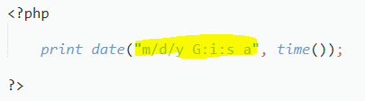

PHP time and date() function and format string flags

