Slide 1
Commodities Vol & Relative-Value Dashboard
Hassan Kanji
Notes:
Ten minutes. What I built, how it decides something is worth trading, and whether those calls
were actually right. Most of my time went into that last part, and it changed what I think of
the tool.

Slide 2
What I built
A daily monitor over 29 commodity and macro instruments. It looks for places where volatility or a relationship has moved outside its normal range, and writes each one up as a trade: what to do, what triggered it, and what has to happen for it to pay.
Notes:
Screenshot of the Signals tab goes in the picture placeholder.
Six commodity groups: energy, precious metals, base metals, grains, softs, livestock. Plus S&P,
the dollar and ten-year futures, so commodities can be tested against the things that push them
around. 23 of the 29 have listed options, so those carry implied volatility as well as price.
It does not forecast prices. It notices when something is priced oddly against its own history
and says so as a trade rather than as a statistic.

Slide 3
Every engine asks the same question
Is this number unusual for this asset, by its own history?
Each quantity gets ranked against its own past year. Top or bottom 10% counts as stretched.
Example: WTI implied vol at the 8th percentile
Options on WTI are pricing less risk than this market has priced on 92% of the past year's days. That says nothing about where oil is going. It says volatility looks cheap against how this market usually prices it, so the trade is to buy volatility.
The bet is mean reversion
Stretched things snap back more often than they stretch further. Every engine runs that same test on a different quantity, and the backtest later is a test of that assumption.
Notes:
Slow down here. If they take one thing away, it is that the tool measures a quantity against its
own history and calls the extremes.
Why percentiles instead of levels: 20 vol is cheap for natural gas and expensive for gold.
Ranking each asset against itself makes one threshold work across everything.
If asked why 10%: it is a slider, not a constant. Loosen it and you get more ideas of lower
quality. The backtest measures that trade-off.

Slide 4
Five engines, five kinds of dislocation
Engine | What it looks for | The trade | Example
Vol dispersion | Two related assets whose vol spread has stretched from its norm | Sell the expensive vol, buy the cheap one | WTI vol rich vs Brent on the same curve point
Variance risk premium | Implied vol well above the volatility actually being delivered | Sell vol and collect the premium | Nat gas 30-day implied 45% vs 32% realised
IV mean-reversion | Implied vol at the top or bottom of its own 1-year range | Buy vol when cheap, sell it when rich | Gold implied at the low end of its 1-year range
Correlation RV | Two assets that normally track, now pulled apart | Buy the laggard, sell the outperformer | Silver drifts from gold after a shared macro move
Lead-lag catch-up | One asset that reliably moves a few days before another | Trade the follower in the leader's direction | Crude moves; gasoline follows 2-3 days later
Notes:
Do not read the table. Explain two properly and say the other three follow the same pattern.
Take the variance risk premium, because that is where a lot of the edge turns out to be. Option
markets tend to charge more for volatility than the asset ends up delivering. When that gap gets
unusually wide, you sell vol and collect it.
And take correlation RV, because people misread it. It is a convergence trade. When two names
that normally move together pull apart, it buys the one that lagged and sells the one that ran.
Lead-lag is the opposite: it follows the leader.
They are listed here in the order the backtest ranked them, best first. The first three trade
volatility so they are measured in vol points. The last two trade price, measured in percent.
That is why the results table has two different units.

Slide 5
Two supporting views
Vol Monitor ranks every asset by implied vol, realized vol and the gap between them, with a data-quality flag so a stale option mark cannot pass as a signal. Correlation & Pairs shows how tightly two assets move together, whether that link is stretched right now, and which of the two moves first.
Notes:
Screenshot of the Correlation & Pairs tab goes in the picture placeholder.
The data-quality flag is computed, not assigned by hand. It measures how often an implied-vol
series actually re-prices. Even liquid commodity options only print a fresh mark on 50 to 70% of
days on this feed, and thin ones barely move. Signals built on a frozen mark get excluded.
That flag turns out to matter more than I expected, which comes up two slides later.
The lead-lag chart is the one to point at. It shows correlation at every lag, so a flat curve
means there is no timing edge, just ordinary correlation.

Slide 6
How I tested whether any of it works
Replay a year, one week at a time
52 replays. At each date the data is rewound and the dashboard's own code runs again, so the signals being graded are the ones it would really have printed. It cannot see past the replay date.
Grade every signal, all 1,970 of them
Not a hand-picked few. One unit per trade, no sizing, marked from the close on the signal date to the close five days later.
Compare each one against doing nothing
A win rate on its own proves nothing. So each trade is also scored as if it had been taken on every date in the year. That is the baseline, and the gap to it is the only number I would call an edge.
Notes:
Sell the baseline here, because it is what makes the rest mean anything.
Concrete version: selling volatility won about 59% of the time. Sounds great, until you check
that selling volatility on a random day with no signal won about 50% of the time, because
implied vol usually runs above realized. The signal is worth the gap, not the 59%.
Without that comparison I would have reported five working engines. With it, two disappear.
The chart answers the obvious question about why five days. Five is not the best number. The
edge more than triples if you hold to 21 days. But replays are five days apart, so five-day
holds are the only ones that do not overlap each other. Anything longer double-counts the same
market moves and makes the p-values look better than they are. So I quote the conservative one
and show the rest.
The shape is a finding too. Almost nothing happens in the first three days. These dislocations
take weeks to resolve, so a one-week hold is probably too short if you were actually trading it.

Slide 7
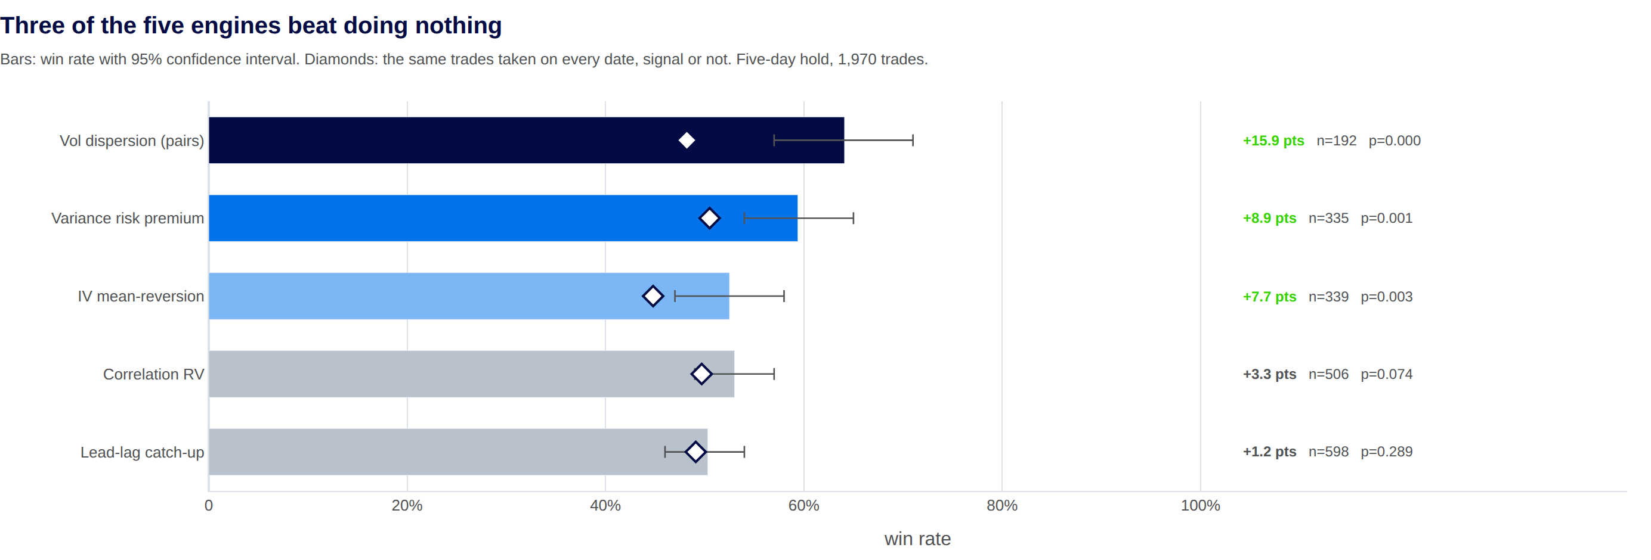
Three of the five engines beat doing nothing
Notes:
Across all 1,970 trades the signals won 54.3% against a 48.7% baseline. A 5.6 point edge, 95%
interval 52.1 to 56.5, p = 0.0000. Real, and unevenly spread.
Vol dispersion is the standout: 64.1% against 48.2%, so nearly 16 points, on 192 trades, and
+12.1 vol points per trade. The variance risk premium is +8.9 and IV mean-reversion +7.7, both
significant.
The two price engines do not work. Lead-lag is +1.2 and has the largest sample of the lot at 598
trades, which is the useful way to put it: this is not a small-sample problem, it is the
most-tested engine and the edge still is not there. Correlation RV is +3.3 with p = 0.07, so
suggestive at best.
Worth explaining IV mean-reversion. It won 52.5%, barely a coin flip, which looks weak. But its
baseline is 44.8%, the lowest of any engine, because buying volatility loses more often than it
wins by nature. Vol drifts down most of the time and pays off in bursts. Against the right
benchmark that 52.5% is a genuine +7.7. Best example on the slide of why the baseline matters.

Slide 8
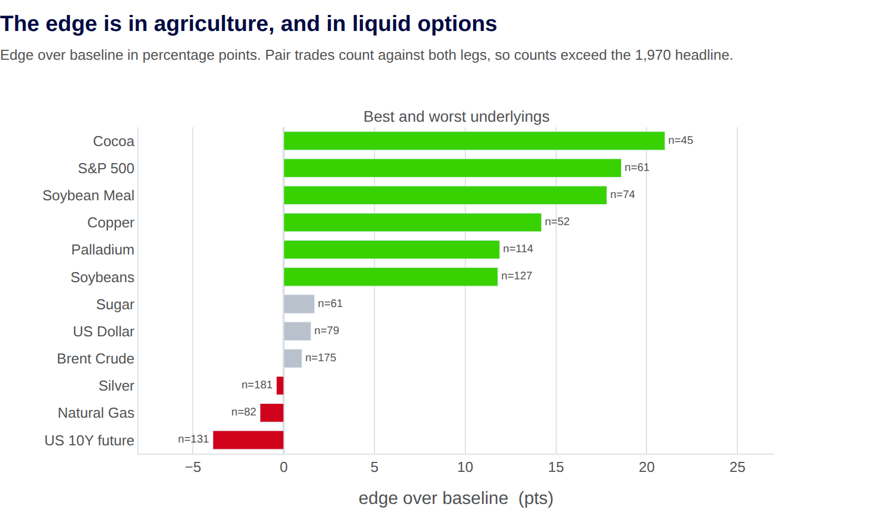
The edge is in agriculture, and in liquid options
Notes:
Two cuts of the same trades.
By underlying, cocoa, the S&P and soybean meal come out best, all around +18 to +21 points. US
ten-year futures, natural gas and silver come out worst. By asset class the pattern is cleaner:
grains +9.3, base metals +9.1, softs +8.6, against energy +3.7 and macro +2.7. The edge sits in
agriculture and away from the most heavily traded markets.
Caveat to say out loud: 26 assets were tested, so a few will look significant by luck alone. WTI
is +9.0 and Brent is +1.0, and those two are nearly the same market. I would not trust any single
name. The class-level pattern is the reliable part.
The right panel is the one I did not expect, and it points the other way from what I assumed.
Signals built on options that re-price most days ran +11.9 points. Signals on options that
re-price rarely ran +6.2. I had guessed the thin markets would be less efficient and give a
better signal. The opposite is true, and the reason makes sense: if the option mark barely moves,
an apparent dislocation is partly stale data rather than a real mispricing. The data-quality
filter is not hygiene, it is where the edge is.
The price engines, which never touch options, sit at +2.5. Same story from another angle: the
volatility engines are carrying this.

Slide 9
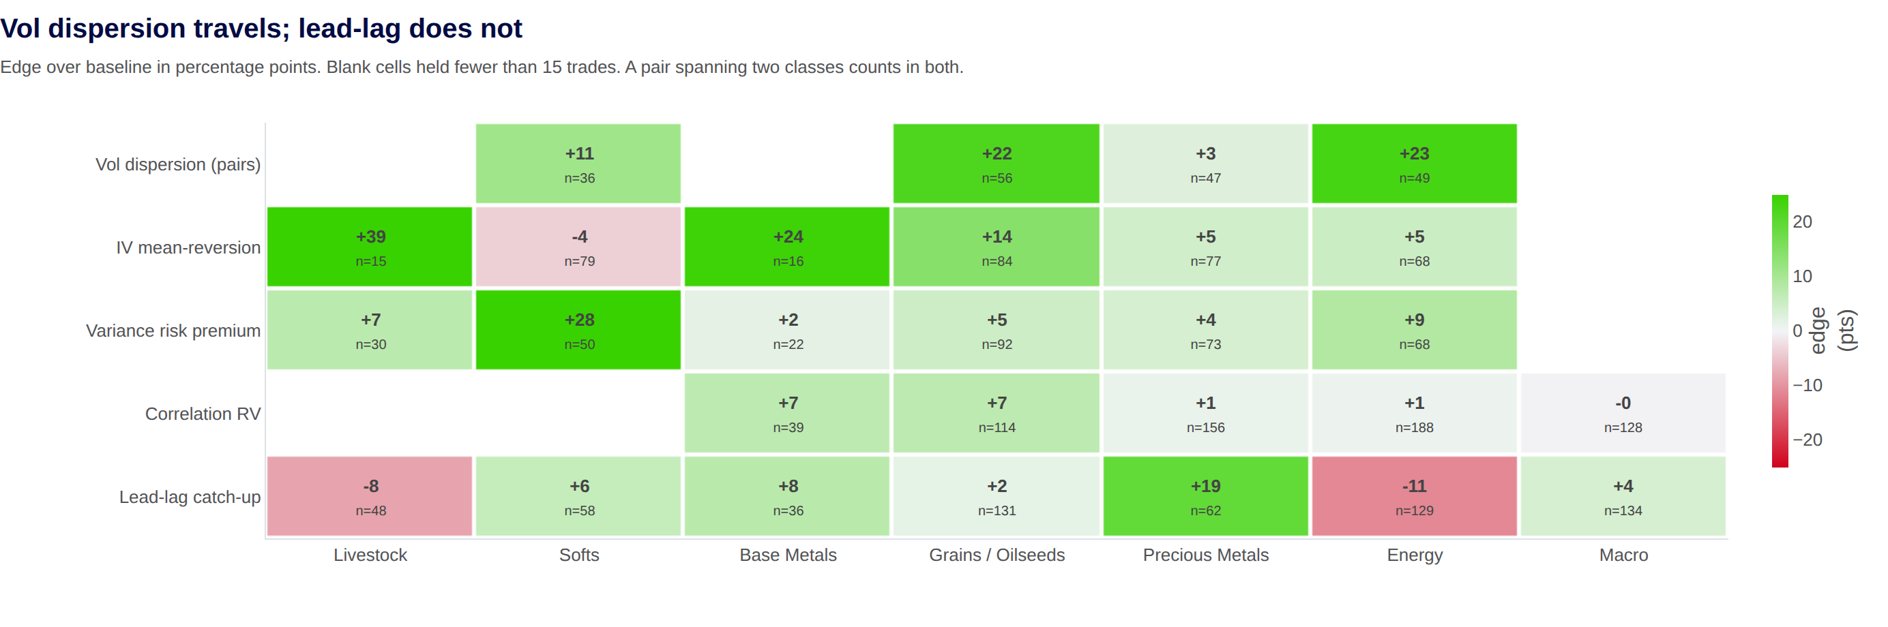
Vol dispersion travels; lead-lag does not
Notes:
This is the two previous slides crossed. Which tool to point at which market.
The thing I was checking: vol dispersion's +15.9 could have come from one lucky corner. It did
not. Grains +22, energy +23, softs +11, on 36 to 56 trades each. It is the only engine that
travels, and it is the one I would keep.
Second reading, and the more useful one. Energy looked mediocre on the last slide at +3.7. That
average hides two opposite things: vol dispersion made +23 in energy while lead-lag lost 11.
Averaging across engines buried both. Same in precious metals, where lead-lag is +19 and
everything else is flat.
Lead-lag is the interesting failure. Overall it is +1.2 and looks dead, but it is +19 in precious
metals and -11 in energy on 129 trades. Those cancel. Either it works somewhere specific and I
have not isolated why, or I am looking at 29 cells and finding the extremes. With one year of
data I cannot tell the difference, and I would rather say that than pick the flattering reading.
Two cells to be careful about if anyone points at them. IV mean-reversion in livestock is +39 on
15 trades, right at the reporting threshold. And in the appendix table the top three
vol-dispersion pairings are soybean meal, corn and soybeans at +33 each, which are largely the
same spread trades counted against both legs, not three independent findings.

Slide 10
A win rate means nothing until you know the baseline
What I would change
The confidence score does not pick winners. Inside an engine its correlation with whether the trade worked is -0.002, and the less confident half did better. Rebuild it as the gap to a base rate rather than a raw hit rate.
Keep vol dispersion, which is the only engine that works across markets. Rework correlation RV and lead-lag rather than trusting their averages.
Show every signal against its baseline in the dashboard, not only in the backtest.
What this does not prove
No costs, no sizing, no option greeks. This measures direction, not profit.
A setup that stays extreme for weeks gets recorded at every replay, so the trades are not independent and the real sample is smaller than 1,970.
One year, one universe, one set of parameters.
26 assets tested, so some of the per-asset results are luck.
Notes:
The confidence line deserves thirty seconds, because it is the part where I tested my own work
and it failed. The score measures how often a setup worked, not how much more often than the same
bet on any other day, so an engine sitting on a favourable base rate scores high with no skill in
it. Raising the minimum-confidence filter looks like it helps, but +8.7 of the +7.2 it delivers
comes from which engines survive the filter and -1.5 from the score itself.
Backup slide with that chart is behind this one if anyone wants to see it.
Then land the title. The dashboard was the build. The baseline was the judgement. Two engines
and the confidence score only looked good until there was something to compare them against.
Then say the limitations before anyone asks. That is the difference between a result and a claim.
The overlap point is the one a sharp listener raises. Weekly replays with five-day holds do not
overlap in time, but the same signal reappearing for six weeks is six correlated records, not six
independent ones. That inflates confidence in the result, which is why I would describe +5.6
points as small and real rather than proven.
If asked what I would do with more time: run the test across several years to see whether vol
dispersion holds up outside this particular one, and test the rebuilt confidence score properly
out of sample.
And if asked what I learned: a win rate without a benchmark is not evidence, building the thing
that tests your work matters as much as the work, and the most useful result was the one telling
me part of it did not work.

