Slide 1

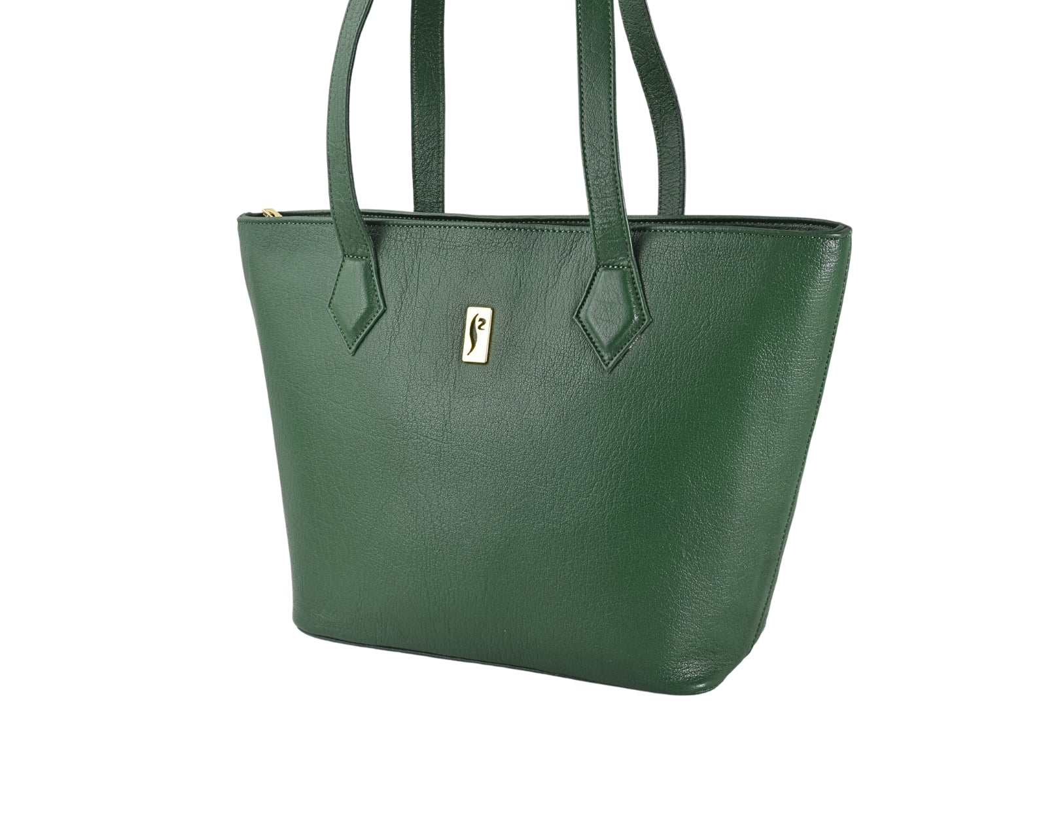

NOW AVAILABLE
Shop our full collection online
Handcrafted leather goods delivered to your doorstep across Pakistan.
SHOP ONLINE AT
silkskinonline.com
SCAN TO SHOP

Slide 2
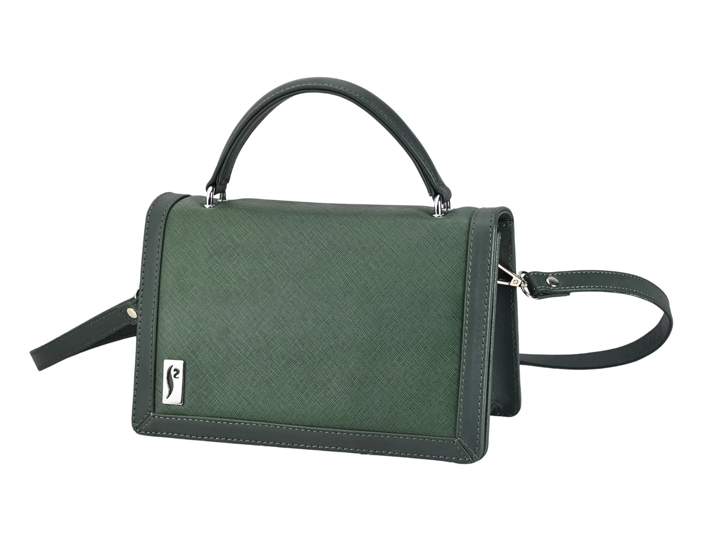

NOW AVAILABLE
Shop our world online
Wallets, bags & accessories — the complete SILKSKIN range at your fingertips.
VISIT US ONLINE
silkskinonline.com
SCAN TO SHOP

Slide 3
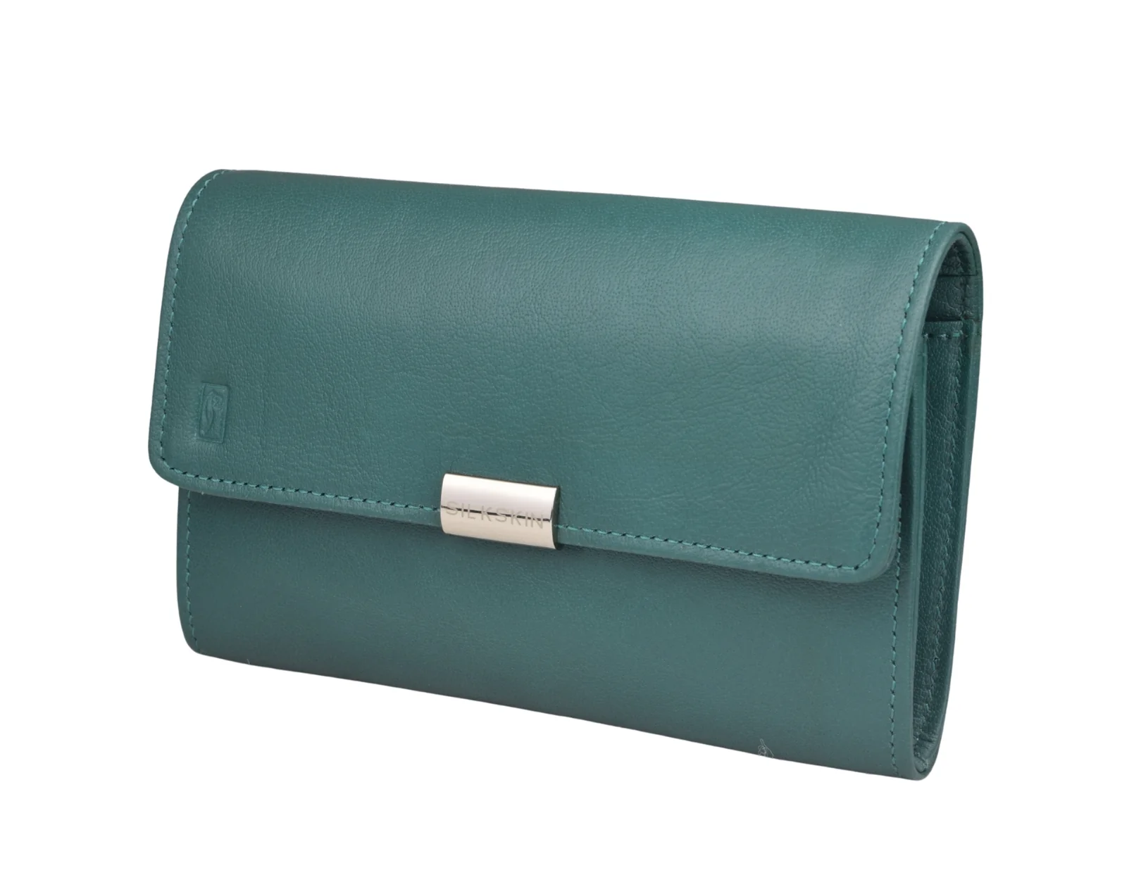

NOW ONLINE
The full collection awaits
Wallets, bags & accessories delivered across Pakistan.
SHOP AT
silkskinonline.com
SCAN TO SHOP

Slide 4

EST. 1987
NOW AVAILABLE ONLINE
Shop the full range
silkskinonline.com
SCAN TO SHOP

