Slide 1

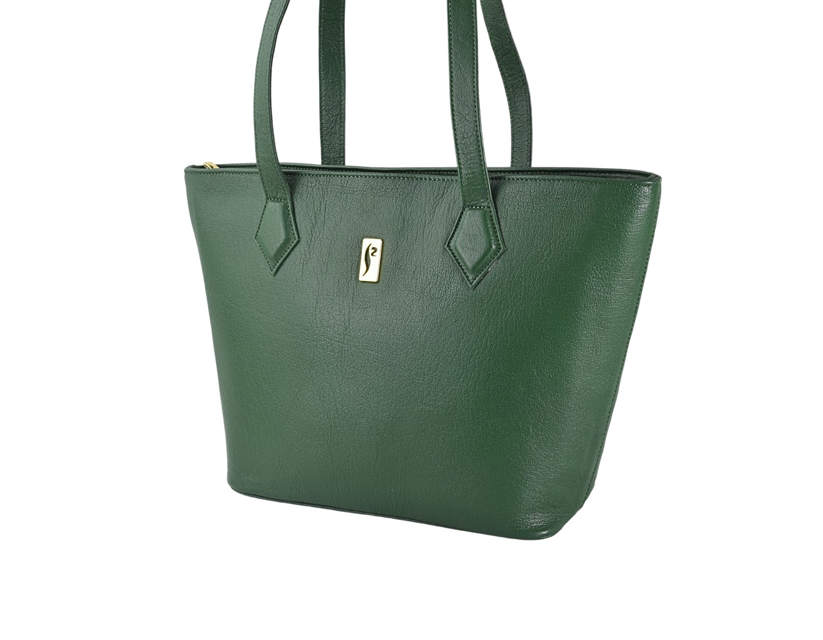

NOW AVAILABLE
Shop our full collection online
Handcrafted leather goods delivered to your doorstep across Pakistan.
SHOP ONLINE AT
silkskinonline.com
SCAN TO SHOP

Slide 2
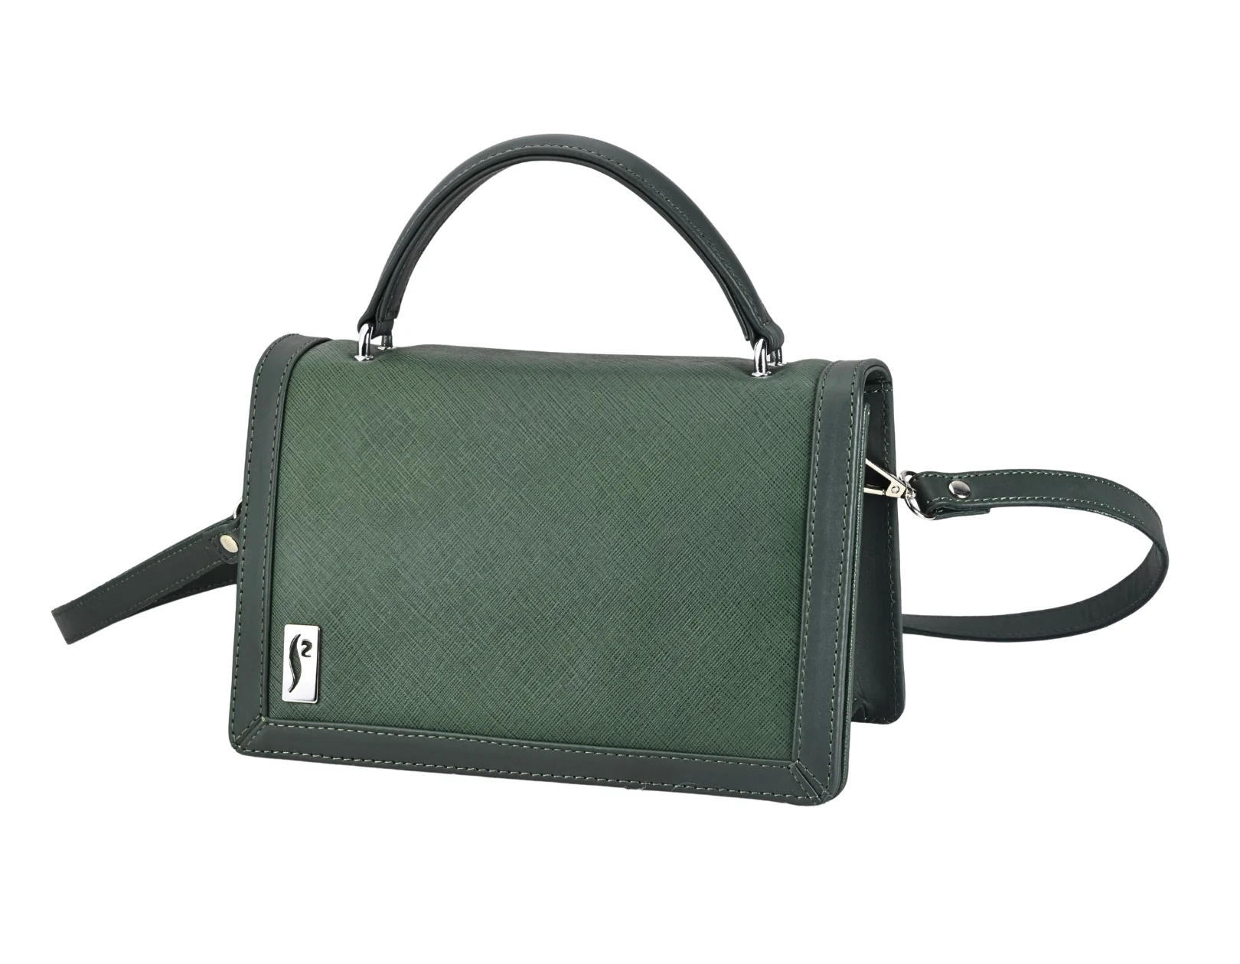

SILKSKIN
LEATHER GOODS · EST. 1987
NOW AVAILABLE
Shop our world online
Wallets, bags & accessories — the complete SILKSKIN range at your fingertips.
VISIT US ONLINE
silkskinonline.com
SCAN TO SHOP

Slide 3
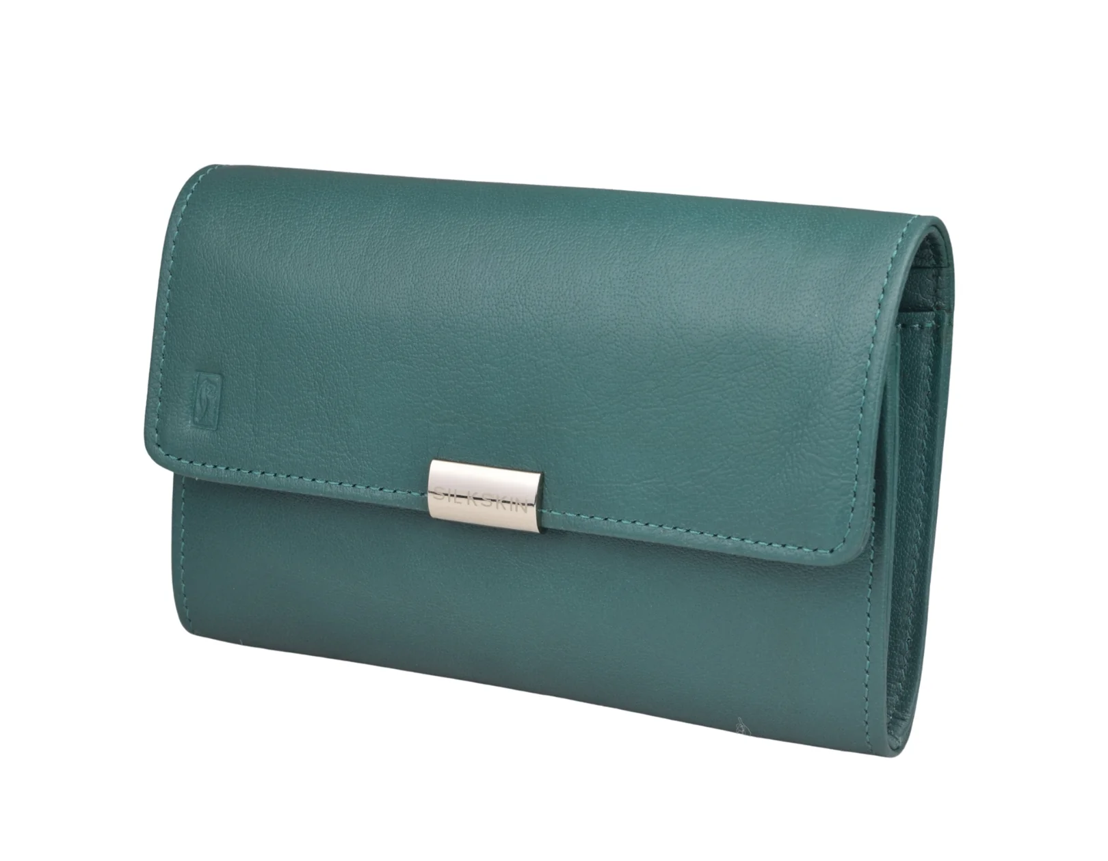

NOW ONLINE
The full collection awaits
Wallets, bags & accessories delivered across Pakistan.
SHOP AT
silkskinonline.com
SCAN TO SHOP

Slide 4

SILKSKIN
LEATHER GOODS · EST. 1987
EST. 1987
NOW AVAILABLE ONLINE
Shop the full range
silkskinonline.com
SCAN TO SHOP

Slide 5
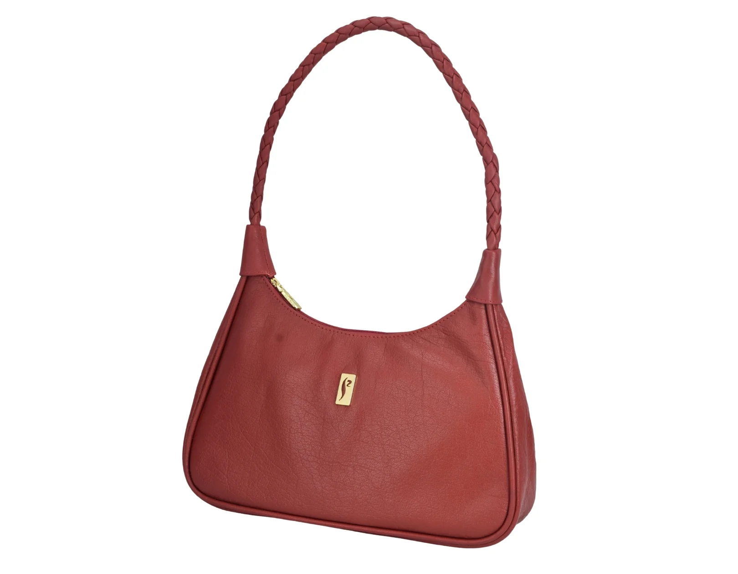
NOW ONLINE
Discover crafted leather
Bags, wallets & more — order from anywhere in Pakistan.
SHOP ONLINE AT
silkskinonline.com
SCAN TO SHOP

Slide 6
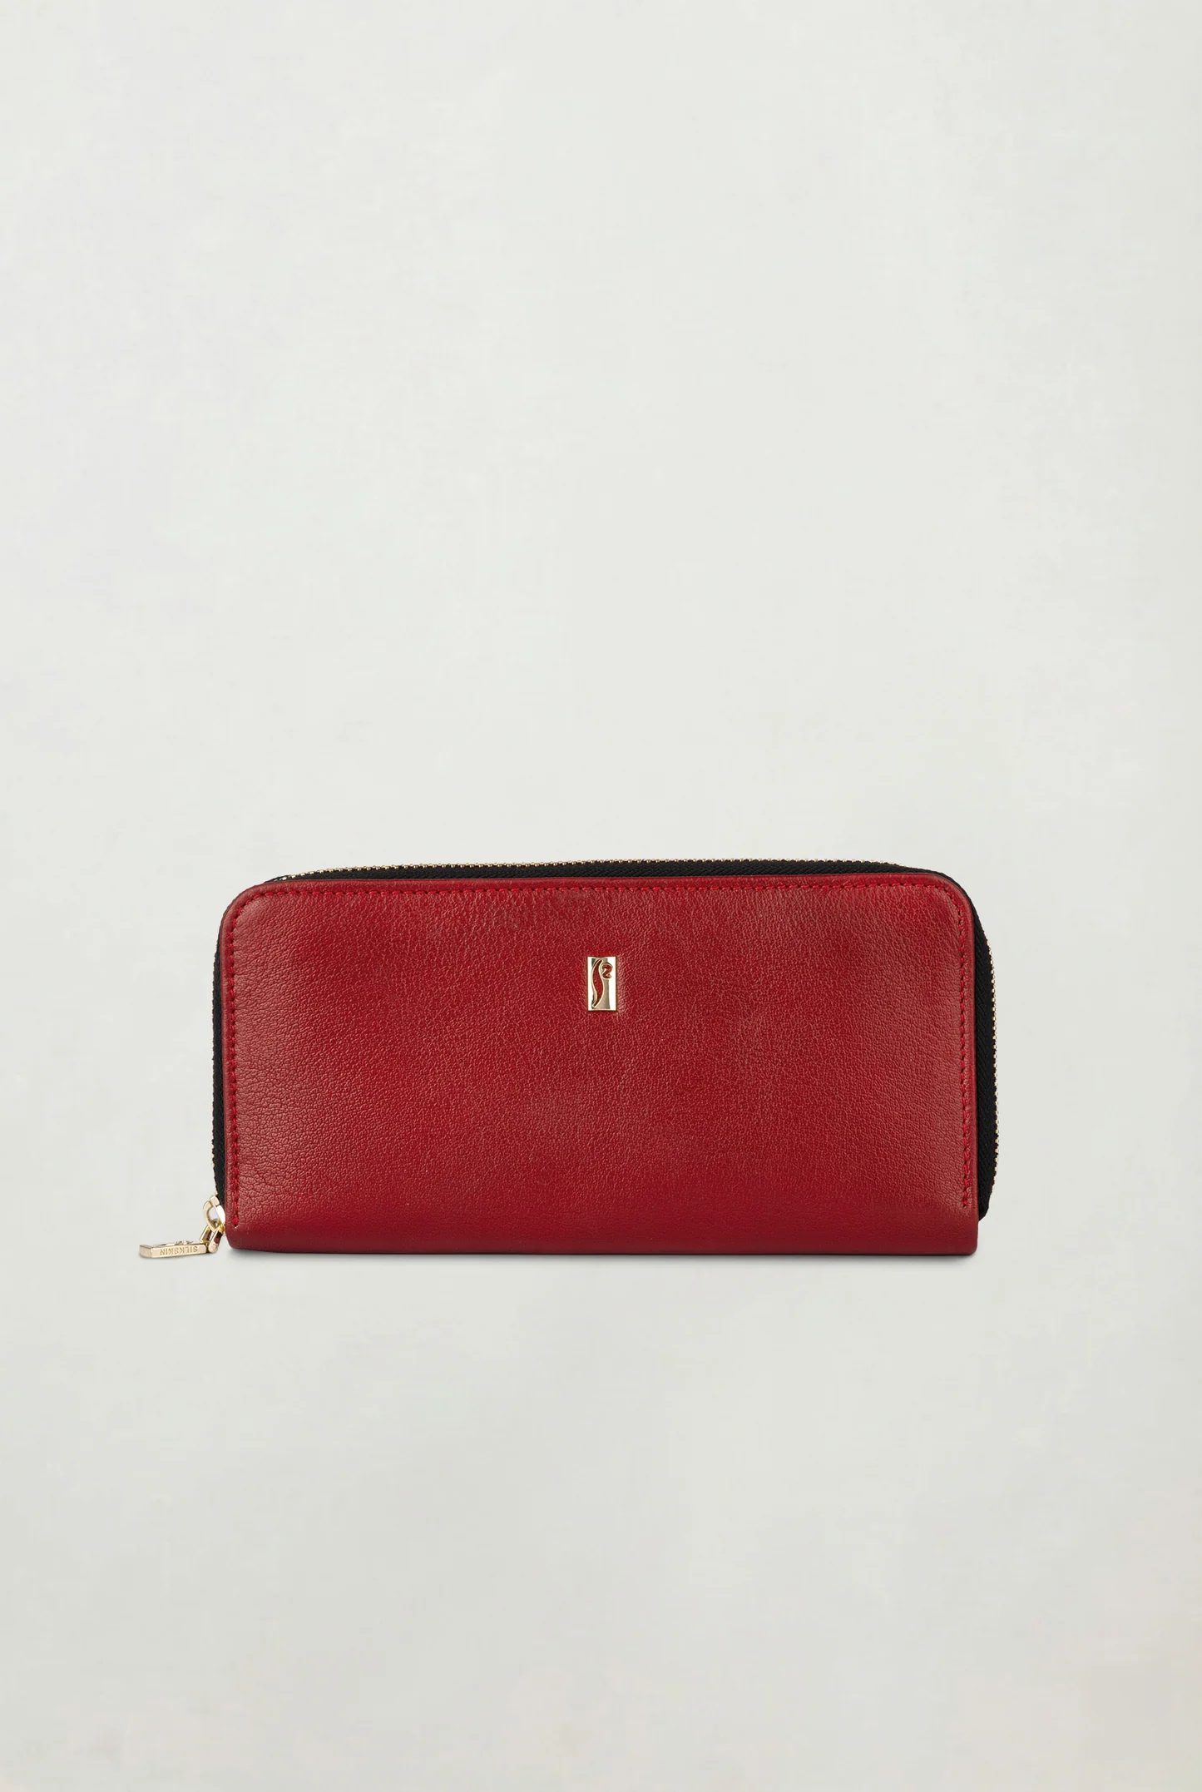

SILKSKIN
LEATHER GOODS · EST. 1987
NOW AVAILABLE
Fine leather, now at your door
Every piece handcrafted with genuine leather since 1987.
SHOP AT
silkskinonline.com
SCAN TO SHOP

Slide 7

EST. 1987 · PAKISTAN
SHOP ONLINE
Your style, delivered
Genuine leather goods — wallets, bags & more. Order online today.
SHOP AT
silkskinonline.com
SCAN TO SHOP

Slide 8

SILKSKIN
LEATHER GOODS · EST. 1987
NOW ONLINE
The art of leather online
Bags, wallets & accessories. Crafted in Pakistan since 1987.
SHOP AT
silkskinonline.com
SCAN TO SHOP

