Slide 1
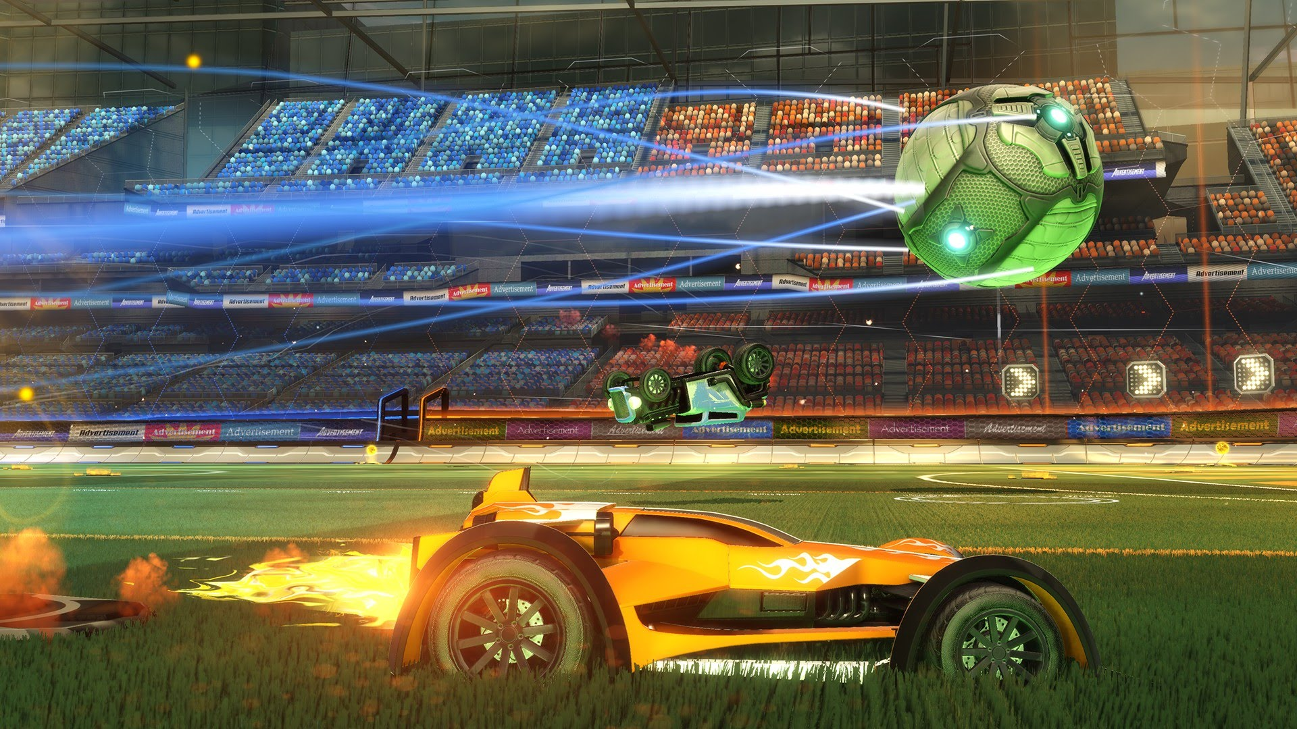
FOOTY BOT

Slide 2
FOOTY BOT
Group members:
Hassan Rasheed
Saad Sohail
M. Ahsan Fahim
BSCS-5B

Slide 3
Abstract
The main idea of the project is to implement a small-scale Robot football game which will consist of three basic elements:
Image processing
Algorithms
Hardware
We have divided our group into three teams of three members each, who worked on each of the above stated elements and helped other sub-teams wherever we could.

Slide 4
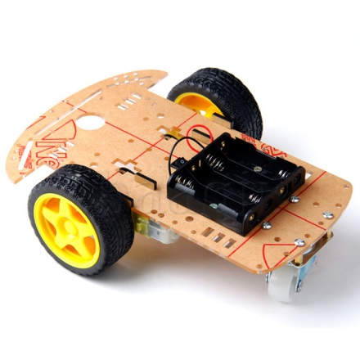
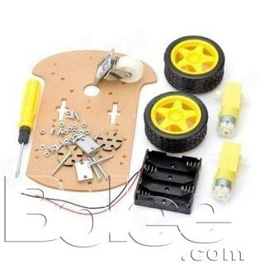
Hardware

Slide 5
Hardware
Board
2 normal wheels
1 free rotating wheel
2 DC motors
6V and 9V Batteries
Screws and nuts
Arduino UNO
Bluetooth Module HC-05
2 Transistor MOSFET 2n7000
Jump wires
Webcam

Slide 6
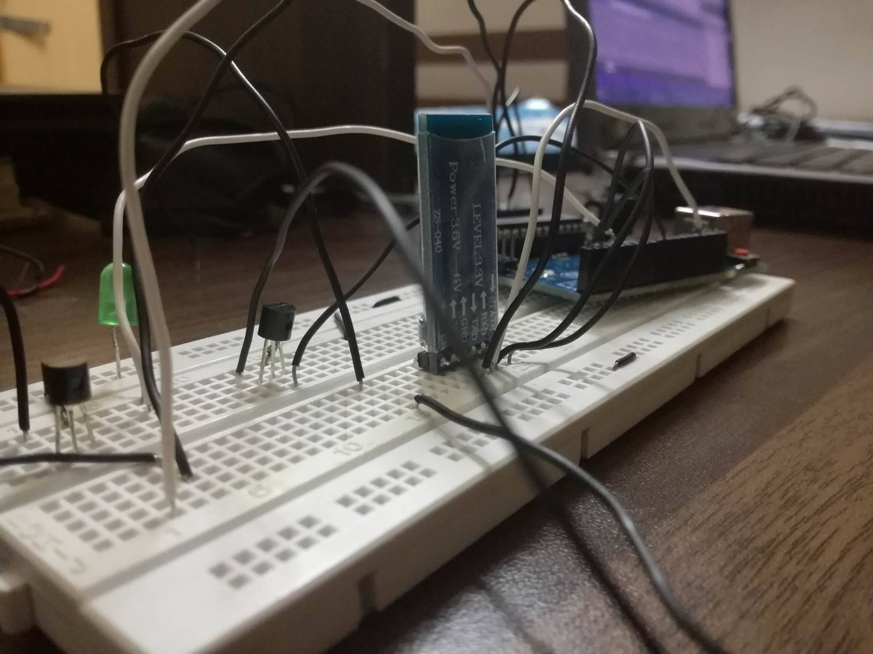
Work in progress

Slide 7
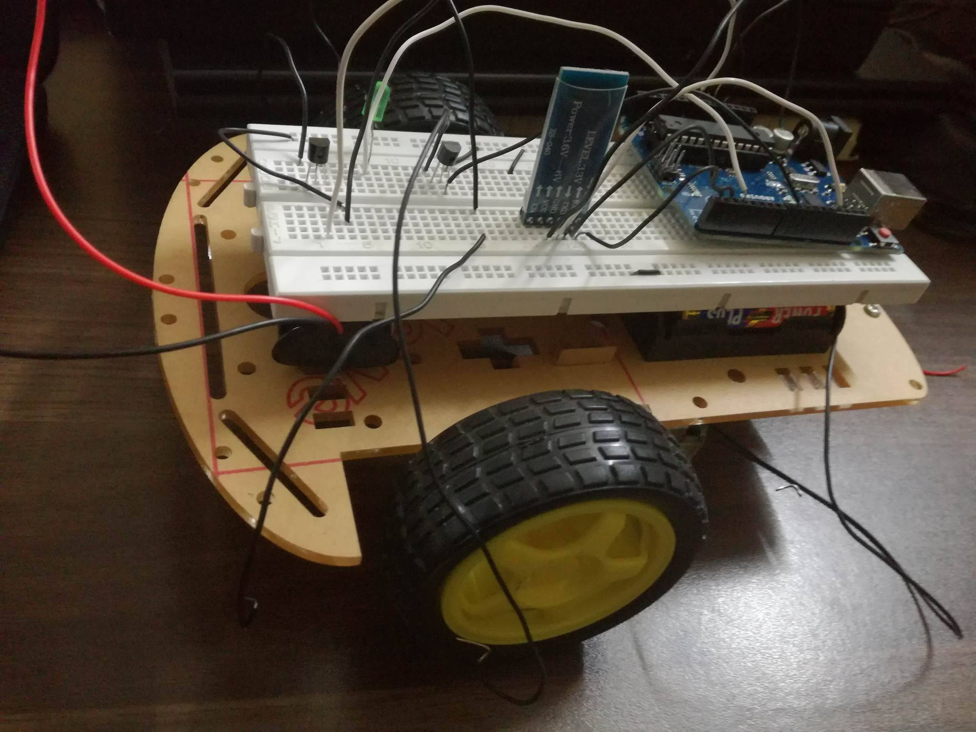
Work in progress

Slide 8
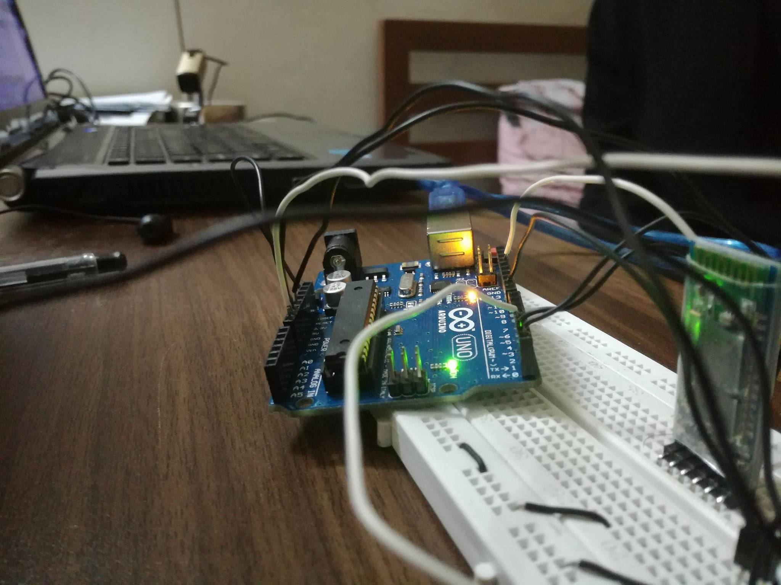
Work in progress

Slide 9
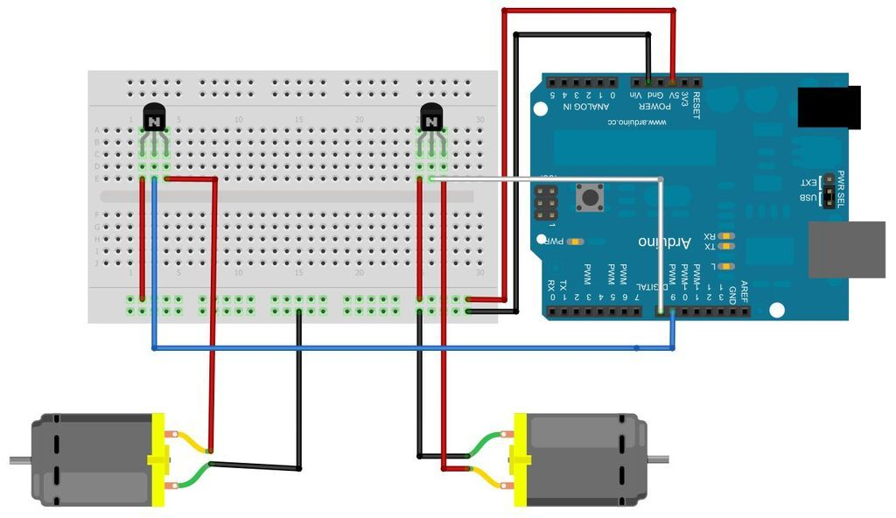
Circuit

Slide 10
Main work of the hardware
Bluetooth Module HC-05
It is an Arduino compatible Bluetooth module which was used to receive serial data from the computer and send it to Arduino Uno so it could perform the tasks it should according to the data received
Arduino Uno
It is coded to act upon the serial data sent by the computer according the coordinates of the ball, robot and the goal, taken by the webcam.

Slide 11
Entity Class
It is the class that we use to define different values for the objects that we then track using our webcam
The functions that we created in our class are the following
Entity(string name);
The constructor takes in an argument name which is actually the type of the entity, i.e whether it is a ball, playerfront, playerrear, goal. These predefined entity names have different values set which are used by opencv to detect them through the camera
int getXPos();
int getYPos();
Scalar getHSVmin();//it returns min HSV value of the entity
Scalar getHSVmax();//it return max HSV value of the entity
void setHSVmin(Scalar min);//used to set min HSV value of the entity
void setHSVmax(Scalar max);//used to set maxHSV value of the entity
Variables: int xPos, yPos;//x y coordinates of the object
string type;//type of object (playerfront,playerrear, ball, goal)
Scalar HSVmin, HSVmax;//to store color of the object

Slide 12
OpenCV
It is an open source computer vision library, we used it to track our objects using their color.
The functions that we used for image processing
trackFilteredObject(Entity &anEntity, Mat threshold, Mat HSV, Mat &cameraFeed)
This function tracks the object that we pass every where in the camera frame.
The first argument it takes is of type entity that is our class for objects that we want to track this contains all the functions and variables that have been shown earlier.
It takes three matrices one is of cameraFeed given by the capture function that reads the feed from the webcam. One is the thresholded image that is set using the calibration mode in which we set the HSV values of the different values of the objects that we want to track. Third is the matrix of HSV values of the object that we want to track.

Slide 13
OpenCV
VideoCapture Object in OpenCV
It is an object in opencv that is used to acquire webcam feed
It has several functions, the ones we used are
-capture.set
Sets the frame width and height, which depends on the camera that you are using
-capture.open(1)
To start taking camera feed (the int type argument is the number of camera from which you want to take the feed from)
-capture.read
To read the feed in the main loop

Slide 14
OpenCV
drawObject(Entity &anEntity, Mat &frame)
-It takes in arguments of type Entity and the Matrix type object ‘frame’
This function draws the name, coordinates and a circle to point out the passed object on the screen. It is called inside the trackFilteredObject function so that we can check if all the objects are being tracked.

Slide 15
How is serial data sent by the computer?
Serial.h
We used Serial.h header which has the following functions, it is an open source library on Github.
-Serial(tstring &commPortName, int bitRate)
Takes in a serial port’s name as of type tstring as an argument, and a bitrate which is 9600 of most of the ports
Takes in the name of the serial port as an argument and opens it to send data
-Write
Writes serial data of type character to the serial port
-Read //not used
Reads serial data from the serial port
-Serial Flush //flushes everything from the serial port’s read buffer

Slide 16
How is serial data sent by the computer?
myData(char* temp, Serial &serial)
This is a function that we created, it takes in char variable which is our data that we send to the Arduino and the Serial type object which we pass by reference so it does not try to open a new port every time it is passed, then we use serial.write() function to write the data passed to the serial port, which is then sent using Bluetooth and received and read by the Arduino.
It sends char data i.e.
‘L’ for left, ‘R’ for right, ‘F’ for forward, ‘B’ for break
‘E’ to stop (E is sent when escape key is pressed)

Slide 17
How does the car move?
string findDirection(Entity playerrear, Entity ball)
It takes in ball and playerrear as two arguments and then compares their x and y coordinates to return the region in which the ball is compared to the coordinates of the playerrear.
There are four regions:
-NORTHEAST
If ball.x > playerrear.x and ball.y < playerrear.y
-NORTHWEST
If ball.x < playerrear.x and ball.y < playerrear.y
-SOUTHEAST
If ball.x > playerrear.x and ball.y > playerrear.y
-SOUTHWEST
If ball.x < playerrear.x and ball.y > playerrear.y
These regions are used by our main function that makes the car move

Slide 18
Main function
void movePlayer(string balld, Entity playerfront, Entity playerrear, Entity ball,Serial &serial)
Balld is the region that is found by findDirection function
Northwest
If ‘Northwest’ the car turns to left until the x coordinate of car’s rear is greater than the x coordinate of car’s front and the y coordinates of both of them are not the same, i.e until the car is facing west.
Then the car moves forward until the x coordinates of both the car’s rear and the ball are same
After that the car turns to the right until car’s front’s y coordinate is less than car’s rear’s y coordinate and the x coordinates of both are not the same, i.e car is facing north
Then the car moves forward until the car’s front’s y coordinate is equal to ball’s y coordinate.

Slide 19
Main function
Northeast
If ‘Northeast’ the car turns to right until the x coordinate of car’s rear is less than the x coordinate of car’s front and the y coordinates of both of them are not the same, i.e until the car is facing east.
Then the car moves forward until the x coordinates of both the car’s rear and the ball are same
After that the car turns to the left until car’s front’s y coordinate is less than car’s rear’s y coordinate and the x coordinates of both are not the same, i.e car is facing north
Then the car moves forward until the car’s front’s y coordinate is equal to ball’s y coordinate.

Slide 20
Main function
Southwest
If ‘Southwest’ the car turns to left until the x coordinate of car’s rear is greater than the x coordinate of car’s front and the y coordinates of both of them are not the same, i.e until the car is facing west.
Then the car moves forward until the x coordinates of both the car’s rear and the ball are same
After that the car turns to the left until car’s front’s y coordinate is greater than car’s rear’s y coordinate and the x coordinates of both are not the same, i.e car is facing south
Then the car moves forward until the car’s front’s y coordinate is equal to ball’s y coordinate.

Slide 21
Main function
Southeast
If ‘Southeast’ the car turns to right until the x coordinate of car’s rear is less than the x coordinate of car’s front and the y coordinates of both of them are not the same, i.e until the car is facing east.
Then the car moves forward until the x coordinates of both the car’s rear and the ball are same
After that the car turns to the right until car’s front’s y coordinate is greater than car’s rear’s y coordinate and the x coordinates of both are not the same, i.e car is facing south
Then the car moves forward until the car’s front’s y coordinate is equal to ball’s y coordinate.

Slide 22
Main function
The same procedure is implemented for goal
There instead of the ball, goal and its region is passed and the car takes the ball to the goal following this procedure

Slide 23
Arduino’s Code
For serial data ‘L’
The pin for right motor is set to high and left motor is set to low
For serial data ‘R’
The pin for left motor is set to high and right motor is set to low
For serial data ‘F’
Both pins are set to high
For serial data ‘B’ and ‘E’
Both pins are set to low

Slide 24
Thank you!

