Slide 1
Online Retail Dataset Hassan Saleem

Slide 2

About Dataset
Name: Online Retail Data Set
Rows: 538000+
Columns: 8
4 Categorical
4 Numeric
Our Target: Customer Categorization

Slide 3
Exploratory Data Analysis
Analysis of Dataset for Modeling
Attributes Datatypes
Descriptive Statistics (Mean, Median, Mode, Min, Max, Std dev)
Missing Values (Customer ID)
Negative Values (Price, Quantity)
Invoice (Other than 6-digit)
Stock Code (Other than 5-digit integer)
Helpful for Data Cleaning

Slide 4
Pre Processing
01
02
03
04
05
06
Invoice
Stock Code
Customer ID
Removed rows that contained invoice greater than 6-digit
Only included Stock Codes that are 5-digit or grater and are legit
Removed rows that contained null Customer ID
Price
Quantity
Conclusions
Removed rows that contained –ve or zero price
Negative quantity values are removed
Droppped about 23% of the records during cleaning

Slide 5
Feature Engineering
Created a SalesTotal Atribute
It represents the attribute in a dataset that is the product of Price and Quantity.
Created a MonetaryValue Attribute
It represents the total sales per customer by summing up the SalesTotal column.
Created a Frequency Attribute
It counts the number of unique invoices per customer, indicating how often they made purchases.

Slide 6
Feature Engineering
Created a LastInvoiceDate Atribute
It extracts the most recent purchase date for each customer.
Created a Recency Attribute
It show how many days have passed since each customer's last purchase by Subtracting
LastInvoiceDate from MaxInvoiceDate.

Slide 7
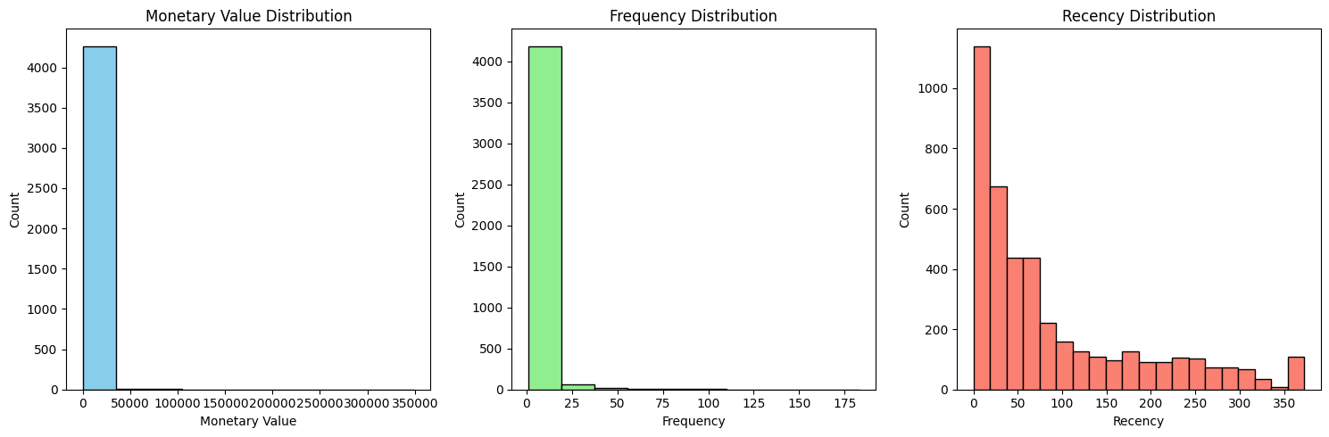
Analysis of Data during Feature Engineering: Histogram

Slide 8
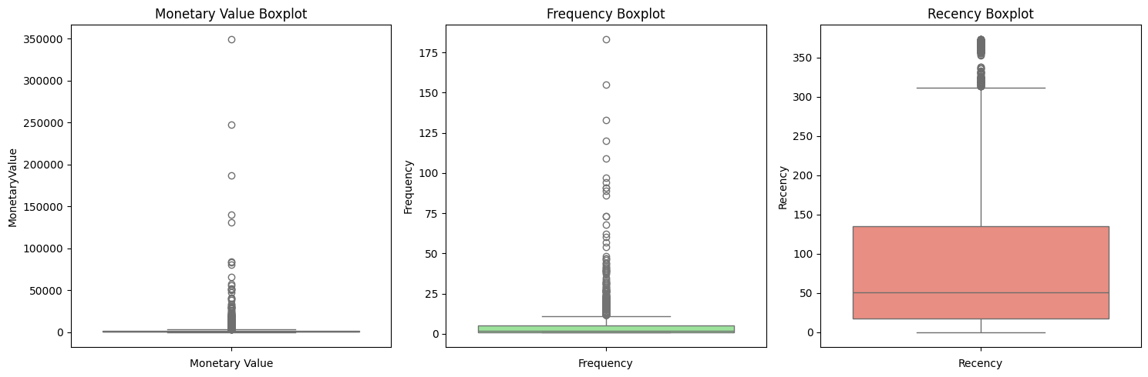
Analysis of Data during Feature Engineering: Boxplot

Slide 9
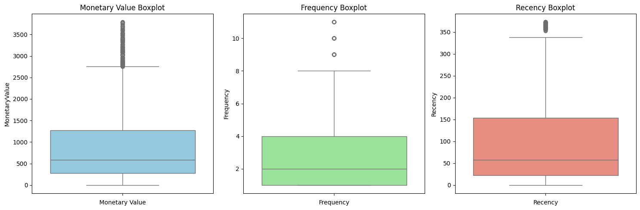
Analysis of Data during Feature Engineering: Boxplot (after removing outliers)

Slide 10
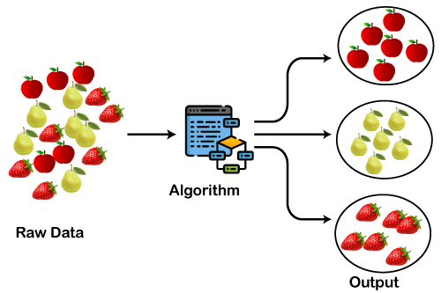
Model Selection
Clustering Problem
Our aim is to categorize customers based on different features
K-Means

Slide 11
Why K-Means
K-Means is ideal for customer segmentation as it effectively groups customers based on MonetaryValue, Frequency, and Recency.
It is fast, scalable, and works well with numerical data, making it suitable for large datasets like Online Retail II.
Finding the optimal number of clusters (K) is easy using methods like Elbow Method and Silhouette Score, ensuring meaningful customer groupings.

Slide 12
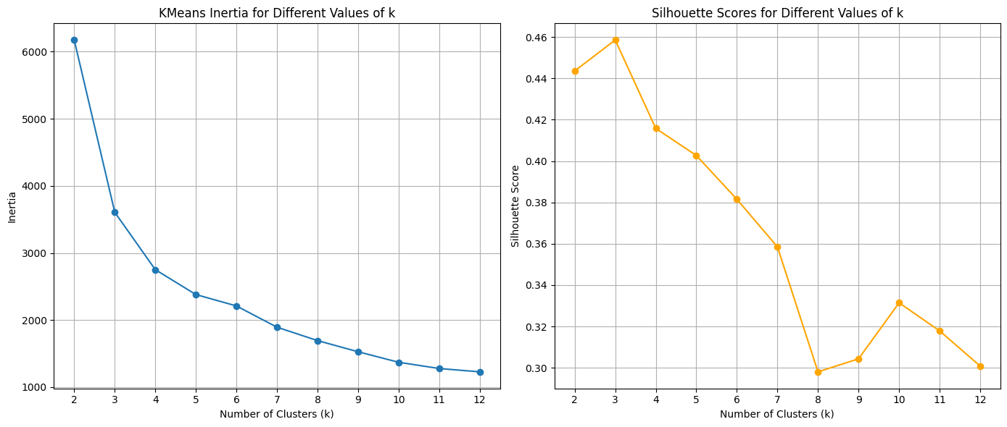
Selecting the value of K

Slide 13
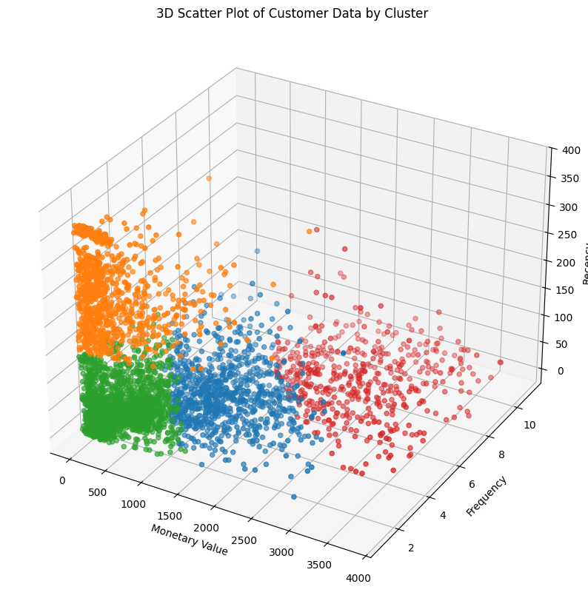
3D Scatter Plot with k=4

Slide 14
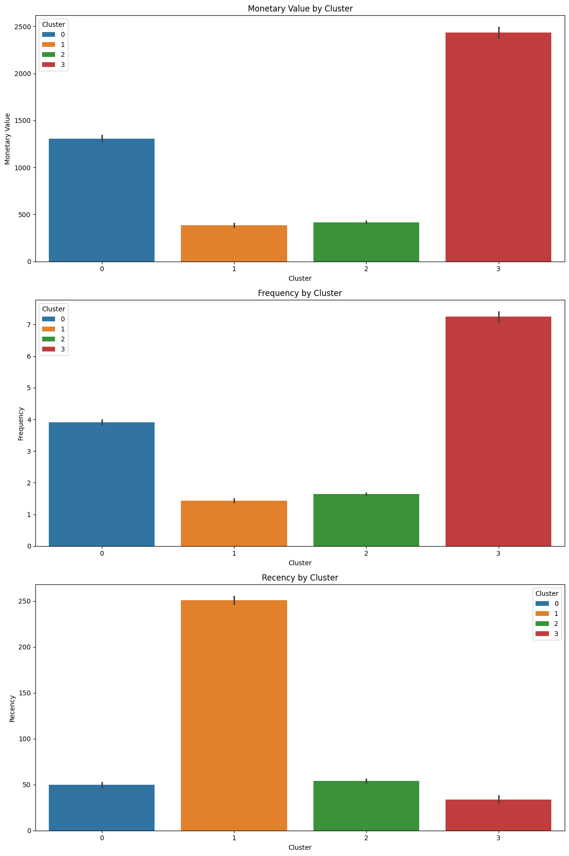
Bar Plot for Clusters Analysis

Slide 15
Results
1. Cluster 0 (Blue): "Retain"
Rationale: This cluster represents high-value customers who purchase regularly, though not always very recently. The focus should be on retention efforts to maintain their loyalty and spending levels.
Action: Implement loyalty programs, personalized offers, and regular engagement to ensure they remain active.
2. Cluster 1 (Orange): "Re-Engage"
Rationale: This group includes lower-value, infrequent buyers who haven’t purchased recently. The focus should be on re-engagement to bring them back into active purchasing behavior.
Action: Use targeted marketing campaigns, special discounts, or reminders to encourage them to return and purchase again.

Slide 16
Results
3. Cluster 2 (Green): "Nurture"
Rationale: This cluster represents the least active and lowest-value customers, but they have made recent purchases. These customers may be new or need nurturing to increase their engagement and spending.
Action: Focus on building relationships, providing excellent customer service, and offering incentives to encourage more frequent purchases.
4. Cluster 3 (Red): "Reward"
Rationale: This cluster includes high-value, very frequent buyers, many of whom are still actively purchasing. They are your most loyal customers, and rewarding their loyalty is key to maintaining their engagement.
Action: Implement a robust loyalty program, provide exclusive offers, and recognize their loyalty to keep them engaged and satisfied.

Slide 17
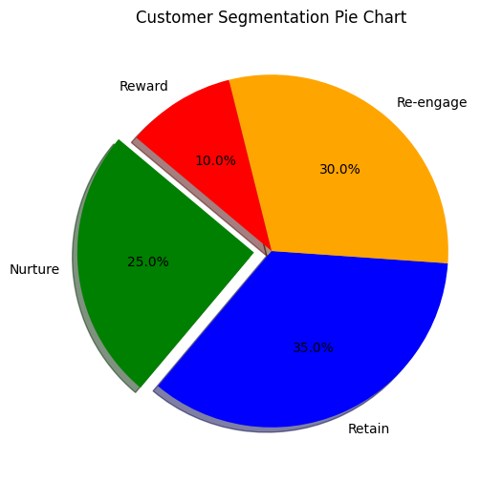
Result Analysis

Slide 18
Thanks!

