Slide 1
Artificial Intelligence VS Software Engineering
1
Hassan Sardar
Master of Science in Computer Science
COMSATS University Islamabad, Wah Campus

Slide 2
Project analysis slide 2
2
TABLE OF CONTENT
1.INTRODUCTION
4.RESULT ANALYSIS
SPEECH PROCESSING
2.WHY AI
5.RECOMMENDATION
3. METHEDOLOGY
6.QUESTIONS

Slide 3
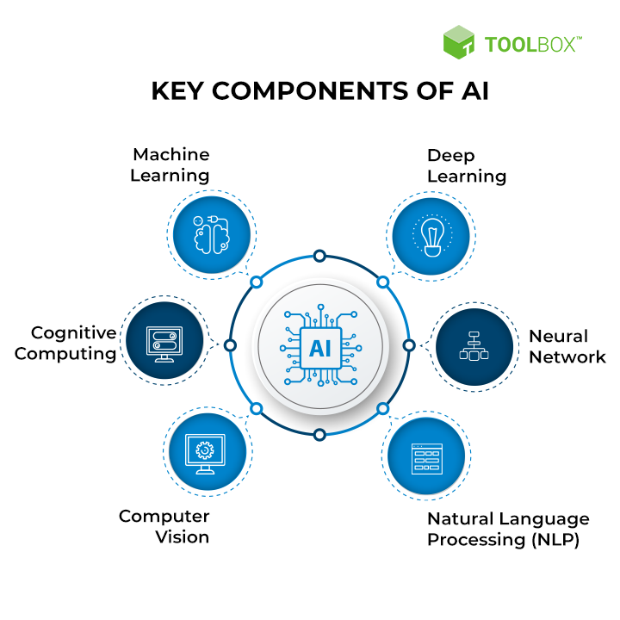
Introduction (1/2):
3
Artificial Intelligence (AI):
AI is defined as the intelligence of a machine or computer that enables it to imitate human capabilities.
Machine Learning:
Automatically Learn from Data
Improves from previous experiences
Deep Learning:
Subset of ML that learns by processing data with the help of artificial neural networks
Extracting key features, pattern from data
Cognitive Computing:
Cognitive computing aims to recreate the human thought process in a computer model

Slide 4
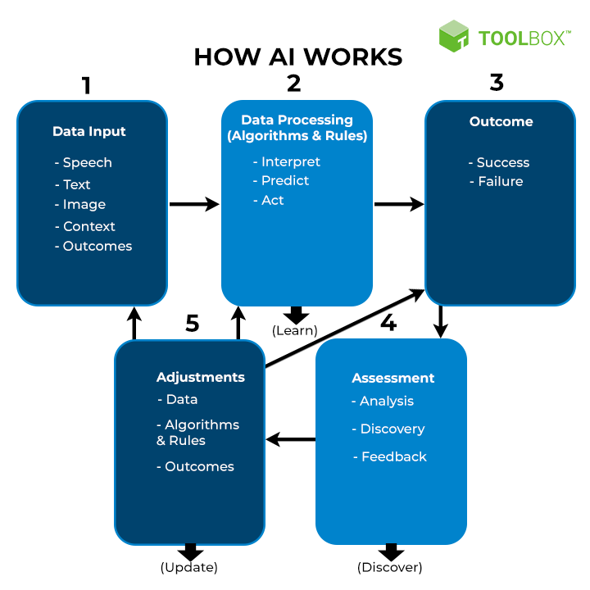
Introduction (2/2):
4
Natural Language processing (NLP):
NLP focuses on helping computers to understand the way that humans write and speak
Neural Network:
Computer Systems that are loosely modeled on neural connections in the human brain and enable deep learning.
Computer Vision:
Computer vision apply deep learning and pattern identification to interpret image content (graphs, tables, PDF pictures, and videos).
How AI Work:

Slide 5
Literature Review
5
Title | Field/domain | Data source(s) | Reference
Investigating the emerging COVID-19 research trends in the field of business and management: a bibliometric analysis approach | Business and management | Scopus, Web of Science | Verma and Gustafsson [1]
COVID-19 and disruption in management and education academics: bibliometric mapping and analysis | Education, business, economics | Scopus, Web of Science | Rodrigues et al. [2]
Publications in psychology related to the COVID-19: a bibliometric analysis | Psychology | Scopus | Zambrano et al. [3]
A bibliometric analysis of corona pandemic in social sciences: a review of influential aspects and conceptual structure | Social science | Scopus, Web of Science, Google Scholar, Emerald | Nasir et al. [4]

Slide 6
Proposed Methodology:
6
Dataset
Predictive analysis on survey data set
ANN is used for prediction
Data Mining:
Important Techniques for Big Data Analysis
Association rules and supervised Techniques for performance detection
Dataset:
Dataset of Jordanian University Students’ Psychological Health Impacted by Using E-learning Tools during COVID-19
Consist of student surveys in csv format
Score before and after the COVID-19
Five classes strongly disagree,agree,uncertain,agree and
strongly agree
Frames
Data Labeling
0
1
2
3
5

Slide 7
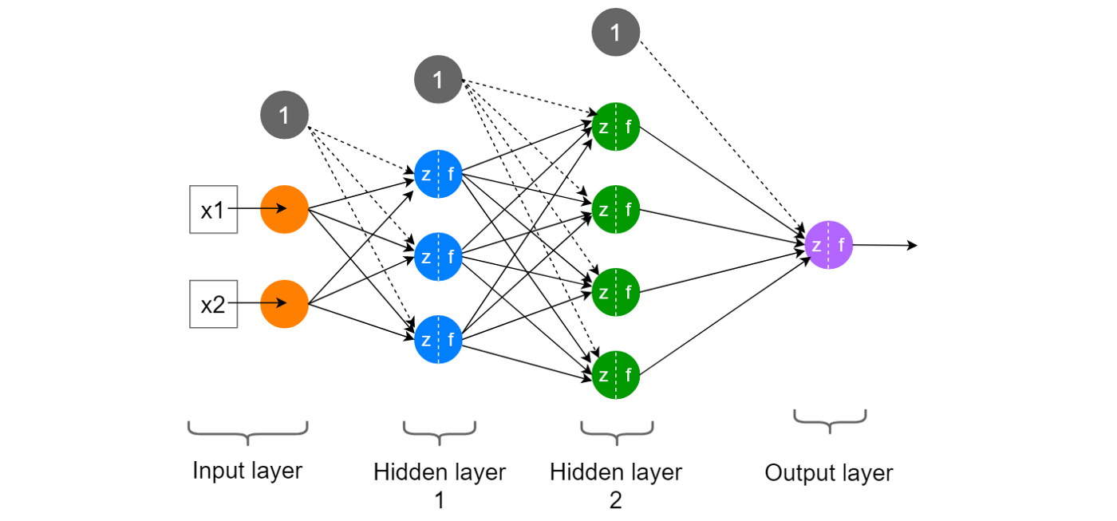
Proposed Methodology:
7
Drop useless column
SMOTE function is apply to fit X and Y values.
SMOTE performs data augmentation
Creating synthetic data points based on the original data.
After sampling X and Y split Train,Test
Apply ANN classifier.

Slide 8
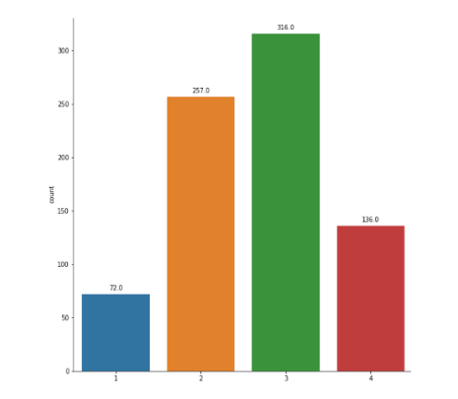
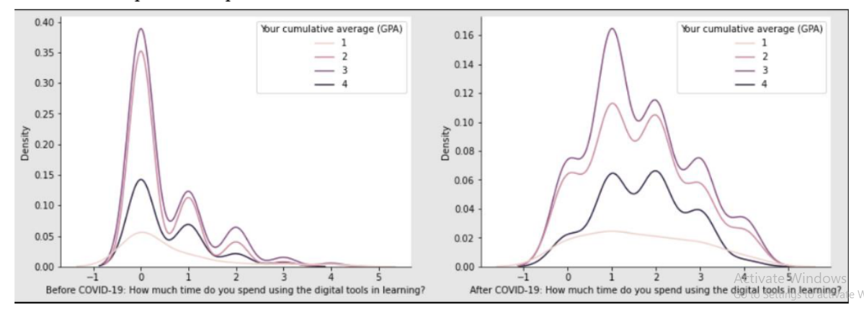
Results and Analysis:
8
CGPA variation and calculation by count
Time spending on Digital tools for Learning

Slide 9
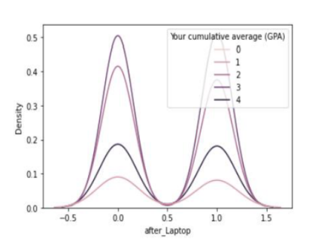
Results and Analysis:
9
Improvement in Grade is spend more than 1 to 3 hours
Excessive use of Online knowledge gaining lead to consistent decline in educational performance
It clarify that excessive use of Virtual equipment damage the student overall performance

Slide 10
Future Implication and Recommendations
10
Moderate Techniques required for E-Learning
Moderate Algorithm for performance evaluation
Dataset limitation consists of lack of sickness attribute
Infectious prevention approaches
Age factors may also be include

Slide 11
11
Questions?

Slide 12
References
12
[1] Abiodun, 0.1., Jantan, A., Omolara, A.E. Dada, K.v., Umar, A.M., Linus, o.U., Arshad, H., Kazaure, A.A., Gana, U. and Kiru, M.U., 2019. Comprehensive review of artificial neural network applications to pattern recognition. IEEE Access, 7, pp. 158820-158846
[2] Ahouz, E, Golabpour, A. Predicting the incidence of COVID-19 using data mining. BMC Public Health 21, 1087 (2021). https://doi.org/10.1186 s12889-021-1 1058-3
[3] Alghamdi AA (2021) Impact of the COVID-19 pandemic on the social and educational aspects of Saudi university students' lives. PL0S ONE 16(4):E0250026 https: doi.org/10.1371 journal.pone.025 0026
[4] Almodaresi, E, Ungar, L, Kulkarni, V., Zakeri, M. , Giorgi, S. and Schwartz, H.A., 2017, July. On the distribution of lexical features at multiple levels of analysis. In Proceedings of the 55th Annual Meeting of the Association for Computational Linguistics (Volume 2: Short Papers) (pp. 79-84)

