Slide 1
Security Integrated Management System
‘’SIMS-LMS’’
Access Password

Slide 2
PLANT
COLONY

Slide 3
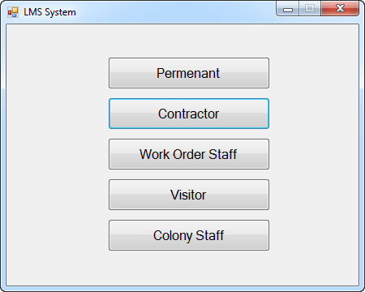
PLANT
/ Supervisor
Pallaydar
Casual- 3P Staff

Slide 4
COLONY
Clinic / Snake Bite
EPQL
Management colony
Masjid
Visitor
Employees Colony
Club
/ Supervisor
Market Visit
Employees Club
Management club
Event
House Servant
Maid
Milkmen
Market Staff
Car washer
Mali
College
Driver
Schooling Staff
Model School
Male Servant
Female Servant
Casual- 3P Staff
EGS
Tutor

Slide 5
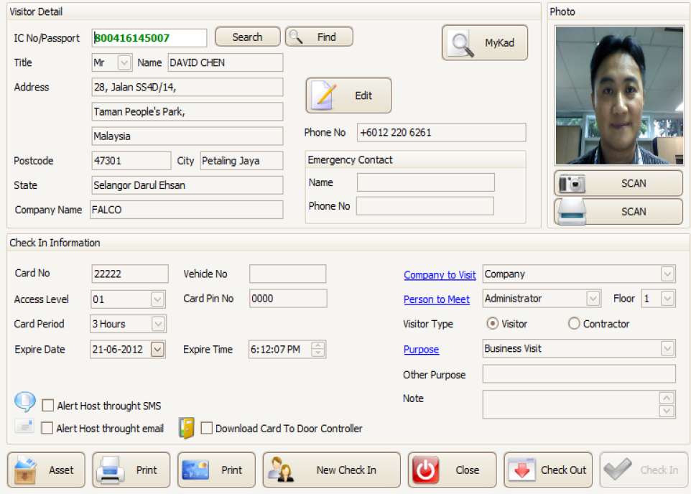
Visitor Form
NIC No.
First Name
Last Name
Area of visit
No. of Male Guest
No. of Female Guest
Host Name
Duration of Stay
No. of Children
Official
Private
Date & Time IN
Date & Time OUT
Identity Collected
Identity Reverted
Host Contact
Link

Slide 6
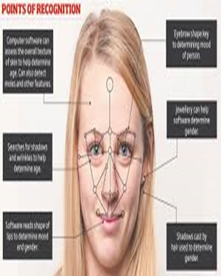
PLANT
Permanent
Work Order Staff
Contractor/
Supervisor
Visitor
Pallaydar
MPT
Work Order Staff
NMPT
Engro Contract
GTE
TAP
Card issuance date
Assigned Card No.
First Name
Last Name
Access Group
Casual- 3P Staff
NIC No.
Date of Birth
Blood Group
Department
Section
P-Number
Designation
Cadre
Crew
Emergency Contact No.
Company Name
WO no.

Slide 7






COLONY
FEMALE SERVANT
MALE SERVANT
SHOP OWNER
Daily Wages
SHOP HELPER
Casual Personal
Work Order Staff
Card issuance date
Assigned Card No.
Contractor
Visitor
First Name
Last Name
Access Group
NIC No.
Date of Birth
Blood Group
Department
Section
P-Number
Designation
Cadre
Crew
Emergency Contact No.
Company Name
WO no.

