Slide 1
Introduction to Machine Learning
“Can machines think?”
-- Alan Turing

Slide 2
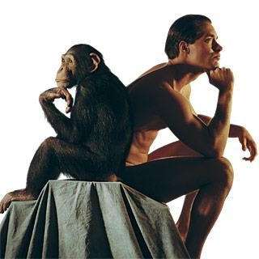
What is intelligence?
What makes humans (Homo sapient) distinct from animals?
Language, writing, reasoning, creative invention, moral choice …

Slide 3
What is intelligence?
Intelligence is the ability to think and understand instead of doing things by instinct or automatically.
(Essential English Dictionary, Collins, London, 1990)
But, What “thinking” means?
Thinking is the activity of using your brain to consider a problem or to create an idea.
(Essential English Dictionary, Collins, London, 1990)

Slide 4
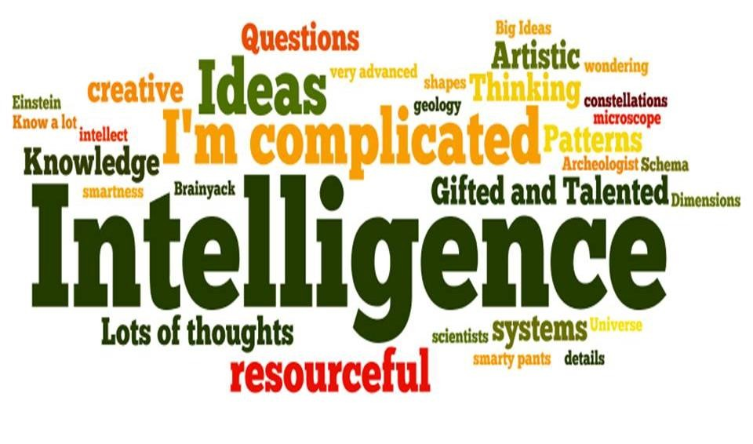
What is intelligence?
Intelligence is the ability to learn and understand, to solve problems and to make decisions.

Slide 5
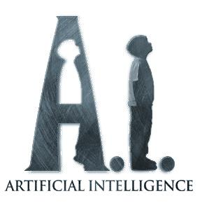
Human vs Non-Human
Can non-humans (man-made objects) have Intelligence?”
To be more specific, “Can Machines Think?”
To address this question, a new discipline was born …

Slide 6
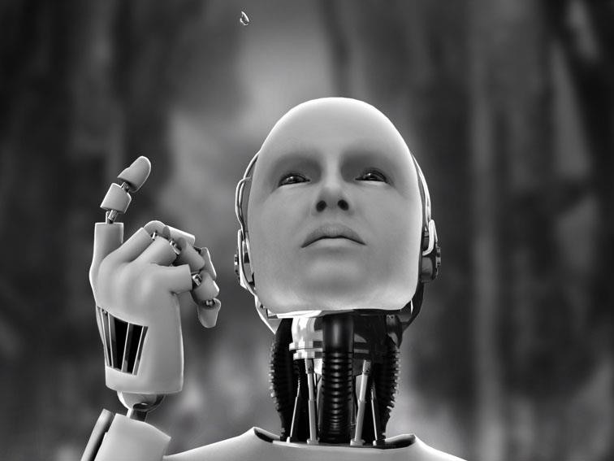
Artificial Intelligence
“A science to make machines do things that would require intelligence* if done by humans.”

Slide 7
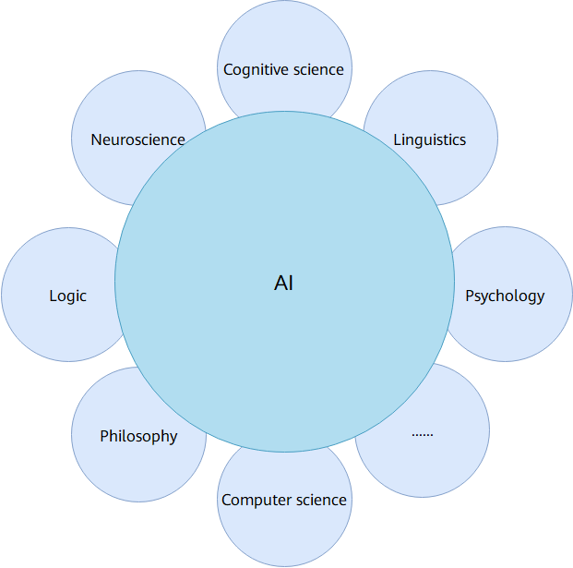
Some Refresh about Artificial Intelligence
"science and engineering of making intelligent machines, especially intelligent computer programs". ---John McCarthy in 1956
The very premise of AI technology is to enable machines to learn from collected data, and make human-like decisions.
Thus, AI is a scientific discipline that studies and develops theories, techniques, and application systems used to simulate and extend human intelligence.
AI has become an interdisciplinary course that involves various fields
Content from Huawei HCIA-AI course material

Slide 8
Some Refresh about AI
The Turing Test by Alan Turing
The main purpose: to test the machine’s ability to exhibit intelligent behaviour that is indistinguishable from that of a human
Instead of asking ‘can a machine think’, Turing was asking: Can a machine pass a behavioral test for intelligence?
Turing focused on observable behavior—if a machine can convincingly mimic human intelligence, it should be considered intelligent

Slide 9
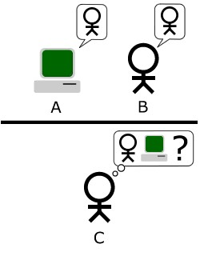
Turing Test
Is it a machine or a human?
Test Setup:
A human judge interacts with a machine and a human through text-based communication.
If the judge cannot reliably distinguish the machine from the human, the machine is said to have passed the test.

Slide 10
Three Important Era of AI (Early Day)
The era of great expectations (1956 – late 1960s)
Unfulfilled promises (late 1960s – early 1970s)
The key to success (early 1970s – mid-1980s)

Slide 11
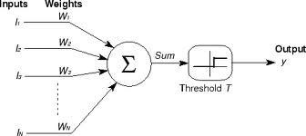
The era of great expectations (1956 – late 1960s)
The early works on perceptron started by McCulloch and Pitts (1957) was continued.
Learning methods were improved and Frank Rosenblatt (1958) proved the perceptron convergence theorem, demonstrating that his learning algorithm could adjust the connection strengths of a perceptron.

Slide 12
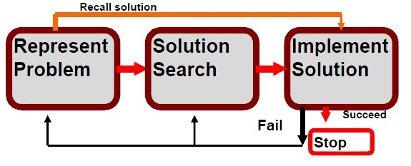
General Problem Solver
One of the most ambitious projects was the General Problem Solver (GPS)
To simulate the thinking process by inventing general methods for solving broad classes of problems
Key idea: To solve problems, programs applied a search strategy by trying out different combinations of small steps, until the right one was found.

Slide 13
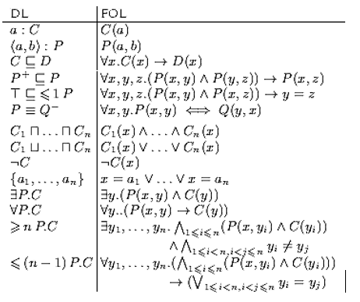
General Problem Solver
The methods were based on formal logic and could generate an infinite number of possible operators – Symbolic AI.
This approach was quite feasible for simple toy problems (eg. Hanoi Tower Problem) at that time

Slide 14
General Problem Solver
Naturally, people expected that If the programs could be “scaled up” to solve large problems, they would finally succeed
However, GPS failed to solve complex problems
The amount of computer time and memory that GPS required to solve real-world problems led to the project being abandoned

Slide 15
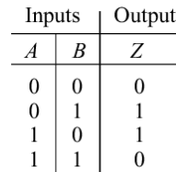
Unfulfilled Promises (late 1960s – early 1970s)
XOR Problem
In 1969, Marvin Minsky, an American mathematician and AI pioneer, proved that perceptrons are essentially a type of linear model capable of processing only linear classification and cannot solve XOR (exclusive OR) problem
By 1970, the euphoria about AI was gone, and most government funding for AI projects was cancelled
AND
OR
XOR

Slide 16
Unfulfilled Promises (late 1960s – early 1970s)
WHY?
AI was still a relatively new field, academic in nature, with few practical applications apart from playing games.
NONE of the AI system at that time could manage real-world problems.

Slide 17
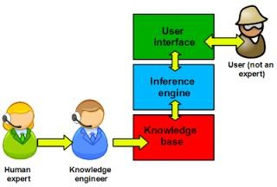
The key to success (early 1970s – mid-1980s)
When weak methods failed, researchers finally realised that the only way
to deliver practical results was to solve typical cases in narrow areas of expertise+making large reasoning steps – the birth of Expert Systems.

Slide 18
Expert System – MYCIN (Stanford University)
MYCIN (1970s) was a rule-based expert system for the diagnosis of infectious blood diseases.
MYCIN’s knowledge consisted of ~ 600 rules derived from human knowledge in a narrow domain through extensive interviewing of experts

Slide 19
However
Expert systems are restricted to a very narrow domain of expertise
Expert systems, especially the 1st generation, have little or no ability to learn from their experience
Expert systems are built individually and cannot be developed fast. Complex systems can take over 30 person-years to build

Slide 20
Data-driven AI = Computational AI
Decline of Symbolic AI, rising of Computational AI (CI)
Symbolic AI – symbols, tools – formal logic
Example: GPS, automated theorem proving, Knowledge Representation
Computational AI – data, tools – Statistics, biological inspired techniques, Math optimization etc

Slide 21
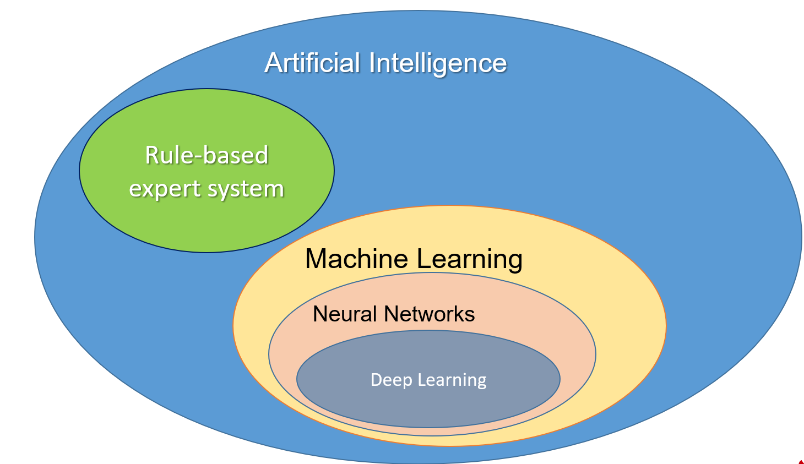
Overview of AI, ML and DL
Content from Huawei HCIA-AI course material

Slide 22
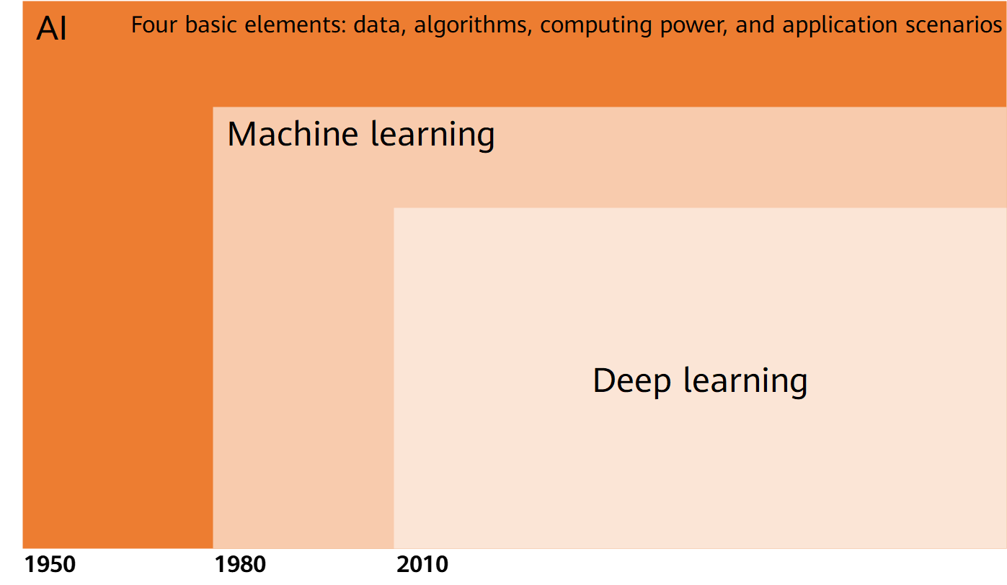
Relationship Between AI, Machine Learning, and Deep Learning
Content from Huawei HCIA-AI course material

Slide 23
Strong vs Weak AI
Weak AI (artificial narrow intelligence)
Specialize in one area
Expert Systems, Intelligence Personal Assistant (Siri/Cortana/Google Home/Alexa etc), AlphaGo and many others
Strong AI (artificial general intelligence)
A computer that is as smart as a human across the board—a machine that can perform any intellectual task that a human being can

