Slide 1

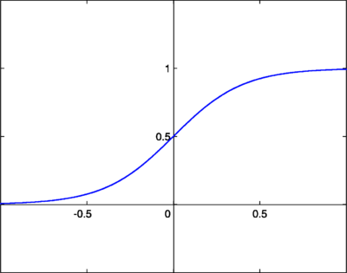

Multiple Cause
(morbidity codes)
Sequence Learning
Fully Connected Layers with Drop-Out
Condition #1
LSTM
LSTM
Condition #2
LSTM
LSTM
The underlying cause of death (113 recode)
…
LSTM
LSTM
$$W^{1}$$
Condition #N
LSTM
LSTM

Slide 2
Multiple Cause
(morbidity codes)
Sequence Learning
Fully Connected Layer
Condition #1
LSTM
LSTM
Condition #2
LSTM
LSTM
…
LSTM
LSTM
The underlying cause of death (113 recode)
Condition #N
LSTM
LSTM
$$W^{1}$$

