Slide 1
CDC Monthly Report: A Deep Pipeline for Prediction of the Underlying Cause of Death
1/28/2017

Slide 2
Outline
Problem Description
Dataset
Baselines
DeepDeath
Results

Slide 3
Problem Description
Given the multiple cause of death in death certificates, predict the underlying cause of death.
Multiple causes of death often are put in 2 parts (part I, II) on the death certificates.
The chain of causes often listed in reverse chronology include helpful information to predict the underlying cause.
We use the 113 recode for the underlying cause.

Slide 4
Dataset
Dataset of all death recorded in US in 2015, by NCHS.
Includes multiple causes, underlying cause, and demographic information.
Includes 2.6 million samples, recorded death.
The number of multiple causes for each death is variable. Often about 2-4 causes with up to 20 in rare cases.
Michigan dataset can also be used but it has 2 restrictions:
Access restrictions
Relatively small

Slide 5
Data Cleaning
The death record data are recorded in tape format.
I processed this data to extract:
Axis entity multiple causes
The underlying cause
All records with the underlying cause (113 recode) greater than 111 was removed. These often relate to non-natural deaths such as suicide.
All records with the underlying cause observed less than 1000 times over the whole dataset are removed.
After filtering the low occurrence causes, we are left with 90 underlying causes.

Slide 6
N-gram Features
To construct our baseline models, we derived the n-gram features
N=1
A->B->C->D Unigrams: A, B, C, D
N=2
A->B->C->D Bigrams: A B,
B C,
C D
N-gram is a defined as an n-tuple consisting of n consecutive tokens within sequential data.
N-gram features
Generating a large and sparse matrix of n-gram features
 | Feature1 | Feature2 | ……
Instance1 | 1 | 0
Instance2 | 0 | 2
……
Training instances

Slide 7
Random Forests
Once the n-gram features derived, we used random forest (RF) to train over the extremely large and sparse matrix of features
RF is an efficient model for dealing with sparse features
Create bootstrap samples
from the training dataset
Ensemble of decision trees
Training Dataset
Majority
Votes
……

Slide 8
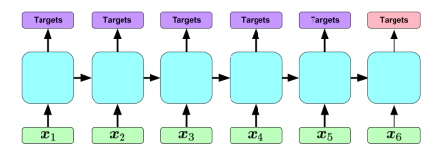
DeepDeath
LSTM has been recently applied to mine EHR data and been shown to bring promise [2].
We propose to use LSTM to predict the main cause of death.
LSTM can efficiently address the varying length problem of our dataset.
[2] Lipton, Zachary C., et al. "Learning to Diagnose with LSTM Recurrent Neural Networks." arXiv preprint arXiv:1511.03677 (2015).

Slide 9
Training
Model was trained over GPU for a few hours with batch size of 1000 samples.
Trained on 70% of data and tested on the rest.
90-class classification accuracy: 36.98%.
Random classifier accuracy for a multi-class classification is 1.1%, we are doing much better than chance.

Slide 10
Results
We can predict much better than chance on a 67-class classification problem.
DeepDeath outperforms other baselines.
There are temporal information in the data as evidenced by Uni+Bigram model compared to the Unigram model.
 | Random Forest on Hadoop |  |  | DeepDeath
 | UniGram (5000) | BiGram (5000) | Uni+BiGram (10000)
ACC (67 classes) | 31.92% | 22.11% | 34.48% | 36.98%

Slide 11
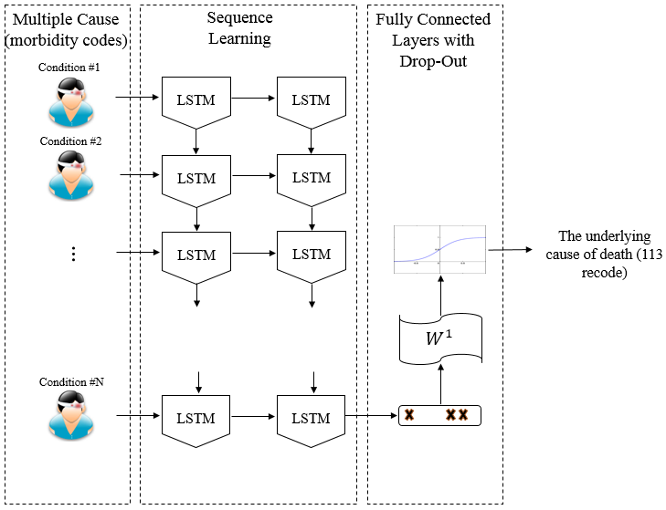
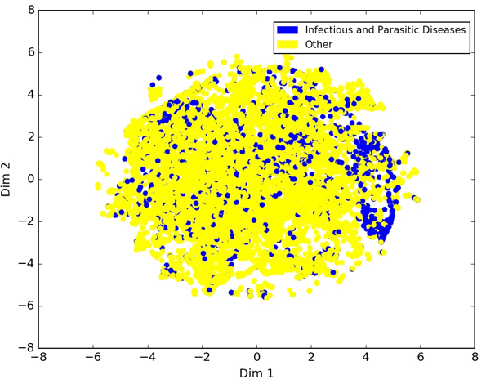
Visualization of Intermediate Features
We used t-SNE, a popular visualization technique that maintains the locality of the samples, to map the features onto a 2D plane
We marked each death either as a death caused by an infectious or parasitic disease, or a non-infectious cause
We observe a meaningful pattern among the samples
Intermediate features generated from the raw features (i.e. the multiple cause trajectories) can be visualized and interpreted by human experts

Slide 12
Next Step
The Utah dataset includes EHR linked to death certificates.
Incorporating EHR into this model makes it more interesting and at the same time more challenging.
It is also interesting to gauge the performance of a model when the causes are clustered into fewer clusters such as 5-10 based on some rational.
The accuracy in that cause is anticipated to be above 90%.

Slide 13
THANK YOU!!!

