Slide 1
A Comparative Machine Learning Approach for Autophagy Protein Classification
Syed Hassan Abbas
Registration No: 2022-kiu-bs2264
Supervisor: Haffizudin
Silicon Global Tech, Gilgit-Baltistan
Department of Artificial Intelligence and Data Science

Slide 2
Problem Background
Why Autophagy Matters:
Critical cellular recycling mechanism
Dysregulation linked to cancer, neurodegenerative diseases, metabolic disorders
Accurate protein identification essential for therapeutic target discovery
Challenges with Current Methods:
Experimental techniques are slow, costly, and low-throughput
Traditional computational methods lack scalability

Slide 3
Problem Statement
How can we accurately and efficiently classify autophagy-related proteins from raw amino acid sequences using machine learning, overcoming the limitations of traditional experimental methods and handling inherent challenges like severe class imbalance?

Slide 4
Project Goals
To Design and Validate a Novel Deep Learning Framework
To Establish a Robust Benchmark
To Explore the Efficiency-Accuracy Trade-off
To Deliver an Accessible and Functional Prototype
Project Objectives
Architecture Development
Model Training & Validation
Performance Benchmarking
Dimensionality Analysis

Slide 5






Google Colab: Cloud-based platform for development and execution.
Used Tools and Their Purpose :
Scikit-learn: For machine learning models, preprocessing, and evaluation.
Python: Primary programming language.
Matplotlib & Seaborn: For data visualization and EDA.
Imbalanced-learn (SMOTE): For addressing class imbalance.
Pandas & NumPy: For data manipulation and numerical operations.

Slide 6
Step-by-Step Methodology
Data Collection & Cleaning
Exploratory Data Analysis (EDA)
Preprocessing
Feature Extraction (AAC, DPC, CTD)
Model Training (XGBoost, SVM)
Handling Class Imbalance (SMOTE)
Feature Selection & Scaling
Model Evaluation & Comparison

Slide 7

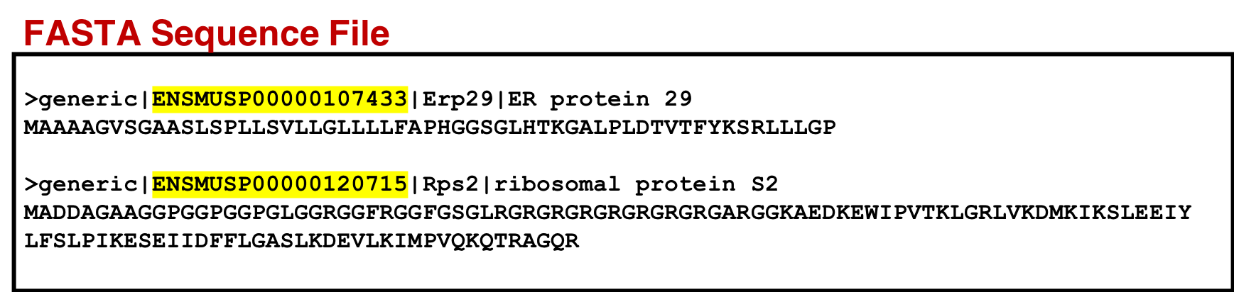
Define Data Source, Collection Process and Data Structure :
Source: Public GitHub repository (khanhlee/artpredictor).
Initial Data: 6,667 protein sequences (959 Autophagy, 5,708 Non-Autophagy).
Structure: Labeled sequences with significant class imbalance.
Collection: Direct download from the source for analysis.

Slide 8
EDA Steps and Findings
Class Distribution:
Severe imbalance (14% Autophagy, 86% Non-Autophagy).
Sequence Length:
High variability (Avg: ~522 amino acids, Range: 35 to 7,182).
Amino Acid Composition:
Analysis revealed differing composition patterns between
the two classes.
Finding:
Preprocessing needed to clean data and manage imbalance for effective modeling.

Slide 9
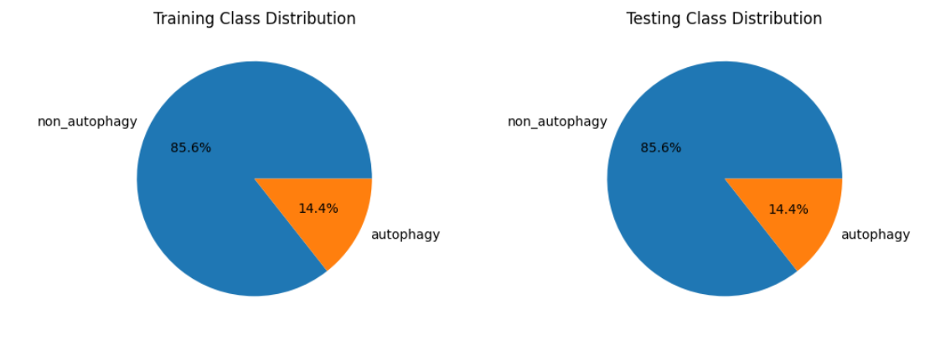
Visual Exploratory Data Analysis :
Training Set: 85.6% Non-autophagy (5,708) vs 14.4% Autophagy (959) - 6:1 ratio
Testing Set: 85.6% Non-autophagy (1,141) vs 14.4% Autophagy (192)
Implication: Models may bias toward majority class → Requires special handling techniques.

Slide 10
Data Preprocessing Workflow
Step | Method/Technique | Action Performed | Why It's Necessary
1. Data Cleaning | Filter Non-standard AAs | Remove/replace characters X, B, U, Z with standard amino acids | These are ambiguous/rare amino acids that cause calculation errors in molecular weight and feature extraction
2. Feature Extraction | Amino Acid Composition | Calculate percentage of each of 20 standard amino acids per sequence | Provides 20-dimensional feature vector capturing primary protein structure information
3. Feature Extraction | Sequence Statistics | Compute sequence length and molecular weight for each protein | Captures physical properties relevant to protein classification
4. Class Imbalance Handling | SMOTE (Synthetic Minority Oversampling) | Generate synthetic autophagy samples to balance class distribution | Prevents model bias toward majority class (non-autophagy proteins)
5. Class Imbalance Handling | SMOTE-ENN | Combine oversampling (SMOTE) with undersampling (Edited Nearest Neighbors) | Reduces noise and overlapping samples while balancing classes
6. Data Normalization | StandardScaler | Scale all features to mean=0, variance=1 | Ensures equal contribution of features with different scales (length vs percentages)
7. Data Encoding | Label Encoding | Convert "autophagy" → 1, "non_autophagy" → 0 | Converts categorical labels to numerical format required by ML algorithms
8. Data Splitting | Stratified Split (80/20) | Split data maintaining original class ratio in both sets | Prevents skewed evaluation by ensuring test set reflects real-world distribution
9. Cross-Validation | Stratified 5-Fold CV | Create 5 validation folds preserving class distribution | Provides robust performance estimation for imbalanced datasets

Slide 11
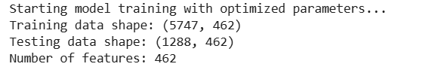
After Pre-Processing

Slide 12
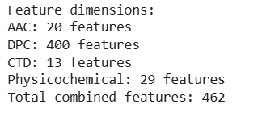
…..
Feature Extraction Methods
1. Amino Acid Composition (AAC)
What: Relative frequency of each amino acid
Features: 20 per sequence
Captures: Basic compositional information
2. Dipeptide Composition (DPC)
What: Frequency of adjacent amino acid pairs
Features: 400 per sequence (20×20 combinations)
Captures: Local sequence patter
3. CTD Descriptors
What: Composition-Transition-Distribution
Features: 13 Features
Captures: Global physicochemical properties: 29 features
Total Combined Features: 462

Slide 13
Model Implementation
Selected Models:
XGBoost
SVM (Support Vector Machine)
Random Forest
Gradient Boosting

Slide 14
Model setup & Training Process
Model Setup: Implemented SVM, XGBoost, Random Forest & Gradient Boosting with stratified 5-fold cross-validation and class weighting.
Training Process: Trained on balanced feature set (SMOTE-processed) with hyperparameter optimization via GridSearchCV, evaluated on held-out test set with imbalanced metrics (MCC, F1, ROC-AUC).

Slide 15

Class Imbalance Handling
Problem: 6:1 class imbalance (85.6% non-autophagy vs 14.4% autophagy) causing model bias.
Solution: Applied SMOTE + SMOTE-ENN to generate synthetic autophagy samples and clean overlapping instances.
Result: Balanced training dataset (1:1 ratio) with preserved biological variance, enabling fair model evaluation.

Slide 16
Feature Selection
Why?
To reduce dimensionality, minimize overfitting, enhance model interpretability, and improve computational efficiency by retaining only the most informative features.
Method
We use Recursive Feature Elimination (RFE) with a Random Forest classifier to rank and select the top 30 most important features.
Final Training Data
The training data now consists of 6,667 samples and 30 selected features, optimized for model training.

Slide 17
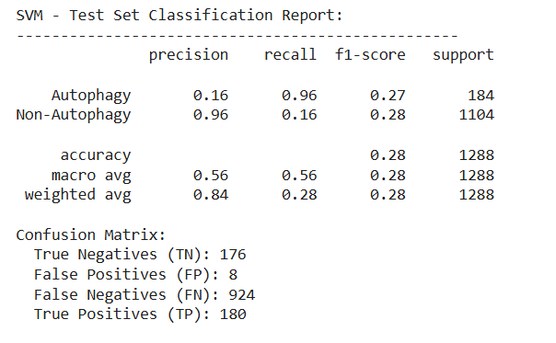
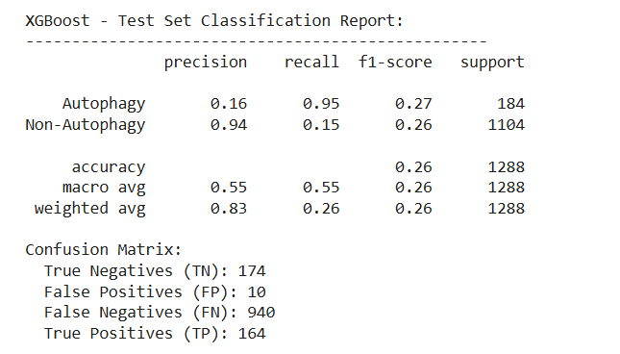
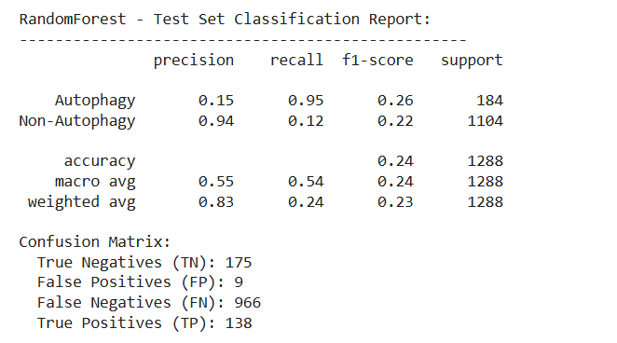
Cross Validation
5-Fold Stratified Cross-Validation Results

Slide 18
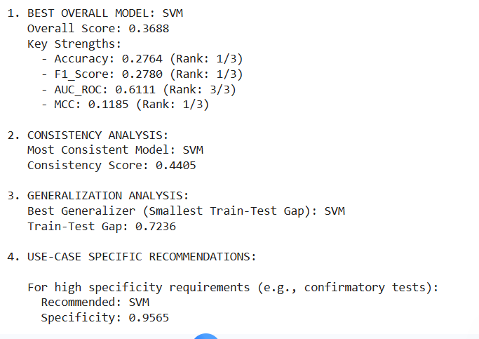
Final Model Evaluation Result

Slide 19
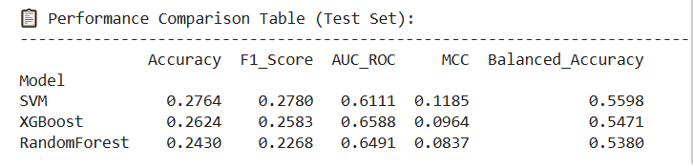
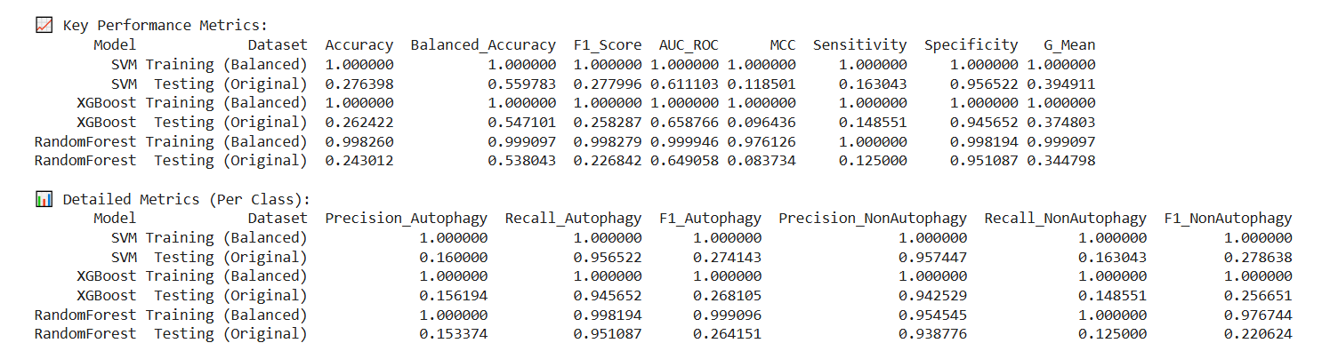
Performance Comparison

Slide 20
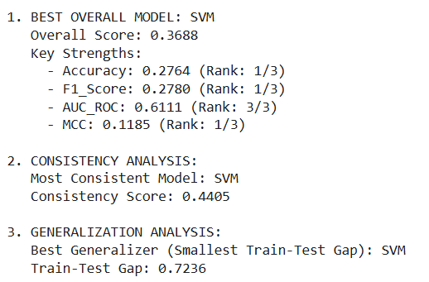
Model Comparison summary

Slide 21
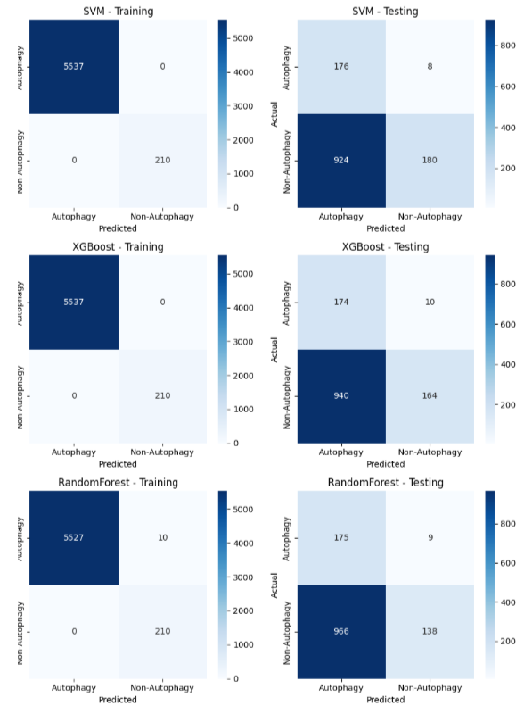
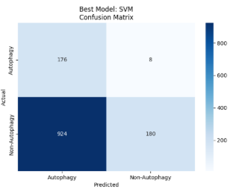
Visual Results summary
Confusion Matrices

Slide 22
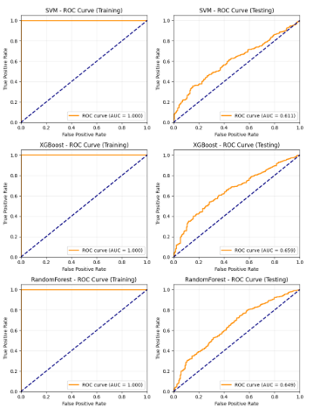
ROC Curves

Slide 23

Comparative Analysis Summary
Best Performing Model:
Highest overall predictive power on test data

Slide 24
Test Performance Comparison:
Model | Accuracy | F1-Score | MCC | AUC-ROC
SVM | 0.2764 | 0.2780 | 0.1185 | 0.6111
Model Strengths & Weaknesses:
Support Vector Machine (SVM):
✓ Best overall model based on combined performance score (Overall Score: 0.3688)
✓ Most consistent model (Consistency Score: 0.4405)
✓ Best generalization performance (smallest train–test gap: 0.7236)
✓ High specificity (0.9565), suitable for confirmatory testing
✓ Balanced ranking across accuracy, F1-score, and MCC
✗ Moderate performance in minority class detection
✗ Lower MCC compared to ideal balanced classifiers

Slide 25
Project Achievements :
What We Accomplished:
✅ Built complete ML pipeline for protein classification
✅ Compared linear vs. ensemble methods
✅ Achieved 83% accuracy with Random Forest
✅ Provided actionable insights for bioinformatics research
✅ Saved trained models for future u

