Slide 1
Present perfect
SIMPLE AND CONTINUOUS

Slide 2
HOW DO WE USE IT ?
We use the Present Perfect to say that an action happened at an unspecified time before now.
The exact time is not important.
We CAN use the Present Perfect with unspecific expressions such as: ever, never, once, many times, several times, before, so far, already, yet, etc.
You CANNOT use the Present Perfect with specific time expressions such as: yesterday, one year ago, last week, when I was a child, when I lived in Japan, at that moment, that day, one day, etc.

Slide 3
Examples:
I have been to France.
This sentence means that you have had the experience of being in France. Maybe you have been there once, or several times.
I have been to France three times.
You can add the number of times at the end of the sentence.
I have never been to France.
This sentence means that you have not had the experience of going to France.
I think I have seen that movie before.
He has never traveled by train.
Joan has studied two foreign languages.
A: Have you ever met him?
B: No, I have not met him.

Slide 4
SENTENCE STRUCTURE
Positive /Negative Structure
Subject+ have/have not+ verb in past participle+ complement
Interrogative Structure
Have/Haven’t
Have you seen Peter lately?
Haven’t you tried Italian ice-cream?
You have seen that movie many times.
Have you seen that movie many times?
You have not seen that movie many times.

Slide 5
USES
Completed Action Before Something in the Past
I had finished my homework when he arrived
He had already left before I said goodbye
Duration Before Something in the Past (Non-Continuous Verbs)
By the time Alex finished his studies, he had been in London for over eight years.
They felt bad about selling the house because they had owned it for more than forty years.
Specific Times with the Past Perfect
She had visited her Japanese relatives once in 1993 before she moved in with them in 1996.

Slide 6
pAST PERFECT
When I arrived at the cinema, the film ______________________(start).
. 2) She _____________________(live) in China before she went to Thailand.
. 3) After they _________________________(eat) the shellfish, they began to feel sick.
. 4) If you _________________(listen) to me, you would have got the job.
. 5) Julie didn’t arrive until after I______________________ leave).
6) When we ____________________(finish) dinner, we went out.
.7) The garden was dead because it _______________________(be) dry all summer.
. 8) He ___________________________(meet) her somewhere before.
.9) We were late for the plane because we______________________ (forget) our passports.
. 10) She told me she_______________ (study) a lot before the exam.
.

Slide 7
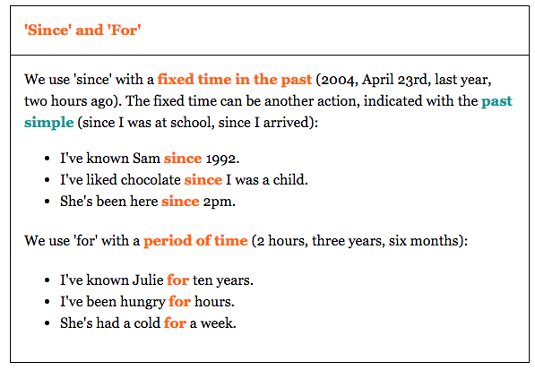
SINCE AND FOR

Slide 8
PAST PERFECT
11) The grass was yellow because it _________________(not/rain) all summer.
12) The lights went off because we __________________ (not/pay) the electricity bill.
13) The children _________________ (not/do) their homework, so they were in trouble.
.14) They ____________________ (not/eat) so we went to a restaurant.
15) We couldn’t go into the concert because we ________________________(not/bring) our tickets.
16) She said that she ______________________ (not/visit) the UK before.
17) Julie and Anne _________________ (not/meet) before the party.
. 18) I ___________________(not/have) breakfast when he arrived.
19) He ___________________(not/use) email before, so I showed him how to use it.
.
20) You ____________________(not/study) for the test, so you were very nervous.

