Slide 1
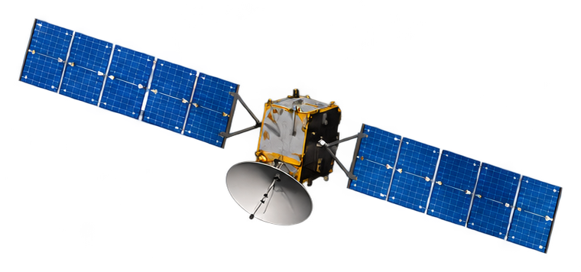
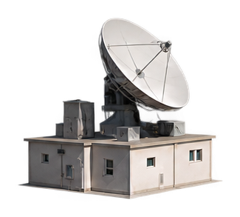

Satellite
Pressure (hPa)
Slant propagation path
1
5
Local bilinear interpolation
30
G₁
G₂
200
300
500
Latitude
650
Path intersection
Path intersection
700
850
G₃
G₄
Longitude
925
Four neighboring ERA5 grid points
Ground receiver

