Slide 1
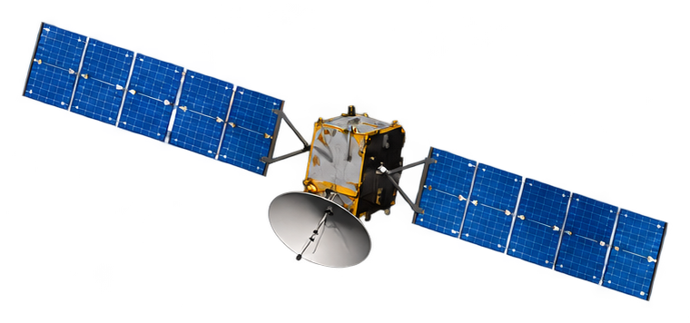
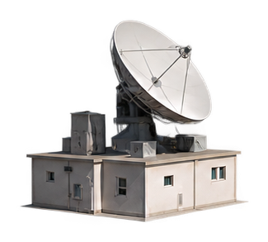

(a)
GEO satellite
(b)
Local bilinear interpolation
G₁
G₂
Pressure (hPa)
Slant propagation path
1
Path intersection
Latitude
5
30
200
G₃
G₄
300
Longitude
Four neighboring ERA5 grid points
500
650
Path sampling points
(c)
Retained meteorological inputs
700
850
50 base features
106 pressure-level
features
925
Surface quantities
Ground receiver
Single-level diagnostics
Variable-level pairs across
10 levels
Column-integrated quantities
50 + 106 = 156 features
Base-only candidate pool: 50
Local sampling schematic; geometry not to scale.

