Slide 1
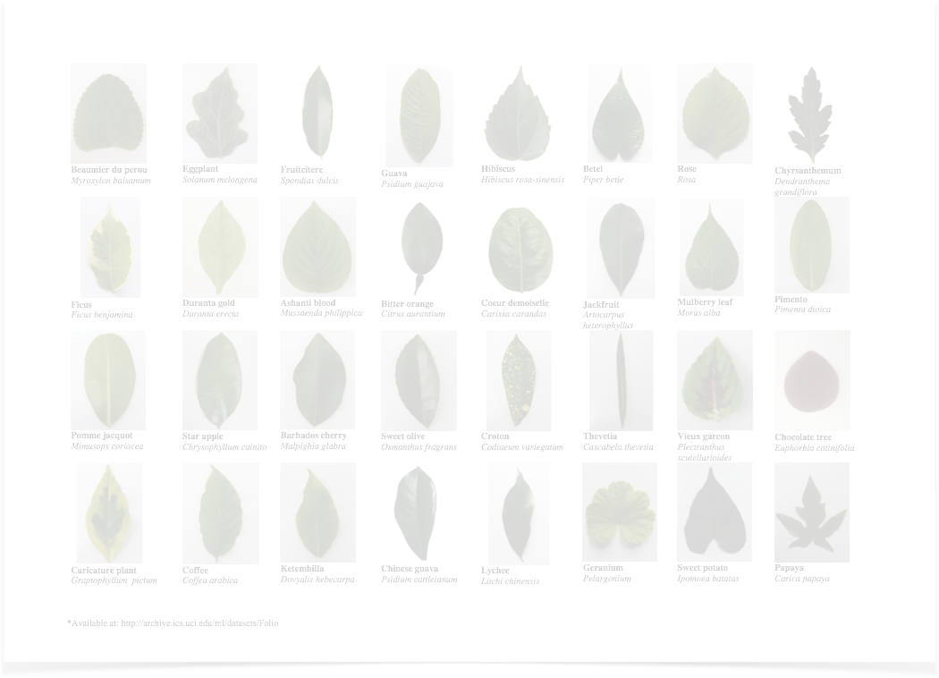
Virtual Botanist
Zoran Ivankovich

Slide 2
Playing with the leaves

Slide 3
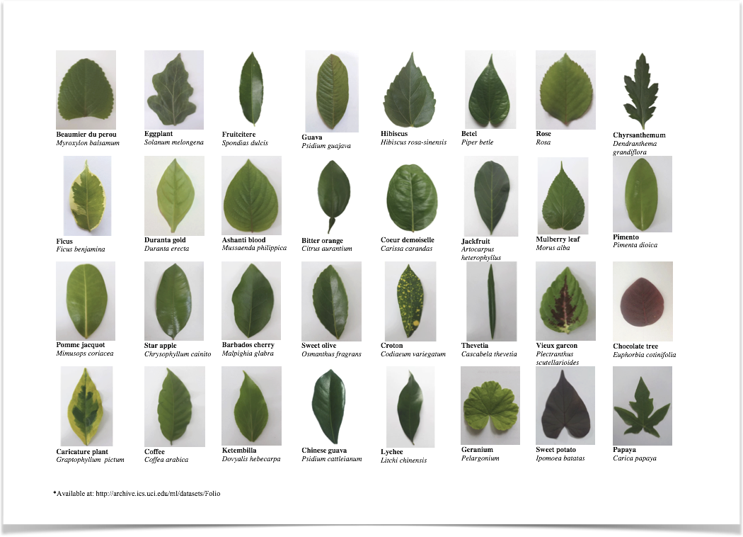
Leaf Collection

Slide 4
Clustering Types
Hard Clustering
Objects belong to one and only one class
Example: K-Means
Soft Clustering
Objects may belong to any one of the classes
Example: Gaussian Mixture Modeling
(EM Algorithm)

Slide 5
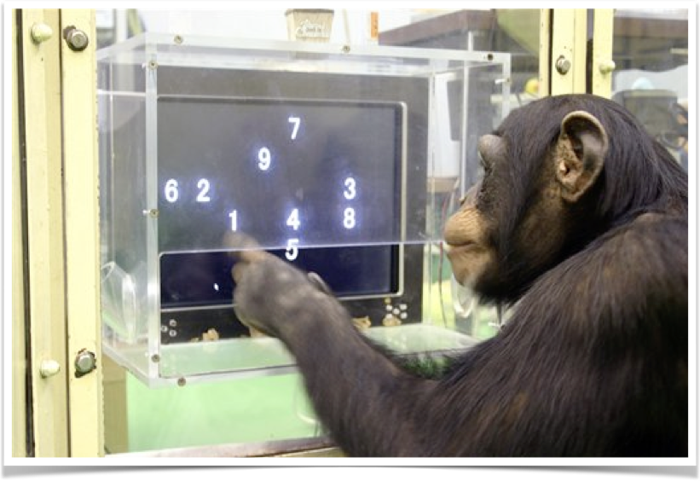
It's time to do Math

Slide 6
Bag of Leaves ~
Mixture of Gaussians
Where do the Gaussians Come From?
They come from the 32 varieties of trees
The leaves from the same tree are from the same distribution
Multivariate Gaussian Distribution
Each leaf doesn't have just one attribute. It has many.
Examples of attributes: Width, Height, Aspect Ratio, Texture Characteristics, Color Characteristics, etc.
N Leaves from each of the k = 32 trees are mixed with a proportion
Also the since each leaf must belong to one tree all the proportions sum to 1.
$$π_{i},1≤i≤k$$
$$\overset{k}{\underset{i=1}{∑}}π_{i}=1$$

Slide 7
Why Expectation Maximization?
$$X_{i}∼\overset{K}{\underset{k=i}{∑}}π_{k}*ϕ(x_{i};μ_{k},Σ_{k})$$
Each Leaf is distributed as
$$logL(θ)=\overset{N}{\underset{i=1}{∑}}log(\overset{K}{\underset{k=1}{∑}}π_{k}*ϕ(x_{i};μ_{k},Σ_{k}))$$
Log Likelihood:
Let's introduce indicator variables
$$z_{i},1≤i≤k$$
Only one of them can be 1 and the rest must be zero.
They are hidden variables that we can't observe.
They also allow us to introduce this neat trick and write the
leaf distribution as such:
$$X_{i}∼\overset{K}{\underset{k=i}{∏}}π_{k}^{z_{ik}}*ϕ(x_{i};μ_{k},Σ_{k})^{z_{ik}}$$

Slide 8
Verdict
$$X_{i}∼\overset{K}{\underset{k=i}{∏}}π_{k}^{z_{ik}}*ϕ(μ_{k},Σ_{k})^{z_{ik}}$$
Recall*
So the new Log Likelihood is:
$$logL(θ)=\overset{N}{\underset{i=1}{∑}}\overset{K}{\underset{k=1}{∑}}log(π_{k}^{z_{ik}}*ϕ(x_{i};μ_{k},Σ_{k})^{z_{ik}})$$
$$logL(θ)=\overset{N}{\underset{i=1}{∑}}\overset{K}{\underset{k=1}{∑}}(z_{ik}*log(π_{k}))+\overset{N}{\underset{i=1}{∑}}\overset{K}{\underset{k=1}{∑}}z_{ik}*log(ϕ(x_{i};μ_{k},Σ_{k}))$$

Slide 9
[Expected] Diversion
To do EM we can compute Expectation with respect to complete data.
However, we have observed X and Theta so we only have to compute with respect to Z.
$$E[Z_{ik}|x_{i},θ]=0*P[Z_{ik}=0|x_{i},θ]+1*P[Z_{ik}=1|x_{i},θ]$$
$$=P[Z_{ik}=1|x_{i},θ]$$
Let's apply Bayes Rule
$$P[Z_{ik}=1|x_{i},θ]=\frac{P(Z_{ik}=1)*P(x_{i}|Z_{ik}=1)}{P(X=x_{i})}$$
NxK matrix*
of probability leaf i
came from tree k
$$=\frac{π_{k}*ϕ(x_{i};μ_{k},Σ_{k})}{∑_{k=1}^{K}π_{k}*ϕ(x_{i};μ_{k},Σ_{k})}=n_{ik}$$

Slide 10
Expectation/Maximization
$$n_{11}$$
$$n_{12}$$
$$…$$
$$n_{1K}$$
$$n_{21}$$
$$n_{22}$$
$$…$$
$$n_{2K}$$
$$…$$
$$…$$
$$…$$
$$…$$
$$…$$
$$…$$
$$…$$
$$…$$
$$n_{N1}$$
$$n_{N2}$$
$$…$$
$$n_{NK}$$

Slide 12

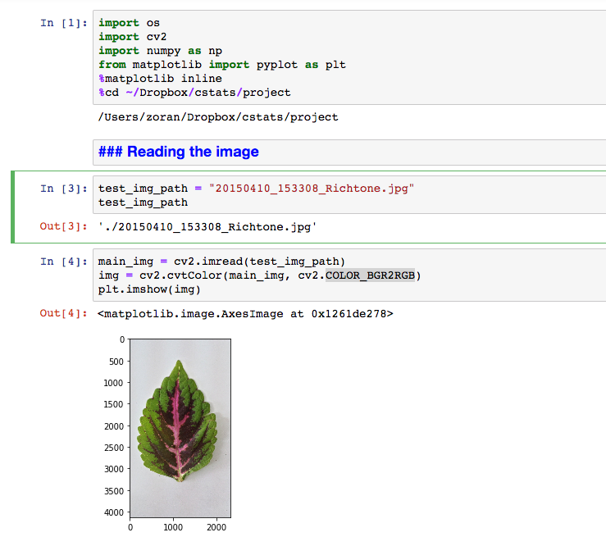

Slide 13

