Slide 1
Client Address Book
By :-
Hasti Mehta (67)
Rohan Patil (68)

Slide 2
What is Client Address Book (CAB)?
CAB is web based platform for storing clients address details.
Address book enables you to store recipient information.
This not only saves you from having to enter recipient information each time you place an order, but also helps to reduce keystroke errors since the entry is already in the system.
It's the perfect tool for sales teams, project teams or any small business with real-time contact management requirements.
It is a responsive website

Slide 3
Features :-
Ability to add , edit or delete contacts.
Online Address Book.
Centralize Contact Management.
Secure Contact Manager.

Slide 4
Technology :-
HTML
CSS
PHP
MySQL
Apache Server
Bootstrap

Slide 5
Why using PHP ?
Advantages :-
Simple & Easy to Grab
Quality Support
Flexibility & Freedom
Integration
Scalability
Customized Development

Slide 6
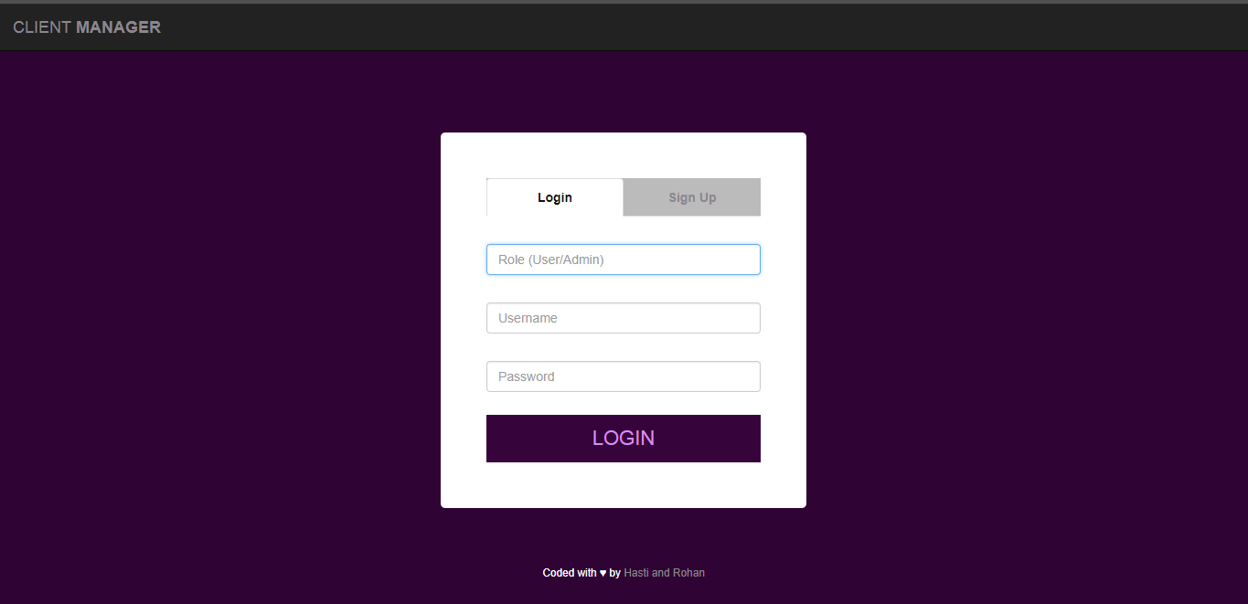
Screenshots :-

Slide 7
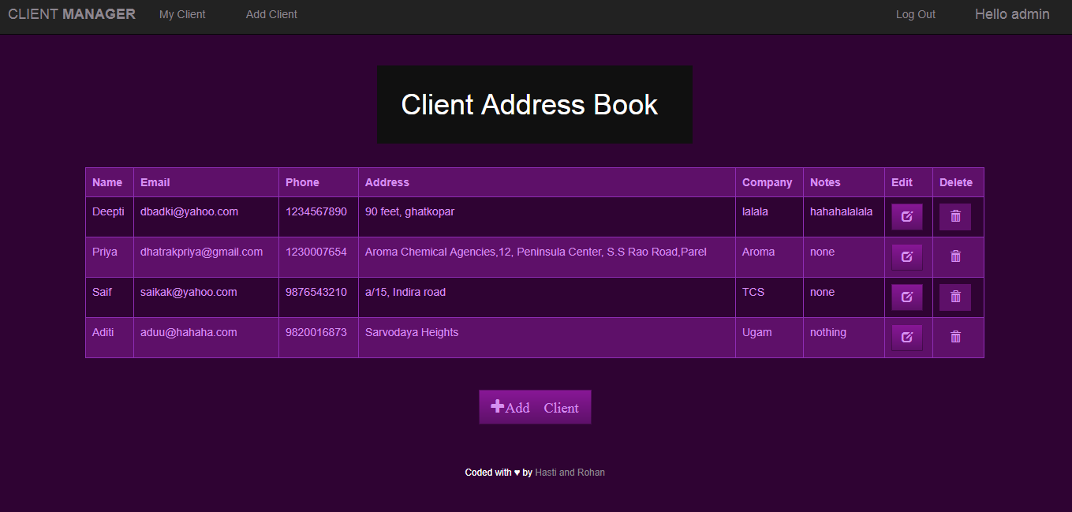
Screenshots :-

Slide 8
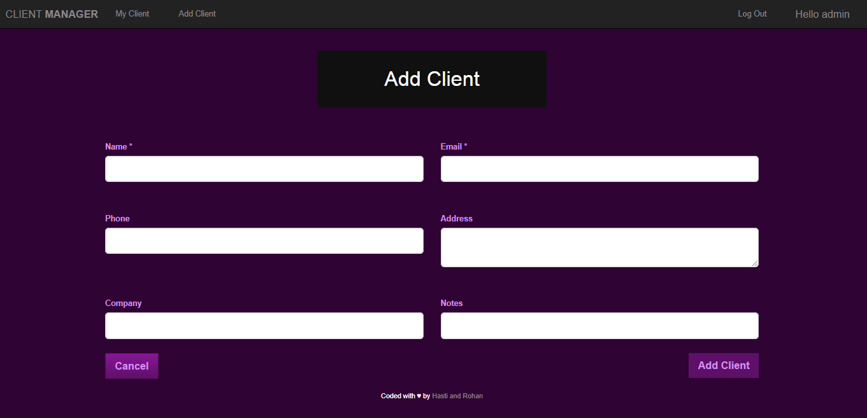
Screenshots :-

Slide 9
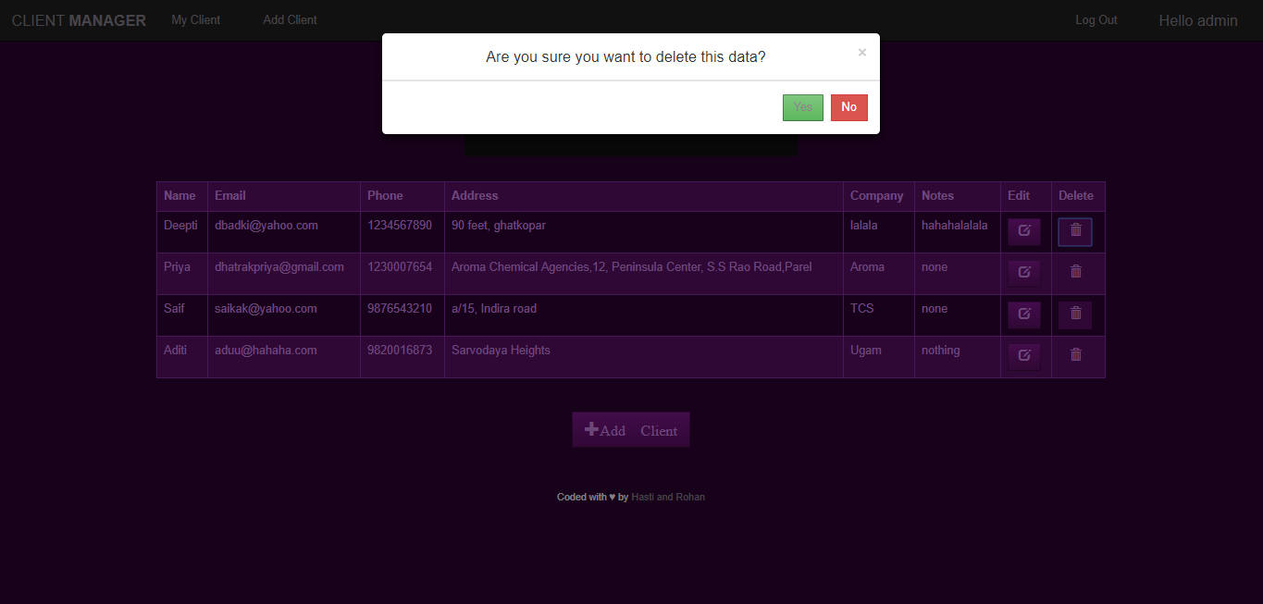
Screenshots :-

Slide 10

Screenshots :-

Slide 11
Thank You

