Slide 1


REVENUE ENABLEMENT · EMEA
MIP for Sellers (101)
A built, tested learning experience — not a plan for one
Build status review · Alex Hastings · 31 July 2026
Copyright ©2026 Pax8 | All rights reserved

Slide 2
WHAT WE BUILT
It rehearses one conversation until the words come out without thinking.
Not a course about Managed Intelligence. A rehearsal room for the single conversation every CAM is about to have in Copenhagen.
1
2
3
They fail first
They rehearse under pressure
They say it cold
Minute one: define a MIP in one sentence, cold. Most can't. Nobody marks it — that moment of exposure is the entire motivational engine.
They're given the sentence, then made to use it six times — each section harder than the last, but never longer.
Minute forty-five: a partner walks up with no prompts. Then they see their first attempt sitting above their last one.
Copyright ©2026 Pax8 | All rights reserved

Slide 3
THE PROBLEM IT SOLVES
Partners are asking. Reps are deflecting.
• The MIP pilot is live and Agent Store is rolling out to the full partner community.
• Partners are raising Managed Intelligence at events — unprompted.
• There has been no confident, consistent answer for a CAM to give.
• So the conversation stalls on us, not on the partner.
THE ONE BEHAVIOUR THIS EXISTS TO PRODUCE
A CAM raises MIP unprompted, places the partner, offers one next step, and logs it.
Everything in the build serves that one sentence. Anything that didn't was cut.
Copyright ©2026 Pax8 | All rights reserved

Slide 4
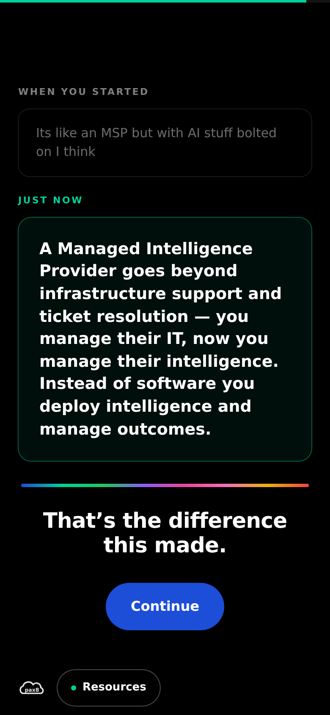
THE MECHANISM THAT DOES THE WORK
They leave holding evidence, not a certificate.
The last screen shows the learner their own minute-one answer, greyed and small — and directly beneath it, what they said forty-five minutes later.
No score. No congratulations graphic. No confetti. The screen has no button for three seconds, so they have to look at it.
Nobody forgets seeing their own words change.
Copyright ©2026 Pax8 | All rights reserved

Slide 5
THE SHAPE OF IT
Six modules. Fifteen screens. Forty-five minutes.
Module | What the learner does | The skill it builds
1 · The sentence | Fails cold, is given the sentence, says it out loud | Can define a MIP unprompted
2 · Why now | Market context, then reads the fear behind three partner lines | Hears intent, not objection
3 · The four levels | Concepts, then places four partner quotes on the ladder | Qualifies by listening
4 · Two questions | Runs the placement tool twice on different partners | Places a partner in ~90 seconds
5 · The conversations | Two branching rehearsals, one hostile | Holds the conversation under pressure
6 · Routes and logging | Picks the route, builds a CRM record in four taps | Hands off cleanly and logs it
Mobile-first, one decision per screen, no timers, and no score shown at any point.
Copyright ©2026 Pax8 | All rights reserved

Slide 6
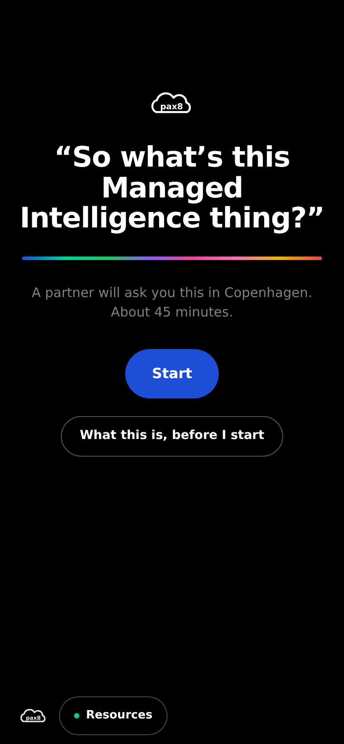
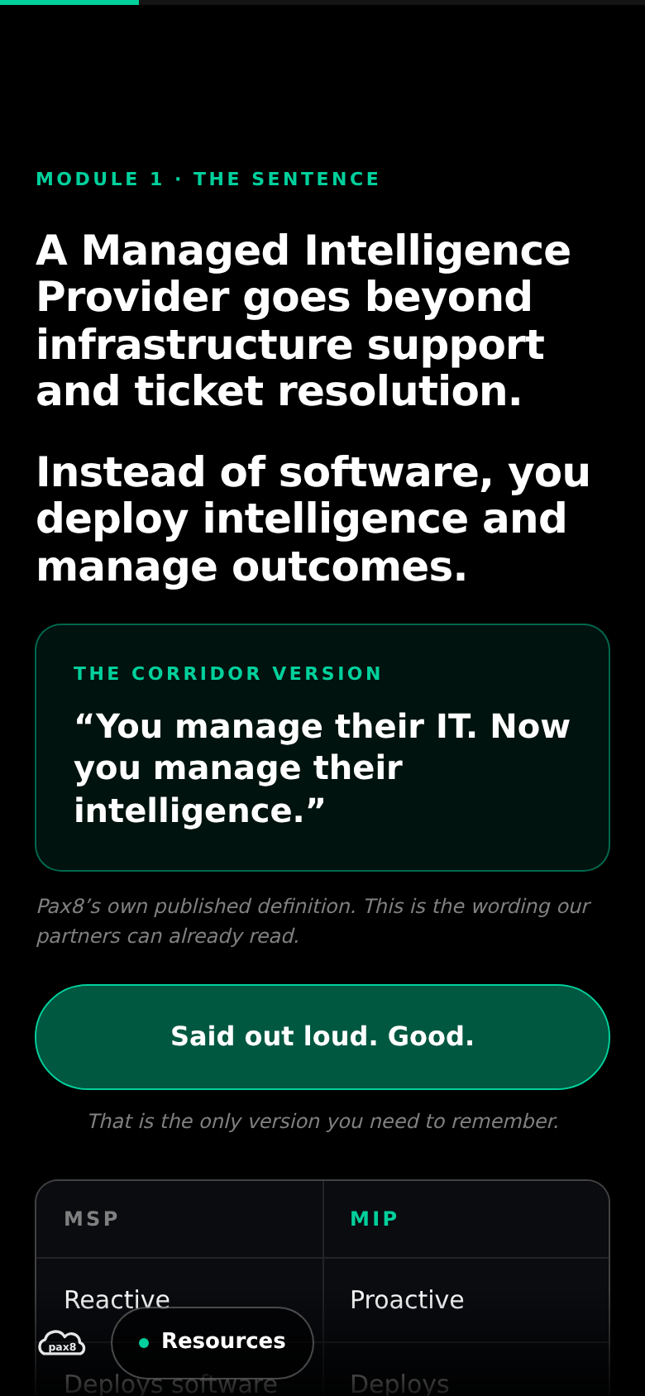
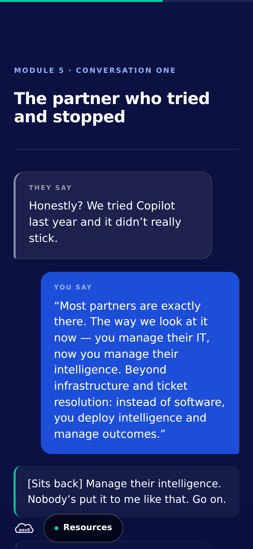
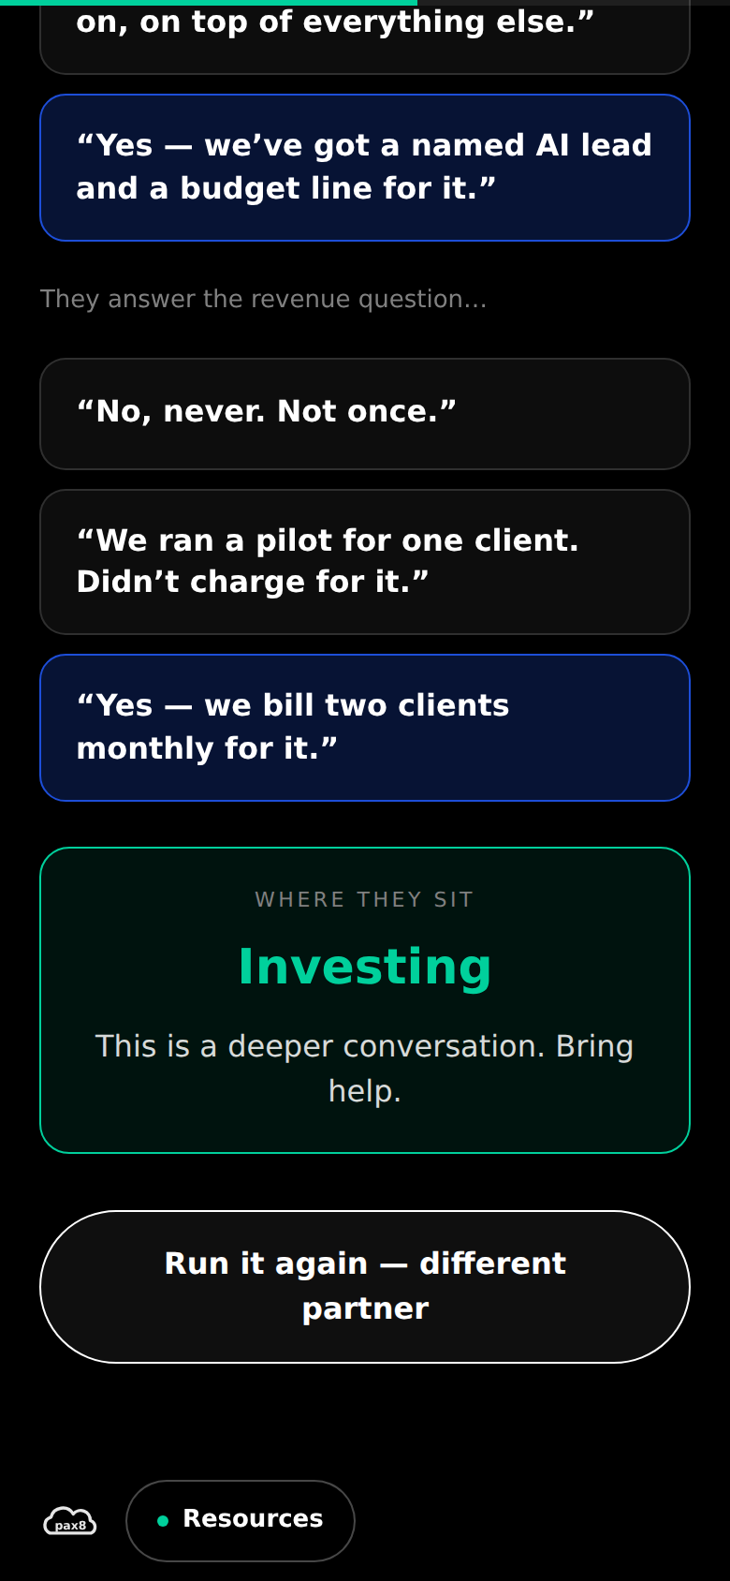
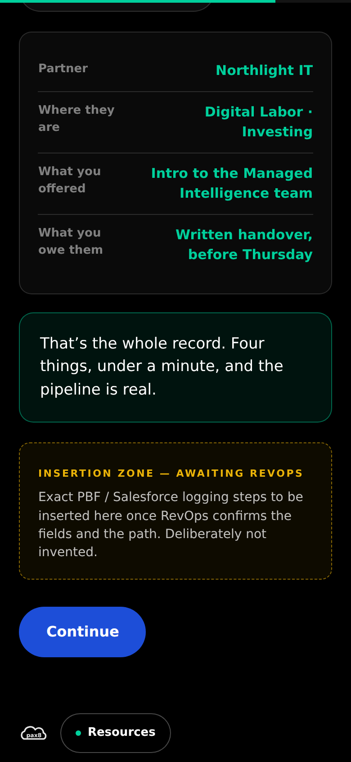
NOT MOCKUPS
This is the actual build, running.
The cold open
The sentence
Rehearsal
Placement
Logging
Copyright ©2026 Pax8 | All rights reserved

Slide 7
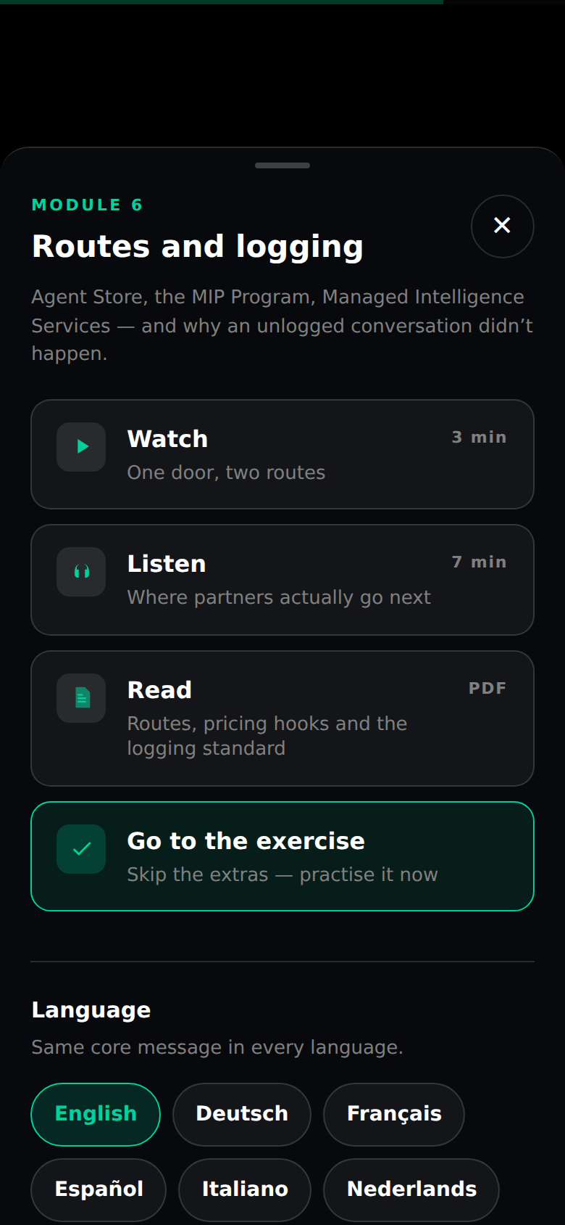
BUILT FROM THE REVIEW FEEDBACK
Every module, four ways in.
A short video · a podcast · a written guide · or straight to the exercise.
Modules 1–3 get a full context screen. Every module is also reachable from a persistent Resources panel that knows where the learner is.
The core message lives in the screen copy itself — so whichever route someone picks, everyone receives the same thing.
Seven EMEA languages wired, English complete.
Selecting another language switches the interface and flags the pack as in review. We do not machine-translate Pax8's approved definition.
Copyright ©2026 Pax8 | All rights reserved

Slide 8
REVIEW RESPONSE
Every point from the review is in the build.
Feedback | What was built | Status
Learning hub per module, multiple formats | Four routes on every module + persistent Resources panel | Done
Multiple languages across EMEA | Seven-locale switcher; English complete, packs drop in | Mechanism done
Module 1 — overview before starting | Full overview screen, placed after the 60-second test | Done — see note
Module 2 — market context and partner patterns | AIP, margin compression, adoption gap, three patterns | Done
Module 3 — explain the concepts first | All four levels defined, plus where Copilot sits | Done
Ground it in real partner conversations | Patterns from the approved proposal; verbatims pending | Partly blocked
Note on Module 1: the overview sits immediately after the 60-second test, not before it. An overview that explains what you're about to learn kills the discovery moment the whole design runs on. Screen 0 offers it up front for anyone who wants it. Happy to flip this if you'd rather.
Copyright ©2026 Pax8 | All rights reserved

Slide 9
HONEST STATUS
What's ready, and what I'm waiting on.
READY NOW
The full 45-minute experience, tested
All six modules and both rehearsals
Market context and concept grounding
Learning hub and language switcher
Rep card (prints from the page)
SCORM-ready — wraps for Workday unchanged
WAITING ON SOMEONE ELSE
PBF / Salesforce logging steps — RevOps
Partner Insights transcripts — Kipp's notebook
Microsoft AI strategy mapping — Product Mktg
Video and podcast assets — production
Approved translations — vendor
Designed rep-card PDF — design
Every one of these is a marked insertion zone in the file. None of them blocks a pilot — and none of them has been invented to fill a gap.
Copyright ©2026 Pax8 | All rights reserved

Slide 10
DECISIONS
Three things I need from you.
1
2
3
Standalone or SCORM?
Which adoption figure?
Who books the debrief?
The build is compliant either way. It decides whether completion is reported automatically or chased manually — and the 30 September gate depends on knowing.
The blueprint says nearly nine in ten SMBs; the MIP source material says 75%. I've used ~75% consistently. One of them needs to be retired.
No HTML file changes behaviour on its own. The manager conversation is the transfer mechanism and it sits outside this build.
The third one is the real risk. Everything else is a build task; that one is the difference between a good experience and an actual behaviour change.
Copyright ©2026 Pax8 | All rights reserved

Slide 11
SEQUENCE
What happens next.
When | What | Who
This week | Decision on SCORM vs standalone; confirm the adoption figure | Kipp
This week | Chase RevOps for the PBF / Salesforce logging steps | Alex
Next | Pilot with a small CAM group — watch where they stall, not what they score | Alex
Next | Partner Insights verbatims replace the placeholder patterns | Alex + Kipp
Then | Video, podcast and rep-card PDF drop into the marked zones | Production
Before 30 Sept | Workday packaging and completion tracking live | Alex
18–20 Oct | Beyond Copenhagen — the reason the deadline is real | —
Copyright ©2026 Pax8 | All rights reserved

Slide 12
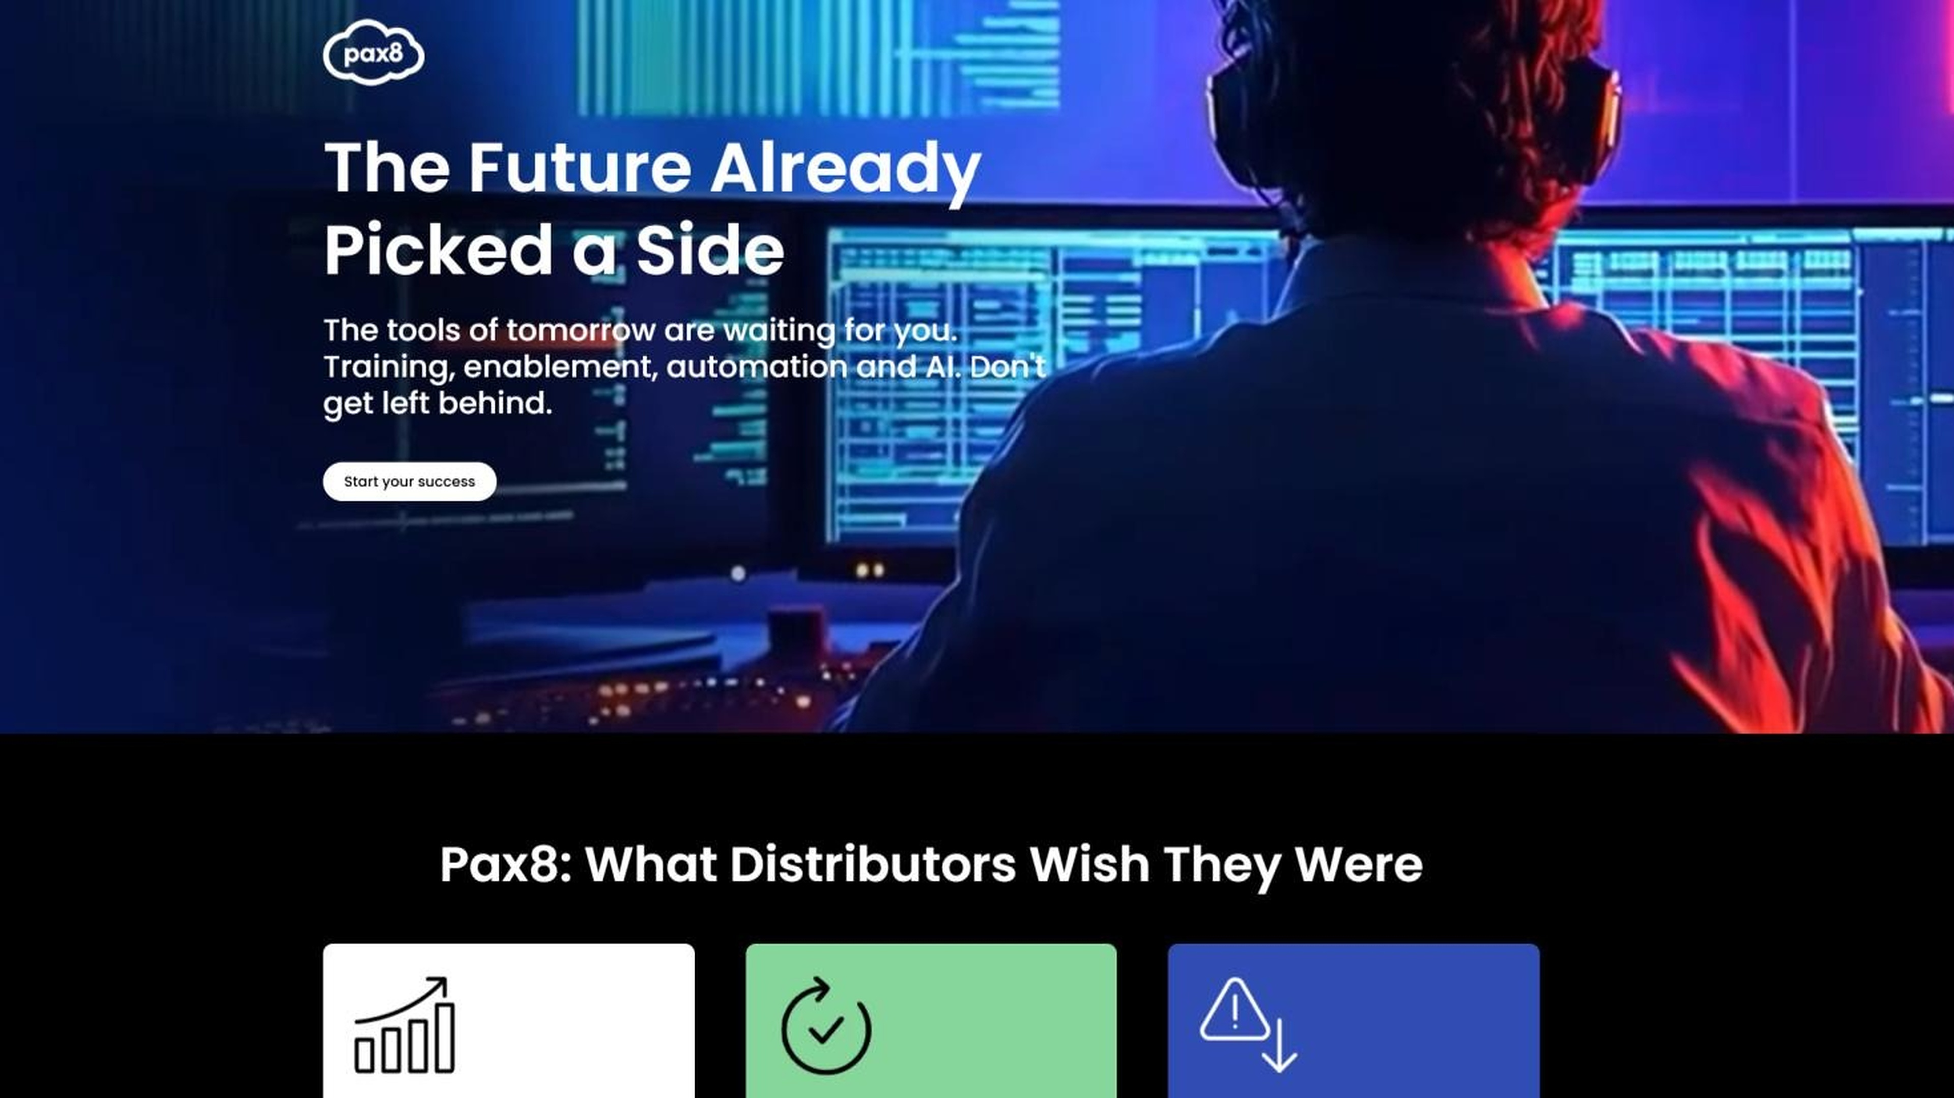
It's built. It's tested.
It runs today.
Alex Hastings
Revenue Enablement Programs Manager, EMEA
alex@hastingshub.com
Copyright ©2026 Pax8 | All rights reserved

