Slide 1
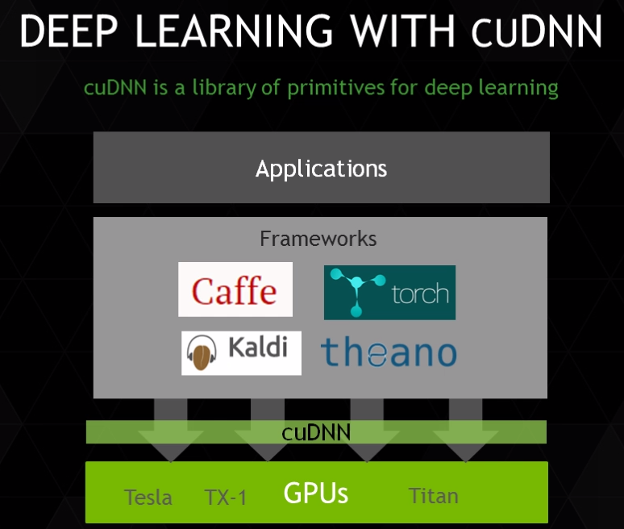
+PDNN

Slide 2
